Slide 1
IPM Issues
Instrumentation meeting
February 9, 2010

Slide 2
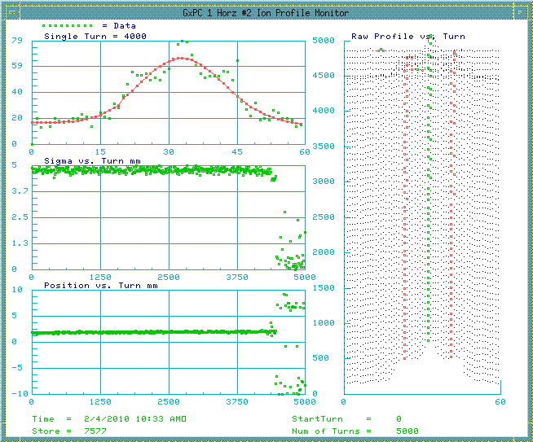
Profile at 120 Gev

Slide 3
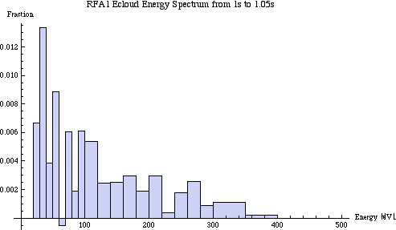
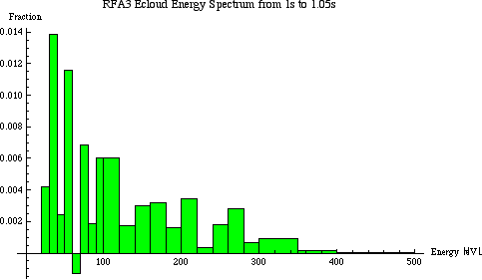
Energy Spectrum
Uncoated
Coated
Fraction = total Q in energy slice (e.g. 20
to 30V) in time slice 1 to 1.05s /(Width of
energy slice * Qtot).

