Slide 1
Proton Source Task Force
Directorate's Meeting
Tuesday, October 5
W. Pellico

Slide 2
History
2008 Department Review of Linac and Booster
What systems needed immediate help
Consider three issues:
Spares, Manpower, Reliability
Two systems stood out – Work then start to repair/replace (No additional funding - use operational task codes – took money from spares):
Booster Magnets (No Fully Tested Spare Gradient Magnet)
Pre-Acc (Cockcroft Waltons – downtime and manpower concerns)
February 2010 – Projections raised concerns and led to discussions with Dr. Holmes –
“OK, if I can't say 20 I will suggest going out 15 years. The current best case scenario for Project X is construction over FY15-19. “ Holmes
“So let's put together a 15 year plan …” Holmes
Roger Dixon
Proton Source Charge March 3 2010
Task Force report released August 17 – Can be found in Doc. Database

Slide 3
Required Proton Throughput Proton Numbers – Jeff Appel

Slide 4
Booster Cycle Rate

Slide 5
Draft Proton Source Task Force Charge
Background: The Linac and Booster will have to supply protons to the Main Injector and to the 8-GeV physics program until Project X and its follow on is available to the physics program. It is now estimated that this is not likely to happen for at least 15 years. Meanwhile both the H⁻ sources and the low energy Linac are becoming more difficult to maintain due to outdated electronics and the expected difficulty of acquiring spare tubes for the modulators and amplifiers. The reliability of this machine has already become an issue. Meanwhile the 8-GeV Booster is also expected to have increasing reliability issues with time just as the physics program demands better performance. To simultaneously support the 8-GeV physics program and the high energy neutrino program it will be necessary to run the Booster at 15 Hz. This requirement will necessitate a substantial upgrade of the RF power system in the Booster, in addition to improvements in the control of beam losses, shielding of the accelerator enclosures, and improved reliability.
The charge to the Proton Source Task Force is:
Determine the vulnerabilities of each major subsystem in the Proton Source system including the
The H- sources and pre-accelerators
The low energy drift tube Linac
The RF System for the low energy Linac including power amplifier tubes and other associated tubes
The 8-GeV Booster magnet systems
The 8-GeV vacuum system
The 8-GeV RF cavities and modulators
The controls and interlocks of all Proton Source systems
Review the planned, but unfunded upgrades of the H- sources, the Booster RF system, and the 15Hz upgrade.
Identify weaknesses
Identify all systems that need to be upgraded or replaced in order to maintain both high energy neutrino and 8 GeV physics programs. Suggest possible upgrades or replacement solutions while taking into account the development of Project X.

Slide 6
Task Force Organization Participants The charge is broad and intended not to be limited, but rather inclusive of all systems in the Proton Source. After a period of two months, allowing for an initial investigation, several small modifications to the original charge allowed listing the names of responsible individuals along with systems identified as critical. The following task force personnel list was submitted and approved:
Linac Task Force Candidates:
Larry Allen (AD/PS) (Modulator)
Trevor Butler (AD/PS) (Modulator)
Howie Pfeffer (AD/EE) (Modulator)
Al Moretti (APC) (New Low Energy)
Paul Czarapata (AD/HQ) (New Low Energy)
Ken Quinn (AD/PS) (High Energy Reliability)
Peter Prieto (AD/Inst.) (High Energy Reliability)
Mike Kucera(AD/Controls) (Linac Controls)
Bob Goodwin(AD/Controls) (Linac Controls)
Steve Hays (AD/EE) (Linac Power Distribution)
Bob Slazyk (AD/MS/Water Group) (Linac LCW Systems)
David Hixson (AD/MS/Water Group)(Linac LCW Systems)
Ben Ogert (AD/MS) (Linac Vacuum)
David Augustine (AD/MS) (Linac Vacuum)
Booster Task Force Candidates:
George Krafczyk (AD/EE)(Pulsed Systems)
John Reid (AD/RF) (High Level RF systems)
Jim Lackey (AD/PS) (Pulsed Systems, Magnets)
Dave Augustine (AD/MS) (Vacuum System)
Craig Drennan (AD/PS) (Booster LL system)
Peter Kasper (AD) (Booster Shielding)
Davis Hixson (AD/MS) (Booster LCW Systems)
Sharon Lackey (AD/Controls) (Booster )

Slide 7
Executive Summary
The Proton Task Force, charged to assess the feasibility of operating the Fermilab Pre-accelerator, Linac, and Booster for the next 15 years, involved nearly thirty systems experts and looked at every major Proton Source technical system.
The conclusion of the Task Force based on the work completed thus far and pending additional inputs is that it is feasible to run the Proton source for another 15 years at the present proton output. However, many forty-year-old systems will require upgrades to maintain current-day operational availability. The items of greatest concern that impact proton availability, in order of highest to lowest concern, are:
1) Booster RF Systems 2) Low Energy Linac Systems 3) Booster Gradient Magnets
4 ) Utilities 5) Cockcroft-Walton Pre-accelerators
This report details proposed solutions to these concerns and to those of other systems considered. Beyond the present annual operating budget, an estimated $37 million (M&S) over the next 6 to 7 years is necessary to address these concerns.
With systems in their current state and given only a flat operating budget, a reasonable expectation of Booster output is about 1.3E17 protons per hour at a cycle rate of 7 to 8 Hz. Machine downtime is expected to be dominated by Booster RF and Linac low energy system failures. The number of those incidents will increase with aging and with higher operational demands. Failure of some Booster gradient magnets should also be expected, although recoverable.
Radiation damage to Booster components will remain an ongoing concern especially given expectations of higher proton throughput. The necessity for systematic replacement and maintenance of radiation-damaged hardware will increase at the expense of greater downtime and greater radiation exposure to workers, but should not preclude continued operation.
Final designs exist for Pre-accelerator replacement and Booster solid-state RF driver amplifiers, but await funding and assignment of required labor resources. Implementation of these improvements, though not sufficient to directly increase proton throughput, will help reduce beam losses, reduce accelerator downtime, reduce worker radiation exposure, and enable Booster 15 Hz cycle rate capability. The 15 Hz capability offers the operational flexibility of providing additional beam cycles within the overall beam loss and beam permit limits. The Task Force has not specifically addressed the issues of achieving increased proton flux.

Slide 8
Executive Summary Points
The Proton Task Force, charged to assess the feasibility of operating the Fermilab Pre-accelerator, Linac, and Booster for the next 15 years.
The conclusion of the Task Force based on the work completed thus far and pending additional inputs is that it is feasible to run the Proton source for another 15 years at the present proton output (which is inadequate for planned program.)
An estimated $37 million (M&S) over the next 6 to 7 years is necessary to address concerns.
With systems in their current state and given only a flat operating budget, a reasonable expectation of Booster output is about 1.3E17 protons per hour at a cycle rate of 7 to 8 Hz.
Radiation damage to Booster components will remain an ongoing concern especially given expectations of higher proton throughput.

Slide 9
One Possible Funding Scenario

Slide 10
Next Step
Make a plan (with options) that includes
Review of Critical and Listed Systems
Timetable based upon priorities and program plans?
Resources
Funding
Manpower
Management
Example - RF Cavities - Just Starting A Plan
Investigate the replacement of Booster Cavities
Design
Cost
Schedule

Slide 11
Conclusion
Can the Source continue to run for 15 years – Assume Present Throughput
Yes but will require $$ and labor
Will have some risks
Linac Tubes
Booster Gradient Magnets
Linac Low Energy (Tank 1 for example - prototype)
New Shielding assessment may constrain throughput (Due Dec.)
Higher Efficiency vs. Acceptable Loss Levels
Occupancy Questions
Equipment Damage to radiation will remain a concern
Can the Booster Run at 15 Hz
No, not without upgrades
Can the Source Deliver the promised beam
Program plan needs to mesh with Task Force requests – Both Funding and Manpower
Increased Flux Not Addressed in task force report although some of the suggested upgrades should improve the flux
RFQ (Beam Quality and Reliability)
Booster Cavity replacement (Aperture, Reliability and Volts)

Slide 12
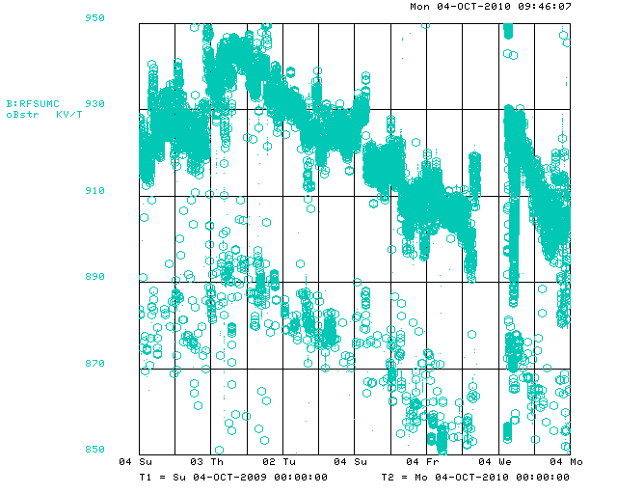
Booster RF Voltage (Over 1 Year)

Slide 13
Booster RF

Slide 14
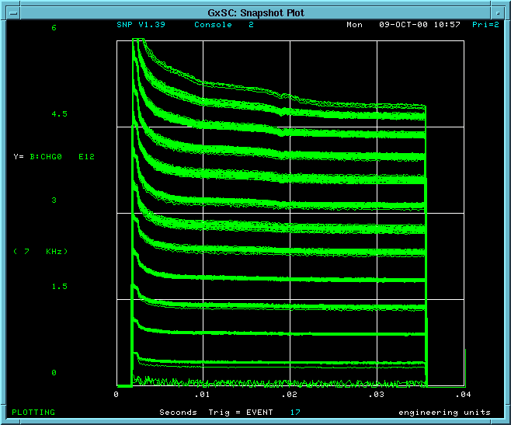
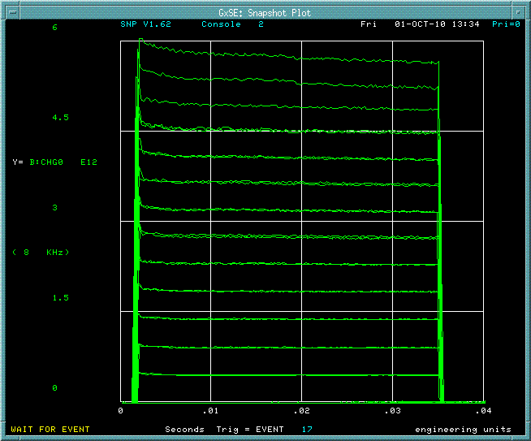
It was 10 years ago today….

Slide 15
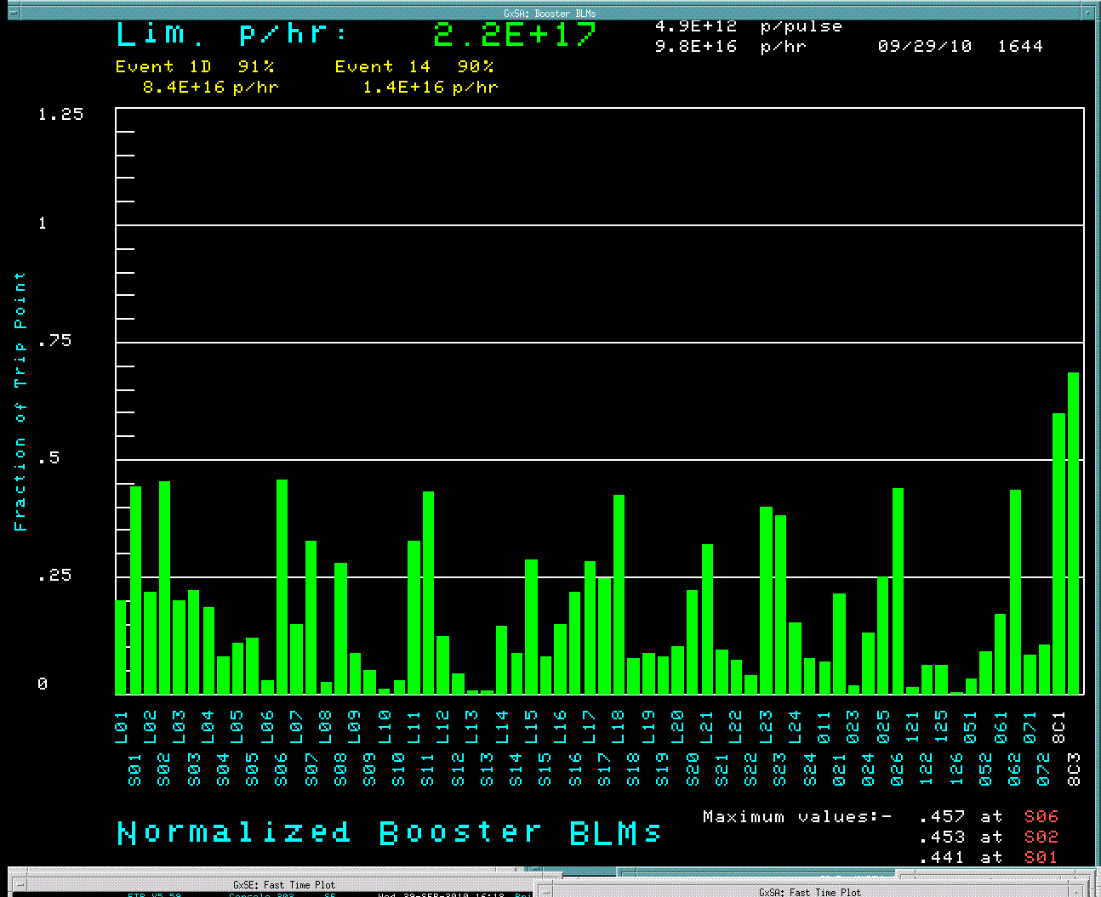
Extra…Extra….Slide (After RF Repair 920KV)

Slide 16
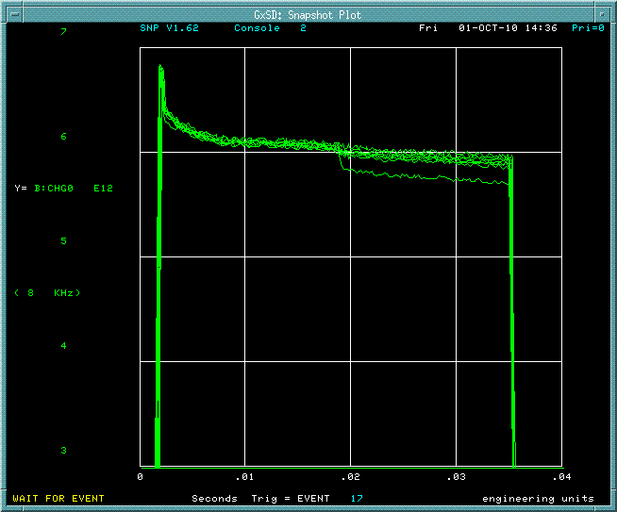
High Intensity Frontier (After RF Fix)

