Slide 1
Indian Institutions and Fermilab Collaboration:
A Road We Travel Together
Shekhar Mishra
Project-X,
International Collaboration Coordinator
Fermilab

Slide 2

Thoughts
Till 2003, Indian Science Program was foreign to me.
  Indian economy was growing very fast. India had established collaboration in many areas with US (NIH, NASA, IT Industries)
  I made it a mission to extend Indian physics collaboration in US
    It started with my initial role in International Linear Collider
  Today this collaboration with India has taken a magnitude that I myself had not contemplated

Slide 3


Vision of Nuclear India
“The introduction of atomic energy in India in the early 1950s was not purely for the sake of introducing atomic power, but essentially for the introduction of new technologies dependent on basic sciences generated within” Bhabha to Ramanna

Slide 4
How did this new effort start ?
Physicists from Indian Institutions have been collaborating at Fermilab since 1986.
In 2002, LHC expected start and ILC were the talk of the town.
India HEP was thinking of packing its bag from Fermilab and moving to CERN
  D0 → CMS
In Fall of 2002, with the help of Indian scientists collaborating at Fermilab, I met with Prof. V. S. Ramamurthy, Secretary, Department of Science and Technology (NSF) and Dr. Anil Kakodkar. Secretary, Department of Atomic Energy (DOE).
  Message I got: “Get our scientists excited about the science and show that there are mutual benefits to both sides.”
  A working group was formed to develop this collaboration
Since that meeting, We have been to India several times
  First just to talk about Indian program, understand what Indian scientists want
  Understand how we can work together.
  Work with Indian scientists in developing a accelerator R&D program
  Today we have one MOU and four Addendums in Accelerator and Neutrino
  We are discussing significant “In-Kind” contribution from India for Project-X
Notes:
4

Slide 5
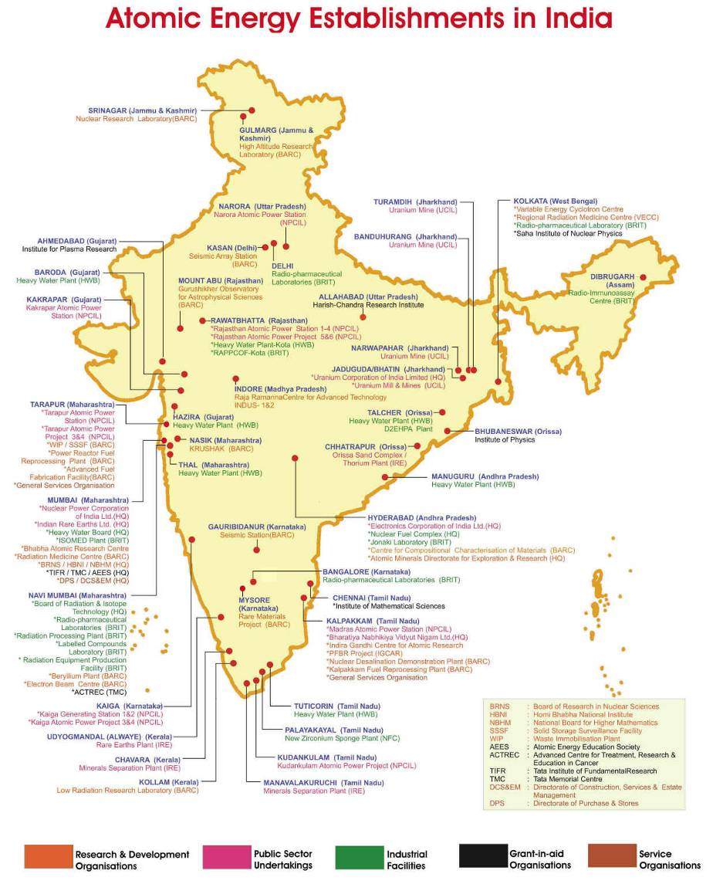
Indian DAE
Notes:
5

Slide 6
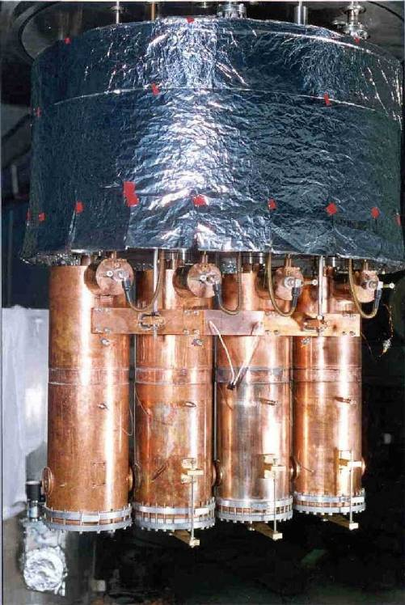
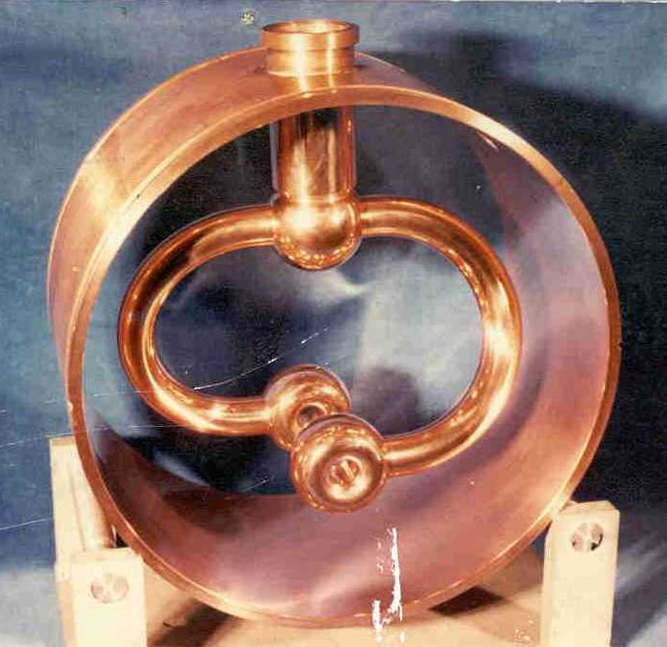
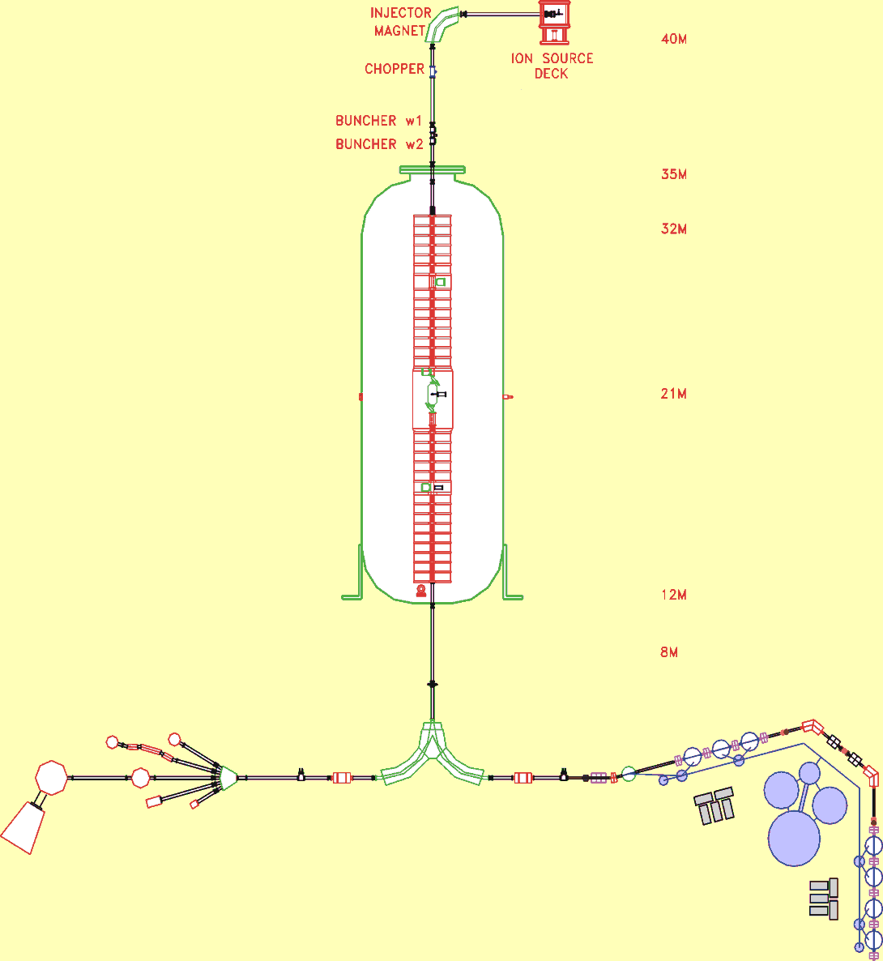
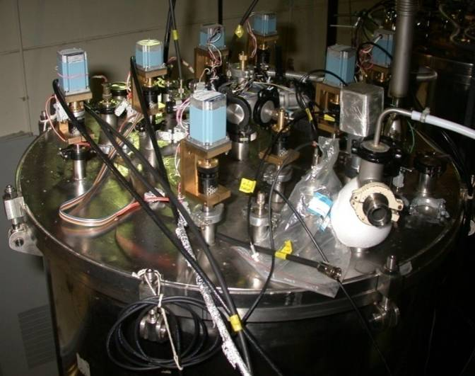

BARC-TIFR Heavy Ion Accelerator
Accelerator layout
Pelletron
Beam hall
Superconducting LINAC Booster
Analyzing magnet
Superbuncher + 3 Modules
Helium Refrigerator
BARC - TIFR
Heavy Ion Accelerator Facility
4 Modules
to new beam hall
Notes:
6

Slide 7
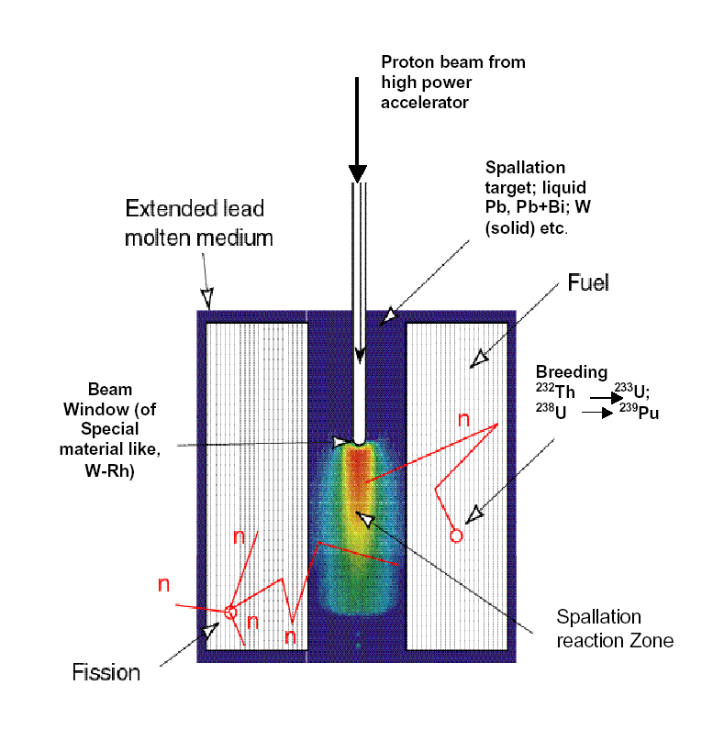
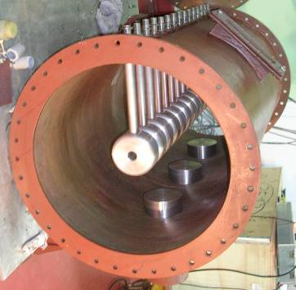
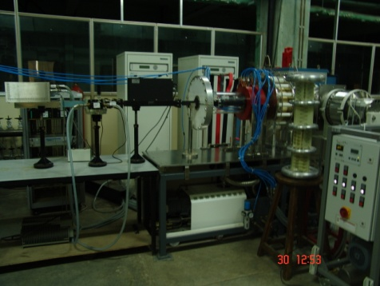
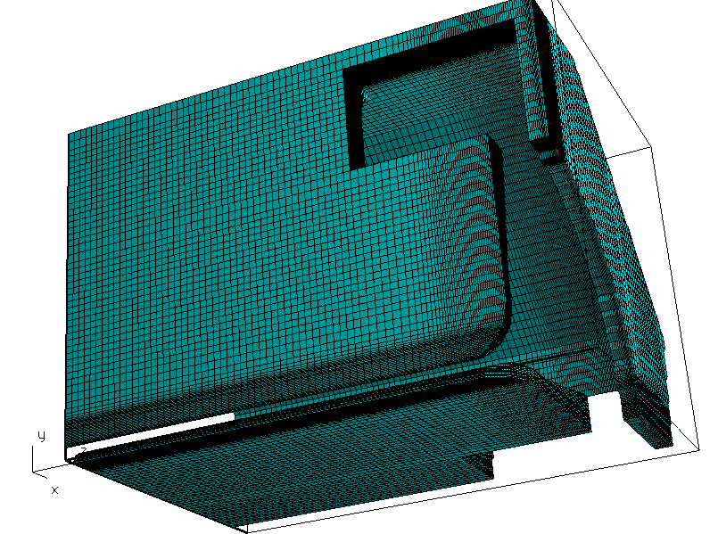
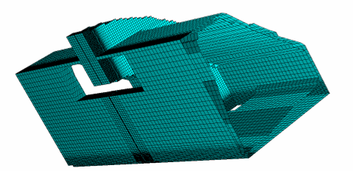
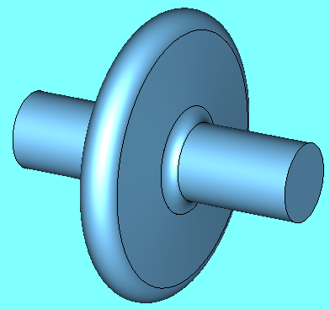
Accelerator Development for ADS
Normal Conducting
Phase III
High current injector 20 MeV, 30 mA
DTL/
CCDTL
SC Linac
Proton IS
50 keV
RFQ
3 MeV
DTL
20 MeV
Phase II
100 MeV
Phase 1
Super-
conducting
Design completed and fabrication is in progress
1 GeV
ECR Ion Source
RFQ
DTL
Beginning/End Cell
Coupling Cell
Elliptical SC Cavity

Slide 8
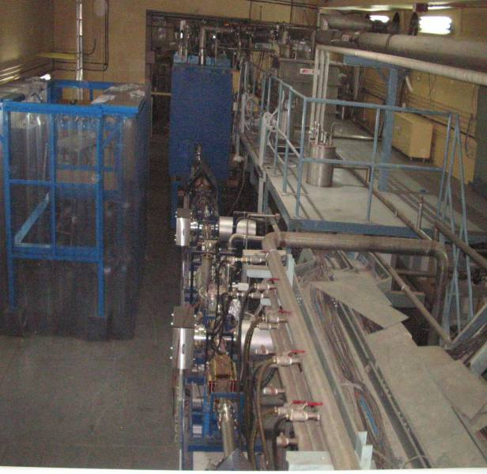
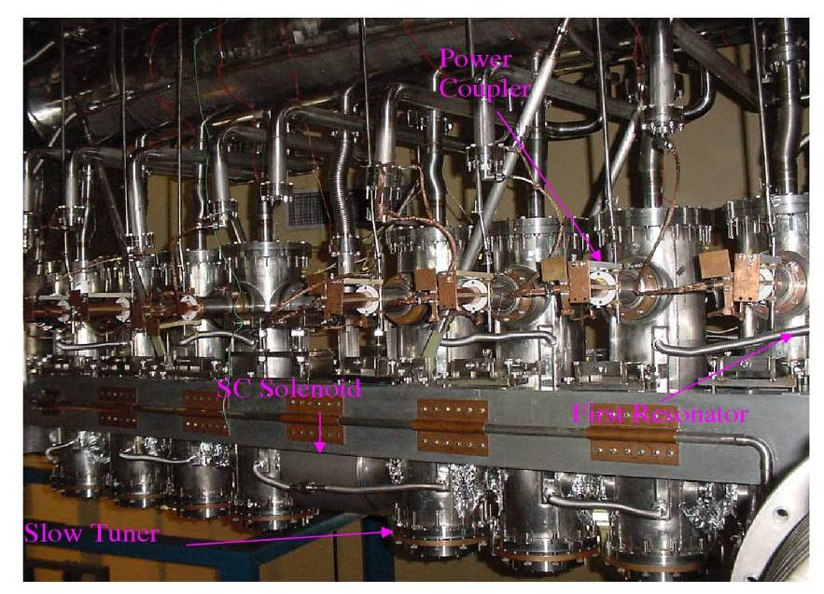
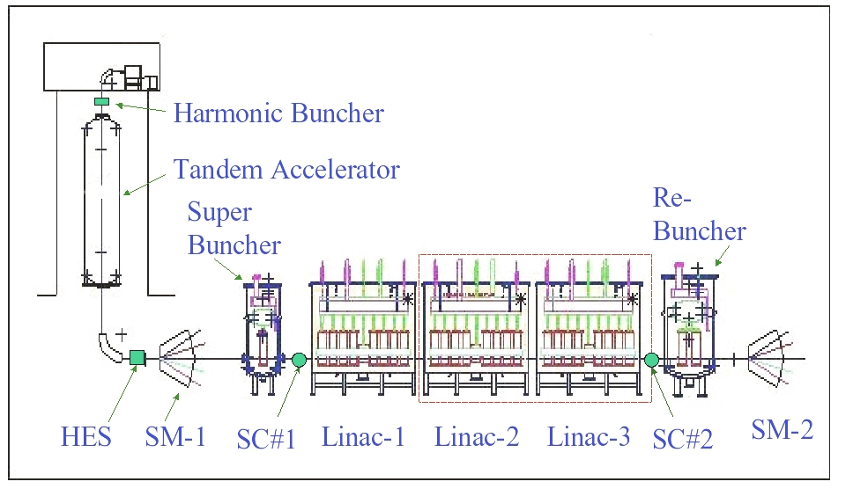
IUAC: Pelletron and SRF Linac
Upgrade to ECR based High Current Injector

Slide 9
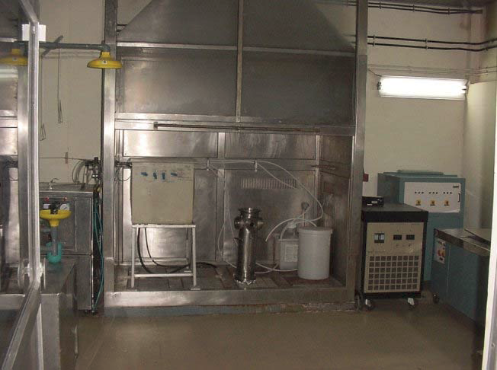
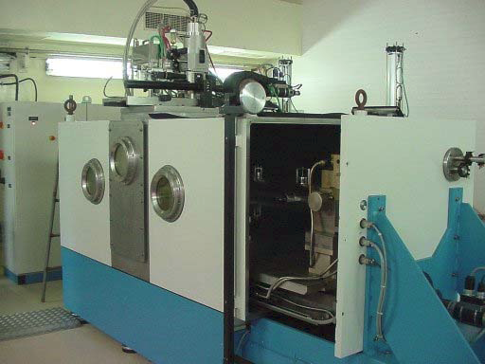
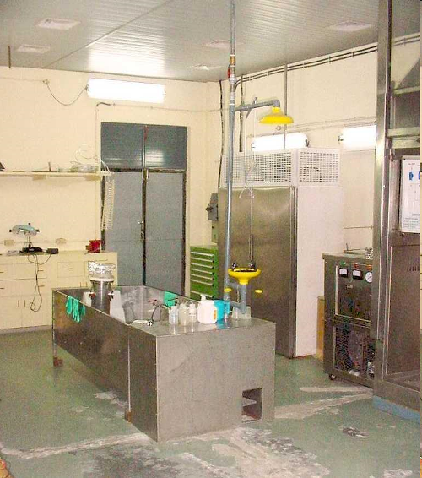
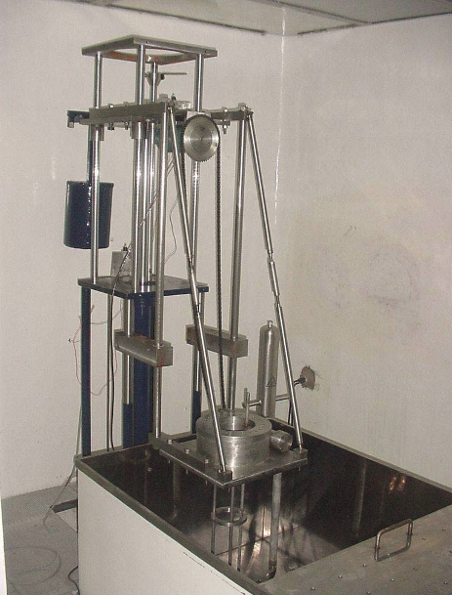
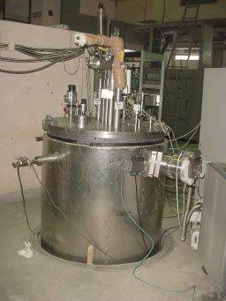
IUAC: SRF Infrastructure
Fume hood
Electron Beam Welding
Oven
Surface Preparation
High Pressure Rinse
Vertical Test Stand
Notes:
9

Slide 10
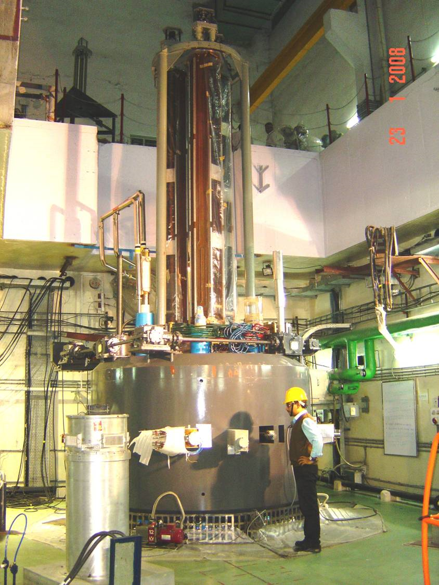
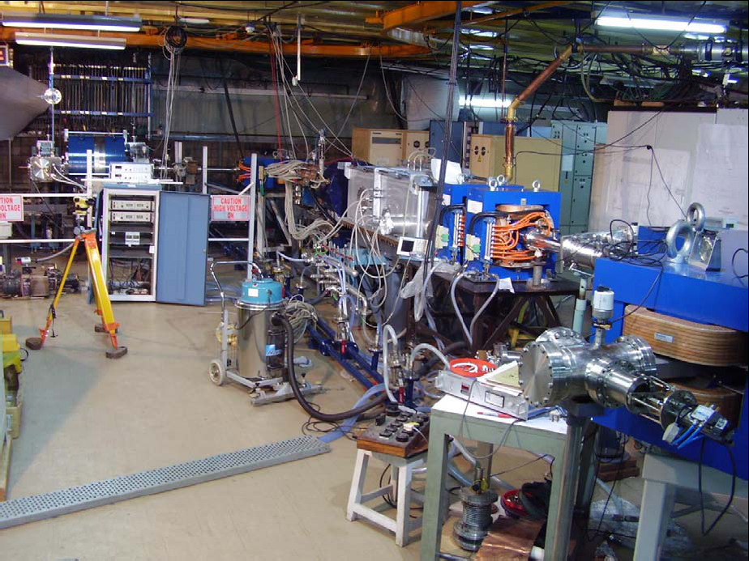
VECC: Nuclear Physics
Superconducting Cyclotron
Radioactive Ion Beam Facilty
R&D on Superconducting RF Linac
Strength
  Cryogenic
  Mechanical Engineering
  RF Power

Slide 11
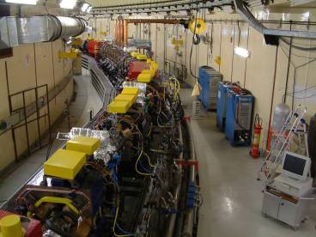
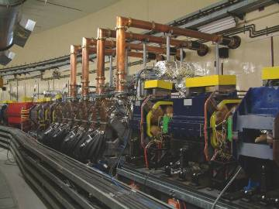
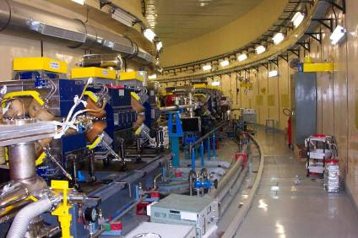
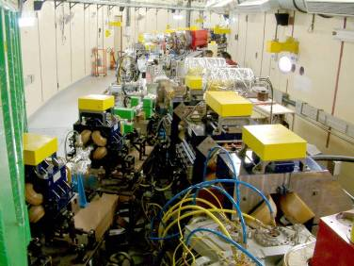
RRCAT: Indus-II
Indus-2 Ring in the Tunnel
RF Cavities installed in Indus-2 Ring
Long Straight Section LS-6 Assembly
Transport Line-3 Joining on to Indus-2
Notes:
11

Slide 12
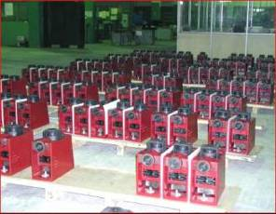
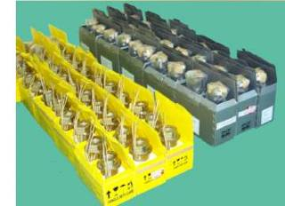
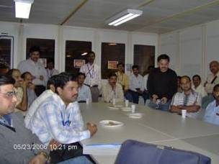
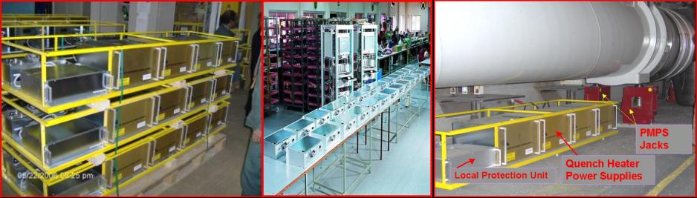
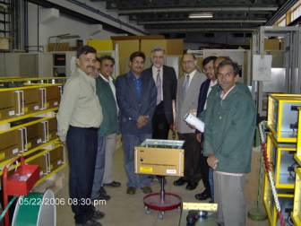
India: LHC Accelerator
7080 Nos. Magnet Positioning System Jacks
MCS (1146 Units) &
MCDO (616 Units)
Magnetic measurements teams- ~100 Man-years
5500 Nos. Quench Heater Power supplies( QHPS)
1435 Nos. Local Protection Units
A part of DAE’s contributions installed in LHC Tunnel at CERN
Notes:
12

Slide 13
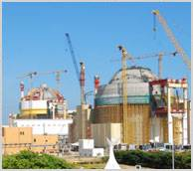
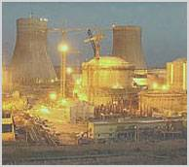
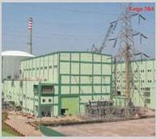



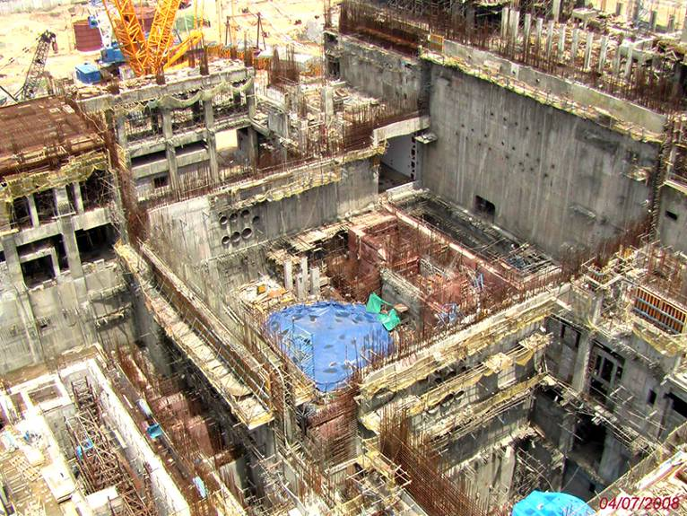
Nuclear Power Reactor
CD-3 to CD-4 in Five yrs.
Indo-US Nuclear Treaty
Notes:
13

Slide 14
It takes a lot of time
Summer 2006 to Jan 2008:
  Initial Interaction and visit by Indian
  ILC R&D funding
  Project-X
Jan 2008 to Jan 2009, it took one year and several trips to get the Addendum MOU III signed.
  Fermilab
  Indian Laboratories
  DOE & DAE
  Management structure
  Funding
    No $ leaving boundaries
  Laws and Lawyers
    Export Controls
    IPR
    Sensitive Country
  US Industries

Slide 15
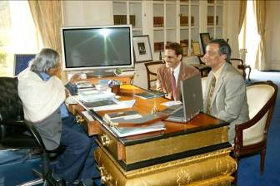
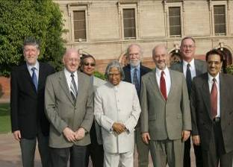
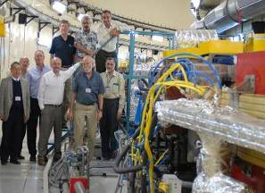
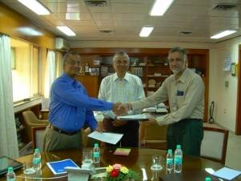
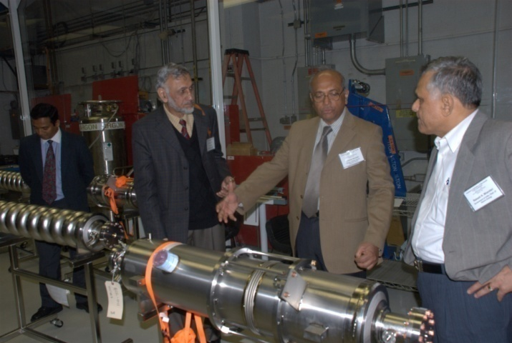
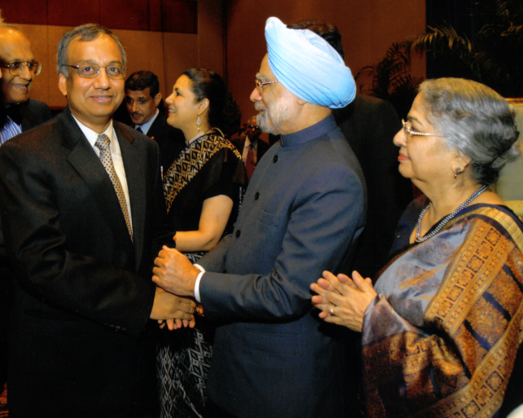
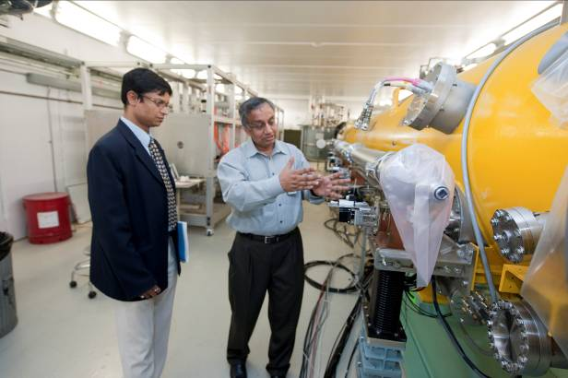
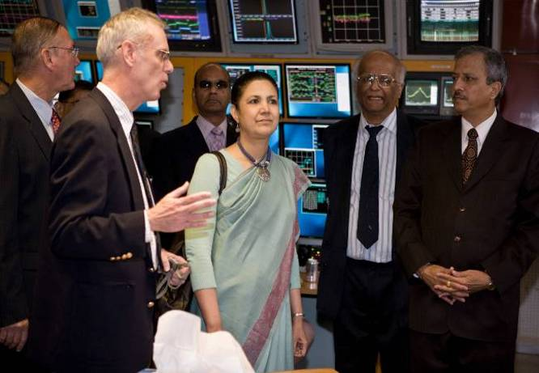
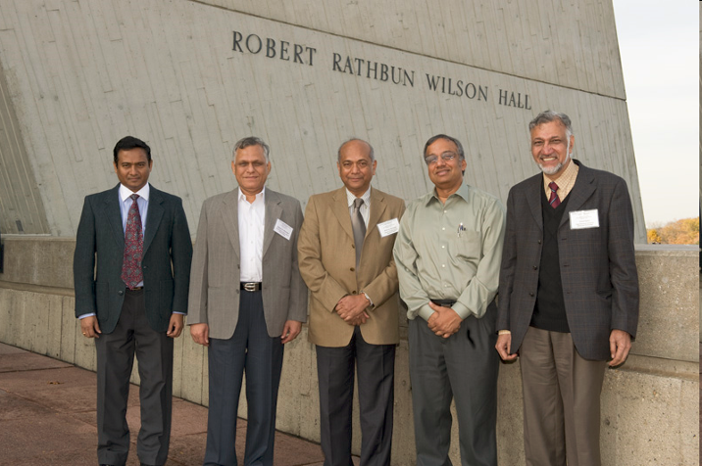
Developing US Collaboration With India
Notes:
15

Slide 16
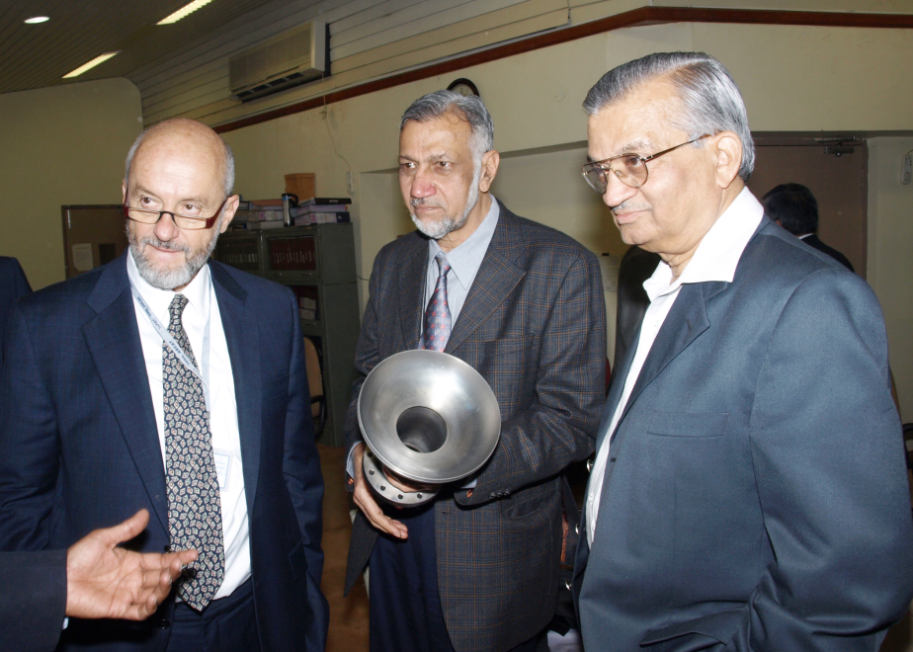
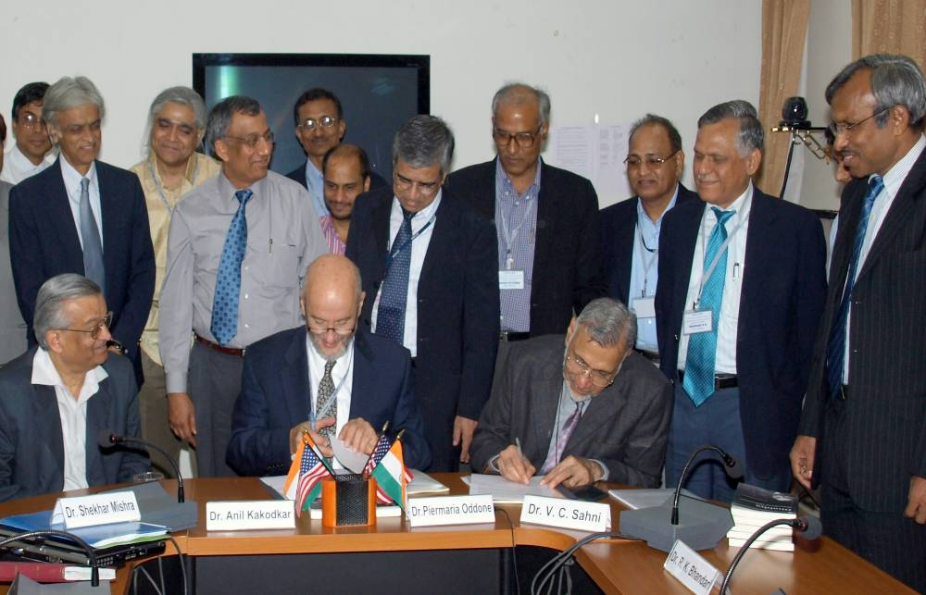
Jan 2009: Addendum MOU III
Initial two Fermilab and SLAC Addendums were focused on ILC Cavity and RF Power.
Addendum III includes All SRF aspects of
  High Intensity Proton Accelerator.
  SRF infrastructure
  Personnel exchange and Training of manpower
  Indian Industries involvement

Slide 17
MOU: US and Indian Laboratories
On Jan 9, 2006, US (Fermilab, SLAC, Jlab, Cornell) and Indian Institutions (BARC, RRCAT, VECC, IUAC, DU) signed an MOU to collaborate on Accelerator and High Energy Physics
We are collaborating under four addendums to the MOU (http://iifc.fnal.gov)
  Fermilab, RRCAT, BARC, IUAC and VECC Collaboration on ILC Main Linac SRF Accelerator Technology R&D
  SLAC, RRCAT, BARC, IUAC and VECC Collaboration on ILC RF Power Sources and Beam Dump Design R&D
  Fermilab and Indian Accelerator Laboratories Collaboration on High Intensity Proton Accelerator and SRF Infrastructure Development (Phase I)
  US and Indian Institutions Collaboration on Neutrino Physics, Related Experiments and Detector Development.

Slide 18
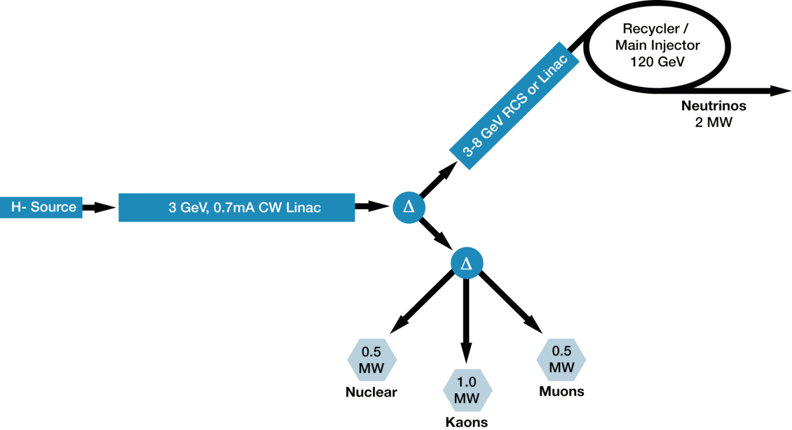
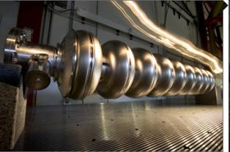
Fermilab Next 10 yrs Strategy
A multi-MW Proton Source, Project-X, is the main part of Fermilab’s strategy for future development of the accelerator complex.
  Project-X is designed to provide flexibility in evolving Fermilab program in response to research results from the LHC
18
Notes:
18

Slide 19
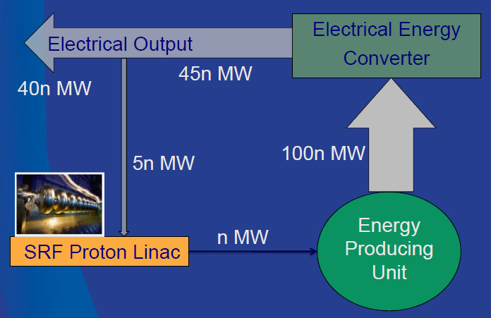
Indian Next 10-15 yrs Strategy
A multi-MW Proton Source is one of part of 3rd stage
  Multi MW CW beam at 1-2 GeV (similar to Fermilab Project-X) could be the accelerator technology demonstration project corresponding to 10s of MW electrical power if applied to a suitable Accelerator Driven Subcritical Reactor.
19
Notes:
19

Slide 20
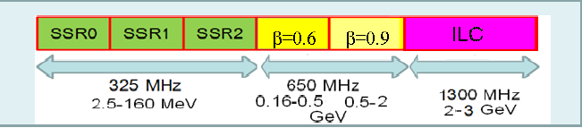
Phase I: R&D Indian Institutions
Fermilab is developing HIPA (Project-X) as a national project with International participation.
  Indian DAE laboratories are 1st international partner.
Indian Accelerator Program for Nuclear Energy and Fermilab High Intensity Proton Accelerator program are aligned in design.
Indian Institution

Slide 21
Phase 1: Deliverable
SSR1 Cavity
650 MHz, β = 0.9 cavity design, prototype and fabrication
650 MHz Cryomodule design
  He Vessel
  Blade Tuner
SRF Infrastructure
  Vertical Test Stand design
  Horizontal Test Stand design and cryostat
  Cryomodule Test Stand design and cryostat

Slide 22
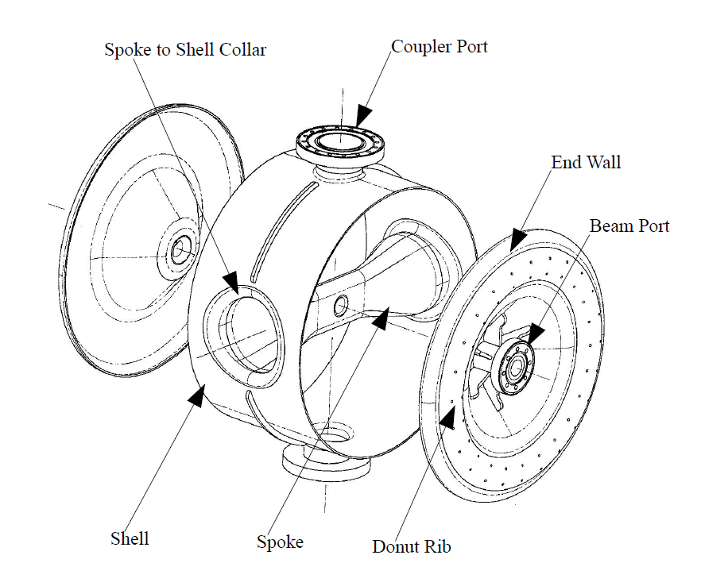
IUAC: Fabrication of SSR1
Two SSR1 cavities are under fabrication at IUAC
Major components of SSR1 – β = 0.22, f = 325 MHz

Slide 23




Spoke – Forming & EBW

Slide 24




Shell – Rolling & EBW

Slide 25




End Wall - Forming
Niobium Coupler Port pullout
Power Coupler Port - Tubes

Slide 26






Elliptical Cavity:
Forming and Machining
Developed forming tooling & process for 1.3 GHz SCRF cavity.
120 T - HYDRAULIC PRESS
Forming
Inspection
Machining
Formed Niobium Half cell
Notes:
26

Slide 27




Manufacturing of Beam Pipe
This compact & dedicated machine it is suitable for clean room application required for the rolling Niobium sheet.
Beam pipe welding
Beam pipe machining

Slide 28





Welding of Components
Cleaning and assembly of pipe-Flange
Pre weld Etching
Pipe-Flange welding
Outside Iris welding Half cell assly
Inside Iris welding Half cell assly

Slide 29



Trimming , frequency and mechanical measurements
Half cell assembly | Before length (mm) | Before Frequency (MHz) | After length (mm) | After frequency (MHz) | Sensitivity MHz/mm
AL -132 | 199.02 | 1286.5080 | 197.5 | 1289.7635 | 2.17
AL-133 | 198.82 | 1288.6623 | 197.92 | 1293.3215 | 5.17
Equator trimming
Frequency Measurement
Mechanical inspection

Slide 30



Equator Welding
Setting inside IUAC EBW Chamber
Frequency measurement
This work was carried out by RRCAT in collaboration with Fermilab and IUAC.
Significant input was provided by DESY and US Company AES
Mechanical inspection

Slide 31




Leak testing (Stage wise + Final)
Leak testing of Niobium half cell
Leak testing of Single cell cavity
Leak testing at 300 K and 77 K,
Qualified for leak rate of 1 x 10 ⁻¹⁰ mbar.l/sec .

Slide 32

RF measurement ( at FNAL)
Frequency TE1CAT001 TE1CAT002
FNAL (23 C) 1297.031 1296.793 dF= -238 KHz ( between two cavities)
RRCAT (27 C) 1296.926 1296.675 dF = -251 KHz ( between two cavities)
'Q' factor
FNAL (23 C) 9960.53 9917.766
RRCAT (27 C) 9076 9328
The frequency measurement data match well between RRCAT & FNAL measurement.
A basic shift in frequency can be attributed to difference in measurement temperature.
The offset between two cavities is very close {~ 13 KHz}.

Slide 33



Cavity assembly in to VTS (FNAL)
The cavity was processed at ANL using the standard procedure and baked at Jlab.
Connecting to VTS inside clean room
Lowering in to Dewar
Mounted on the VTS

Slide 34

1-cell Cavity 2 K VTS test result
No Field Emission
Quench at Equator
The equator weld is a suspect. Welding procedure.
These cavities have been barrel polished at Fermilab and awaits further processing and testing.
RRCAT in collaboration with IUAC will fabricate 2, 7 cell, 1300 MHz cavities to validate their procedure and infrastructure.

Slide 35

END Group R&D
High RRR End Group under machining from a Single Billet .
The Three Major suggestions that have been incorporated are
  All flanges will be NbTi and not NbTi ring embedded in Nb flange .
  HOM port length kept same but location of joint changed.
  Some minor modifications on flange thickness
Notes:
35

Slide 36

650 MHz Cavity Design
Fermilab, DU, RRCAT and VECC are collaborating on 650 MHz elliptical cavity design.
Left cell Regular cell Right cell
r
50
r
50
r
50
R
200.277
R
200.277
R
200.277
L
106.974
L
103.75
L
106.974
A
82.5
A
82.5
A
82.5
B
84.5
B
84
B
84.5
a
20
a
18
a
20
b
39.5
b
38
b
39.5
α
7.02
α
5.2°
α
7.02
All dimensions are in mm.
36

Slide 37


650 MHz, 1-cell development
Calculation of Mechanical Deformation for beta 0.90 single cell cavity
Both ends fixed
One end open
Applied Pressure= 2 Bar
Applied Pressure =2 bar
Max stress = 33.4 MPa
Max Displacement= 85.5 um
Max stress = 75.4 MPa
Max Displacement= 0.942 um

Slide 38

650 MHz, β = 0.6 cavity design
VECC has been working on 704 MHz, b = 0.6 cavity design, prototype and testing.
Recently under IIFC discussions VECC have decided to switch their frequency to 650 MHz
  Despite having significant infrastructure for 704 MHz

Slide 39




Internal Configuration of Cryomodule for 650 MHz Cavity
Possible Options & their evaluation
Goal :Use Popular T4CM Cryomodule design for Fermilab Project X
-(Although cavity size is up by a factor of 2)
Option A- Single Pipe support
Evaluation Based on:
Static heat leaks (approx)
Pressure drop in HGR pipe
Stiffness of the system (approx)
Availability of pipes
General Mech. Engineering issues
Option B- Support on two pipes
Option D- Rectangular Duct support with interception flange
Option C- Rectangular Duct support
Notes:
39

Slide 40



Option Chosen for Detailed Analysis
Option E-
Vacuum Vessel with Dia 46inches.
Retaining essential features of T4CM design.
But incorporating Value Engineering Changes.
The Cross section
The 3-D Model (Under designing)
The 3-D Model
RRCAT-FNAL CRYOMODULE
RRCAT-FNAL CRYOMODULE
Notes:
40

Slide 41






The Final Model –External View
The 80K Thermal Shield
Cavity Support System
(With Cavity of 650MHz)
The 650MHz cavity with helium Vessel
The 650MHz cavity
The 5K Thermal Shield
(only Upper segment)
Notes:
41

Slide 42


RRCAT: SRF Infrastructure
  Similar to ANL design bench for electro-polishing of SCRF cavity has been developed, it can process up to nine cell cavity. The stand is capable of :
    Rotating the cavity at 2-10 rpm.
    Holding the cavity in horizontal position during processing & in vertical position during draining/ rinsing and for loading the cathode
    Slip ring with 4 carbon brushes to connect power supply.
    The flow circuit has been tested with water.
    Acid pumps, valves & plumbing have been procured.
    25V – 1000A DC Power supply has been procured.

Slide 43



RRCAT: SRF Infrastructure
Ultra Pure Water Plant
High Pressure Rinsing Set up in Clean enclosure (Class 100)

Slide 44




RRCAT: Cavity RF Measurement
PNEUMATICALLY OPERATED RF FREQUENCY MEASUREMENT SETUP
RF FREQUENCY PEAKS OF DUMB-BELL
RF MEASUREMENT SET UP FOR FREQUENCY AND FIELD DISTRIBUTION
RF FREQUENCY PEAKS OF SINGLE CELL CAVITY

Slide 45

Indigenous Development of Nb
NFC, Hyderabad (materials development)
RRCAT, Indore ( electrical and superconducting properties, elemental analysis)
SUMMARY & COMPARISION OF TEST RESULTS
S.No. | Source | Sample ID | RRCAT RRR Results
Measurement results
1 | NFC | Nb/NFC/I80Nb III/U/B | 96 ( 20.03.09)
2 | NFC | Nb/NFC/IU1/Ti clad expt | 98 ( 06.04.09)

Slide 46

Building for SCRF Cavity Development
Cavity Processing Building (Expected to be ready by mid of 2011)
The building will house clean rooms, Electron Beam welding machine. High Vacuum Annealing Furnace, Electro-polishing setup, Centrifugal barrel polishing machine etc.
SCRF Lab Building (Expected to be ready by mid of 2011)
The building will house Cavity forming facility, machining facilities, CMM, SIMS, material testing facility etc
Fermilab has shared infrastructure information with RRCAT.
Bid for Electron Beam Welder with specifications similar to AES is out.
AES has agreed to collaborate with RRCAT on some of these development.

Slide 47





Vertical Test Stand Design
Indian Institutions have provided engineering resources to design an upgraded Vertical Test Stand for Fermilab.
  It is being fabricated by a US vendor
  using ARRA funds
  RRCAT also purchased one
RRCAT has carried out design of the following:
  Liquid Helium Vessel Shell
  Liquid Helium Vessel Top Flange
  Vacuum Vessel Shell
  Vacuum Vessel Flange
  Top Insert Plate
RRCAT has also verified the design of following by Analysis
  Assembly of LHe Vessel Top Flange, Weld Rim
  Top Insert Plate
  Assembly of Vacuum Vessel Flange, LHe Vessel Flange, Top Plate, Support Pads
  Magnetic Shield design – 300K & 2K
VTS-2 TOP PLATE – CRYOGENIC & VACUUM INSERTS
VACUUM VESSEL
80K SHIELD
LIQUID HELIUM VESSEL
2K MAGNETIC SHIELD
3-D MODELS OF VTS-2 VESSELS

Slide 48

Horizontal Test Stand (HTS-2)
Fermilab has fabricated and is operating the first US Horizontal Test Stand for 1.3 GHz elliptical cavities.
Indian collaboration is designing an upgraded Horizontal Test Stand for Fermilab and RRCAT.
  Test a combination of two cavities and/or magnet
  650 MHz and 1300 MHz cavities
  CW or pulse mode testing of cavities
  Incorporating modifications based on operational experience of HTS-1
A 3-D model of the HTS-2 being designed

Slide 49
Phase II: Discussions
The Phase II of this collaboration is under discussion. It is expected to expand the collaboration to all non SRF areas of Project-X
  But it would be tied to the Phase III (construction of Project-X at Fermilab)
Elements of Phase II: (Very Preliminary)
  Front End: Source and RFQ
  325 MHz RF Power
  Instrumentations and Controls
  Superconducting Magnet
  Cryogenics

Slide 50


BARC: ECR Ion Source
Five electrodes
2.45 GHz
50 keV
50 mA
0.02 π cm-mrad
Schematic of the ECR Ion Source
Ion source with 3 electrode extraction system made & Testing is in progress

Slide 51


RFQ Parameters
1. Bunching 2. Focusing 3. Acceleration
Frequency | 352.21 MHz
Energy | 50 keV/ 3 MeV
Input current | 30 mA
Vane voltage | 80 kV
Avg. Aperture R₀ | 3.63-4.53 mm
Length | 4 m
Total RF power | 500 kW
Transmission | 98%
Design of a 325 MHz RFQ has started

Slide 52




BARC: 350 MHz, 700 W
Solid-state Amplifier
Total Power Gain : 20 dB
3dB Band width : 10 MHz
No. of modules : 4 plus 1 drive module
Efficiency : 50%
Devices LR301, DMD1029
VSWR of each Module & Total amplifier : <1.2
RF amplifier set up
Wilkinson designed based power combiners /splitters at 2KW (1:8) and 1KW (1:4) power levels
At 1KW, with transmission loss of < 7%.
Return Loss :> 20dB at combining port and >13 dB at dividing ports
Isolation >28 dB
8 modules test set-up for 2.5 kW is underway
Single RF module
1:8, 2 kW power combiner
1:4, 1 kW power combiner

Slide 53



New RF Driver: 350 MHz, 2.5 kW (CW and pulse mode) for 60 kW RF system
A new RF driver for 60 kW RF system has been developed based on
tetrode TH 393. Efforts are being made to test it at 3⁺ kW (CW) level.
Tetrode and its cavity
CW mode results:
Frequency: 350 MHz
Power: 2000 ⁺ Watt (CW)
Gain: 15 dB
Efficiency: 56 %
Class A
Device: TH 393
DC Bias supplies and input RF driver
The amplifier has been tested in pulse mode also.
Pulsed Mode Results:
Center frequency: 350 MHz
Pulse width:1 mS
Pulse repetition rate: 100 Hz
Pulse power (pk):4 kW
Single pulse details
Series of pulses / pulse train

Slide 54


350 MHz, 60 kW RF system for deuterium 400 KeV RFQ
For 400 KeV (D⁺ ) radio frequency quadrupole (RFQ) accelerator based Neutron Generator (pilot ADS project), the RF system has been tested upto 14 kW and efforts are in progress for 60 kW testing.
RF Power waveform on spectrum Analyzer
RF system set up (14 kW @ 350 MHz)

Slide 55
Collaboration on High Energy Physics
Indian institutions have been collaborating on Fermilab based High Energy Physics experiments since 1986.
  Several students have received PhD from Indian universities while working on Fermilab experiments.
Recently we have established a Neutrino Physics collaboration with India (Addendum IV)
  Indian Institutions have joined MINOS, MIPP and LBNE
  Students and faculties are contributing to the analysis
    Several PhD thesis
  Faculty and engineering staff are getting involved in design of future experiments.
On the request of Indian DAE/DST
  We are holding a joint interaction meeting in Jan 2011 to discuss collaboration on all aspect of Project-X Physics
  Tie Accelerator contribution to physics participation

Slide 56

What Next
The magnitude of the Phase III is very large and the regulations are very complicated.
  DOE and DAE are negotiating this
We are the
US we …
Will you follow
through
Critical
Technology
CERN/DESY
Non-
precertification
Our records
are clean
Making a Bridge
Strategic
R&D center
Inspection

Slide 57

Wind of Change

