Slide 1
POSINST Simulations and Problems
X. Zhang
12/16/2010

Slide 2
Simulation Parameters
For bench marking with VOPAL
Np | 7.0E10/bunch
Beam Size Sigma | 3 mm x 3 mm
Sigma Z | 0.30 m
Dipole By | 0.234 Tesla
Vacuum Chamber (Ellipse) | 58.8 mm x 23.88 mm (Half Axis)
Maximum SEY | 2.2 @ 300eV
Grid Size | 64 x 64
Step Size | 25 ps or 2.5 ps
Macro Particles | 10000 (or 40000) for culling

Slide 3
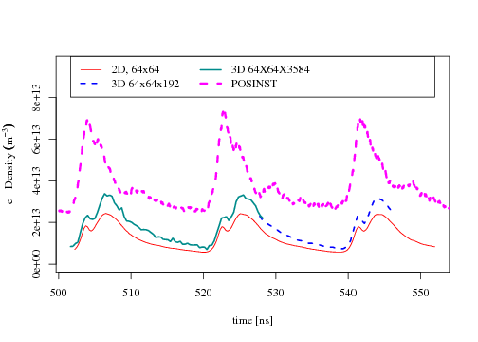
Differences with VOPAL
About 2 times difference in average density over 1-sigma

Slide 4
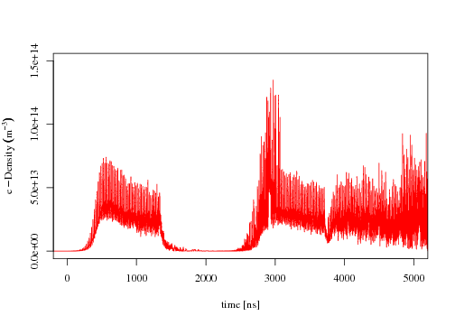
Problems of POSINST
Numerical Instability or “virtual cathode”?
Huge spiking noise

Slide 5
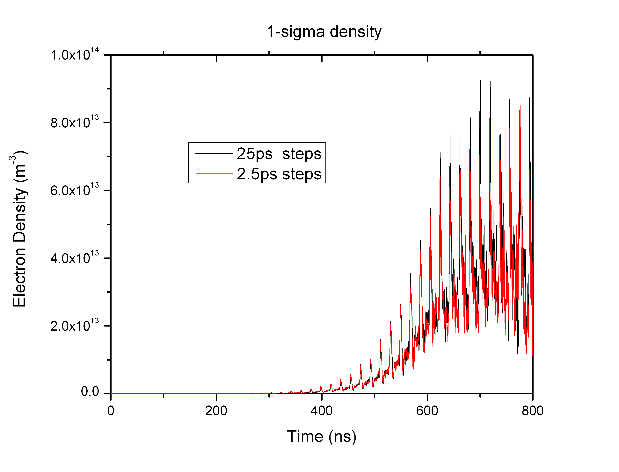
Differences in Step Size
Not much differences until 800 ns

Slide 6
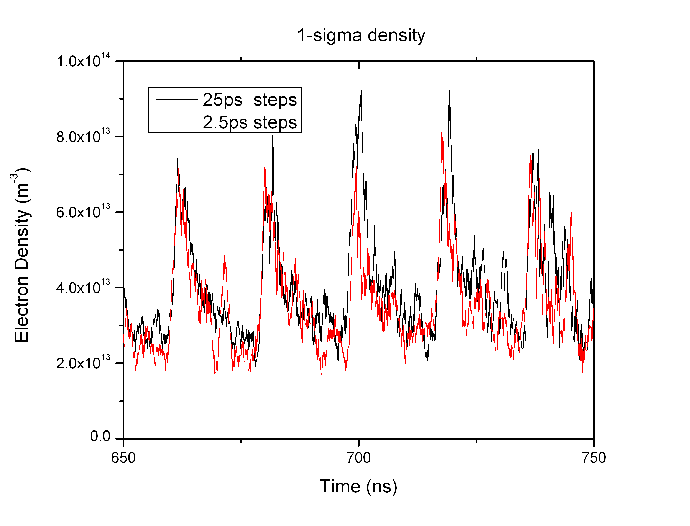
Differences in Step Size
Zoom in of the last plot

Slide 7
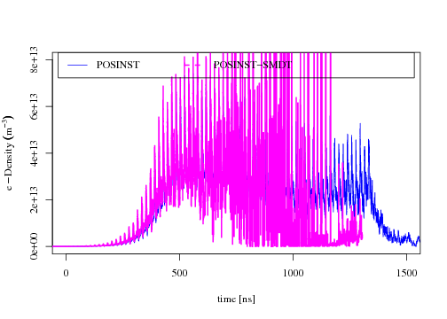
Different Number of Macro Particles
Noise and fluctuation increased when less macro particle used

Slide 8
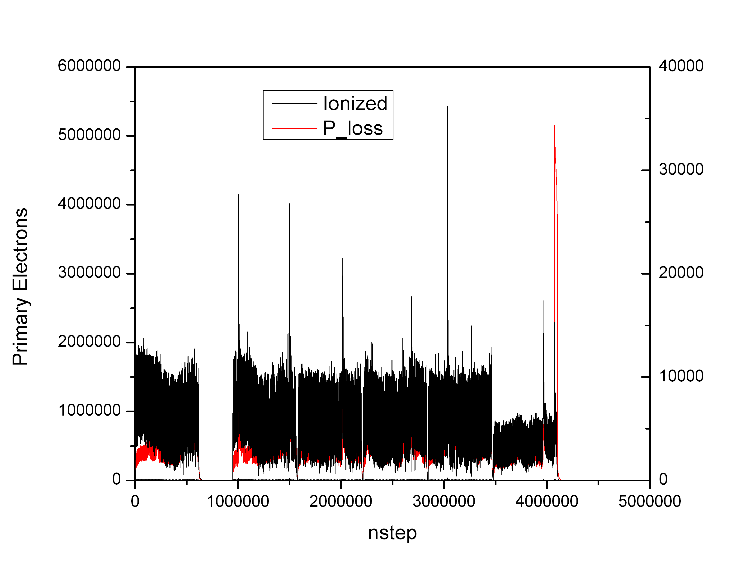
Probably “Bugs”

Slide 9
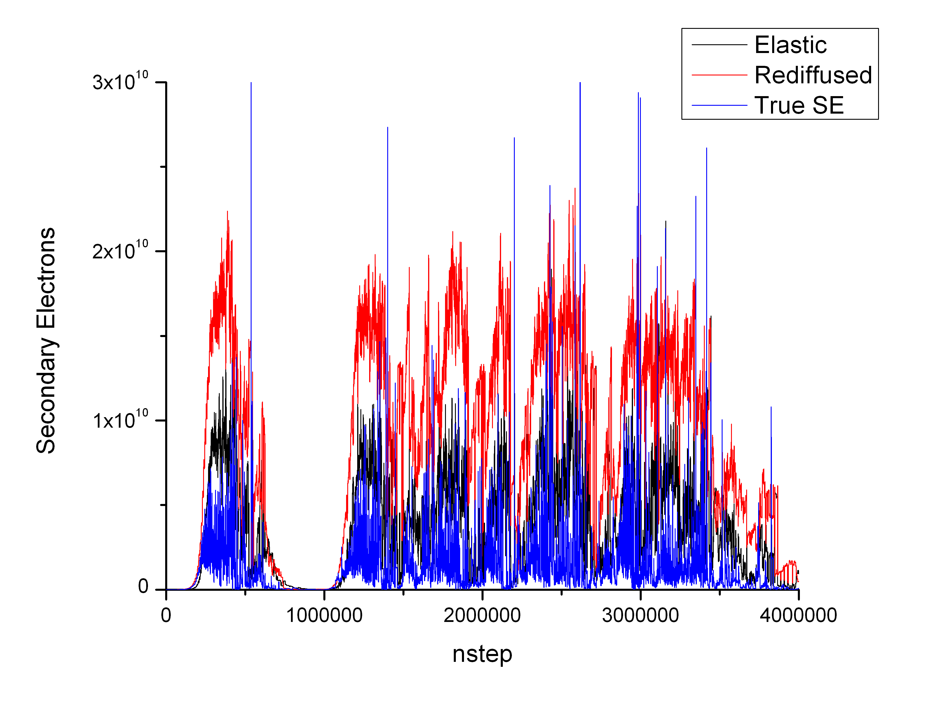
Noisy Secondary Electron Generation

Slide 10
POSINST Parameter Upper Limit
Maximum number of macro particles: 100000
Maximum steps: 10001
Culling method:
Input culling rate and maximum number of macro particles for culling (nexmax).
Culling at the end of each bunch passage and gap passage if nexmax reached.
Randomly (uniform) throw away particles.
Increase the charges of the survivors by the same factor to keep the same total charge.
Compress phase space.
Particle weight:
Secondary has the same charge as the primary.
Seed ionized and proton loss electron macros may have different charges, but kept the same through the simulation.

