Slide 1
Science Funding in the UK and the priorities for the Science and Technology Facilities Council
Richard Wade
Fermilab May 2011

Slide 2
Introduction
Science funding landscape in the UK
and where STFC fits in
Role and activities of STFC
Priorities for UK Science Priorities (including particle physics)

Slide 3
HM Government &
Notes:
The Science and Technology Facilities Council is an independent, non-departmental public body of the Department for Business, Innovation and Skills (DBIS).
The majority of our funding is public money from DBIS, allocated through the Comprehensive Spending Review.
STFC also receives a capital allocation from government for investment in infrastructure or assets.
STFC receives additional funding from a variety of other sources, including the other Research Councils, the European Space Agency, the European Commission and industry.

Slide 4
STFC Remit
Funding agency for research in Astronomy and Nuclear and Particle Physics
Responsible for major international subscriptions (CERN, ESO, ILL, ESRF)
Operator of National Laboratories at RAL and Daresbury

Slide 5
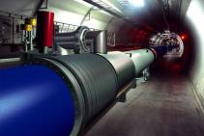
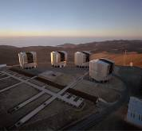
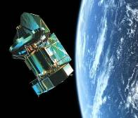
Understanding our Universe STFC’s Science Programme
Particle Physics
Revealing the structure and forces of nature
Large Hadron Collider (LHC), CERN
Ground based Astronomy
European Southern Observatory (ESO), Chile
Very Large Telescope (VLT)
Atacama Large Millimeter Array (ALMA)
European Extremely Large Telescope (E-ELT)
Space based Astronomy
Funding for exploitation of space missions
STFC Space Science Technology Department (RAL Space)
Nuclear Physics
Facility for anti-proton and Ion research (FAIR), Germany
Nuclear Skills for - medicine (Isotopes and Radiation applications)
energy (Nuclear Power Plants)
environment (Nuclear Waste Disposal
Notes:
Our vision is to maximise the impact of our knowledge, skills, facilities and resources for the benefit of the UK and its people.
Our highest priority in particle physics is to exploit the Large Hadron Collider (LHC) at CERN. The LHC will reveal how nature operates at the energy scales where our current standard model of particle physics breaks down and will transform our understanding of the fundamental rules of the universe.
Our highest priority in ground-based astronomy is to exploit our membership of the European Southern Observatory which gives access to the world-leading Very Large Telescope, the new ALMA millimetre astronomy array, and to carry out R&D towards the next generation European Extremely Large Telescope and the UK-led Square Kilometre Array radio telescope project.
Our highest priority in space-based astronomy is to exploit the new observatories such as Herschel, Planck, GAIA and James Webb Space Telescope, and to lay the technical groundwork for future cutting edge missions in the ESA Cosmic Visions programme.
Our highest priority in nuclear physics is to participate in the Facility for Antiproton and Ion Research, the new European Laboratory being constructed in Darmstadt, Germany that will offer an array of new experimental tools for nuclear research.

Slide 6
CERN

Slide 7
ALMA Chile

Slide 8
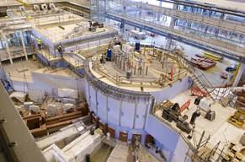
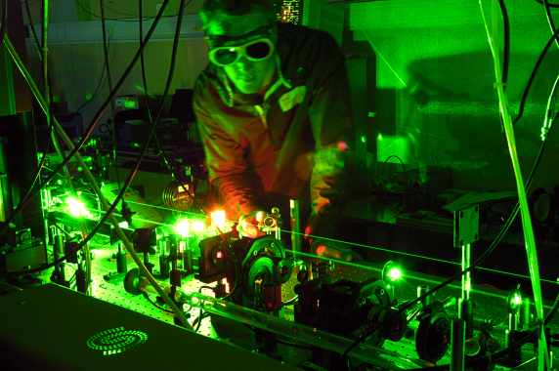
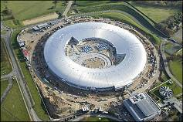
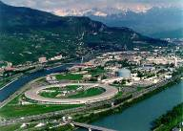
STFC Facilities – driving scientific research
Neutron Sources
Providing powerful insights into key areas of energy, biomedical research, climate, environment and security.
Institute Laue-Langevin (ILL), Grenoble
ISIS Pulsed Neutron and Muon Source
High Power Lasers
Providing applications on bioscience and nanotechnology
Central Laser Facility
Demonstrating laser driven fusion as a future source of sustainable, clean energy
HiPER
Light Sources
Providing new breakthroughs in medicine, environmental and materials science, engineering, electronics and cultural heritage
Diamond Light Source Limited (86%)
European Synchrotron Radiation Facility (ESRF), Grenoble
Notes:
We are a science-driven organisation, making it possible for a broad range of scientists to do the highest quality research tackling some of the most fundamental scientific questions.
We provide access to world-class facilities in the UK including
Neutron and Muon Sources
Lasers
Computational Science and Engineering
Atmospheric, Astronomy and Space Science
Synchrotron light sources and free electron lasers
Materials Analysis

Slide 9
Diamond Light Source

Slide 10
ISIS Pulsed Neutron Source

Slide 11
ILL High Flux Reactor

Slide 12
ILL and ESRF

Slide 13
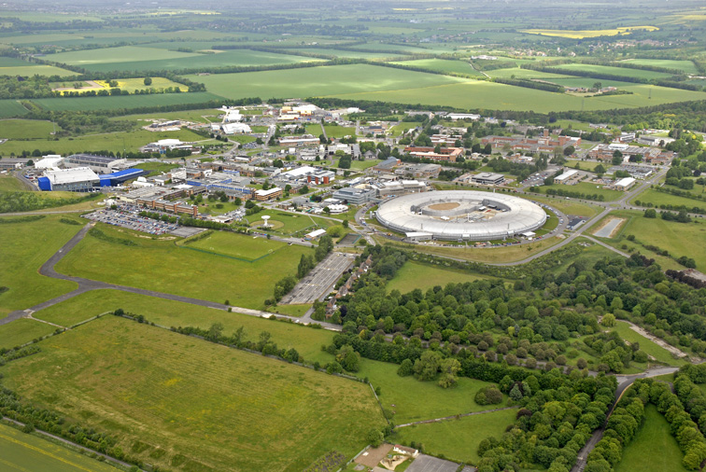
Harwell Campus
Medical Research Council
Health Protection Agency
World’s most powerful source of pulsed neutrons
ESA Centre
ISIC
World’s most intense laser
Space Science & Tech Department
Diamond Light Source

Slide 14
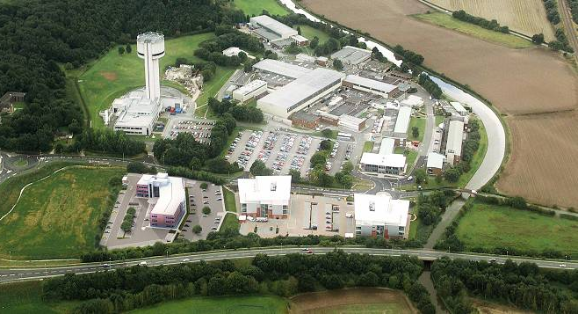
Daresbury Science and Innovation Campus
Daresbury Campus
SuperSTEM
Security Futures Lab
Accelerator Test Facility
Computational Science & Engineering
Engineering Technology Centre
Innovation Technology Access Centre
Vanguard House (under construction)
Cockcroft Institute
Innovation Centre

Slide 15
Science Funding Landscape

Slide 16
Background
The UK is a relatively small country with 60m population and 6th biggest economy globally.
But produces around 9% of scientific papers and 14% of the most highly cited scientific publications.
Ranked second to US in most scientific disciplines based on publications and citations.
Has some of the best Universities in the world (3 in the top ten list of Universities in the world).

Slide 17
So what’s the problem
Widely held perception that we are smart but fail to capitalize
Collapse of traditional manufacturing
manufacturing contributes just 18% of GDP
Reliance on service industries (particularly banking and insurance)
A feeling that if we could harness and exploit our ideas better then the economy would grow

Slide 18
What’s the evidence for this
First thing to say is that the UK investment in research as a percentage of GDP is lower than our competitors (US, Japan, Germany and France for the purpose of this discussion)
Despite this we are second to the US in terms of numbers of papers and citations
And interestingly we top the list in terms of papers and citations per capita!
But we are bottom of the list in terms of patents per capita.

Slide 19
No shortage of government initiatives
Realizing our Potential
Technology Transfer (one way)
Knowledge Exchange (two way)
Economic Impact
Impact (societal and economic)
Note that these are not initiatives to put more money into science, they are ways of getting more out of the investment.

Slide 20
Just a little history
1979 Margaret Thatcher
1st woman Prime Minister
1st Prime Minister with a degree in science!
Only Prime Minister with a science degree
1997 Tony Blair
Appoints David Sainsbury as Science Minister
Gordon Brown Chancellor of the Exchequer
None of them scientist but they get it.
Pledge to double science spending!

Slide 21
Just a little history
In addition Gordon Brown was happy to borrow in order to fund capital projects
The scientific community were encouraged to think big. Projects would be funded by capital investment and the running costs would be affordable in the context of growing budgets.

Slide 22
R&D Spending in Real Terms

Slide 23
And then came the economic crisis
Halts economic growth
Bank bail-out adds to national debt
Loss of confidence in and popularity of government
May 2010 election results in coalition government
Election fought on a platform of cuts and debt reduction
But where would the cuts fall

Slide 24
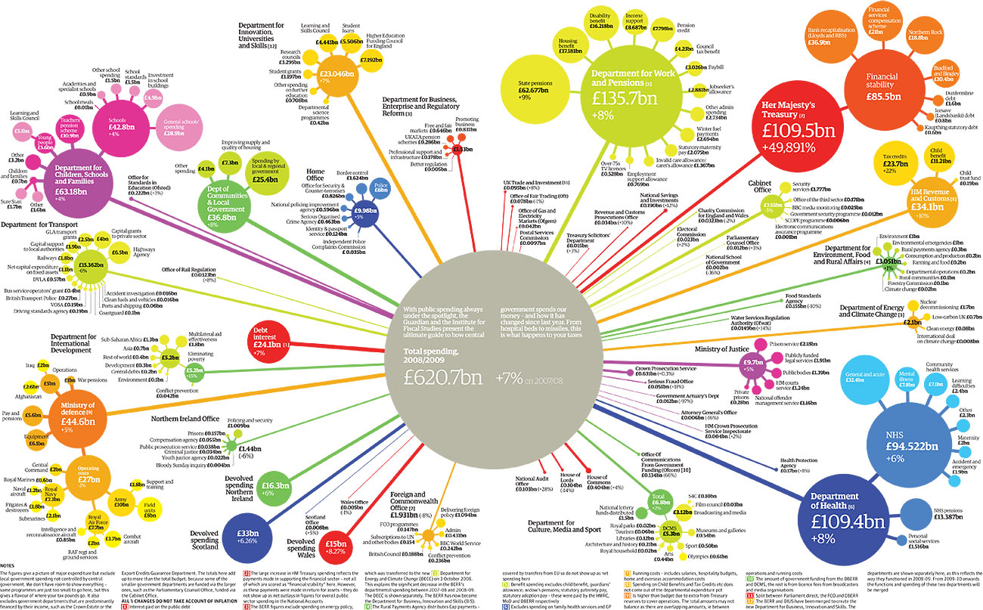
Research councils
Notes:
This is for a year earlier diagram produced by institute of fiscal studies for guardian each year shows where govt spending goes
Interesting that only a year earlier the interest on national debt (red circle due west of centre) was half that shown on previous slide - that is because of the orange circle (NE east of centre), the cash used to bail out the banks
BIS is orange-yellow circle NNE of centre – quite small, RCs are fourth satellite clockwise from base – not big
STFC not shown on here – but if it was we are about the size of the first circle (clockwise from base) which is the same size as the smallest satellite of Dept for work and pensions (yellow-green circle NNE of centre) which is the amount the govt spends on free TV licences for the over 75s
Message is we are very small beer – both financially and in terms of political headache
But silver lining we are irrelevant in producing savings
So if we can demonstrate our importance in rebalancing the economy
Delivering impact skills, jobs, inward investment etc
It is not too hard for them to give us a more generous settlement
Big but we are not the only ones saying that

Slide 25
To the edge of the cliff and back
In preparation for a change of government the Treasury asks for “bleeding stumps” scenarios
Modeling for 25% cut in resource and 50% in capital
Forced to stare into the abyss
At this level just not possible to continue business as usual (everything on the table for cuts)
Cut in capital poses particular threat to CERN membership

Slide 26
So what happened?
We made a strong case for the importance of science (both applied and more fundamental) to the economy.
We also argued for the inspirational value of subjects like HEP and Astronomy (attracting students etc).

Slide 27
In the end science did relatively well
Despite 25% average cuts across government, science budget is protected and held flat
Government buys the argument that membership of international organizations such as CERN cannot be subject to short term financial threats and fully funds
National facilities top-sliced
New emphasis on impact and economic growth

Slide 28
Priorities for the Future

Slide 29
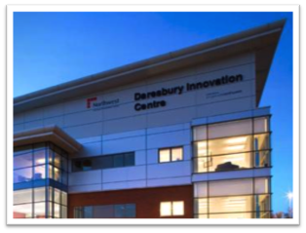
Promoting Greater Interaction with Industry
Collaborative access to facilities
Establishment of Science and Innovation Campuses at Harwell and Daresbury

Slide 30
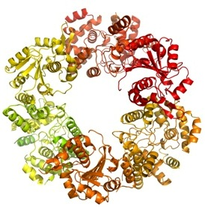
Focus on Global Challenges
Energy
Climate change
Security
Health

Slide 31
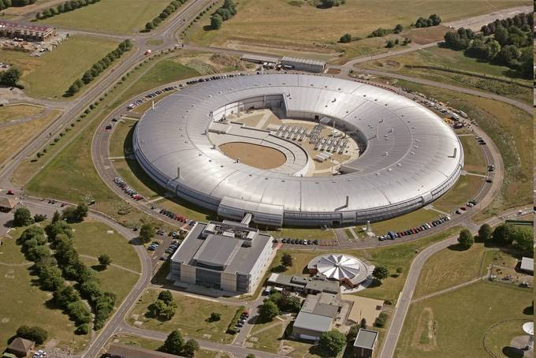
Diamond Light Source
The largest scientific instrument built in the UK in > 40 years.
Funding announced for 10 new beamlines (~£100m)

Slide 32
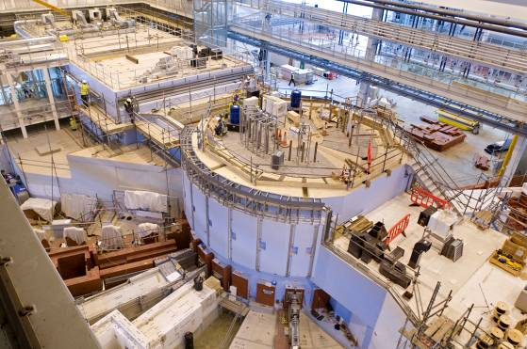
ISIS
ISIS is the world's most productive pulsed neutron spallation source.
Target Station 2 expands the science programme into soft matter, advanced materials and bio-science
£21m announced for new beamlines

Slide 33
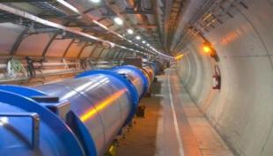
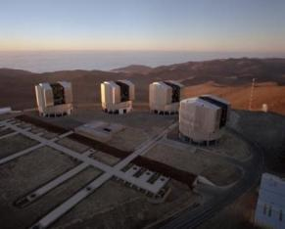
International Subscriptions
International subscriptions are fully funded at the levels which have been agreed with our international partners.
A planned reduction of ESRF exploitation from 14% to 10% is included.

Slide 34
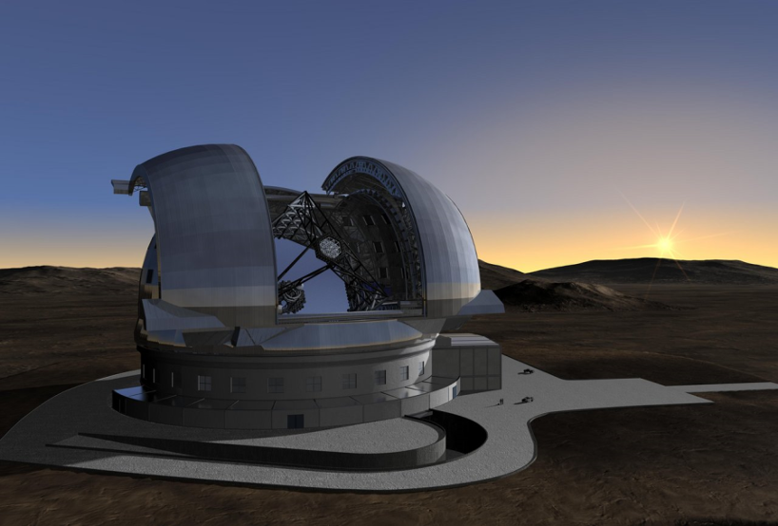
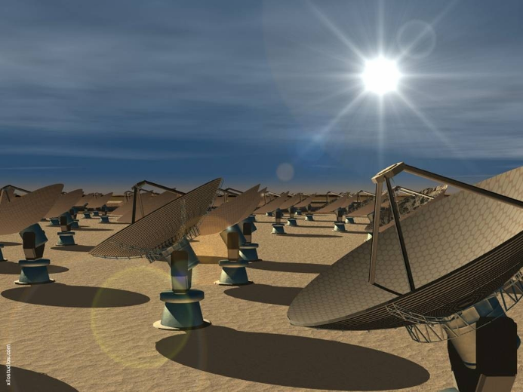
Astronomy and Cosmology
Our highest priorities in ground-based astronomy are:
to exploit our membership of ESO, which gives access to the world-leading VLT telescopes and to the new ALMA millimetre astronomy array, and to carry out R&D towards the next generation European Extremely Large Telescope (E-ELT) and
the UK-led Square Kilometre Array (SKA) radio telescope project.

Slide 35
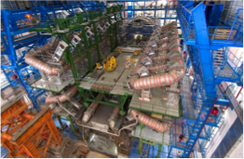
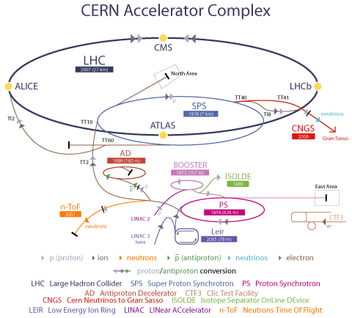
Particle Physics Priorities
Energy Frontier
Exploitation of LHC
Upgrades to ALTAS and CMS detectors
LHC luminosity upgrades

Slide 36
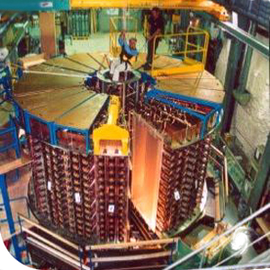
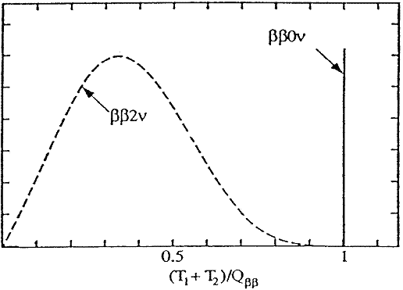
Neutrino mass and mixing
Minos
T2K
Super-Nemo

Slide 37
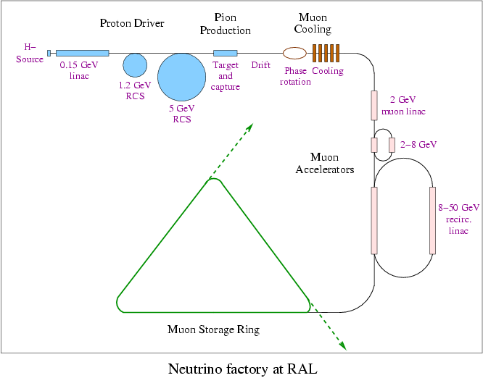
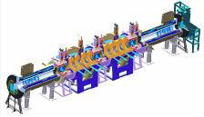
Muon Collider and Neutrino factory
MICE
Capital funding very tight
NF R&D
Unlikely to be able to grow activity

Slide 38
Accelerator R&D
Funding via Cockcroft and John Adams Institutes and the ASTec Centre
ALICE and EMMA (energy recovery linac, electron FFAG)
Front End Test Stand for high power proton beams
Targets
Applications

Slide 39
Conclusions
Inflation will eat into flat budgets so funding will be tight over the next four years.
The science programme for Particle Physics and Astronomy is very narrow.
Government will want to see evidence of impact.
But the government has recognized the importance of science including fundamental science.

