Slide 1
Beam Loading Studies in Accumulator Ring for µ2e project at Fermilab V.I. Balbekov and L.G. Vorobiev APC, Fermilab
Mu2e meeting, May 25, 2011 L.G. Vorobiev #1

Slide 2
Outlines:
Assumptions. Parameters.
Bunching without Beam Loading.
Model for Beam Loading.
Beam Loading with RF ramp.
Beam Loading with RF “OFF”. Instabilities.
Feedback.
Conclusion. Discussion. TODO.
Mu2e meeting, May 25, 2011 L.G. Vorobiev #2

Slide 3
Problem to be solved
Beam loading – beam induced voltage,
supplementary to RF-generator, resulting in:
Phase shift of the generator voltage and the amplitude wobbling around the generator RF
Smears the inter-bunch gaps.
Instabilities.
May compromise the “inter-bunch extinction” requirement, jeopardizing the whole experiment.
Mu2e meeting, May 25, 2011 L.G. Vorobiev #3

Slide 4
Assumptions.
All three momentum stack batches in the Accumulator have been
taken as a starting point. The “1+1+1” scheme was not considered.
Only 2.5 MHz cavities have been taken into consideration
➔ harmonic number 4.
53 MHz cavities have been omitted.
Mu2e meeting, May 25, 2011 L.G. Vorobiev #4

Slide 5
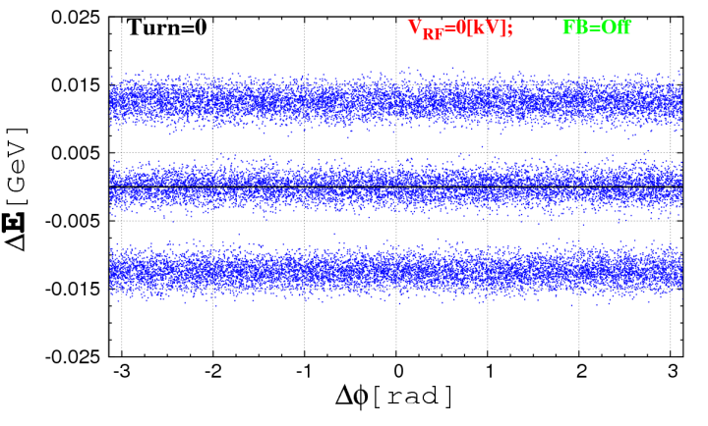
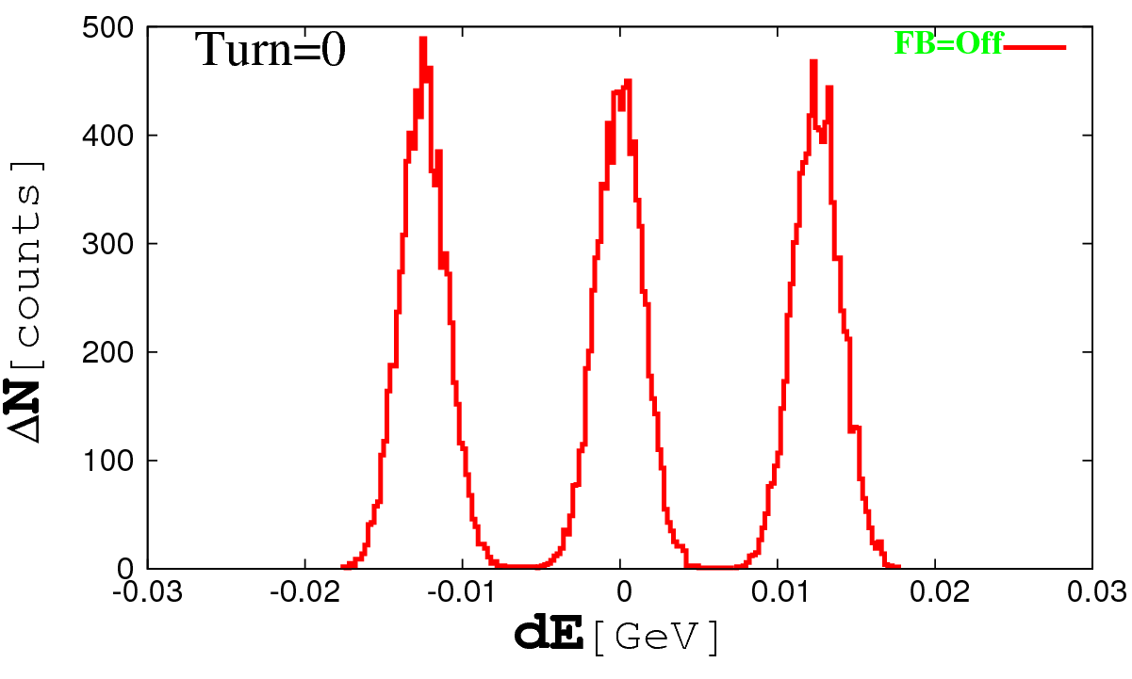
Parameters
N_{p} =1.5x10¹³ protons, T_{revolution} =1.59x10⁻⁶ s , Beam current I= eN_{p} / T_{revolution} = 1.5 A
σ = 1.5 MeV. 2.5 MHz RF used.
±~15 MeV
FW≤150ns
395 nsec
>1.53μsec
From: Chandra Bhat and Mike Syphers, Mu2e Accelerator Working Group meeting, March 9, 2010
A Gaussian-like 3σ truncated initial distribution (left), a corresponding histogram (right)
Mu2e meeting, May 25, 2011 L.G. Vorobiev #5

Slide 6
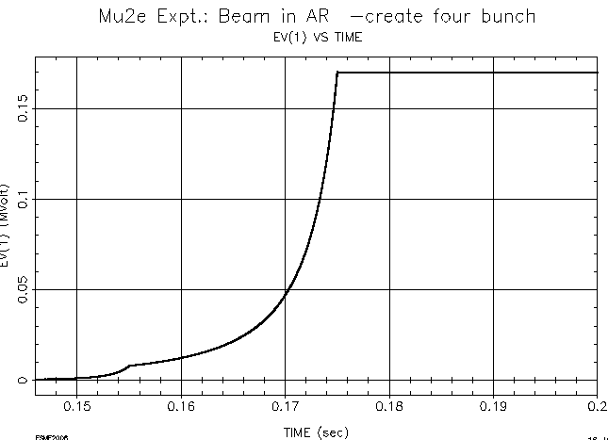
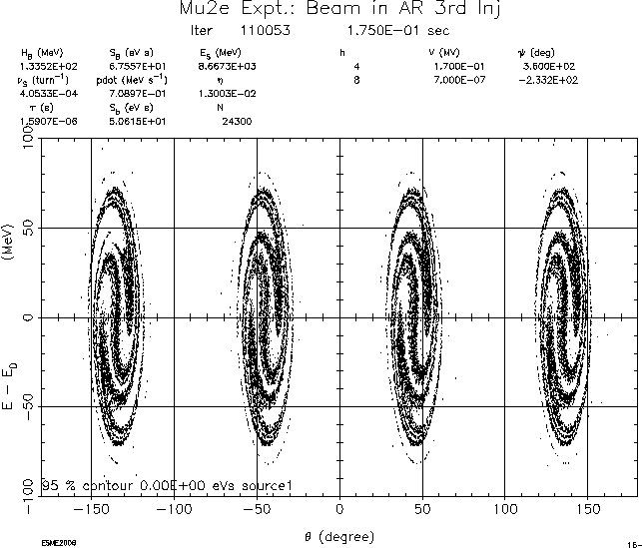
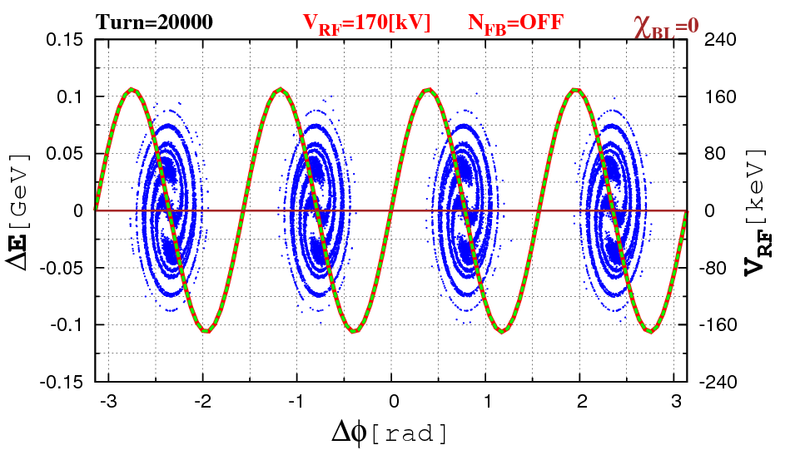
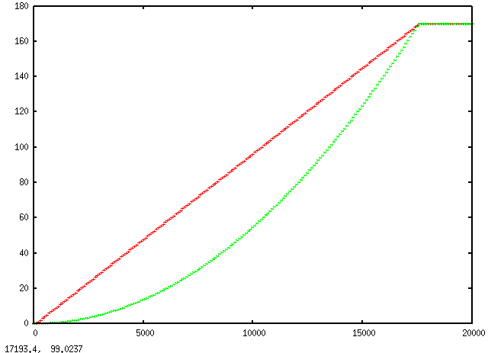
Bunching without Beam Loading
From: Chandra Bhat and Mike Syphers, Mu2e Accelerator Working Group meeting, March 9, 2010
RF voltage, as a function of “n”:
a parabolic or a linear function.
Momentum stack bunching for parabolic RF ramp
Mu2e meeting, May 25, 2011 L.G. Vorobiev #6

Slide 7
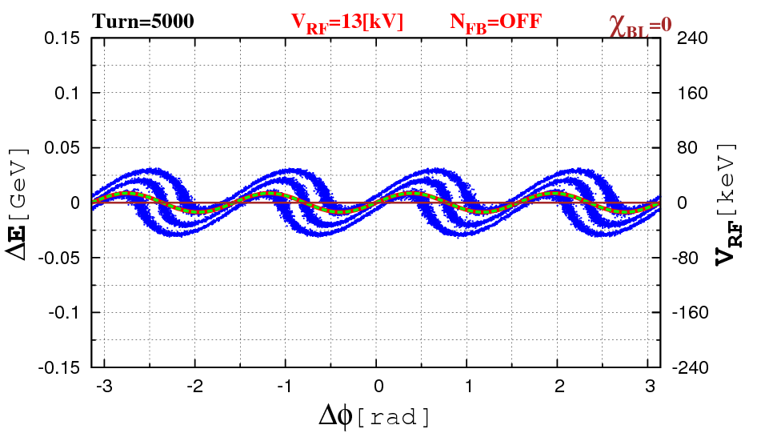
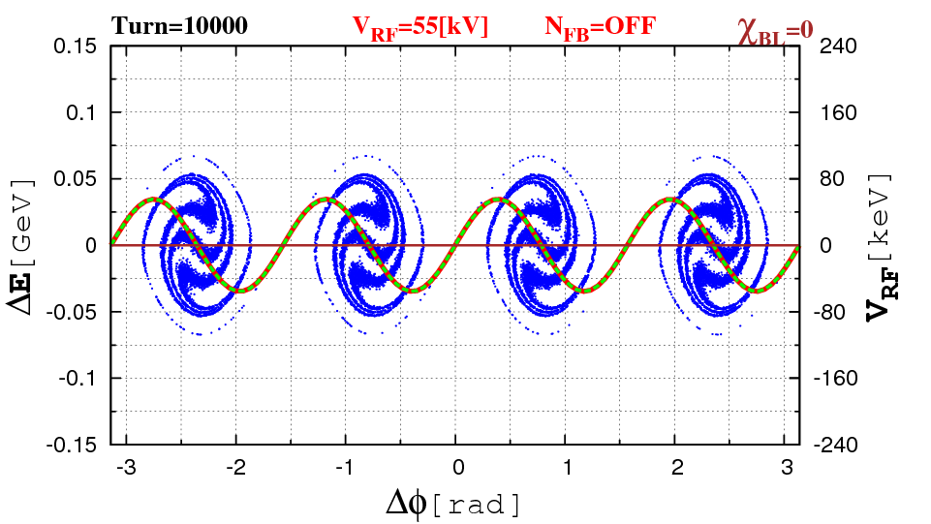
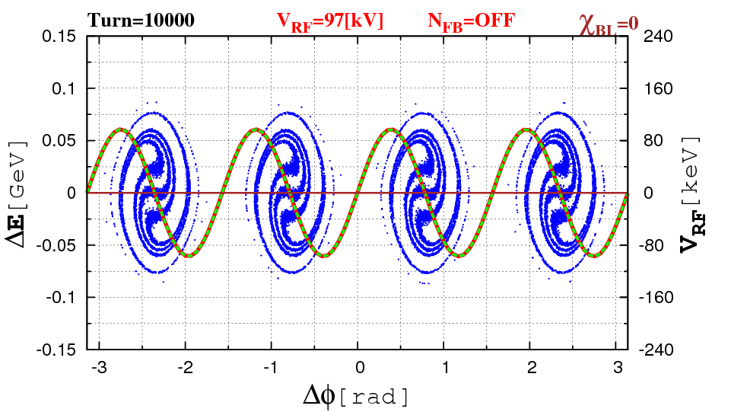
Bunching with RF parabolic/linear ramps
RF_min=0, RF_max=170kV, 5000, 10000 and 20000 turns
Beam’s longitudinal coordinates , during the momentum stack bunching for parabolic RF voltage growth and for linear ramp
NO much difference
Mu2e meeting, May 25, 2011 L.G. Vorobiev #7

Slide 8
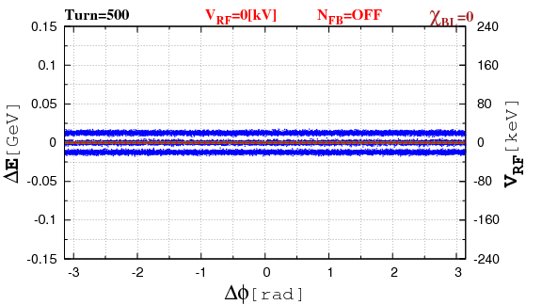
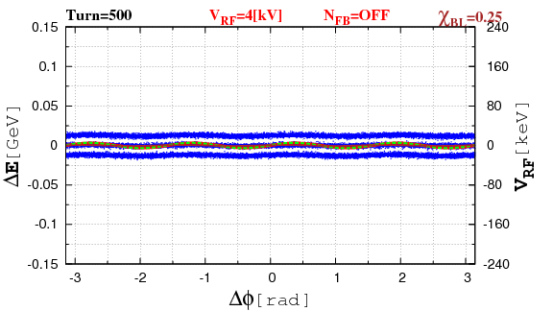
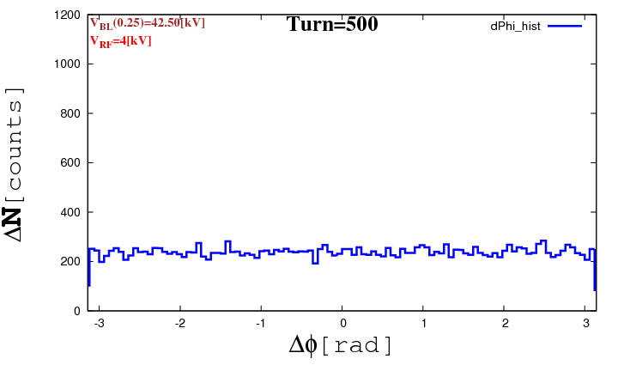
Beam Loading with linear RF
Longitudinal dynamics and histograms without (left) and with (right) beam loading for
n=1,…,20000 turns
For movies use Full Screen Mode F5
I=1.5 A, Z=70 kΩ , IZ=90 kV ➔ 4 times less than Project ???
Mu2e meeting, May 25, 2011 L.G. Vorobiev #8

Slide 9
Beam Loading via Fourier Expansion
χ is a beam loading factor
Mu2e meeting, May 25, 2011 L.G. Vorobiev #9

Slide 10
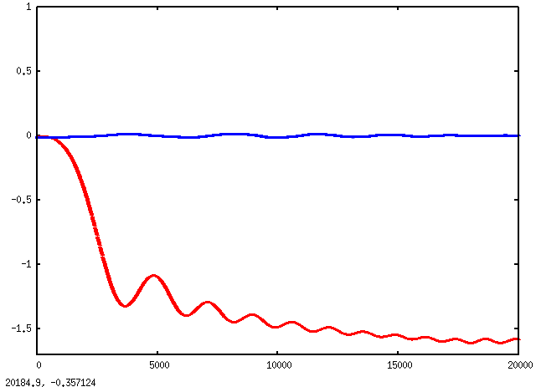
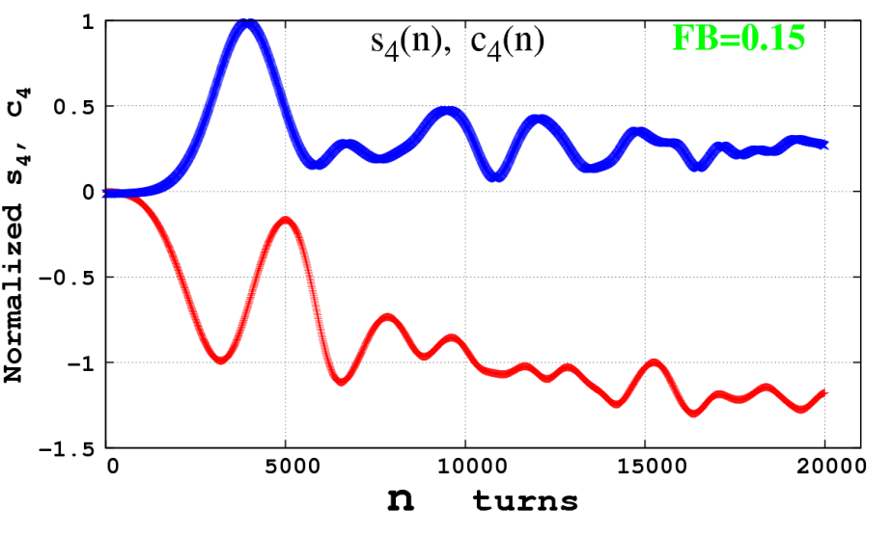
Driving Fourier Coefficients: S₄ , C₄
Normalized Fourier coefficients s₄ (blue), c₄ (red) of the beam current for n=1,…,20000
No beam loading : χ=0
Feed-Forwarding:
VFF_{max} (n)=V_{max} (n)·sin(4ϕ) -
V_{max} (n) × c₄(n)·cos(4ϕ)
Normalized Fourier coefficients s₄ (blue), c₄ (red) for n=1,…,20000 with beam loading: χ=0.15
Mu2e meeting, May 25, 2011 L.G. Vorobiev #10

Slide 11
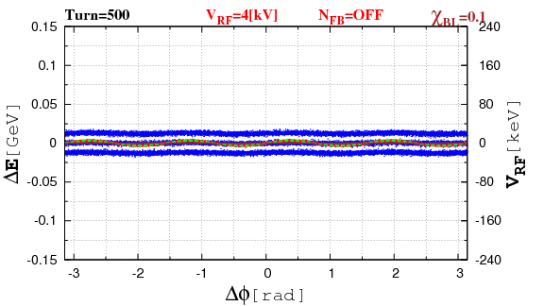
Beam Loading with linear RF
χ=0.15, 0.1 and 0.05
Longitudinal dynamics with linear RF ramp
and beam loading factors of χ=0.15, 0.1, 0.05
for n=1,…,20000 turns
For movies use Full Screen Mode F5
Mu2e meeting, May 25, 2011 L.G. Vorobiev #11

Slide 12
Beam Loading with linear RF
Conclusion: acceptable χ=0.05 ➔
that corresponds to 4-8 kΩ, 6-12 kV
(design regime is: 7×40 kΩ=280 kΩ
V_{BL} =1.5[A]×280 kΩ=420 kV; 420/12=35)
Thus, Either Beam current/35 or shunt impeadance/35
Mu2e meeting, May 25, 2011 L.G. Vorobiev #12

Slide 13
Beam Loading with RF “OFF”
Beam, circulating with RF generator “off”, will experience instabilities.
The beam looses the energy, when passing the RF cavity, so the phase distribution of the whole particle ensemble trends downward.
The instability develops pretty fast for the higher shunt impeadance and slows down for smaller impeadences.
Mu2e meeting, May 25, 2011 L.G. Vorobiev #13

Slide 14
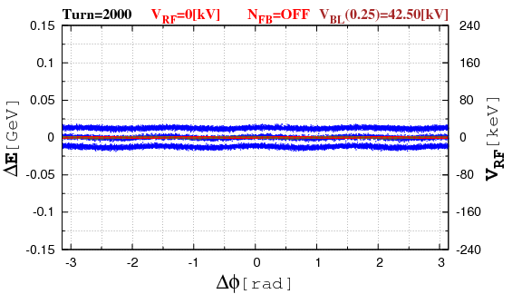
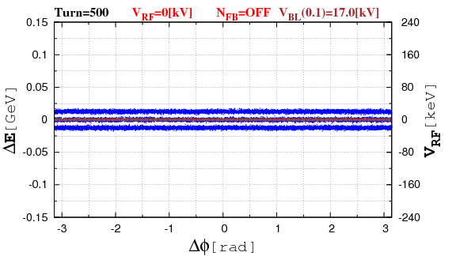
Beam Loading with RF “OFF” - Instability
For movies use Full Screen Mode F5
Longitudinal dynamics with zero RF and beam loading factor of χ=0.25, 0.1, 0.05 and 0.025 for n=1,…,20000 turns
! Instability !
The instabilities’ threshold: χ=0.0025 (theory)
(no instabilities observed during 100K turns)
Mu2e meeting, May 25, 2011 L.G. Vorobiev #14

Slide 15
Feedback
Nominal Parameters: 1.5 kA, 280 kΩ, V_{BL} =420kV
To operate the Accumulator under the design parameters
(clean bunching + suppressed instabilities)
we need a correction via feedback.
Our “Feedback” model works as the following.
On each n-th turn, pick up Fourier coefficients N turns back, i.e. “n-N”.
This BL data is applied to the current Beam Loading on the “n-th” turn.
Goto 1.
Mu2e meeting, May 25, 2011 L.G. Vorobiev #15

Slide 16
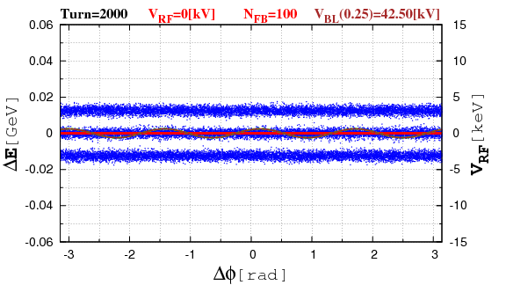
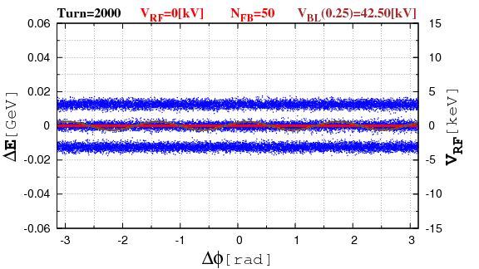
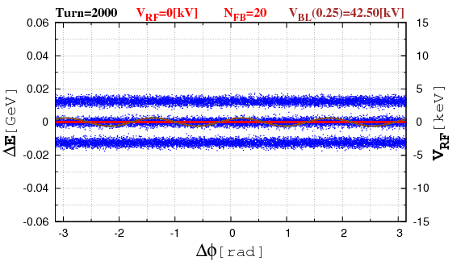
Feedback – RF “OFF”. Instability Suppressed.
1/10 Nominal Parameters: 1.5 kA, 280 kΩ, FB delay: 100, 50 and 20 turns
For movies use Full Screen Mode F5
Mu2e meeting, May 25, 2011 L.G. Vorobiev #16

Slide 17
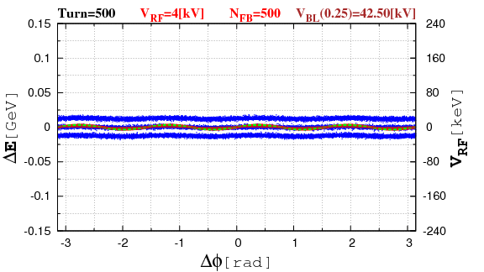
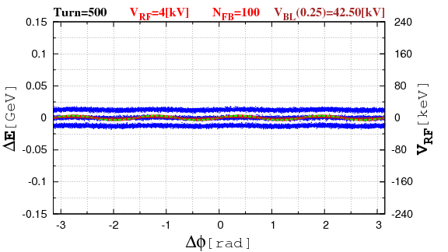
Feedback - Linear RF
1/10 Nominal Parameters: 1.5 kA, 280 kΩ, FB delay 100 and 20 turns
For movies use Full Screen Mode F5
Mu2e meeting, May 25, 2011 L.G. Vorobiev #17

Slide 18
Feedback - Linear RF
Nominal Parameters: 1.5 A, 280 kΩ, FB delay 100 and 20 turns
For movies use Full Screen Mode F5
Mu2e meeting, May 25, 2011 L.G. Vorobiev #18

Slide 19
Discussion, Conclusion
Beam Loading effect is critical for longitudinal dynamics.
When RF is “OFF” instabilities develop.
Feedback is indispensable to improve the bunching quality and to suppress instabilities.
Note: the effect of instabilities may be overestimated, when taking into account all three batches.
TODO
Realistic Injection into Accumilator: 1-2-3
Realistic FB scheme
Taking into account 2.5 MHz + 53MHz cavities with Beam Loading effect, instabilities and FB.
Mu2e meeting, May 25, 2011 L.G. Vorobiev #19

