Slide 1
Linac/400 MeV BPM System Plans and Status Nathan Eddy PIP Meeting 9/7/11

Slide 2
Motivation
Update existing RF Logamp electronics with Digital electronics
FPGA, ADC, Digital Signal Processing
Long term stability
Flexibility to modify system as needed
Implement calibration system to improve long-term stability
Implement phase measurement for Time of Flight/Energy measurement

Slide 3
Project Scope
Includes the processing of the BPM pickup signals to determine beam position through the duration of the Linac beam pulse
Compute position averages and deliver all of the position data to the ACNET control system every 66 ms (15HZ)
A limited number of BPM’s in the Linac and 400 MeV line will be required to deliver all of the position data samples to applications running in ACNET at the 15 Hz rate
Does not involve changing the BPM detectors or the cabling that comes up from the Linac enclosure.

Slide 4
BPM Specifications Document Craig Drennan
BPM Phase ~ 0.1 degrees @201MHz

Slide 5
Linac Section
Instrument all existing Linac BPMs
Total of 76 BPMs (2 plates/channels)
LE Linac (13)
Transition (6)
HE Linac (57)
Module 1 & 2 - 6 each (12)
Module 3-6 – 8 each (32)
Module 7 (9)

Slide 6
400 MeV Area
48 BPMs of varying styles
8 Dump Area
40 in Transport Line
Support existing applications
Beam Steering
Momentum Measurements

Slide 7
BPM Styles

Slide 8
Use Updated MTA BPM Electronics
Low cost NIM based design developed by PPD previously used in Anti-proton source
Satisfies all required specifications
Make use of existing rack/crate infrastructure
Use Linac Controls Software developed for MTA

Slide 9
MTA BPM Board
μC
Ethernet
ADCs
50MS/s
USB
fpga
LVDS
Bus
Analog
Quad
DCs
Digital I/O
DDS
SlowDAC
Upgrade MTA board
μC, FPGA, ADC, clock & LO scheme
Add ability to measure beam phase (relative to RF)

Slide 10
MTA Installation
Ethernet
LVDS Serial Bus
LinacCLK
Readout speeds for 8 (1Kbyte + header) UDP packets
Provides all RAW digitized I/Q data for 20usec @25MHz
2.4ms for master and 7ms from single slave

Slide 11
MTA BPM Software
Position & Intensity Parameters
Standard Controls BPM Application
Software for Needed for Linac
Waveform data currently readout via Python script
Need to implement into ACNET
Application?
Phase Measurement
Setup & Control Parameters

Slide 12
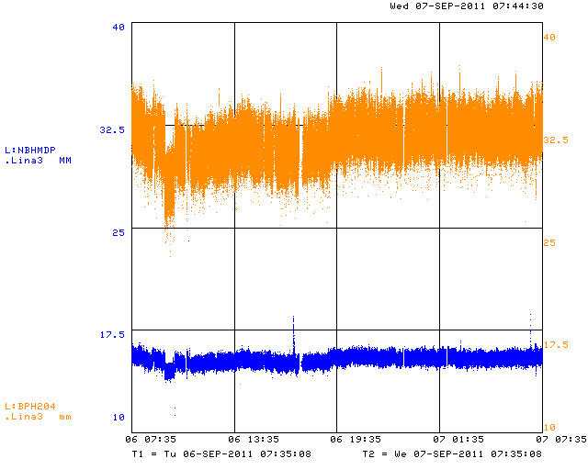
Linac BPM Test
Split signals to 4 BPMs
BPV204, BPH204
D42BPV, D43BPH
Two MTA boards were installed in March and are being readout and data logged
Need to confirm scale factors

Slide 13
Phase Measurement Test
MTA
Board
A
B
C
Inputs
201MHz
Ref
4way
splitter
LO generated at Ref+1.25MHz (locked)
I/Q sampled at 25MHz (unlocked)
See <0.05 degree rms for single channel (plate) when averaged over 19us

Slide 14
Triggering
Fully configurable within the FPGA
Linac Clock Event
External Trigger (TTL)
Delay & Acquisition Window
Beam Search
MTA System currently uses Linac Clock Event with a fixed Delay and Acquisition Window

Slide 15
Data Acquisition
Provide average Position, Intensity, & Relative Phase over each beam pulse for every BPM @15Hz
Provide “waveform” data for select BPMs @15Hz
Can select minimum of 1 BPM per crate
Decimate data rate to 5-10MHz
Option to store all data to on-board ram for “slow” readback

Slide 16
RF Signals – Use 2nd Harmonic

Slide 17
Linac BPM Prototype
4 Input
Channels
uC
Ethernet
USB
LO
Dist
Ref
Channel
FPGA
LVDS
Serial Bus
JTAG
Clock
Select
RF Input (805)
TTL I/O

Slide 18
Basic Components
Analog Quadrature Downcoverter – AD8348
Provide from 0-40db variable gain
ADC – LTC2265 (upgrade)
12 bits @ 805MHz/16 = 50.3MHz
FPGA – Altera Cyclone III (upgrade)
Can provide all needed DSP
uController – Stelaris LM3S5B (upgrade)
32 bit ARM processor operating at 80MHz
Ethernet – Wiznet W5300 (upgrade)
16 bit providing ~4MB/s bandwidth
Custom LVDS Serial Data Bus (modified)
25MHz providing ~2.5MB/s data transfer
Can be sped up if needed

Slide 19
Timing & Calibration Scheme
Base band is set to 22.5° per ADC sample at 50.31Msps
Mini-Circuits
ROS-1640-219
Quadrature
Downconverters
Mini-Circuits
RBP-400
Directional
Coupler
AD9518
1610 -1640
MHz VCO
811.24875
Mhz LO
IN A0
PFD
AD8348
Balun
Band
Pass
3dB
Pad
Coupler
1622.4975MHz
292-490 MHz
Osc
Micrel
SY89872
Micrel
SY89474
FP
804.96
MHz
AD8348
Coupler
Splitter
÷ 8
Ref
101.406 MHz
Coupler
100.62 MHz
Micrel
SY89872
LVDS 2:2
Mux/Fanout
÷ 2
Ref
Sel
LVDS bus
100.62 MHz
Ref
AD4360
Synthesizer
402.48 MHz
CAL Tone
100.622
MHz VXO
FGPA
PFD
Osc
ADF4001

Slide 20
Board Status
4 Prototype Boards produced
1 prototype 99% assembled. (Had to order cal tone amps with correct footprint)
3 additional prototypes 15% assembled - Paula is working on these now
Testing Status
Nominally checked
Power Supplies (+1.2,+1.8,+2.5+3.3,+5)
Microcontroller, FPGA, Network connection
Clock Fanout PLL chip. Generates 404.0614MHz
From 100.6223 MHz reference -> 3.144 MHz IF.
Mixers, Offset Trim DACs, Gain DACs for the mixers
IF BB Filters appear to be OK.
ADC serial links for setting internal registers.
Yet to do
ADC data – adjust timing
CAL tone
Ref Channel
Mixer IF Output after
BB Filter, ADC clock
Scope FFT of IF

Slide 21
Rough Schedule Projection
Complete bench testing of initial prototype – 1-2 week
Complete assembly of 3 remaining prototypes – 1 week
Begin Linac Beam testing – end of September
Verify all Data Acquisition Modes
Position, Intensity, Phase
Benchmark readout time for “waveform” data
2 months
Place order for 75 production boards – November
Once convinced no hardware modification needed
Begin testing assembled boards – early 2012
Install and begin operation – before shutdown

Slide 22
Rough Budget Estimate
Produce 75 Boards
Parts purchased
PCB, Front-Panels & Assembly ($20k)
Infrastructure
15 refurbished NIM crates acquired
Replacing 15 of 25 existing crates
Cables ($10k)
805MHz RF Distribution?

