Slide 1
PIP- Booster RF
Spare cavity status and tuner update
9/28/11
M. Slabaugh

Slide 2
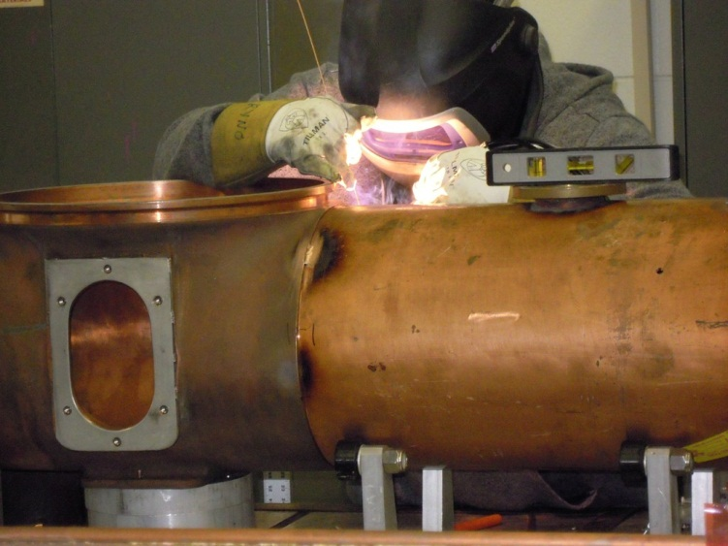
Spare Booster RF Cavity
Cavity assembly was on hold for several weeks due to safety concerns (grinding on copper)
Resume welding on 9-29
Vendor having problems brazing ceramics, will use older ones on hand
Best case estimate, end of October
Realistically, hope to have
before the holidays…

Slide 3
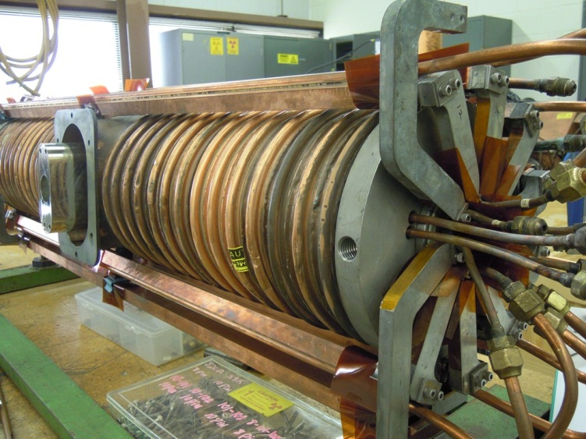
Spare Booster RF Cavity
Cavity testing
Temperature spike on wide-bore cavity due to bad contact in the tuner stem. Did not flag at normal operating parameters!
Begs question??? “Acceptable” may no longer work!
Already know we have to re-work some cooling

Slide 4
Booster RF Tuner model and drawings

Slide 5
Booster RF Manpower and Schedule
Manpower and discussion points
AD/MSD has provided two technicians for full-time RF/tuner work
TD is supplying one technician to help (and learn) build tuners
All three technicians are in training
Current MSD schedule (D. Augustine) is estimating about 5 weeks (25 days) to remove/rebuild/re-install one cavity
Not counting in schedule 10 tuners from TD budgeted for FY12. If available, these would help.

Slide 6
Schedule- rebuilding tuners
9 cavities = 228 days (6/21/12 - 6/5/13)

Slide 7
Schedule- procurement new tuners
Ferrites delivered Sept. 2012

