Slide 1
FNAL Linac
7835 Procurement Plan
Proton Improvement Plan
Fernanda G. Garcia
Accelerator Division
11/2/2011 Proton Source Department

Slide 2
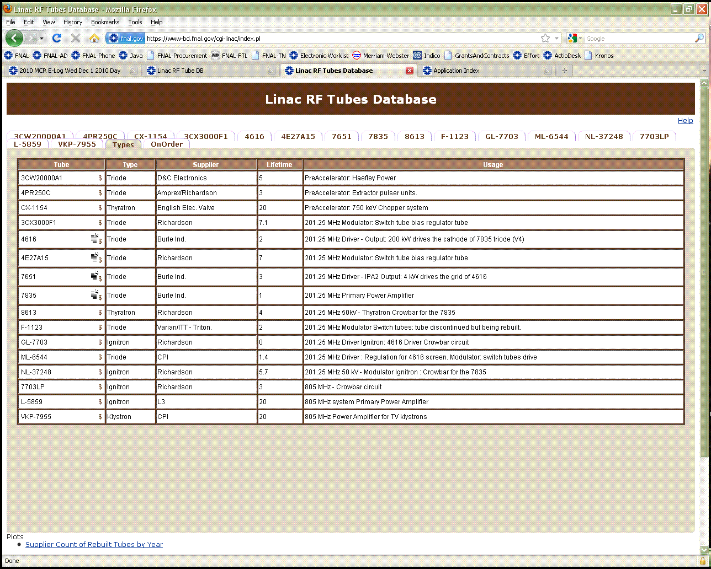
Linac Vacuum Tubes
In order to operate, Linac/PreAcc combine require
16 different type of vacuum tubes
8 different manufactures/distributors

Slide 3
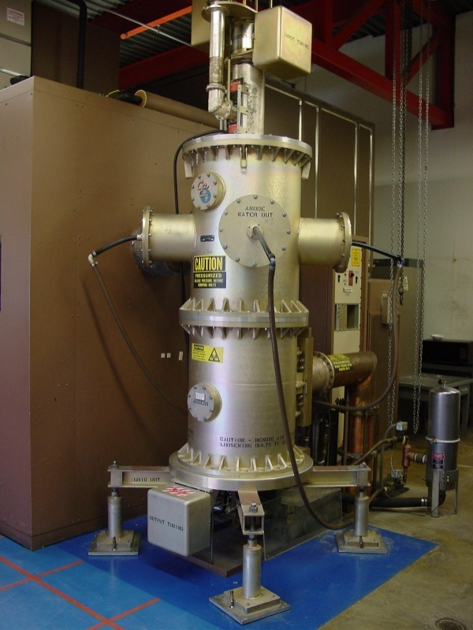
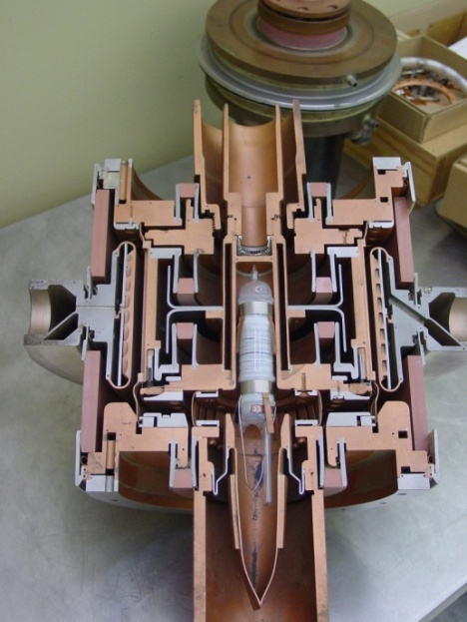
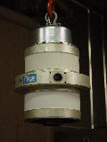
Linac Vacuum Tubes
201 MHz System - Primary Power Amplifier
7835 (Triode Primary Power Amplifier)
Complex technology
Use only in the National Laboratories
BNL, LANL*, FNAL
Operation Needs: 4 ¼ tubes/year
Only one vendor – Photonis USA Industries
Typical delivery time: 210 days
Expensive: (FY11) $210K for new tube
Deterioration of product quality for the past
~6 years is a concern.
Cut out 7835
LANL is building a new 201MHz system based on Thales tube.
Reference: Beams-doc-3934-v2

Slide 4
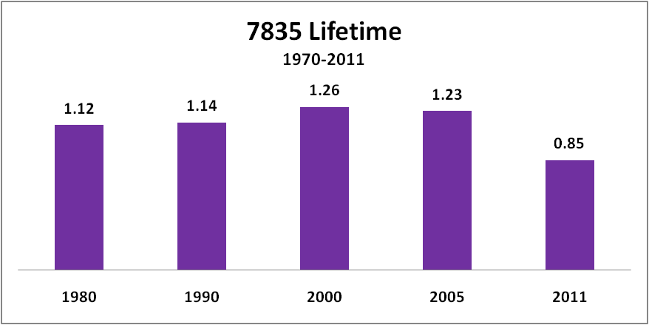
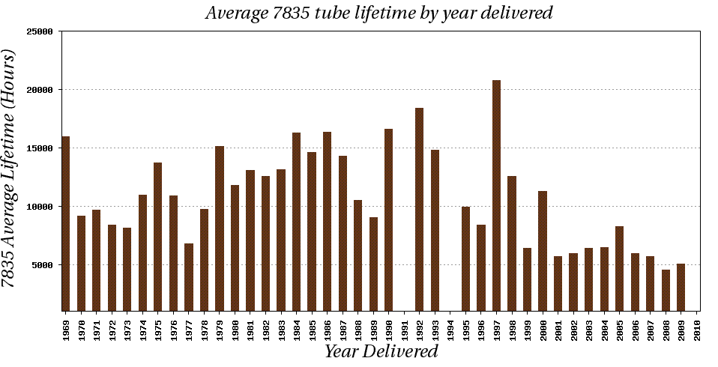
Linac Vacuum Tubes
201 MHz System - Primary Power Amplifier
(years)
Linac requires ~ 4 ¼ tubes/year to operate
Average Lifetime based on past 5 years: ~ 0.85 years
~ 30% lifetime
reduction
MiniBooNE
April’02
NuMI
May’05
NuMI
Slip
Stacking
Jan’08
Pbar
Slipstacking
Aug’04

Slide 5
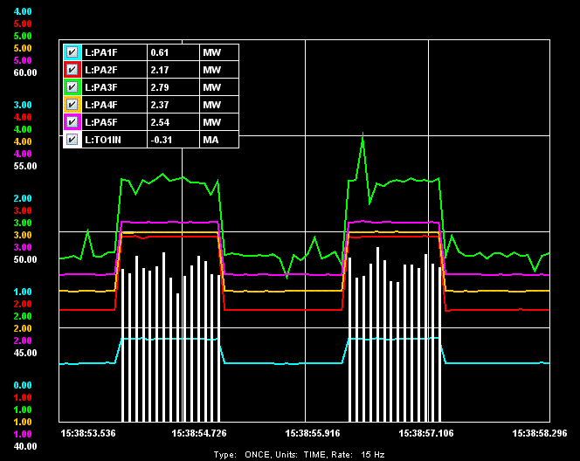
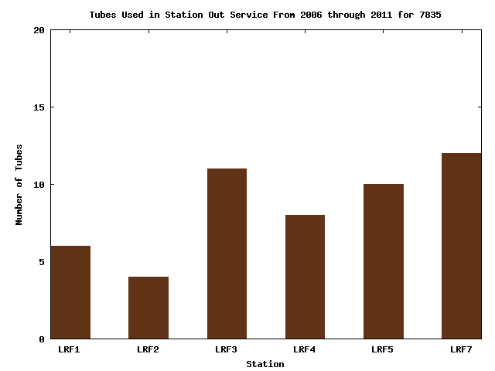
Linac Vacuum Tubes
201 MHz System - Primary Power Amplifier
DTL Tank | Energy Out (MeV) | Peak Power_{+30mA} (MW) | Peak Power_{tank} (MW)
1 | 10.4 | 0.8 | 0.6
2 | 37.5 | 2.9 | 2.1
3 | 66.2 | 3.5 | 2.7
4 | 92.6 | 3.0 | 2.3
5 | 116 | 3.2 | 2.5
DF: 0.037%

Slide 6
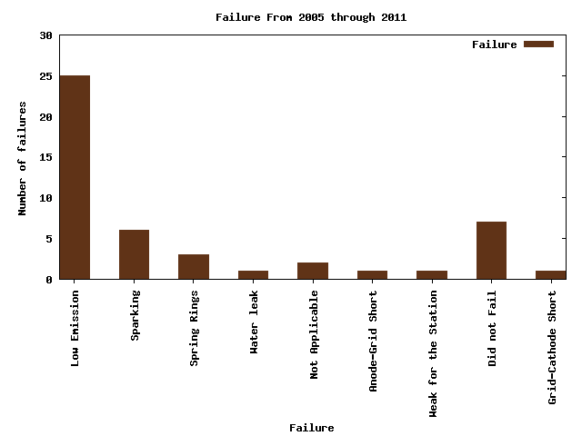
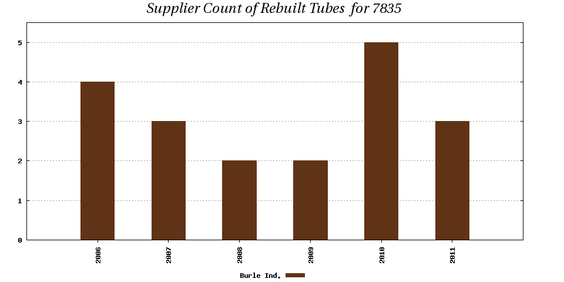
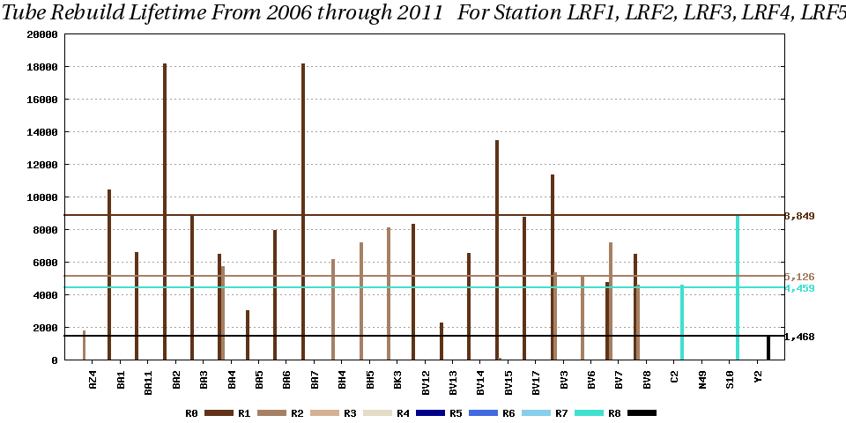
Linac Vacuum Tubes
201 MHz System - Primary Power Amplifier
<# hrs> ~7,550
Photonis USA rebuilds these tubes.
# of rebuilds is determined by
the rebuild viability of the anode and
the grid-block assembly.
Low Emission
It is difficult to predict how many rebuilds one can get.
5
4
3
2
1
0
R0 ~ 8850 hrs
R1/R7 ~ 5,000 hrs
R8 ~1,500 hrs
2006 2007 2008 2009 2010 2011

Slide 7
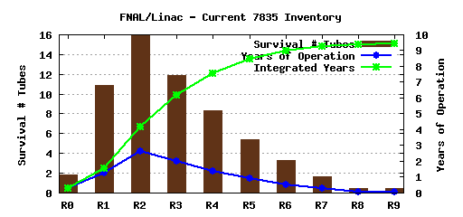
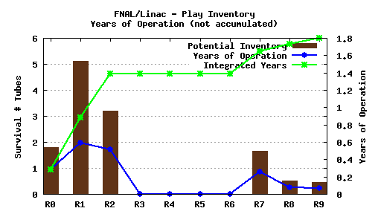
Linac Vacuum Tubes
201 MHz System - Primary Power Amplifier
Status | Tube Count
Active | 5
Spare | 9
Failed | 15
Being Rebuilt | 1
Stand By | 2
Conditioning | 0
TOTAL | 32
Avg Lifetime_{5years}: ~ 0.83 years
With the current inventory...
Current Status (11/1/2011)
Rebuilds available up to R6
assume 5% loss for each R#
Rebuilds not available
# tubes
Integrated # years
operation
# tubes
Integrated # years
operation
~ 9.5 yrs
~1.8 yrs

Slide 8
Linac Vacuum Tubes
201 MHz System - Primary Power Amplifier
2004 Tube Task Force Documentation:
“Fermilab must increase its reserve of 7835 Power Tubes to a level consistent with a two-year spare supply. We have been directed to do this by all DOE driven Review Boards who examine the operations of our accelerator complex and by an internal vulnerability assessment.”
R. Andrew, P. Czarapata
01/12/2005
June/2010 –Proton Task Force
Proton Source Department Head dictated that Fermilab should have a four-year spare supply.
The assumption is that this is a more realistic minimum inventory investment required in order to implement a backup plan in case another technology is chosen for the present Linac Low Energy region (work under HLRF task).

Slide 9
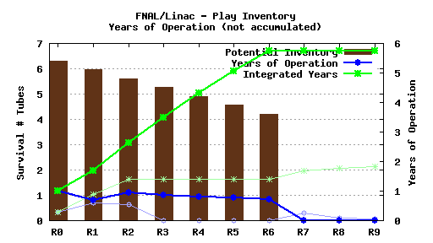
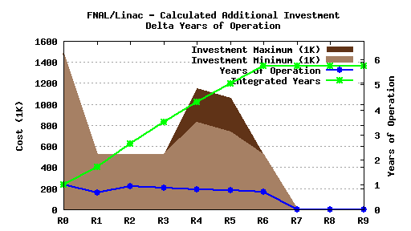
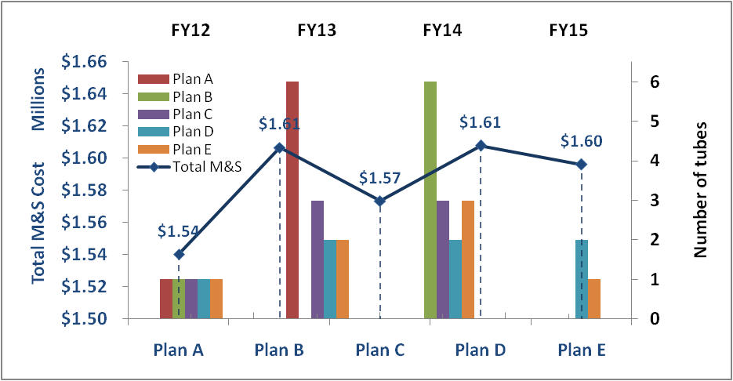
Linac Vacuum Tubes
201 MHz System - Primary Power
Amplifier
Assuming:
Avg Lifetime_{5years}: ~ 0.83 years
Rebuild available up to R6
PIP Total tubes: 7
These tubes alone during its lifecycle will provide
~ 5 years of Operations
Photonis can accommodate
any ordering schedule that
suits our needs.
- Shipping schedule can be
mutually determined between
FNAL and Photonis.
- 2011 orders until Dec 20th !!!

Slide 10
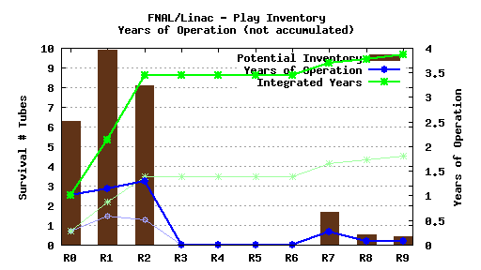
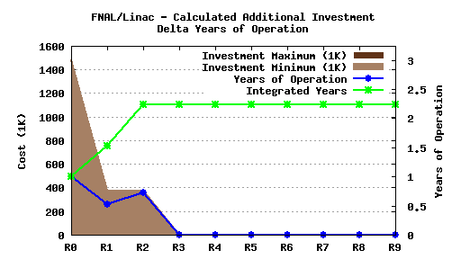
Linac Vacuum Tubes
201 MHz System - Primary Power
Amplifier
Assuming:
Avg Lifetime_{5years}: ~ 0.83 years
Rebuild available up to R6
PIP new tubes combined with
rebuilding current FAILED tubes
yields ~4 years of Operation.
Rebuild M&S: computed by analyzing the most
historical most common rebuild task.

Slide 11
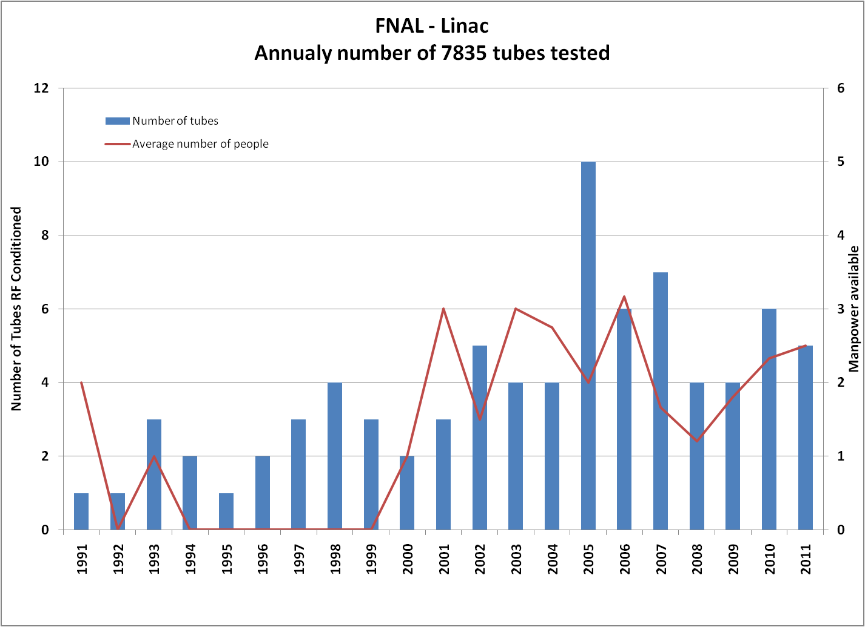
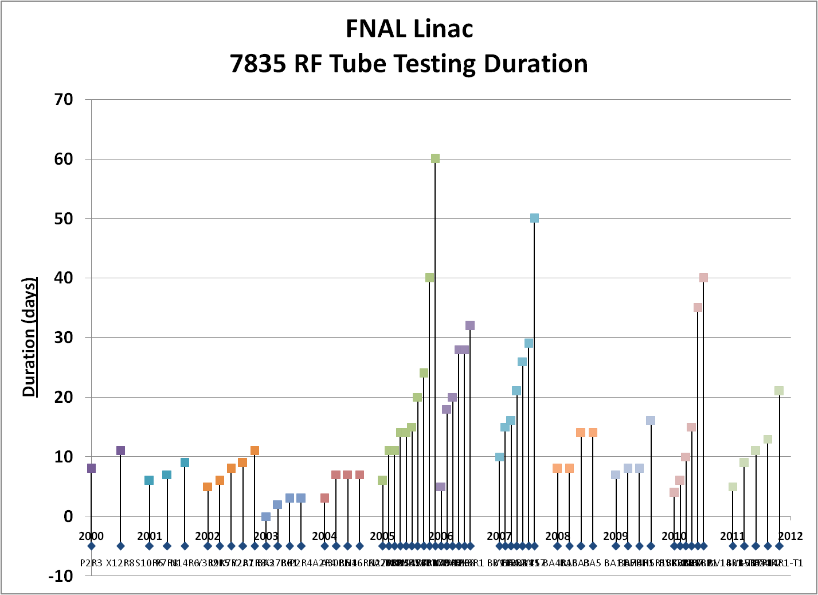
Linac Vacuum Tubes
201 MHz System - Primary Power
Amplifier RF Test Conditioning
At a Glance:
Tube preparation & RF conditioning
2 Linac RF techs FT ~ 3-4 months/year
About 6 tubes/year are conditioned.

Slide 12
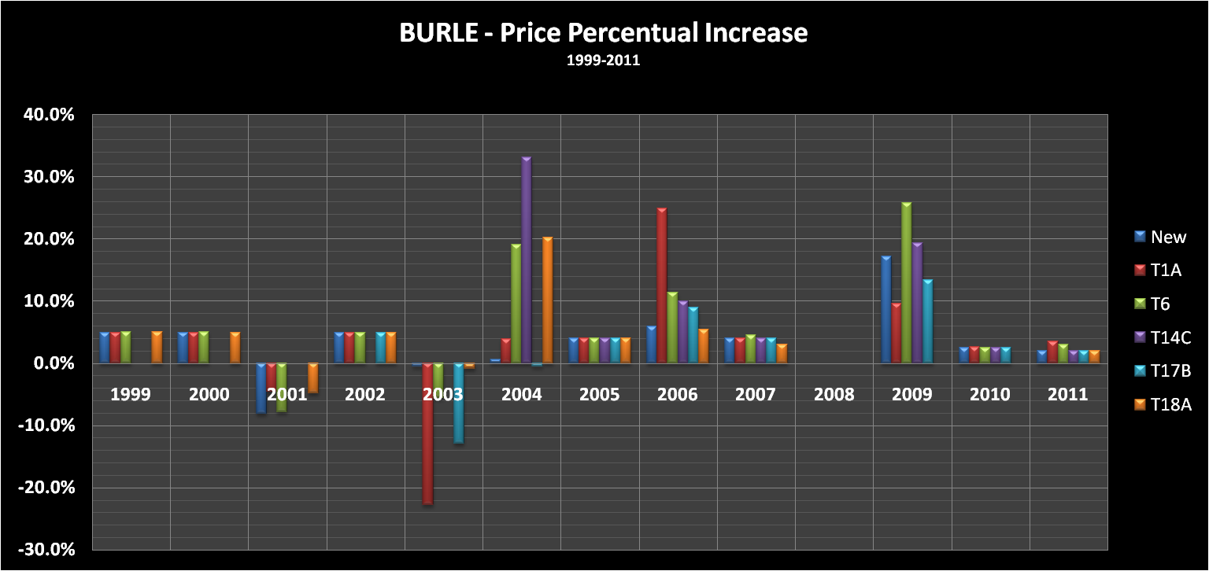
Linac Vacuum Tubes
201 MHz System –
Primary Power Amplifier
Prices are set via Basic Ordering Agreement (BOA) between BNL, FNAL and Photonis.
Every BOA is valid for 1 year
Last 2 BOA’s price escalated by 2%.
Expectation for 2012 prices: 5% increase.

Slide 13
Linac Vacuum Tubes
201 MHz System - Primary Power Amplifier
Status | Tube Count
Active | 5
Spare | 9
Failed | 15
Being Rebuilt | 1
Stand By | 2
Conditioning | 0
TOTAL | 32
4 tubes flagged as “Failed” are to be scrapped soon.
S10R7-> Anode replaced as R6, Grid mount since R4
Y2R8 -> Anode replaced as R7, other parts reused for many rebuilds...
N27R8 -> lost vacuum in storage!
N14R7 -> Anode replaced as R7, other parts reused many times
Current Status (11/1/2011)

