Slide 1
SNS Accumulator Ring Instability Damper and Beam Transfer Function Studies
Robert Hardin

Slide 2
Before I Begin… Many Thanks Go To:
Craig Deibele, Sasha Aleksandrov, Slava Danilov, Andy Webster, Jeff Bryan, Jim Diamond, George Link, Syd Murray III
You… For giving me the opportunity to be here today!

Slide 3
Overview
Introduction to the SNS facility
Motivation for a ring instability damper system
Basic elements of the analog system
Experimental damping result highlights
Fundamentals of beam transfer function measurements
Beam transfer function result highlights
Summary and Conclusions

Slide 4
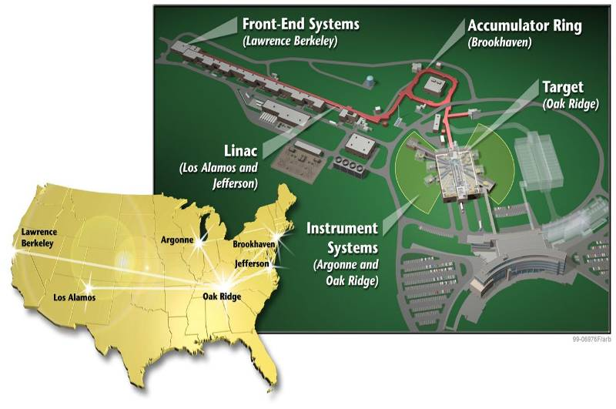
The Spallation Neutron Source: is an accelerator-driven user facility for neutron scattering research at Oak Ridge National Laboratory in USA

Slide 5
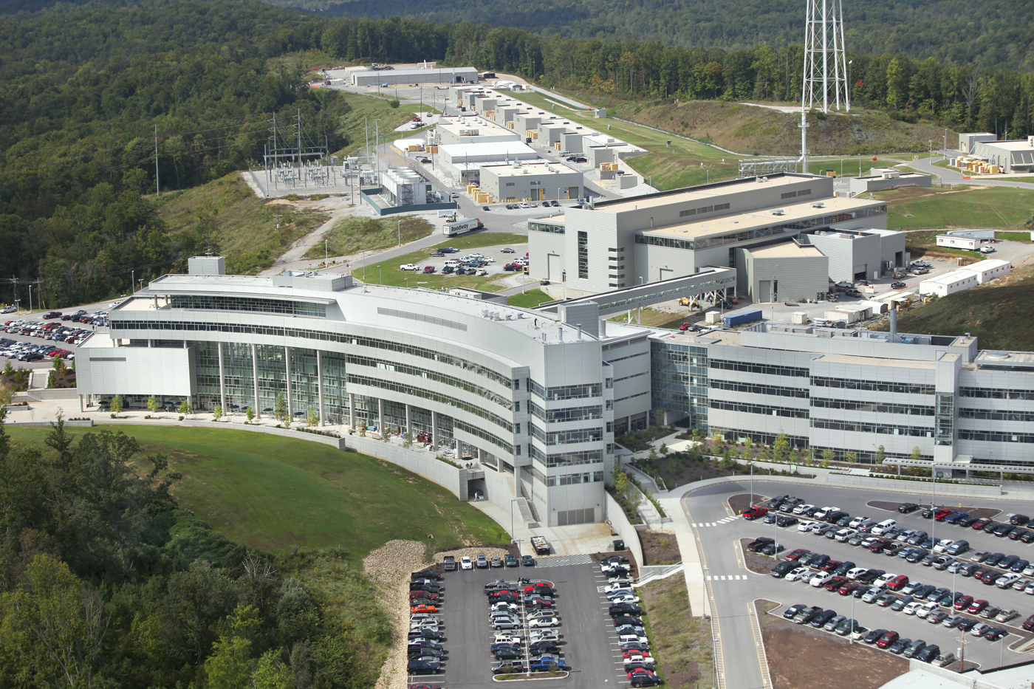
2010

Slide 6
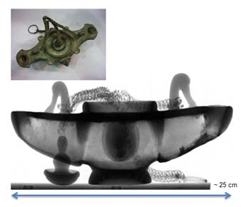
Neutrons are used for research in:
Biology & Medicine
Biotechnology & Energy
Fundamental Physics
Imaging
Magnetism
Materials
Nanotechnology
Superconductivity
Neutron Radiograph of an ancient Greek lamp
www.ornl.gov

Slide 7
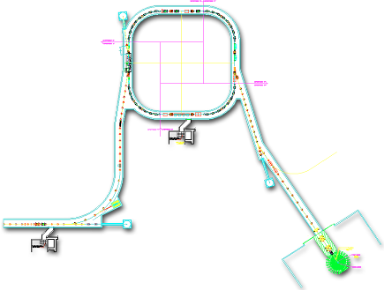
SNS Accelerator Complex
1 GeV LINAC
Accumulator Ring: Compress 1 msec long pulse to 700 nsec
Collimators
Front-End:
Produce a 1-msec long, chopped, H- beam
Injection
Extraction
RF
<1 μsec
1000 MeV
RTBT
2.5 MeV
HEBT
Front-End
LINAC
Liquid Hg Target
Chopper system makes gaps
945 ns
mini-pulse
Current
Current
1 ms macropulse
1ms
1 ms macropulse
1 ms

Slide 8
Baseline Beam Parameters
P beam on target : 1.44MW (800 kW – 1MW)
I beam average: 1.44mA
Maximum Beam energy: 1 GeV (925 MeV)
Duty factor: 6%
Rep. rate: 60Hz
Pulse width: 1ms

Slide 9
Proton beam follows a sinusoidal path
In a perfect world…
In the real world…
Hill’s Eq.
“Tune” describes the number of oscillations the beam completes per revolution
Here the “Tune” is 6.2 → .2 determines the phase advance of the beam around the ring

Slide 10
Motivation for the instability damper system at SNS
As the proton beam accumulates in the ring, the beam can become unstable.
Instability can produce losses in the beam, which reduces the power to target and increases radiation in the ring.

Slide 11
Motivation for the instability damper system at SNS (2)
Vacuum Wall
electron
Proton Beam
Electron can be captured by the proton bunch “potential well” until bunch passes.

Slide 12
Motivation for the instability damper system at SNS (2.5)
Electron freed via proton impact
“Free (Lost) Proton”
Lost protons can cause electrons to be produced by impacting the chamber walls.
Electrons are accelerated/decelerated by the proton beam potential, with a net gain of energy.
Electrons cascade (secondary, tertiary, etc.) and can survive the gap between beam passages → net gain of electrons.
With enough electrons, the protons can be shaken (not stirred) to produce an instability.

Slide 13
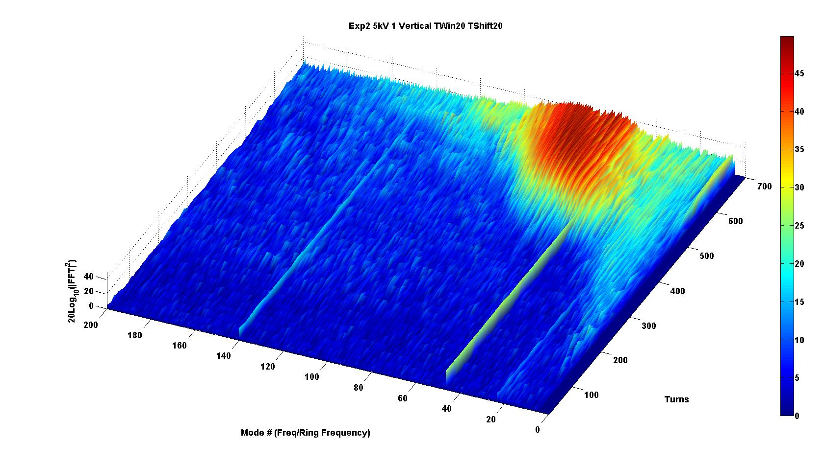
Motivation for the instability damper system at SNS (3)
So why implement a ring feedback system?
Minimize or control instabilities in the ring
Reduce losses → Better performance → Higher beam intensities to target
Ring Frequency = 1044389 Hz →
Mode ≈ Frequency

Slide 14
Basic elements of the feedback system
Pickup (BPM Stripline) + Cable
Signal Processing (LLRF, Timing, Filtering)
RF Power Amplification
Kicker (BPM Stripline) + Cable
Beam
Pickup
Signal Processing
Power Amplification
Kicker
Timing delay is crucial to maximize the damping…
so that the 0.2 “Tune” produces a 90 degree phase advance between pickup and kicker

Slide 15
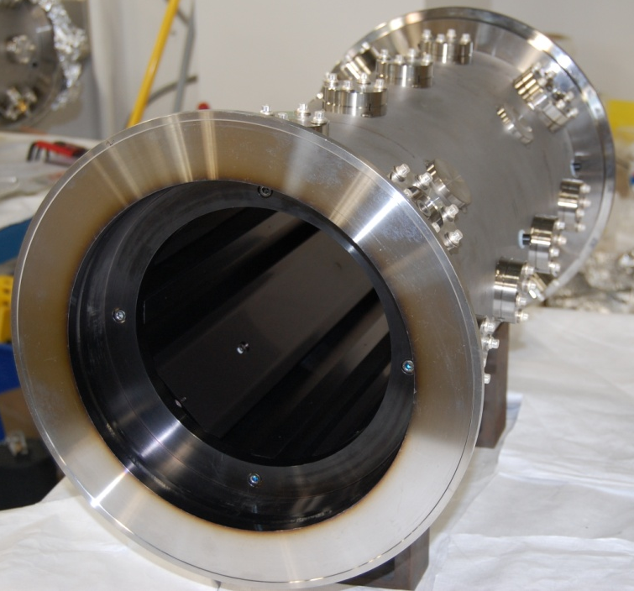
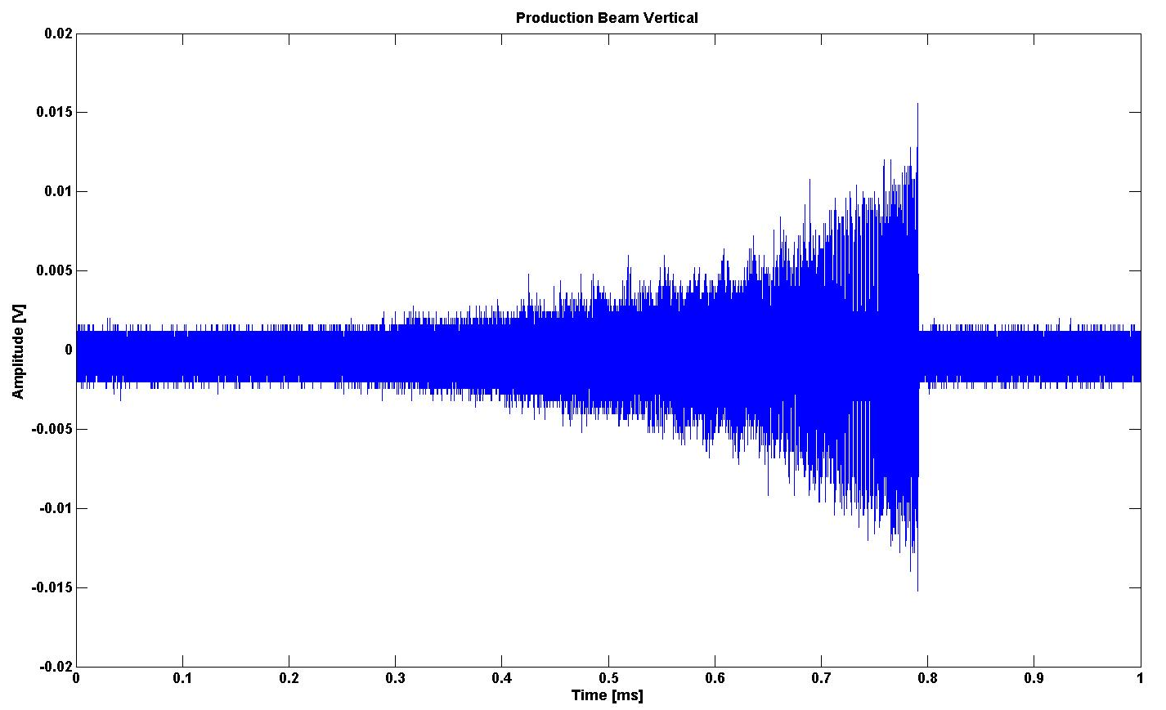
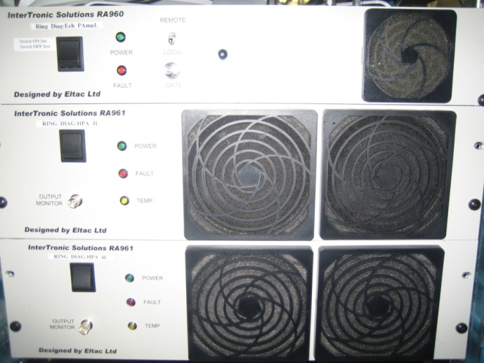
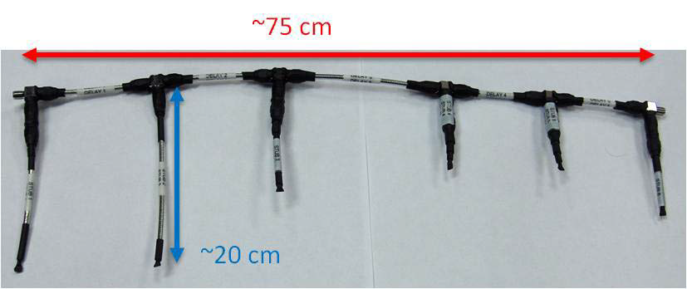
Ring damper system overview
Consists of 2 independent systems
Vertical (Up and Down)
Horizontal (Left and Right)
PA
Stub LPF
Z3
RF
Switch
Delay
COMB
SLP-300
Var. Atten
PA
Beam
Pick Up Electrode
Kicker Electrode

Slide 16
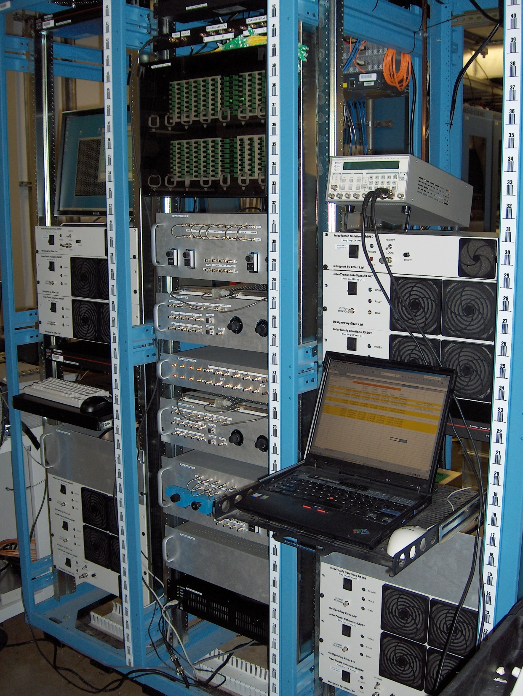
Damper System
Fiber Optic Delays
Horizontal Comb Filter
Amplifier set
Horizontal LLRF
Power Combiners
Vertical LLRF
Vertical Comb Filter

Slide 17
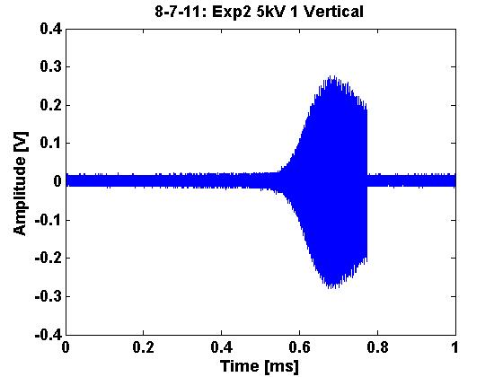
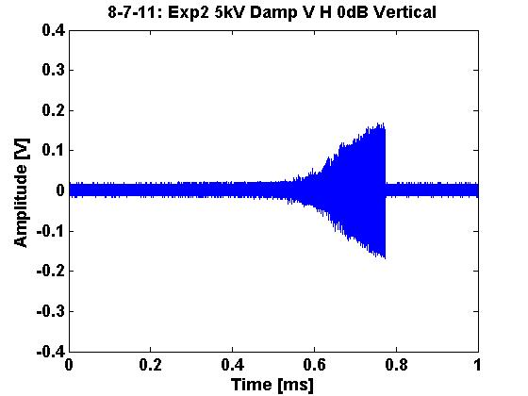
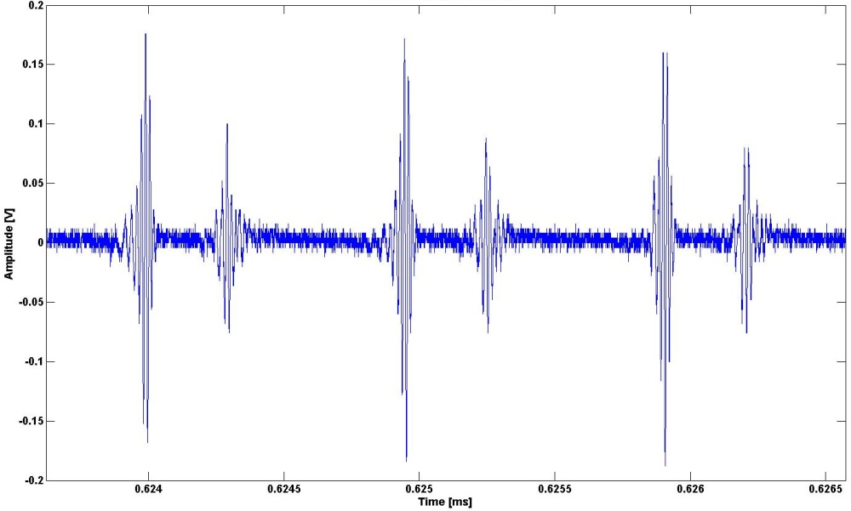
Experimental Damping Results
Damping OFF
Damping ON (0 dB Atten.)

Slide 18
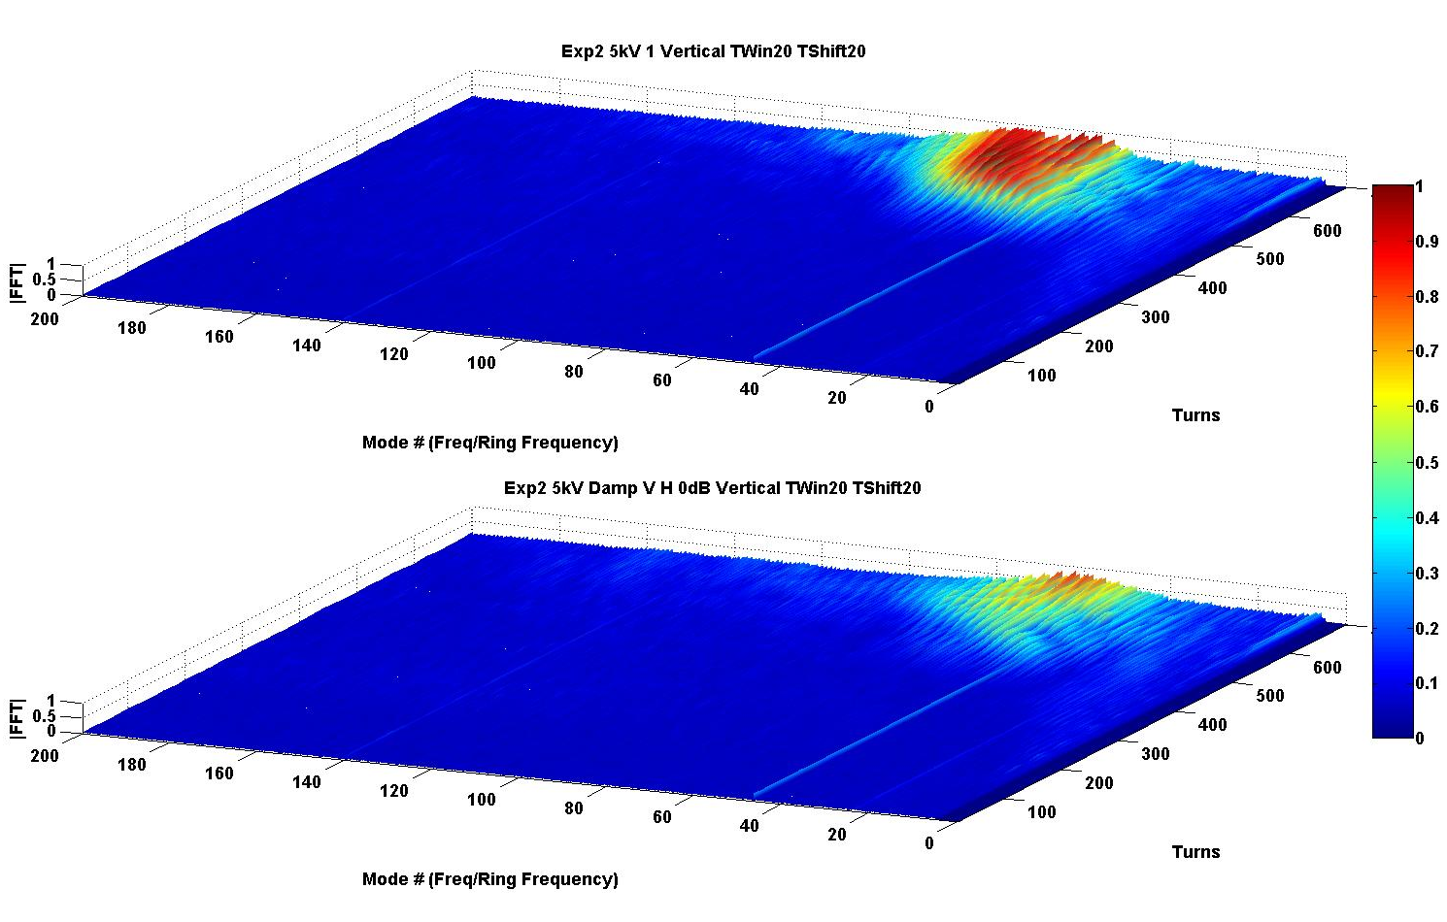
Damper has reduced the instability
Damping OFF
Damping ON (0 dB Atten.)

Slide 19
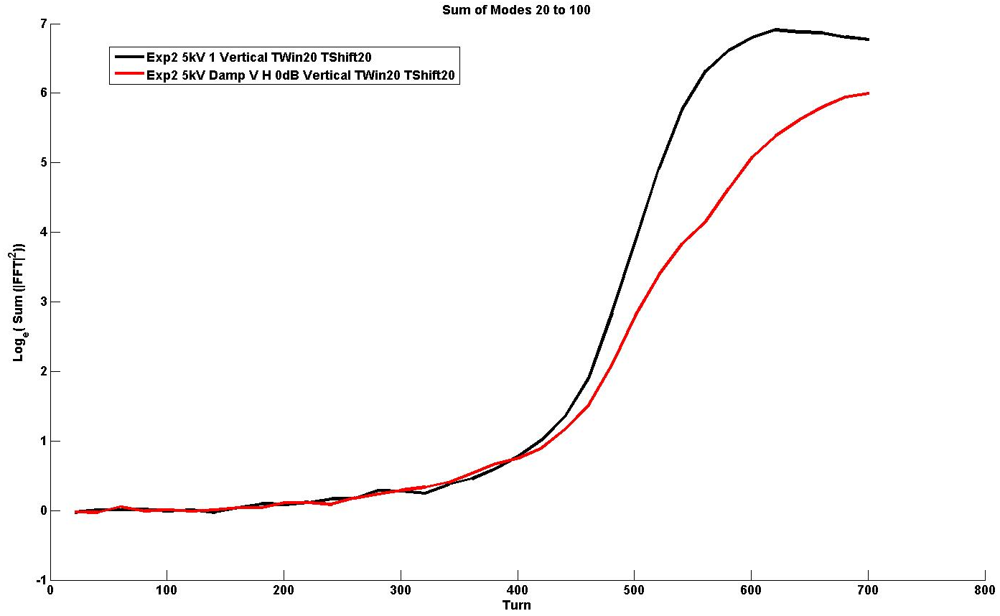
Growth rate of the active frequencies is reduced by ~ 60%
Growth Rate
(No Damping) ~ 20 turns
Growth Rate (With Damping) ~ 35 turns

Slide 20
Damper system is effective…
Continuously looking to improve the system
Maximizing the bandwidth (via equalizer)
Minimizing magnitude and phase dispersion in LLRF system
Maximizing signal output to Power Amplifiers
Utilize the damper system to supplement the physics group observations of the beam dynamics
Have been actively monitoring the beam during production and observed some unique dynamics (not discussed today).
Recently observed the beam may have an additional tune present, which limits the damping ability in the current configuration.
Employed the damper system in Beam Transfer Function measurements to observe the beam response to external excitation. (Next)

Slide 21
Introduction to Beam Transfer Function Measurements
Pick Up Electrode
Kicker Electrode
PA
Stub LPF
Z3
RF
Switch
Delay
COMB
SLP-300
Var. Atten
PA
Pick Up Electrode
Stub LPF
Z3
NWA
Kicker Electrode
PA
RF
Switch
Delay
COMB
SLP-300
Var. Atten
PA
Network Analyzer is used to excite the beam at a given frequency and observe the magnitude and phase of the response.

Slide 22
Stub LPF
Z3
Pick Up Electrode
NWA
Kicker Electrode
PA
RF
Switch
Delay
COMB
SLP-300
Var. Atten
PA
Turns 0 to 136
beam
NWA excitation
Turn Window is determined by the Network Analyzer IFBW

Slide 23
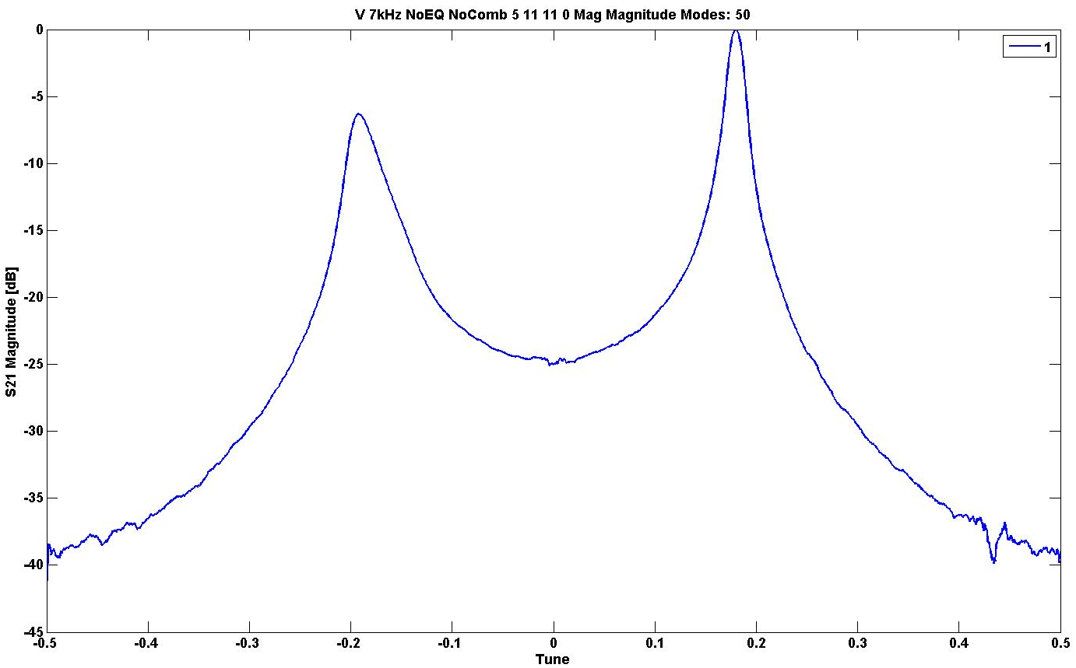
Stub LPF
Z3
Pick Up Electrode
NWA
Kicker Electrode
PA
RF
Switch
Delay
COMB
SLP-300
Var. Atten
PA
1601 Frequency Point Steps → 1601 Macro Pulses
~ 30 sec @ 60 Hz for this measurement
1044389 Hz width (Ring Frequency)

Slide 24
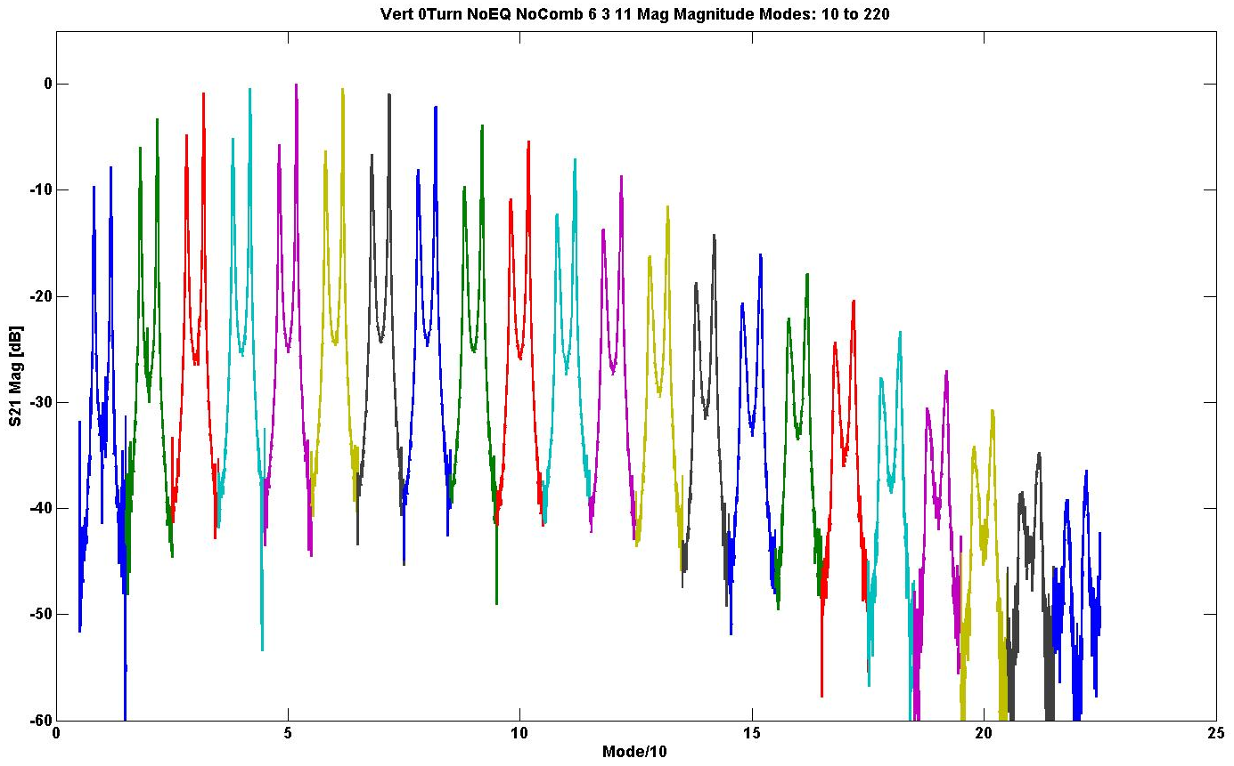
Note: Only every 10th mode is shown here
Typically others only make 1 or 2 of these measurements…

Slide 25
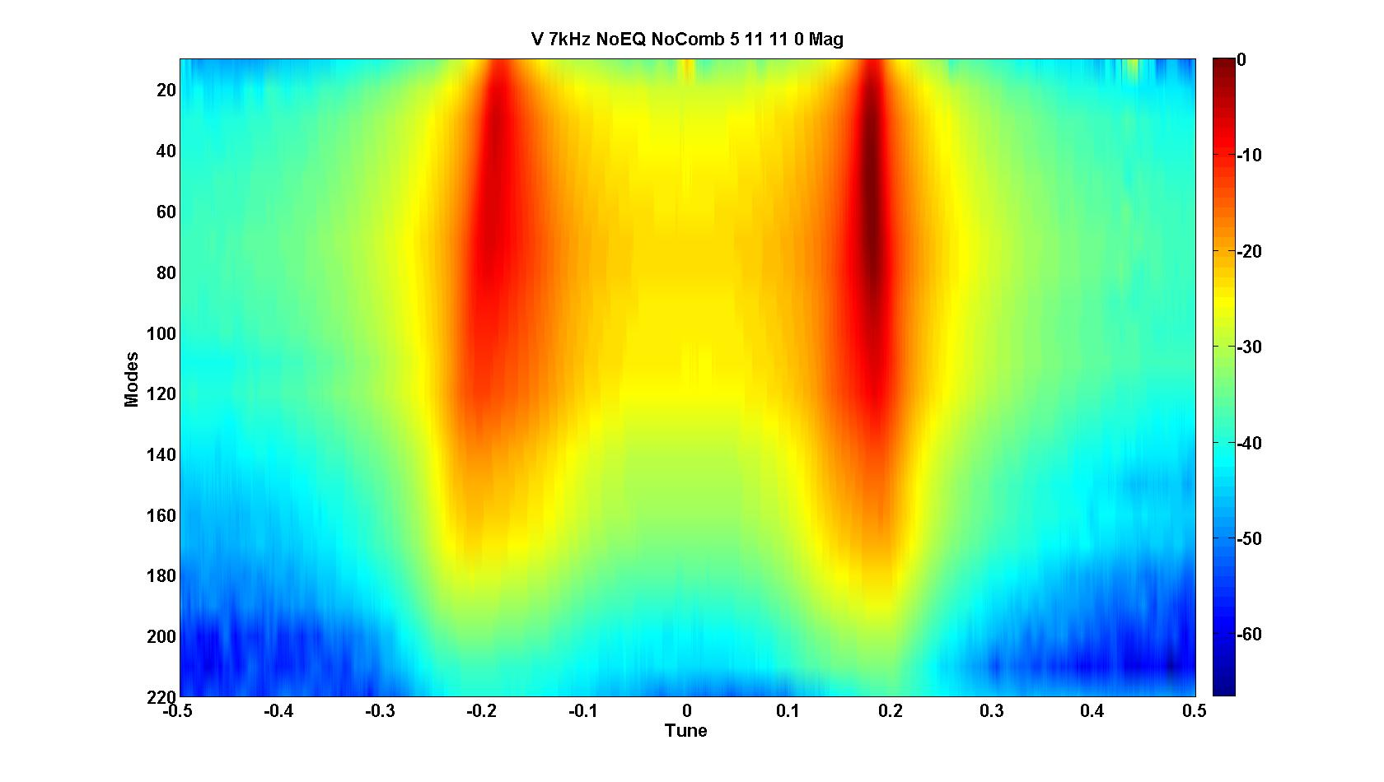
Mode =
N*RF
(N+1)*RF
(N+2)*RF
(N+6)*RF
(N+3)*RF
(N+4)*RF
(N+5)*RF
1044389 Hz width (Ring Frequency)
Make measurements into a more compact form.

Slide 26
Lower Side Band (LSB)
Upper Side Band (USB)
Betatron sidebands reveal the tune.

Slide 27
Turns 0 to 136

Slide 28
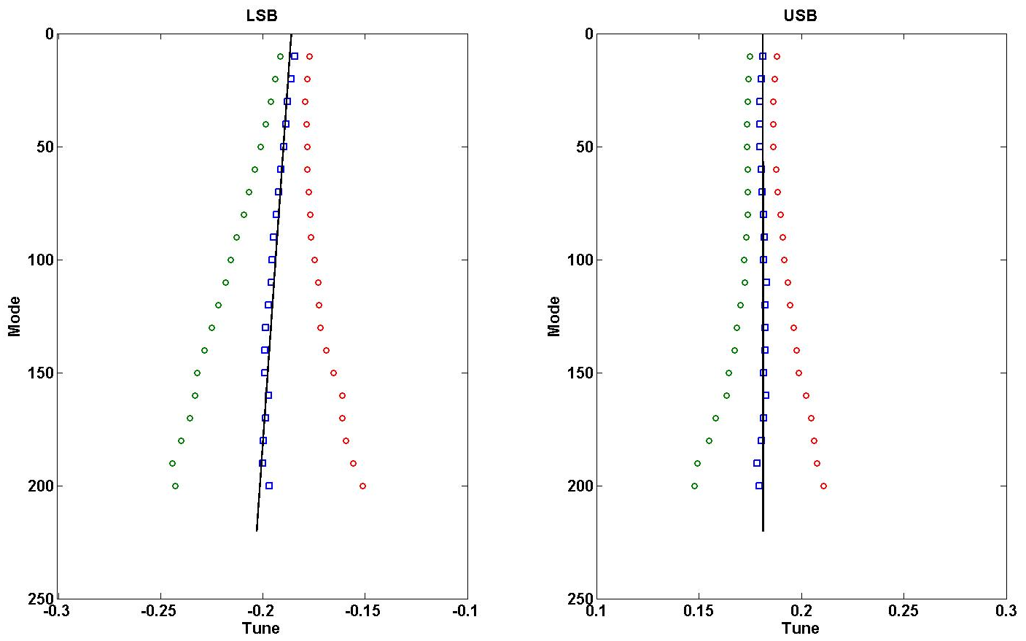
BTF Ring Tune Determination
Fitting algorithm to determine the tune…
Separate measurement gives the vertical tune ~ 0.1799
USB.. Pretty much a straight line… LSB on the other hand.. Currently no explanation

Slide 29
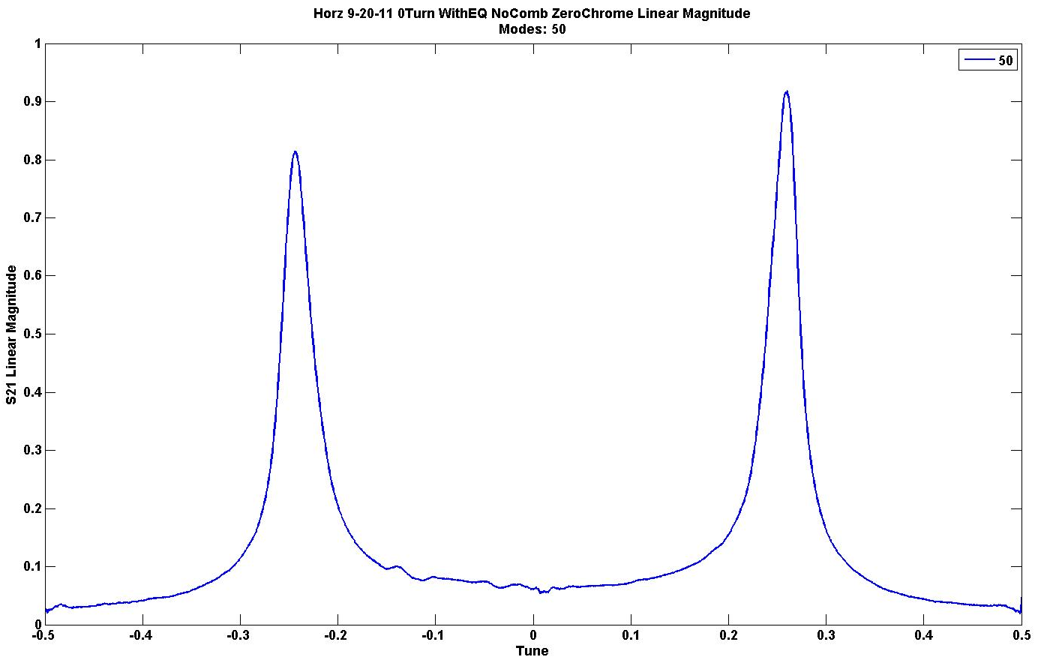
Additional information can be extracted from the BTF response measurements
Determine the FWHM, assuming Gaussian function (NOT A FIT.. Just -6 dB points below peak) → Convert to RMS

Slide 30
Vary the Chromaticity to determine capability of BTF measurement as a diagnostic
ξ_{X} | -7.9 | -5.33 | -2.66 | 0
ξ_{Y} | -6.9 | -4.66 | -2.33 | 0
*Coasting BTF theory defines the sideband frequency widths to be:
∂f^{(+/-)} = RMS Frequency width
f₀ = Ring Frequency
dp/p = Momentum spread (DETERMINED FROM ZERO CHROMATICITY CASE)
m = Mode (VARIES)
Q_{f} = Fractional Tune (VARIES)
ξ = Chromaticity (VARIES)
= Slip Factor (-.2173)
*Kornilov, et al., GSI-Acc-Note-2006-12-001
Zero Chromaticity

Slide 31
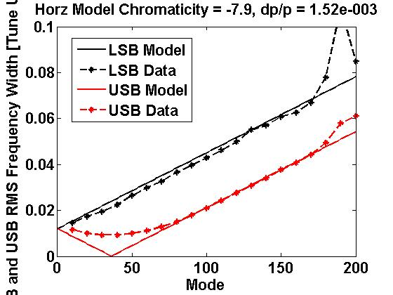
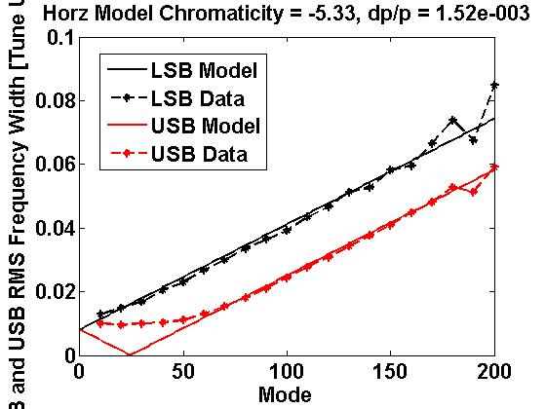
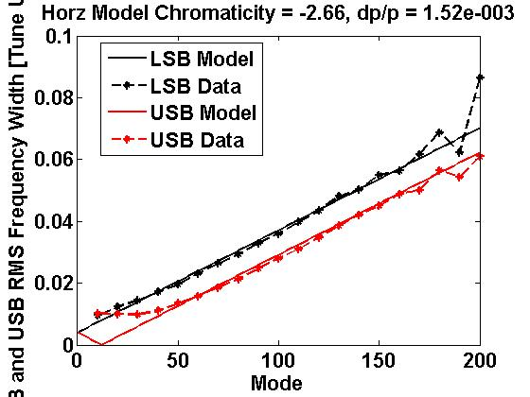
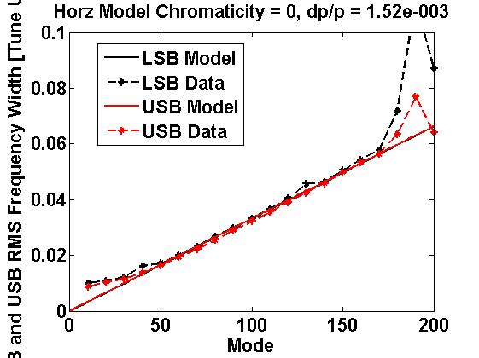
Frequency Width [Tune]
Frequency Width [Tune]

Slide 32
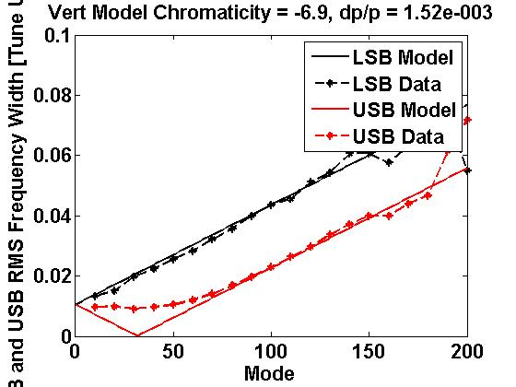
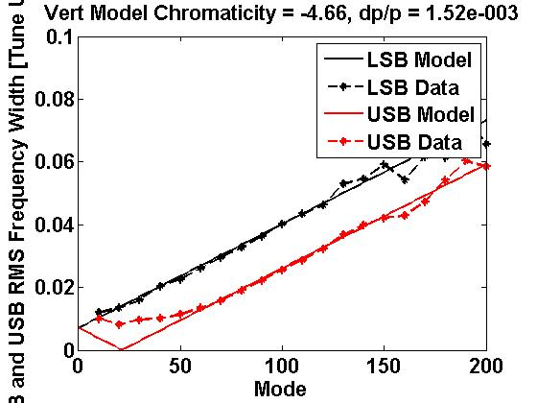
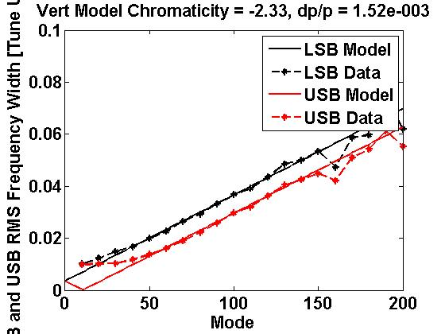
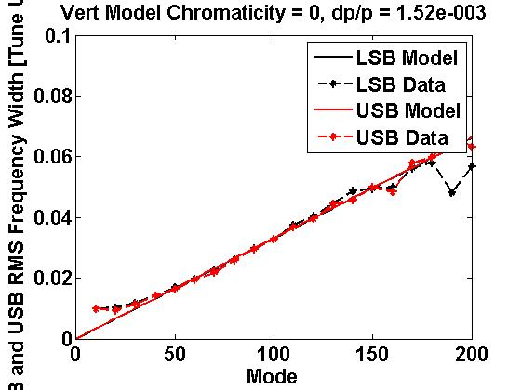
Frequency Width [Tune]
Frequency Width [Tune]

Slide 33
Chromaticity Measurement Results
ξ Setting | Fit ξ (Avg) | % Difference | Tom Pelaia ξ
ξ_{X} = -7.9 | -7.32 | 7.6 | -6.75
ξ_{X} = -5.33 | -5.17 | 3.0
ξ_{X} = -2.66 | -2.83 | 6.0
ξ_{X} = 0 | -.45 | ---
ξ_{Y} = -6.9 | -6.84 | .87 | -5.89
ξ_{Y} = -4.66 | -4.71 | 1.2
ξ_{Y} = -2.33 | -2.46 | 5.6
ξ_{Y} = 0 | -.14 | ---
Tom’s Chromaticity measurements use the single mini-pulse injection into the ring method. (No RF Cavities on)

Slide 34
Currently we are unsure about the source of this effect. It could be due to the reduced signal acquisition time (7 kHz IFBW) which gives us the ability to only look at ~136 us of accumulation.
If we were to reduce the IFBW, the expectation is that the minimal measurement resolution would improve, but at the cost of having to look at a longer portion of accumulation. (Under investigation)

Slide 35
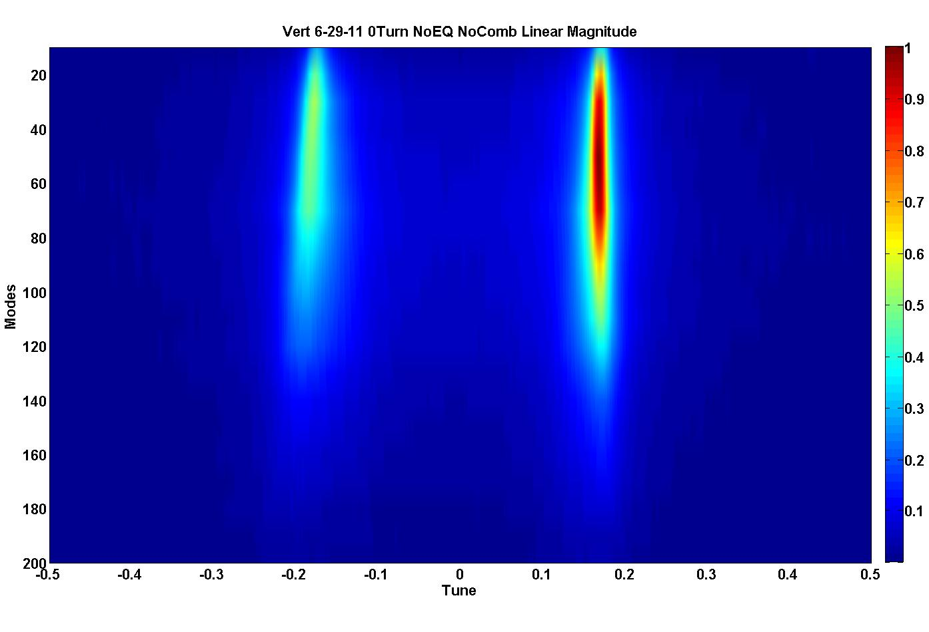
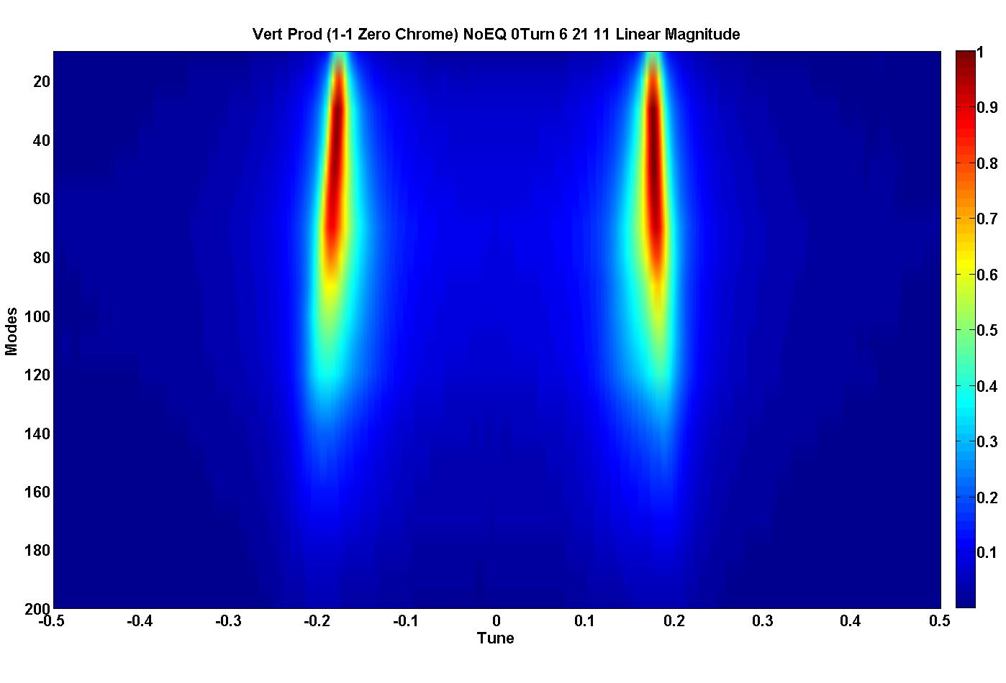
One additional measurement…
Typical Production (ξ = -6.9)
Zero Chromaticity
By changing the chromaticity to 0 (minimizing the tune spread) with the quadruples, the LSB response is essentially equal to that of the USB.
This is due to reducing the Landau damping that naturally occurs with the natural chromaticity for the LSB.

Slide 36
Measurement of the Ring Tune and Chromaticity are successful (during early accumulation)
So far the data presented has focused on the very beginning of accumulation (Turns 1-136).
What happens when we shift our observation time to later in the accumulation cycle?

Slide 37
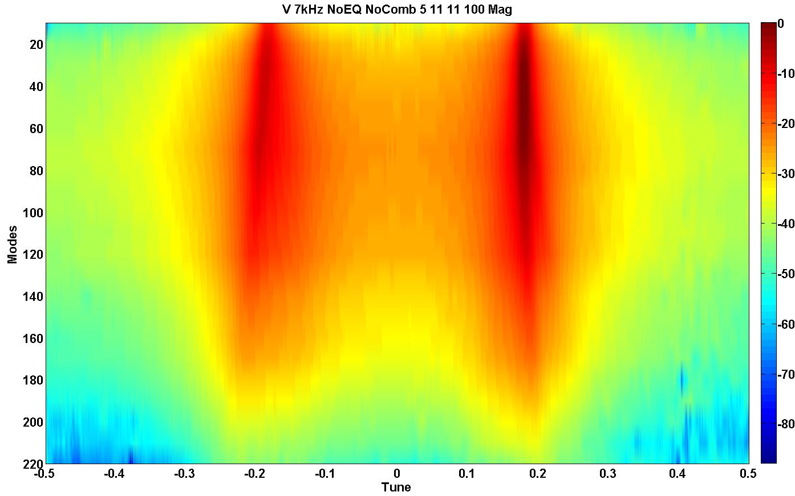
Turns 100 to 236

Slide 38
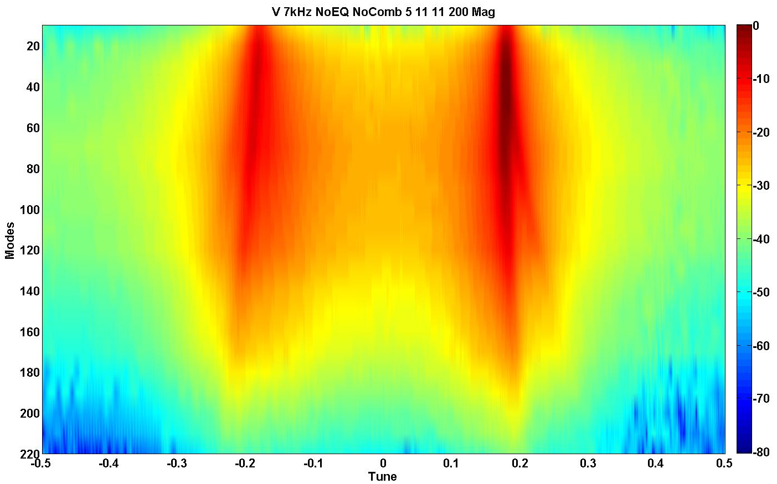
Turns 200 to 336
USB
Splitting Begins

Slide 39
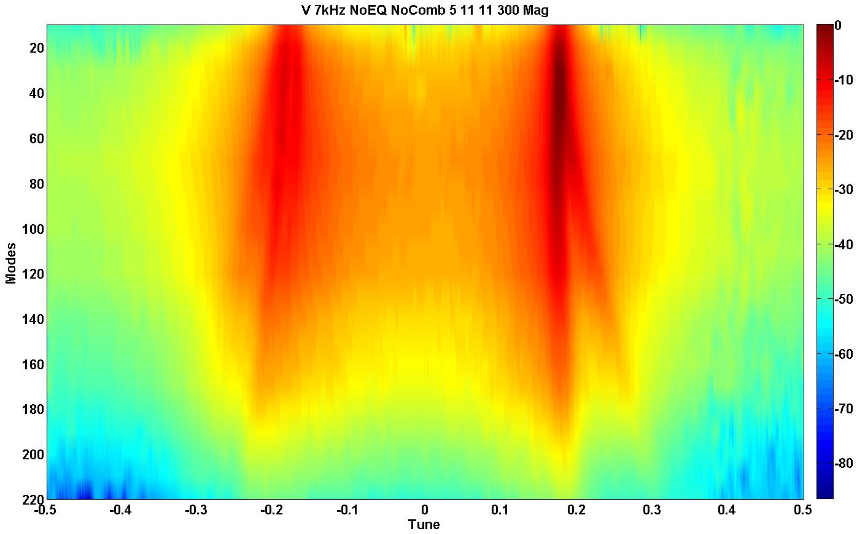
Turns 300 to 436
LSB Splitting Begins

Slide 40
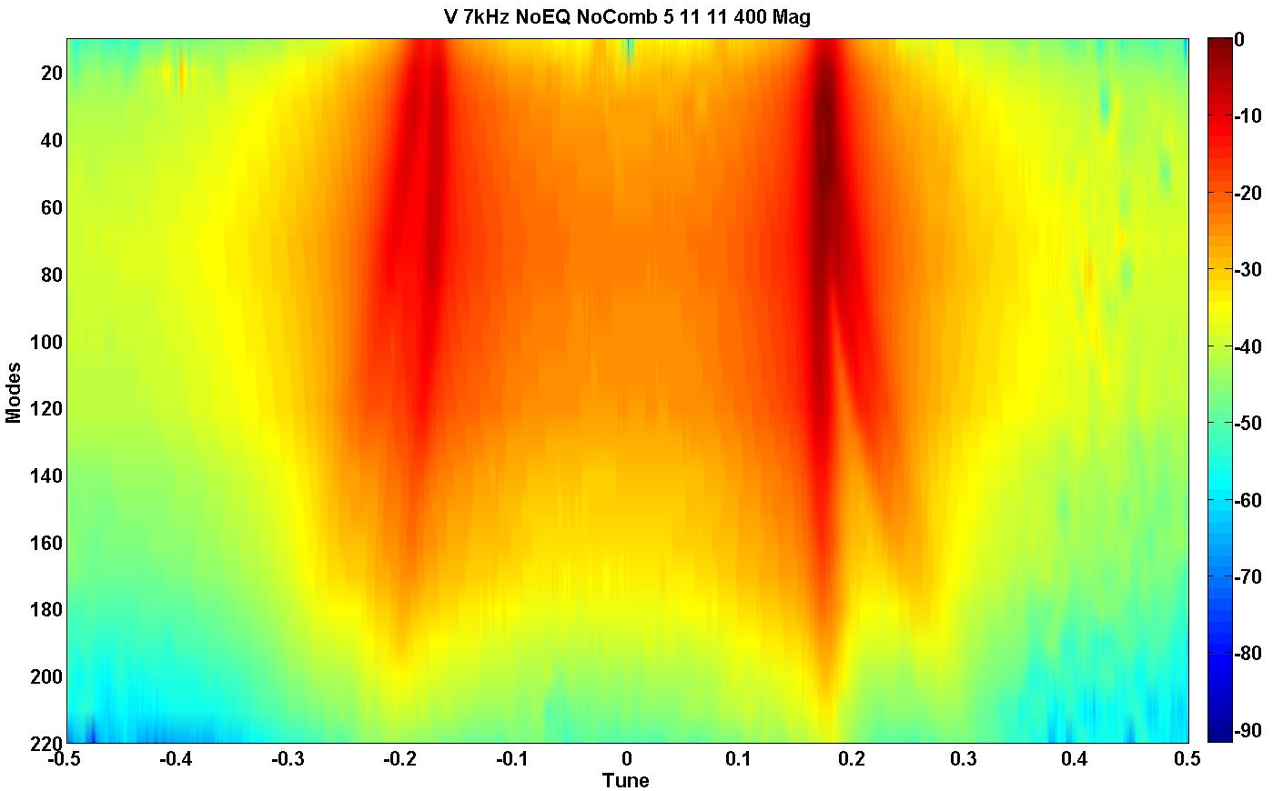
Turns 400 to 536

Slide 41
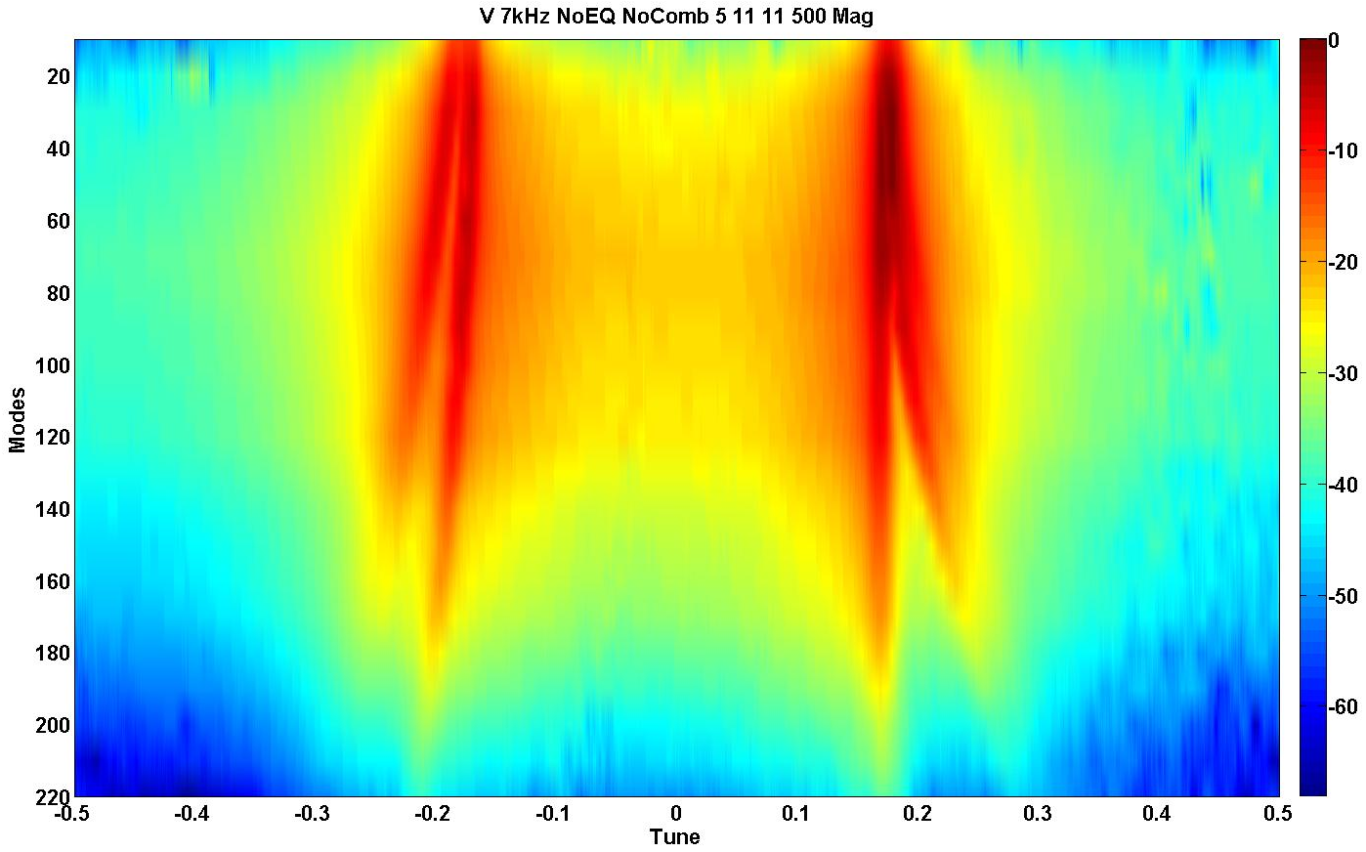
Turns 500 to 636

Slide 42
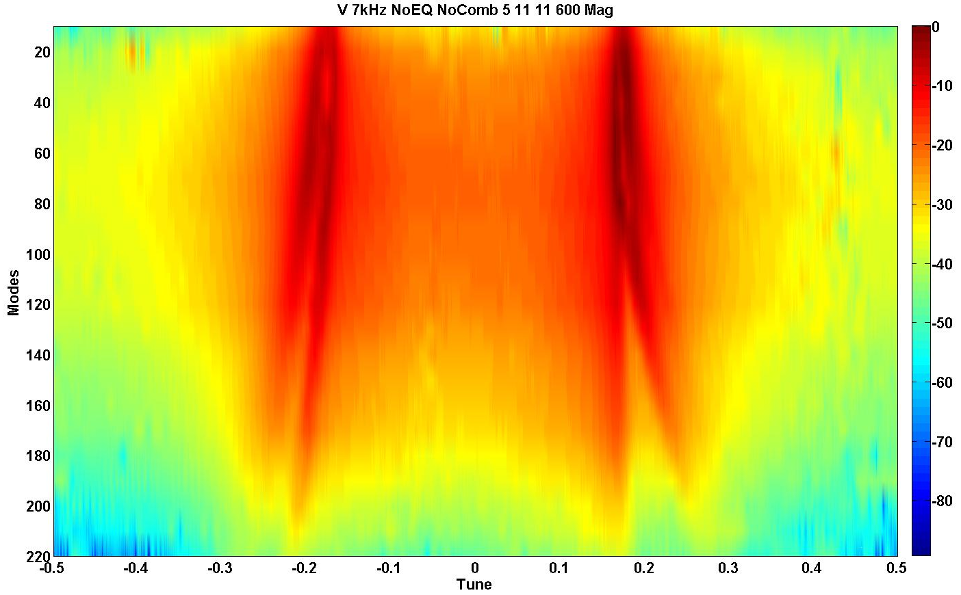
Turns 600 to 736
Note: 720 Turns of Accumulation

Slide 43
What happens when we shift our observation time to later in the accumulation cycle?
During accumulation the beam dynamics become very complex.
To determine if the beam intensity was the root cause, experiments were performed by varying the number of pulses accumulated.
If the intensity is the primary cause it could lead to additional problems as SNS continues to increase toward the design goal as well as interfere with the ability to damp instabilities.

Slide 44
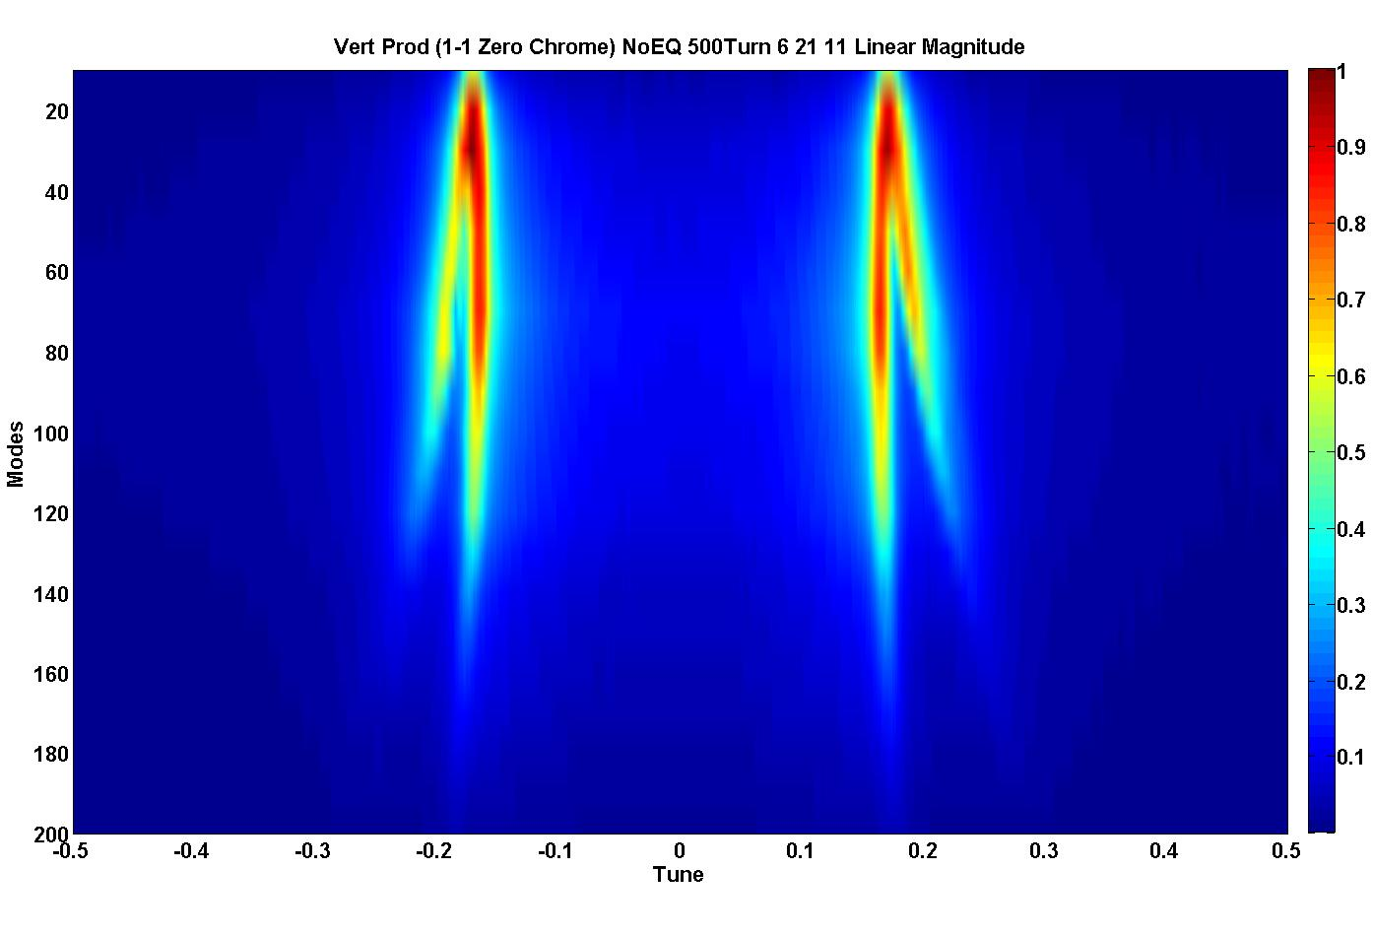
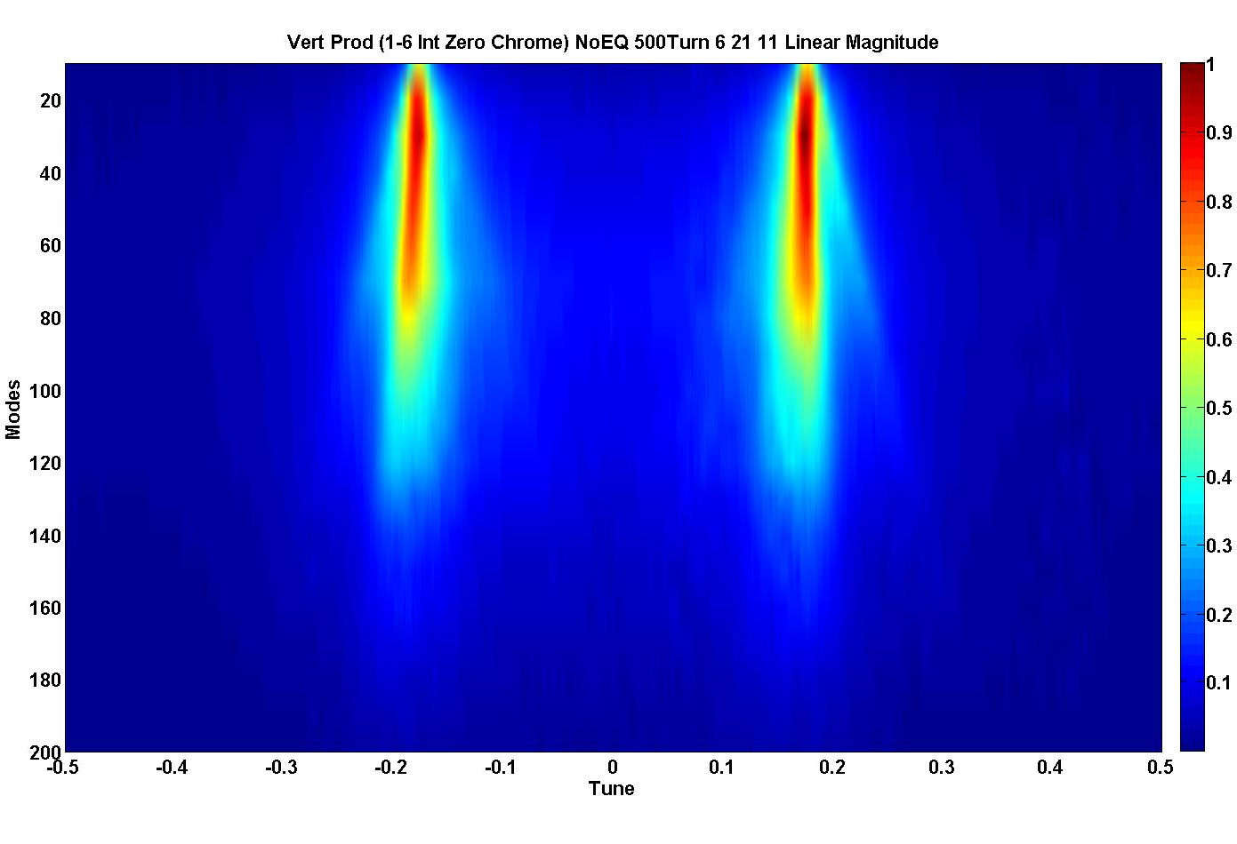
Variation in beam intensity accounts for majority of BTF splitting.
Comparing the Zero Chromaticity Intensity Variation
100% Int
17% Int
Turns 500 to 636
Turns 0 to 136

Slide 45
Summary and Conclusions
Feedback damper system is effective.
Continually trying to improve its effectiveness.
Beam Transfer Function measurements are a useful tool for monitoring beam dynamics and parameters.
Can be used as an additional physics diagnostic system to measure the tune and chromaticity. (Verified)
Illuminates unique dynamics that have not been observed before (to our knowledge).

Slide 46
Once Again… Many Thanks Go To:
Craig Deibele, Sasha Aleksandrov, Slava Danilov, Andy Webster, Jeff Bryan, Jim Diamond, George Link, Syd Murray III
You… For giving me the opportunity to be here today!
Without them, none of this work would be possible!

Slide 47
Download Completed… Begin The Questions.

Slide 48
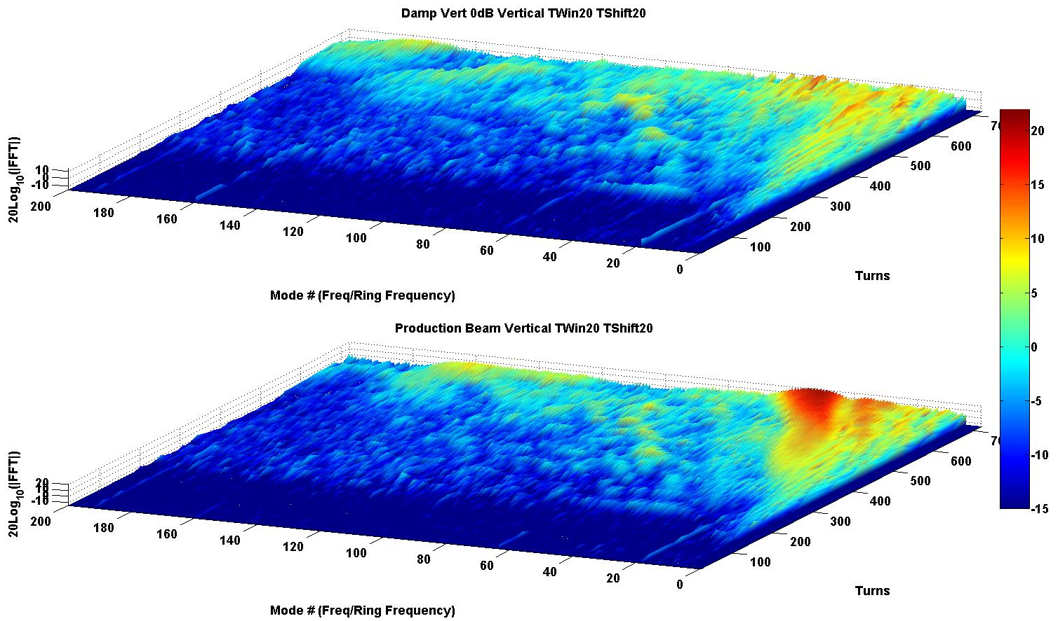
Vertical Production (~815 kW to target)
Damping On
Damping Off

Slide 49
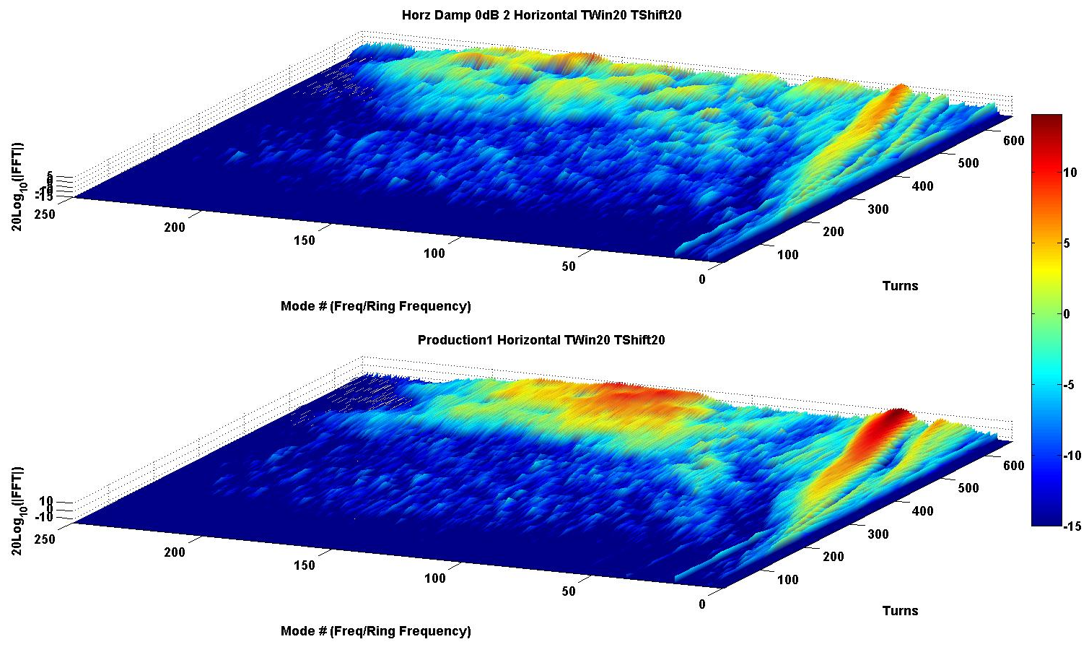
Horizontal Production (~815 kW to target)
Damping On
Damping Off

Slide 50
3.31E-04 = (dp/p)*η →
dp/p = 1.52e-3

Slide 51
Ring damper system overview (2)
High Impedance pick-off
180 Degree Hybrid
Fiber Optic Delay ~300ns
Low Pass Filter
PA
Stub LPF
Z3
RF
Switch
Delay
COMB
SLP-300
Var. Atten
PA
180 Degree Hybrid
Low Pass Filter with a notch @ 402.5 MHz
RF Switch to pass/block signals
Comb Filter to block ring frequency and harmonics
Attenuators to vary system gain
Power Amplifiers

Slide 52
BTFs can also be used to measure the Chromaticity (tune spread) and dp/p (momentum spread) via the frequency spread about the response peaks.

