Slide 1
Booster Bias Supply Upgrade
November 30th, 2011

Slide 2
Three new Ferrite Bias Supplies Built
Two are complete – for NOvA
One is fully tested and operational
The other runs but needs further troubleshooting for odd slewing problem
Third one is 40% complete - Booster spare
Finished in the next 3-4 weeks
There are 10 “Ling” MK I supplies that will need upgrading – Booster West Gallery only
Replace main rectifier Transformer – marginal power rating for 15 Hz operation.
Replace PVC SCR heat sinks – prone to LCW water leaks with any pressure surge.
Upgrade can be done one at a time by changing out supply with spare.

Slide 3
Ling transformer test, November 15th, 2011
2250A @ 1Hz
2250A @ 15Hz

Slide 4
Ling transformer test, November 16th, 2011
2250A @ 15Hz

Slide 5
Ling transformer test, November 17th and 18th, 2011
2250A @ 15Hz with fans
2250A @ 15Hz with fans
and top plate lifted 3.5 inches

Slide 6
MK I Bias Supply SCR Packages – PVC cased heat sinks

Slide 7
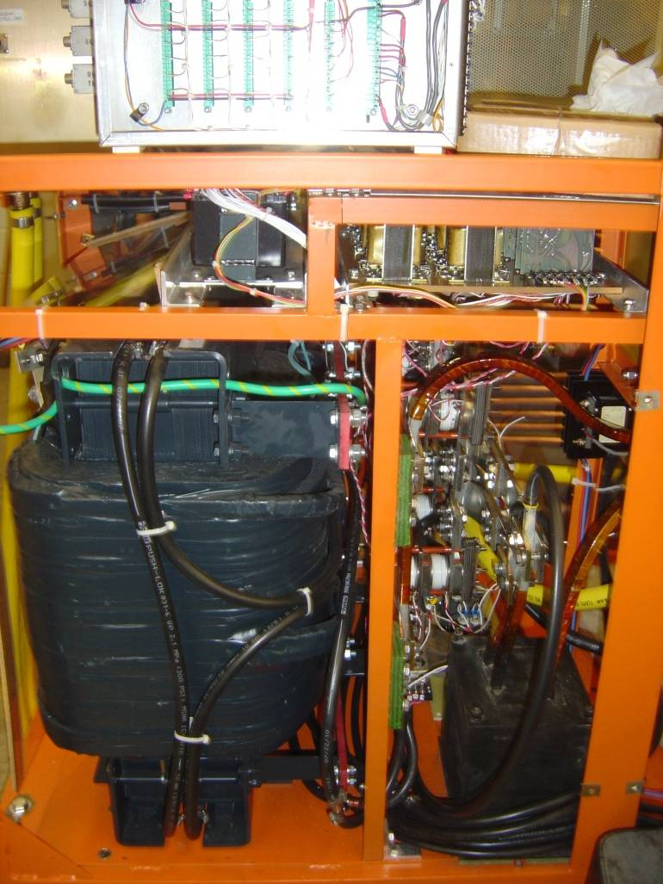
New Style SCR Packages with Larger Transformer

Slide 8
MK I Bias Supply
Main Rectifier Transformer

Slide 9
MK I Bias Supply
SCR Packages with Main Rectifier Transformer - Behind

Slide 10
Last transformer order was in 2007. The vender was NWL and they provided six units at a cost of $16,474 ea.
The expected lead time is 4-6 months so they should be sent out for bid ASAP.

