Slide 1
Multi-Turn Stripping Injection and Foil Heating with Application to Project X
A.I.Drozhdin, I.L. Rakhno, S.I.Striganov, and L.G. Vorobiev
Fermilab, APC
Presentation Based on:
Phys. Rev. ST Accel. Beams 15, 011002 (2012)

Slide 2

Place in Project X
Overall Site Plan:
http://projectx.fnal.gov/
Reviews, Workshops, Meetings
2007-present
Proton Driver, Director Review, 2005 (W.Chou)
This Presentation→

Slide 3
Outline
Beam Transport & Multiturn Injection
    H⁻ transport from Linac. Collimation, Matching
    Painting Injection
    Zero and Full space charge
    STRUCT & ORBIT
Stripping Foil Implementation
    Absorbed Energy Calculations
    Thermal Calculations

Slide 4
Charge exchange injection
H⁻ stripping injection (concept): G.I. Budker, G.I. Dimov in 1963. Implemented for a small 1.5 MeV storage ring.
Practical Implementation in ANL in 1975. Injection from 50MeV linac into Zero Gradient Synch. R.L.Martin et al.
Indispensible for Project X

Slide 5
Charge exchange – cont’d
Liouville’s Theorem
Total deriv. of phase space distr. function =0
Applied to: any Hamiltonian dynamical syst. subject to a conservative external forces (collisionless charged particles ensemble with quads, dipoles,…)
Charge exchange/Stripping – non-Liouvillean

Slide 6
Charge exchange – cont’d
Benefits: much higher beam powers without significant emittances ε_{x,y} growth
Drawbacks: H⁻ handling - uncontrolled stripping (magnetic field < 500 Gauss), black body radiation, residual gas → stray H⁰, H⁻, protons
losses
+ Foil Issues (sustainability, additional losses)
W. Chou - Proton Driver
Director's Review, March 2005

Slide 7
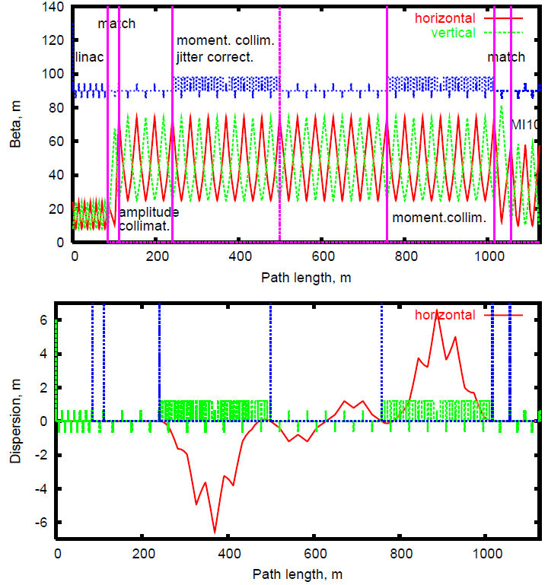
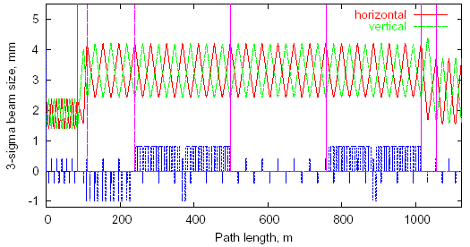
H⁻ transport from Linac
matching section Linac → FODO lattice 80-100 m
amplitude collimation 3 cells, no dipoles, 100-230 m
momentum collimation & jitter correction 6+6=12 cells + dipoles,
230-500 m, 780-1000m
straight section (dummy): adjustment of the Linac and beam line on the Fermilab site, 6 cells, 500-780 m
Stripping foils & Beam dumps (1-8): vertical bars (bottom plot), 100-230 (6), 380(7), 900(8) m
A.I.Drozhdin, Beam-docs, Dec 2004

Slide 8
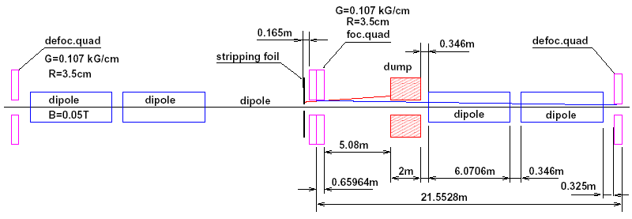
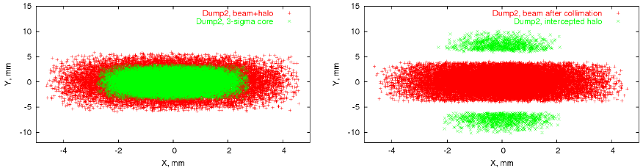
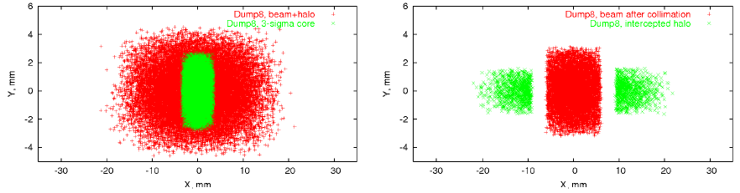
H⁻ transport from Linac, cont’ed
B<500 G
One 60⁰ cell (6 cells)
Amplitude & Momentum Collimation: stripping upstream focusing quad
+
intercepting Hº and protons by the beam dump located in 5 m behind the focusing quadrupole.
A.Drozhdin, Beam-docs Dec 2004
Dump 2
Dump 8

Slide 9
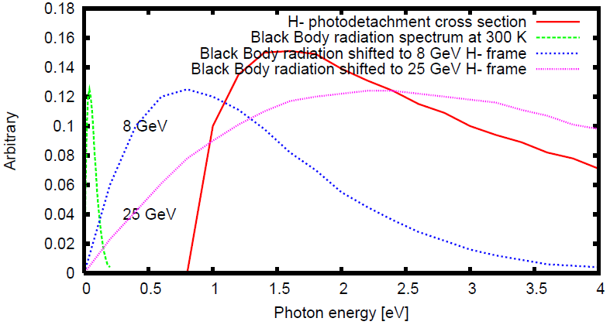
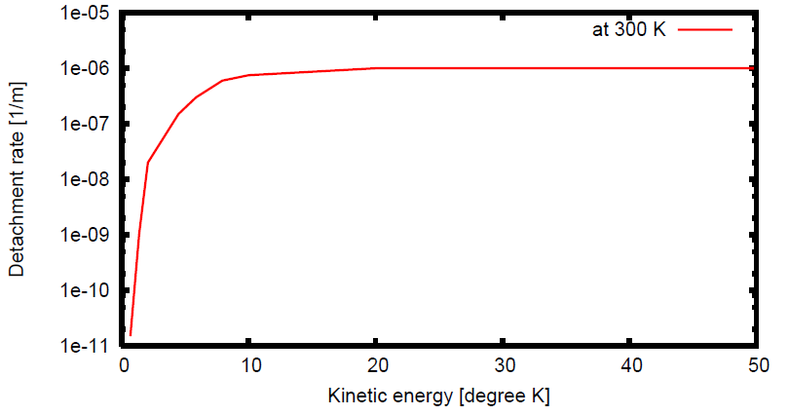
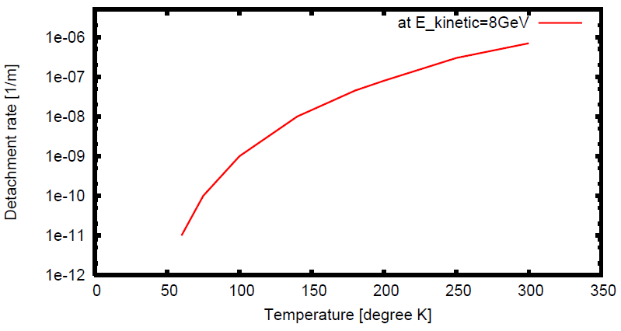
Blackbody Radiation
(Top) Doppler Effect shifts lab frame infrared photons (green) to energies (blue , magenta) in excess of the range where the cross section of photodetachment (red) is large.
(Middle) Rate is increased by 3 orders of magnitude with H- from 0.8 to 8 GeV
(Bottom) The pipe temper. lowered to liquid nitrogen (77 K) decreases photodetachment by 3 order of magn.
+
Residual Gas Stripping (not shown)
Implemented in STRUCT
H.C.Bryant and G.H.Herling, Journl. Modern Optics, 2006.

Slide 10
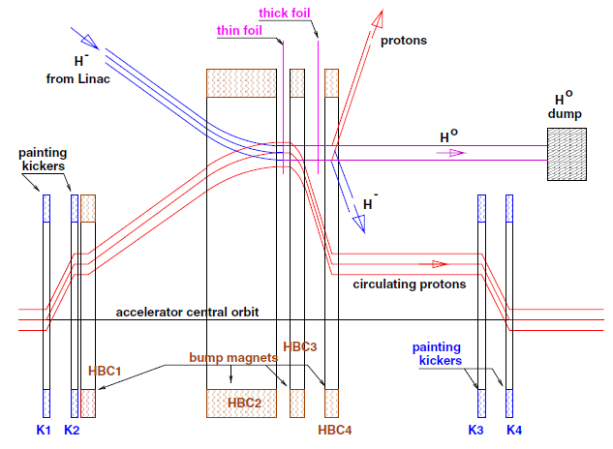
Painting Injection, Layout
Thin Foil – Stripping, Thick Foil – Bypassed:
handles H⁻, H⁰ and protons

Slide 11
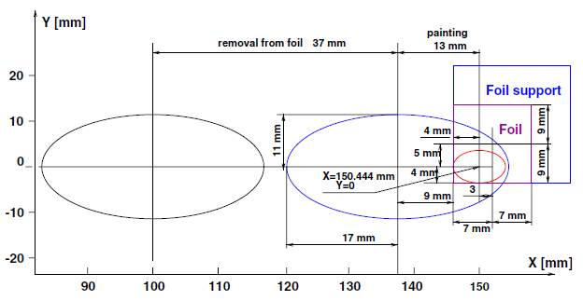
Painting Injection, Layout - cont’d
Injected and circulating beam
at 3-μm Foil (14 x 18 mm²)

Slide 12
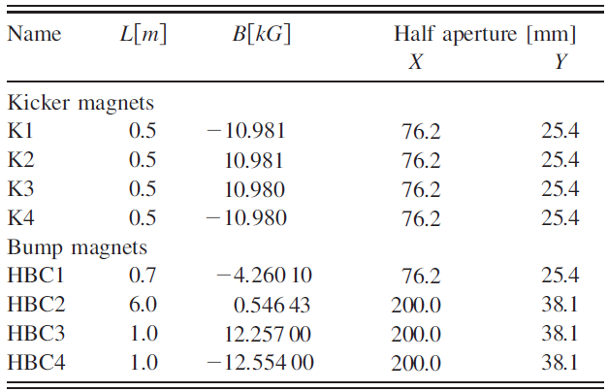
Painting: Kickers and Bumps
Parameters: Fast Kickers & Bumps

Slide 13
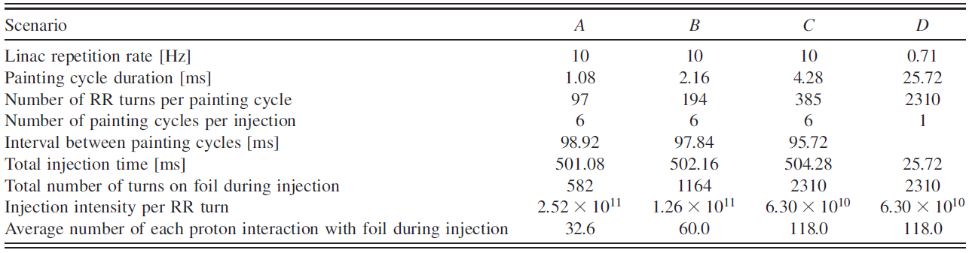
Painting: ABCD Scenarios
Painting injection for 1.47e+14 protons per pulse (ppp)
in the Recycler Ring
Scenario A:
97x6=582 turns, 98.92(Idle)+1.08(Painting)=100 ms (10Hz Linac rep. rate), 5x100+1.08=501.08 ms

Slide 14
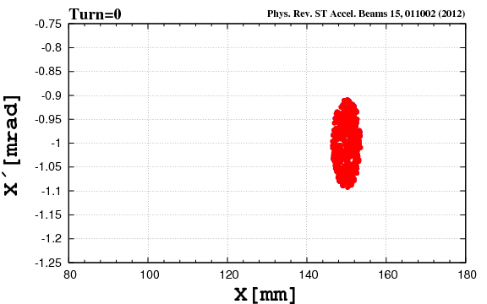
Painting: (x,x’,y,y’) Movies
For animation
Press F5
Horizontal Painting (x,x′):
inside→outside

Slide 15
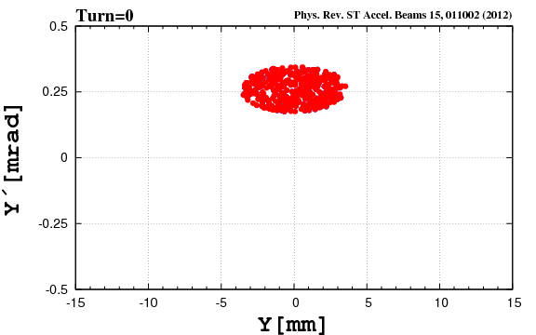
Painting: (x,x’,y,y’) Movies, cont’d
For animation
Press F5
Vertical Painting (y,y′) :
outside → inside

Slide 16
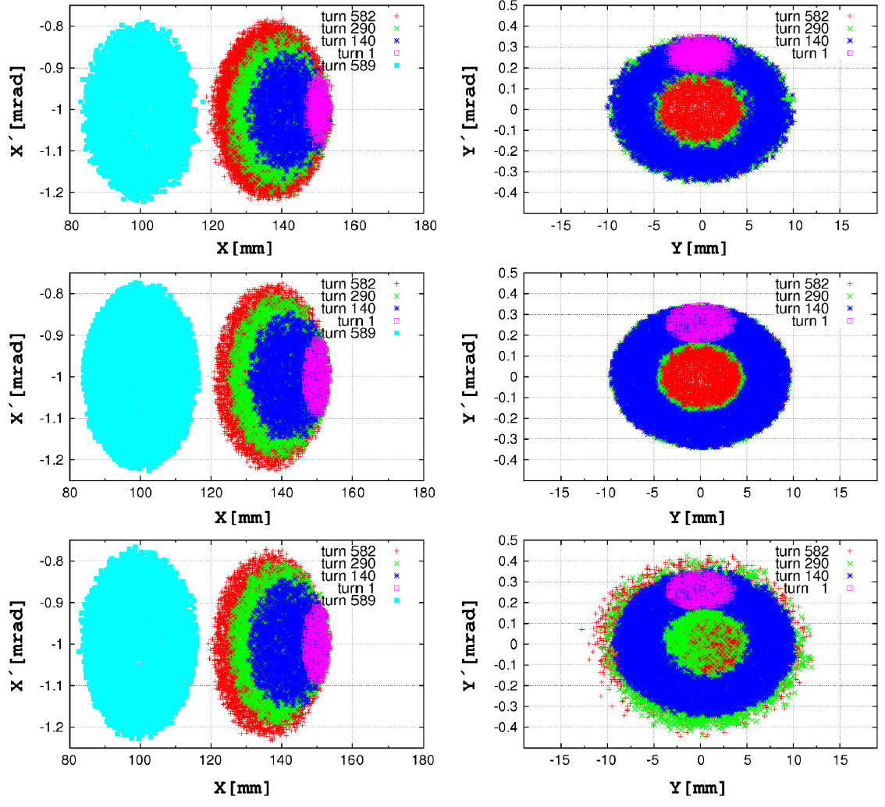
Painting: (x,x’,y,y’) Snapshots
STRUCT
ORBIT
ORBIT + SC

Slide 17



Painting: KV distribution
Large input ε
Quasi-KV
Small input ε
Finer Brushes
KV
Qausi KV Distribution: particles -Shell of 4D Ellipsoid in (x,x′,y,y′)
Finest Brush: Infinite Number of Strokes/Tracks

Slide 18
Painting: KV distribution
Why KV?
KV – linear transverse forces
Smallest amplitudes/envelopes among RMS equivalent
Smallest Tune shift: 3 times less, compared to Gaussian Beam
Longitudinal painting (Δφ,ΔE) - below

Slide 19
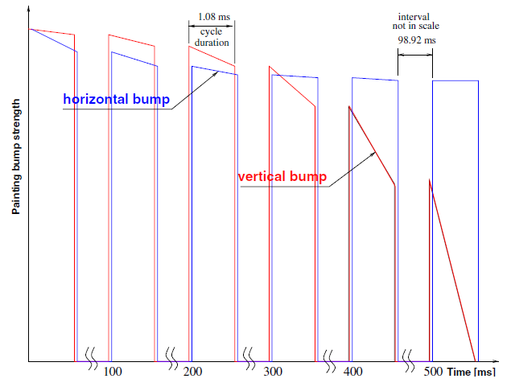
Painting: Kickers Ramp
Horizontal and vertical painting
bump functions during injection

Slide 20
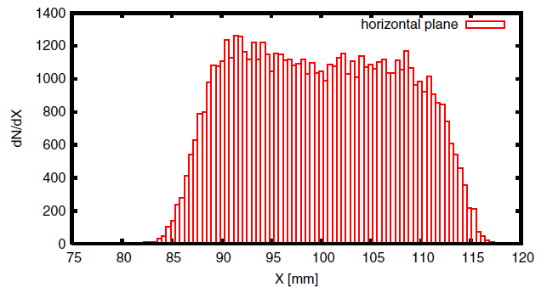
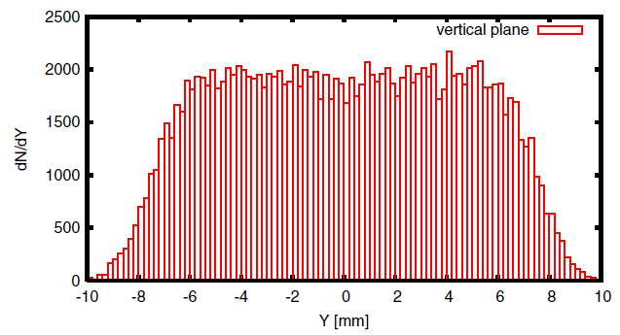
Painting: Transverse Distribitions
Particle distributions after painting.
Horizontal (top) vertical (bottom)

Slide 21
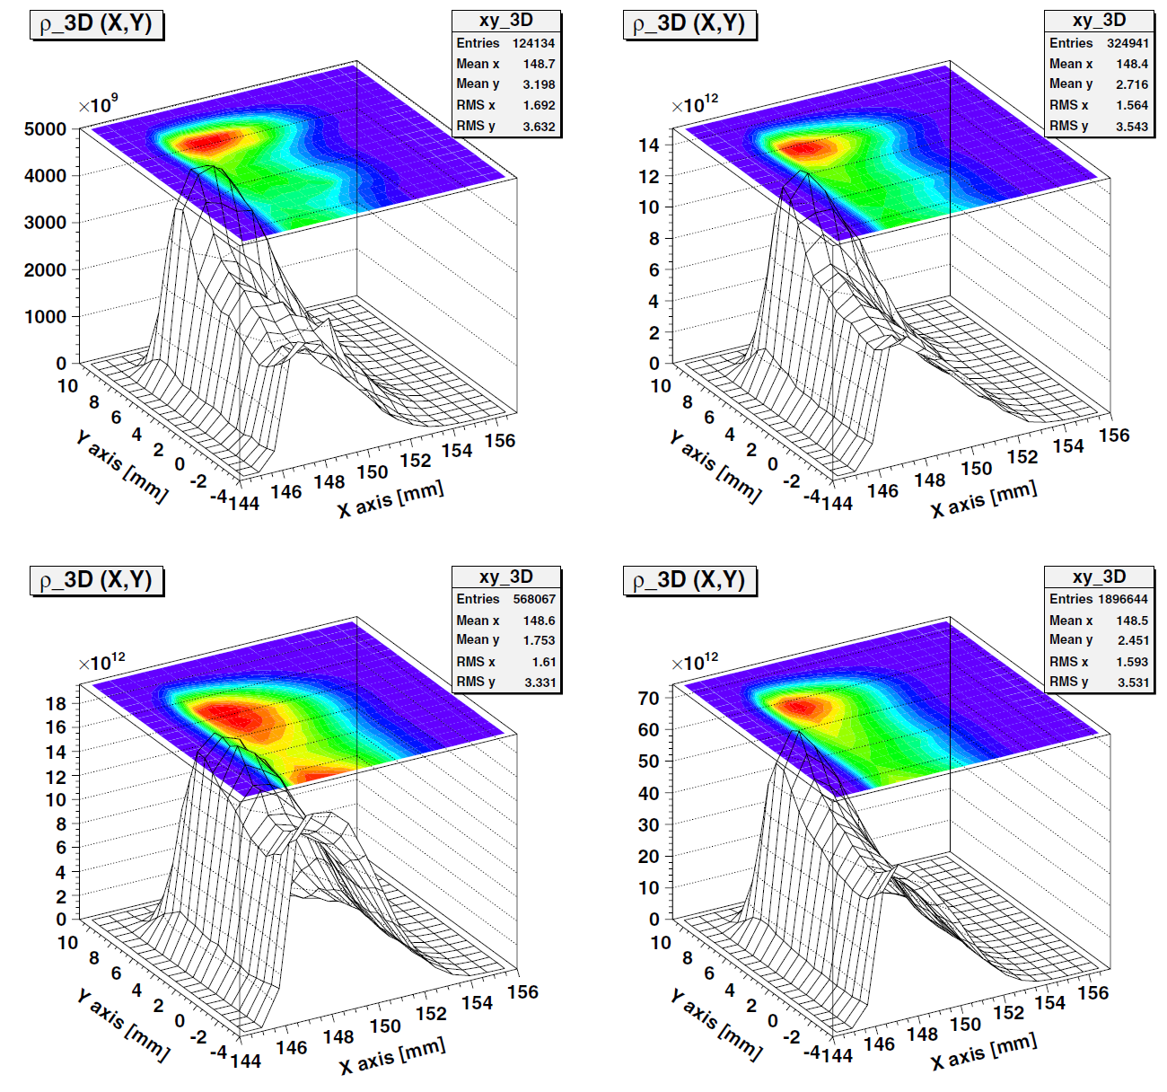
Painting: Hits on the Foil
Scenario A
(582-turn injection)
1st (top, left), 4th (top,right), 6th (bottom, left) and all six (bottom, right) cycles of the
Particle hit number on the foil during 1st, 4th, and 6th cycles are: 62067, 162470, and 284034, respectively. The total hit number is 948322. Average number of interactions with foil =33 (for each injected particle). Hit density at the maximum of the distribution =1.31e+14 proton/mm^2 at 2.52e+11 particles injected at every turn.

Slide 22
Injection: (Δφ,ΔE)
From 8 GeV Linac, with 325 MHz chopper
RR (and MI) operate with 52.8 MHz
The ratio=6.15 is not integer. Therefore - Phase slippage.
Inclusion of 2nd harmonic (flatten sprtr)
P.Yoon, D.Johnson, and W.Chou, 2008, using ESME

Slide 23
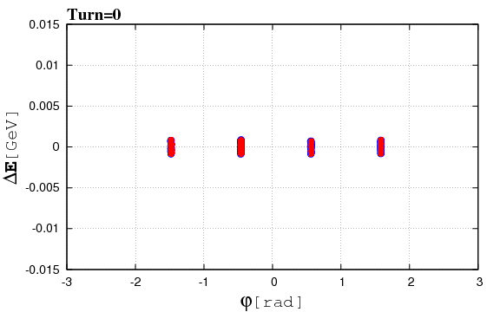
Painting: (Δφ,ΔE) Movie
For animation
Press F5
ORBIT Longitudinal Painting due to phase slippage:
Increased Longitudinal Emittance
2nd RF Harm. → Larger Synch. Tune Spread (flattened sprtrx)

Slide 24
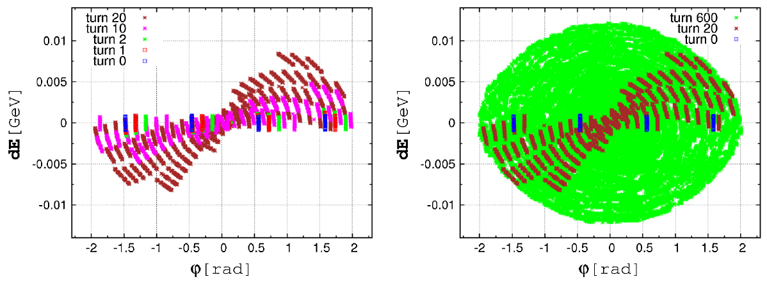
Painting: (Δφ,ΔE) Snapshots
Longitudinal Painting due to phase slippage after 0, 1, 2, 10, and 20 turns (left) and after 0, 20, and 600 turns (right).

Slide 25
Painting: STRUCT & ORBIT
STRUCT (Fortran)
Used in KEK and Fermilab.
ORBIT (C++ classes within SuperCode Shell).
Used in SNS, SPS and Fermilab.
Code validation & upgrade

Slide 26
Painting Injection: TBD
Non-linear Lattice
Different Chopper System
Different Kicker Ramps (sine/cosine)
Beam Loading, Feedback & Feedforward
Painting Injection + “void” turns (SC effects)
Laser Stripping (supplementary or instead the Foil)
…

Slide 27


II. Stripping foil heating
Irradiation with a pulsed beam: nonstationary phenomenon
Incoming Outgoing
T is the temperature of the hottest spot on the foil.
N is the beam hit density. Heat conductivity is ignored.
As usual, the devil is in the details:
Significant number of secondary electrons escape the foil (~600 µg/cm²).

Slide 28
Stripping foil heating
is the ratio of energy taken away by all secondary electrons that escape the foil to energy of all secondary electrons generated in the foil.
Energy distribution of the secondaries generated along the proton track, d²N/dEdx, well known only for electron energies in the region I ‹‹ E ‹‹ T_{max} and behaves as E⁻², where I is mean ionization potential of the target atoms, T_{max} is maximum kinetic energy of secondaries according to kinematics.
At very low energies, the distribution is barely known.
Monte Carlo and deterministic calculations.

Slide 29
Stripping foil heating
During the first passage of an injected H⁻ ion through the stripping foil, the energy deposited by two stripped electrons is comparable to that by the proton.
However, the same proton will make about a hundred more passages through the foil during the multi-turn injection, so that one can safely ignore the energy deposition by the stripped electrons.
The analysis is limited to foil temperatures not exceeding 2500 K (i.e. foil failures due to evaporation are not taken into account).

Slide 30


Absorbed energy calculation: Monte Carlo
The modeling of electron transport in the foil was performed with the MCNPX code down to 1 keV and with MARS code down to 200 keV. In our model:
where is appropriately normalized electron flux.

Slide 31

Absorbed energy calculation: Monte Carlo
The outgoing energy, , is calculated in two different ways.
For MARS code, the calculation starts with protons incident on the foil and the delta-electrons that escape the foil are counted.
For MCNPX code, the calculation starts with the delta-electrons themselves, realistic dependence of angle vs energy according to kinematics, …

Slide 32
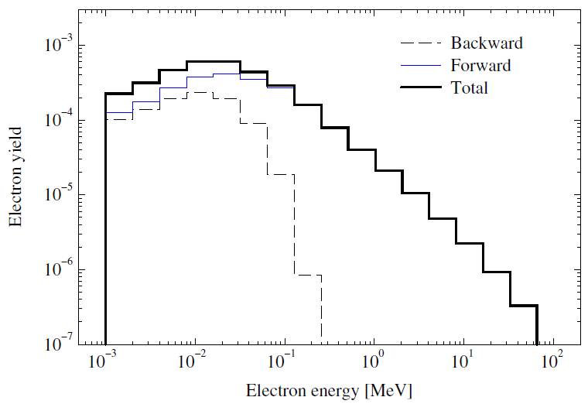
Absorbed energy calculation: Monte Carlo
Calculated (MCNPX) energy distributions of delta-electrons that escape a 600-µg/cm² carbon foil. Normalization is per (normally) incident 8-GeV proton.

Slide 33
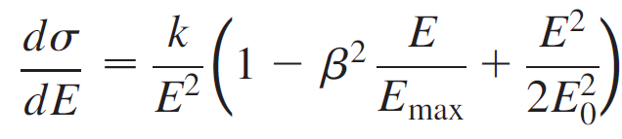
Absorbed energy calculation: Deterministic
A simple model (N. Laulainen and H. Bichsel, 1972), developed initially for low-energy (50 MeV) protons, was modified for high energies in order to take into account relativistic effects:
M₁
M₂
E is electron kinetic energy, E₀ is proton total energy.
The expression is inaccurate for energies close to mean ionization potential (~70 eV for carbon). Such low-energy electrons are produced at ~90 degrees.

Slide 34
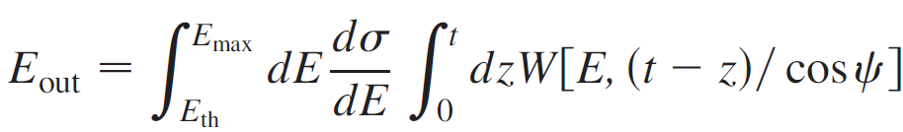
Absorbed energy calculation: Deterministic
E. Kobetich and R. Katz (1969) proposed an empirical expression for energy deposited in the foil based on a fit to experimental data:

Slide 35
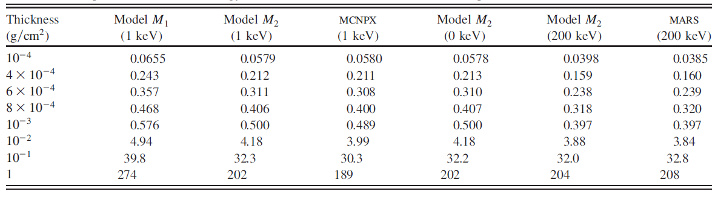
Absorbed energy calculation: results
Energy (keV) taken away by generated delta-electrons that escape the carbon foil of a given thickness. Normalization is per incident 8-GeV proton. Electron cutoff energy is shown in parentheses.
For model M2 with low energy cutoff, the deterministic calculations and MCNPX agree within a few percent for thicknesses from 10⁻⁴ up to 1 g/cm².
The model M2 with energy cutoff of 200 keV agrees well with MARS.

Slide 36
Absorbed energy calculation: results
Fraction of escaped energy, , according to model M2 with energy cutoff of 0 keV. Ratio deposited energies according to M2 with cutoff energies of 200 and 0 keV.

Slide 37
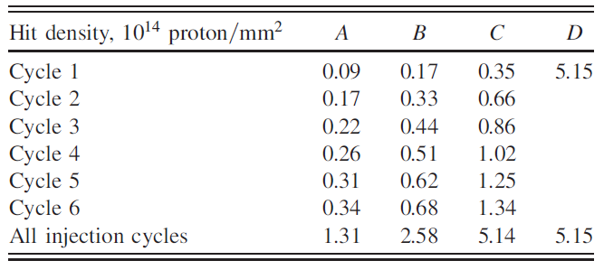
Thermal calculations
Calculated hit density on a foil at the hottest spot for various injection cycles and painting scenarios A thru D (p.13).
The line for all injection cycles is to study average foil heating.
Location of the hottest spot moves around the foil during the injection painting.

Slide 38
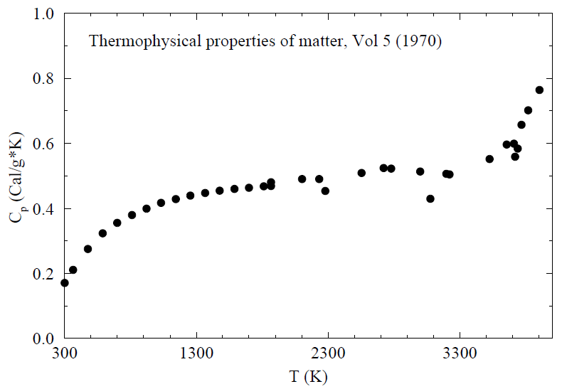
Thermal calculations
Given the beam hit density, numerical integration of the thermal equation is performed with the Runge-Kutta method.
Realistic dependence of specific heat vs temperature.

Slide 39
Thermal calculations

Slide 40
Thermal calculations

Slide 41
Thermal calculations

Slide 42
Conclusions
Several painting scenarios were studied numerically with kick duration and waveform as variables. The criterion is to minimize the number of hits and, consequently, foil heating.
For each scenario a comprehensive analysis of secondary electron production and energy deposition in the foil was performed.
Monte Carlo and semianalytical methods to calculate energy deposition in the foil agree well. The cases of stationary and rotating foils were compared.
So far, the stripping foil remains the principal option for injection in Project X.

