Slide 1
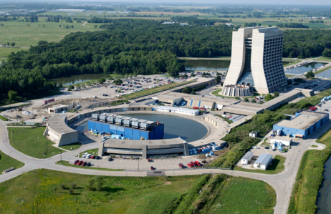
Booster Beam Notching Overview for 2012
December 7, 2011
S. Chaurize

Slide 2
Current Notching in 2011
A 3 bucket gap is created using two kickers located at Long 5 and Long 12
Notcher – A High Voltage(55kV) Kicker at Long 5
Noker - Lower Voltage Kicker (20-40 kV) at Long 12
Used to clean out remnant Notched Beam in buckets
At 700 MeV
Beam is kicked vertically into collimator region at Long 6 and Long 13 with upstream gradient magnets seeing some deposited notched beam loss.
The notch timing and synchronization is accomplished by modules in the Booster LLRF Room and local timing modules.
Beam notch for non-cogged cycles occurs at 400 Mev
Cogged notch occurs close to 700 MeV

Slide 3
Notching in 2012 Phase 1
A 3 bucket gap is created using three Long kickers located at Long 12
3 Notcher – High Voltage(46kV) Kicker at Long 12
Notcher converted to Notch1
Noker converted to Notch2
Build/Commission new Notch3 mostly with parts on hand.
Beam is kicked vertically Horizontally At L12 into new absorber at Long 13
The notch timing and synchronization is accomplished by modules in Booster LLRF Room. (Same as before)
Beam notch for non-cogged cycles occurs at 400 Mev. (Same as before)
Cogged notch occurs close to 700 MeV. (Same as before)

Slide 4
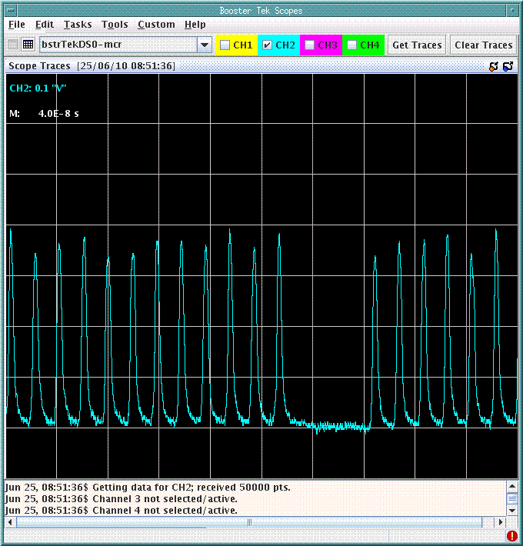
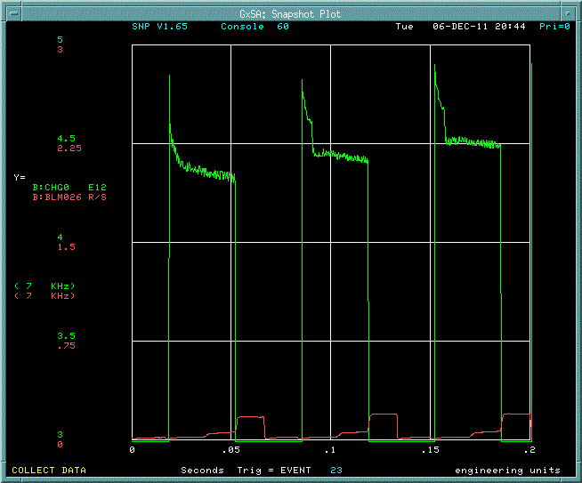
The Notch
3 Bucket Notch Width
non-cogged Cycle
Notch @ 400MeV
Cogged Cycle
Notch @ ~700MeV
Extraction Loss

Slide 5
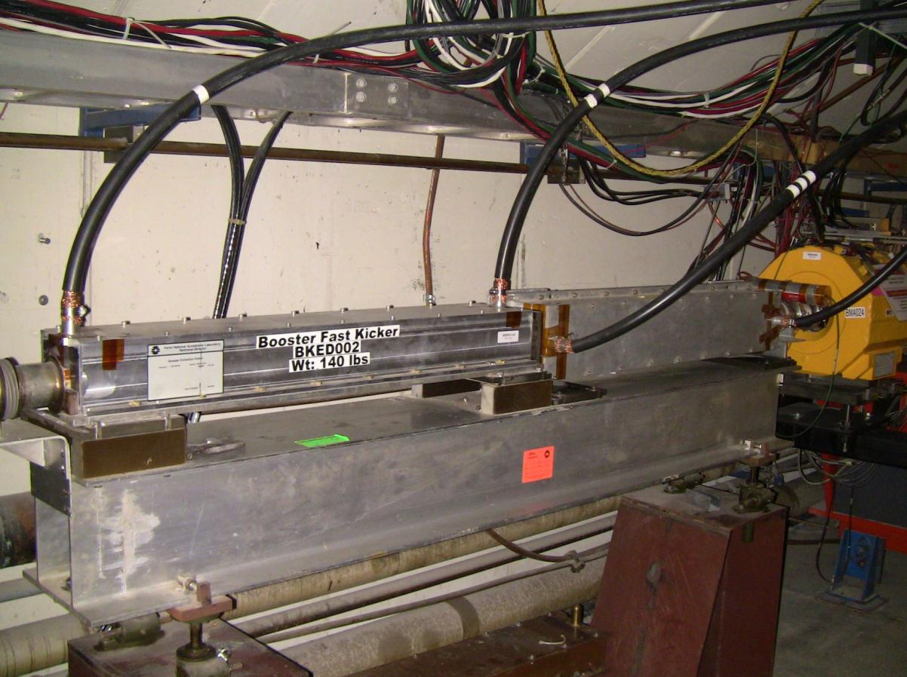
L5 Notcher Current Location Notcher magnet will be moved to L12 Vertical Pinger magnet will be removed from L12 and put here in its place
Hor. Pinger
Notcher

Slide 6
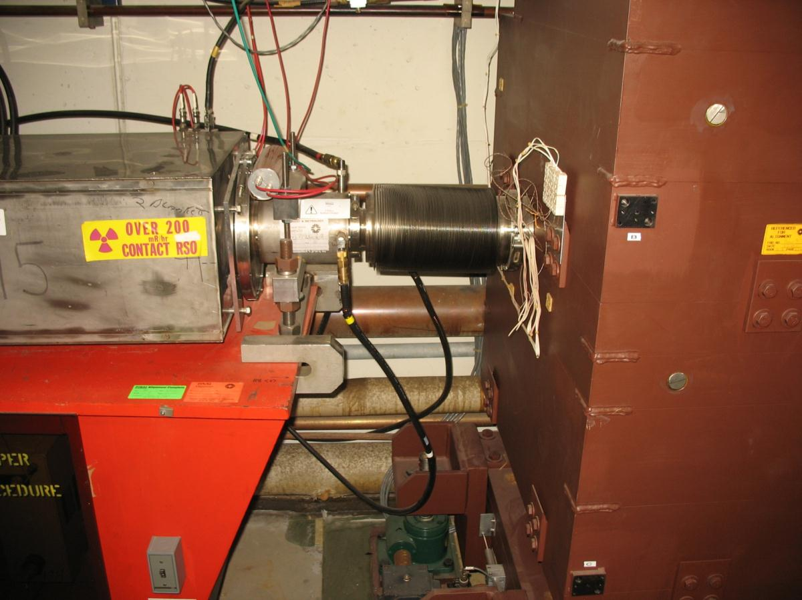
L6a Absorber/Collimator

Slide 7
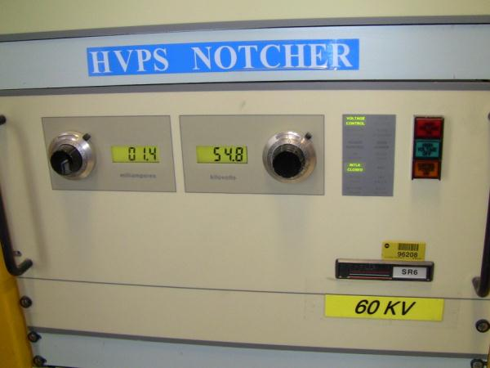
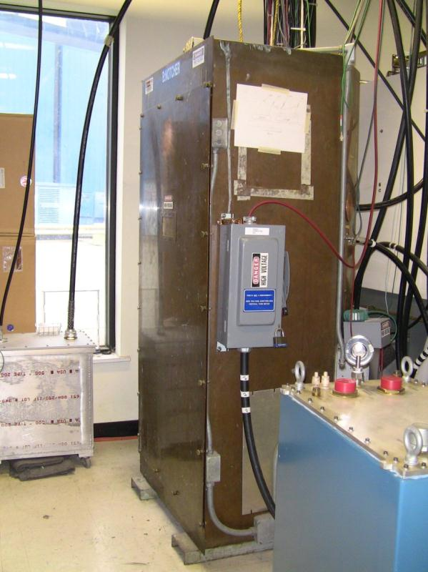
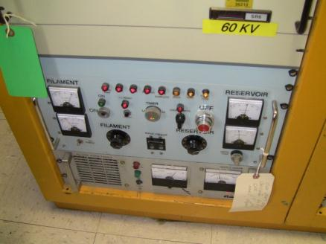
L5 Notcher Power supply components such as these Will need to be moved to support Long 12 region
CX1168 tube
cabinet
CX1168 tube
Low Level
equipment

Slide 8
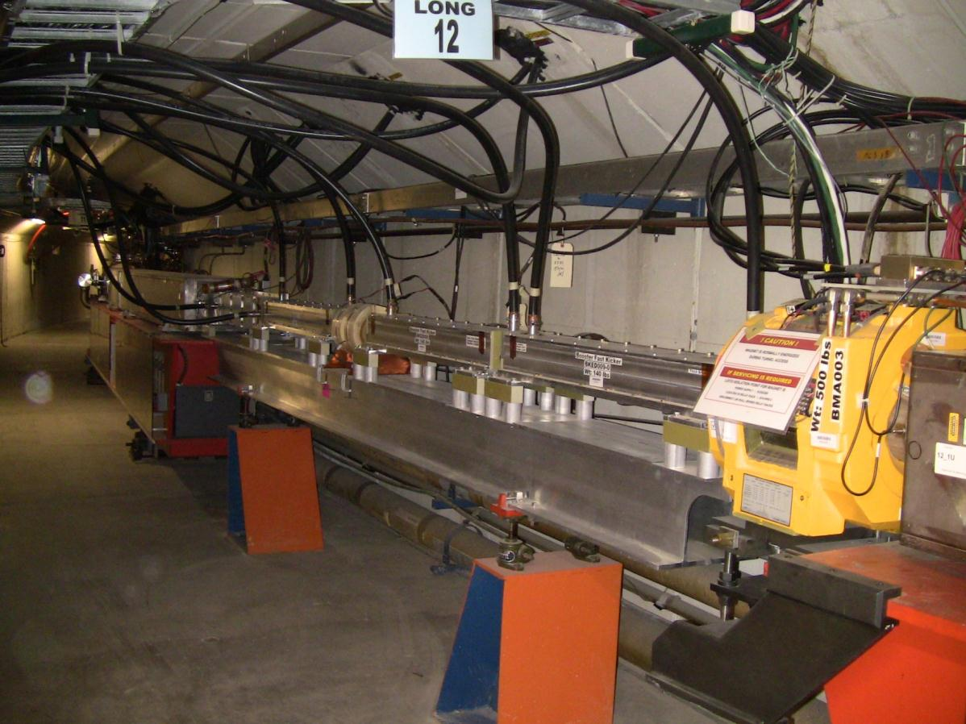
L12 Noker Current Location
Noker
Beam direction

Slide 9
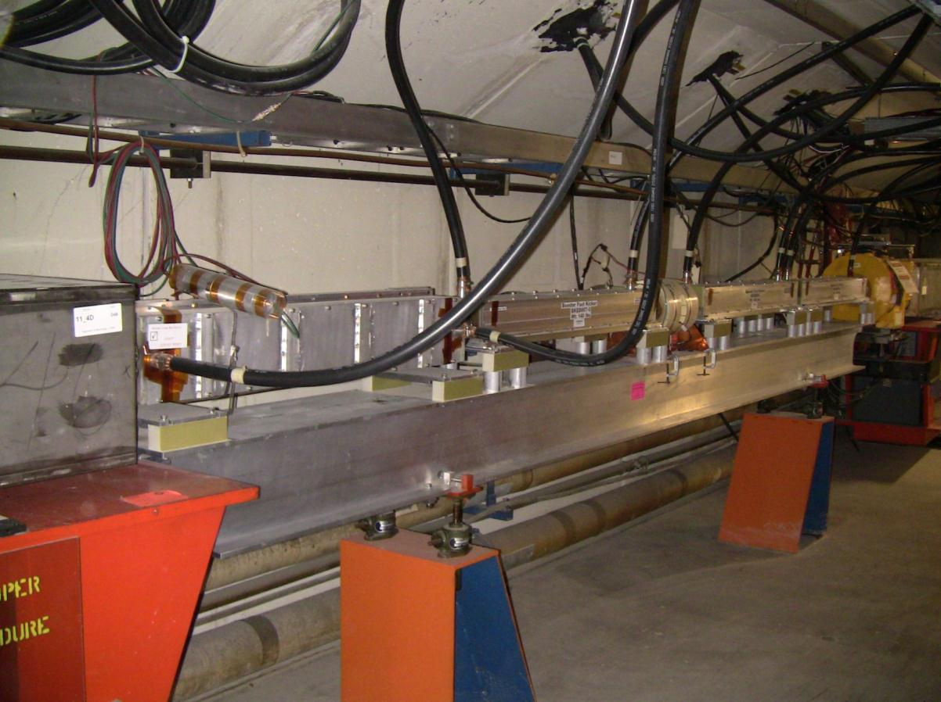
L12 Noker Current Location
MKS04
Ver. Pinger
De-commissioned
Horz. Pinger
Noker
Beam direction

Slide 10
L12 Noker Current Location
MKS04
Notch2
Notch3
Notch1

Slide 11
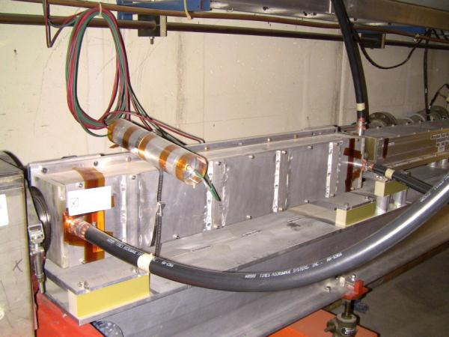
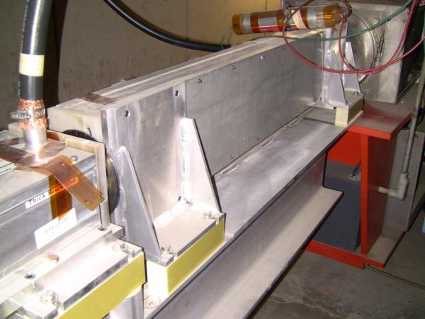
Kicker magnets rotated to kick Horizontally

Slide 12
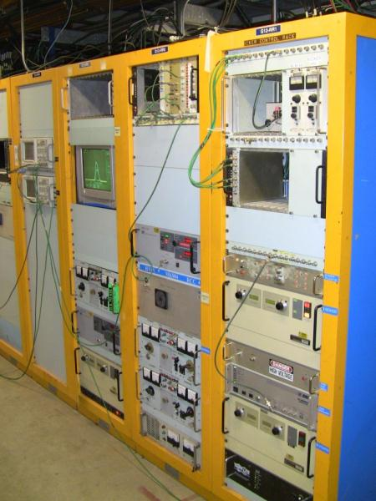
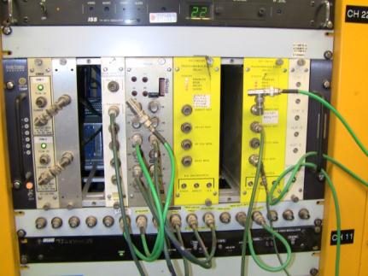
L12 Noker & Extraction Kicker MKS04 Power supply components such as these will need to be installed/relocated to support notch2 & notch3 in east Booster Gallery
CX1168 tube
cabinet
Beam sync
Modules
and other NIM crate
Support modules.

Slide 13
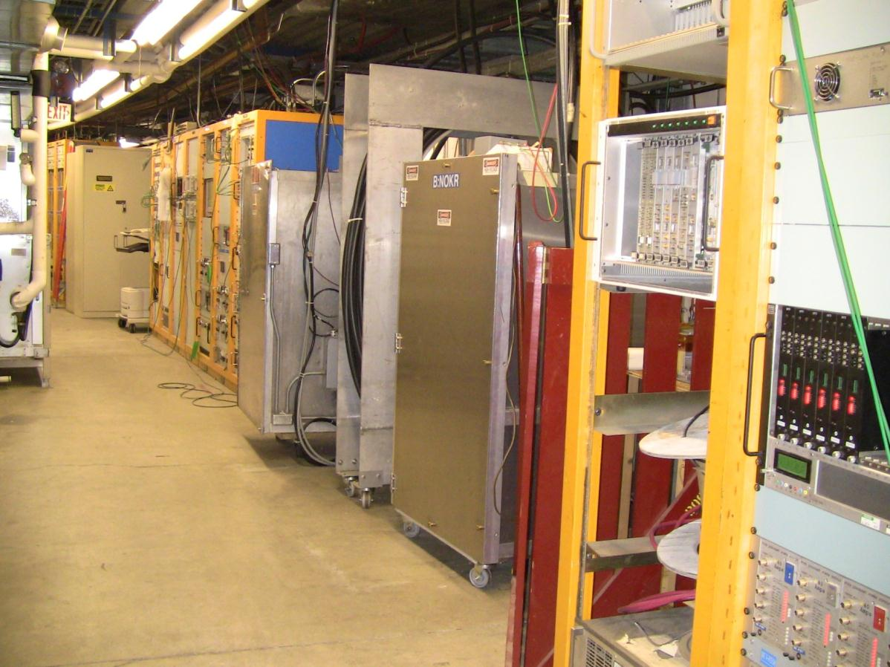
Make Room For 2 more systems In East Gallery

Slide 14
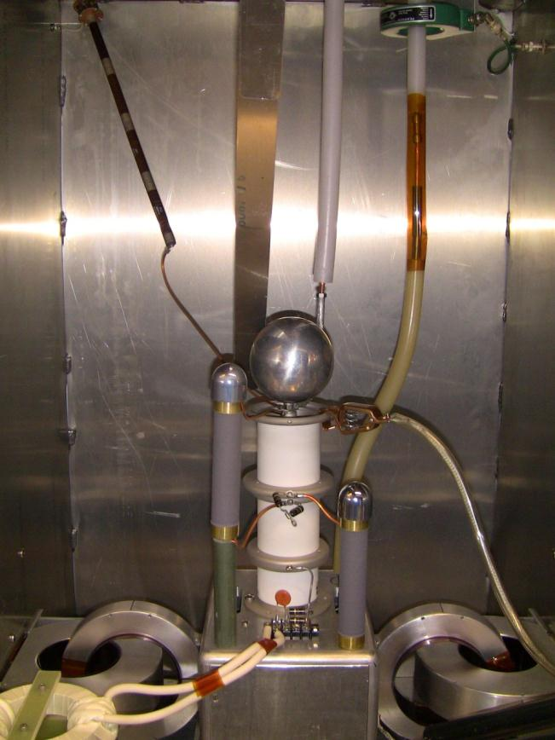
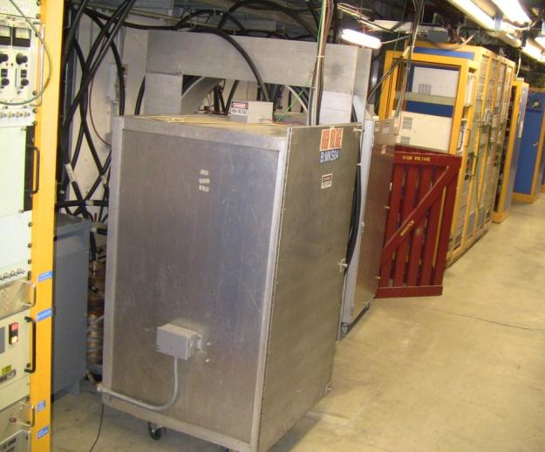
Build another Thyratron Cabinet For Notch3

Slide 15
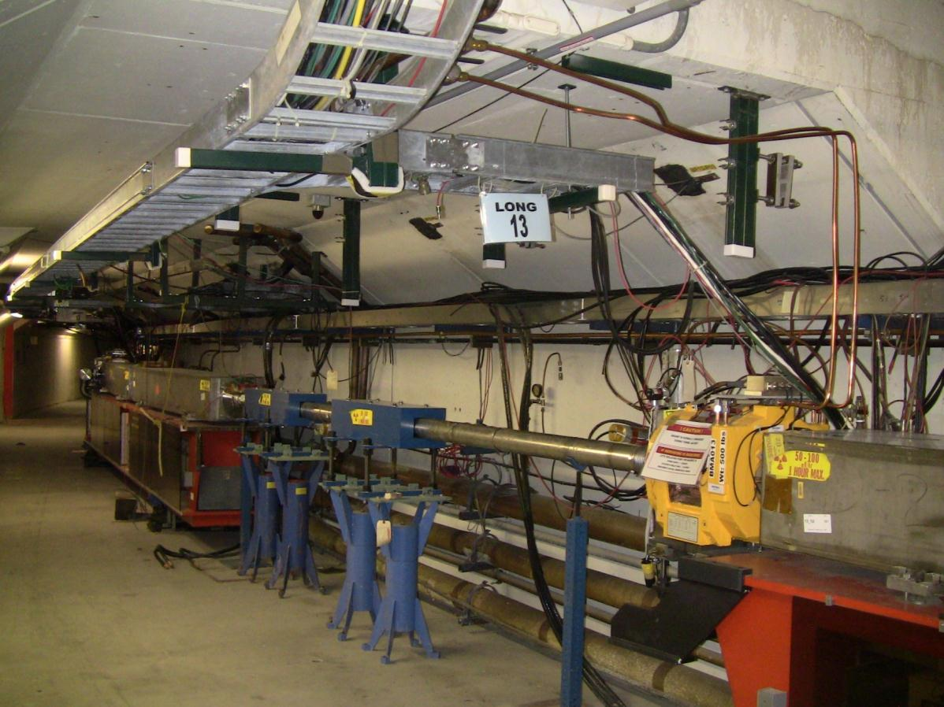
Long 13 Current Noked beam absorber
Beam direction

Slide 16
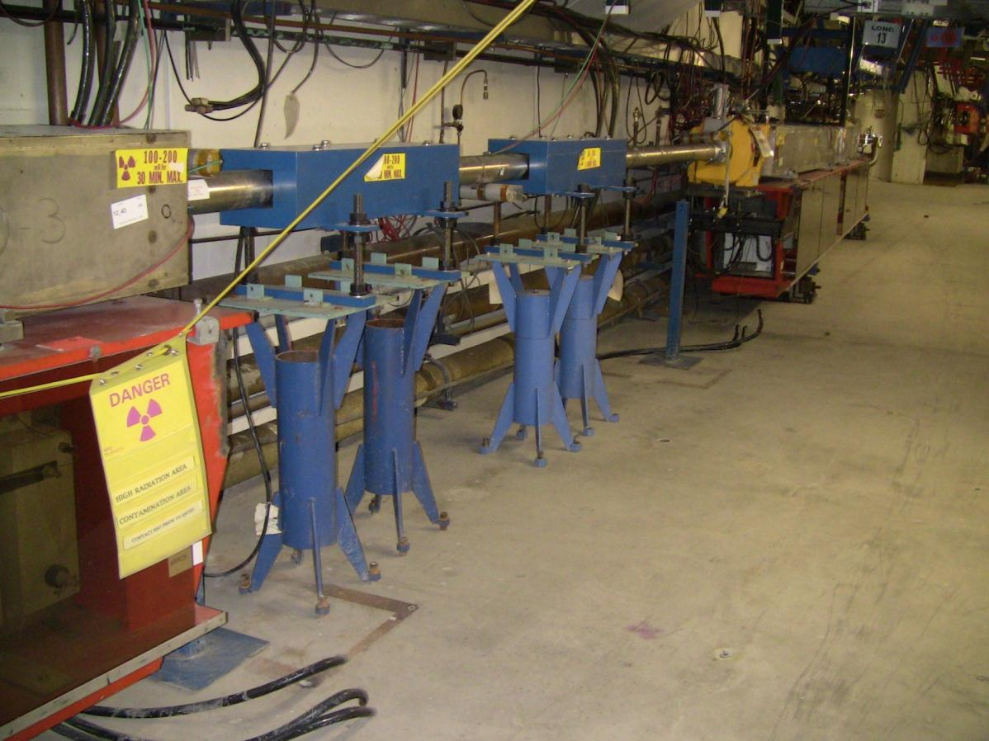
Long 13 Current Noked beam absorber
Beam direction

Slide 17
Notching in later 2012-Beyond Phase 2
Convert 3 Long kicker magnet notchers to short doublets magnets
6 short style kicker magnets would be driven by faster thyratrons to allow quicker fill times creating a cleaner notch
2 short magnets will mount in the foot print of one long magnet(current) kicker.

Slide 18
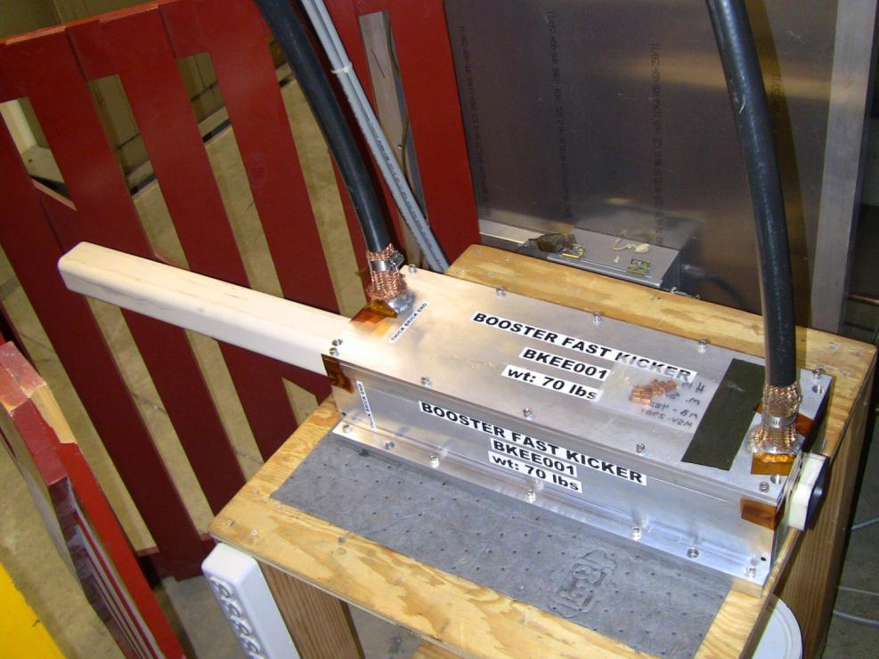
New short kicker prototype faster rise/fill time

Slide 19
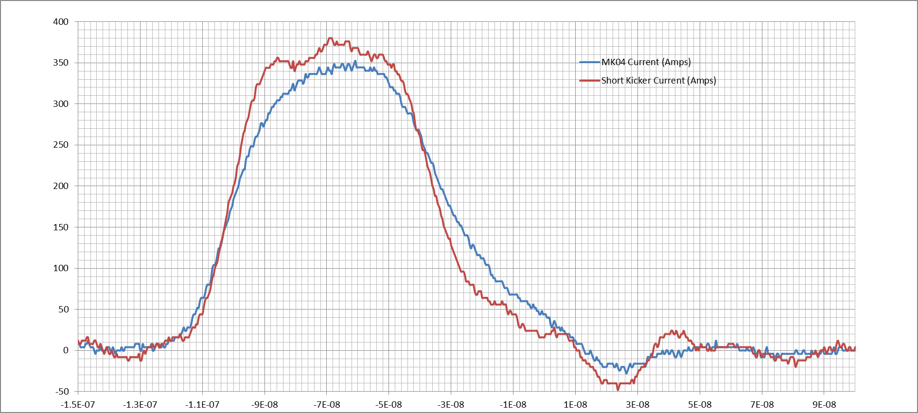
Short Kicker/Long kicker (25 ohm setup) on CX1168 Thyratron tube test-setup.
MKS04 (Long Kicker)
Rise = 30nS
Fall = 50nS
ShortKick (Short Kicker)
Rise = 21nS
Fall = 33nS
Typical Booster kicker rise time 40 ns
J. Lackey, R. Mraz, S. Chaurize

Slide 20
Conclusion
Phase 1 of new notching scheme should reduce extraction losses with a cleaner notch still using long kicker modules.
Losses will be better directed to a more optimized absorber close to the notching kickers.
Phase 2 will implement faster rise kicker modules to further reduce losses.
With higher beam throughput in 2012 and beyond this new notch system configuration should help reduce losses and minimize activation of critical areas in the Booster enclosure.

Slide 21
More L13 tunnel Pictures

Slide 22
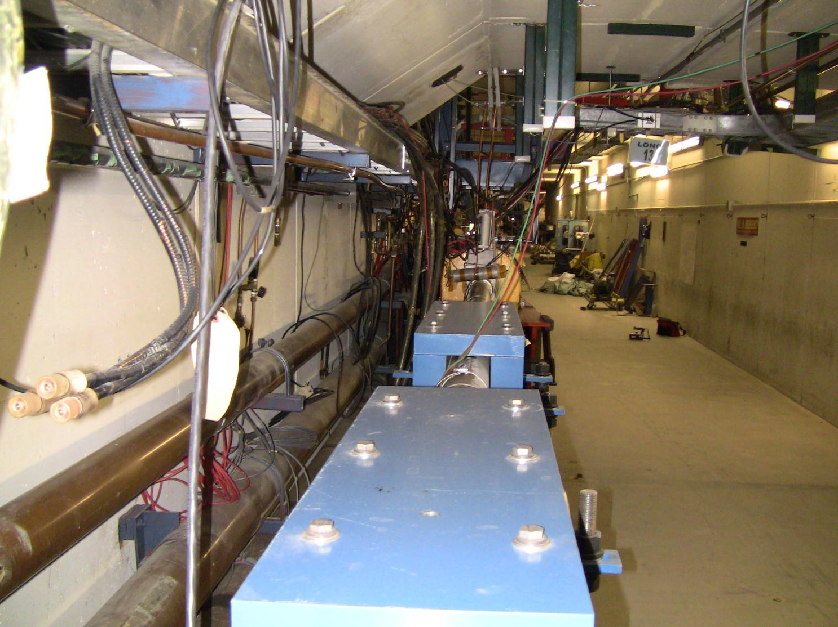
31””
10”

Slide 23
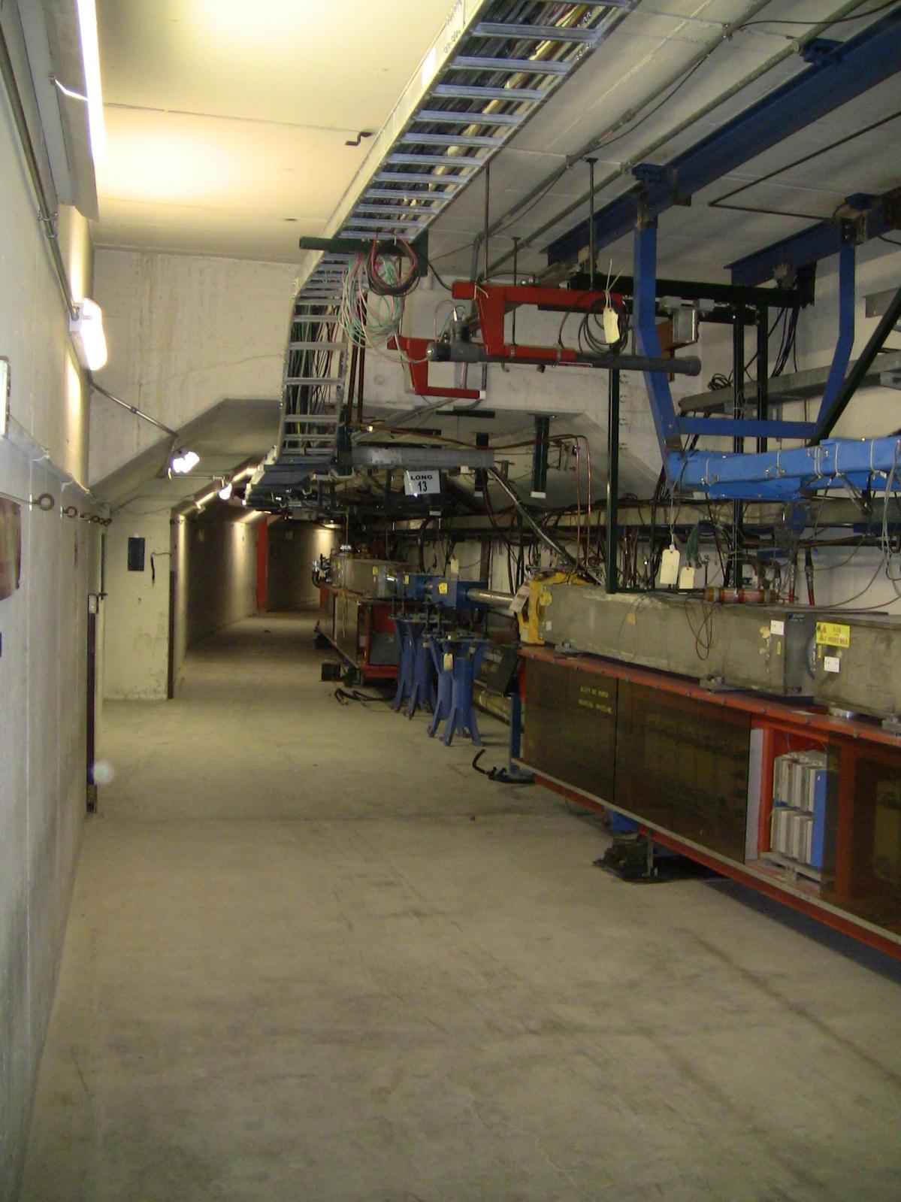
30”
30”
12’-3 ”
24”
96”
18’-11 ”
75”
10 ‘
All Measurements Approximate

Slide 25
