Slide 1
NGLS DESIGN STUDY
AND
ACCELERATOR R&D
John Corlett for the NGLS Accelerator Systems Team
March 15, 2012

Slide 2
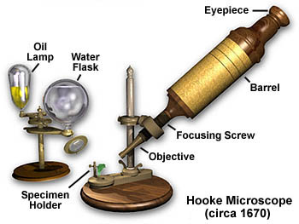
What is the NGLS?
Why do we need it – now?
NGLS will be the world’s fastest X-ray microscope
High repetition rate X-ray laser with ultrafast pulses
Significant impact on the DOE mission
  Urgent energy science: photosynthesis, combustion, catalysis…
Unique machine that will enable global leadership in critical areas
Recent X-ray laser breakthroughs (LCLS/FLASH/FERMI@elettra) point the way…
  Ten year time horizon, NGLS is not an incremental advance
Worldwide, no source – operating today or under construction – will be able to provide all the capabilities of NGLS
Notes:
Critical area of science and technology
Science of light sources are strongly connected to cutting-edge industries (pharmaceutical, chemical, semiconductor, nanotech….)
Technology of light sources is strongly connected to cutting-edge industries (optics, EUV lithography, lasers ……)

Slide 3
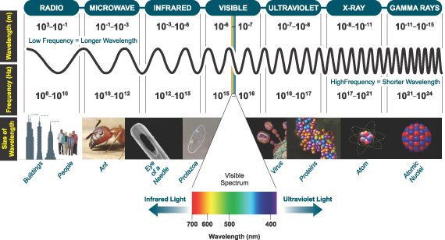
Light – Electromagnetic Spectrum
wavelength (m)
frequency (Hz)

Slide 4
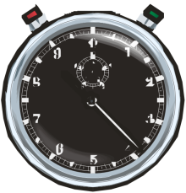
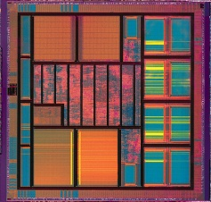
Ultrafast Phenomena
Time
1 second
1 fs is to 1 second
as
1¢ is to the U.S. national debt
Oscillation period of visible light
1/ν ≈ 2 × 10⁻¹⁵ seconds
10⁻³ sec
(milli)
(for wavelength λ = 600 nm)
(~$14 Trillion)
Stop watch
10⁻⁶ sec
(micro)
Fast shutters
electron interactions
in solids
10⁻⁹ sec
(nano)
Macroscopic chemical reactions (explosion)
10⁻¹² sec
(pico)
High speed electronics
10⁻¹⁵ sec
(femto)
Molecular vibrations
10⁻¹⁸ sec
(atto)
Electron motion in atomic levels

Slide 5
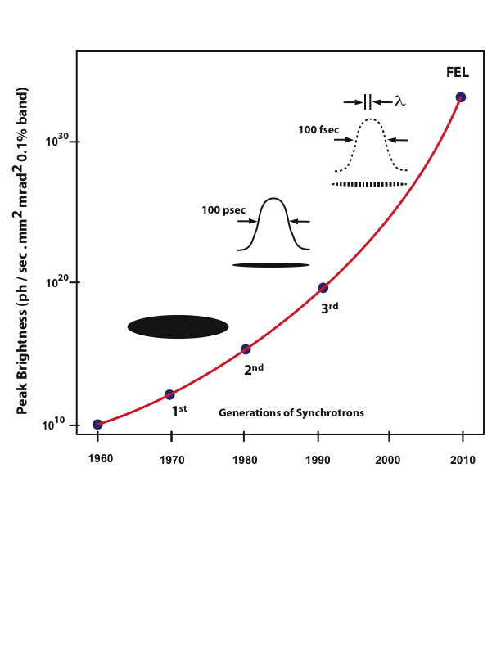
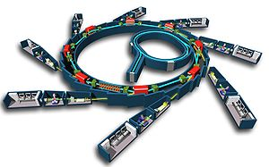
Three generations of light sources have driven X-ray science:
Next generation sources will be intense, ultrafast, coherent
Synchrotron radiation from accelerated electron beams
Notes:
Body slide from the first section of the presentation’s middle. Consider having the first-topic image from the mapping slide repeated here. Use the headline (no more than two lines) to make an assertion about this topic. In the body of the slide, support that headline with images and with words, if necessary. See CSP, pages 116-117 and 147-151.
This slide shows one orientation for the image and text in the body of the slide. Other orientations appear in this template. Choose the one that best supports your headline assertion.
Some institutions will insist that you place an institutional logo on each slide. Other institutions recommend a logo on the first slide and the last. If you do place a logo on each slide, make sure that logo is at the bottom of the slide rather than the top. Placing the logo at the top (the place on a slide that receives the most emphasis) shifts the emphasis away from the work and to the people or place doing the work.

Slide 6
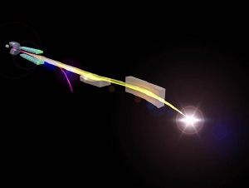
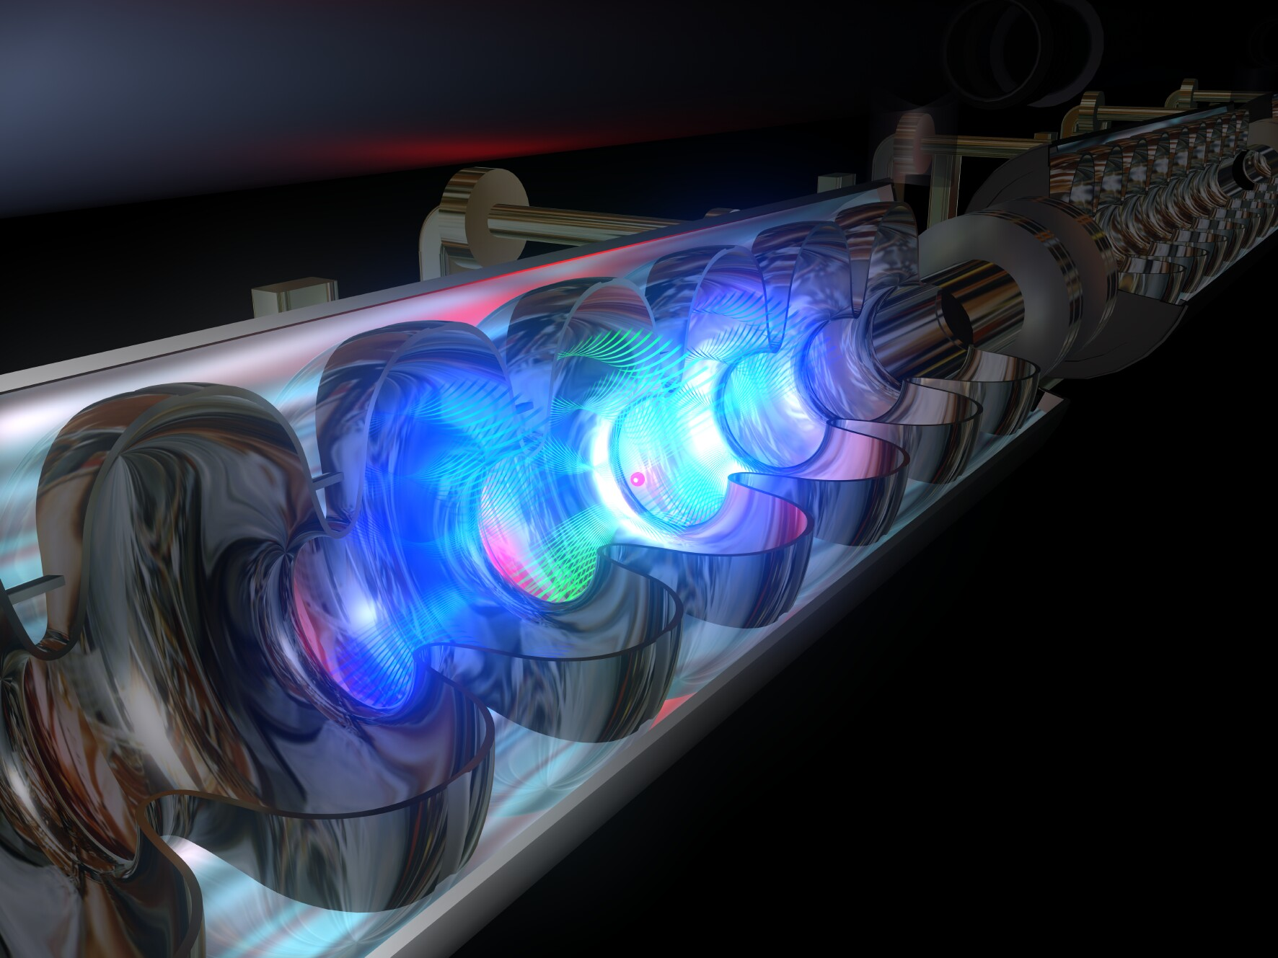
What is the NGLS? – Technologies
~ 100 microjoule
~ microseconds
~ 100 attoseconds to 100 femtoseconds
Goal: beams of intense, ultrafast, coherent X-ray pulses at high repetition-rate
X-rays
time
Free electron lasers (FELs)provide intense, ultrafast, coherent, X-ray pulses
A superconducting accelerator and high rep-rate injector provides high brightness electron beam
EUXFEL

Slide 7



Comparison with existing light sources
Today’s storage ring x-ray sources
Weak pulses at
high rep rate
~ nanoseconds
~nanojoule
~ picoseconds
Today’s x-ray laser sources
~ milliseconds
Intense pulses at
low rep rate
…
~millijoule
…
~ femtoseconds
Tomorrow’s x-ray laser sources
~ microseconds
Intense pulses at high rep rate
~100 microjoule
~ attoseconds to femtoseconds
Notes:
Storage rings and FELs provide beamlines with about 1 Watt average power (0.1% BW)
Next generation superconducting-linac-driven FELs can provide hundreds of Watts, and with flexibility in X-ray pulse characteristics
Orders of magnitude more average power in coherent beams, with many (10) orders of magnitude greater peak brightness than storage rings

Slide 8
NGLS Capabilities
High repetition rate soft X-ray laser array
  Up to 10⁶ pulses per second
  Average coherent power up to ~100 W
Spatially and temporally coherent X-rays (seeded)
  Ultrashort pulses from 250 as – 250 fs
  Narrow energy bandwidth to 50 meV
Tunable X-rays
  Adjustable photon energy from 280 eV – 1.2 keV
    higher energies in the 3rd and 5th harmonics
  Polarization control
  Moderate to high flux with 10⁸ – 10¹² photons/pulse
Expandable
  Capability
  Capacity

Slide 9
NGLS Approach
High average power electron beam distributed to an array of FELs from high rep-rate injector and CW SCRF linac
Beam spreader
High-brightness, high rep-rate gun and injector
CW superconducting linac,
laser heater, bunch compressor
Array of independent FELs
X-ray beamlines and endstations
NGLS offers significant advances over current capabilities:
More photons per unit bandwidth
More photons per second
Shorter pulses
Controlled trade-off between time and energy resolution

Slide 10
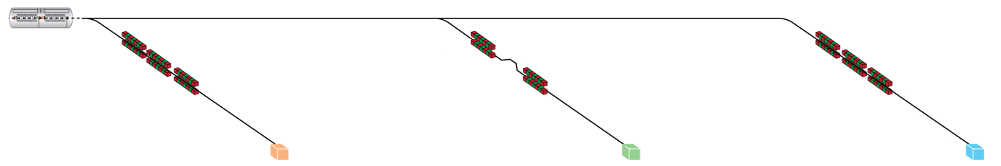
Three initial FEL beamlines to span the science case
Seeded / self-seeded
2 color seeded
SASE or self-seeded
10 μs
10 μs
≤1 μs
5 – 150 fs
0.25 – 25fs
5 – 250 fs
High resolution
~Time-bandwidth limited
10¹¹ – 10¹² ph/pulse
10⁻³ – 5x10⁻⁵ bandwidth
High-resolution spectroscopy
Diffract-and-Destroy
(with harmonics)
Ultra-fast
Sub-fs pulses
2 color
10⁸ ph/pulse
Multidimensional
spectroscopy
Highest rep rate
High flux
10¹¹ - 10¹² ph/pulse
100 W
Diffract-and-Destroy
(at highest rate)
Photon correlation
spectroscopy
Notes:
the initial three beamlines each provide capabilities not available elsewhere, and match the science needs described earlier
3 notional “starter” FELs: ultra-high resolution, ultra-fast / 2-color, high rep rate
SASE BL 3 ultimately only limited by the photoinjector (and charge required to lase)
Baseline design of NGLS has 1 nC bunches every 1 μs, multiplexed to different BLs. This beamline could have 10 pC bunches every 10 ns (100 MHz rep rate)
Lasers up to ~10 MW or 10’s micro-Joule in UV – 100 W in IR

Slide 11
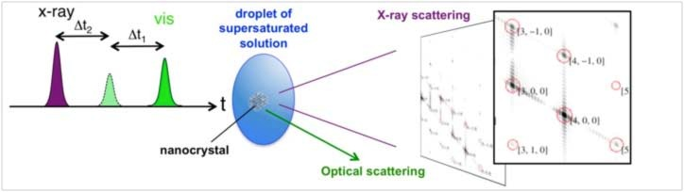
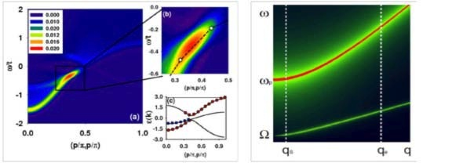
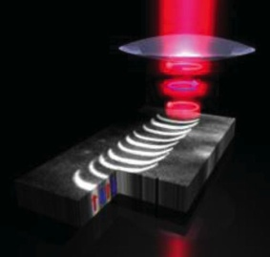
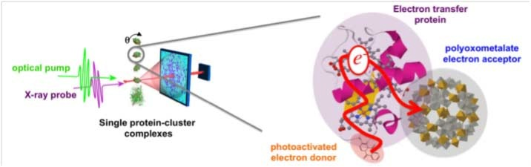
Broad Range of Energy Science
Uniquely Enabled by NGLS
Natural and Artificial Photosynthesis
Fundamental Charge Dynamics
Advanced Combustion Science
Catalysis
Nanoscale Materials Nucleation
Dynamic Nanoscale Heterogeneity
Quantum Materials
Nanoscale Spin and Magnetization
Bioimaging: Structure-to-Function

Slide 12
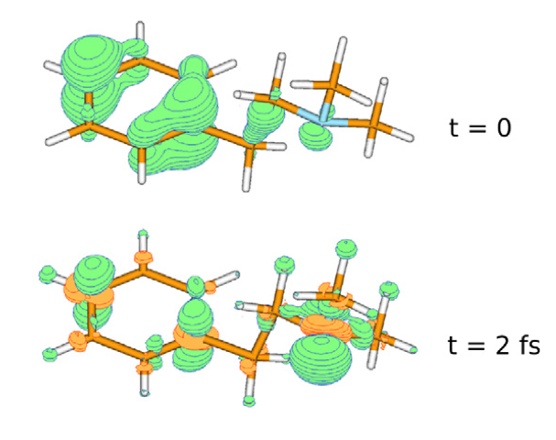
NGLS - What Does it Do?
High repetition rate X-ray laser with ultrafast pulses
NGLS will probe the motion of molecules, atoms, and electrons
On their natural time scales – femtoseconds (fs) and faster….
With unprecedented resolution
  nanometers (molecules) to Angstroms (atoms)
With chemical sensitivity – Carbon, Oxygen, Nitrogen…..

Slide 13
Time to do Experiments - Photosynthesis
Required | 10¹⁷ | photons
Damage Limit | 10⁸ | ph/pulse
Max Rep. Rate | 10⁵ | Hz
Sample Replacement:
10⁵ Hz
Time to do experiment:
Photons Required / (Photons/Pulse x Rep. Rate)
 | Source (intrinsic)
 | Max. ph/pulse | Max. Rep. rate [Hz] | Time to do experiment |  | Time resolution
Storage Ring | 10⁵ | 5x10⁸ | 10¹⁷/10⁵/10⁵ | 100 days | 100 ps
Pulsed FEL | 10¹⁰ | 10² | 10¹⁷/10⁸/10² | 100 days | ~fs
NGLS | 10⁹ | 10⁶ | 10¹⁷/10⁸/10⁵ | 3 hours | ~fs

Slide 14
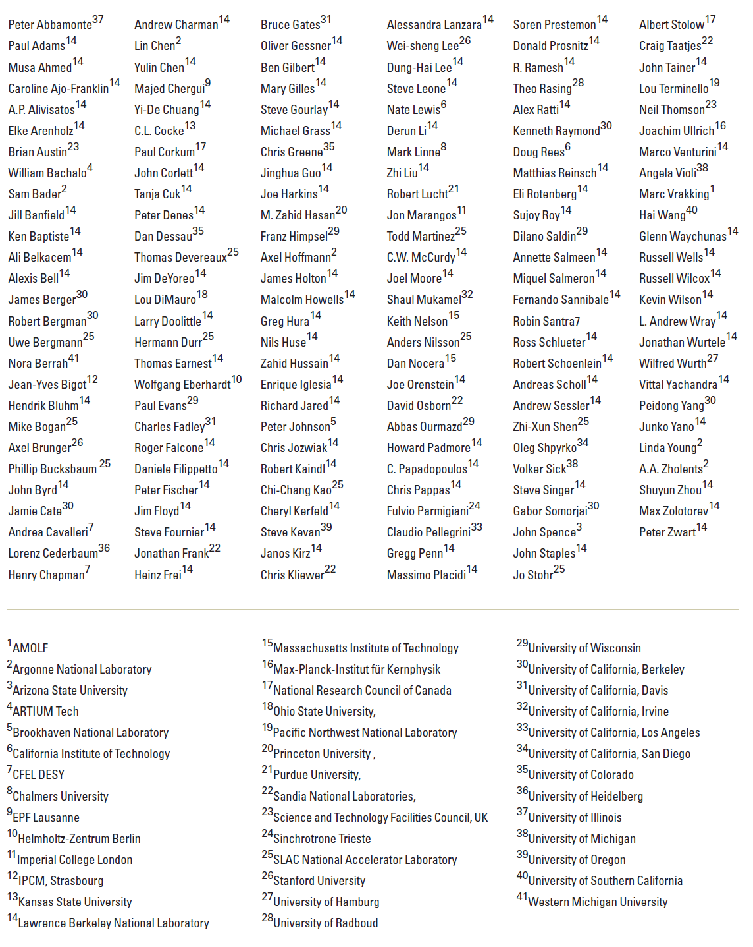
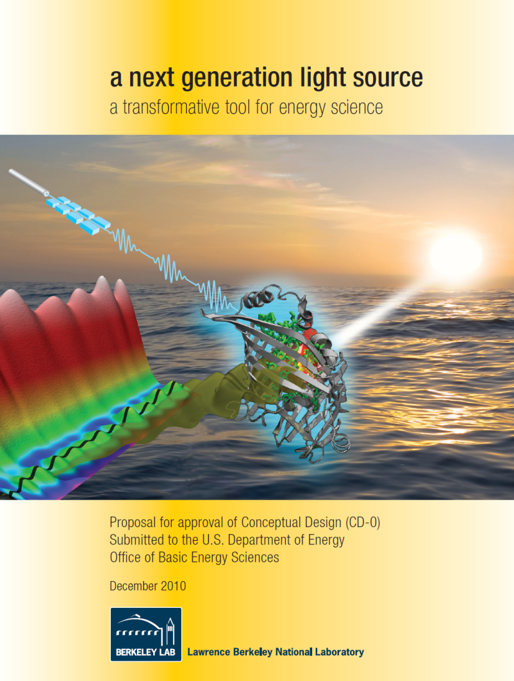
NGLS CD-0 Proposal
Scientific and Technical Contributors
Submitted December 2010
More than 150 contributors
Representing >40 national and international research institutions

Slide 15
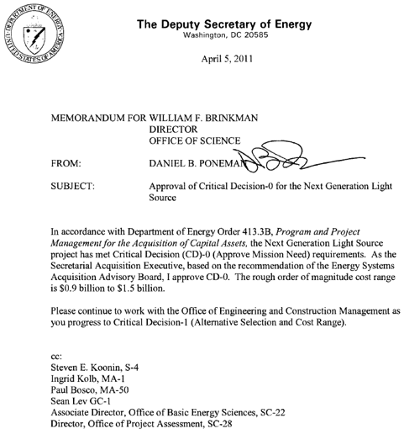
NGLS project status
LBNL submitted a CD-0 proposal in December 2010
DOE approved “Mission Need” for the Next Generation Light Source
Currently no DOE budget to pursue a Project
LBNL is
  Fully committed to NGLS
  Performing Accelerator and Detector R&D
  Performing feasibility studies which will inform a Conceptual Design

Slide 16
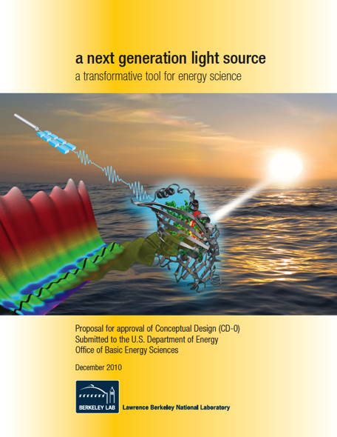
Science requirements drive machine design
Tuning range
Maximum photon energy
Peak flux
Average Flux
Repetition rate
Two-color capability
Pulse duration
Bandwidth
Accuracy
Stability
Synchronization
Contrast ratio

Slide 17
Work in progress to better define the machine layout
Injector
  Bunch compression, emittance compensation, acceleration
Linac and spreader
  Bunch compression
  Diagnostics
  Cryomodules, accelerating gradient, cavity quality factor, field emission, higher-order-mode power
  Collimation
  Kicker and septum magnets, spreader transport lattice
FEL design
  Undulators
  Seeding
Beam dumps

Slide 18
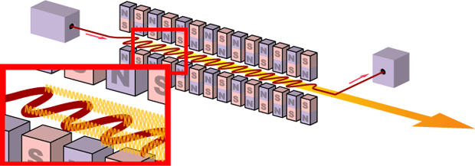
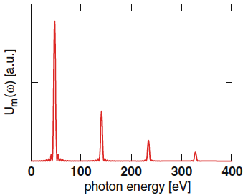
Undulator radiation
Undulators
Electron bunches
X-ray pulses
Over one undulator period, the electron is delayed with respect to the light by one optical wavelength
Notes:
Over one undulator period, the electron is delayed with respect to the light by one optical wavelength
Resonance equation
Fundamental and odd harmonics produced

Slide 19
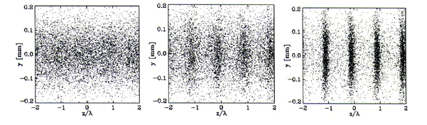
FEL bunching
Undulators
Electron bunches
X-ray pulses
Microbunching: electrons losing energy to light travel a longer distance than electrons gaining energy from the light
y (mm)
y (mm)
y (mm)
z/λ
z/λ
z/λ
Notes:
Electrons losing energy to the light wave travel on a sinusoidal trajectory of larger amplitude than electrons gaining energy from the light wave
The result is a modulation of the longitudinal velocity which eventually leads to a concentration of the electrons in slices which are shorter than the optical wavelength

Slide 20
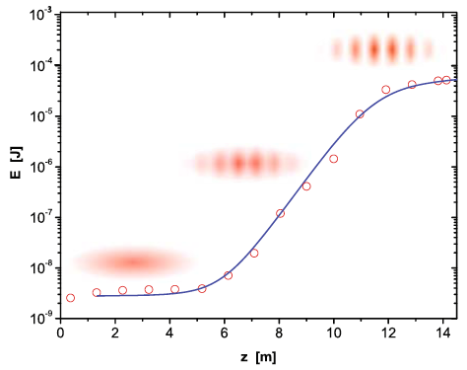
FEL gain
Undulators
Electron bunches
X-ray pulses
The particles within a microbunch radiate like a single particle of high charge
The resulting strong radiation field enhances the microbunching even further and leads to an exponential growth of the radiation power
Coherent power per pulse ≥10⁵ times storage rings
Notes:
The particles within a microbunch radiate like a single particle of high charge.
The resulting strong radiation field enhances the microbunching even further and leads to an exponential growth of the radiation power.

Slide 21
Linac schematic layout
Laser heater
Linearizer cryomodules
Accelerating cryomodules
Injector
Spreader
CM1
CM2
HL
CM3
CM9
CM10
CM30
Bunch compressor 1
Bunch compressor 2
Accelerating cryomodules
Gun
0.75 MeV
Heater
70 MeV
BC1
168 MeV
BC2
640 MeV
Spreader
2.4 GeV
~670 m
Notes:
Balancing demands on systems
Using common components
Next steps:
Integrate spreader kicker and septa with transport lattice
Work with partner Lab to improve SCRF linac performance
Increase gradient from 13 MV/m to 16+ MV/m
Increase Q_{o} from 1x10¹⁰ to 2x10¹⁰

Slide 22
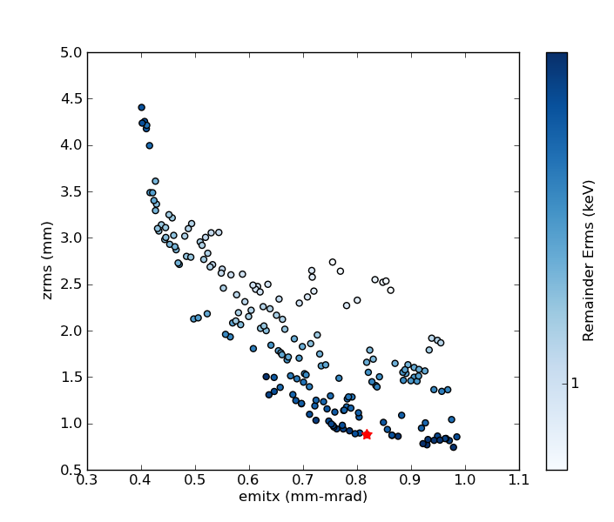
Injector multivariate optimization
Buncher
Gun
5 keV
Pareto front of genetic optimization
300 pC, ~70 MeV design point
Delivers required beam brightness
RMS energy spread
RMS bunch length (mm)
1 keV
Projected normalized emittance (m-rad, 100%)
Notes:
Uses main linac cryomodule
Genetic algorithm

Slide 23
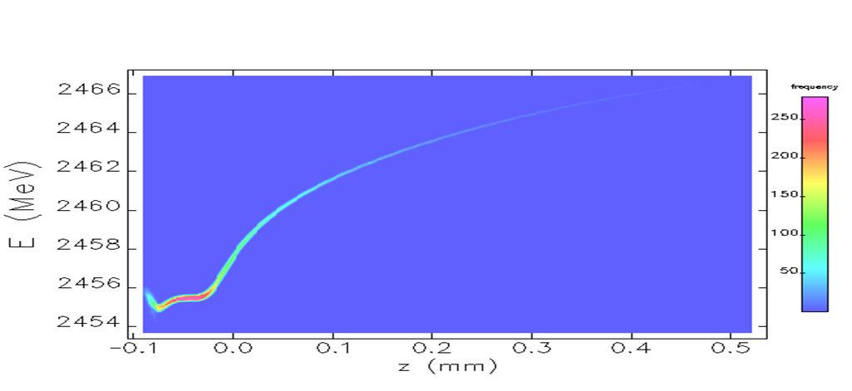
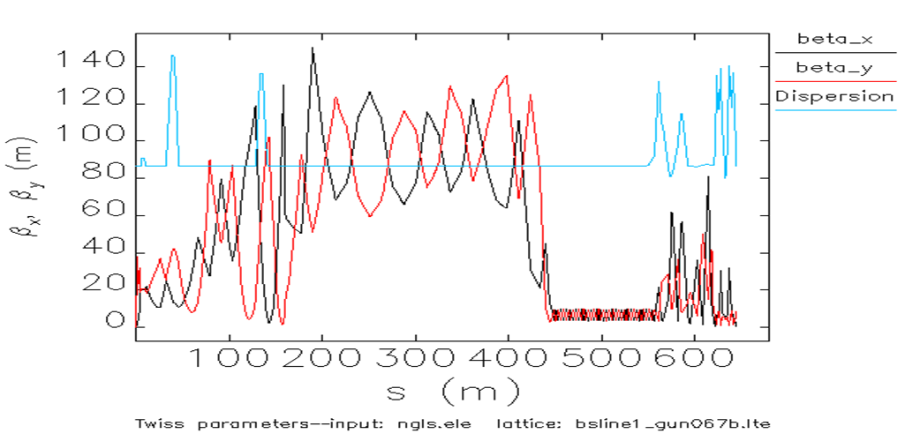
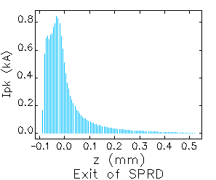
Beam dynamics modeling through linac
Two-stage compression
2.4 GeV
  APEX-gun generated beams (300pC)
  ≥ 600 A peak current and small residual energy chirp within usable beam core
  limited CSR-induced projected emittance growth
Longitudinal beam phase-space
at entrance of FEL beamlines*
Twiss functions through the Linac
This part of the bunch lases
Current profile
*’Elegant’ simulation through the linac starting from an ASTRA-simulated beam out of the APEX-gun based injector
Notes:
ASTRA
ELEGANT
IMPACT
<0.6 micron
<100 keV

Slide 24
Physics & technology challenges
electron bunch
≳100 µm
~100 m
≲100 µm
Transverse phase space
  Small electron beam emittance ε
Longitudinal phase space
  Large peak current I_{peak}
  Small energy spread σ_{E}
Electron beam energy γ
  High gradient accelerator
Short period undulators
Collective effects
Average power
  High repetition rate injector
  CW superconducting accelerator
X-ray temporal control
  FEL design & seeding techniques
~1 nm
Power/
undulator length

Slide 25
Accelerator Systems R&D
High repetition rate
Advanced FEL operation
High average power
Superconducting accelerator developments
Notes:
High repetition rate
Injector (APEX)
Spreader
Advanced FEL operation
Seeding
Lasers
Undulators
Instrumentation & diagnostics
Timing & synchronization
High average power
Beam dumps
Superconducting accelerator developments
High Q_{o}
Higher order mode power
Field emission
Harmonic cavity

Slide 26
Injector design goals – APEX gun
Repetition rate 1 MHz
Charge per bunch from ~10 pC to ~1 nC
Emittance <10⁻⁶ mm-mrad (normalized)
Electric field at the cathode ≥~10 MV/m (space charge emission limit)
Beam energy at the gun exit ≥~500 keV (space charge control)
Bunch length ~100 fs to ~10 ps for handling space charge effects, and for allowing different modes of operation
Compatible with magnetic field control within the gun (emittance exchange and compensation)
10⁻¹¹ Torr vacuum capability (cathode lifetime)
Accommodates a variety of cathode materials
High reliability for user operations
The gun is the most challenging component
LBNL approach uses a CW VHF cavity
Notes:
100 MHz capability
Only partial funding for injector

Slide 27
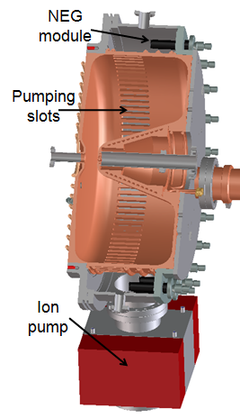
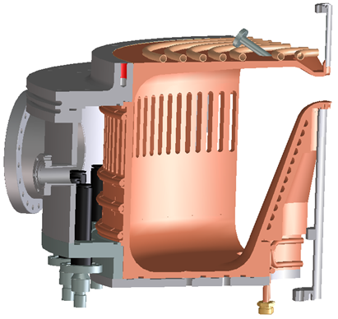
APEX gun
VHF cavity operates in CW mode
Low power density on cavity walls
High conductance vacuum slots
High gradient at cathode
Frequency | 187 MHz
Operation mode | CW
Gap voltage | 750 kV
Field at the cathode | 19 MV/m
Q₀ | 30887
Shunt impedance | 6.5 MΩ
RF Power | 90 kW
Stored energy | 2.3 J
Peak surface field | 24 MV/m
Peak wall power density | 25 W/cm²
Accelerating gap | 4 cm
Diameter/Length | 70/35 cm
Operating pressure | < 10⁻¹¹ Torr

Slide 28
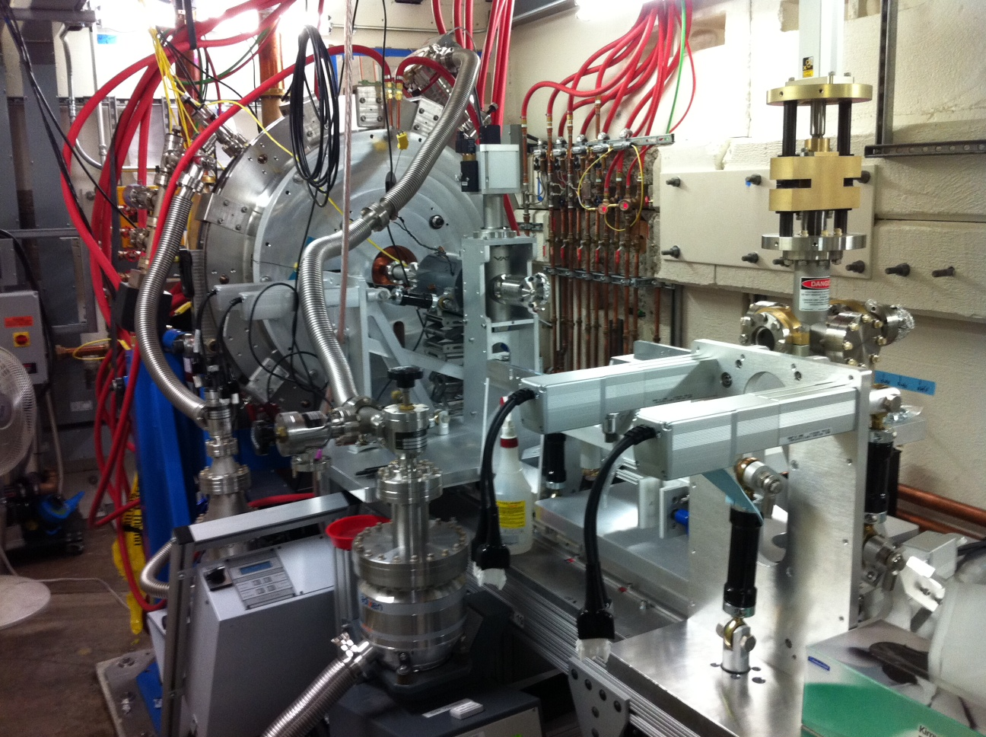
APEX gun in test area
APEX cavity is successfully RF conditioned
Notes:
Repetition rate 1 MHz
Charge per bunch from ~10 pC to ~1 nC
Emittance <10⁻⁶ mm-mrad (normalized)
Electric field at the cathode ≥~10 MV/m (space charge emission limit)
Beam energy at the gun exit ≥~500 keV (space charge control)
Bunch length ~100 fs to ~10 ps for handling space charge effects, and for allowing different modes of operation
Compatible with magnetic field control within the gun (emittance exchange and compensation)
10⁻¹¹ Torr vacuum capability (cathode lifetime)
Accommodates a variety of cathode materials

Slide 29
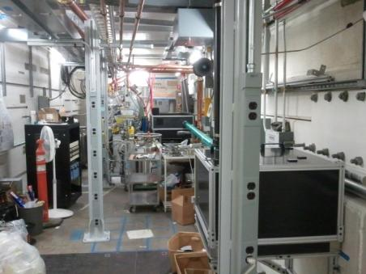
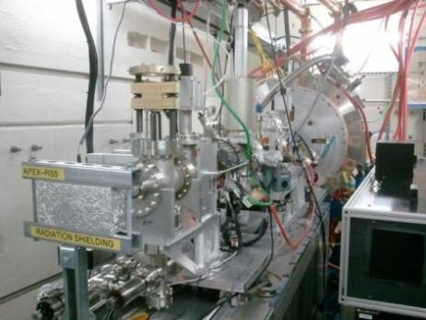
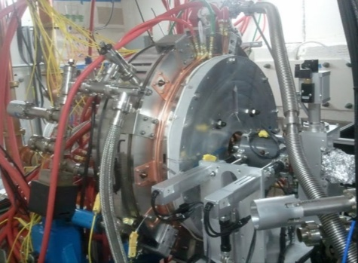
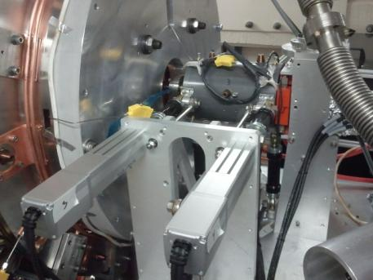
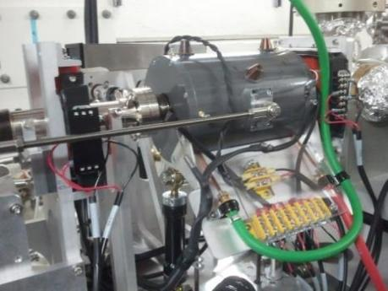
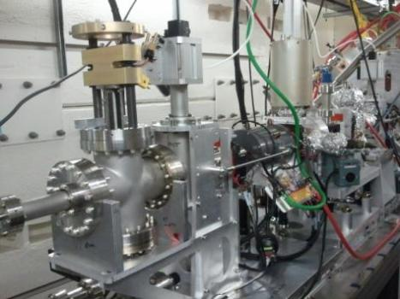
APEX in the Beam Test Facility
Notes:
Installation almost complete
Laser beam on cathode plug
Photoemission test about to start

Slide 30
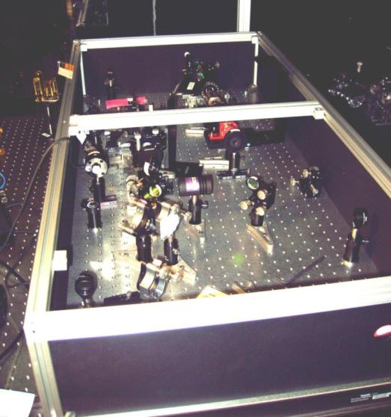
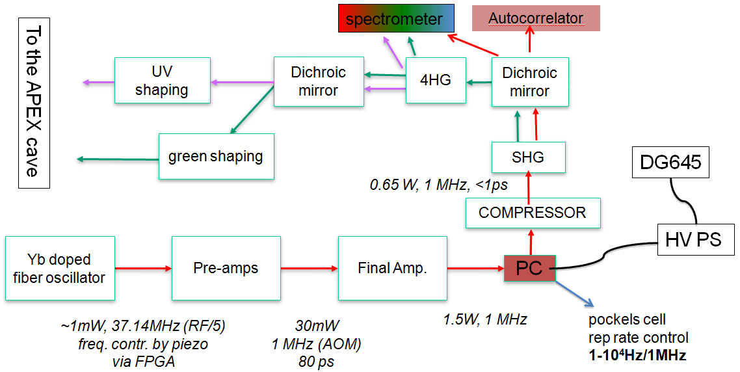
APEX Activity and Plans
F. Sannibale
Yb fiber photocathode drive laser
1 MHz reprate Yb fiber laser
  LLNL/UCB/LBNL collaboration
Notes:
0.7 W @ 1052 nm (systems being optimized)
240 mW @ 526 nm
~ 1.5 nC, 1 MHz CsK₂Sb
85 mW @ 263 nm
>300 pC, 1 MHz Cs₂Te
Other lasers available for future use
1 MHz, 2 W, 1052 nm (Calmar)
1 MHz, >100 W,1064 nm, cryo-cooled Yb:YAG (Qpeak Inc., STTR)

Slide 31
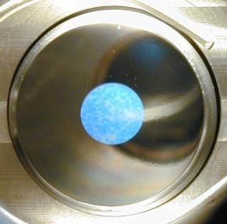
Photocathode materials
Alkali Antimonides eg. K₂CsSb
- Fast
- Reactive; requires UHV ~10⁻¹⁰ Torr pressure
- High QE (typically >5%)
- No pulse charge saturation
- Requires green light (532 nm, 2nd harm. conversion from IR)
- For 1 nC & 1 MHz rep-rate, ~ 1 W IR required
- Unproven lifetime at high rep-rate and high average current
Cs₂Te (developed by INFN/LASA and delivered to LBNL)
- Fast
- Relatively robust and un-reactive (~10⁻⁹ Torr )
- Demonstrated in a high gradient rf gun
- High QE (typically >5%)
- No pulse charge saturation
- Requires UV 250 nm, 3rd or 4th harm. from IR laser)
- For 1 nC - 1 MHz reprate, ~ 10 W IR required
- Unproven at high rep-rate and high average current
The APEX gun will also be used to test the BNL diamond amplifier cathode

Slide 32
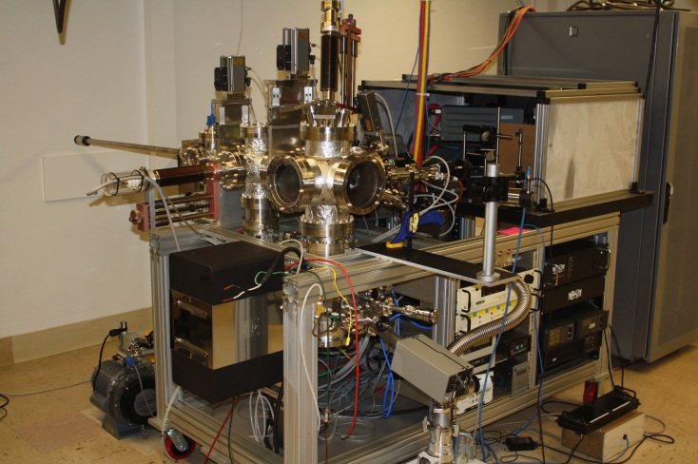
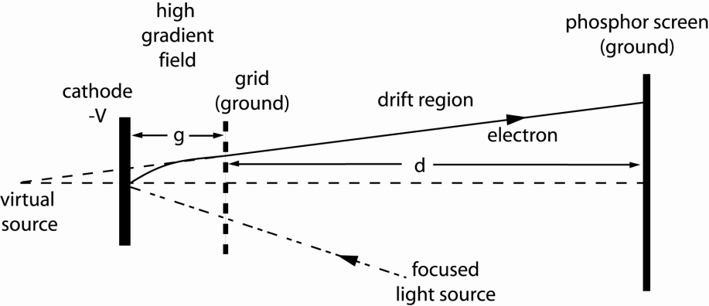
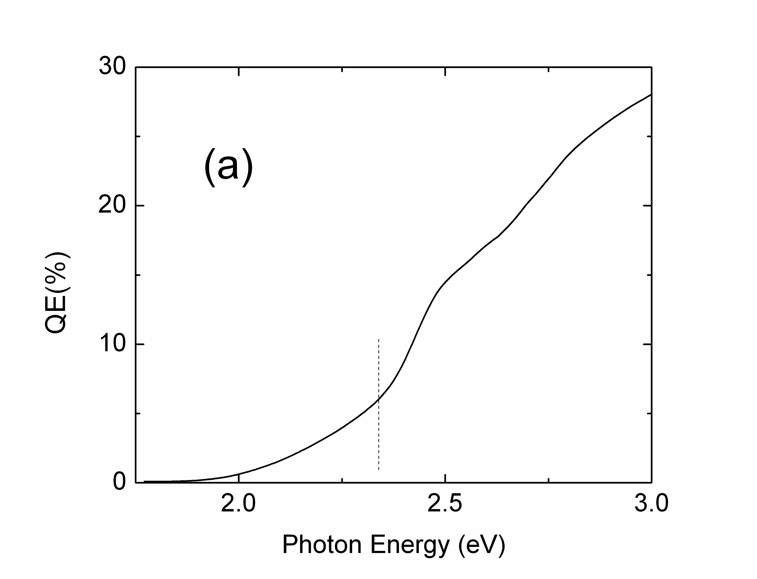
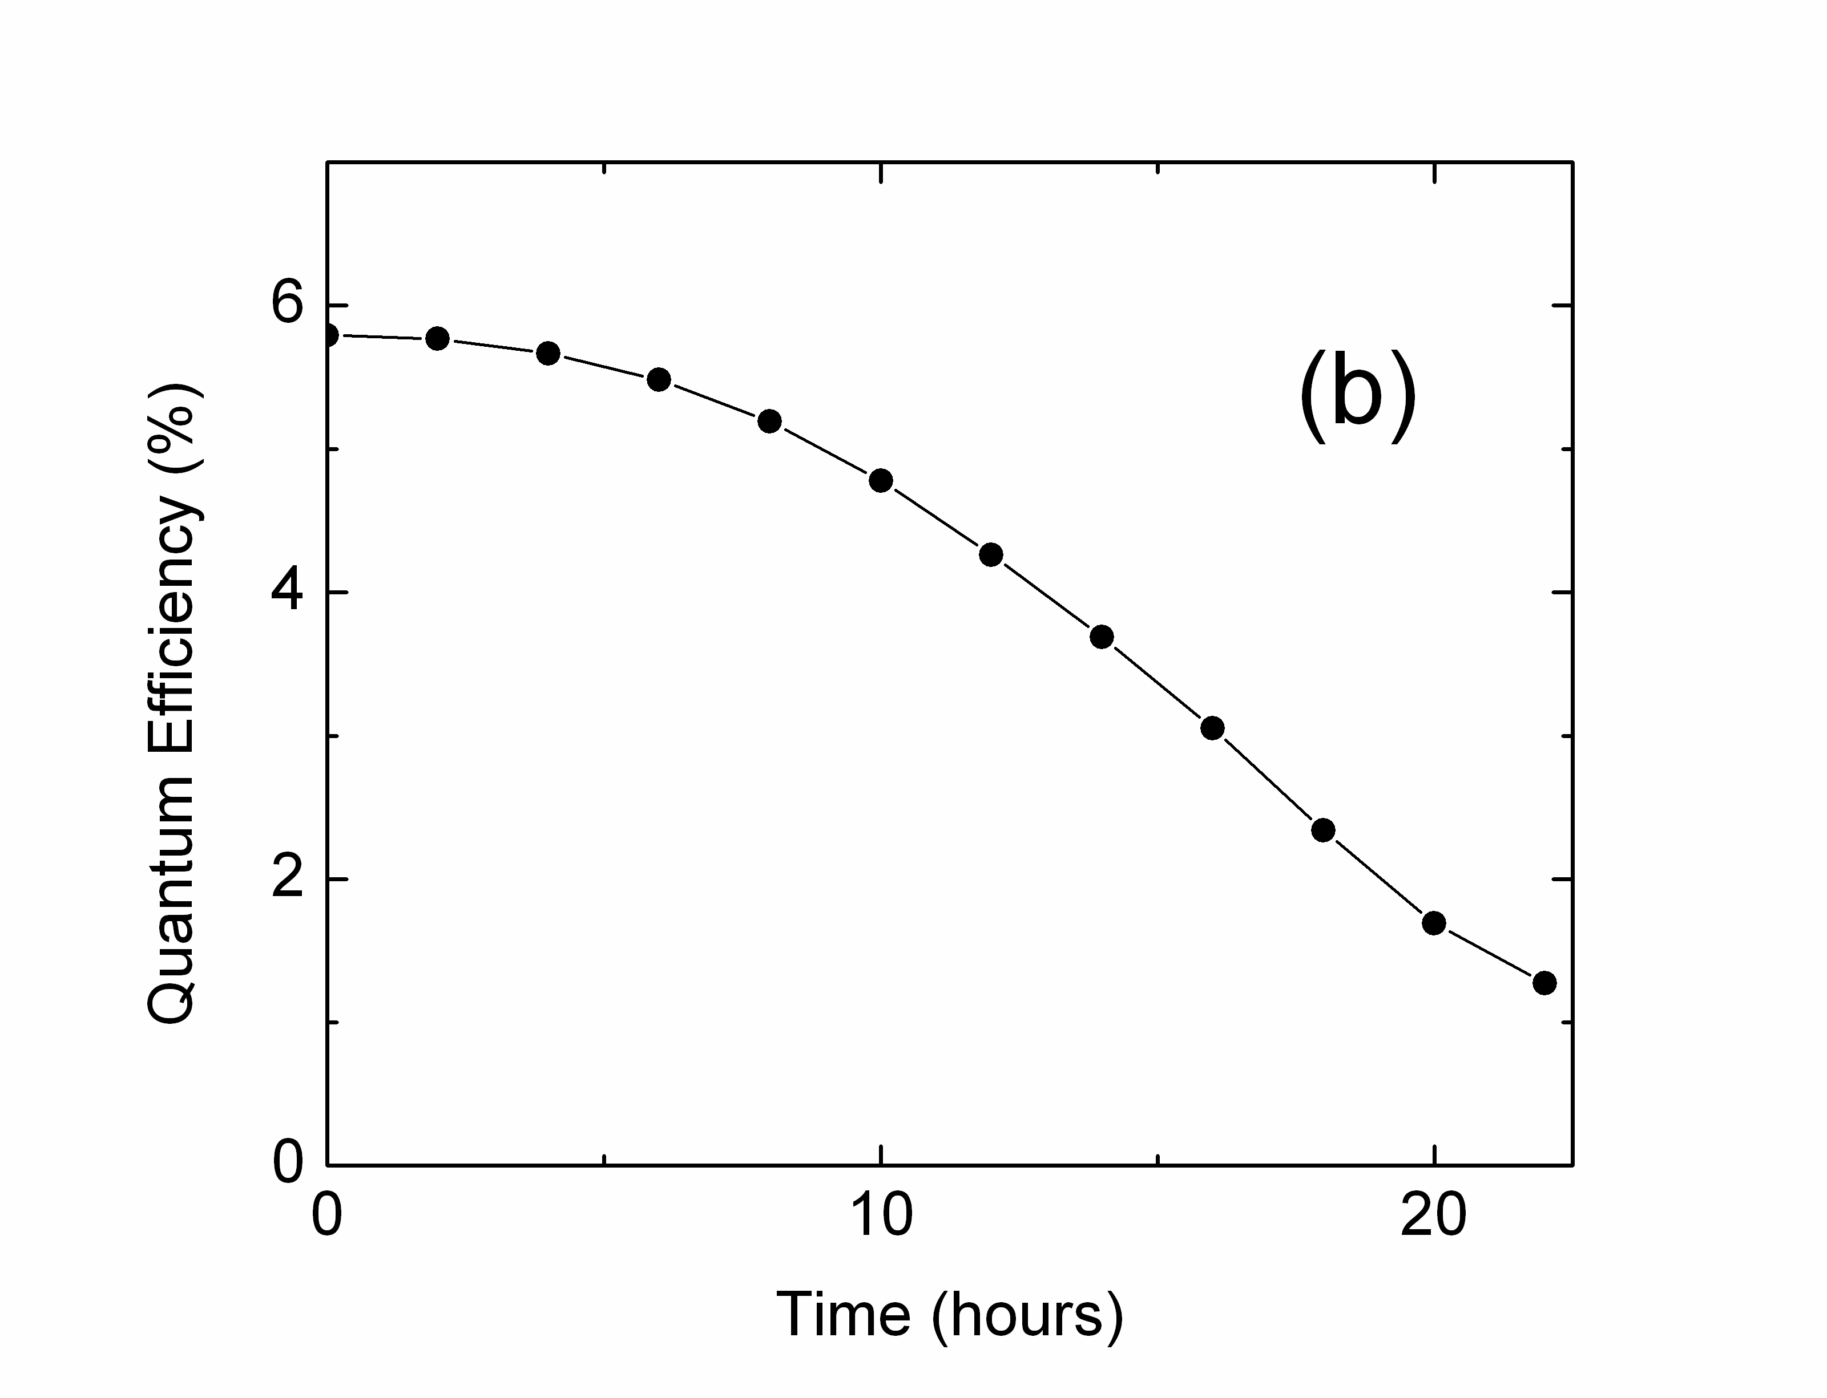
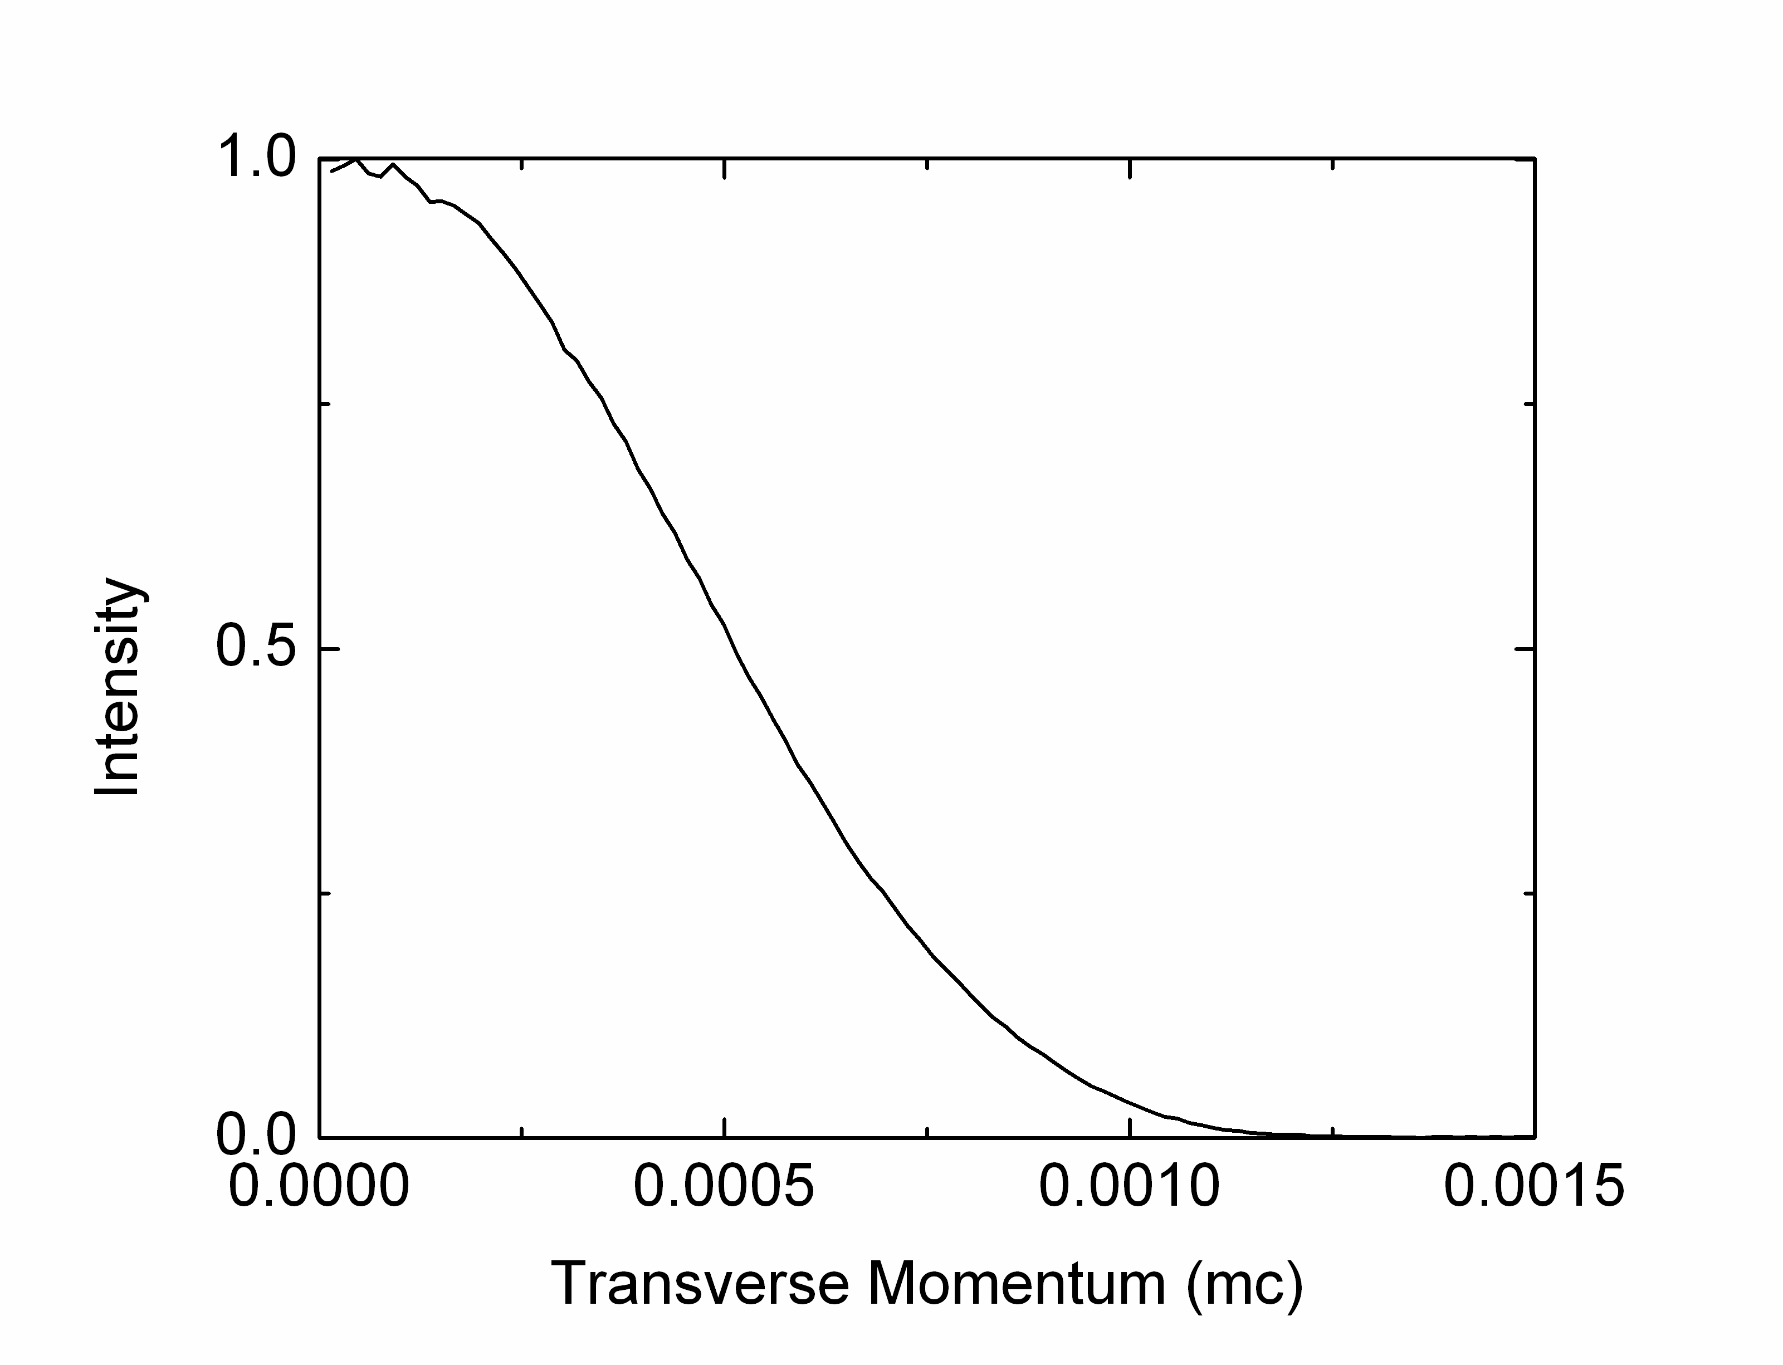
Photocathode materials R&D
K₂CsSb:
6% QE at 532 nm
0.36 microns / mm rms ε_{n}
>> 1 week lifetime
Good lifetime at
10⁻⁹ mBar
Low transverse
momentum
High QE
Notes:
Padmore leads
ALS, surface & materials science expertise

Slide 33
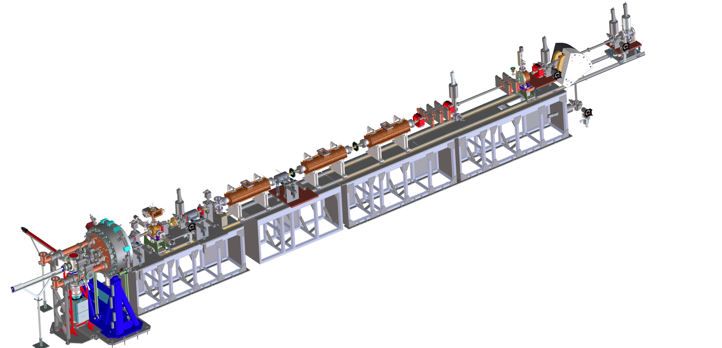


APEX stages
Phase-II:
Beam characterization at 15–30 MeV
6-D brightness measurements
Phase I:
Beam characterization at gun energy (750 keV)
Phase 0:
Gun and photocathode tests
Diagnostics systems in collaboration with Cornell CLASSSE
Accelerating cavities in collaboration with ANL AWA
Planning for final installation in 2013
Notes:
Phase 0 (1 MHz)
Photocathode tests
QE Vs time
QE maps
Cathode emittance
High current cathode performance (~mA)
Energy measurement with correcting coil
Phase 1 (1 MHz)
Beam characterization at the gun energy (750 kV)
Space charge emittance
Time and energy resolved measurements
Phase II (10 Hz)
Beam characterization at the injector exit (15-30 MeV)
6D brightness measurement
Jitter measurements
Review held November 28
Chair I. Bazarov (Cornell)

Slide 34
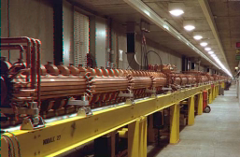
Accelerating structures
Normal conducting
  High power dissipation in structure walls
    Operate in pulsed mode for highest gradient
      E.g. 120 Hz SLAC linac (2.9 GHz)
      ~ 20 MVm⁻¹
Superconducting
  Capability to operate CW at high gradient
    Options for beam recirculation and energy recovery
    ≲20 MVm⁻¹ a goal for CW operations
    CEBAF 12 GeV upgrade

Slide 35
A superconducting accelerator is efficient for high repetition-rate beam
 | Superconducting | Normal conducting
Q_{o} | 2x10⁹ | 2x10⁴
Power loss (W/m) [@ 1 MV/m, 500 MHz] | 1.5 | 56,000
Wall-plug power (kW/m) [@ 1 MV/m, 500 MHz] | 0.54 | 112
Power requirement reduced by ~200

Slide 36
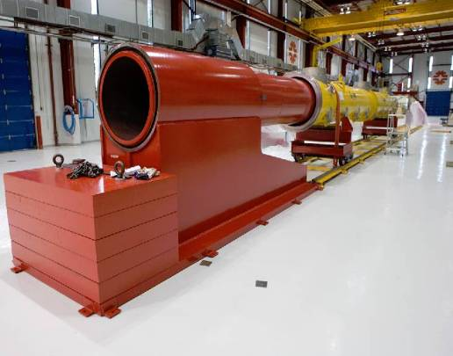
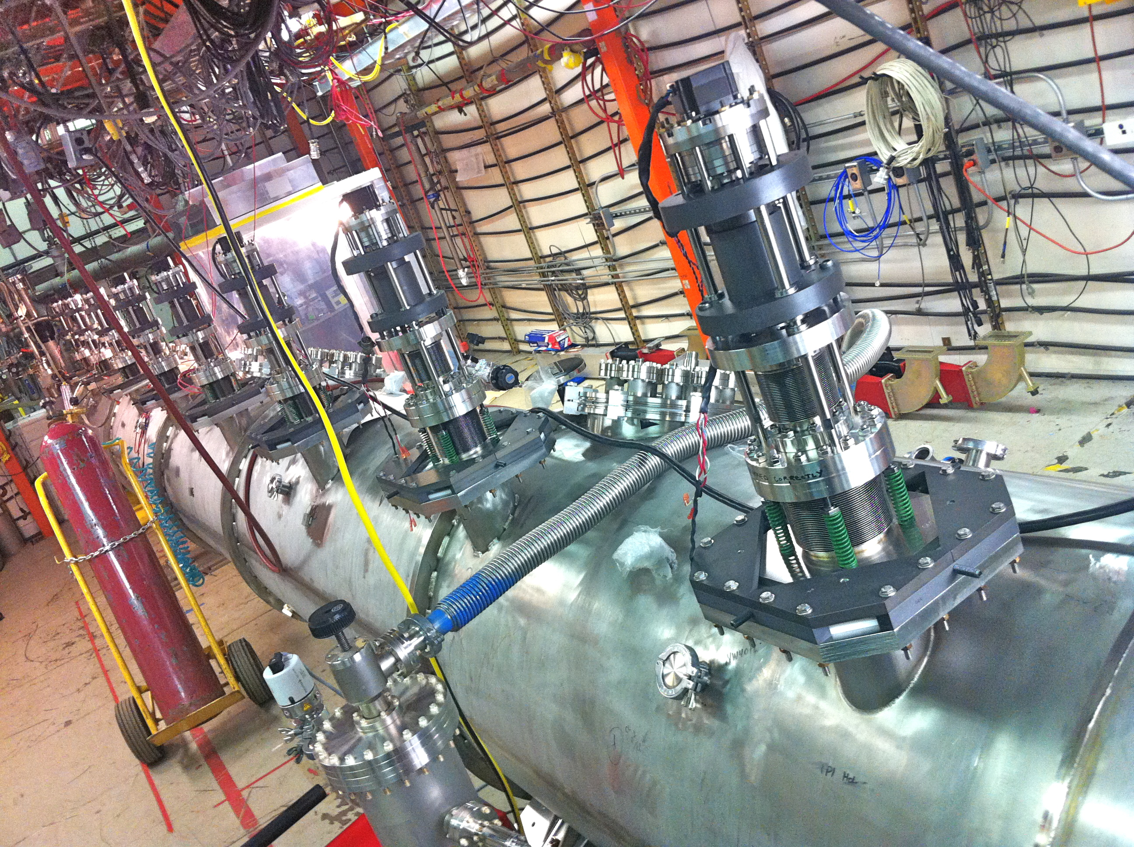
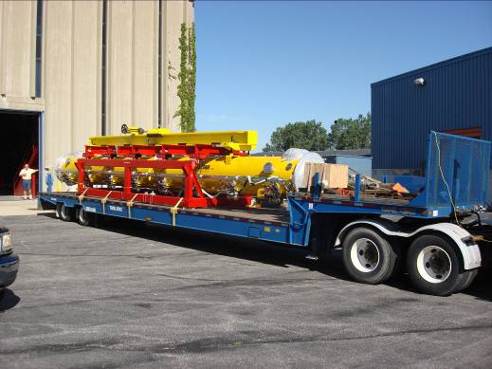
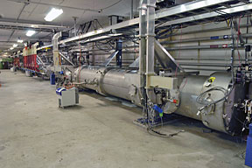
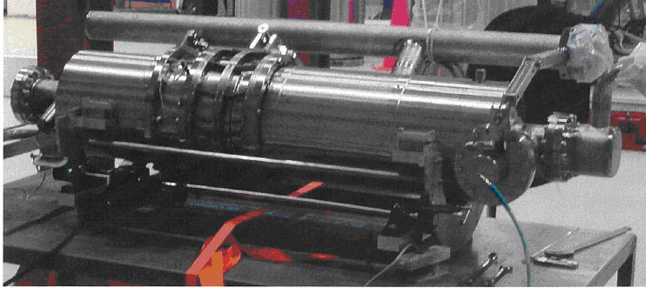
SCRF cryomodules are mature technology
Notes:
Linac total ~350 m long
Tunnel ~500 m long
Everything in tunnel – cryogenics, instrumentation, power supplies, and radiation too!

Slide 37

NGLS cryomodule concept
Current cryomodule concept uses “TESLA” cavities in JLAB-style housing
  Cold/warm transitions on each cryomodule
  Distribute 5 K liquid, cool to 1.8 K at cryomodule
  Warm magnets & diagnostics
Design questions
  Operating gradient increased to ~16 MV/m
  Q₀ ≥ 2x10¹⁰
HOM power dissipation and absorption
Field emission
Number of cavities within a single module
Shield temperature and arrangement
Power coupler design
Tuner type and access
Selection and sizing of cryogenic circuits
Minimization of acoustic noise
Warm to cold transitions

Slide 38




Cryomodules (harmonic cavities)
Fermilab cryomodules installed at FLASH
  Modify for CW operation?
Notes:
CW heat dissipation
#cells per cavity
HOM damping

Slide 39
Optimizing the beam spreader
Electrostatic Septum
2.0 m, 9.6 mrad
Magnetic Septum
1 m, 45 mrad
Pulsed Kicker
1 m, 0.6 mrad
x
z
Linac line
D
F
D
ARC
D
Electrostatic septum allows 5x weaker kickers (1/5 stability tolerance)
Footprint reduced ~1/3
Notes:
Further optimization under way (CSR, impedance, footprint, diagnostics)

Slide 40




The FEL undulators are large arrays of precision magnets
Notes:
~100 m long
Vibration ≤ 15 nm rms over ≤ 100 Hz (for position, 40 nm for angle)
VC-F – like

Slide 41

Undulator technology
Currently undulator technology limits period ≳ 15 mm
Requires beam energy ~2 GeV to radiate at 1 nm
Superconducting devices could provide significant performance improvements
  R&D projects under way to develop short-period undulators using Nb₃Sn
Better performance
Hybrid PM
In-vacuum hybrid PM
Nb₃Sn
SPring-8 Compact SASE Source
Notes:
Update plots

Slide 42




Superconducting undulator R&D
Planar Nb₃Sn undulator
HTS tape undulator
Cryostat for test and measurement
Notes:
Motivation
Reduce costs and enhance performance
Shorter FELs
Shorter, lower energy linac
Higher photon energy
Greater tuning range
Potential radiation damage resistance

Slide 43

Seeded FELs - 1
V
E
Wiggler period
Undulator parameter
k
k
E
Laser wavelength
V
Electron beam couples to E-field of laser when co-propagating in an undulator
Over one undulator period, the electron is delayed with respect to the light by one optical wavelength

Slide 44
Seeded FELs - 2
∆E_{beam}
∆E_{beam}
Time
Time
Energy-dependent path length
Induced current modulation in the electron beam
I_{beam}
Harmonic content in the beam allows for radiation at a harmonic of the modulating wavelength
Time
Notes:
Combination of energy and dispersion

Slide 45



Self-seeded FELs
LCLS Hard X-ray Self Seeding – demonstrated at 1.5 Å
e⁻ chicane
1st undulator
2nd undulator with taper
SASE FEL
Single crystal: C(400)
Self-seeded FEL
SASE FEL spectrum
Seeded FEL spectrum
~ 20 eV
~ 0.5 eV
Near Fourier Transform limit
Initial results: 40x reduction in BW (40x increase in peak brightness)

Slide 46
Self-seeded FELs
LCLS Soft X-ray Self Seeding – in planning stages
e-beam
ξ/2
M₁
M₃
2nd undulator
1st undulator
η/2
Source
plane
γ’/2
M₂
Re-entrant
plane
S
G
Phil Heimann, SLAC

Slide 47
High-gain harmonic generation (HGHG)
dispersive chicane
e⁻ bunch
modulator
radiator
laser pulse
n ~ a few to ~10
L.-H. Yu et al, Science 289 932-934 (2000)

Slide 48




FERMI@elettra demonstrates HGHG at ~10th harmonic (~20 nm)
UV laser seed (~200 nm)
FEL gain at 20 nm
4 nm FEL cascade under construction
FEL photon energy ~ 38 eV
Photon energy fluctuations = 1.1 meV (RMS)
FEL bandwidth = 5.9e⁻⁴ (RMS)
FEL bandwidth fluctuations = 3% (RMS)
Enrico Allaria
Notes:
DESY Photon Sciences:
HASYLAB
EMBL – European Molecular Bio Lab
New bio institute on infectious diseases
CFEL – Center for FEL Science
MPSD – Max Planck Inst. For Structural Dynamics
U. Hampurg (Physics Dept. on DESY Campus)
XFLE, FLASH, PETRA (ultimate storage ring)

Slide 49
Laser seeded FELs – ECHO
Developing R&D plans
  Beam experiments
  Laser developments
EEHG
HHG
HGHG
Stupakov, G., Using the Beam-Echo Effect for Generation of Short-Wavelength Radiation, Physical Review Letters 102 (2009) 074801
Notes:
Our approach for a future machine is to use a range of FEL designs, including the ECHO technique under development
We will develop seeded FEL capabilities in an R&D program – Echo, HHG, self-seeding, oscillators, … etc
Need 10’s micro-Joule in UV (200 nm) – i.e. 10’sto 100 Watts in IR
Simulations use GENESIS and GINGER codes
Stupakov, G., Using the Beam-Echo Effect for Generation of Short-Wavelength Radiation, Physical Review Letters 102 (2009) 074801

Slide 50


HHG seeded FEL R&D
HHG seeding at 50 – 100 eV
HHG seeding demonstrated at 61.5 nm (SCSS)
Harmonic generation in FEL to reach 1 nm
~100 eV
We are building a 1 kHz, 40 mJ, HHG source for seeding R&D
Notes:
~100 kW (peak) seed power at ≤50 nm
~10’s nJ per pulse
Needs laser development for higher repetition rate
~kW average power @ ~4µm
Phase-matching in capillaries
Tunability
Development of long-pulse capability
Diagnostics, control, reliability

Slide 51


NGLS at the LBNL site
LBNL site boundary
Bevatron
FELs
LINAC
NCEM
ALS
TMF
Mined tunnel
Notes:
Note ALS – one of 1st 3rd generation light sources / premier SXR facility

Slide 52
Summary
DOE has approved Mission Need for a Next Generation Light Source
  LBNL led the effort
    We are:
      Developing science case and experimental requirements
      Optimizing machine design to best meet science needs
      Executing and developing R&D plans
      Strengthening and building collaborations
        Seeking partnership with FNAL
          Expertise in SCRF and cryosystems

Slide 53
B. Austin, K.M. Baptiste, D. Bowring, J.M. Byrd, J.N. Corlett, P. Denes,
S. DeSantis, R. Donahue, L. Doolittle, P. Emma, D. Filippetto, J. Floyd,
J. Harkins, G. Huang, T. Koettig, S. Kwiatkowski, D. Li, H. Nishimura,
T.P. Lou, H.A. Padmore, C. Papadopoulos, C. Pappas, G. Penn, M. Placidi, S. Prestemon, D. Prosnitz, J. Qiang, A. Ratti, M. Reinsch, D.S. Robin,
F. Sannibale, R. Schlueter, R.W. Schoenlein, A. Sessler, J.W. Staples,
C. Steier, C. Sun, T. Vecchione, M. Venturini, W. Wan, R. Wells, R. Wilcox, J. Wurtele
NGLS DESIGN STUDY AND ACCELERATOR R&D TEAM

Slide 54
Backup slides

Slide 55
Summary schedule
(for planning purposes)
CD-0
CD-1
CD-2/3a
CD-3b
CD-4a
CD-4b
TBD
FY
11
12
13
14
15
16
17
18
19
20
21
22
23
R&D
Conceptual design
Preliminary Design
Procurement / Construction
Installation
Commissioning

Slide 56

New era in X-ray Science: Nobel Prizes for X-rays and lasers portend the future scientific impact of true X-ray lasers
Nobel Prizes – X-ray Related
1901: Röntgen
1914: von Laue
1915: Bragg, Bragg
1917: Barkla
1924: Siegbahn
1927: Compton
1936: Debye
1962: Perutz, Kendrew
1962: Crick, Watson, Wilkins
1964: Hodgkin
1976: Lipscomb
1979: Cormack, Hounsfield
1981: Siegbahn
1985: Hauptman, Karle
1988: Deisenhofer, Huber, Michel
1997: Boyer, Walker
2006: Kornberg
2009: Ramakrishnan, Steitz, Yonath
21st Century – X-ray Lasers
Nobel Prizes – Laser Related
1964: Townes, Basov, Prokhorov
1971: Gabor
1981: Bloembergen, Schawlow
1997: Cohen-Tannoudji, Chu, Phillips
1999: Zewail
2000: Alferov, Kroemer
2001: Cornell, Ketterle, Wieman
2005: Hansch, Hall
Notes:
Synchrotron Nobel Prizes?
Rich history of X-ray related Nobel prizes, and most recent x-ray related Nobel prizes have all made use of modern synchrotron sources
Note substantial lag between invention of laser (1960) and laser science Nobel prizes (1981, 1997 ….). Modern 3rd generation synchrotron sources have only been around for 20 years or so....
True x-ray lasers (with full coherence, tunability, and controlled pulse durations) represent a dramatic advance

Slide 57






X-ray lasers and X-ray science are developing rapidly
Superconducting linac
30 kHz (burst mode)
Soft and hard X-rays
Operational in 2015
Experimental Hall
5,000 m²
Notes:
LCLS-II operational in 2017
Capacity roughly on par with XFEL
Capabilities will be limited (100 Hz operation)

Slide 58

X-ray lasers and X-ray science are developing rapidly
World’s first seeded X-ray FEL – tunable in soft x-ray range
UV laser seed (200 nm)
FEL gain at 20 nm
1 nm FEL under construction
FEL photon energy ~ 38 eV
Photon energy fluctuations = 1.1 meV (RMS)
FEL bandwidth = 5.9e⁻⁴ (RMS)
FEL bandwidth fluctuations = 3% (RMS)
ITALY
Upgrade of FLASH – World’s first X-ray FEL
Superconducting
- Potential for CW operation)
FLASH-II
- Tunable (adjustable undulators)
- Seeded (coherent)
GERMANY
Notes:
DESY Photon Sciences:
HASYLAB
EMBL – European Molecular Bio Lab
New bio institute on infectious diseases
CFEL – Center for FEL Science
MPSD – Max Planck Inst. For Structural Dynamics
U. Hampurg (Physics Dept. on DESY Campus)
XFLE, FLASH, PETRA (ultimate storage ring)

Slide 59

APEX Phase 0
Demonstration of gun RF performance
Demonstration of vacuum performance with RF power
Dark current characterization
Cathode physics (lifetime, QE, intrinsic emittance) at full repetition rate

Slide 60

APEX Phase I adds diagnostics
Beam dynamics (6-D measurements)
Diagnostics tests
Low energy beam characterization
Planned for spring 2012
Quadrupole triplet
X-Y corrector
Retractable slits
Deflecting cavity
YAG screens
Spectrometer
Diagnostics systems in collaboration with Cornell CLASSE

Slide 61
Technical developments since CD-0
Increased tuning range (1.0 – 4.6 nm)
Increased beam current (600 A)
Larger energy spread (100 keV)
Larger vacuum aperture in undulators (6 mm)
Longer period undulators (29.4 mm)
Increased minimum undulator K (1)
Out-of-vacuum undulators
Increased average β-function in FEL (15 m)
Higher beam energy (2.4 GeV)
Second bunch compressor
Redesign of spreader including electrostatic septum
Notes:
Continued optimization of accelerator systems
Improved performance to meet science requirements
Balance risk between multiple systems
Reduced risk in some critical components

Slide 62


ECHO seeded 2-color attosecond
A. Zholents, G. Penn, “Obtaining two attosecond pulses for X-ray stimulated Raman spectroscopy”, NIM–A, 612, 2, (January 2010)

Slide 63




FEL harmonics measurements at LCLS
Now using filters
Daniel Ratner
Fit to detected signal level with attenuators
Future using spectroscopic fast CCD detector
  LBNL detector

Slide 64
Instrumentation and diagnostics R&D
Motivation
  Diagnostics to optimize performance, control and feedback systems to stabilize beam
High–resolution for high–brightness beams
Large dynamic range for flexible operating modes
Non-intercepting for high beam power
High repetition rate
X-ray beam and electron beam systems
  Beam position monitors
  Transverse profile monitors
  Longitudinal profile monitors
  Beam energy measurements
  Beam arrival time monitors
  Current monitors using toroids
  Beam loss monitors

Slide 65


SCRF linac power requirements (CD-0)
RF frequency 1.3 GHz
Cavity tuning excursion ±25 Hz
ψ_{Beam}<15°
R/Q 1036 Ω
Cavity length 1.038 m
Q_{o} 1x10¹⁰
I_{beam} 1 mA
RF power requirement is ~20 kW per cavity
  7 cavities per cryomodule ≈ 140 kW per linac cryomodule
  27 cryomodules
  3.8 MW RF power capacity
  Dominated by beam power requirement

Slide 66



Timing & synchronization R&D
CW
Laser
Laser reprate
Stabilized link (>100 m)
Master clock
Notes:
Motivation
Need systems that will allow for precision timing for pump-probe experiments with pulses femtosecond duration and less
Synchronization of FEL seed lasers and endstation lasers
Combination of stabilized systems and time-stamping
Feedback on CW SCRF linac will provide ultra-stable beam

Slide 67

HGHG demonstrated at Brookhaven SDL
HGHG
Spectrum of HGHG and unsaturated SASE at 266 nm under the same electron beam condition
  Note SASE at saturation would still be order of magnitude lower intensity
Intensity (a.u.)
0.23 nm FWHM
SASE x10⁵
Wavelength (nm)
L.-H. Yu et al, Phys. Rev. Let. Vol 91, No. 7, (2003)

