Slide 1
Synoptic Overview
A very quick overview of the Synoptic GUI Tool for building Accelerator Applications

Slide 2
What is Synoptic
A “drag and drop” GUI for building accelerator applications
It is the graphical counterpart to the ACL scripting language
It is part of the control system infrastructure. It is a service not just an application
It has been operational since the Summer of 2010. Currently 507 displays. It is used by NML, HINS, HTS. Will be used for the NoVA far detector. Future users will be CMTF, MuCool, CHL.

Slide 3
What is Synoptic
Doesn’t replace the current way of programming but rather it is a value added tool just like ACL
Meant for light-weight monitoring and control applications not industrial strength applications
The software equivalent of hardware “bread boarding”
Ability to have live web displays

Slide 4
Why use Synoptic?
Designed for ease of use for programming challenged users
Less resources in future will mean finding more efficient ways to get the same job done (in this case programming)
One can rapidly prototype applications and have them up and running in a short time
Great tool for systems diagnostics with Synoptic’s mobile access to accelerator component parameters. Cuts in-transit “dead-time” to work on systems problem since diagnostics can begin in-transit
Great project for short term employees like summer students. Can focus on project rather than tackle learning our control system and possibly a programming language. They may come away with more and you many get more from them!

Slide 5
Where to find Synoptic

Slide 6
Where to find Synoptic

Slide 7
Where to find Synoptic

Slide 8
On the Web
Uses default browser on iPad and iPhone

Slide 9
On the Web
Works in Firefox or Opera not the default browser on an Android

Slide 24
Future enhancements to Synoptic
Support for ACL scripts
3D plots
Mobile version using Advanced Message Queuing Protocol (AMQP) , HTML5 support

Slide 25
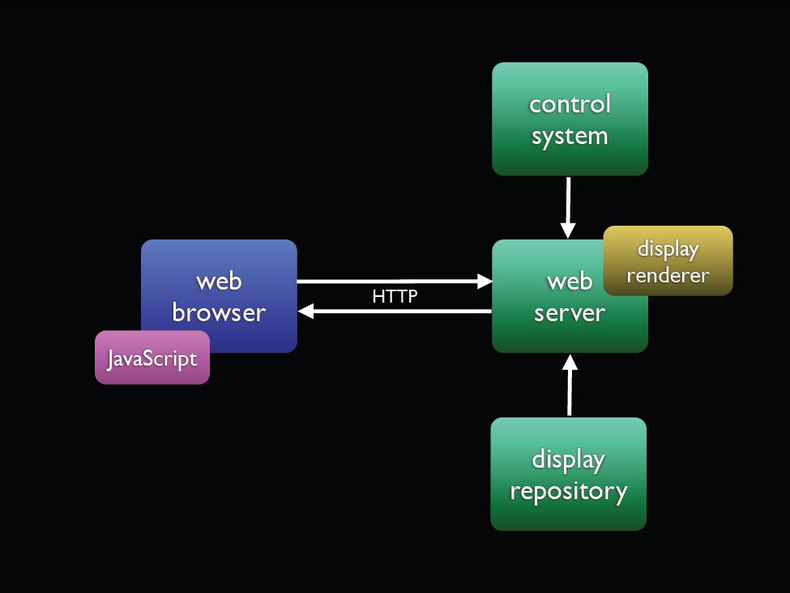

Slide 26
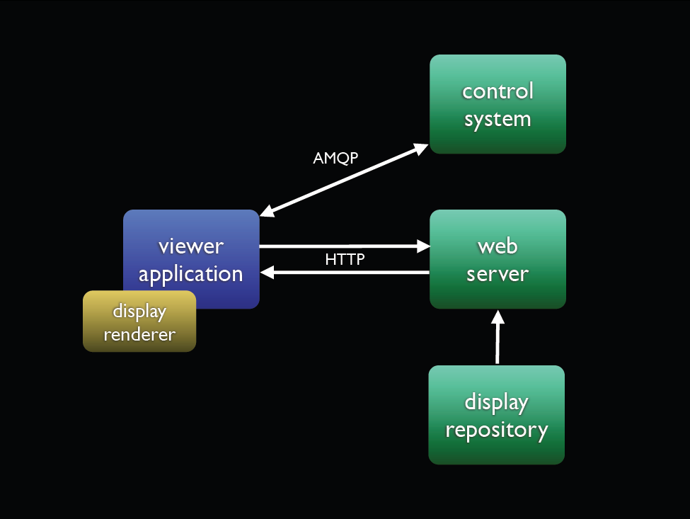

Slide 28
3D Graphics Demo

Slide 29
3D Graphics Demo

Slide 30
Contacts and Links
Thanks to Andrey Petrov for the use of his Synoptic Slides
Alex Waller waller@fnal.gov x4442
Andrey Petrov apetrov@fnal.gov x6877
Live Stream of Andrey’s Synoptic Talk
http://vmsstreamer1.fnal.gov/Training/AD/120302ADSynoptic/index.htm
Synoptic Users Guide
http://beamdocs.fnal.gov/AD-public/DocDB/ShowDocument?docid=3567

