Slide 1
Control System Application Development in C/C++
Carl Schumann (schumann@fnal.gov)
1 June 2012

Slide 2
Assumptions
You are familiar with the control system as a user.
You are familiar with the Linux prompt.
You know how to program in C.
However, if I use terms without explanation that you don’t understand ask for clarification please.
This presentation will get you started it will not make you an expert.

Slide 3
Types of C/C++ Development
Applications
Primary Applications (PA), e.g., Parameter Page
“Text”
May be mapped to index page(s)
Secondary Applications (SA), e.g., Fast Time Plot
“Graphics”
Typically started by a PA
User Libraries
“clib” is the most prominent
Users may create their own to share code across applications
Services

Slide 4
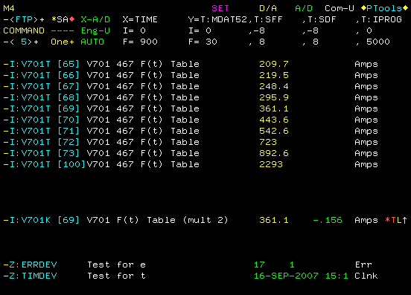
Sample PA (Parameter Page)

Slide 5
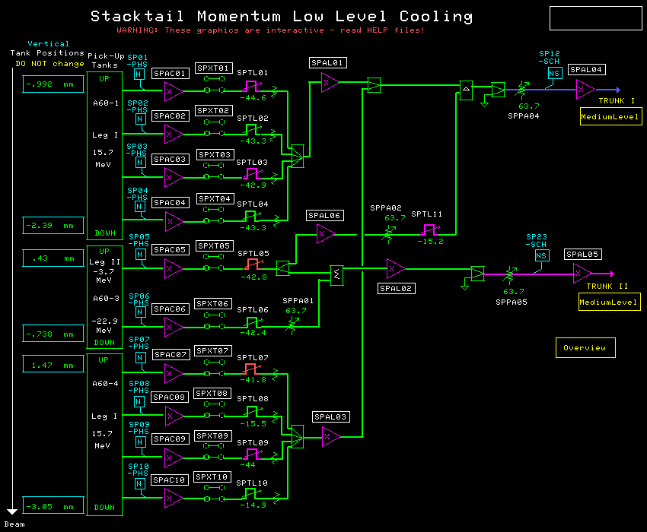
Sample SA (Lex SA display)

Slide 6
The Tool Chest
Mecca (now a meaningless acronym)
Source code capture (CVS)
Build system (make)
Insures that all production code is captured
User libraries (ULs), including “clib”
Testing environments
Z Page – test PA changes without committing
W Page – allow others to try out your changes
D7 – test SA changes without committing
Debuggers – step through source code, etc.
DDD - default
Totalview

Slide 7
Documentation
Controls Home Page
"Linux Mecca“ under heading “Linux Controls”
"Program Libraries“ in list across top of home page
Index Page and D7 – "Applications Linux“ next to “Program Libraries” on home page
PA0001 - Index Page
PA0323 – D7
Example PAs on the X index page
"New User“ – Introductions to several topics

Slide 8
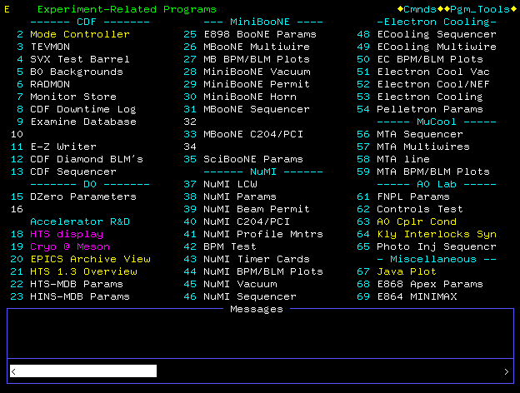
The Index Page (a PA itself)

Slide 9
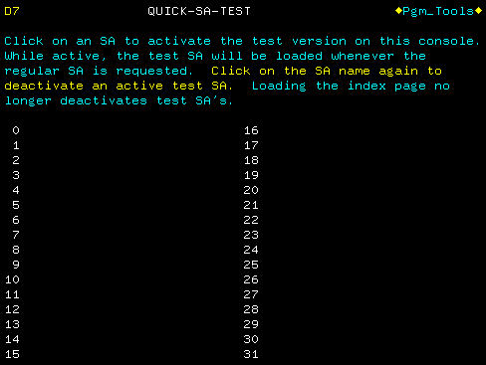
D7 (PA used for SA testing)

Slide 10
C vs C++
C++ is a complicated language. To use it properly takes some investment. C takes much less investment.
You can create useful applications without using C++ features.
For nearly all users I recommend sticking to the C subset.

Slide 11
PA Event Loop
Event loop is responsible for handling user input
Use PA4014 as a starting point
PA4014’s main routine

Slide 12
Scenario – PA Modification
Check out the existing source code
mkdir <working directory>
cd <working directory>
mecca –-copy <PA name, e.g., pa0507>
Modify the source code
Build the changes, place on Z page, and test
mecca –-dev
debug_slot
Commit changes
mecca –-commit

Slide 13
A Note about mecca --copy
The term copy is historical. (It was actually a copy for VMS Mecca.)
On Linux it is really either
Checkout if the directory is empty
Update if the directory is non-empty
This allows concurrent development. Copy semantics are simple but were error prone.

Slide 14
Scenario – PA Creation
Create a working directory and allocate a PA number
mkdir <working directory>
cd <working directory>
Mecca –-copy <example, e.g., pa4014>
mecca –-newpa
Provide description
Rename working directory with PA name
Build, place on Z page, and test
mecca –-dev
debug_slot
Commit changes
mecca –-commit

Slide 15
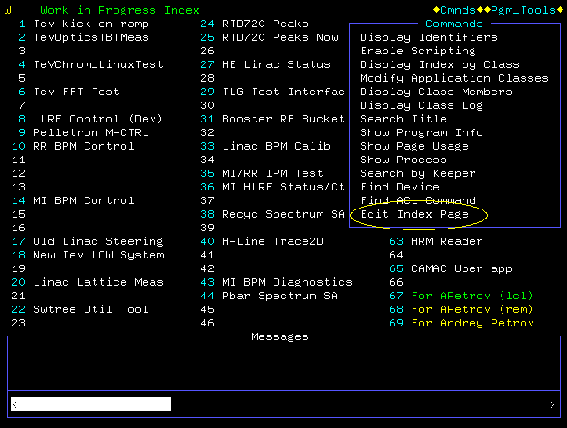
Scenario – Mapping a PA

Slide 16
Scenario – Using Test Libraries
Edit depends.opt, e.g., change ul_clib to /export/home1/hendricks/cns/mecca/uls/ul_clib
On the command line use testclib command to indicate which slots should use the test library.
All user libraries are dynamic/shared so both steps are needed.
depends.opt used to find headers at compile time
testclib used to find shared library at run time

Slide 17
Scenario – Undoing Changes
Modifications may be retreated. This can be done by anyone that notices or suspects an issue with a “recent” change.
Use the mecca –-retreat <PA name> command.
The user will be given a history of changes and prompted for how far back to retreat.

Slide 18
Scenario – Examining History
Mecca uses CVS (Concurrent Version System).
So one can use CVS to do all sorts of useful things.
There is a web interface to the CVS repository:
“Linux CVS Repository" under “Linux Controls “
Two useful things to do:
Look at “annotated” source code
Look at differences
Directory structure, i.e., mecca/pas/<PA name>

Slide 19
Scenario – Monitoring Changes
Mecca sends emails to interested parties when code is changed.
These emails include links that allow one to see differences from on-site or via VPN.
Use the mecca –-subscribe <PA name> command.

Slide 20
Briefly
Mecca maintains meta-information about applications, e.g., keeper and status.
Mecca has diagnostic capabilities, e.g., the ability to run just the preprocessor. Use the <stem>.E target.

Slide 21
Q & A
What was not clear?
What more do you want to know?
Thanks for taking time to educate yourselves about the control system.

