Slide 1
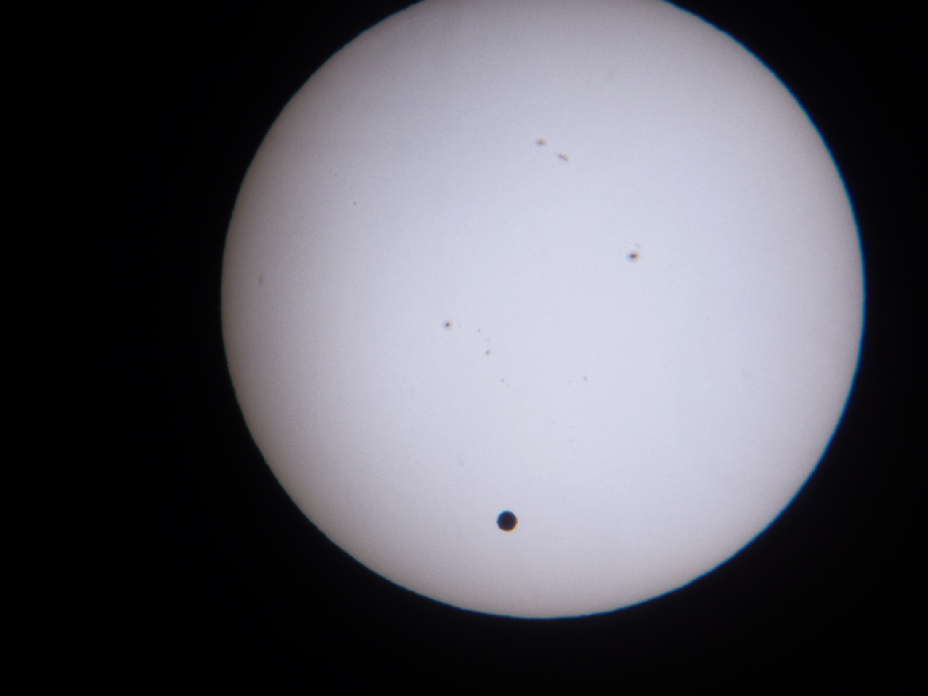
PIP Update
June 6th 2012

Slide 2
Agenda
Summary Update
Budget/RLS
Current Activities
Upcoming Activities/ Changes
Update Slides
LCW Augustine
Linac High Power RF Steimel
Linac BPMs Eddy
Booster Alignment Kiyomi

Slide 3
Update
General Info
Latest Budget Numbers
New Numbers Uploaded
66% year done – still have lots of $$ scheduled to be spent!!
RLS Info
Elmie
Task Info
RFQ
Lots of simulations and email being exchanged…..
Early results seem to indicated the energy is lost at the extraction gap
Solid State – We Generated a ‘schedule’ to help assist planning
High Power testing – needs to get going
Cavity 7 Refurb -– Tuners put back on – 15 Hz testing next
Absorber work continuing – Drawings Complete –
Salah will give update talk next week on Kickers
Linac Modulator Work - Continental Electronics gave a proposal
OBL BUD | YTD OBL | 05/12 RIP | BUD BAL
5106.888 | 1856.316 | 119.442 | 3131.13

Slide 4
Solid State and Cavity Refurbishment Schedule
BRF | Solid State | Cavity 15Hz | Status | Date Removed | Planned Install | Date Installed
1 | X |  |  | 11/12/2012 | 1/2/2013
2 | X |  |  | 10/15/2012 | 11/29/2012
3 |  | 6/15/2012 |  | 9/10/2012 | 10/29/2012
4 |  | 6/15/2012 |  | 8/13/2012 | 9/24/2012
5 | X |  |  | 7/16/2012 | 8/27/2012
6 | X |  |  | 6/15/2012 | 7/30/2012
7 | X |  | cavity refurbishment underway | 5/4/2012 | 6/15/2012
8 | X | X |  | 10/8/2011 |  | 5/2/2012
9 |  | 8/15/2012 |  | 12/17/2012 | 1/28/2013
10 |  | 8/15/2012 |  | 1/14/2013 | 2/25/2013
11 |  | 2/15/2013 |  | 2/11/2013 | 3/25/2013
12 | X |  |  | 3/18/2013 | 4/29/2013
13 |  | 11/15/2012 |  | 4/15/2013 | 5/27/2013
14 |  | 11/15/2012 |  | 5/13/2013 | 7/1/2013
15 |  | 12/15/2012 |  | 7/15/2013 | 8/26/2013
16 |  | 12/15/2012 |  | 8/12/2013 | 9/30/2013
17 |  | 9/15/2012 |  | 9/16/2013 | 10/28/2013
18 |  | 9/15/2012 |  | 10/14/2013 | 11/25/2013
19 | X |  |  | 11/18/2013 | 12/30/2013

Slide 5
Plans – this week
Cavity Refurb –
15 Hz testing
Install in two weeks?
Need to pull another cavity – when?
High Power Testing – testing of fixture this week!!
Tuner Work – Cone effort needs to be improved
LCW starting – not yet draining of system

Slide 6
Talks
Augustine - Vacuum
Status of PIP purchases 5/30/2012
The following purchases are for Linac
Two large root blower stations 114K. This req I am told is waiting for Directorate approval – This has been approved by Directorate but waiting on DOE
Have received quote for dewer repair at A-0. We are making sure the legalize between Fermi and the contractor are understood. Once this is done I will write the req. This is 37.2 K
I think at this point I am just about out of money – Not quite but close
Booster
Have received quote for the two roots blower station for the Booster fan rooms. I am writing the req
Turbo pumps. I have not started on this yet.
Vacuum Valves
I am in contact with MDC in California; we are hammering out the design of the new vacuum valves for Linac and Booster. Once this is decided they will quote.
 |  | OBL BUD | YTD OBL | 05/12 RIP | BUD BAL
2103.01.05.03.AD AD-Linac PIP Vacuum Systems Replacement |  | 180 | 0 | 113.492 | 66.508
2103.02.05.03.AD AD-Booster PIP Vacuum Systems Replacement |  | 180 | 0.49671 | 0 | 179.5033

Slide 7
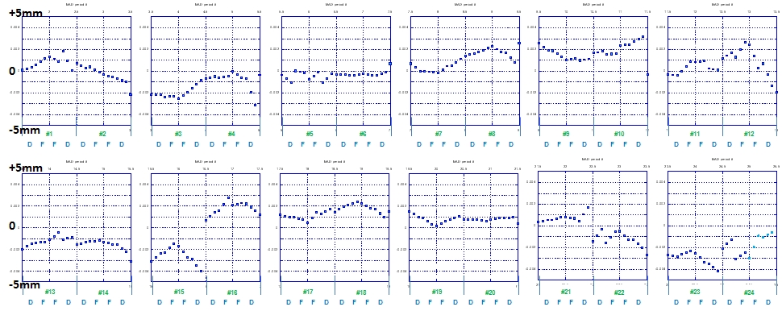
Magnet move (Kyimo)
Two magnets were realigned in May 2012 prior to a long shutdown.
period 21: D-down magnet (end of the magnet by -1.3mm) period 22: D-up magnet (beginning of the magnet by +1.3mm)
1.3 mm
1.3 mm

Slide 8
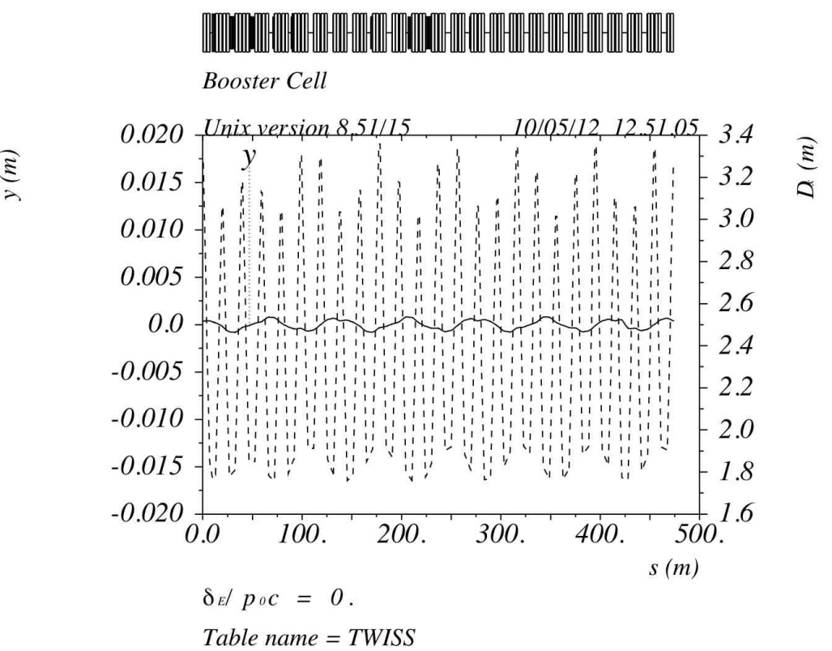
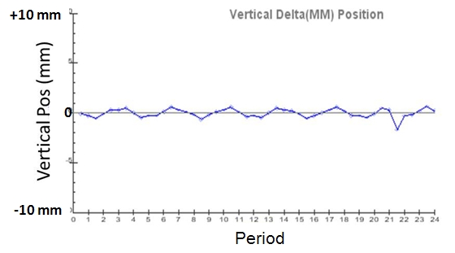
Simulation results of the beam orbit difference
with the vertical alignment error.
Magnet Move Program
MAD

Slide 9
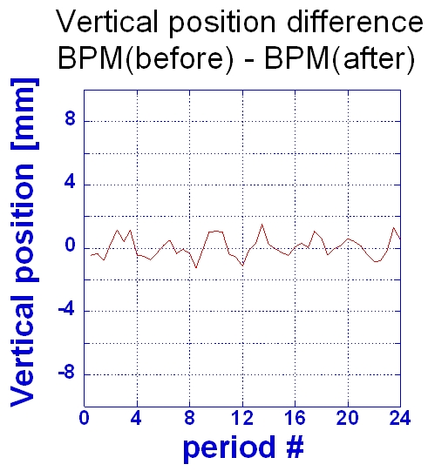
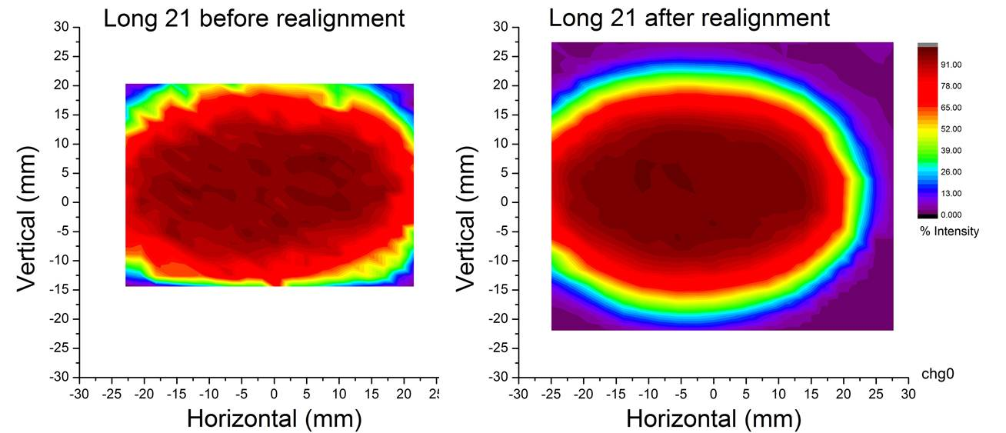
Measurements
Difference of the measured orbit between before and after a magnet move
Measured aperture before (left) and after (right) the magnet realignment.

Slide 10
Linac 200MHz RF System Upgrade
200MHz RF system power tube (Photonis 7835) has a single supplier and few customers.
Company will charge what they think will be just under cost of technology upgrade until it is no longer profitable for it.
Three upgrade options are under investigation
Procure 200MHz klystrons
Copy Los Alamos design using Thales tube
Copy SNS 400MHz front-end design

Slide 11
Klystron Option
Have received preliminary quote from CPI to produce prototype 200MHz, 7MW klystron for 1.5-2M$.
First round of estimates has total upgrade costing $7M in M&S.
Still working on labor costs for testing and installation.
Probably need preliminary sketch of layout of klystron components in Linac gallery.
Will probably require significant civil construction to make room for large klystrons.

Slide 12
Tube and 400MHz Options
We have preliminary cost estimates from John Lyles in Los Alamos that put the M&S for Thales tube upgrade at about 9.5M$.
Labor estimates in progress; will be larger than klystron option due to greater engineering time needed to modify LANSCE design to meet Linac specs.
Haven’t started 400MHz evaluation yet, but will be most expensive in terms of M&S, labor, and machine down time due to replacement of 200MHz DTLs and LLRF system.

Slide 13
Modulator Issues
Some kind of modulator upgrade is necessary for long term Linac operation.
Modulator specifications for all 7835 upgrade options are less difficult then a modulator upgrade for 7835 operation.
If the modulator upgrade proceeds ahead of the tube upgrade, the modifications needed for the tube upgrade should not be financially significant (klystrons would require some kind of pulse transformer anyway).

Slide 14
Near Term Plans
Produce document comparing costs of different upgrade options and not performing any upgrade.
Finish labor cost estimates for constructing and maintaining klystron and Thales tube upgade.
Complete cost estimates for 400MHz upgrade.
Make case to second floor for next course of action.

