Slide 1
Reliability and Controls for Project-X and Applications to Accelerator Driven Systems
Sampriti Bhattacharyya, The Ohio State University
Supervisors: RK Yedavalli (OSU), Aseet Mukherjee(FNAL), Jim Kerby (ANL)

Slide 2
Contents
Reliability
Controls
Reliability & Its Importance
Tools &software
Failure Distributions
Project X Reliability
Methods of Modeling
Data Validation against SNS
Availability & Controls
Fast Beam Tuning
Beam Modeling
State Space Method of beam representation
$χ^{2}$Minimization Control Technique
Reliability and controls are particular importance to Accelerator Driven Systems

Slide 3
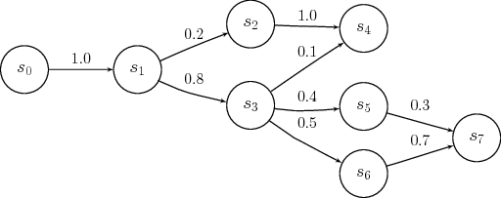
Reliability Analysis
RELIABILITY: “The probability that a system will perform its intended function for a specified interval of time under the stated conditions”
WHY DO RELIABILITY ANALYSIS?
Build & understand system failure model
Compute expected lifetime, net downtime (Availability), repair time and mean time between repair
Identify weak & critical components.
Understand component interdependencies
Estimate allocated resources, labors, spares
Reliability Block Diagram (or RBD)
Fault Tree Analysis
Markov Modeling
Failure Mode and Effect Analysis (FMEA)
Root cause Analysis
Simulation often coupled with the mentioned techniques
How to do Reliability Analysis

Slide 4
Importance : Project -X
Past accelerators were designed and built without a formal reliability analysis - such tools were not widely in use during that time.
Project-X being a high intensity for accelerator, the total available beam is crucial to design.
Must demonstrate that it can meet the requirements specified in the Reference Design Report: 90% for the 3GeV section, 85% for 6-120GeV to get approval.
In comparison to the Tevatron and other existing accelerators, the required reliability of Project X is ambitious but not dramatically so.
620m linac. Possible ADS test-bed.
IS, LEBT, RFQ, MEBT
β=0.11 SSR0
β=0.22 SSR1
β=0.4 SSR1
β=0.61 LE650
β=0.9 HE650
325 MHz (2.5 – 160 MeV)
650 MHz (0.16 – 3GeV)

Slide 5
Accelerator Reliability Work
Though no extensive systematic analysis has been much carried out on reliability of accelerators, there has been some work done in this field. A reliability study of the Spallation Neutron Source (SNS) has been done using a spreadsheet (Oak Ridge National Laboratory), and a customized reliability software called AvailSim was developed for the proposed International Linear Collider (SLAC). Out present work on reliability of Project-X uses a commercial simulation software called Availability WorkBench (AWB) by Isograph. Data has been validation against SNS reliability results.

Slide 6
Reliability Tools
Tools | Pros | Cons
Spreadsheet | Previously used by SNS. Deterministic. Good to get started. Good source of data for our present work. | User interface hard to use. Error prone: Lack of visualization tools make problems difficult to locate.
AvailSim | Many accelerator specific concepts built in. Free. | No GUI. Not validated against real data.
Sapphire (semi-commercial) | Used in NASA and nuclear industry. Developed by Idaho National Lab, free. | NDA per user. GUI not great.
ReliaSoft (commercial) | Good user interface. Most widely used reliability package with many options. SNS has started using this. | File format is proprietary … cannot access except through ReliaSoft.
Isograph’s AWB (commercial) | Good user interface. File format is open, accessible by any program. | Not as widely used as ReliaSoft, and lacks some GUI features.
Some accelerator specific complexities cannot be fully represented by a commercial software. We chose AWB since it gives us the flexibility of interfacing it with other programs, and passing on the data to anyone

Slide 7
AWB features
Reliability centered analysis. Gives Mean time between Failures (MTBF) Mean Down time (MDT) Mean time to repair (MTTR) and several o/p parameters.
Different failure functions : Exponential, Weibull, Normal, Log-Normal…
Handles repair, maintenance, labors, cost, redundancies
Easy drag and drop option to build block diagram
Fault Tree Analysis, Life Cycle cost, Weibull Anaylsis.
Open file format.
AWB Modeling Example
Can represent series, parallel, r out of n systems, hot & cold spares, online & offline repairs

Slide 8
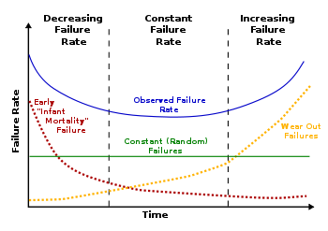
Failure Distribution
Can be exponential, Weibull, normal, Poisson, chi-square, gamma, etc.
The most realistic description of failure characteristic of a component is a “bathtub curve” with three periods: early (burn in) period with dropping failure rate; useful period with constant failure; and late (or wear out) period with an increasing failure rate.
AWB allows any kind of failure to be assigned to the components, including the bathtub characteristic via a Tri-Weibull.
For simplicity as well as agreement with SNS work presented here assumed an exponential failure distribution,
$F\left(t\right)=\int_{0}^{t}{λ{\text{e}}^{−λτ}\text{d}τ}=1−{\text{e}}^{−λt}$
i.e. a constant failure rate (the system is “memory less").
Bathtub curve

Slide 9
Project X Reliability
Work done:
Explored various reliability techniques(deterministic, stochastic- simulations)
Identified the right software - AWB
Determined the correct method of modeling- Hierarchical modeling
Collected component data
Modeled the main subsystems – 13 of them
Validated data against SNS (and also debugged the SNS data sheet)
Augmented external software to enable automated model building and also to link in accelerator specific concepts.

Slide 10
Methodologies
Two ways of modeling:
Hierarchical graphics … but no real hierachical modeling (no parameterization)
Can migrate to bottom most level. Whole system with all subcomponents in one diagram.
Can be cumbersome to handle. Very large computational time.
Hierarchical modeling, with subsystems parameterization
Allows less computational time. Easy to represent. Each subsystem is studied specifically. However, parameterizing loses some complexity.
We modeled a scaled down version of both. Extrapolating to the full PX, the full scale model takes ~3500 hours to simulate vs ~30 hours with the hierarchical model.

Slide 11
Top Level Project-X: Subsystems
Component Name | Data Source | Remarks
Conventional Facilities | SNS + Pr x | MTBF data → SNS. Component list matched
Beam Vacuum | SNS? | Total MTBF to be estimated
Global Ins Vacuum | Estimated? | Not known yet. Higher than local.
Global Controls | Estimated/SNS | Not known/SNS data not clear
Global Cryo | Estimated | Not known, but higher than local.
LEBT | SNS+Pr x | Info from Lionel. Some same as SNS
RFQ | SNS | Kept the same as SNS
MEBT | SNS | Same as SNS
HWR | SNS | Model info of cryomodules from PrX But, individual component data obtained from SNS (like cavities, etc)
325 MHz | SNS
650 MHz | SNS
Magnet Packages | PrX+SNS | Rough approximate values, SNS data
Beam instrumentation | PrX+SNS | Do not have info on number or MTBF

Slide 12
Top- Level PX

Slide 13
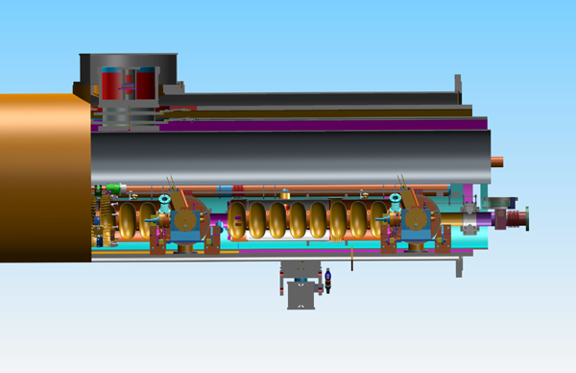
Cryomodule Modeling
Building block of the linac: most crucial component to model.
Anything in cold volume (cold magnet, cavity) has repair time ~400 hours.
A cryomodule is a n-1 out of n system, means it can take up to 1 failure. Load on system increases after 1 failure.
Some MTBF values for components from SNS are either too high (as if they never fail, not true I think?), or too low. But have been kept so for now.
No aging account, dormant failures, start up failures have been counted, there are options.
Individual components all have exponential failure.
Labor, cost, inspection and schedules maintenance not considered.

Slide 14
Cryomodule Modeling
HE650 Breakdown Example
Cryomodule in AWB

Slide 15
Parameterization
Cumulative Failure Rate
Occurrences
Repairs requiring warming the CM
t
t
Cryomodule cumulative failure probability b)Repair time, fit as exponential plus two Gaussians.
AWB data collected to plot the Failure and Repair characteristic.

Slide 16
Post Parameterization
Gaussian Repair
Exponential Repair
Calculations: Let $M$ be the MTBF obtained for a single HE650 cryomodule. The repair distribution is fit as the sum of three functions: two Gaussians plus one exponential (may extend later, e.g. use Weibull). Let $ai$, for $i=\text{1}⋯\text{3}$, be the area of each function. The whole HE650 cryomodule can be represented by 3 blocks, each with MTBF
$$\frac{a_{i}}{\sum{a_{i}}}M$$
and repair time distribution taken from the fit.

Slide 17
Ion Source & LEBT System
The ion source/LEBT system is different from SNS.
Filament type with higher MTBF, has online hot spares, no Cs, no RF source, and many other changes.
Since the lifetime of the ion source is still very low (300 hours), a switching magnet switches to the hot spare as soon as one of the sources fails.
The system is subdivided into two subsystems:
Subsystem 1 :Two ion sources (1 is a hot spare) in parallel along with a solenoid, scanner and power supplies for each of them.
Subsystem 2 Bending magnet and everything downstream, which do not have hot spares. Switching ion sources take ~10 minutes, and a tuning time of 2 hours. For those without hot spares, the system goes offline and the repair is ~10 hours.
Ion Source

Slide 18
Ion Sour& LEBT System
Plus signs on the block denotes of futher subcomponents. Ion Source has many.
Parameterized Systems
Subsystem 1
Subsystem 2

Slide 19
Magnet Package
Magnets can be warm or cold.
Logic: n-1 out of n system, that is, maximum 1 failure.
Parallel structure similar to cavity package consisting of a magnet, a magnet power supply, connecting leads and instrumentation in series in each line.
Parameterized like a cryomodule
Real system is more complex … ~200 magnets.

Slide 20
Data Validation
Systems | MTBF |  | Difference (%) | #of simulations | Lifetime*
 | Spread-sheet | AWB
Medium Beta SCL (1 module) | 4476 | 4479 | 0.06% | 10,000 | 12,000
Ion source | 53.9 | 53.5 | -0.75% | 1000 | 1000
Cryoplant | 1306 | 1290 | -1.22% | 1000 | 5000
RFQ | 4804 | 4798 | -0.12% | 1000 | 15,000
MEBT | 827.6 | 828.1 | 0.06% | 1000 | 3000
*Lifetime in this respect means the number of simulation hours.
As we can see, using component data from SNS, the MTBF of the systems matches SNS estimates (using Markov Analysis) within 1.5% error. Most of the systems so far have been modeled, and data can be plugged in as and when available for useful analysis.

Slide 21
Completing Project X Analysis
Mostly limited by lack of input
Reliability of components (MTBF and repair)
Number of components
Redundancy and other inter-dependence information
If this information were available now, expect the full model could be completed in 3-6 months
Have code to edit XML to replicate components (don’t have to enter multiple identical parts manually)
Methods in place to do parameterization

Slide 22
PX, ADS, and Reliability
ADS – Accelerator Driven Systems – proposed by Robert Wilson 20 years ago, but lacked a suitable accelerator
PX, tapped at 1GeV, is close to what ADS needs
Continuous beam: Pulsed beam causes thermal shock
Superconducting ⇔ efficient
In its building stage, so ideal for understanding of ADS
620m linac. Possible ADS test-bed.
IS, LEBT, RFQ, MEBT
β=0.11 SSR0
β=0.22 SSR1
β=0.4 SSR1
β=0.61 LE650
β=0.9 HE650
325 MHz (2.5 – 160 MeV)
650 MHz (0.16 – 3GeV)

Slide 23
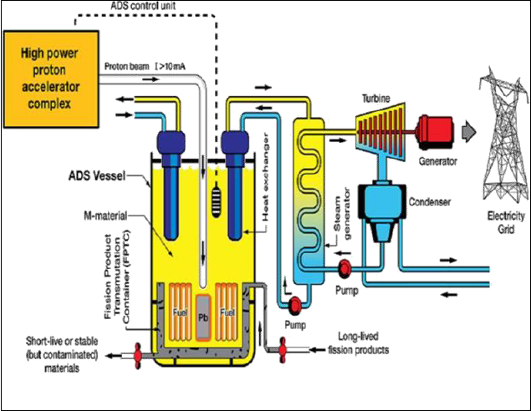
What is ADS?
Accelerator used to produce neutrons
Fuel need not be “fissile” … can use U238, Thorium, even waste from conventional reactors
H⁻ Ion Source
High intensity Proton (H⁻) accelerator
10-20% of generated power used by accelerator
Spallation Target produces neutrons when collided by proton beam
Neutrons induce fission in fuel
Fuel

Slide 24
Importance of Reliability to ADS
More stringent for ADSS are and complex.
Availability >99% compared to <80% for the Tevatron
Maximum of 3‑5 failures a year compared to 70-80 typical for existing accelerators
Reliability analysis exposes the weakness in the design – indispensable for ADS design.
Ion source fails often
Cryomodule repair is a major source of downtime.
Beam tuning is another major area of downtime.

Slide 25
How to deal with Downtime
Minimizing Downtime
FAST RECOVERY
Efficient reliable material
Advanced monitoring, diagnostics and prognostics..and safety engineering
Robotics and Automation
Quick Tuning of beam/cavity/RF power
Control and Optimization
Remote handling and repair
Material Science
Fast response electronics
New Generation Electronics
Minimizing danger
…

Slide 26
Beam Control & ADS
Frequent beam interruptions leads to thermal shocks on the targets, leading to damage.
Many “short” interruptions ok , longer ones should be limited to 3-5 a year.
Definition of “short” depends on nature of fuel … seconds to minutes
Present accelerators: ~80 medium to long failures a year
Tuning time ~hours – not feasible for ADS.
Intelligent controls can reduce this, increasing availability.
ADS needs many improvements. Controls may not top the list … but it is also needed, and it is where I might contribute

Slide 27
Mapping to Standard Control
Large body of work on industrial controls we can draw from
But first have to cast the accelerator in the language of such controls
A simple control system. We have a reference beam size, and an intelligent controller, corrects the difference between the reference and actual by controlling the magnet. ….The real work is NOT SO SIMPLE.
Σ
Intelligent Controller
Actuators (Magnets)
Plant (Beam Model)
Sensor (BPM or Laser Scanner)
Ref
Beam size

Slide 28
Beam Position & Beam Size Control:
Beam position is the most important aspects of beam tuning.
A lot of work in progress here
Difficult from the accelerator standpoint
Theoretically, at least, a more standard controls problem
Linearizable with good precision
Well constrained (many BPMs)
Can we automate tuning beam size?
Simulation shows beam size can grow with magnet drifts, even if the center is kept fixed
Under-constrained: more actuators (magnets) than sensors (laser scan)
More challenging

Slide 29
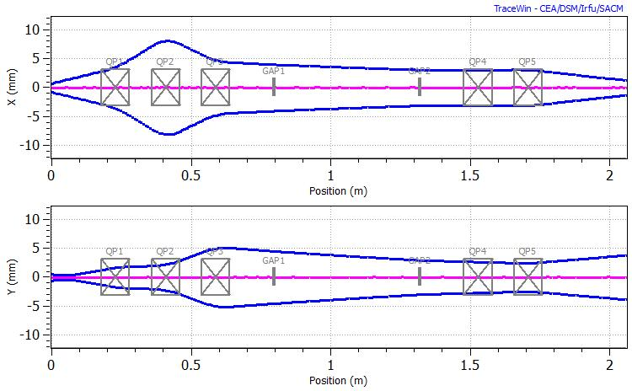
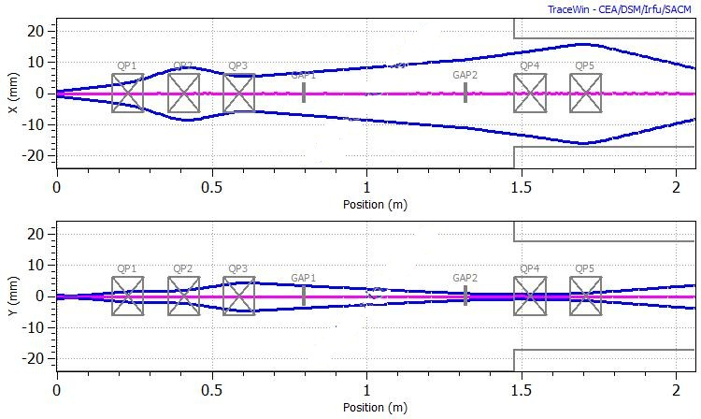
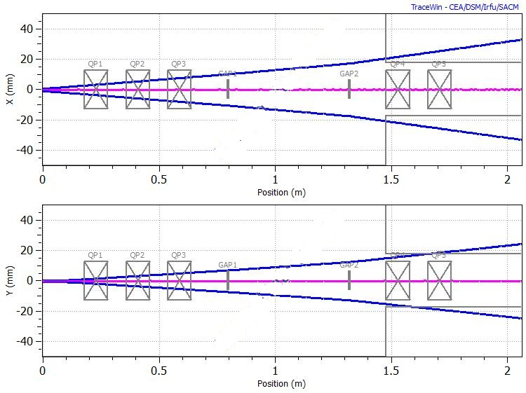
Size variation with magnet drifts
Tracewin Simulation of a proton linac slice (PX).We applied small changes in the magnet currents.
Changing the magnets caused variation in size, though center remained the same
Magnets off

Slide 30
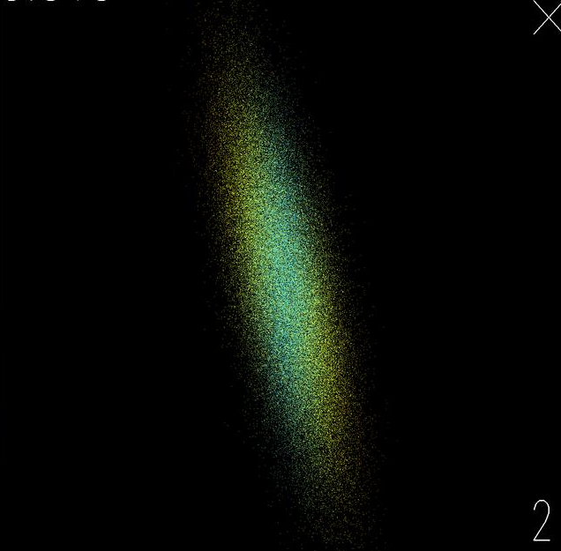
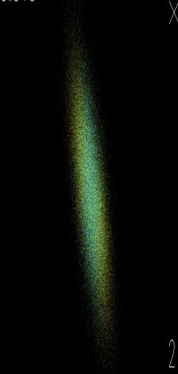
Laser Scanning: Measurement Feedback
Counts vs. Laser Position
H⁻→H + e⁻
Scan
Laser
Front View
Magnets (both sides)
Laser beam
Side View
Electron trajectory. Momentum ~1/2000th proton’s Bends a lot in field
Electron Detector

Slide 31
Beam Modeling
State Space Method of Beam Modeling:
$\dot{x}\left(t\right)=Ax\left(t\right)+Bu(t)$ in continuous time domain
$x\left(k+1\right)=Ax\left(k\right)+Bu\left(k\right)$ in discrete domain
x is called the state vector, u is the input or control vector, $A$ is called the plant matrix, and $B$ is the input or control matrix.
Simulated a small section of PX using TraceWin.
We intend to represent the beam in form of equation (2),
$$\vec{v}(k+1)=A\vec{v}(k)+B\vec{u}(k)$$
where $A$ and $B$ the beam and control matrices as before. Here $k$ denotes the position index corresponding to $z$. For controls, the dynamics of the beam is too fast with time, so we are first interested in the variation of beam size with position and try to model the beam in spatial co-ordinates.
Lot of work on matrix modelling of beam has been done before: we explore non-linear beam modelling in state space method, a model that can be fed to the controller.

Slide 32
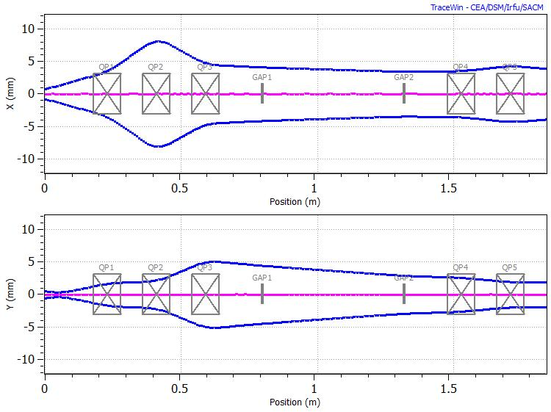
Simulated Linac
Quadrapoles
Drift
Envelope
Beam Center
Simulated linac (a part of PX) in tracewin, with 5 quads

Slide 33
Beam Modeling
In the first test, we turn off all the magnet currents. Therefore, $\vec{u}=0$. We take $\vec{v}$ as
$$\vec{v}\left(k\right)=\left(\begin{matrix}B_{x}(k) \\ B_{y}(k)\end{matrix}\right)$$
Which did not work. To allow a wider range of functions, in particular linear, we expanded $\vec{v}$ to a 4‑vector of beam sixe (Bx, By) and slope (Sx, Sy) and we choose $A= A_{0}$ so as to get a linear result
$\vec{v}\left(k\right)=\left(\begin{matrix}B_{x}(k) \\ S_{x}(k) \\ B_{y}(k) \\ S_{y}(k)\end{matrix}\right)$ and $A=A_{0}=\left(\begin{matrix}1 & 1 & 0 & 0 \\ 0 & 1 & 0 & 0 \\ 0 & 0 & 1 & 1 \\ 0 & 0 & 0 & 1\end{matrix}\right)$
Yields
$$S_{x}\left(k\right)=S_{x}\left(k−1\right)=⋯=S_{x}\left(0\right)$$
$$B_{x}\left(k\right)=B_{x}\left(k−1\right)+S_{x}\left(k\right)=⋯B_{x}\left(0\right)+kS_{x}(0)$$
We start by modelling off magnet situation, and then only the drifts in a linac with operating magnets. And then we introduce out Bu term and model the entire magnet.

Slide 34
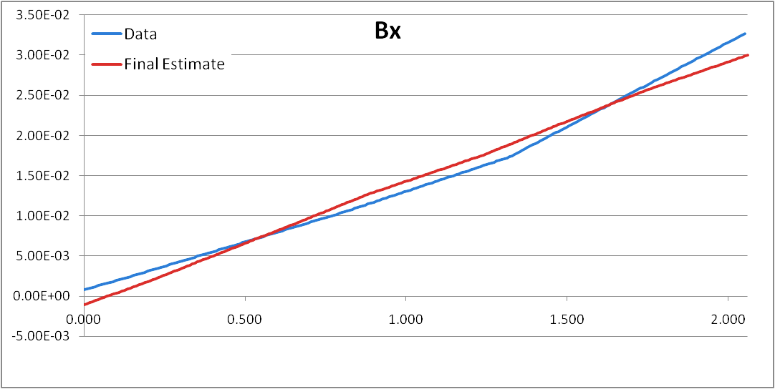
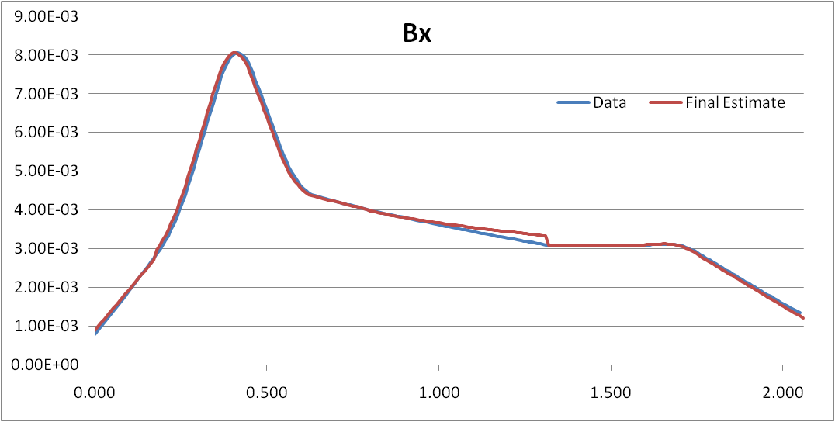
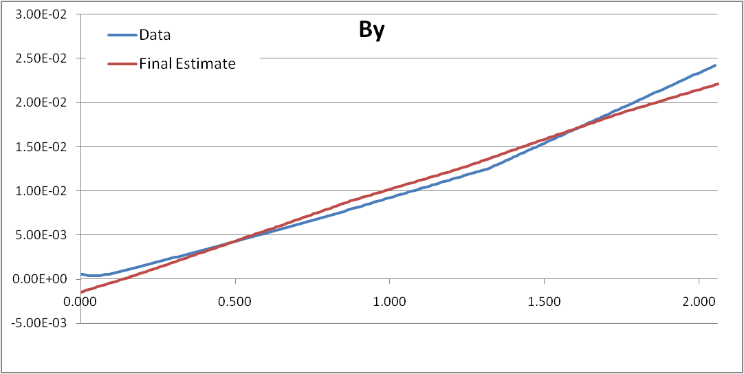
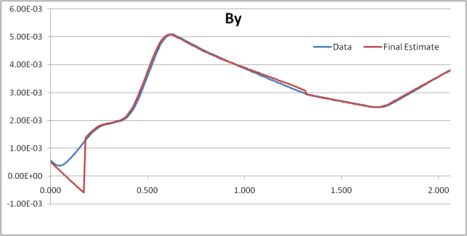
Linear Model Results
Linear model could map the beam great when magnets were off, but failed to map the focal point, in a magnet on situation.

Slide 35
Non Linear Beam Modeling
Linear model works well for magnet-off data, but poorly for magnet-on data. In this model, we are going to do an addition in quadrature : $a⊕b≝\sqrt{a^{2}+b^{2}}$
We start with a linear model like before, except label the components $L$ instead of $B$ to distinguish the linear aspect , $\vec{v}\left(k\right)=A\vec{v}\left(k−1\right)$
To get final beam size estimates, we next add a constant to it:
$B_{x}\left(k\right)=L_{x}\left(k\right)⊕s$
We do this because we note that, except at a focal point, the beam between magnets and gaps shows linear growth or shrinkage. At a focal point the linear term would go to zero and then flip sign ... the size would become negative. We want to turn this into something which is always positive, and has a minimum value. This is one fairly simple way to do that.

Slide 36
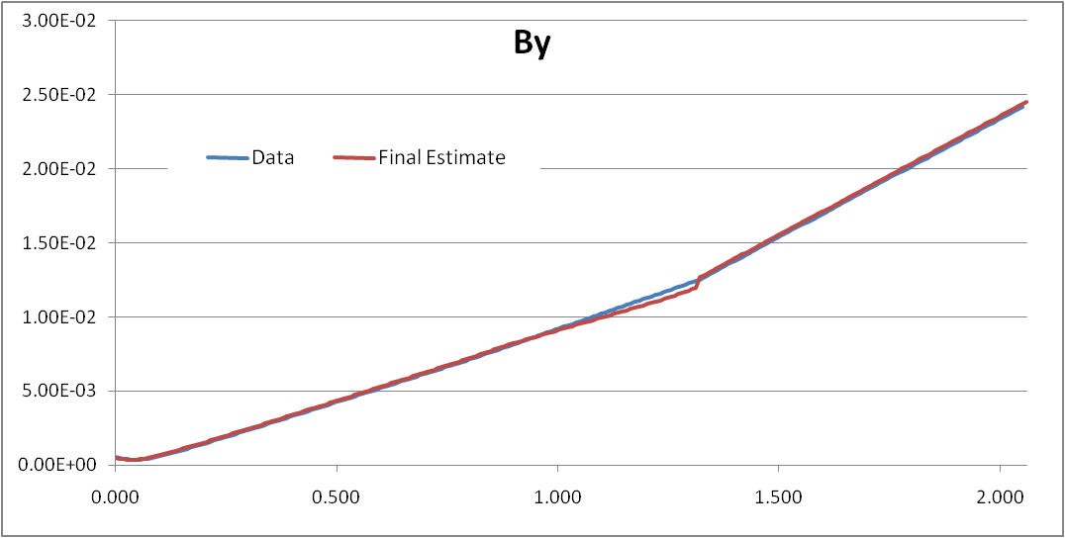
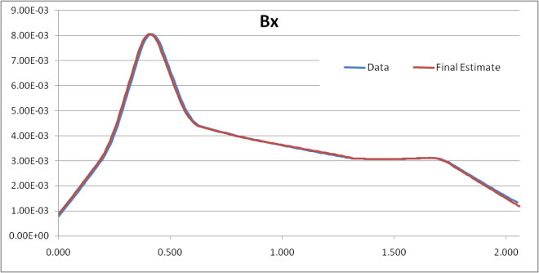
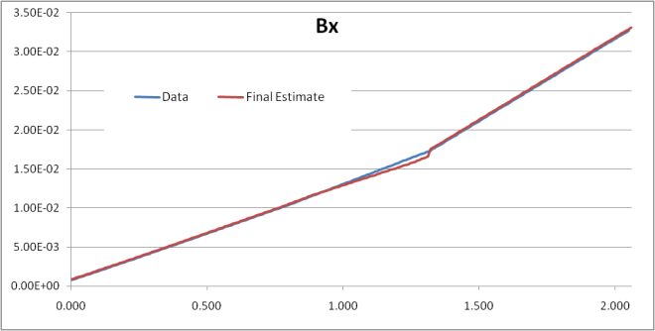
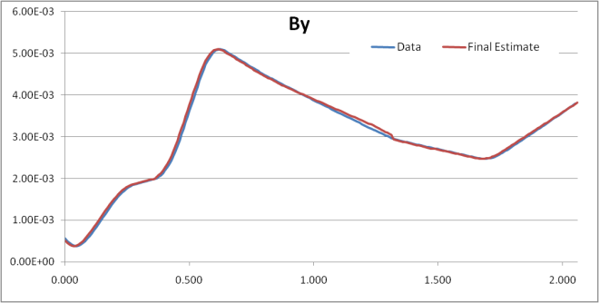
Non Linear Model Results
Non linear model maps both the magnets on and off condition pretty well.
Have not yet merged this model with the χ² minimization (next) to form a control system, but the simplified model looks promising

Slide 37
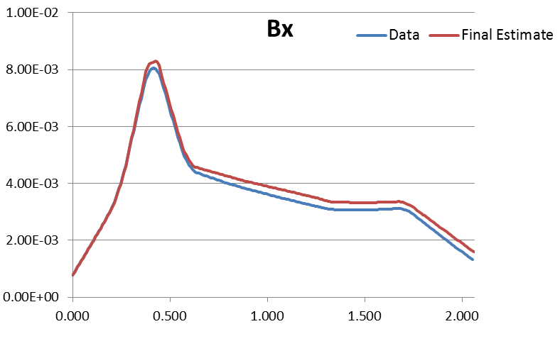
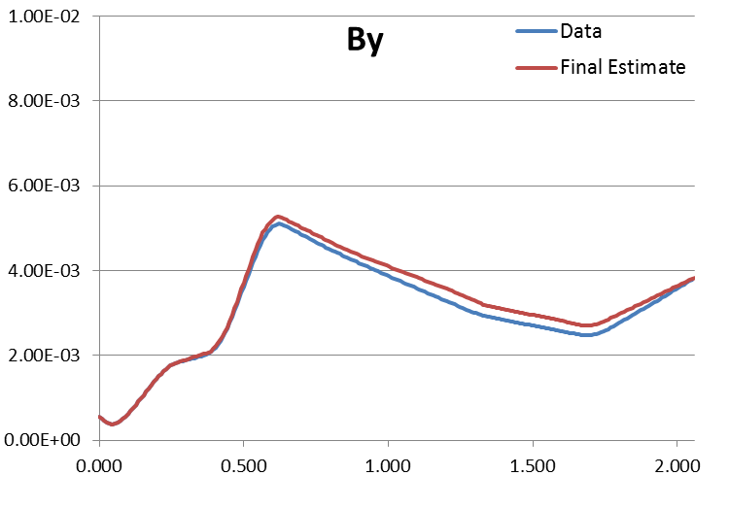
Final Model
Final Modeling based on- $\vec{v}\left(k+1\right)=A\vec{v}\left(k\right)+B\left(k\right)\vec{u}\left(k\right)$
where
$$B\left(k\right)=\left(\begin{matrix}0 \\ Sx \\ 0 \\ Sy\end{matrix}\right)$$
Here, $u$ is taken as a scalar, that is the magnet current at that position $k$. So,
$$u\left(k\right)=i for k≠drift and u\left(k\right)=0 for k=drift$$
For a drifted magnet condition, one can say the only variation occurs in $B(k)$ and $u(k)$ and we can therefore write,
$$Δv= ΔB.u+B.Δu$$
And we can express $u$ as
$u=K.v$ ( K is the controller gain, may be dynamic

Slide 38
χ² Minimization Control Technique

Slide 39
Results
Beam size
Beam size
k
k
Above, we show the simulation with all magnet nominal (blue) , randomly changed (drifted situation- red), and after being corrected using χ² minimization (green). The x-axis shows distance along the beam, while y shows beam size. Only one pair of “measurements” at ~2m is used in the χ² calculation.
We can see, in figure 11, despite minimal input data, the algorithm is able to bring the beam back close to nominal in both the vertical and horizontal directions.

Slide 40
Controls : what’s next?
Beam profile control is a new area to explore We may be able to handle such under constrained problems
Merge the simplified beam model with χ² minimization
However, χ² minimization is not common to control systems
Try to overlay a 2nd “state space” model with time (rather than position) as the variable
See if conventional control methods can be applied
More realistic simulations to see whether such solutions to under-constrained systems actually work

Slide 41
Acknowledgement
My supervisors : Aseet Mukherjee, Jim Kerby, and Rama K Yedavalli.
Steve Holmes, for giving me an opportunity to work in PX. And to everyone in TD and AD, as well as at CDF who has helped me gain understanding of accelerators and their components.
George Dodson, ORNL, for his reliability data on SNS.
Tom Himel, SLAC, for AvailSim.

