Slide 1
PIP Update
June 13 2012

Slide 2
Agenda
Summary Update
Budget/RLS
Current Activities
Upcoming Activities/ Changes
Update Slides
Booster 150KW PA S. Kotz
Booster Lattice Measurements Meghan McAteer
Short Kickers Salah Chaurize

Slide 3
Update
General Info
Latest Budget Numbers
No Change from last week
Labor
Keep an eye on labor changes – impact to schedule!
RLS Info
Elmie
Task Info
RFQ
Still more simulations –
Some agreement on energy – efficiency still being discussed
Alignment work – then pump down and recheck of energy (without endplate)
High Power Testing of Ferrites – making progress – Testing Today
Cavity 7 Refurb - Tuners were removed to make better connection?
Absorber work continuing – Drawings Complete – (see pic)
Linac Modulator Work - Continental Electronics – approval to proceed

Slide 4
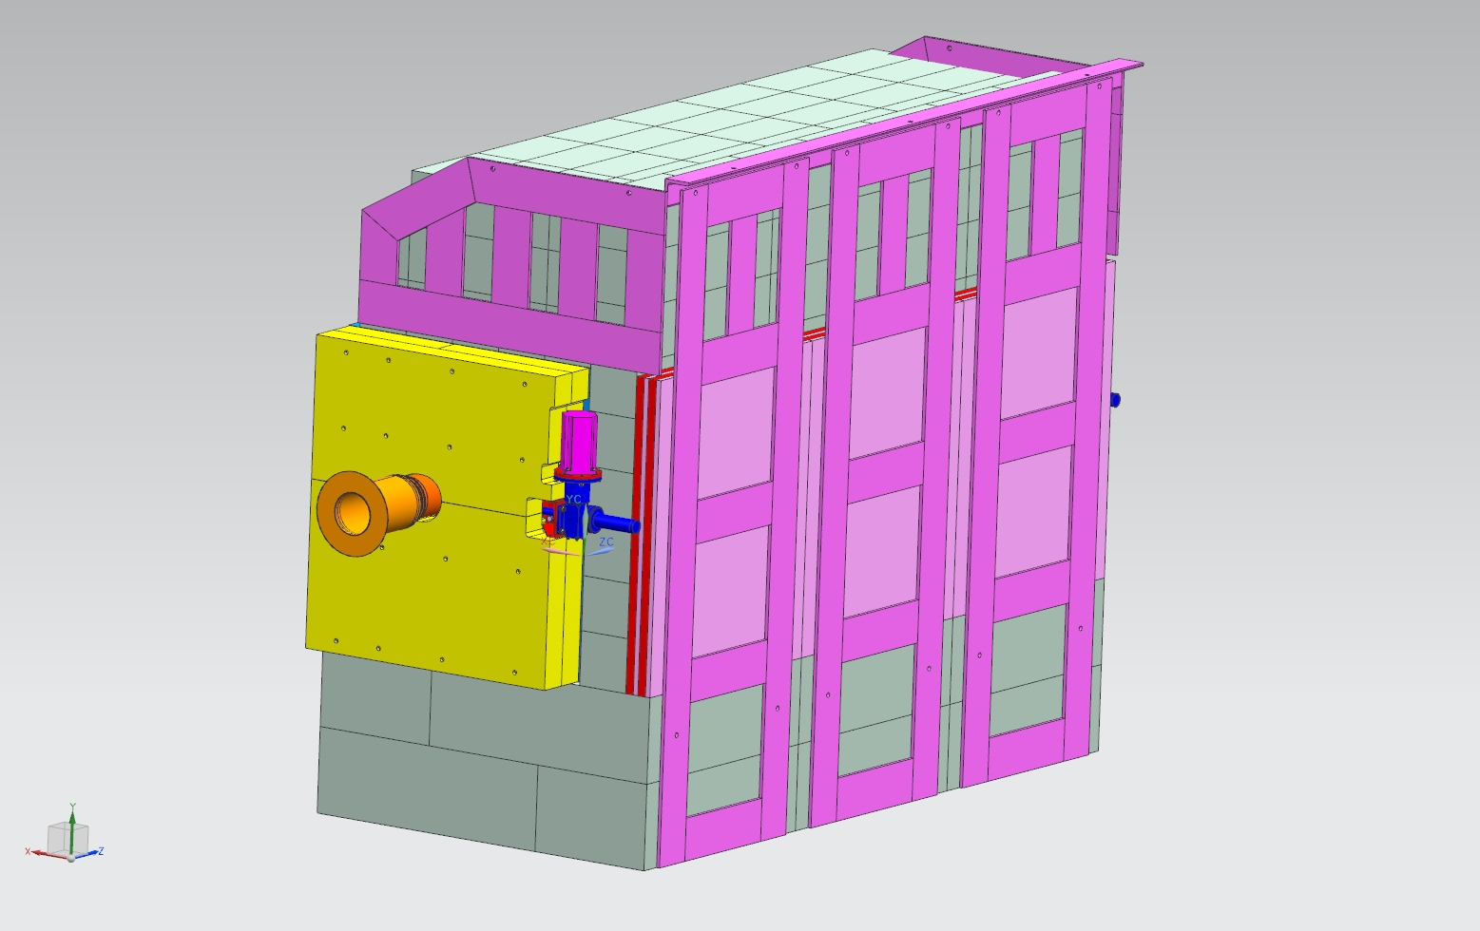
Booster Absorber – note the fine Italian pink marble

Slide 5
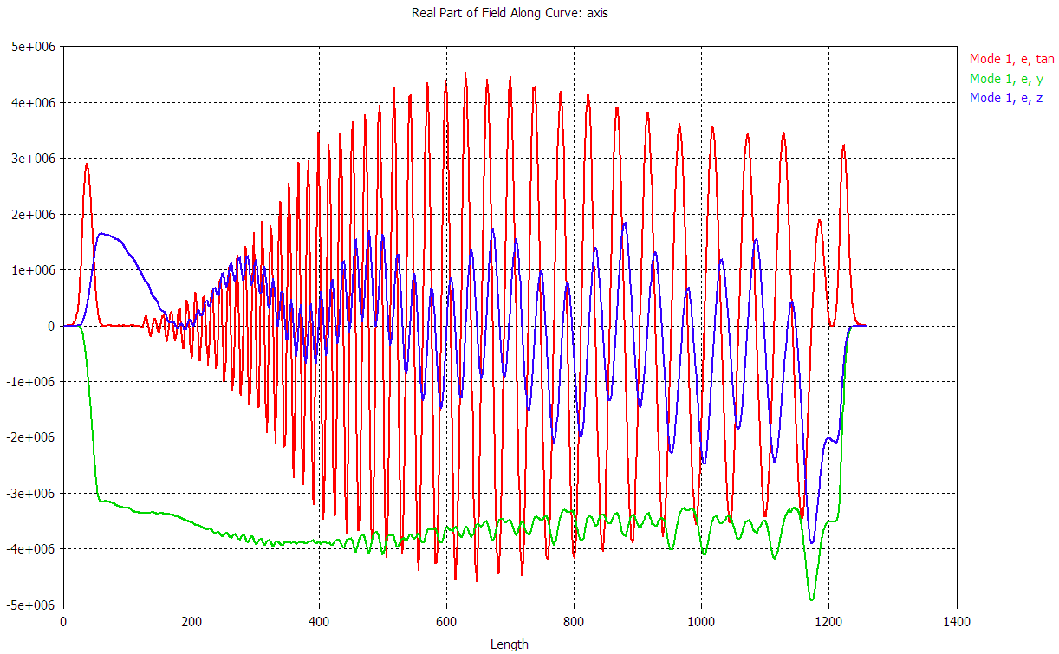
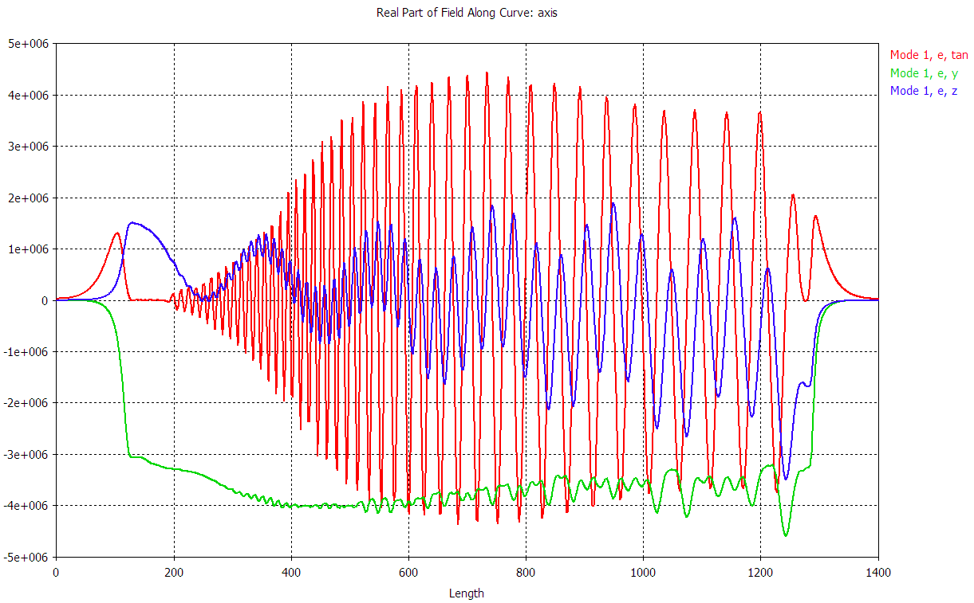
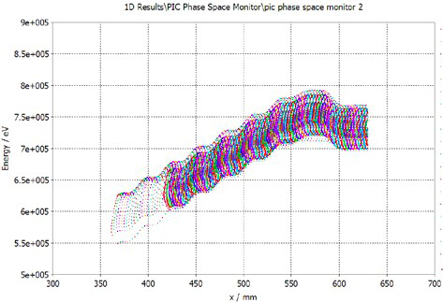
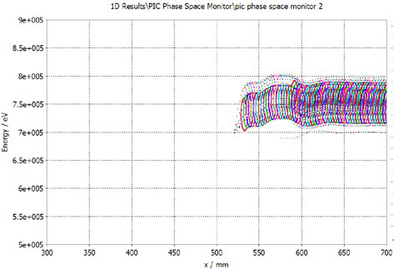
RFQ Energy Update – Simulation Slides

Slide 6
Booster 150 KW Power Amplifier
Status Update
6/12/2012
S. Kotz

Slide 7
As of June 12, 2012
2 Completed units for NoVA
7 Stations installed (East Side):
1,2,4,5,6,7 and 8
1 Additional unit built & tested
Station 3 (Not Mounted Yet)
2 Units partially built
1 repaired unit awaiting testing
1 unit awaiting Y567 Tube

Slide 8
Schedule
14 Additional PA’s Needed
10 Stations (West Booster Gallery)
4 Spares
P.O. Requests Submitted
40% of Material Received & Inventoried
All hardware
Most of FNAL Machine Shop Items
Still waiting for some larger pieces
Cathode Resonator
Copper Shroud
Power Module Outer Shell

Slide 9
Budget
Budgeted: $323,859
Year to Date Obligations: $41,774
Balance: $282,085
(As of 12/31/2011)
First 12 Units Cost
Next 14 Units Costs
$170,500 Total
$14,208 / PA
$207,700 Total
$14,835 / PA
(Increase of 4.4%)

Slide 10
Timeline
Complete build & testing of first 12 PA’s
June 2012 (On Track)
Begin build of next 14 PA’s
July 2012
Build & test units (2 / Month)
Goal is January 2013
Install into Stations
When able

Slide 11
Booster Optics Correction: Progress and Plans
6/13/2012
M. McAteer

Slide 12
Outline
Beta beating correction results
Optics measurements with corrector packages turned off
Work to be done

Slide 13
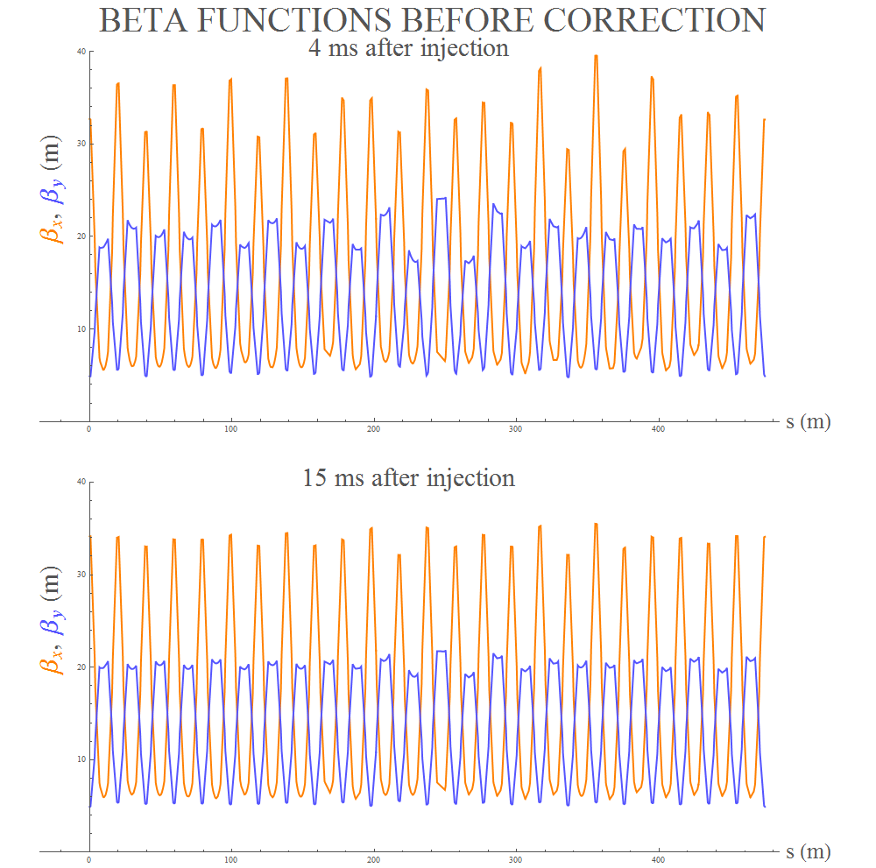
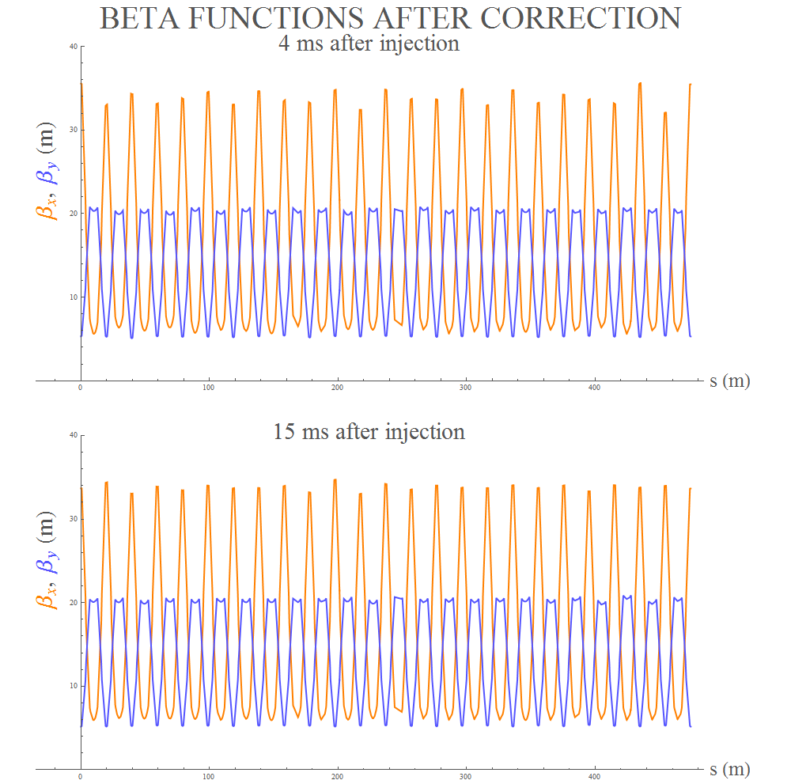
Beta Beating Correction Results

Slide 14
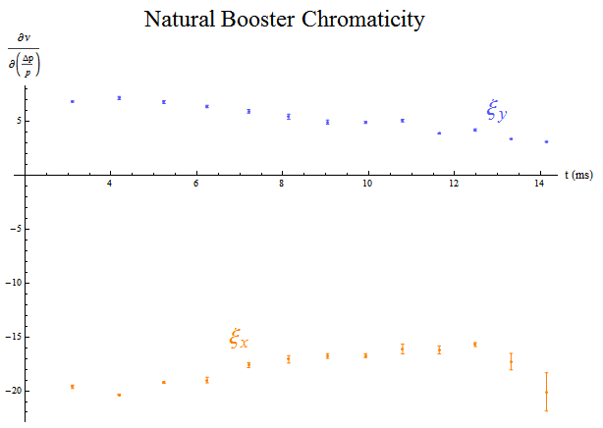
Optics measurements with corrector magnets turned off

Slide 15
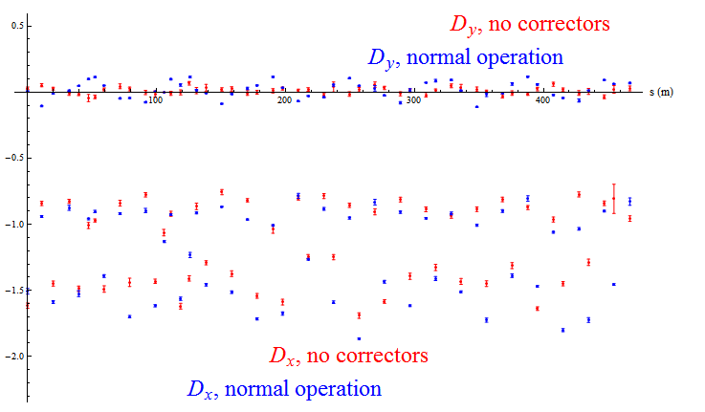
Dispersion, with and without corrector magnets

Slide 16
To Do Next:
Once magnet moves are completed and orbit is optimized, we will measure and correct optics again
Since we can significantly reduce beta and dispersion beating, it may be a good idea to do that before the next round of aperture scans
Source of apparent BPM scaling problem is still unknown; Manfred Wendt suggested a straightforward test of BPM response that we can do when beam is back

Slide 17
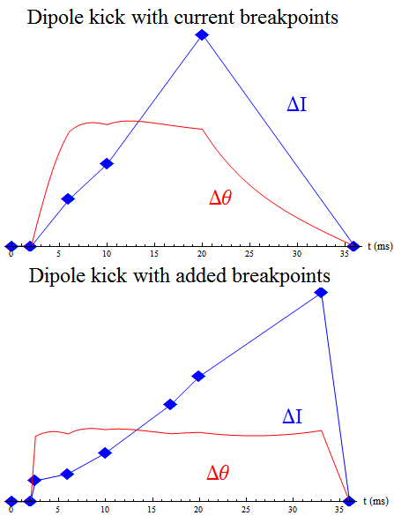
We could make better optics measurements right after injection and after transition if we added a few more breakpoints to the dipole ramps.

