Slide 1
Low-Energy Linac
Tanks 2, 3, 4 and 5
(3 Slides)

Slide 2
Station 7
Station 5
Station 4
Station 3
Station 2
172MHz
BPM
NIM
BPM
NIM
BPM
NIM
BPM
NIM
1/8” Hard
Line (SMA)
3/8” Heliax (N)
Coupler

Slide 3
Station ?
Station 5
Station 4
Station 3
Station 2
BPM
NIM
BPM
NIM
BPM
NIM
BPM
NIM
805 MHz
1/8” Hard
Line (SMA)
3/8” Heliax (N)
Coupler
Splitter
Attenuator

Slide 4
Station 5
Station 4
Station 3
Station 2
BPM
NIM
BPM
NIM
BPM
NIM
BPM
NIM
Coupler
Splitter
805 MHz
Attenuator
If
Necessary
3/8” Heliax (N)
Location | Minimum Power Need | Required Power
Input to BPM Modules | -10 dBm | Various
Sta. 2: Input to coupler | 10 dBm | 18-20 dBm
Sta. 3: Input to splitter | -6 dBm | -6 dBm
Sta. 3: Input to coupler | 14 dBm | 14 dBm
Sta. 4: Input to coupler | 10 dBm | 10 dBm
Sta. 5: Input to splitter | -6 dBm | 6 dBm

Slide 5
High-Energy Linac
Seven modules and the Transition Section, all in the Diagnostics Room.
(1 Slide)

Slide 6
Diagnostics Room
LDR-0
LDR-1
805MHz
BPM
NIM
BPM
NIM
5-1
5-2
5-3
5-4
6-1
6-2
0-1
0-2
0-3
1-1
1-2
1-3
BPM
NIM
2-1
2-2
2-3
3-1
3-2
“7-5"
BPM
NIM
6-3
6-4
7-1
7-2
7-3
7-4
BPM
NIM
3-4
4-1
4-2
4-3
4-4
3-3

Slide 7
Booster & Linac 400 MeV Line
Two locations
(4 Slides)

Slide 8
Booster Gallery Plan View
BPM Rack
Debuncher Room
~10m
805 MHz Source
Booster Gallery
~40m
BPM Rack
BPM Rack
Linac Gallery

Slide 9
Booster 400 MeV Line (Far)
GR24-RR6-1
GR24-RR6-2
GR24-RR6-3
805 MHz
BPM
NIM
Q10
V-Q11
Q12
DEB
Q13
BPM
NIM
Q15
Q16
Q23
Q17
SEPU
BPM
NIM
Q6
Q7
Q8
Q9
BPM
NIM
HSEPD
PFOIL
L1D
S01
L1U
S24

Slide 10
Booster & Linac 400 MeV (near)
LG1-RR4-1
LG1-RR2-3
BPM
NIM
BPM
NIM
Q1
Q2
LAM
Q3
Q4
Q5
BPM201
BPM201
BPM203
BPM204

Slide 11
All 400 MeV line
Heliax Cable
(already exists)
Debuncher Room
805 MHz
New
Heliax
Cables
GR24-RR6-1
GR24-RR6-2
GR24-RR6-3
BPM
NIM
Q10
V-Q11
Q12
DEB
Q13
LG1-RR4-1
LG1-RR2-3
BPM
NIM
Q15
Q16
Q23
Q17
SEPU
BPM
NIM
BPM
NIM
BPM
NIM
Q1
Q2
LAM
Q3
Q4
Q5
BPM201
BPM201
BPM203
BPM204
Q6
Q7
Q8
Q9
BPM
NIM
HSEPD
PFOIL
L1D
S01
L1U
S24

Slide 12
Back Panel of the BPM Module
Left
A0
Right
B0
Bottom
A1
Top
B1

Slide 13
Obsolete Layouts

Slide 14
GR24-RR6-3
GR24-RR6-1
BPM
NIM
BPM
NIM
BPM
NIM
805MHz
~10 dBm
BPM
NIM
OBSOLETE: Nov 2012
~0 dBm
6 @ -9dBm

Slide 15
GR24-RR6-3
GR24-RR6-1
805MHz
BPM
NIM
BPM
NIM
OBSOLETE: Nov 2012
BPM
NIM
BPM
NIM

Slide 16
LG1-RR-1
805MHz
BPM
NIM
OBSOLETE: Nov 2012

Slide 17
LDR-0
LDR-1
805MHz
BPM
NIM
BPM
NIM
OBSOLETE: Nov 2012
BPM
NIM
BPM
NIM
BPM
NIM

Slide 18
LDR-0
LDR-1
BPM
NIM
BPM
NIM
BPM
NIM
BPM
NIM
805MHz
~10 dBm
BPM
NIM
OBSOLETE: Nov 2012
6 @ -9dBm
~0 dBm

Slide 19
LG1-RR-1 (LG1-RR2-3)
BPM
NIM
805MHz
~6 dBm
OBSOLETE: Nov 2012

Slide 20
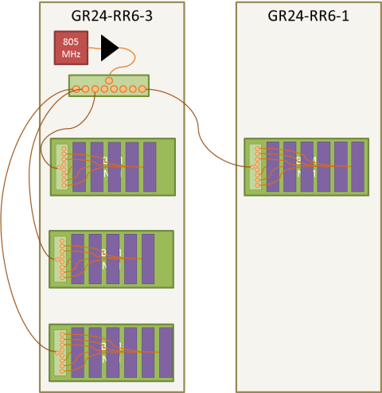
Power Levels
20 dBm
24 dBm
27 dBm
20 dBm
-0.5 dBm
16 dBm
Heliax Cable
(already exists)
New
Heliax
Cables
805MHz
Debuncher Room
LG1-RR2-3
LG1-RR4-1
805 MHz
BPM
NIM
BPM
NIM
9 dBm
LDR-0
LDR-1
805MHz
100 feet
BPM
NIM
BPM
NIM
0 dBm
-4 dBm
BPM
NIM
BPM
NIM
9 dBm
-0.5 dBm
-10 dBm
BPM
NIM

