Slide 1
PIP Update
Oct 10 2012

Slide 2
Agenda
Summary Update
Current Activities
Updates/Talks:
Dave Johnson – Linac Notching (laser)

Slide 3
Update
General Info
Current Work
Booster RF cavity rework – RF 6
LCW – Fill is not done – fixing leaks
RFQ – Never ending Electrical work, New Injector being installed
HPower RF – A 1.4M is waiting for signature - ODDONE,PIERMARIA
Waiting for 1.4 req. before submitting second req. for remaining cost
High Power Ferrite Testing –
Booster Absorber – Kicker and PS work continues – Kicker Testing
Linac Modulator – Working out labor for task vs funding
Booster Solid State – Rack work was in progress last week?
Booster Modulator work – 7 done 3 in progress, 12 still need socket rings (due Oct 25)
Tuner with new ferrite – waiting for RF6 completion/testing
Cogging – Software work continues
Booster Shielding – Started to review again old doc/absorber/penetrations
Shutdown - comments (Fernanda, Todd, Mary)
End of Fiscal Year – cleaning up Pro-Card numbers/ Lab still looking at FY12 for FY13 (Pier – decisions)

Slide 5
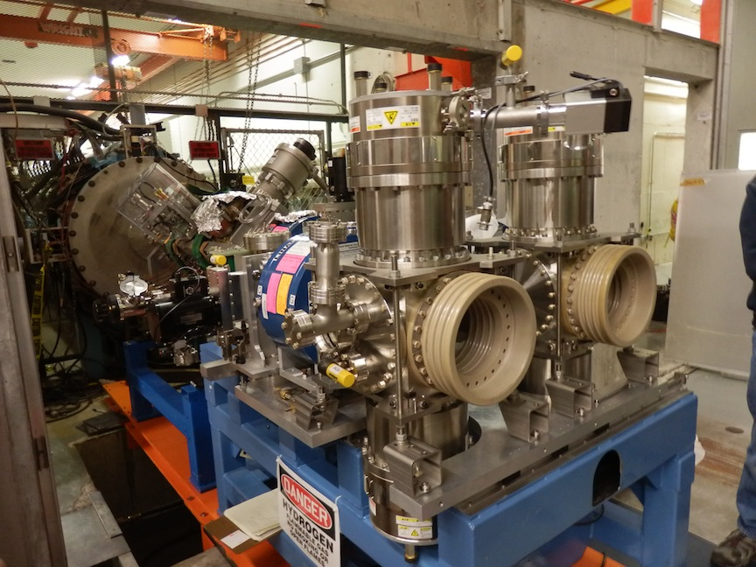

Slide 6
Completion Date
Before FY13 Budget
Required for 12 Hz Required for Flux
Required for 15 Hz Required for Reliability
Task identified as a goal requirement but many of these overlap.
Recent Budget guidance still being worked through the planning and RLS process.

Slide 7
Upcoming
RLS – Just about done with updates
Fiscal Year Start –
Reports (October)
PMG
Quarterly Report
Will have special meeting today with Ann to discuss FY13
Need to have
PIP talk at PAC (Monday)
Where’s the beam

Slide 8
Talks
Dave Johnson – Linac Notching

