Slide 1
LCW Upgrades - Final
Booster RF Cavity LCW Isolation Valve Replacement.
8 valves and unions previously replaced
An additional 10 valves and unions were replaced during long shut-down. The remaining 20 will be replaced when possible - coordinate with cavity rework schedule.
Remaining Stations: 9, 10, 11, 12, 13, 14, 15, 16, 17, 18
Booster Bus LCW Strainer and Isolation Valve Replacement.
Remove existing Y-strainers and replace with basket strainers at wall opposite beamline. Replace isolation valves.
Strainers at 6 locations were installed: 1, 3, 6, 7, 13, & 19
Basket strainer and parts for the remaining 7 locations have been purchased and will be installed when possible.

Slide 2
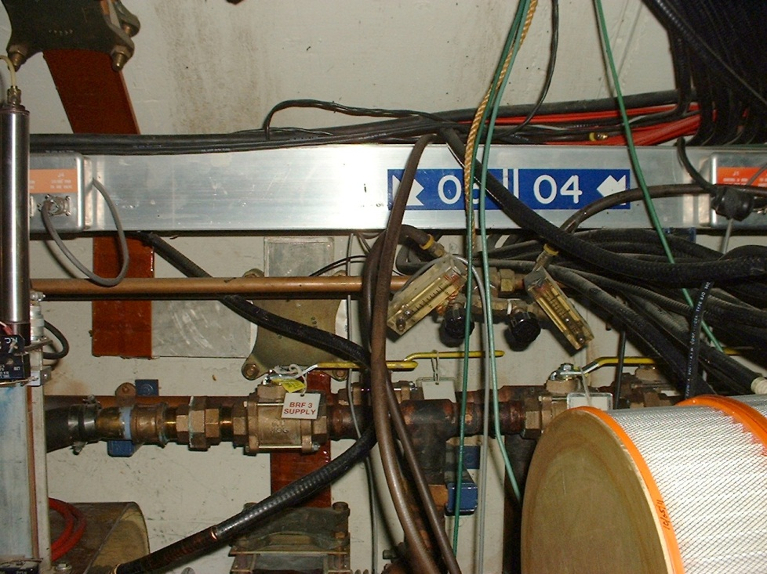
LCW Upgrades - Final
Booster Cavity LCW Isolation Valve Replacement
Old Valves at 03 & 04
New Valves at 03 & 04

Slide 3
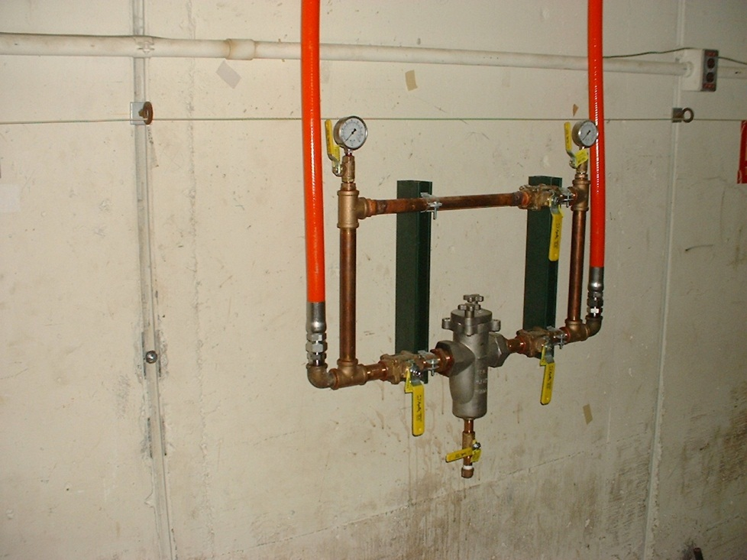
LCW Upgrades - Final
Booster Cavity LCW Strainer & Isolation Valve Replacement
Old Strainer & Valves at 07
New Strainer and Valves at 07

Slide 4
LCW Upgrades - Final
Finish connection of LCW Return piping in East and West Booster Galleries to LCW Return piping at CUB.
All work was completed at the end of August 2012
LCW Return Pump at CUB
Remove northern most old, existing return pump, and install previously purchased pump, and relocate valves to allow return pump isolation.
All work was completed early October 2012

Slide 5
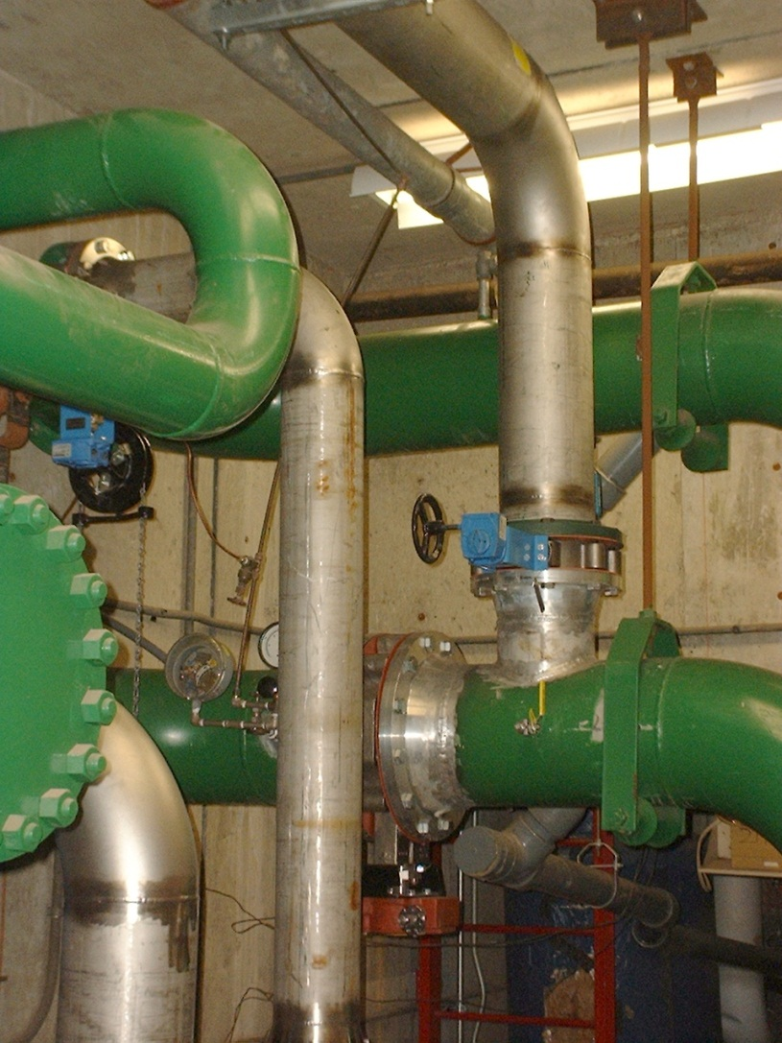
LCW Upgrades - Final
LCW Return Pump and LCW Return Piping at CUB

Slide 6
LCW Upgrades - Final
Install LCW Isolation Valves in CUB Utility Tunnel
Work is complete
EDWA Magnets
Repipe EDWA magnet coils in parallel instead of in series
Work is complete
Remove LCW Piping for Long 13 New Absorber
Remove sections of 95LCW piping and cap
Remove sections of 55LCW Supply and Return
Work is complete

Slide 7
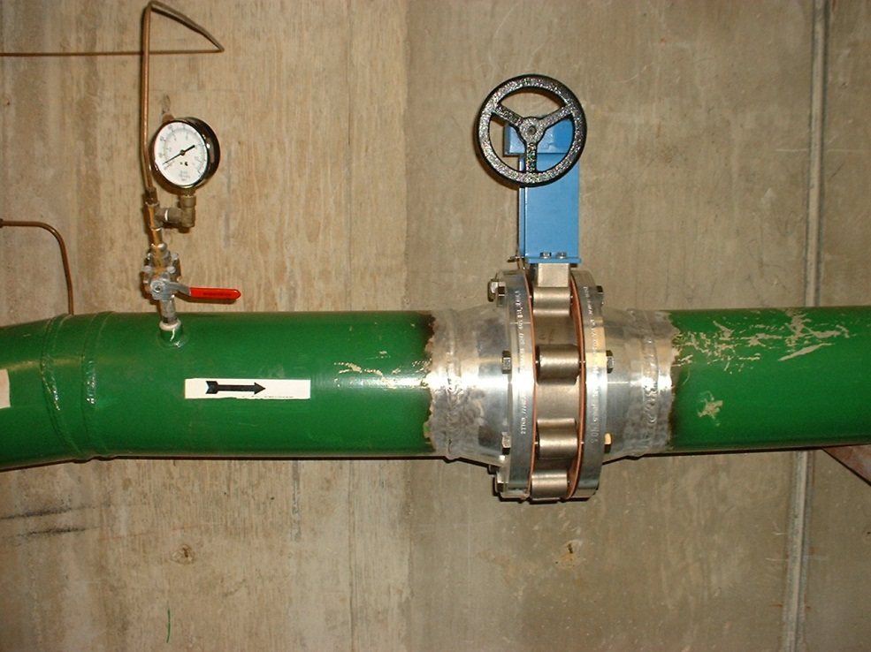
LCW Upgrades - Final
LCW Enclosure Isolation Valves in CUB Utility Tunnel
New Valve in LCW Return from Enclosure
New Valve in LCW Supply to Enclosure

Slide 8
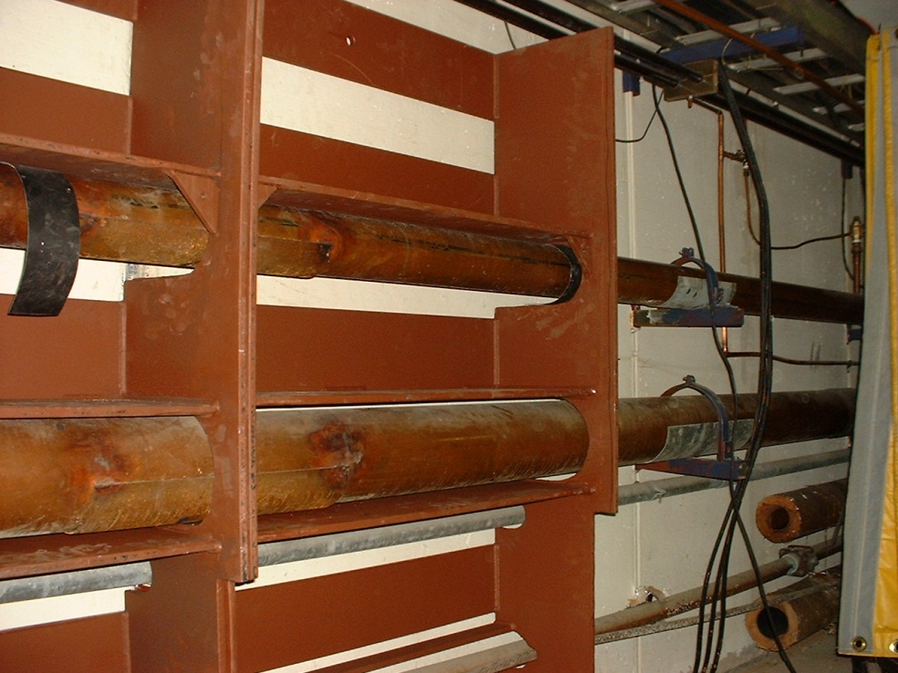
LCW Upgrades - Final
Remove LCW Piping for Long 13 New Absorber
Removed 55 LCW and Capped 95 LCW
Removed 55 LCW and 95 LCW

Slide 9
LCW Upgrades - Final
Miscellaneous LCW Work
Magnet bus hose fittings for drainage
Repair Choke leaks and Choke Tubing
Remove Candy Cane Stop-Cocks and plug
Replace Long 3 LCW Hoses
Replace 400 MeV LCW hoses up chute
Install LCW bypasses at return valves in the Galleries
Work above is complete

Slide 10
LCW Upgrades - Final
Booster Refill, Leak Testing, Commissioning and Balancing
Booster LCW has been refilled
Leak checking complete (never really complete!)

