Slide 1
PIP Update
April 24th 2013

Slide 2
Agenda
Summary Update
Current Activities/Updates
Startup Plans
Upcoming Talks, Reports, Meetings
Updates/Talks:
Ken Domann - Project Schedule and Budget Report
Fernanda Garcia - Report on CPI site visit

Slide 3
Update
General Info
Booster Beam: Running still at reduced levels (Shutdown today due to feeder work)
Studies are underway:
Apertures / Orbit Smoothing will continue – Kiyomi, Boosters
Optics measurements - Yuri
Booster SS: Stations are operating – controls / shunt problems (One more shut failure)
Booster voltage still low – but after 7 repair should be near operating levels (2 weeks?)
Booster RF cavity rework – RF1 installed yesterday – being aligned today
Cavity from RF15 – tuners being reworked
Spare cavity work – Any news?
Booster RF Cavity 7 (8 also but less) has been pulled for RF leak issue
We will have 17/19 cavities after the next swap (up from 16) – may allow high-intensity
Booster Ferrites
Low Frequency tester – shipped – Any news?
Second LF tester completed and tested – looks good
RFQ –2nd source will be ready for operations next week! Trim will be installed in May
HLRF –site visit at vendor (Fernanda and Al – Past Monday)
Linac Modulator – Talk by Mark from SLAC Friday (Thursday talk on Klystron Mod)
Booster Shielding – First part of document given to ES&H, Another scan next week…
Booster Transverse damper needs to be re-commissioned, Long damper plans started
MI Startup: End of May/Early June – delays due to water…not sure what day
Startup comments (Fernanda, Todd)

Slide 4
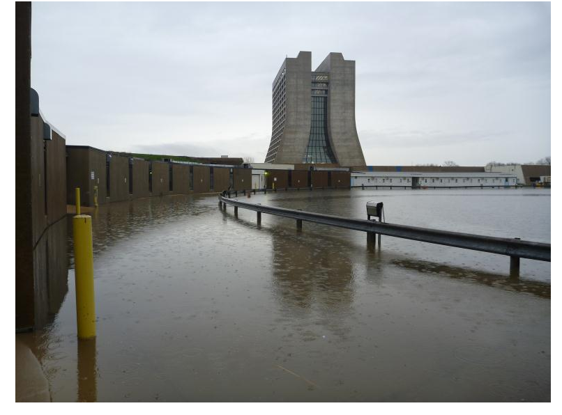
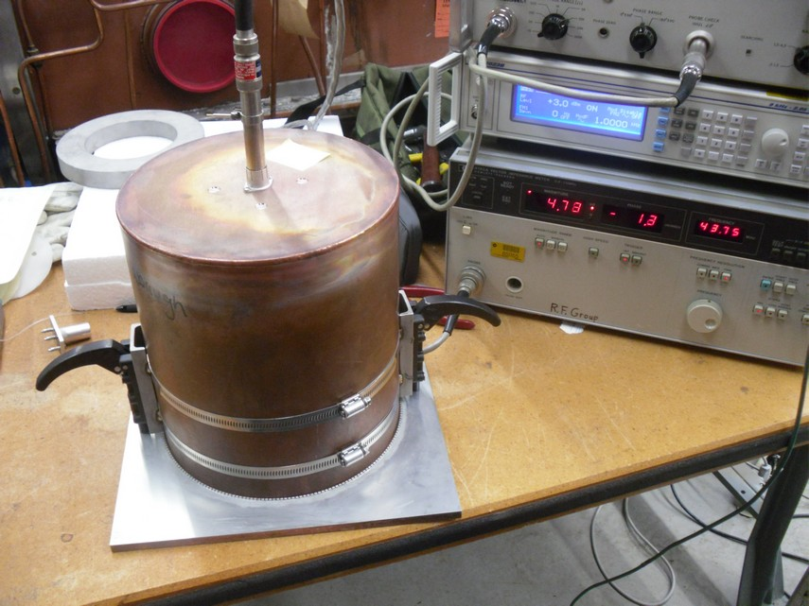
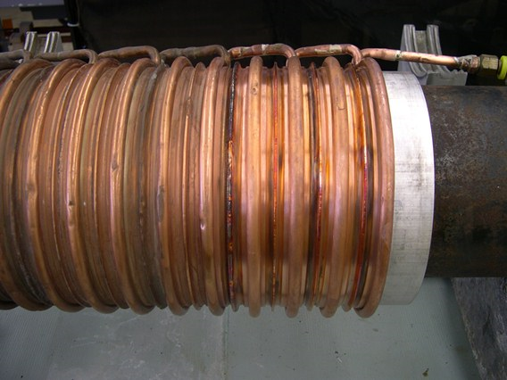
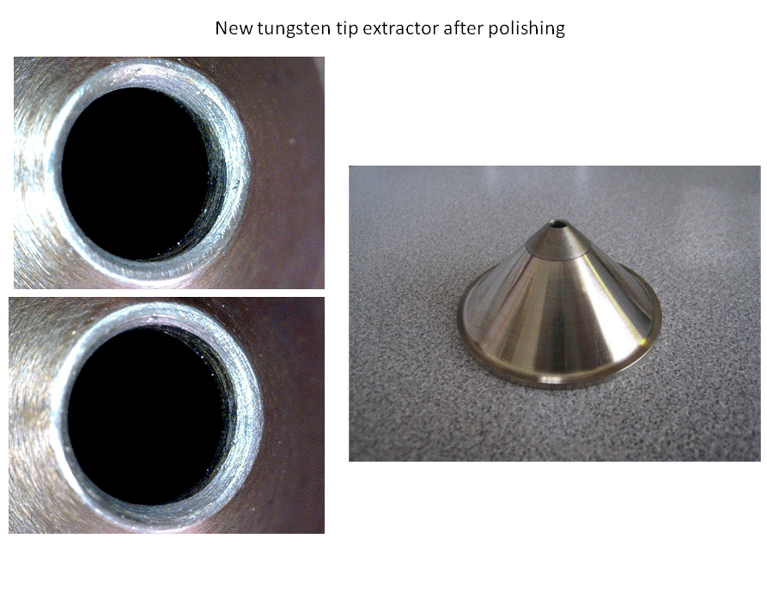
Booster LCW leak
Low Power Ferrite Tester
Repaired Tuner after last 4 sections were repaired

Slide 5
Upcoming Talks
Future Meetings:
Today:
Eliana Gianfelice - Booster Optics Correction Procedure and Results
To be Scheduled:
Dave Augustine - Vacuum Installations Finished and in Planning
Jean-Paul Carneiro - TraceWin 3D Simulations of the Fermilab Linac
Bill Pellico - Loss Test Scans for Shielding Assessment
John Reid - Solid State Installation - Final Report

Slide 6
Upcoming
Reports
Update of PIP Design Report – Yearly update work
PMG & Quarterly report in April (Completed – submit today)
Budget Issues – No change from last week -
Lots of talk about next year – nothing is certain but could be a tough year…..
- Please use the E-Log to put general work in progress updates/photos – weekly would be nice – if progress is being made in task

