Slide 1
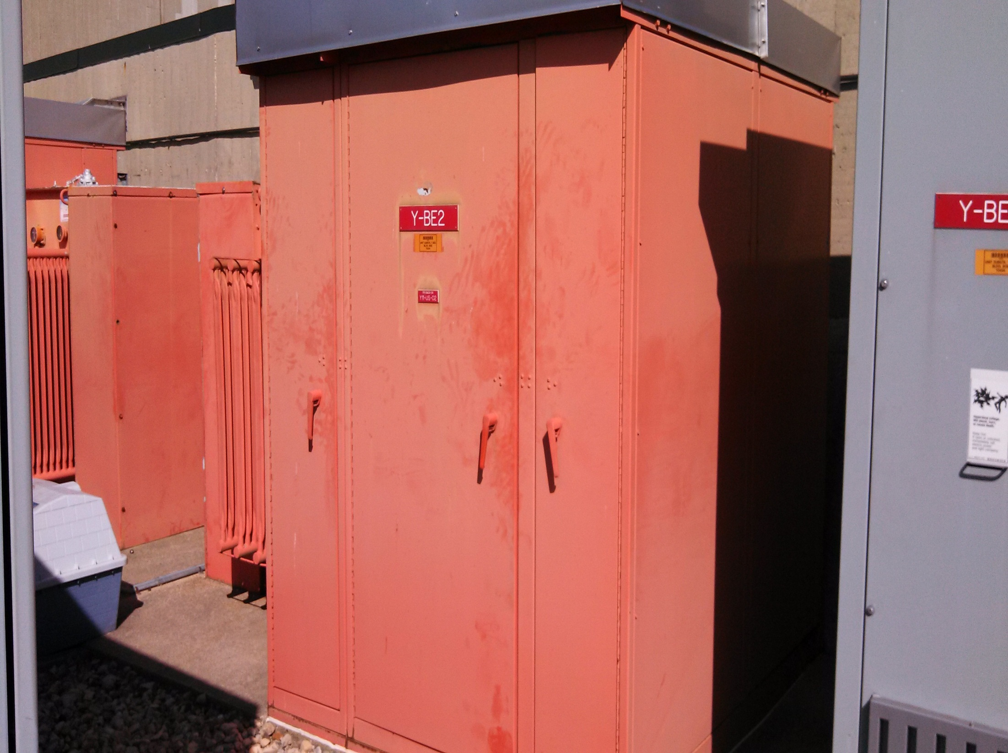
Turn Off Power Friday the 17th @ 6 PM
Take Mechanical Measurements For Bus Bar Extensions (If Needed)
Electricians Arrive Early Saturday To Begin Disconnecting Substation
Electricians Will Also Move Chipmunk Forward
Crane Will Arrive Around 8-9 AM
Work Will Be Completed Saturday the 18th

Slide 2
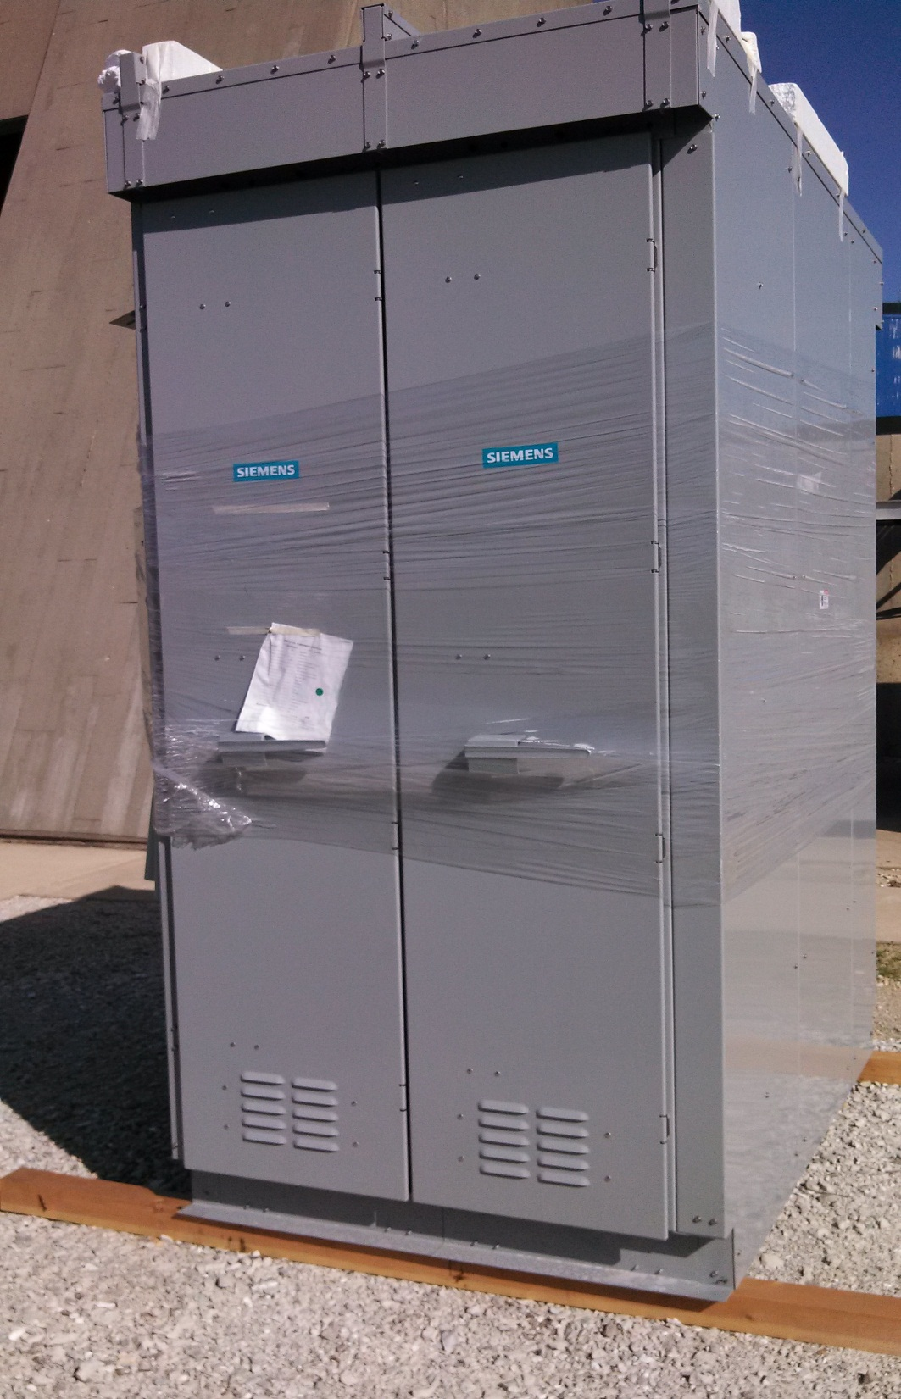
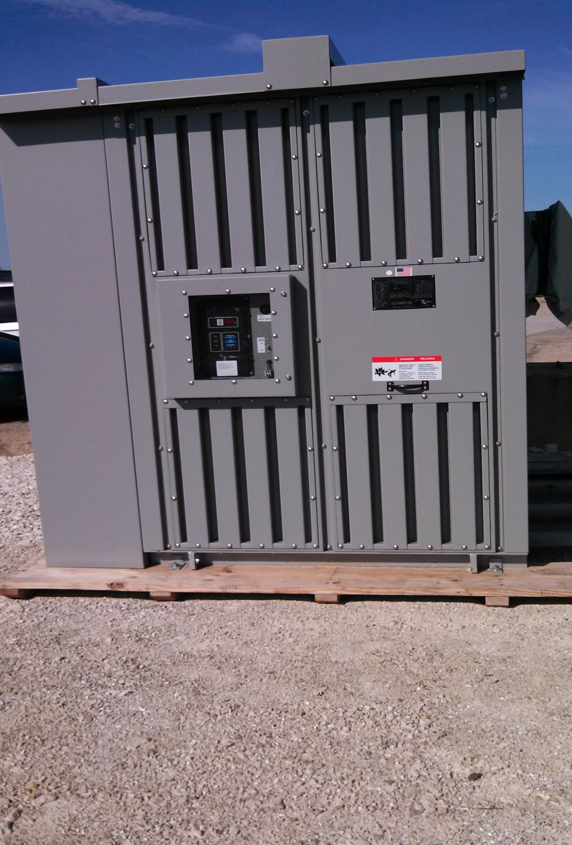

Slide 3
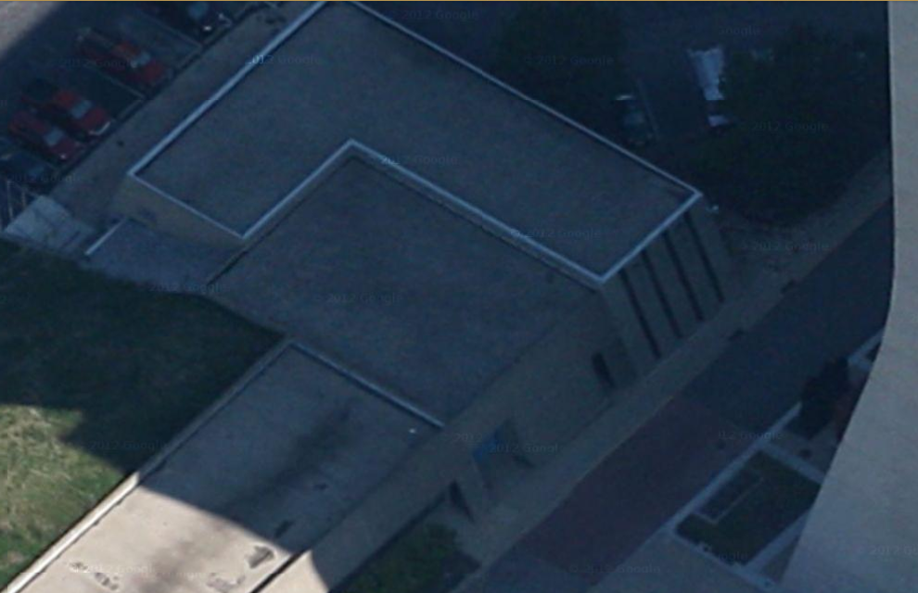
In The Process of Ordering
5 Week Lead Time
Crane Work To Be Handled By Contractor
Lead Abatement To Be Handled BY T&M
Joliet Steel Will Relocate Beam
Proposed Hatch
Location

