Slide 1
PIP Update
June 12th 2013

Slide 2
Agenda
Summary Update
Current Activities/Updates
Startup Plans
Upcoming Talks, Reports, Meetings
Updates/Talks:
Jean-Paul Carneiro - TraceWin 3D Simulations of the Fermilab Linac

Slide 3
Update
General Info
PreAcc Beam: Source Current ~60ma
Linac Beam: Tank 1 in at ~ 34ma, Tank 3 ~29ma, Tank 7 ~26ma
Booster Beam: Pushing Higher Intensity in preparation of MI startup
Have reached about 4E12
Studies are underway:
Apertures / Orbit Smoothing will continue – Kiyomi, Boosters
PreAcc/ Linac capture & acceleration tuning
Cogging software work continues
Booster optics software – Tan, Eliana -> streamlining and documenting
Booster SS: No recent failures upstairs – some issues with RF19 (tunnel?)
Booster RF cavity rework
Cavity from RF15 – being high power tested – will go back in next week at RF7 location
Spare cavity work – have made progress – ceramic ends put on and preparing to vacuum test (2 weeks?)
Booster RF Cavity 8 will outer tuner replaced – fixed RF leak!
Tuner that was removed did have problems – pitting on cones…which were not there before install
We will have swap a cavity next week – and then set schedule for another cavity (two cavities out) when labor available
Booster Ferrites
National Magnetics working on order – any news? Also need to send back cores with incorrect dimensions.
High mu cores – still no news?
RFQ –2nd source is up and running – several problems (still investigating) Trim delivered 6/12 – small current gain
HLRF – Exchanging documentation with CPI – we have resubmitted our bid to them for cost update – done this week?
SLAC (Ongoing discussions about role and Klystron issues – very helpful) Craig Burkhart visited the lab two weeks ago….
We will write a new PO this week/early next if all goes well…
Linac Modulator – no news – testing
Booster Shielding – We are finishing up the write-up….plan is to have a meeting and then submit report to ES&H
Booster Transverse/Longitudinal dampers – Higher intensity allowed tune-up but need to proceed with new hardware
MI Startup: Date set for Jun24th?
Startup comments (Fernanda, Todd)

Slide 4
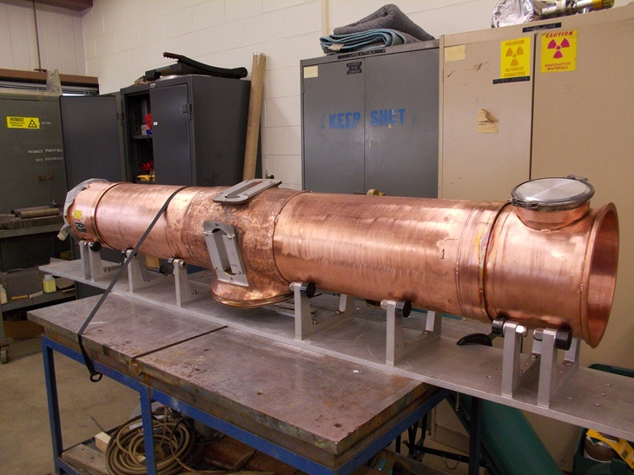
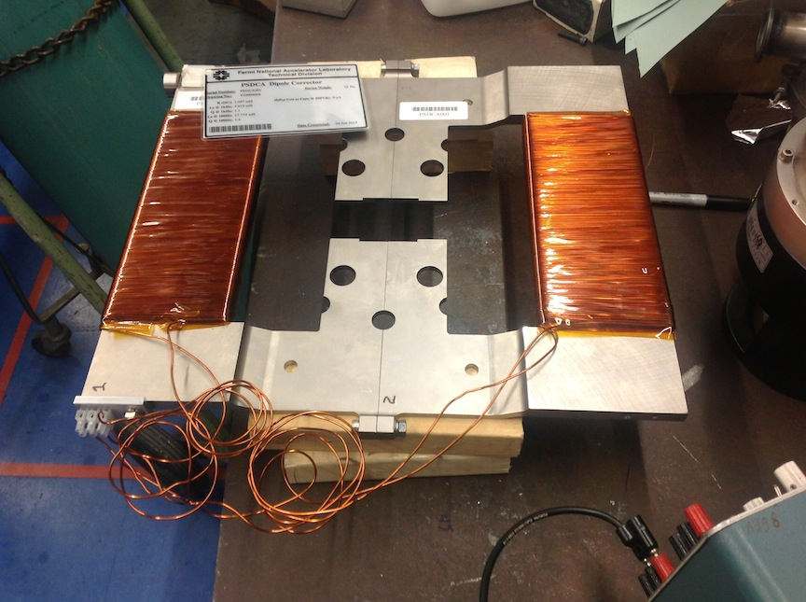
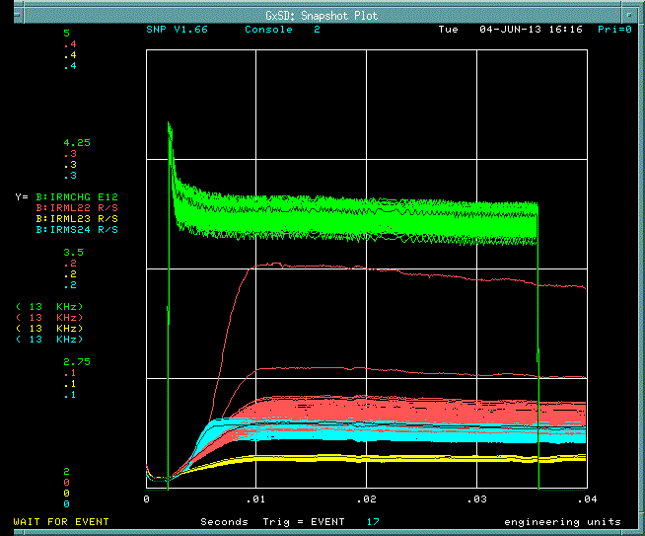
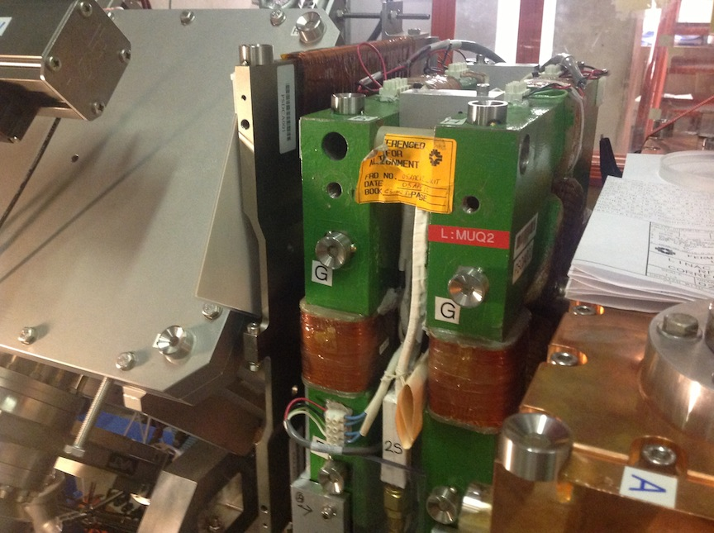
Spare Cavity
New RFQ trim
Booster ~4E12
Efficiency ~ 91%
New RFQ trim installed

Slide 5
Upcoming Talks
Future Meetings to be Scheduled:
Bill Pellico - Loss Test Scans for Shielding Assessment
John Reid - Solid State Installation - Final Report
Kiymoi – Booster cogging plans
Eddy – Booster damper plans
Tan – RFQ Summary (after install of corrector and source B operating)

Slide 6
Upcoming
Reports
Update of PIP Design Report – Yearly update work
PMG – some time next month….
Budget Issues – Submitted FY14 labor and Budget
Labor given to other divisions
Will soon need to work with department heads to firm up names
PIP 11 M FY14 budget given to Ann
Please use the E-Log to put general work in progress updates/photos – weekly would be nice – if progress is being made in task
Need to post

