Slide 1
TAC Proton Accelerator Facility:
The Status and Road Map
Haci Sogukpinar
Eskisehir Osmangazi University
Turkey

Slide 2
Outline
Turkish Accelerator Center Project
Proton Accelertor Overview
TAC Proton Accelerator Working Group
TAC-PAF Stages
LINAC layout of TAC-PAF
TAC-PAF Experimental Station Layout
TAC-PAF Design Studies
User potential surveys for TAC-PAF
Conclusions

Slide 3
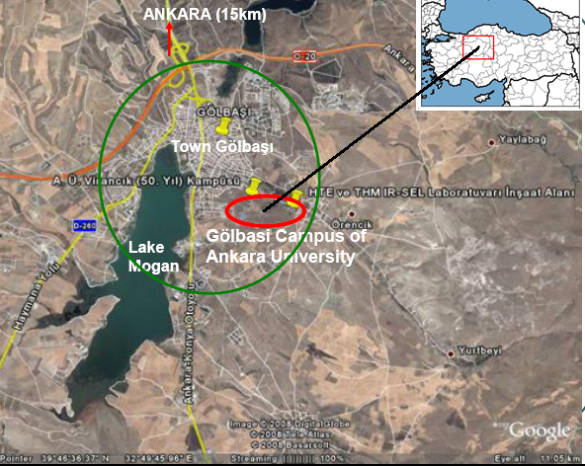
TAC -Golbasi Campus Of Ankara University
3

Slide 4
Turkish Accelerator Center (TAC)
started in 1997
supported by the Turkish State Planning Organization (SPO)
has progressed in four phases:
  Phase-I - to study the feasibility of TAC and was completed in 2001
  Phase-II - to prepare a TAC conceptual design and was completed in 2005
  Phase-III - to finalize the TAC technical design report and to establish a test laboratory which will be completed in 2016
  Phase-IV will be to construct the TAC facility
Web page: http://thm.ankara.edu.tr

Slide 5
Turkish Accelerator Center (TAC) will Include:
TARLA (Turkish Accelerator and Radiation Laboratory at Ankara) Facility
Sc linac based IR FEL & Bremstrahlung facility 15-40 MeV
TAC Synchrotron Radiaton Facility (SR)
A third generation light source based on dedicated 3 GeV electron synchrotron
TAC SASE FEL Facility (SASE FEL)
A fourth generation light source based on 1 GeV electron linac
TAC Particle Factory (PF)
Electron-positron collider (charm factory), Ec.m.= 3.77 GeV
TAC Proton Accelerator Facility (PA)
LE PA: 3-250 MeV, HE PA: 2 GeV
High power and high flux proton accelerator
5

Slide 6
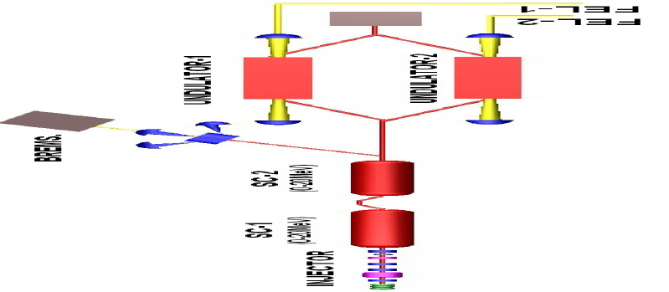
Layout of TAC- TARLA
6

Slide 7
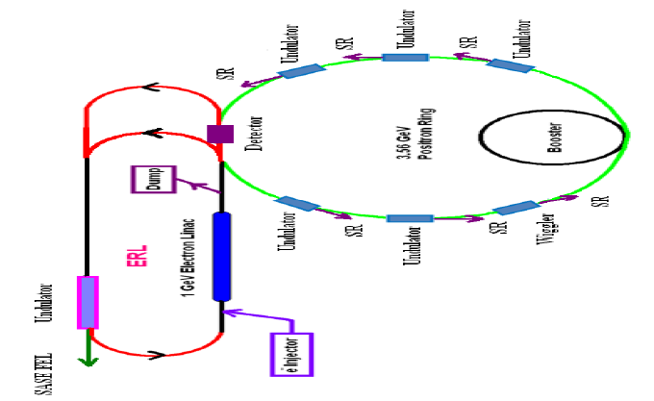
Layout of TAC- SASE FEL, PF, SR
7

Slide 8
Recently
Accelerator Technology Institute has been established: http://hte.ankara.edu.tr
Graduate programs on
  Accelarator Physics and Technologies,
  Accelerator Based Radiation Sources, and
  Detectors and Data Analysis Technologies

Slide 9
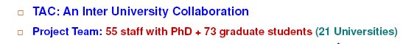

TAC collaboration

Slide 10
Proposed time schedule for TAC (2013-2025)
 | 2013 | 2014 | 2015 | 2016 | 2017 | 2018 | 2019 | 2020 | 2021 | 2022 | 2023 | 2024 | 2025
TARLA
PA- LE
SR
SASE FEL
PA-HE
PF
 | R&D, CDR |  |  | TDR |  |  | BUILD AND INSTAL |  |  |  | OPERATION
 | TARLA: Sc linac based IR FEL & Bremstrahlung facility 15-40 MeV
 | TAC LE Proton Accelerator (3-250 MeV)
 | TAC Synchrotron Radiaton Facility (SR) (3 GeV)
 | TAC SASE Free electron laser based on electron linac (1-6 GeV, 1-100 nm)
 | TAC HE Proton Accelerator (250-2000 MeV)
 | TAC Particle Factory (PF) (Ecm=3.77 GeV)

Slide 11
Proton Accelerator Facility Overview
Objectives
. TAC Proton Accelerator Facility (TAC PAF) is planned to supply a proton beam with the beam power of 1 MW at a final energy of 2 GeV.
. To develop Proton Beam Utilization & Accelerator Application Technologies
. To support R&D programs
Period: 2014- 2025

Slide 12
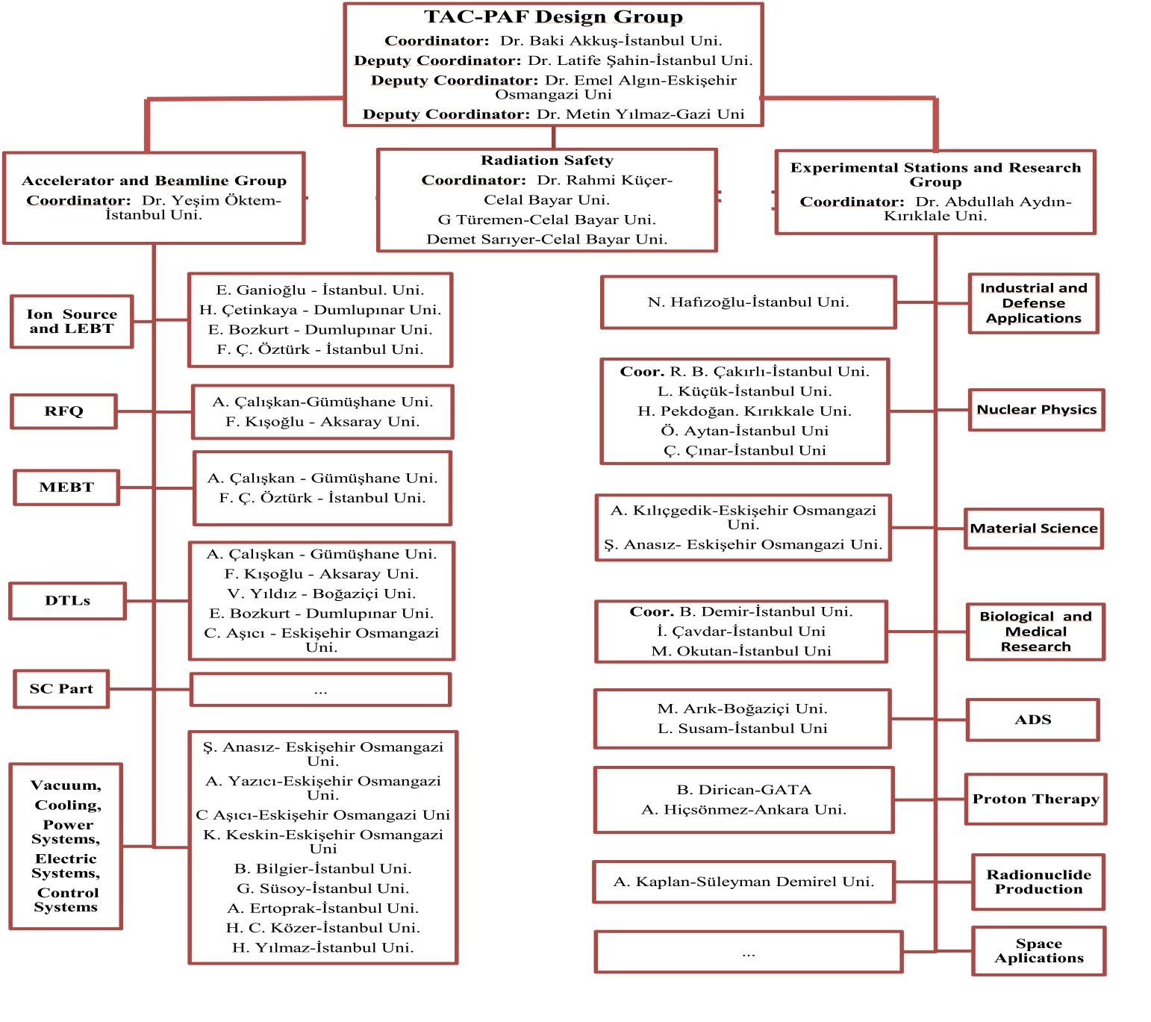
TAC Proton Accelerator Working Group

Slide 13
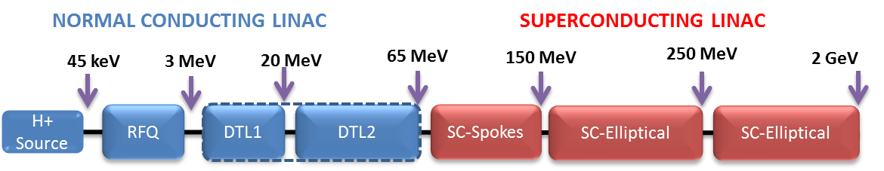
LINAC Layout of TAC-PAF
HE-PAF
LE-PAF
Stage 1
Stage 2
Stage 3

Slide 14
TAC-PAF Design Studies
Ion source studies
LEBT design studies
RFQ design studies
DTL design studies
SCL design studies
Design of the accelerator tunnel for TAC-PAF

Slide 15
Ion Source Studies (H. Çetinkaya, PhD. Thesis)
USPAS – Microwave Linear Accelerator Course, 16 – 27 Jan. 2012: Cavity Design with CST Microwave Studio
CAS – Ion Source School, 29 May – 8 June 2012: Lectures on background accelerator physics, fundementals of atomic and plasma physics, and wide range of topics starting from ion source requirements to ion source structures
TAEK Sarayköy Nuclear Research Center: Investigation of previously made microwave ion source structure starting from plasma creation to proton extraction
Pakistan Atomic Energy Commission, between August 15 – September 15, 2013: Electrode simulation using CST, Comsol, Simion

Slide 16
Ion Source Studies (H. Çetinkaya, PhD. Thesis)
A negative ion source was changed to a positive H+ ion source.
Considering the peak current of ion source to be between 10 – 60 mA because of application areas
A choice can be made between a microwave discharge and a duoplasmatron ion source for TAC PAF
Microwave Discharge Ion Source has a long life (about 1 year) and low emittance
Test stand studies of TAC-PAF ion source have been started to make more realistic designs and to understand future technical problems

Slide 17
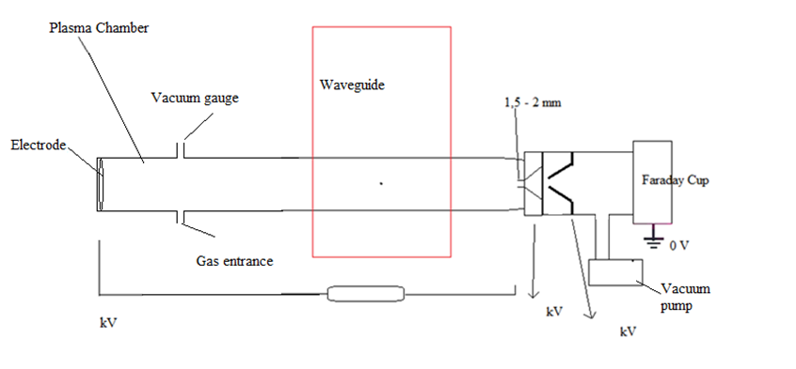
Ion Source Studies
Turkish Atomic Energy Authority Sarayköy Nuclear Research Center (TAEK-SANAEM) had made a Microwave Discharge Ion Source
The technical support for the ion source from TAEK has been obtained
Figure shows Microwave Ion Source test stand drawing for TAC-PAF.

Slide 18
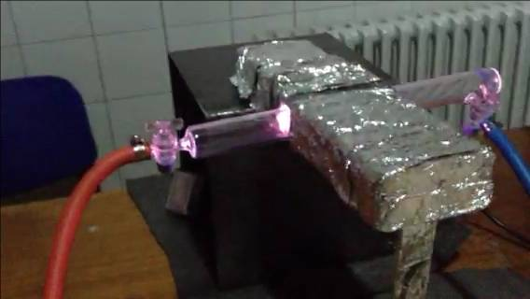
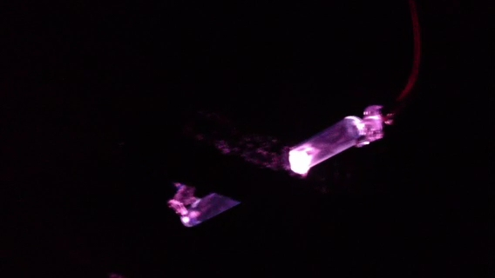
Ion Source Studies
The aims of test stand are to get experience on ion sources, to get mechanical information on the parts of system.
The plasma creation of ion source had been recently completed successfully.
The next step is to design an extraction system and to measure the beam current.

Slide 19
LEBT Studies
LİNAC4-LEBT makes the beam parameters fit with RFQ within the acceptance of RFQ by using 2 solenoids (for focusing) and 2 steerer (for steering)magnets.
LEBT with quadrupole magnets has been studied for TAC-PAF as an alternative to solenoids.
The configuration of solenoids and that of quadrupoles were simulated using the TRAVEL code and their results have been compared with each other.

Slide 20
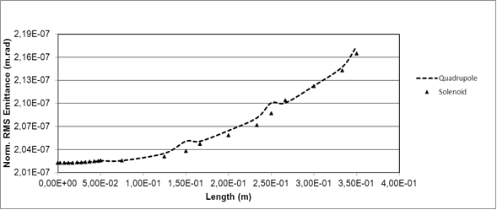
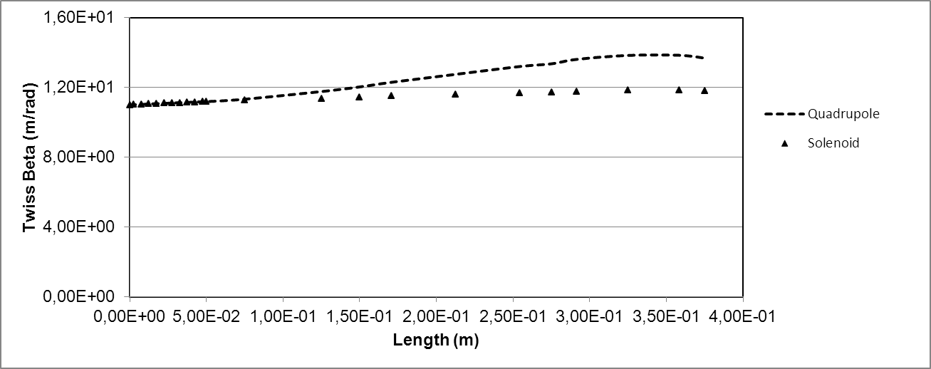
LEBT Study Results
The evolution of transverse emittance, beta function and halo formation of the beam were analysed and compared with the ones of the configuration of solenoid.
Consequently, we can not say which magnet has advantageous according to the Figure on the right top.
It is clearly seen that beta function in the configuration of solenoid is constant approximately while the variation in the configuration of quadrupole is evident. So, this puts forward the use of solenoid.

Slide 21
RFQ Studies (Dr. A. Çalışkan)
The 2D cavity design has been done using RFQfish from the SUPERFISH code group.
RF frequency is 350 MHz, but later, it will be tuned as 352.21 MHz.
It is aimed that the power dissipation in cavity walls is minimum and the parameters of the quality factor and the shunt impedance are maximum.

Slide 22
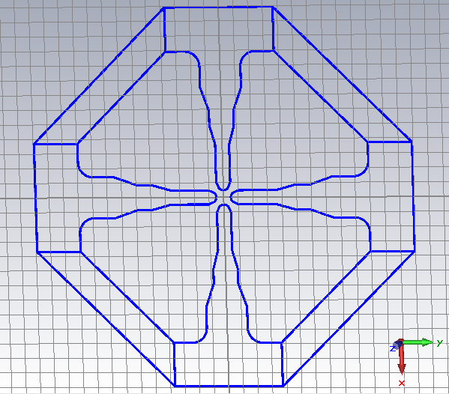
The cross section of designed RFQ cavity
2D RFQ cross section has been drawn as below by using the geometrical parameters obtained from SUPERFISH.

Slide 23
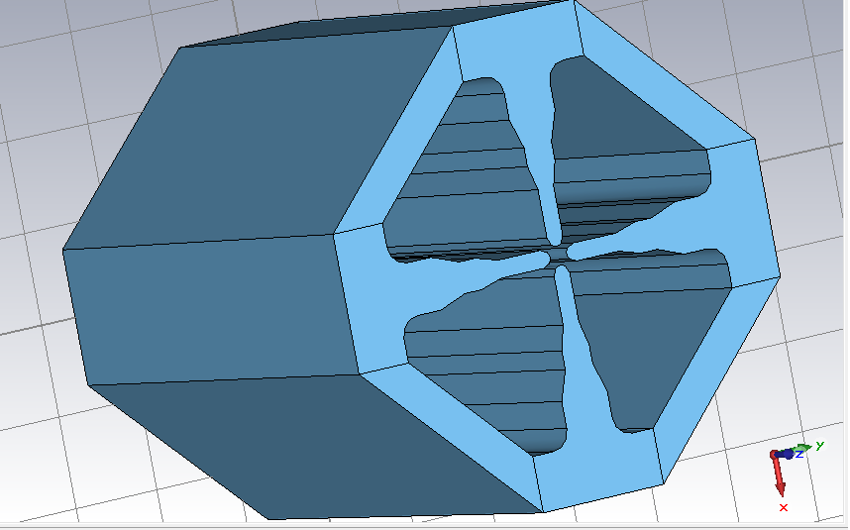
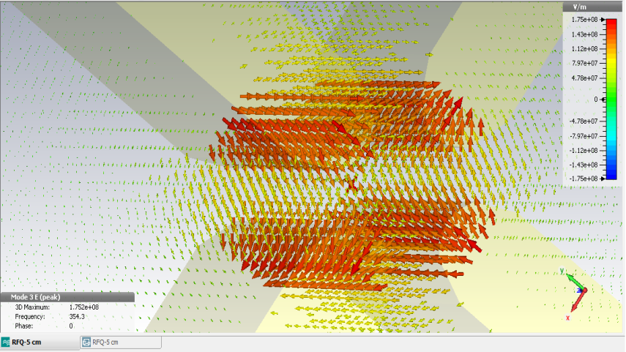
Designed 3D un-modulated RFQ model
3D plotting of 2D RFQ cavity has been performed at the second stage.
For 3D plotting, the CST Microwave Studio was used.
These results obtained from CST MWS are close to those calculated from two-dimensional SUPERFISH code.
Next, the beam dynamics simulations of RFQ accelerator by using the LIDOS.RFQ code is planned.

Slide 24
Optimized geometrical parameters of RFQ accelerator
Parameter | Value | Unit
Quality Factor (Q) | 11405 | -
Shunt Impedance (Z) | 1926,843 | MOhm/m
Power Dissipation (W) | 93,79 | W/cm
R₀ | 0,498 | cm
ρ | 0,4233 | cm
V_{g} | 60 | kV
α_{bk} | 10 | degree
B_{w} | 0,48 | cm
B_{d} | 3,6 | cm
W_{s} | 0,84 | cm
H | 9,934 | cm
W_{b} | 1,4 | cm
R_{c} | 1,02 | cm
α₁ | 15,5 | degree
α₂ | 19,5 | degree

Slide 25
DTL Studies (E. Bozkurt, V. Yıldız)
The preliminary design of two different DTL structures to operate at 352.21 MHz for Turkish Accelerator Center Proton Accelerator Facility was studied.
Both structures were designed considering the energy range from 3 MeV to 65 MeV.
After the preliminary design structures were compared by efficiency, length, and simplicity of machining and production.
SUPERFISH program was used for the electromagnetic design and Parmila program was used for the tank design.
Next, the beam dynamics will be studied for the designed DTL by using PATH manager.

Slide 26
Determined DTL Parameters
Parameters | DTL Design – 1 |  |  | DTL Design - 2
 | DTL – 1 | DTL – 2 |  | DTL – 1 | DTL - 2
Tank Number | Tank1 | Tank2 | Tank3 | Tank1 | Tank2 | Tank3
Frequency (MHz) | 352.21 | 352.21 | 352.21 | 352.21 | 352.21 | 352.21
Tank Diameter (cm) | 53 | 53 | 53 | 51 | 51 | 52
Bore Radius (cm) | 1 | 1 | 1 | 1 | 1 | 1
Inner Nose Radius (cm) | 0.4 | 0.4 | 0.4 | 0.3 | 0.3 | 0.3
Outer Nose Radius (cm) | 0.4 | 0.4 | 0.4 | 0.3 | 0.3 | 0.3
Corner Radius (cm) | 0.6 | 0.6 | 0.6 | 0.3 | 0.3 | 0.3
Flat Length (cm) | 0 | 0 | 0 | 0 | 0 | 0
Face Angle | 0 | 0 | 0 | 4.4 - 11.17 | 13.02 – 17.68 | 17.78 – 20.44
Stem Diameter (cm) | 2.5 | 2.5 | 2.5 | 2.5 | 2.5 | 2.5
Drift Tube Diameter (cm) | 9 | 9 | 9 | 9 | 9 | 9
Input Energy (MeV) | 3 | 20.26 | 50.40 | 3 | 20.27 | 45.17
Output Energy (MeV) | 20.26 | 50.40 | 65.38 | 20.27 | 45.17 | 65.17
Number of Drift Tubes | 68 | 66 | 28 | 64 | 51 | 34
Total Number of Drift Tubes | 162 |  |  | 149
Length (cm) | 813.25 | 1470.35 | 799.33 | 764.6 | 1099.2 | 947.98
Total Length (cm) | 3115.6 |  |  | 2793.78
Power Dissipation (MW) | 0.8818 | 1.5475 | 0.8568 | 0.8895 | 1.2350 | 1.0868
Total Power Dissipation (MW) | 3.28 |  |  | 3.21

Slide 27
SCL design studies
It is under R&D stage
27

Slide 28
The design of the accelerator tunnel for proton accelerators (G. Türemen, R. Küçer)
The interactions of protons with matter degrade the energy of the protons.
These interactions produce prompt radiation in the form of a spray of secondary particles.
The shielding design at proton accelerators is especially affected by the secondary neutron radiation which is produced in nuclear interactions in the target and an accelerator component.

Slide 29
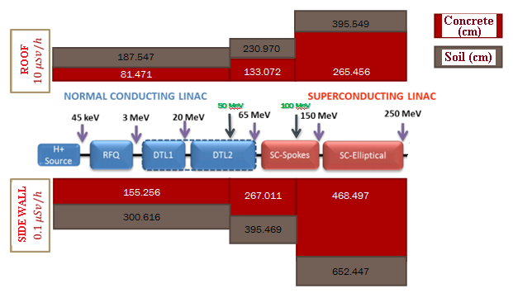
Design of the accelerator tunnel for proton accelerators
A tunnel which dimensions of 6mx5mx10m was defined for shielding of 50-250 MeV protons.
The thickness of the side wall and roof shielding for the selected energies was determined for concrete and soil with a simulation the Monte Carlo Code FLUKA.
The side wall and roof shielding effect is shown in the figure.

Slide 30
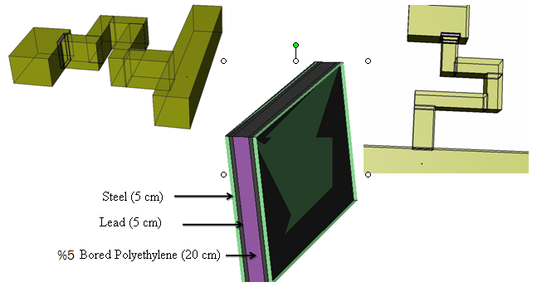
Tunnel Corridor and Door Design

Slide 31
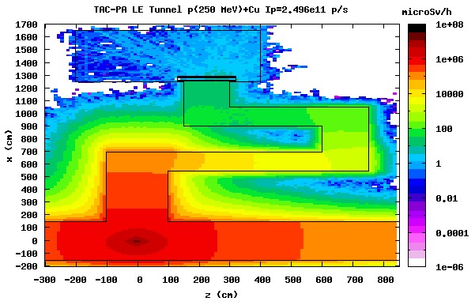
Neutron dose distribution at the entrance of the tunnel corridor and door

Slide 32
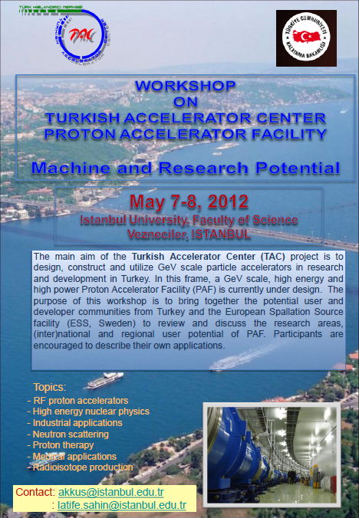
User Potential Surveys
The first workshop named “Workshop on Turkish Accelerator Center Proton Accelerator Facility - Machine and Research Potential” was performed between May 7th and May 8th, 2012.
A new LINAC and experimental stations designs of TAC-PAF were introduced after this user workshop

Slide 33
User Potential Surveys
Second workshop called “National Proton Accelerator Workshop” for user potential and demands from other areas covering industry, material science, etc. had been organized in collaboration with TAEK- PAF (TAEK Proton Accelerator) time between April 18th and April 19th, 2013.
The workshop was organized to give information about the built and planned proton accelerators in Turkey
To see demands for researches by using a proton accelerator technology and to evaluate the development and implementation activities.
The user profile and the road map for proton accelerators were tried to be determined in this workshop.
80 people participated in the workshop from universities and various institutions. 19 papers and 9 posters have been presented.

Slide 34
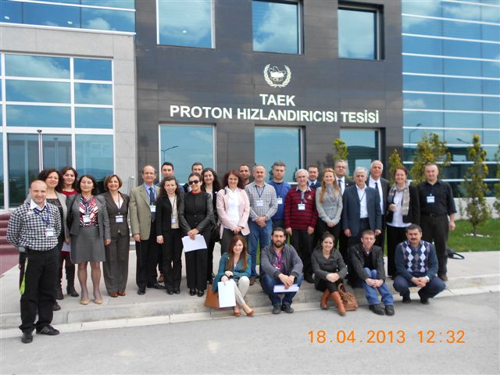
The results of second workshop
I
Within the TAC-PAF project, the necessity of R & D activities of hadron therapy was emphasized.
In general, it was discussed on the importance of neutron spallation source and of neutron usage in industry, R & D and different application areas.
It was stated that the TAC-PAF project will be a major infrastructure in terms of neutron production.
It was also expressed that the current TAEK-PAF should have an infrastructure that will allow the production of neutrons.
The accelerator-driven systems and its future in the world should be evaluated in the next workshop.
The importance of staff training for accelerator technology and of skilled manpower was emphasized.

Slide 35

TAC-PAF Possible Experimental Station Layout
Industrial and Defense Applications:
1. Neutron radiography
2. Neutron source
4. Nano-technology
5. Semiconductor application
Neutron Region:
1.Isotope production
2.Magnetism
3.Structural Materials
4.Polymers
5.Industry
6.Electronics
Nuclear Physics
Material Science:
1.Microbeam
Biological and Medical Research
3 MeV
20 MeV
65 MeV
150 MeV
250 MeV
2 GeV
Accelerator Driven Systems
1. Nuclear Transmutation
2. Nuclear Energy
LINAC Front Ends
DTL 1
SC-Elliptical
H+
RFQ
DTL 2
SC- Spokes
SC-Elliptical
Radioisotope Production
Proton Therapy
R&D
Radioactive Ion Beam
1. Nuclear Physics
2. Nuclear Astrophysics
Space Applications

Slide 36
Proton Microbeam
Proton microbeam with a small beam spot size < 1mm is very useful for many scientiﬁc and technical applications in the ﬁelds of material, biological, and medical sciences.
A proton microbeam has usually been used to study distribution of elements in a variety of surfaces. There are four main application ﬁelds: PIXE in vacuum and air, RBS, a micromachining for MEMS applications, and a hydrogen proﬁling for mineral material and biological samples.

Slide 37
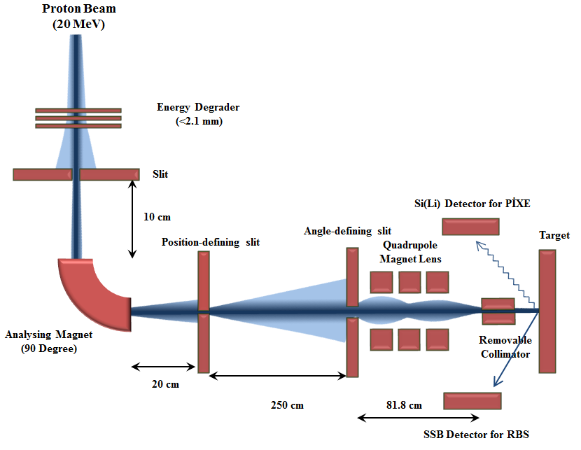
TAC-PAF Proton Microbeam Design (E. Alğın)

Slide 38
Research On Accelerator Driven Systems
Accelerator driven systems (ADS) can be studied to provide a possible alternative to critical reactor systems
High-energy protons produced by an accelerator bombard a 'target',
Produce an intense neutron source; this part of the process is termed 'spallation'.
These neutrons are multiplied up in a sub-critical reactor
These neutrons can have reactions to generate nuclear power with thorium as fuel
Nuclear waste transmutation can be achieved.

Slide 39

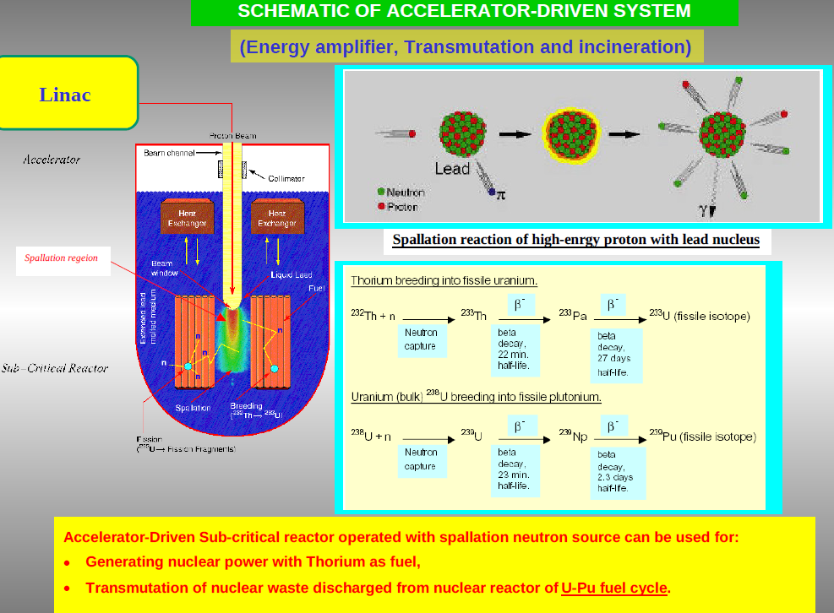

Slide 40
Cyclotron in Turkey
There are 12 cyclotrons in Turkey and all of them are
used for radioisotopes production.
Turkish atomic energy agency (TAEK) constructed
a cyclotron with 1,2 mA beam current and energy ranges between 15-30 MeV for radioisotopes production
⁶⁷Ga, ¹¹¹In, ²⁰¹Tl , ¹⁸F isotops are being produced and ¹⁰³Pd, ¹²⁴I, ¹¹C, ¹³N, ¹⁵O, ⁶⁸Ga will be produced in the near future.
There will be also R&D program for this cyclotron.

Slide 41
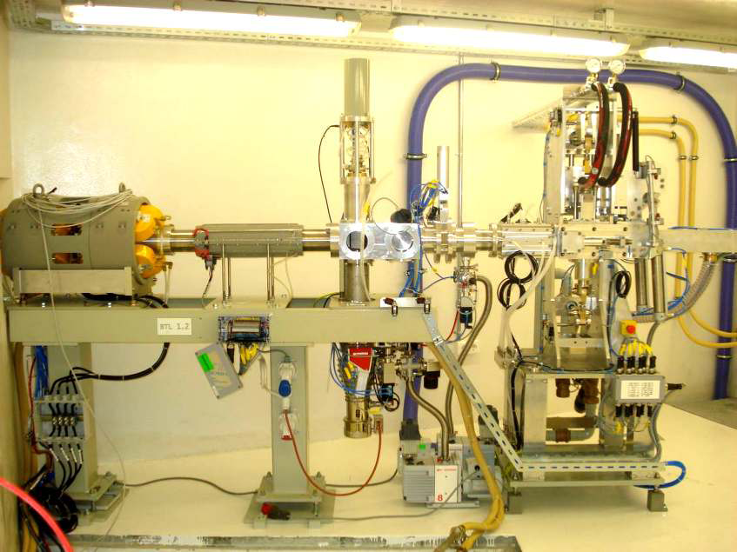
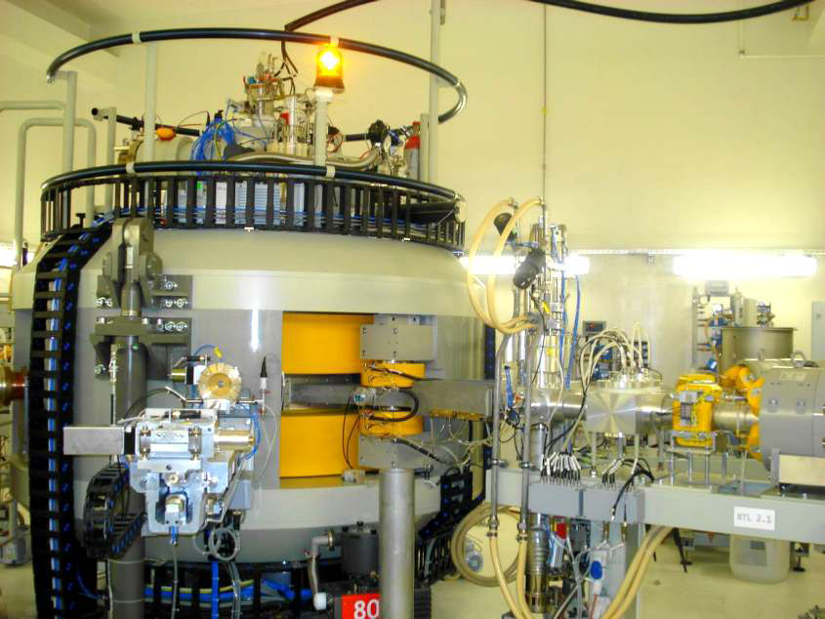
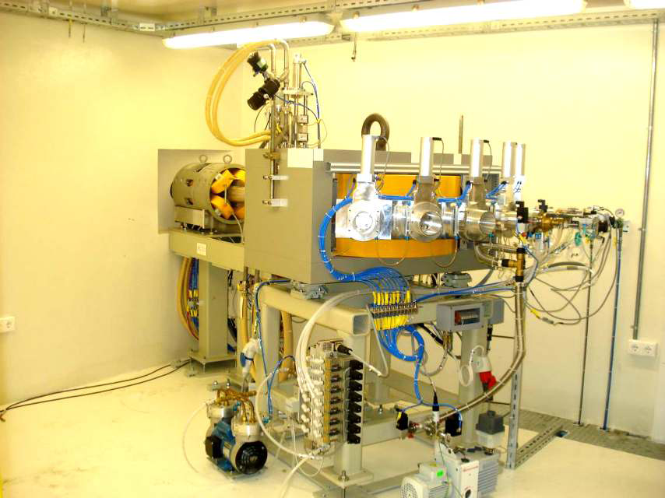
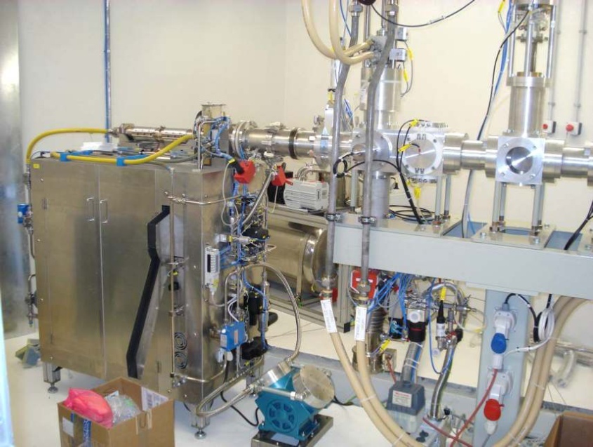
Cyclotron in TAEK

Slide 42
There are ~150 Medical Linacs for electron and photon therapy in Turkey*
Accelerator | Electron Energy (MeV) | Photon Energy (MV) | Number
Linac | 4-6-7-8-10-12-14 | 6-15 | 80
Linac | 4-6-8-10-12-14-16 | 6-18 | 62
Linac | 8-10-12-14 | 10-15 | 1
Linac | 4-6-8-10-12-15-18-20-25 | 6-25 | 2
Linac | 4-6-7-8-10-12-14 | 6-10-15 | 2
Linac | - | 6 | 3

Slide 43
Future Collaborations:
CERN, Europe
ESS, Sweden
INFN, Italy
Fermi Lab.

Slide 44
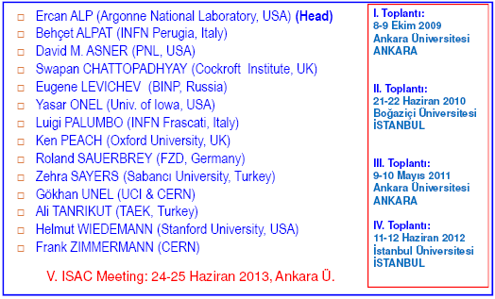
International Scientific Advisory Committee (ISAC)
June 24-25

Slide 45
Summary and Conclusions
Design studies have been in progress in TAC-PAF group.
Students have been sent to different accelerator laboratories to get experience.
Collaborations are in progress with the different accelerator laboratories.
The project proposal for the Ministry of Development is planned to be presented at the beginning of 2014, once a complete project including all technical details, work plan, and budget breakdown is finished.

Slide 46
THANK YOU FOR YOUR ATTENTION!

