Slide 1
High Power Target R&D Program at Fermilab
Modified from AccApp’13
P. Hurh, K. Ammigan, B. Hartsell, R. Tschirhart (FNAL)

Slide 2
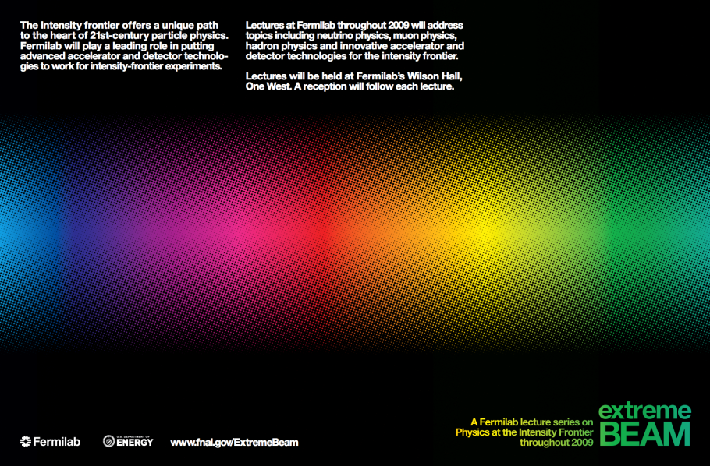
HPT R&D Program Motivation
In 2009, claims to the Intensity Frontier explored
By 2011, operational target challenges experienced
  Fermilab (NuMI-MINOS)
  SNS
  CERN (CNGS)
  J-PARC (T2K)
Plans for exploring the intensity frontier at Fermilab
  Project X

Slide 3
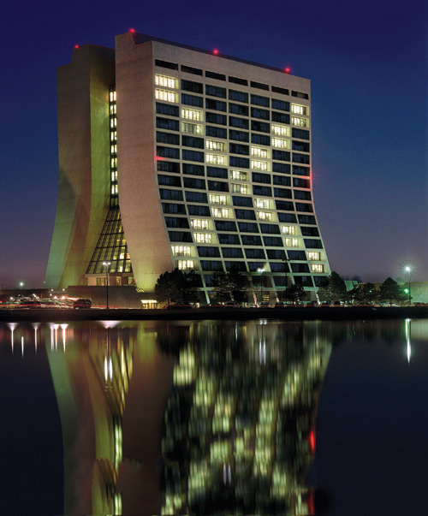
What is Project X?
Project X is a proposed proton accelerator complex at Fermilab that would provide the particle physics world with powerful and sensitive tools to explore a new scientific frontier. This facility would provide particle beams to multiple experiments searching for rare and hard-to-detect phenomena that will further our understanding of fundamental physics.
“Project X” was a temporary title used at a 2007 planning meeting where the first version was introduced. The name, for better or worse, has stuck thus far.

Slide 11
1 MW
3 GeV
CW
<1 cm sigma
Rotating graphite target
Or liquid gallium waterfall target

Slide 12
1 MW
3 GeV
CW
<1 cm sigma
Rotating graphite target

Slide 13
1 MW
3 GeV
CW
<1 cm sigma
Rotating graphite target
Or liquid gallium waterfall target

Slide 19
Example Power Staging Plan for the Research Program
Program: | Onset of NOvA operations in 2013 | Stage-1: 1 GeV CW Linac driving Booster & Muon, n/edm programs | Stage-2: Upgrade to 3 GeV CW Linac | Stage-3: Project X RDR | Stage-4: Beyond RDR: 8 GeV power upgrade to 4MW
MI neutrinos | 470-700 kW** | 515-1200 kW** | 1200 kW | 2450 kW | 2450-4000 kW
8 GeV Neutrinos | 15 kW + 0-50 kW** | 0-42 kW* + 0-90 kW** | 0-84 kW* | 0-172 kW* | 3000 kW
8 GeV Muon program e.g, (g-2), Mu2e-1 | 20 kW | 0-20 kW* | 0-20 kW* | 0-172 kW* | 1000 kW
1-3 GeV Muon program, e.g. Mu2e-2 | ----- | 80 kW | 1000 kW | 1000 kW | 1000 kW
Kaon Program | 0-30 kW** (<30% df from MI) | 0-75 kW** (<45% df from MI) | 1100 kW | 1870 kW | 1870 kW
Nuclear edm ISOL program | none | 0-900 kW | 0-900 kW | 0-1000 kW | 0-1000 kW
Ultra-cold neutron program | none | 0-900 kW | 0-900 kW | 0-1000 kW | 0-1000 kW
Nuclear technology applications | none | 0-900 kW | 0-900 kW | 0-1000 kW | 0-1000 kW
# Programs: | 4 | 8 | 8 | 8 | 8
Total max power: | 735 kW | 2222 kW | 4284 kW | 6492 kW | 11870kW
LBNE
Muon
Kaon
Neutron
Neutron
Neutron
* Operating point in range depends on MI energy for neutrinos.
** Operating point in range is depends on MI injector slow-spill duty factor (df) for kaon program.

Slide 20
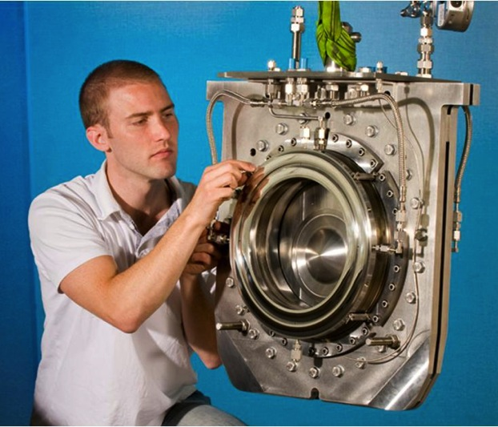

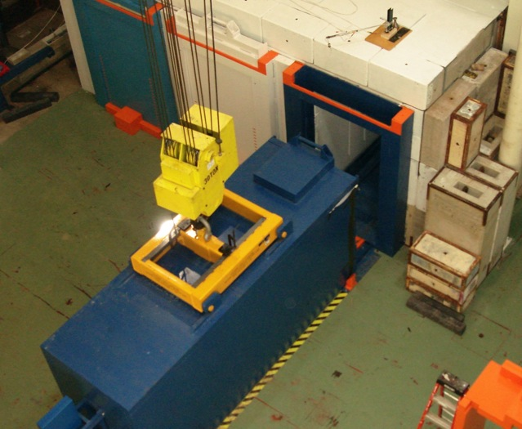
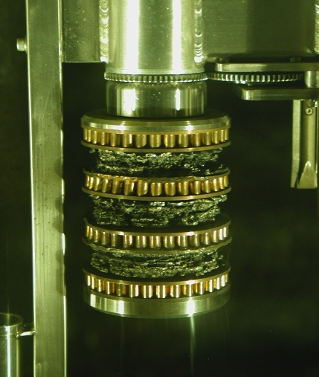
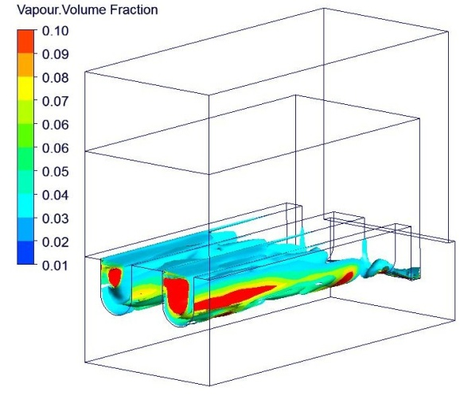
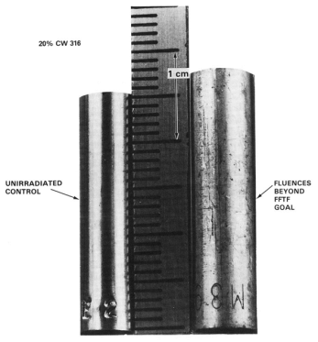
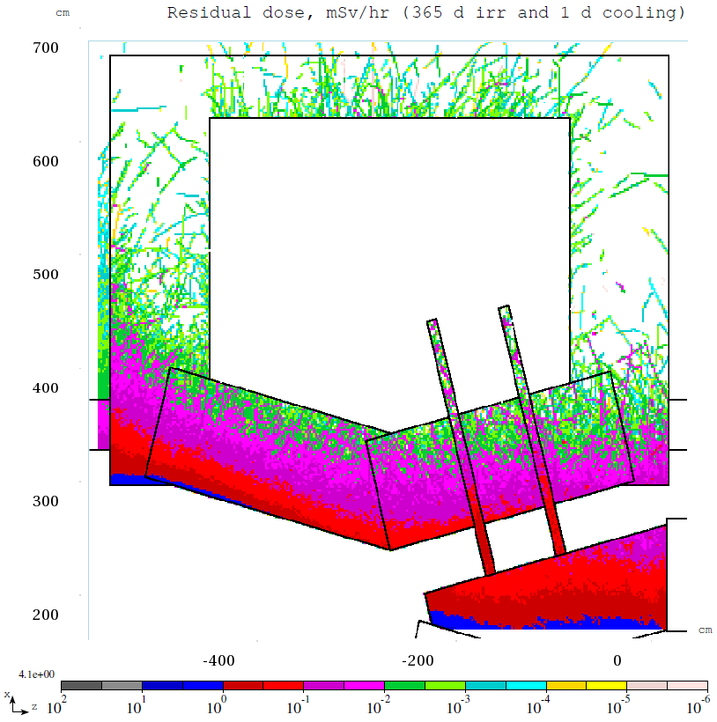
The High Intensity Frontier Presents Critical Targetry Challenges:
Thermal Shock
Remote Handling
High Heat Flux Cool
Radiation Protection
Liquid Metal
Beam Windows
Radiation Damage

Slide 21
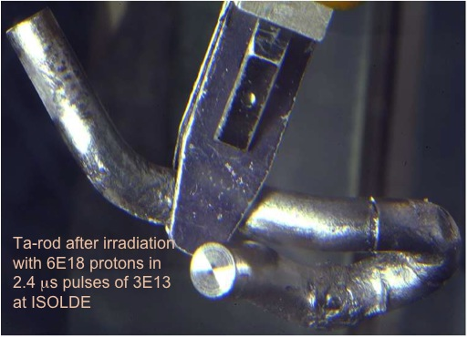
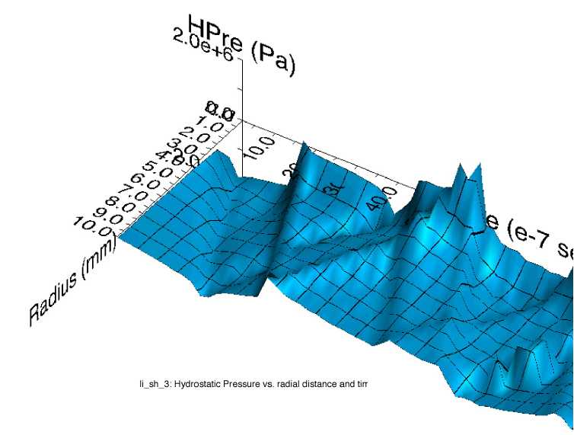
Thermal Shock (stress waves)
Ta-rod after irradiation with 6E18 protons in 2.4 μs pulses of 3E13 at ISOLDE (photo courtesy of J. Lettry)
Simulation of stress wave propagation in Li lens (pbar source, Fermilab)
Fast expansion of material surrounded by cooler material creates a sudden local area of compressive stress
Stress waves (not shock waves) move through the target
Plastic deformation or cracking can occur
Notes:
Ta-rod after irradiation with 6E18 protons in
2.4 μs pulses of 3E13 at ISOLDE

Slide 22
Thermal Shock (stress waves)
Methods to overcome thermal shock:
  Material Selection
    High specific heat
    Low coefficient of thermal expansion
    Low modulus of elasticity
    High strength (tensile and fatigue) at elevated temperature
  Segment target length
  Manipulate beam parameters (spot size, intensity)
Affects flowing liquid targets and CW beam with rotating targets as well
  Cavitation in liquid metal (SNS)
  Rotating target in CW beam (FRIB)
Notes:
One misconception about thermal shock is that it does not apply to CW beam or liquid targets. Pulsed beam on liquid has resulted in quite some problems for SNS and rotating solid targets also set up a dynamic and cyclic effect that must be addressed during R&D.

Slide 23
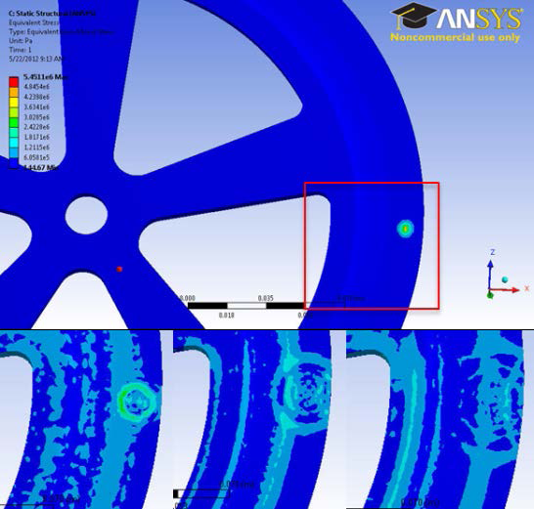
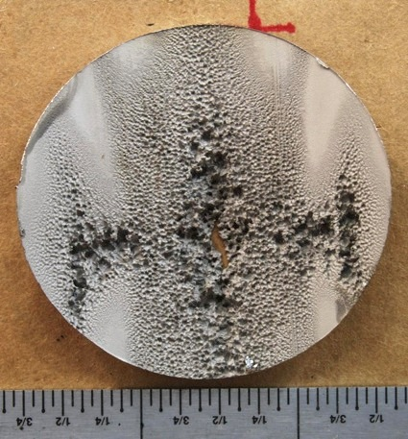
Thermal Shock (stress waves)
Stress developing:
0 μs (top), 1.8 μs, 4.2 μs
and 6 μs. Unit is Pa
Stress wave from the
beam pulse is seen
M. Avilov, FRIB, 06/14/2012
Beam induced cavitation damage in SNS target. B. Riemer for PASI 2012
Notes:
One misconception about thermal shock is that it does not apply to CW beam or liquid targets. Pulsed beam on liquid has resulted in quite some problems for SNS and rotating solid targets also set up a dynamic and cyclic effect that must be addressed during R&D.

Slide 24
Thermal Shock R&D at Fermilab
Initially focus on beryllium response
  Neutrino targets
  High intensity beam windows
Simulation (ANSYS, LS-DYNA)
HiRadMat Test
NOvA ME Target Be Fin Test
Working closely with HPT community on other materials and irradiation environments
  RAL
  FRIB
  CERN
  Tungsten
  Graphite
  Titanium Alloys

Slide 25
High Intensity Beam Pulse Test at HiRadMat (CERN)
HRMT-14 Collimator materials test rig (image courtesy of A. Fabich, CERN)
Proton beam capabilities:
  up to 4.9e13 ppp
  440 GeV
  0.1 mm – 2.0 mm sigma radius
Test on Be windows to detect:
  Onset of plastic deformation (DIC, strain gauge)
  Fracture (DIC, leak detection, high speed camera)
  Effect of mis-steered beam (DIC, strain gauge, leak detection)
  Beam induced resonance (Strain gauge, LDV, High speed camera)
May also use previously irradiated Be

Slide 26
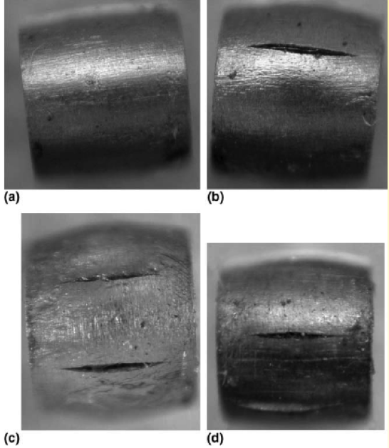
Radiation Damage
Displacements in metal crystal lattice
  Embrittlement
  Creep
  Swelling
  Fracture toughness reduction
  Thermal/electrical conductivity reduction
  Coefficient of thermal expansion changes
  Accelerated corrosion
  Transmutation products (impurities, gas production)
Very dependent upon irradiation conditions (eg. temperature)
0 DPA
3.2 DPA
14.9 DPA
23.3 DPA
S. A. Malloy, et al., Journal of Nuclear Material, 2005. (LANSCE irradiations)
Notes:
One notes that all the properties that are important for thermo-mechanical health of the target are affected by radiation damage. The dependence on irradiation temperature is due to annealing (or healing) the crystal structure is faster at higher temperatures.

Slide 27
Radiation Damage
p
100+ MeV
n
1-14 MeV
Irradiation Source | DPA rate (dpa/s) | He gas production (appm/DPA) | Irradiation Temp (˚C)
Mixed spectrum fission reactor | 3e-7 | 0.1 | 200-600
Fusion reactor | 1e-6 | 10 | 400-1000
High energy proton beam | 6e-3 | 100 | 100-800
14.9 DPA
23.3 DPA
Effects from low energy neutron irradiations do not equal effects from high energy proton irradiations. Table compares typical irradiation parameters.
Notes:
Irradiation parameters are quite different, especially gas production which is particularly worrisome. However nuclear materials scientists have a lot of expertise that they could lend in this area.

Slide 28
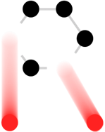



RaDIATE
Collaboration
Radiation Damage In Accelerator Target Environments
See Kavin Ammigan’s talk:
The RaDIATE collaboration R&D program: status and update
THOTA03
Thursday 09:35
Broad aims are threefold:
to generate new and useful materials data for application within the accelerator and fission/fusion communities
to recruit and develop new scientific and engineering experts who can cross the boundaries between these communities
to initiate and coordinate a continuing synergy between research in these communities, benefitting both proton accelerator applications in science and industry and carbon-free energy technologies

Slide 32
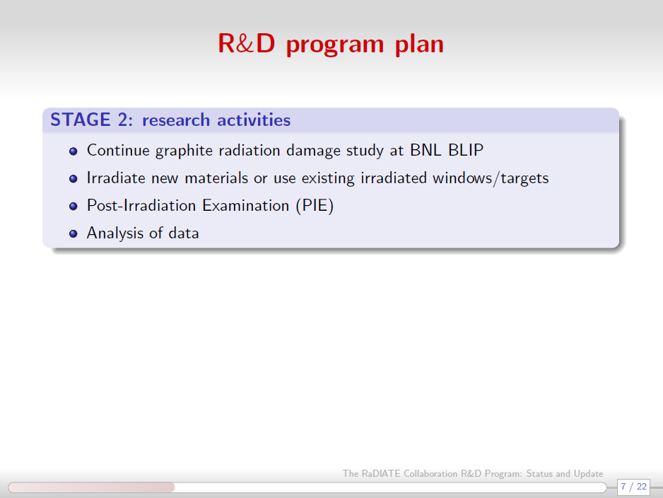

Slide 36
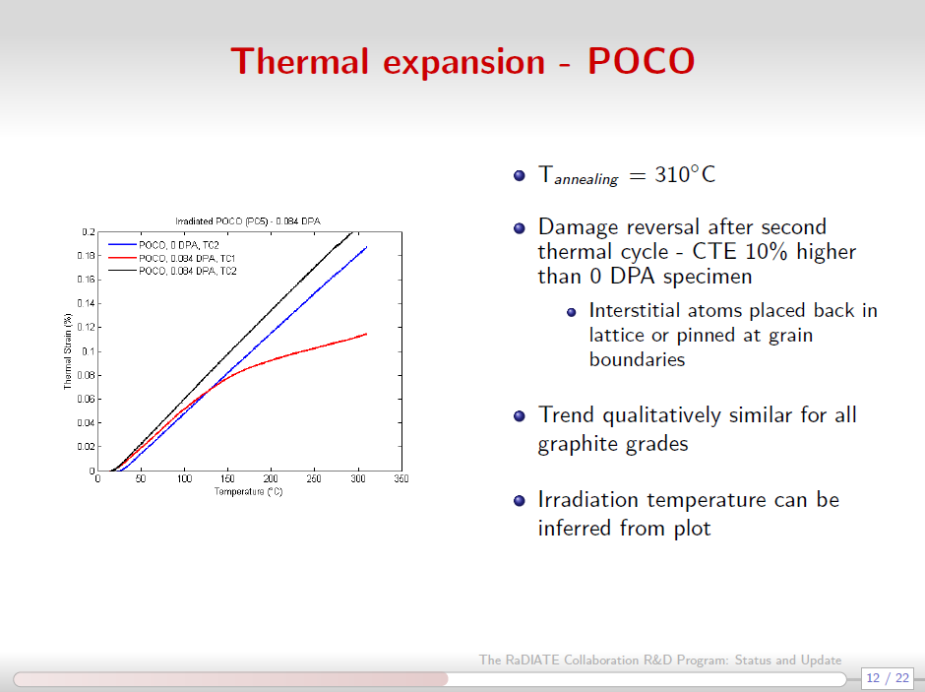

Slide 37
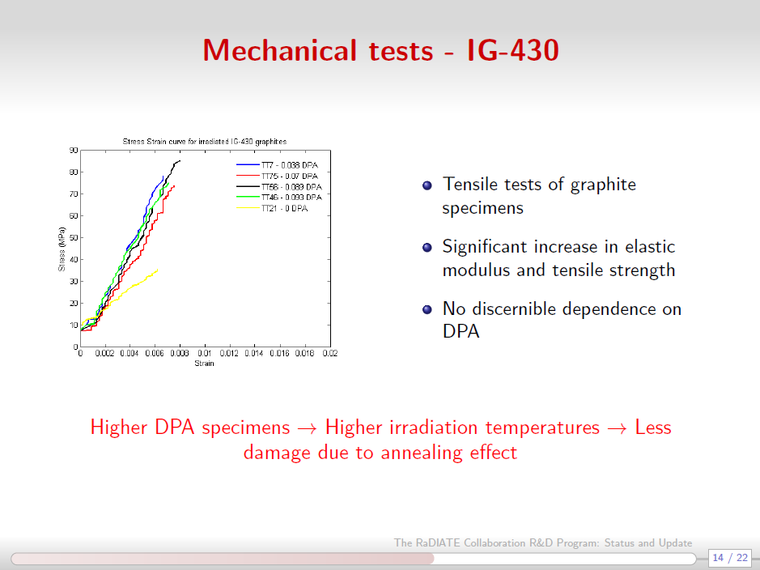

Slide 39
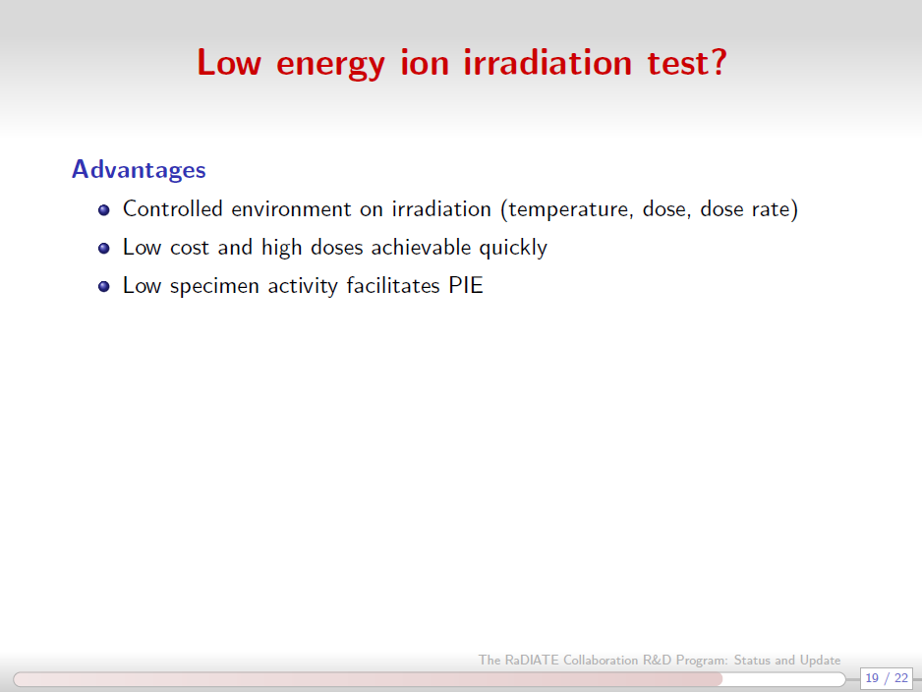

Slide 40
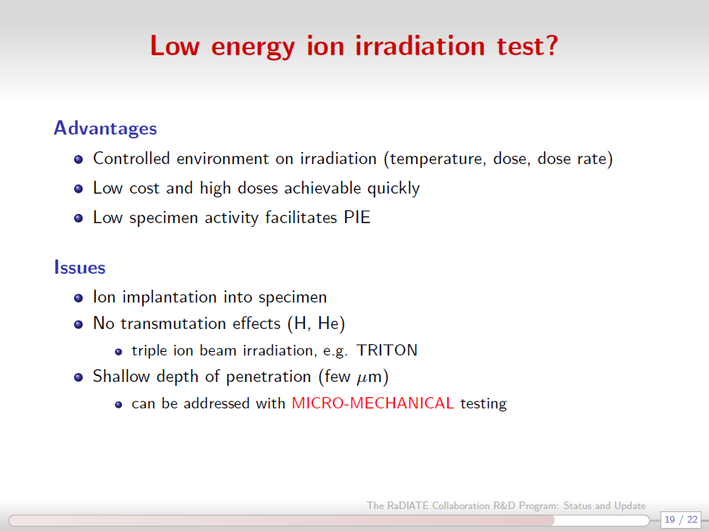

Slide 41
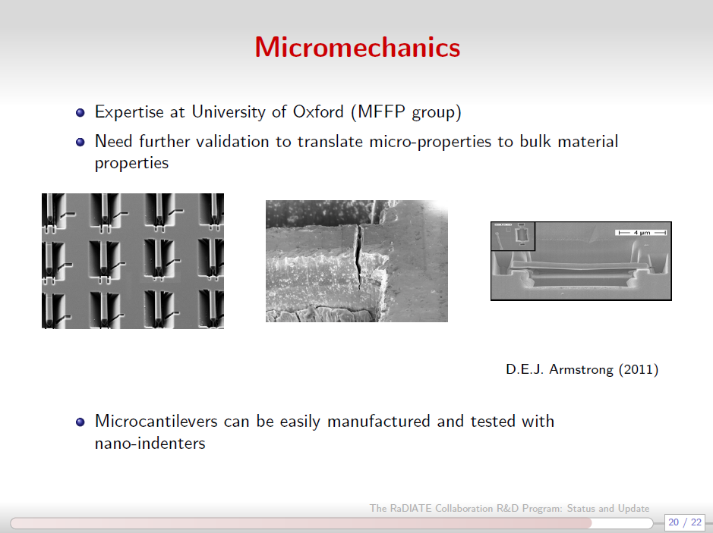

Slide 42
RaDIATE
Collaboration
Radiation Damage In Accelerator Target Environments
(www-radiate.fnal.gov)
Broad aims are threefold:
to generate new and useful materials data for application within the accelerator and fission/fusion communities
to recruit and develop new scientific and engineering experts who can cross the boundaries between these communities
to initiate and coordinate a continuing synergy between research in these communities, benefitting both proton accelerator applications in science and industry and carbon-free energy technologies

Slide 43
Summary
High Intensity Frontier motivates HPT R&D
Fermilab program (neutrino) focused primarily on:
  Thermal Shock
  Radiation Damage
    Graphite (& C-C composite)
    Beryllium
Engaged in the global HPT community
  RaDIATE
  HiRadMat
  5th High Power Targetry Workshop at Fermilab (May, 2014)

