Slide 1
SLAC Site Visit for Marx Modulator Control Development
Trevor Butler
December 18th 2013

Slide 2
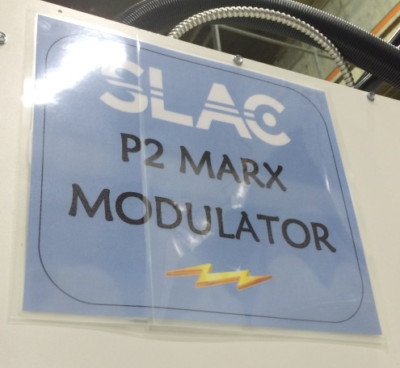
Introduction
This project started in Dec 2011 with discussions with many vendors
SLAC Proposed developing a Marx modulator based on P2 Marx
Instead of purchasing a prototype modulator from the beginning, to reduce contingency, the development work was broken up in three phase so far. This has the added benefit of spreading out cost.
The goal of this development work is threefold
Develop system to show proof of principle for application into Linac
Decrease the cost of the prototype by reducing the design contingency
Need to keep engineers working on this project
Key members of the design will likely be retiring at SLAC in the next few years, and by continuing the development, their expertise can be utilized.
System designers (Mark and Tony) are the overall system experts will be around for a while, where many of the component experts will be retiring soon.

Slide 3
Stages
Phase 1 ($57,456 on 2/3/2012)
Simulate circuit model and present resulting waveforms demonstrating critical parameters
Develop controls block diagram with hardware preferences and required future development.
Develop vetted detailed cost estimate with schedule, major component choices and quotes
Produce footprint of modulator along with utility needs
Phase 2 ($73,914 on 9/25/2012)
Verification of cell hardware at the two cell level
Modify two Marx cells and the test stand to accommodate the Fermi cell parameters.
Demonstrate the transient waveform characteristics at the single and two cell level.
Phase 3 ($46,556 on 10/1/2013)
Incorporate the model of the cavity and triode into the circuit model in order to generate expected cavity gradient.
Control algorithm will be written to feed-forward on the gradient signal.
A simulated beam will be "injected" into the simulated cavity to model effect of vernier Marx firing to keep flat gradient. SLAC will evaluate the effect of various damping factors on the control algorithm and determine how fast the desired waveform can be achieved
Detailed block diagram of the control algorithm will be authored. The deliverable will be a final report of the study results.
Received revised cost estimate for the prototype.
Future Phases
Would further reduce system cost by eliminating the final contingencies of the design.
Would be stepping stones to keep development moving while waiting for final decision. If we wait to long, many of the developers will have moved on to other projects, increasing the start up time to keep this project moving

Slide 4
Fermi Marx System Outline
Power Supply Rack
10+5 Cell Marx Modulator
Triode
4kVDC
480VAC
4kVDC
35 kV
1kVDC
~300 A
Cell info
Reference
PS Controller
Marx “Application Manager” Level
Fast interlocks
Cavity
Reference
Outside world

Slide 5
Fermi Marx System Outline
35 kV
Cell D,E
Cell 1
Cell 10
Triode
3
3
3
Cell C
Cell 2
Cell 9
3
3
3
Cell B
Cell 3
Cell 8
3
3
3
Cell A
Cell 4
Cell 7
Three independent bus voltages
Two types of similar cells
Vernier
Main
ground
3
3
1 kV bus
4 kV bus1
4 kV bus2
Cell 5
Cell 6
3

Slide 6
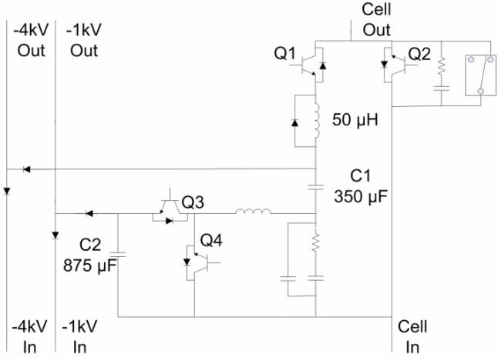
Marx Cell Structure
Fundamentally, the same cell as the P2 Marx
However, different values for silicon, snubbers, and PWM filter
Cell snubber
di/dt limiting inductor
PWM filter

Slide 7
Basic Cell Circuit

Slide 8
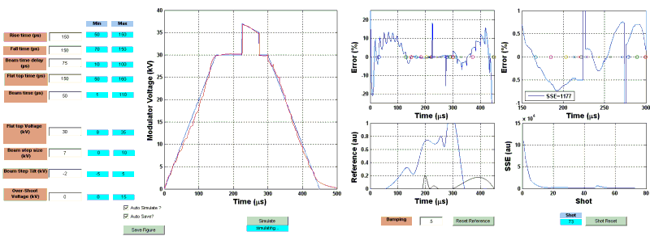
Voltage Control Mode
No Overshoot of the voltage waveform which will be required in the final system
No adaptive control of extra beam step to accommodate beam
Different Start Times
Different Beam Shapes
Different Beam Types

Slide 9
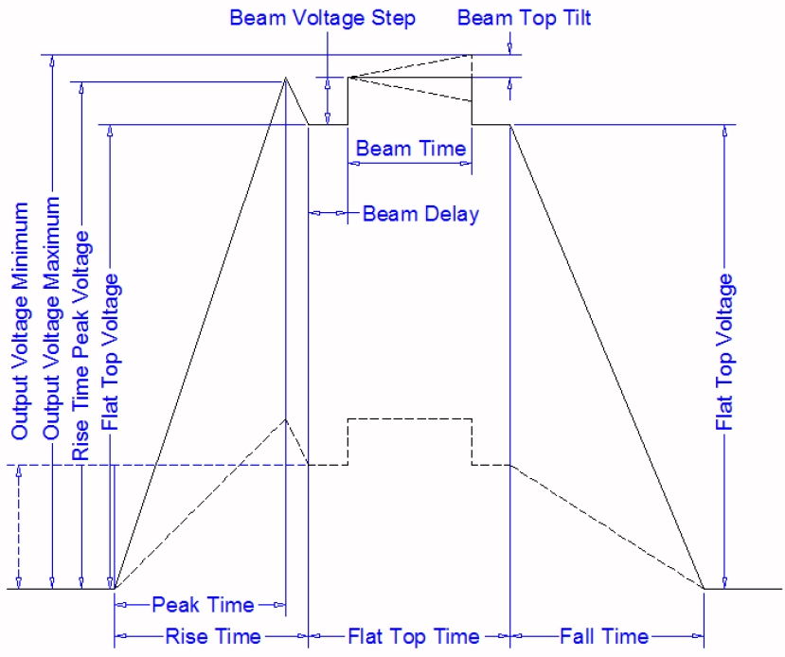
Cell “Roles”
Vernier + Main
Main

Slide 10
Cell “Roles”
Temporal:
Staggered main cell turn on
(2) Short vernier cell turn on then off
(3) All main cells on
(4) All vernier cells turn on then off
(5) All main cells still on
(6) Staggered main cell turn off
(1)
(2)
(3)
(4)
(5)
(6)

Slide 11
Cell “Roles”
Amplitude “correction”:
main PWM
(2) main PWM
(3) main 4kV bus + main PWM
(4) Vernier 4 kV bus + vernier PWM
(5) main PWM
(6) main PWM
(1)
(2)
(3)
(4)
(5)
(6)

Slide 12
Original Control Topology (Voltage)
Document “Fermilab Linac Modulator Controls Modifications for SLAC Marx” (4/23/2013) – 18 pages
Developed initial frame work for controls topology
SLAC initial suggestion was voltage regulation as the original specification seamed to indicate
Discussed the challenge in doing a modulator design based on voltage control only
Creating a flat pulse gradient pulse by overshooting the voltage during the begin to reduce filling time
Compensating for the Beam Loading using the present LLRF system. Extra difficult because the old system was designed specifically around the limitations in the tube based modulator
Interfacing with the driver waveform generator and bypassing the present gradient regulator and amplitude control module.
Ends with the analysis that using gradient control would be the best option for the new modulator

Slide 13
Optimal Control Topology (Gradient)
Document “Update of Fermilab Linac Modulator Controls Modifications for SLAC Marx” (11/1/2013) – 15 pages
This paper was used as a starting point of the controls design of the modulator using gradient feedback instead of voltage control
SLAC used this paper as a template to create in initial block diagram that would be edited to suit our desires for operation
Advantages of Gradient Regulation over Voltage Regulation
System can be used to compensate for the fill time of the accelerating cavities by overshooting the voltage (Still working on the algorithm to achieve this)
Replace the present interlocks, waveform generator, gradient regulator, and amplitude control module by placing all functionality into the modulator control system
Regulate the voltage level out of the modulator by observing the cavity gradient, insuring that the system will keep the required voltage needed for the gradient set point. This would also add a lock command to inform the accelerator controls system when the modulator is ready to accept beam
Replace the amplitude control features of the LLRF system by decoding our pre-pulse, beam chopper, beam toroid, and playing a modulator voltage waveform required to keep gradient flat. This should work better than the present system and should make the system free from daily tuning maintenance.

Slide 14
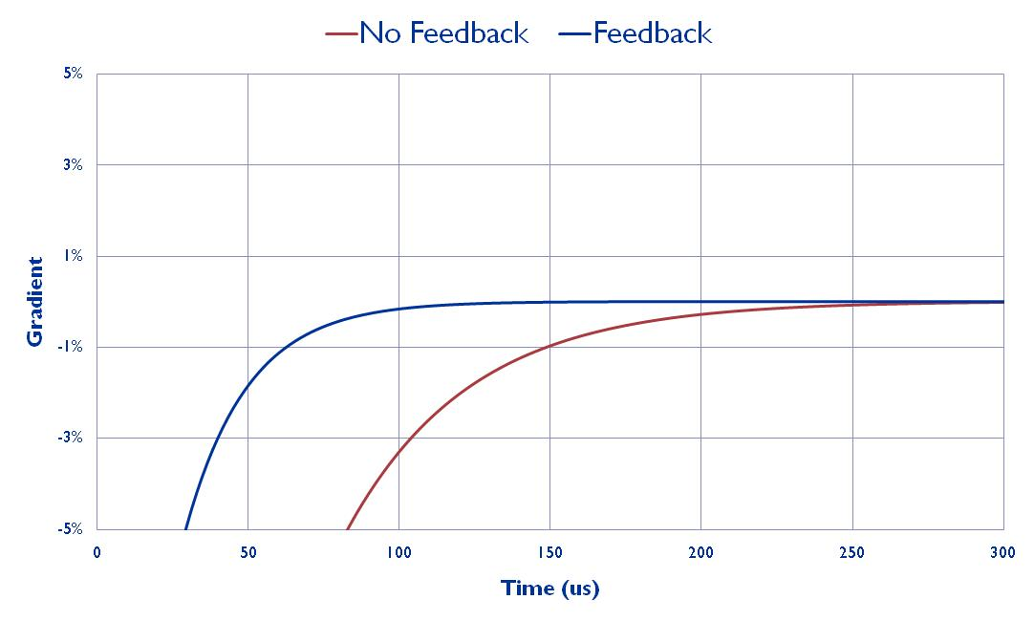
*Cavity Field Simulation (Feedback)

Slide 15
Visit to on Dec 10-11th 2013
Meet with Mark Kemp and Tony Beukers to discuss the third round of studies with the goal of modeling the Marx modulator in a RF system with beam loading and modulator amplitude control
Discussed main goals of this next stage of development.
Went over the control model initially proposed by SLAC as a first attempt at taking our controls specification and translating into block diagrams
During our 8 hours together, we found many corrections and additional features that must be added.
Created list of tasked needed to complete this stage of engineering development.

Slide 16
Interlocks & Gate Pulse

Slide 17
Interlocks & Gate Pulse
Used to replace the some of the functionally of the present interlock module
May still need to build a DC interlock summing box to input present and future interlocks into Marx Modulator
Replace the functionally of the present driver pulse control of the waveform generator
Will be used to shut down the modulator in the case of the driver system droops or trips off

Slide 18
Main Cell Start Up

Slide 19
Main Cell Start Up
Will be used to raise the modulator gradient slowly, preventing to much reverse power in the system
Will learn the required voltage waveform for each gradient set point and wave shape
All rise time, fall time, flat top time, etc. will be programed via the modulator control system, with a overall gradient set point feed from our control system to merge both systems
Will provide a lock command to the vernier portion of the modulator controls, but also to the ACNET control system to enable beam and verify gradient is not only up to nominal level, but is flat across the pulse

Slide 20
Feed Forward Pulse (for Vernier)

Slide 21
Feed Forward Pulse (for Vernier)
Will replace almost all of the functionally of the present LLRF system
Will replace the amplitude control portion of the LLRF
Will still need to use the phase set point, and phase feedback of the LLRF system
Will decode the type of beam coming on each pulse
Will create tables for each type of beam since, if the beams start at different times and may have different shapes, they will each require a different table (like the present system)
Unlike the present system, since this system will be doing a point to point algorithm on the waveform
It is unknown how the sampling frequency of 80 kHz will work with the waveform to achieve the desired waveform stability – goal of determining this is part of the study
Will be a challenge at where to store the data since we only know the beam type 1 ms before beam, and it takes longer than that to download data from the application manager to the individual cell.
We may end up storing the data for each cell in each cell and update any changes during the dead time, requiring a pulse during the 1 ms time window telling the cells which table to fire.

Slide 22
Vernier Start Up

Slide 23
Vernier Start Up
After the modulator voltage waveform is locked, the new Marx control system will apply a vernier pulse to compensate for the beam step.
This system would be constantly learning, keeping constant correction of the gradient
Since beam current can change with in a few seconds, constant learning is critically to achieving system stability. We anticipate this working well, but this stage of controls development should give further confidence.
The gain and frequency response characteristics of the 7835 tube can also change (not typically a problem with Klystrons, such as ILC)
This requires the Marx modulator control system to also monitor gradient waveform during not beam pulse, and if the start to drift with a certain percentage of a settable error, then the modulator will loos lock
This would require a relearning of the main loops, occasionally disabling beam in the Linac. With proper turning, this should rarely occur during normal operation with proper setting of the limits, but may occur frequency during the first 15 minutes after a station is turned on for the first time
Since the firing of the main cell is not limited to the PWM frequency of the vernier cell, achieving the desired resolution of the beam step should work well. More details of this algorithm will need to be shown to prove this, but early studies look promising

Slide 24
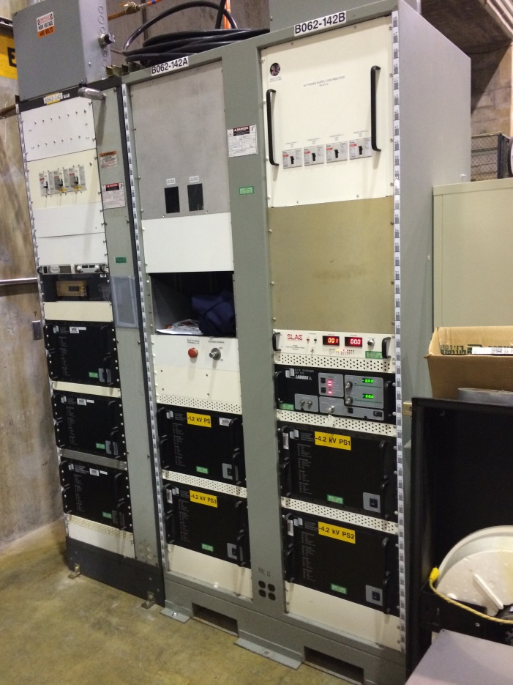
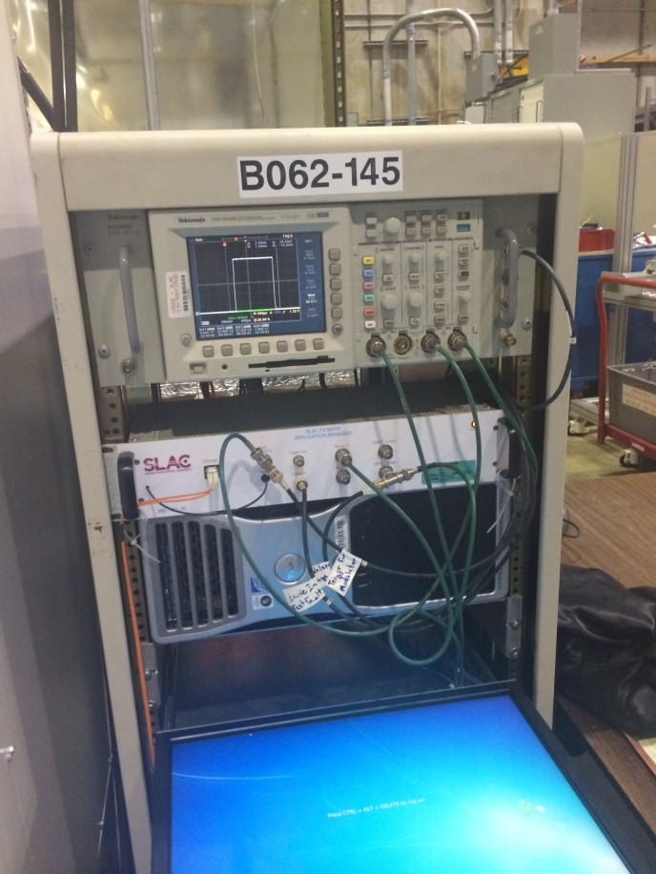
SLAC P2 Marx

Slide 25
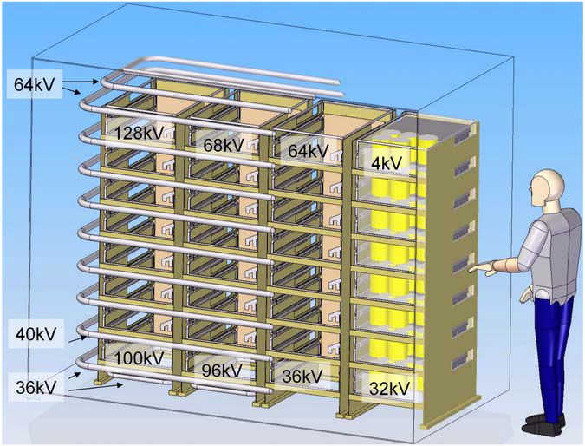
SLAC P2 Marx Conceptual Diagram
Vernier Cells
Main Cells

Slide 26
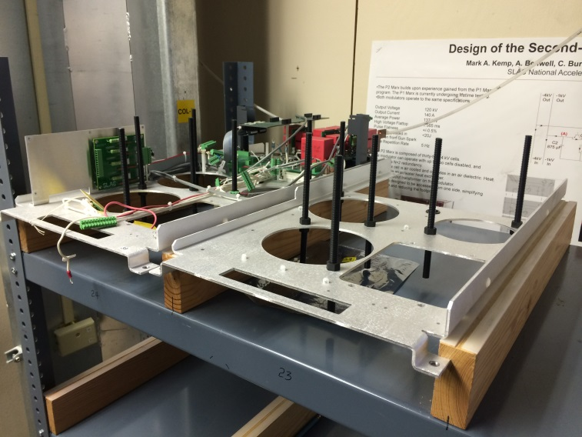
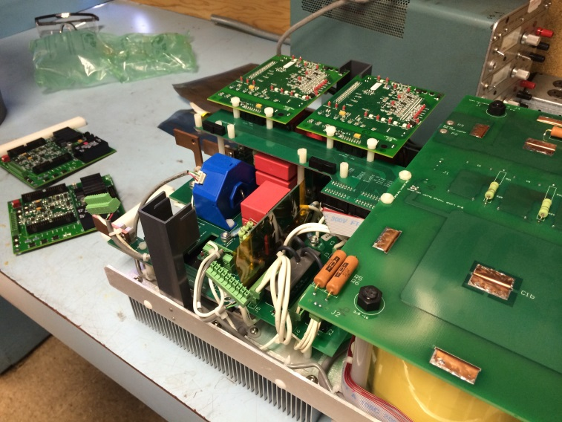
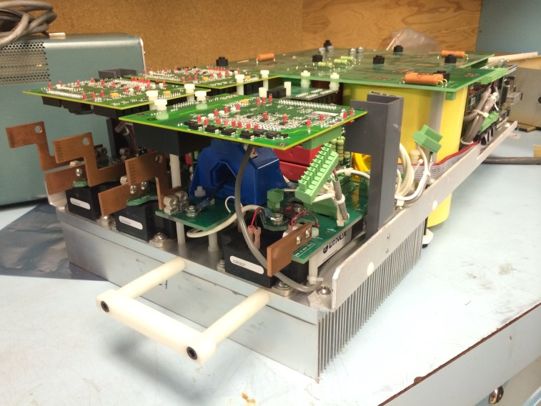
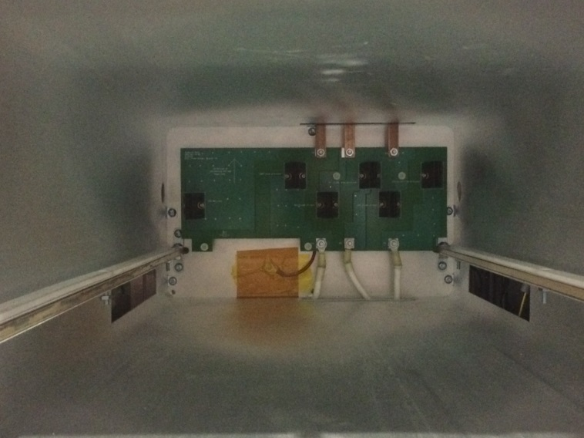
P2 Marx Cell Construction
Built on commercially made frame
Limited hard wiring since most of design is PCB based, giving the cell increased dimensional accuracy
CNC Machined Accuracy
Full 3D Model of the Cell
Charging Supply Connections
Stripline
for HV Connections
All cards are modulator for easy repair & connectorized
Built in backstop to protect connector
Easy connectors for quick replacement

Slide 27
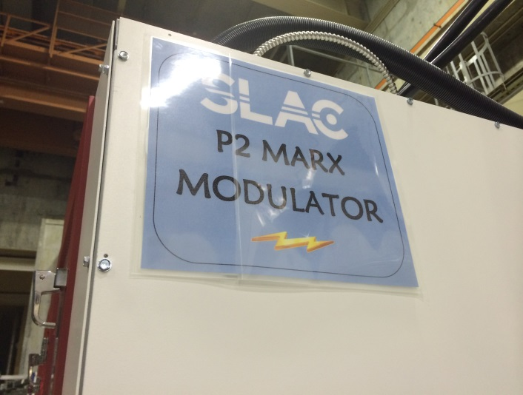
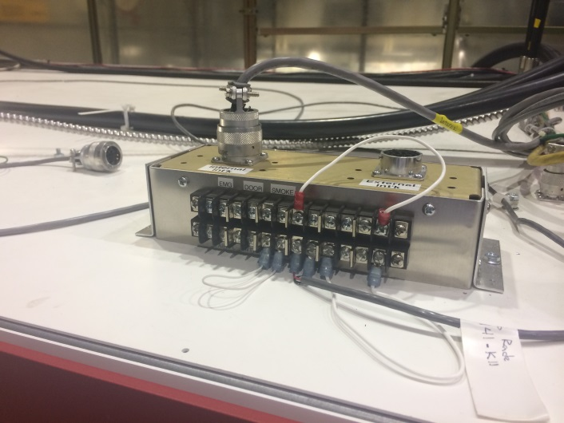
Easy Repair and Low MTBF
External Interlocks
Easy to repair for low MTBF! Can be designed to run without cells. System could be repaired during next operational downtime.

Slide 28
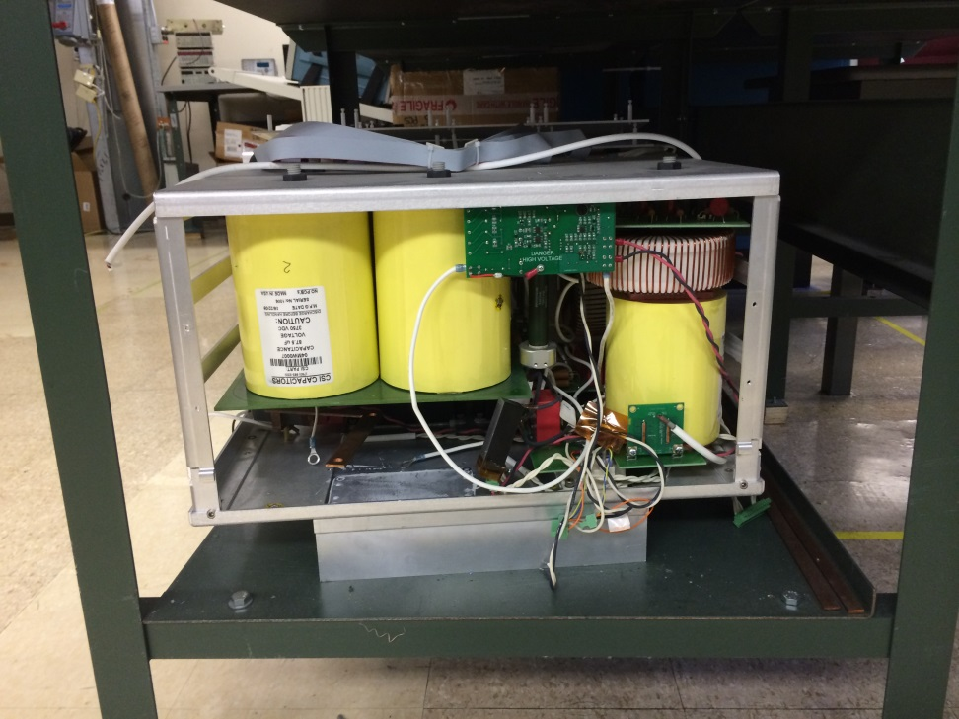
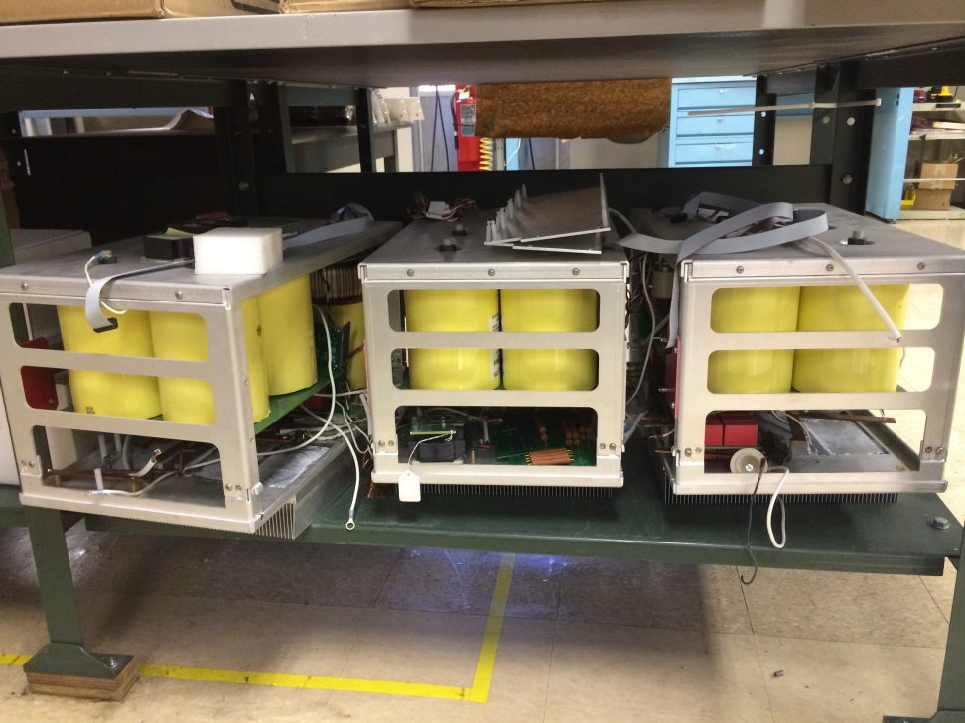
Marx P2 Prototype & 3 Cell Design
Prototype
Larger Frame
Heatsink on bottom
Original 3 cell test
Larger Frame
Point-Point Wiring

Slide 29
Future Activities for Development
Finalize modulator dimensions
Mark Kemp: Refine solid model of modulator enclosure
Can this be installed between the offices and the present modulator to development and installation?
Finalize control HW
Mark Kemp: Create functional diagram of P2 control hardware and the processes within each block
Tony Beukers: Modify functional control diagram as to how it will relate to Fermi Marx
Would the application manager need major changes? (Extra cost)
Simulate how to achieve overshoot (Largest Controls challenge)
Tony Beukers: Simulate
Refine signal definitions/terminology
Tony Beukers: create spreadsheet with signal definitions. Should contain type of signal/source/and destination

Slide 30
Future Activities for Development
Author state diagram of On/Enable/Standby/Off status
Tony Beukers: refine state diagrams
Simulate the gradient feedback scheme.
Trevor Butler: Send SLAC model of the triode and accelerating cavities.
Tony Beukers: Simulate feedback scheme
Formal timing diagram.
Tony Beukers: Refine what was done for P2. Need something to communicate the restrictions on the hardware manager or application manager performance (timing data needs to be "loaded" 1 ms before the beam.
Revised single unit cost estimate.
Mark Kemp: produce new cost estimate.
Goal: Complete above work by March 31st, 2014
May be pushed based on either Fermilab or SLAC Personal
Will either increase or decrease our confidence in this Marx modulator typology before committing any further funds to the project.

Slide 31
The End

Slide 32
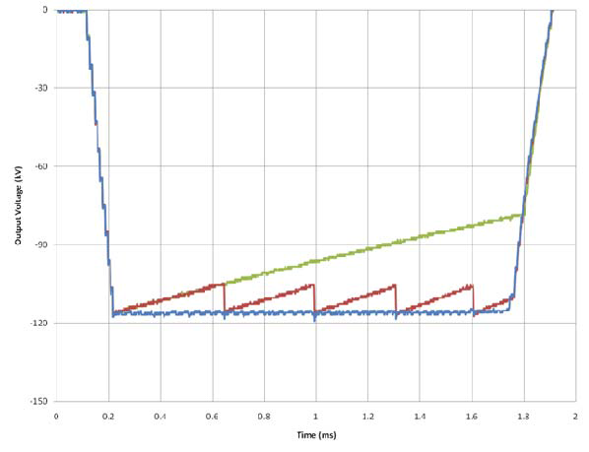
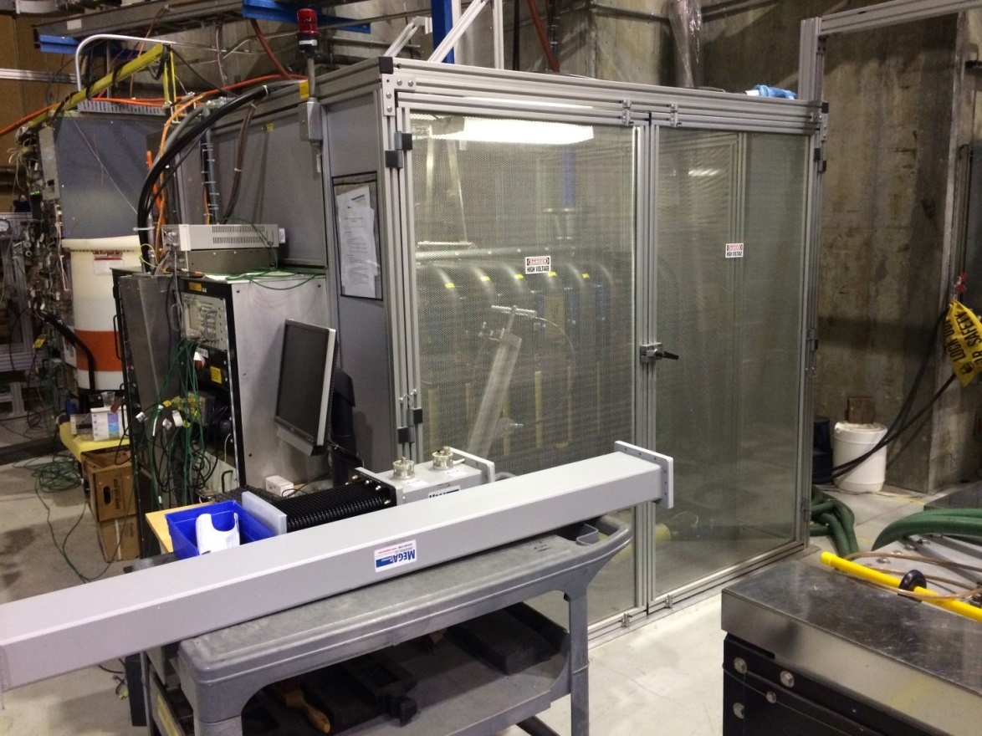
SLAC P1 Marx
Original System
16 x (11 kV)
Problem failed series capacitors due to voltage grading
PCB failure due to corona

