Slide 1
Introduction to Longitudinal Phase Space Tomography
Duncan Scott

Slide 2
Introduction
Integral Transform techniques have been in existence since 1917
Radon transforms
Iterative, ‘algebraic’ techniques have been developed since the 1970s
Iterative methods are used to reconstruct a beam distribution
They are very simple
Require little input information
Non-linear rotations can be accounted for
Algebraic Reconstruction Techniques Concepts
Forward and Back Projections
Weight Matrix
Tracking Maps
NB the following is qualatitive and for illustration purposes (i.e. minus signs could be wrong).

Slide 3
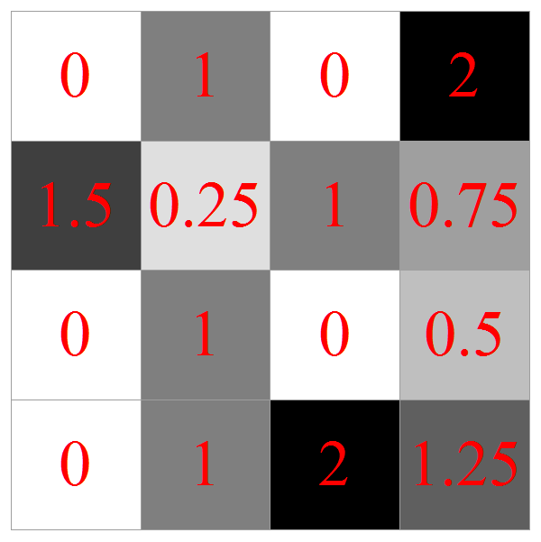
Forward Projections
Example 2-D density distribution
bunch charge density
Discretized on a grid

Slide 4
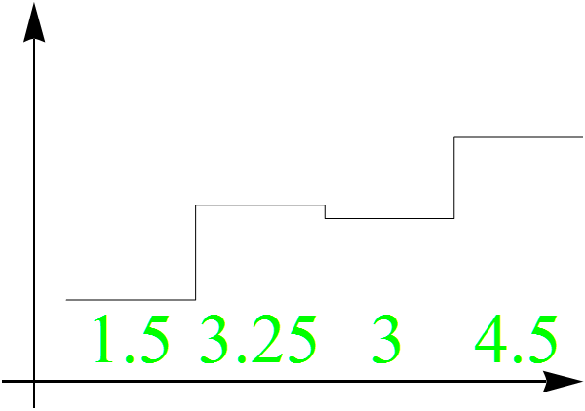
Forward Projections (FP)
2-D density distribution
bunch charge density
Generate Projections, histogram

Slide 5
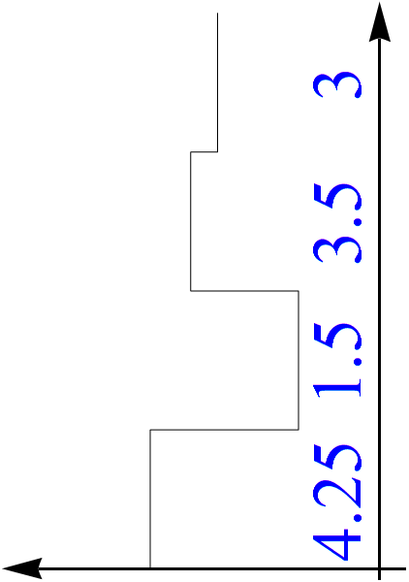
Forward Projections (FP)
2-D density distribution
bunch charge density
Generate Projections, histogram
Do at different angles

Slide 6
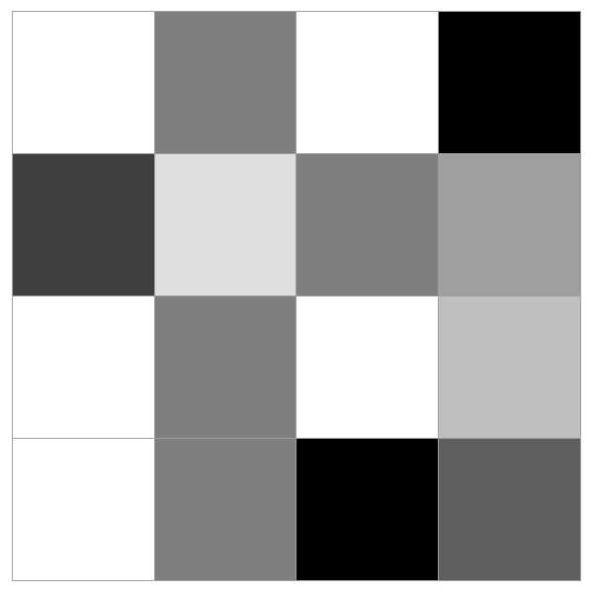
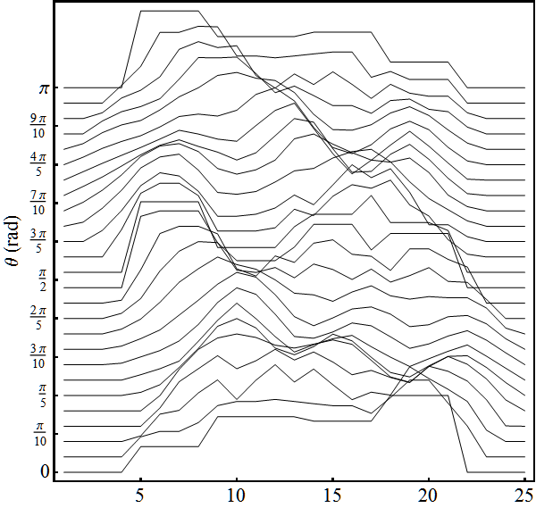
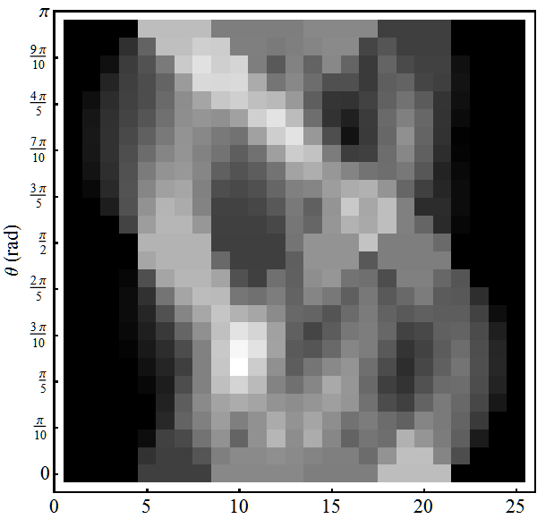
Mountain Range Plots (Sinogram)
Many projections at different angles give mountain range plot, or sinogram
This is the raw data used to reconstruct the initial density distribution
Original Distribution
Mountain Range Plot
Sinogram

Slide 7
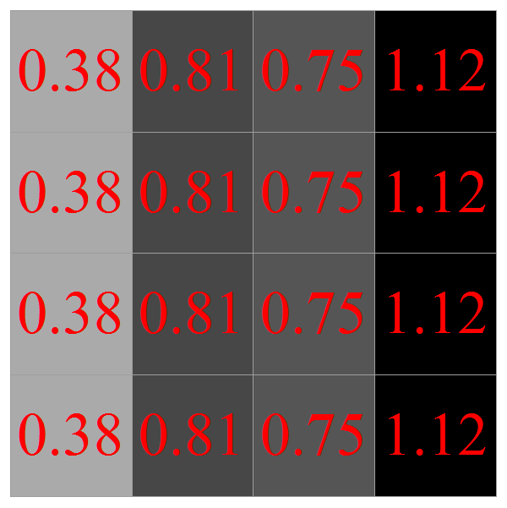
Back Projection (BP)
The contents of a particular projection are evenly shared along all the cells that could have contributed to each bin

Slide 8
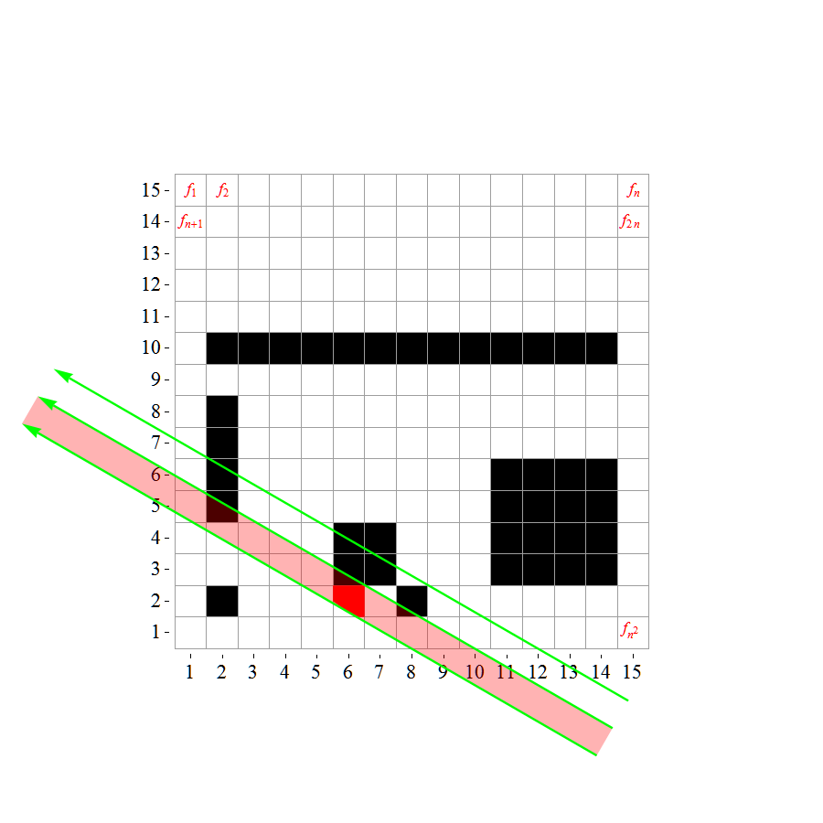
Weight Matrix
At arbitrary angles the back/forward projected values can be weighted
e.g. the area the bin intersects with
This will be used in a different way when we consider particles rotating in longitudinal phase space

Slide 9
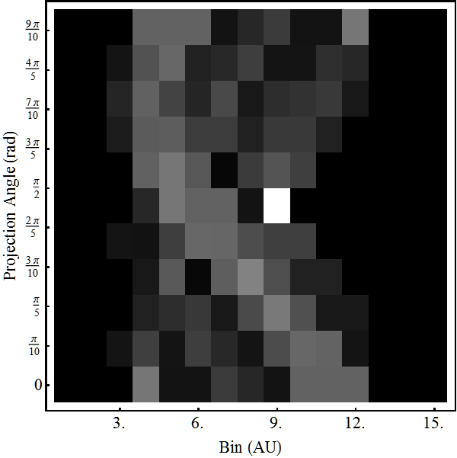
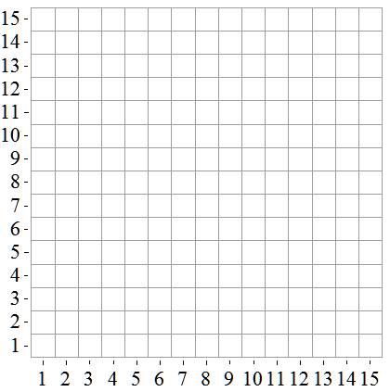
Iterative Reconstruction
Initial projection data can be quiet crude
15 bins at 10 angles sinogram
First iteration is an arbitrary guess of the answer
e.g. a grid of zeros
Reconstruction grid can be of any dimension as long as the weight matrix is calculated correctly

Slide 10
Iterative Reconstruction
Forward project the guess for a particular angle and bin
FP =0

Slide 11
Iterative Reconstruction
Forward project the guess for a particular angle and bin
The raw data tells us the answer should be 3
FP=0
measurement = 3

Slide 12
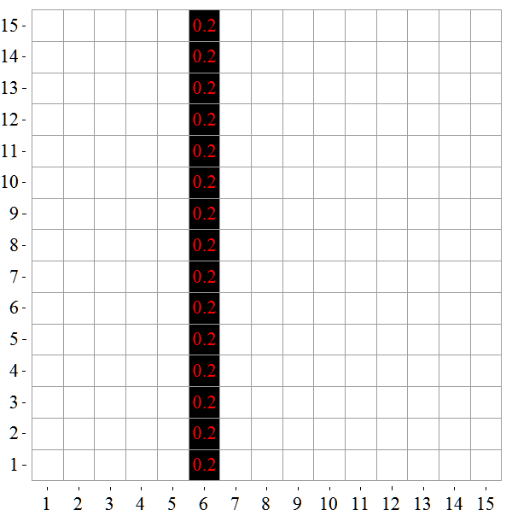
Iterative Reconstruction
Forward project the guess for a particular angle and bin
The raw data tells us the answer should be 3
Back project the difference evenly over contributing cells to give a correction grid
∆cell = 3/15 = 0.2
Weight matrix gives all 1s
FP=0
measurement = 3

Slide 13
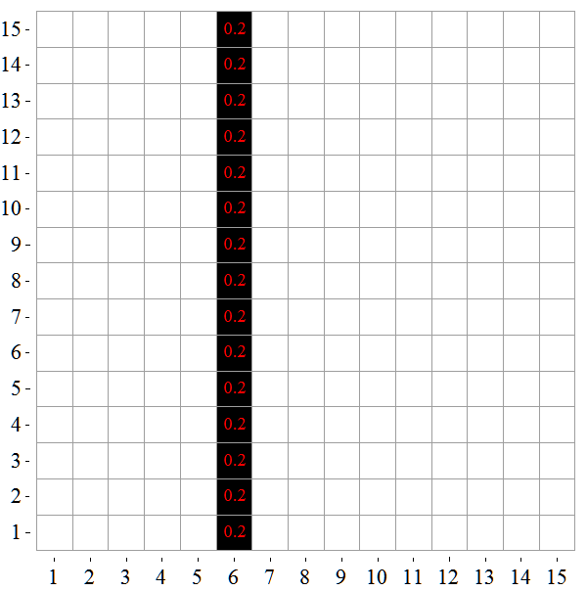
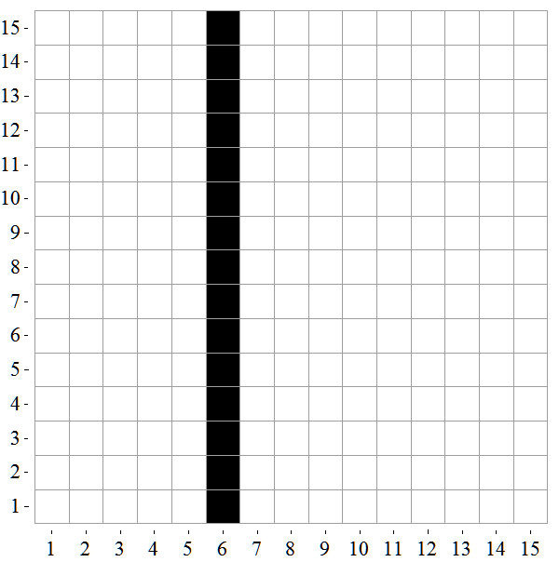
Iterative Reconstruction
Forward project the guess for a particular angle and bin
The raw data tells us the answer should be 3
Back project the difference evenly over contributing cells to give a correction grid
Combine the correction grid and the original guess to give the next iteration
Guess
Correction
+
=
New
Guess

Slide 14
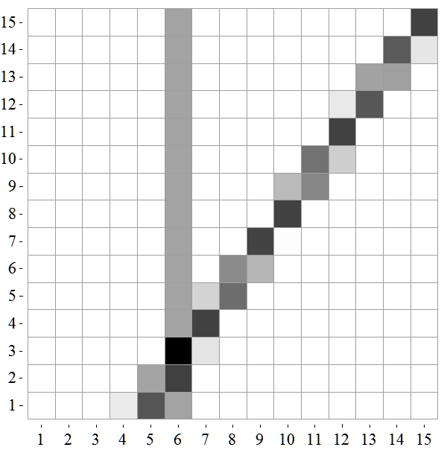
Iterative Reconstruction
Different shades
due to weight matrix
Forward project the guess for a particular angle and bin
The raw data tells us the answer should be 3
Back project the difference evenly over contributing cells to give a correction grid
Combine the correction grid and the original guess to give the next iteration
Repeat for different projection and Bin

Slide 15
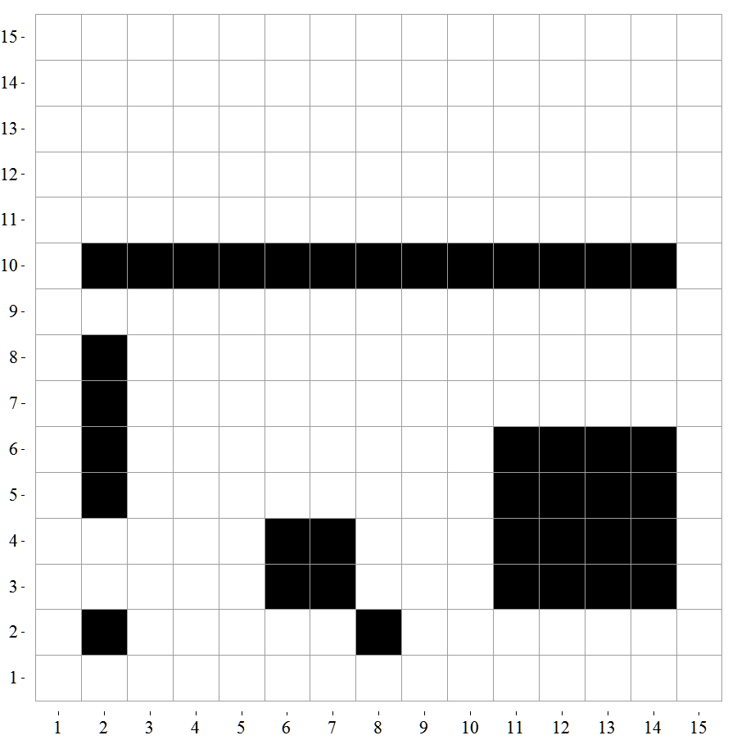
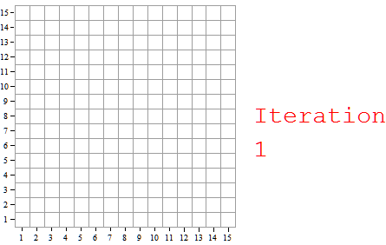
Iterative Reconstruction
Repeat many times and the original image is reconstructed

Slide 16
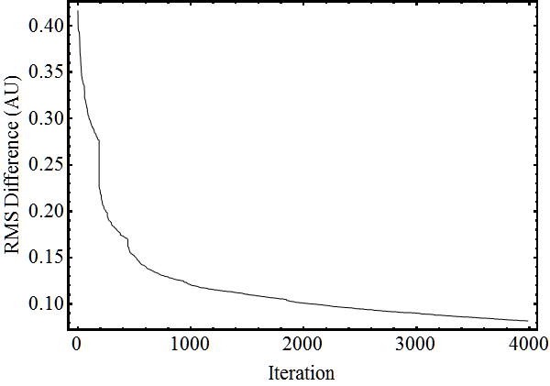
Convergence - Discrepency
The difference between the measured and reconstructed projections can be used as a merit function for the algorithm
There are numerous, rigorous, demonstrations that iterative algorithms will converge
K. Tanabe, “Projection method for solving a singular system,” Numer. Math. vol. 17, pp. 203-214, 1971.

Slide 17
Beam Reconstruction
The above method, with some modifications, can be used to reconstruct the longitudinal phase space of a bunch, given a series of projections from Wall Current Monitors
Example raw data from WCM, bunch rotating, aim to reconstruct at injection

Slide 18
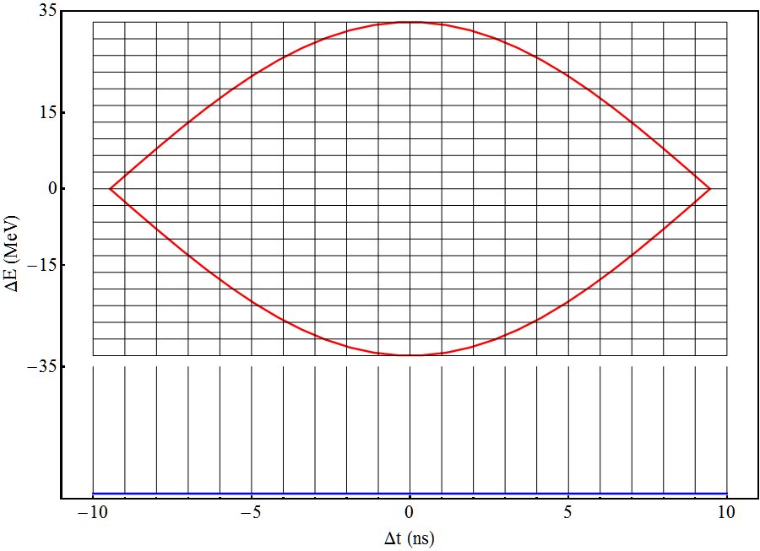
Beam Reconstruction
53 MHz,
1MV RF Bucket
The reconstruction grid and projection bins are aligned
The weight matrix contains 1s and 0s
The intersection with the separatrix can slightly change this
Bins aligned with reconstruction grid
Projection
(WCM Signal)

Slide 19
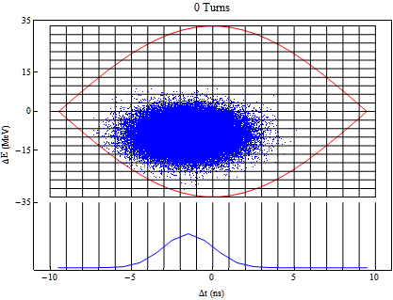
Beam Reconstruction
53 MHz,
1MV RF Bucket
The reconstruction grid and projection bins are aligned
The weight matrix contains 1s and 0s
The intersection with the separatrix can slightly change this
The beam is rotating with variable speed
Account for this by using Tracking Maps to modify the weight matrix
Bins aligned with reconstruction grid
Projection
(WCM Signal)

Slide 20
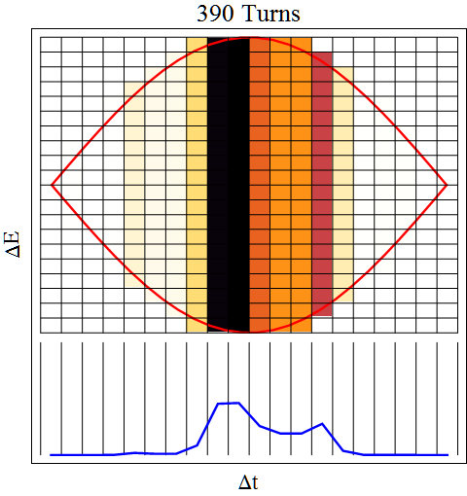
Tracking Maps
Non-Linear Rotation is accounted for by tracking
Start by Back Projecting a profile

Slide 21
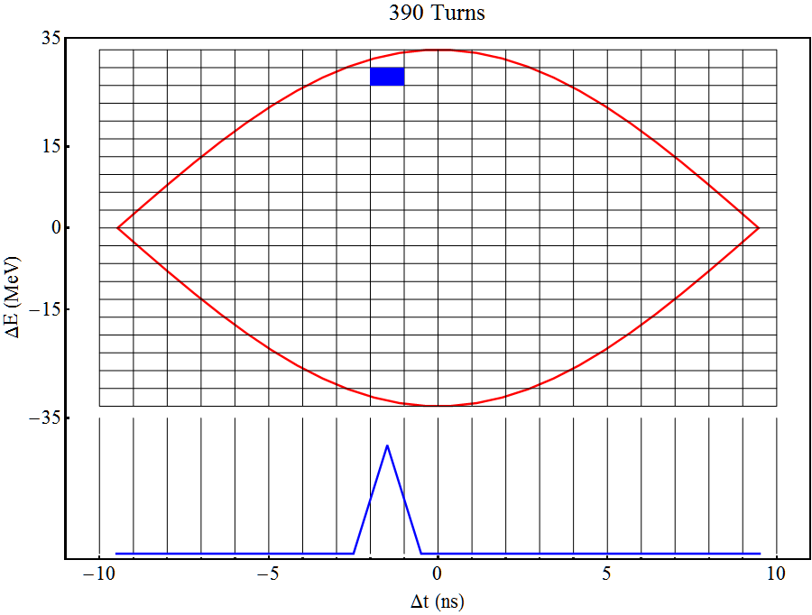
Tracking Maps
Non-Linear Rotation is accounted for by tracking
Start by Back Projecting a profile
Concentrate on one cell
But first a very simple example….

Slide 22
Map Matrix Example
Particle moves from {1,4} to {2,2}

Slide 23
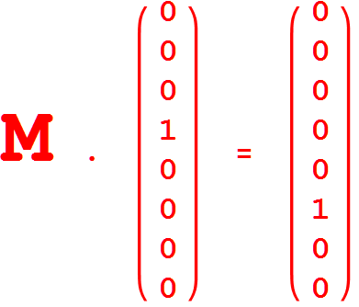
Map Matrix Example
Particle moves from {1,4} to {2,2}
Express grid as a vector
M is the Map

Slide 24
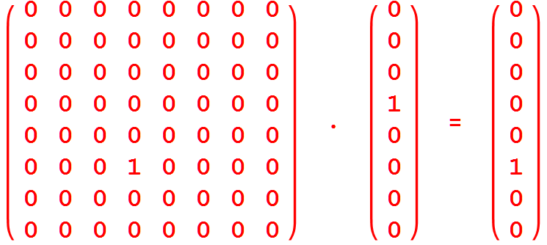
Map Matrix Example
Particle moves from {1,4} to {2,2}
Express grid as a vector
M is the Map

Slide 25
Map Matrix Example
Particle moves from {1,4} to {2,2}
Express grid as a vector
M is the Map
4th column ‘moves’ particles from 4th component of vector

Slide 26
Map Matrix Example
Particle moves from {1,4} to {2,2}
Express grid as a vector
M is the Map
4th column ‘moves’ particles from 4th component of vector
Rows determine final position, i.e. 6th

Slide 27
Tracking Maps (cont.)
Non-Linear Rotation is accounted for by tracking
Start by Back Projecting a profile
Concentrate on one cell
We want to know where the particles in this cell were at injection

Slide 28
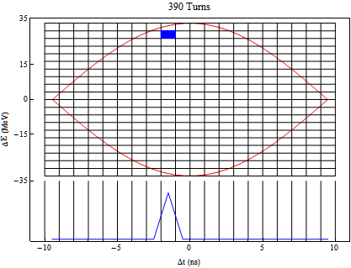
Tracking Maps (cont.)
Non-Linear Rotation is accounted for by tracking
Start by Back Projecting a profile
Concentrate on one cell
We want to know where the particles in this cell were at injection
Therefore, track backwards

Slide 29
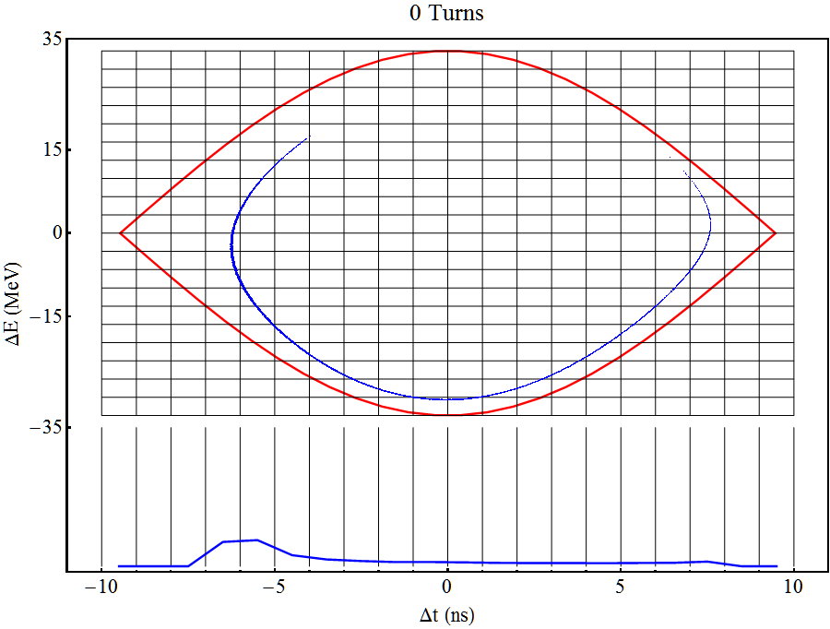
Tracking Maps (cont.)
Non-Linear Rotation is accounted for by tracking
Start by Back Projecting a profile
Concentrate on one cell
We want to know where the particles in this cell were at injection
Therefore, track backwards
After tracking count the number of particles in each cell

Slide 30
Tracking Maps (cont.)
Non-Linear Rotation is accounted for by tracking
Start by Back Projecting a profile
Concentrate on one cell
We want to know where the particles in this cell were at injection
Therefore, track backwards
After tracking count the number of particles in each cell
Doing this for each cell and turn generates a series of maps telling us:
what fraction of particles starting in cell X propagate to each other cell in the grid

Slide 31
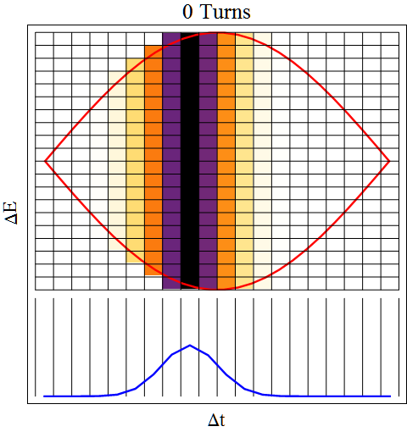
Example Reconstruction
Back Project 1st profile to give the initial Guess of the answer

Slide 32
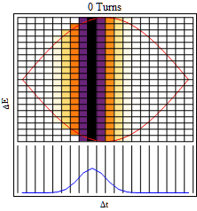
Example Reconstruction
Back Project 1st profile to give the initial Guess of the answer
Forward map the Guess a random number of turns

Slide 33
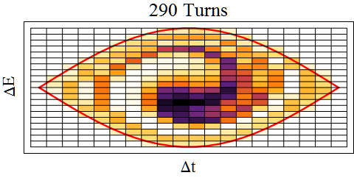
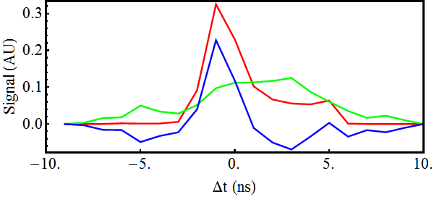
Example Reconstruction
Back Project 1st profile to give the initial Guess of the answer
Forward map the Guess a random number of turns
Project forward- mapped Guess and compare with measurement
Measured
Answer
Difference between
Guess and
measurement, ∆projection
Projection of
Forward Mapped Guess

Slide 34
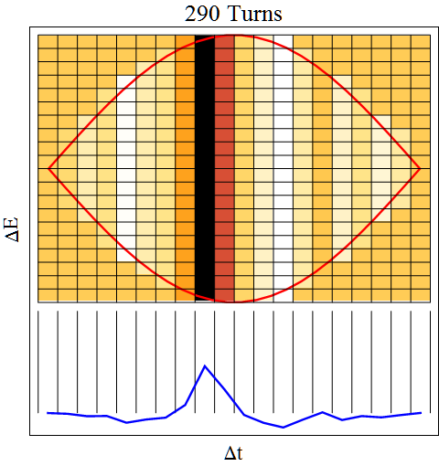
Example Reconstruction
Back Project 1st profile to give the initial Guess of the answer
Forward map the Guess a random number of turns
Project forward mapped Guess and compare with measurement
Back-project ∆projection to create correction grid, ∆grid

Slide 35
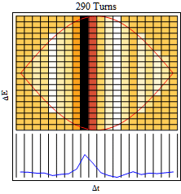
Example Reconstruction
Back Project 1st profile to give the initial Guess of the answer
Forward map the Guess a random number of turns
Project forward mapped Guess and compare with measurement
Back project ∆projection to create correction grid, ∆grid
Backward map ∆grid to injection

Slide 36
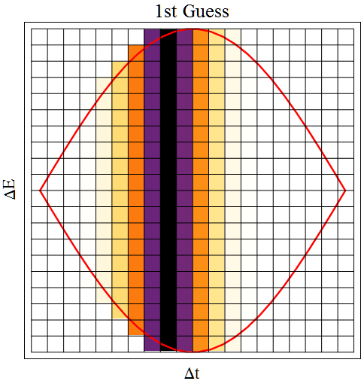
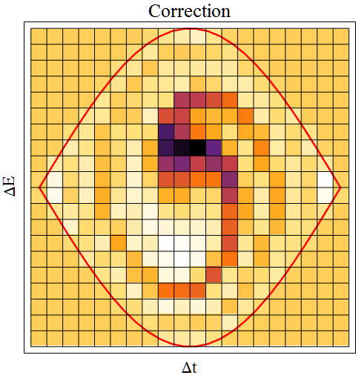
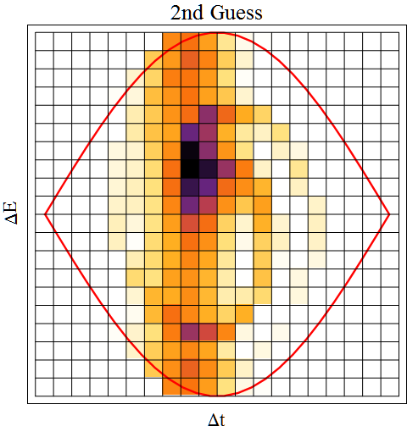
Example Reconstruction
Back Project 1st profile to give the initial Guess of the answer
Forward map the Guess a random number of turns
Project forward mapped Guess and compare with measurement
Back project ∆projection to create correction grid, ∆grid
Backward map ∆grid to injection
Combine Guess and ∆grid to give new guess and repeat
+
=

Slide 37
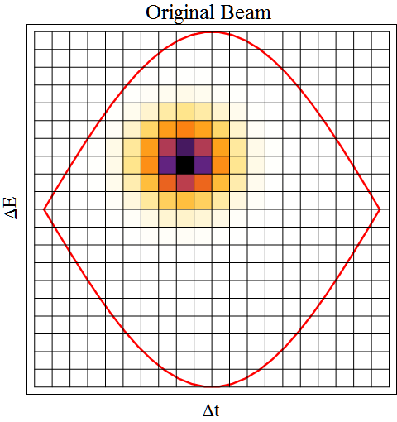
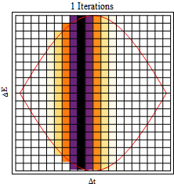
Example Reconstruction
Repeat to reconstruct original beam

Slide 38
Conclusions
Iterative techniques are simple but effective
Compare projections of a Guess to data
Use the comparison to make corrections to Guess
Repeat until difference in projections is suitably small
Maps can be generated using simple or complicated particle tracking and saved
Using saved maps should enable reconstructions to be done “online”
Combined all these elements into ACNET Application
Version 1 goal:
Reconstruct 1 entire batch every 30 seconds
Also get information on single and coupled bunch modes, (beam loading…?) and … ?

