Slide 1
35 years of H- ions at Fermilab

Slide 2
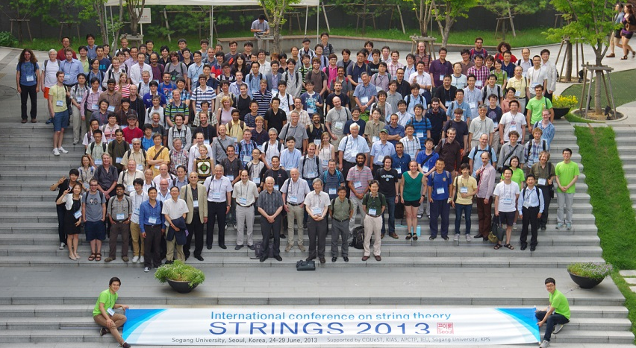

Slide 3
Outline:
How we got here
Where we are
Where we are headed

Slide 4
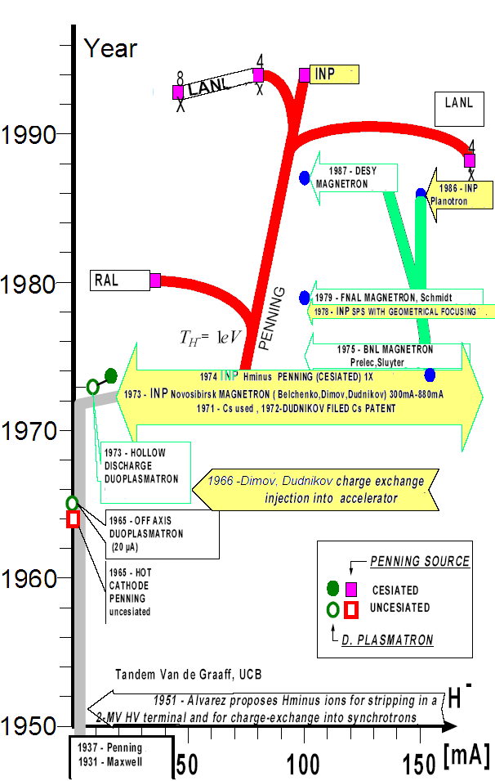
Figure: V.Dudnikov

Slide 5
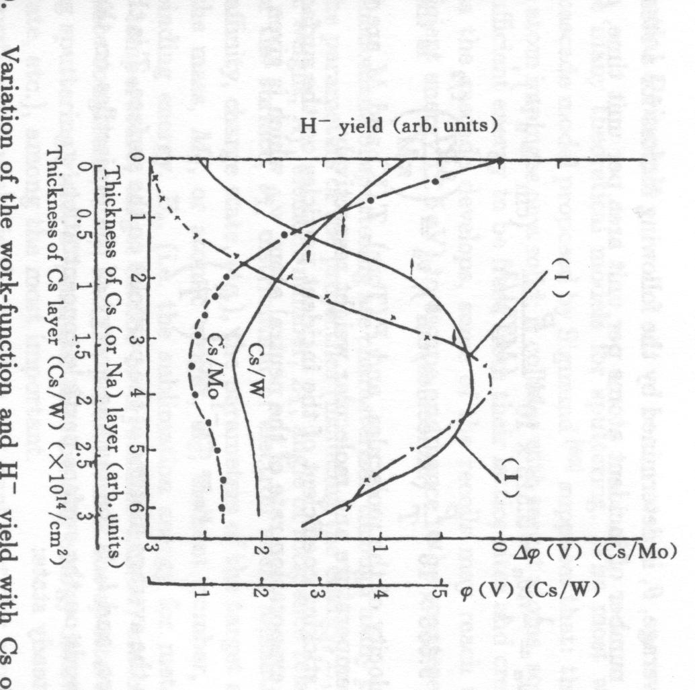
Surface production of ions
4.6eV:Mo
Metals have an abundance of loosely bound electrons, for molybdenum it takes 4.6eV to removed an electron.
Cesium has a work function of 2.1eV, but can lower the surface work function of molybdenum to 1.6eV with a 0.6 monolayer.
Since the work function exceeds the electron affinity of hydrogen atoms, a majority of hydrogen particles leave the surface as neutrals. However a few will pick up an excess electron when leaving the surface.
Some of these H- ions will make their way though the plasma to the anode and be extracted.
2.1eV:Cs
1.6eV:Cs on Mo
Zhang: Ion Sources

Slide 6
Magnetron sources
H₂
Mo
Cs
Cathode (-)
Cs
e⁻
~1 mm
H⁺
H₂⁺
Cs⁺
e⁻
Anode (+)
B
H⁻
e⁻
Figure: Martin Stockli
In gas discharge plasma positive hydrogen and cesium ions are formed
These ions are accelerated toward the cathode
Some of the ions that strike the surface have enough energy to “bounce” off the surface, and some small number of those leave the surface as H- ions.
Plasma parameters
n_{H2} ~ 10¹⁶ cm⁻³
n_{e} ~ 10¹³-10¹⁴ cm⁻³
Te ~ 1eV / 15 eV

Slide 7
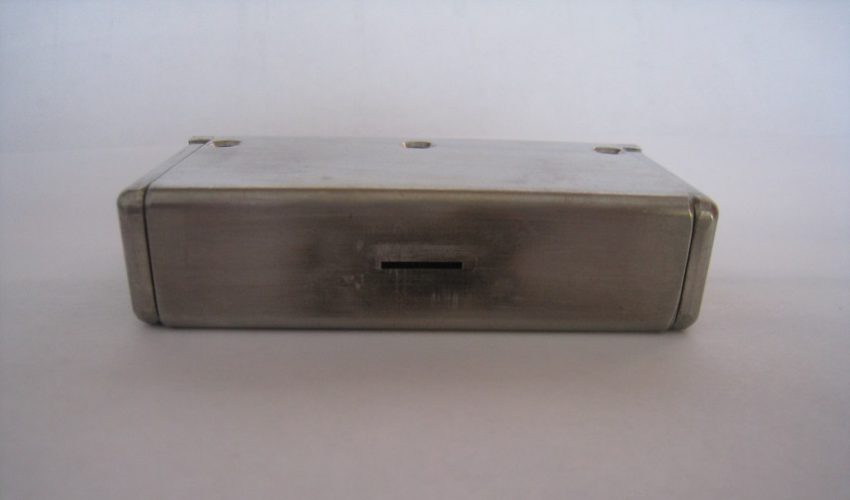
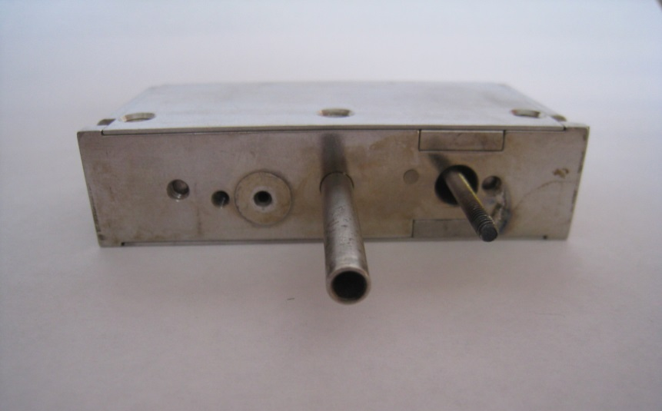
Prototype magnetron H- ion source bought by FNAL for $40k from Brookhaven in the late 70’s
This source was designed for fusion research
Low current DC source
Large gas volume (important later on)
Used Cs pellets to enhance H- production

Slide 8
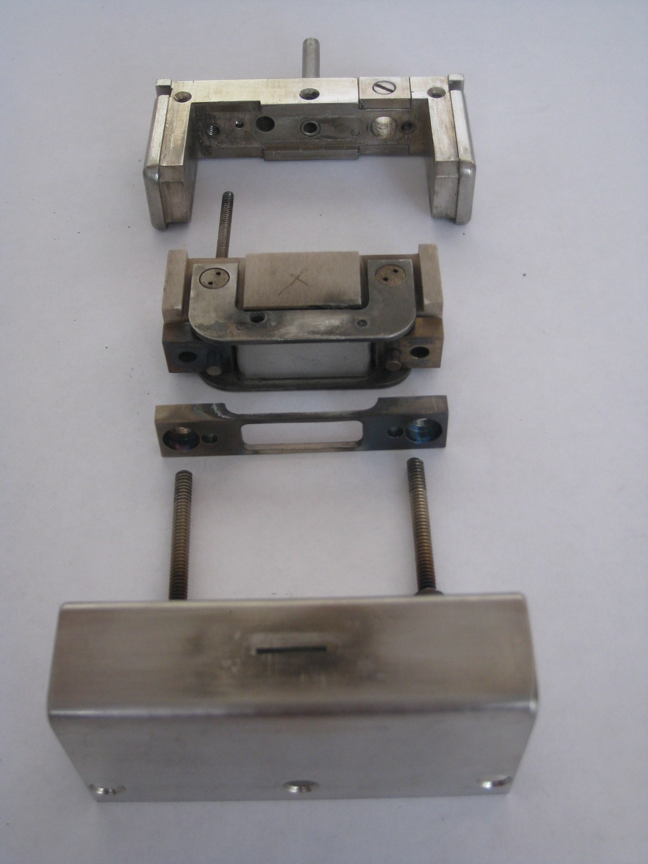
Hydrogen inlet
Source Body
Cathode connection
Anode
Cathode
Anode cover plate (extraction aperture)
3in

Slide 9
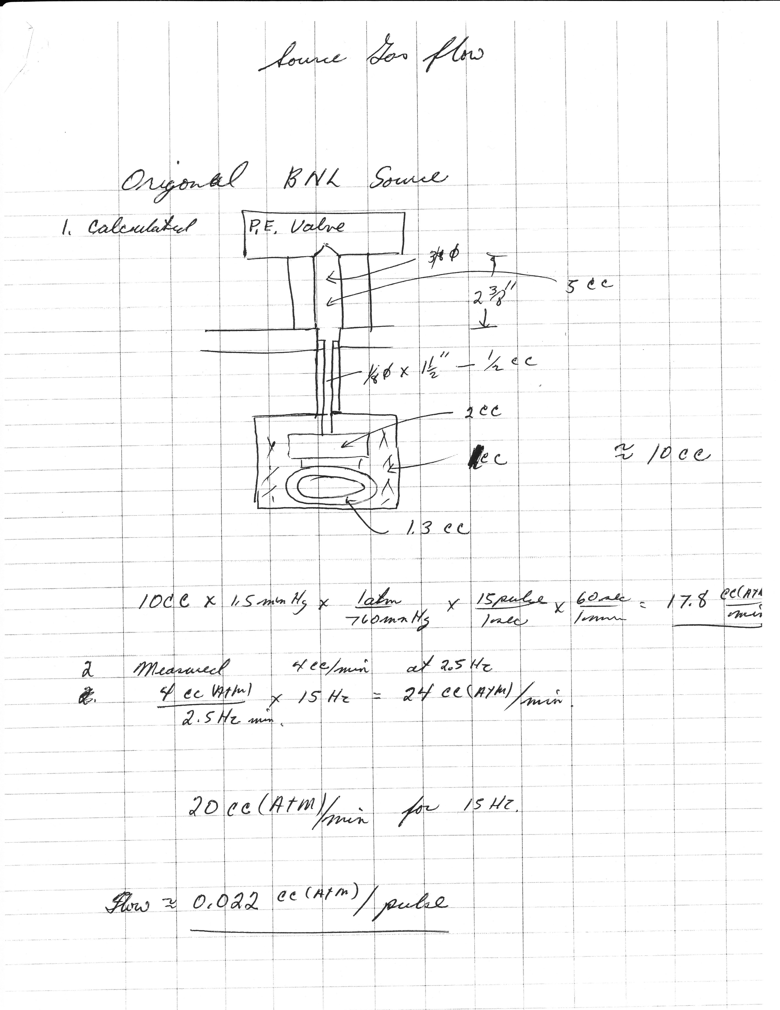
BNL source was installed in bell jar and tested at 15Hz
Interesting side note early test were done using cesium chromate and titanium powder to make cesium tablets that were inserted into the cathode

Slide 10
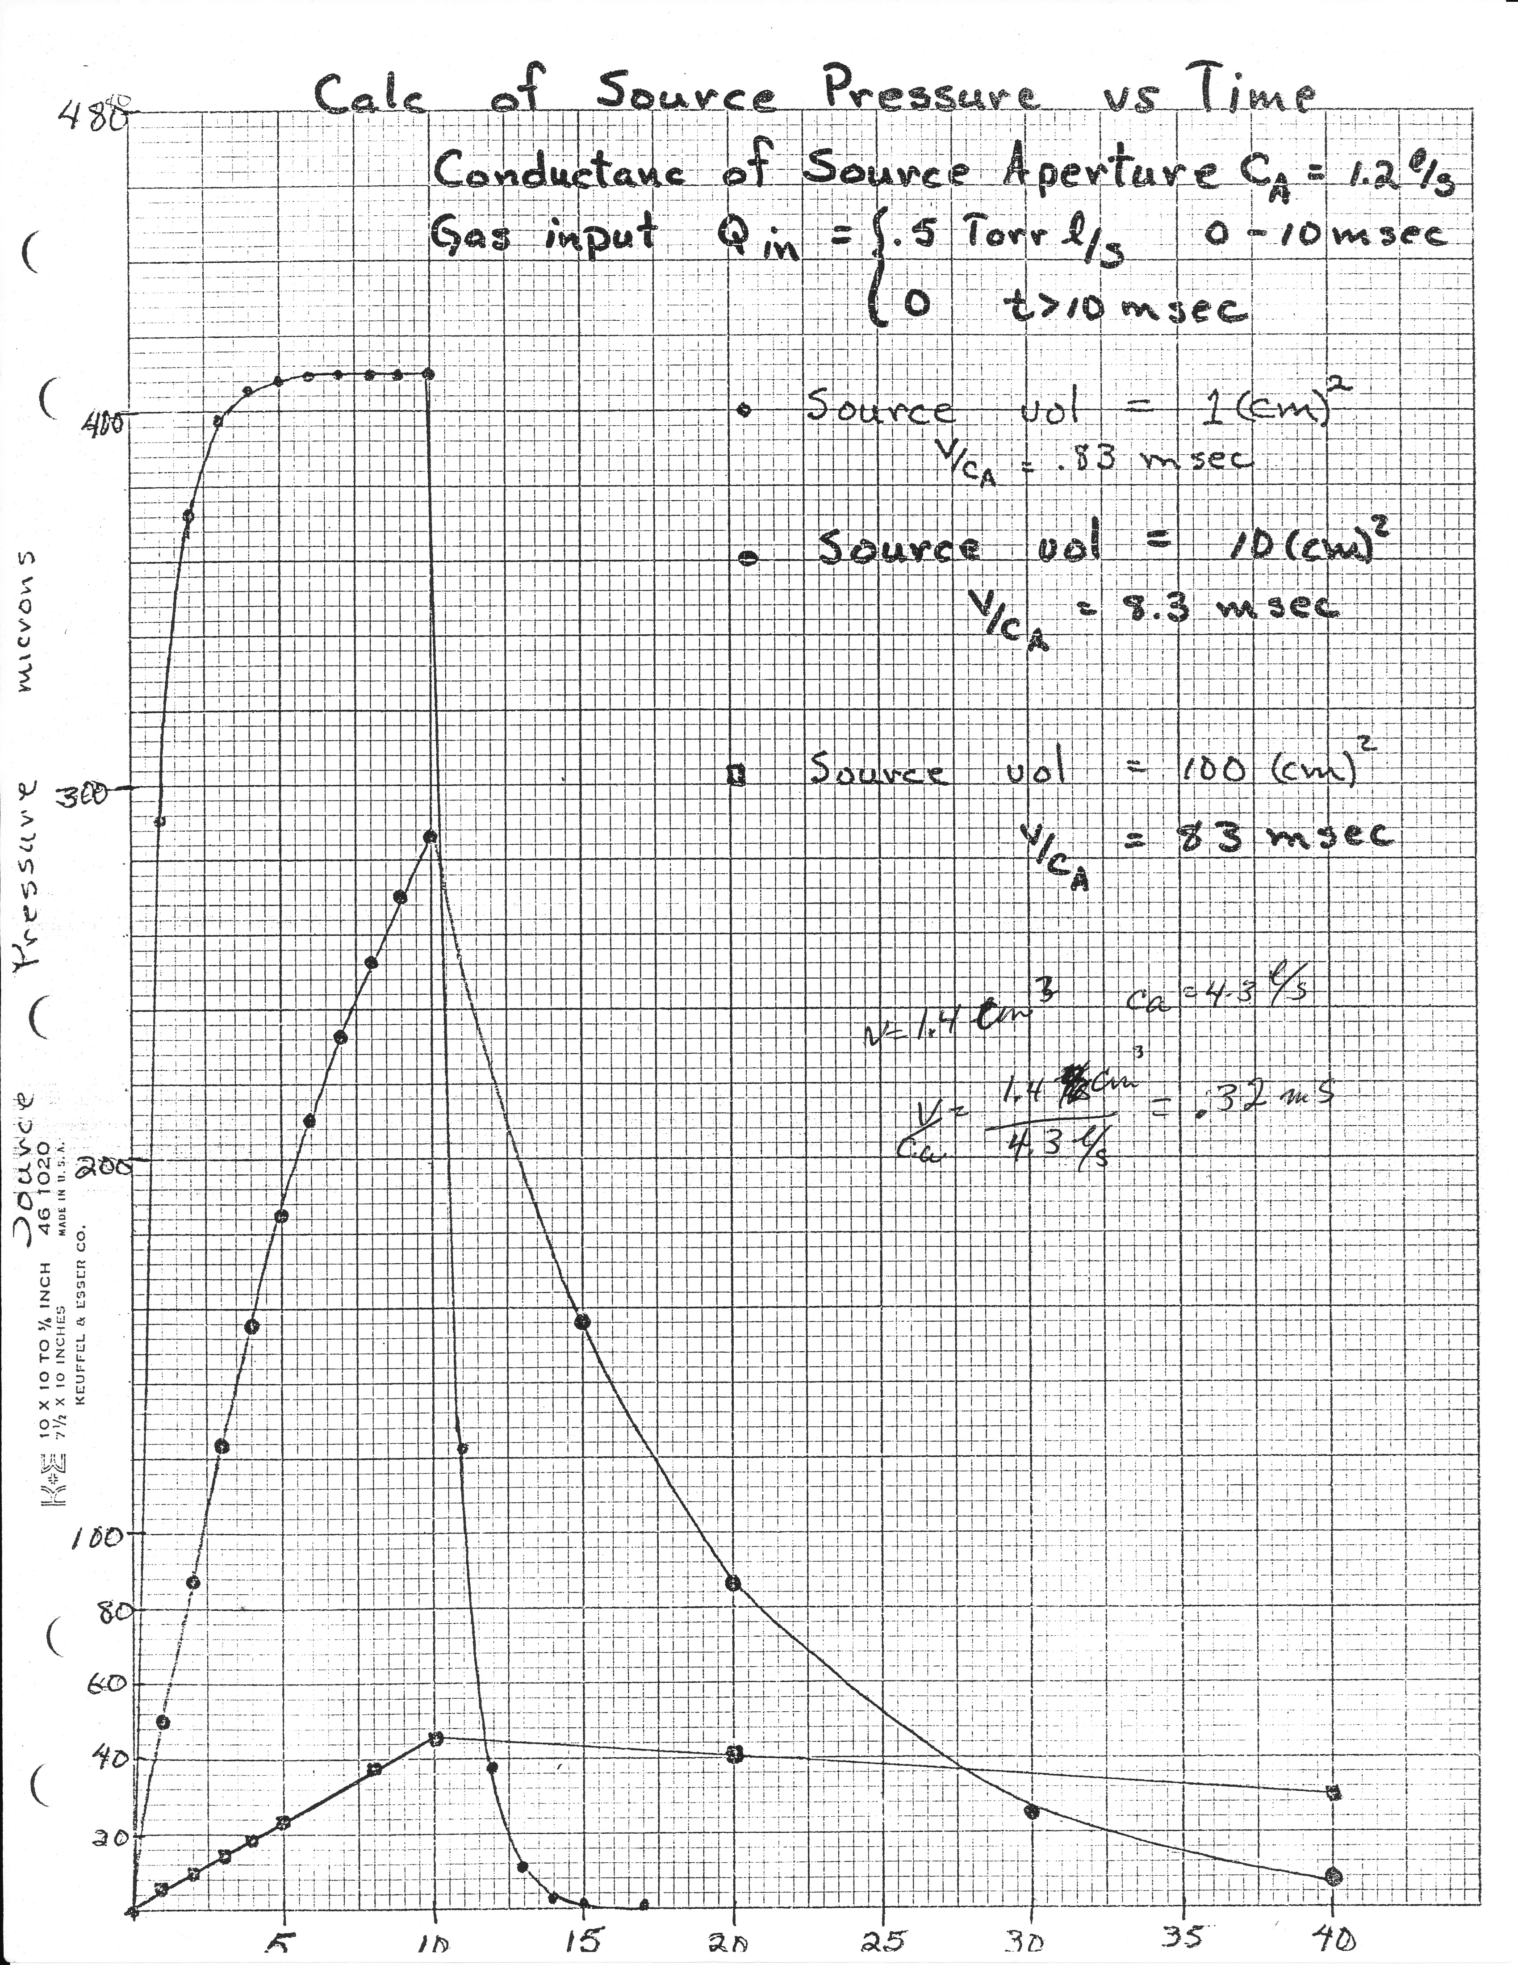
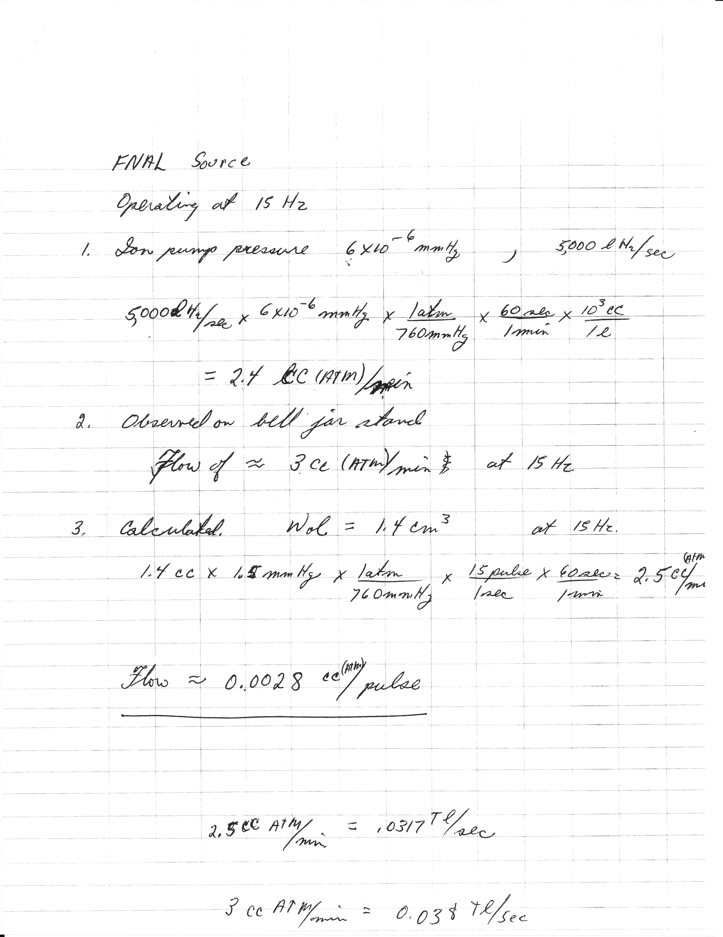
Chuck Schmidt chose the new source volume based on source pressure.
The fill time of the BNL source was 8.3ms and it did not reach high enough pressure for plasma to form at 15Hz reprate.

Slide 11
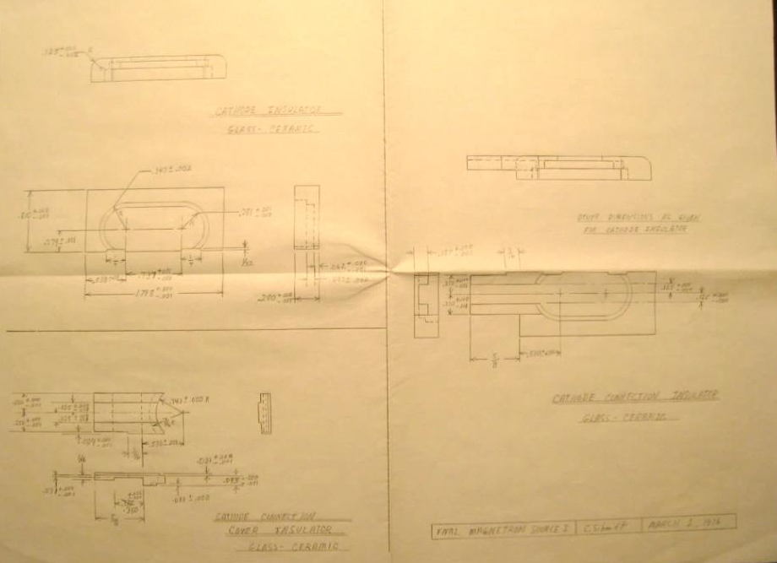
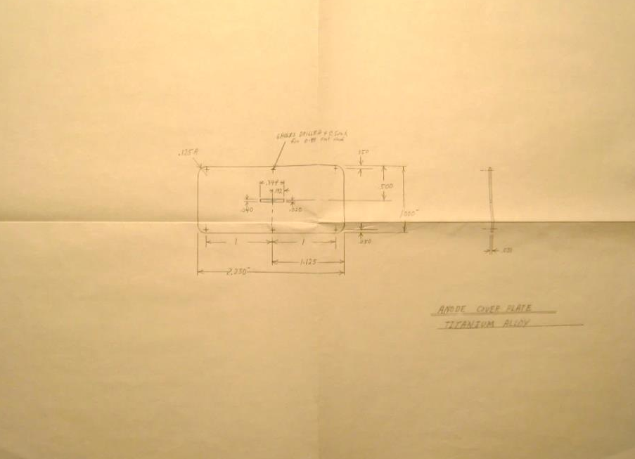
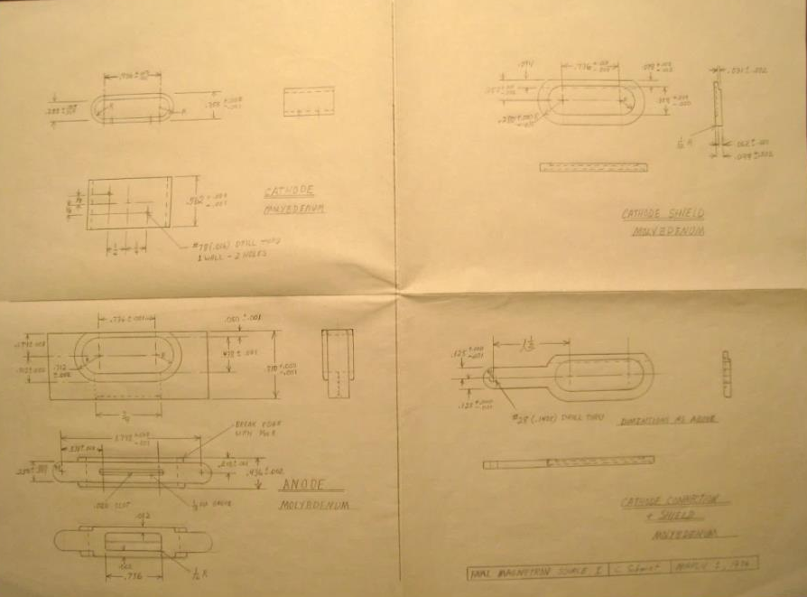
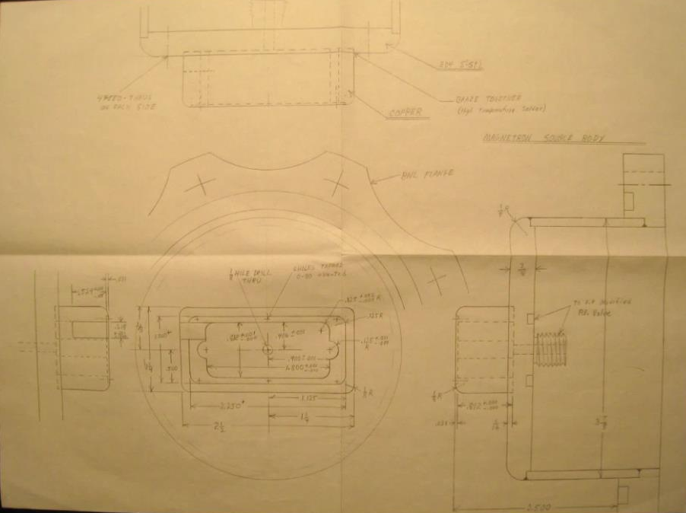
Original source drawings done on CW Schmidt’s kitchen table in 1976
Clever design by Chuck Schmidt reduced internal volume by a factor of 10 !

Slide 12
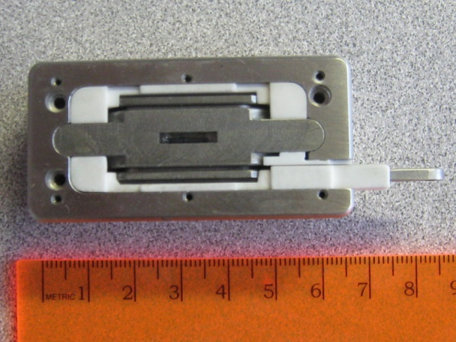
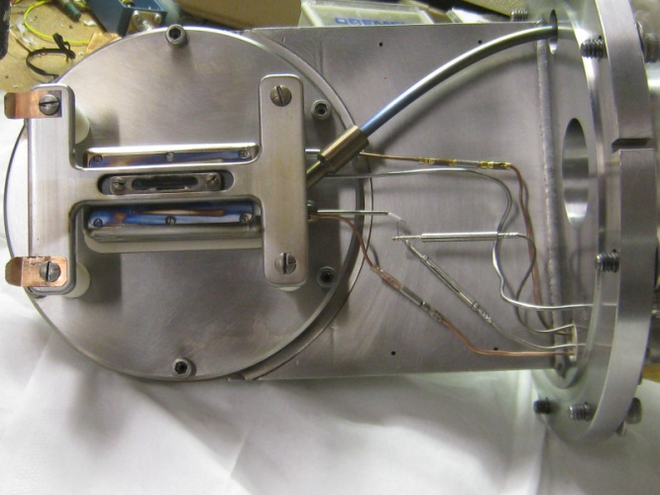
Chuck’s source that was used in the Cockcroft-Walton accelerators:
Compact size

Slide 13
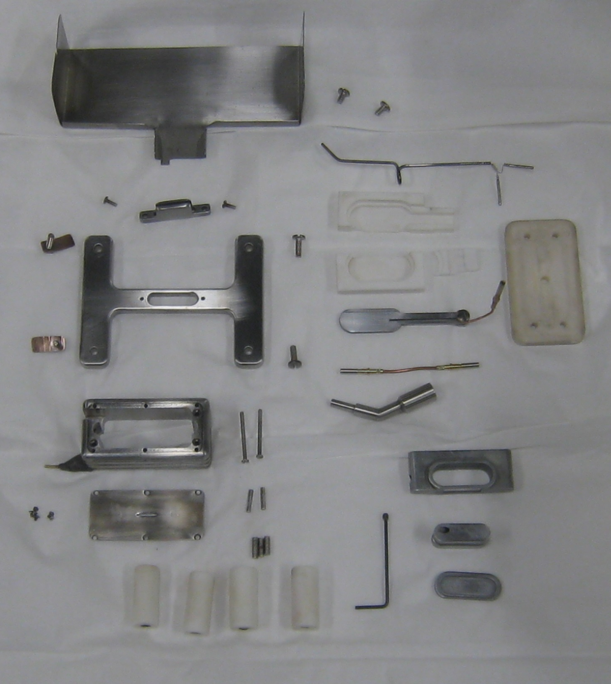
Chuck Schmidt’s original design.
Based on the BNL source
Appropriate for pulsed operation.
extractor
Anode cover plate
Anode
Mo cathode
Extraction aperture
1mm x 0.1mm

Slide 15
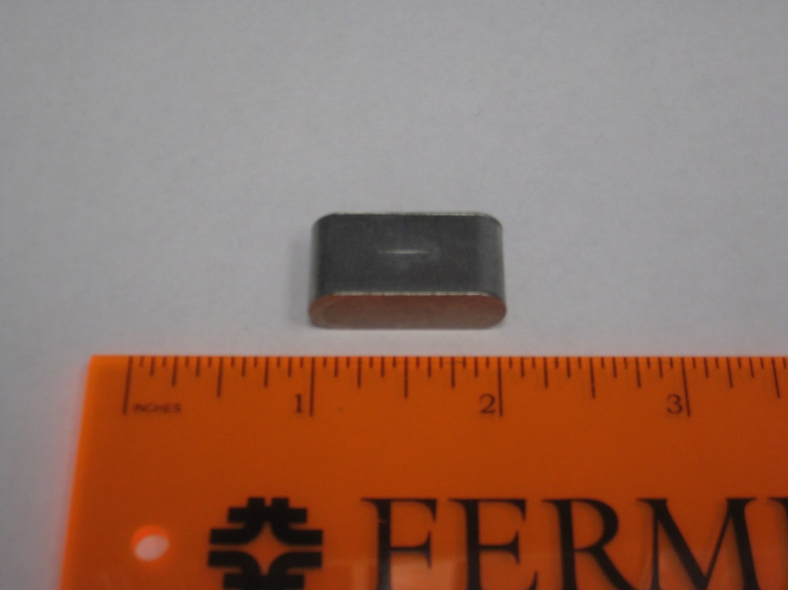
The original magnetron used a flat cathode which will become very important later on !
Parameter | Value
Arc current | 180A
Arc Voltage | 130V
Beam current | 50mA
Power efficiency | 2mA/kW
Source lifetime | 3 months

Slide 16
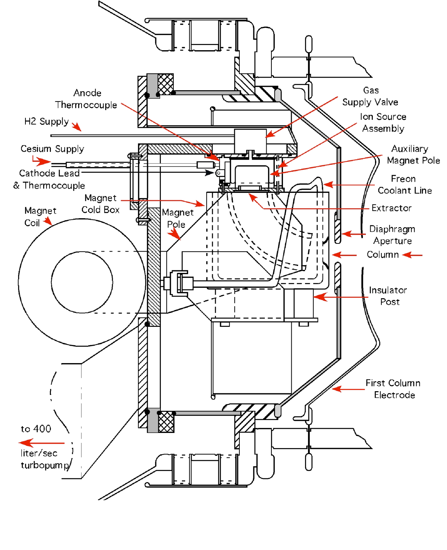
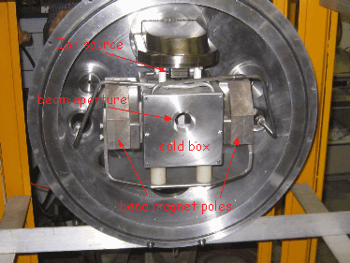
Cockcroft-Walton
The source was mounted pointing down with a 90deg bend magnet.
There was a cold box that trapped Cs before it entered the accelerating column.
Co-extracted electrons swept away by the bend magnet
H-

Slide 17
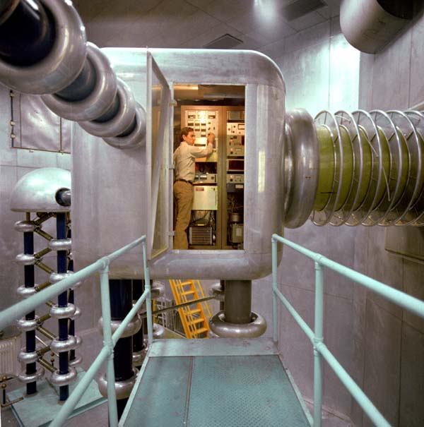
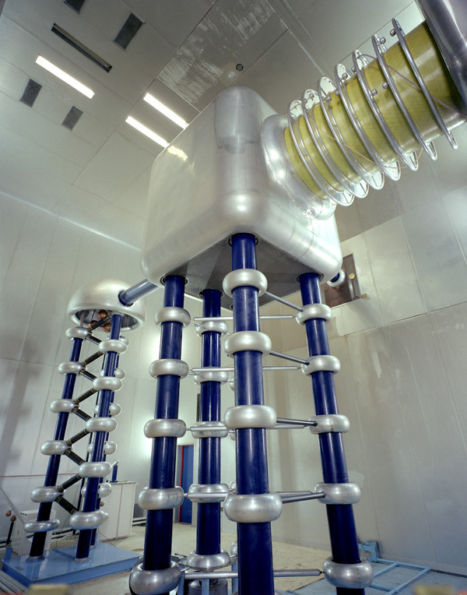
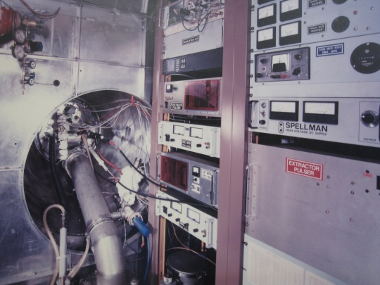
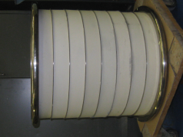
Cockcroft- Walton continued
750keV accelerating column
100kV between each electrode
Dome contains ion source electronics and vacuum pumping

Slide 18
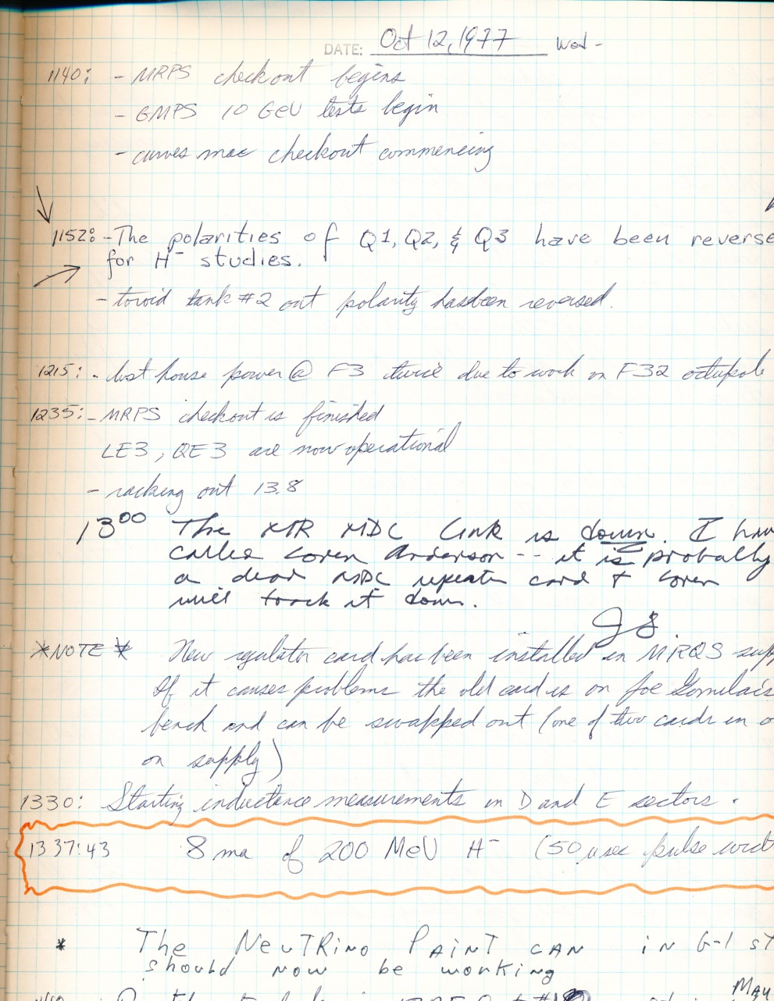
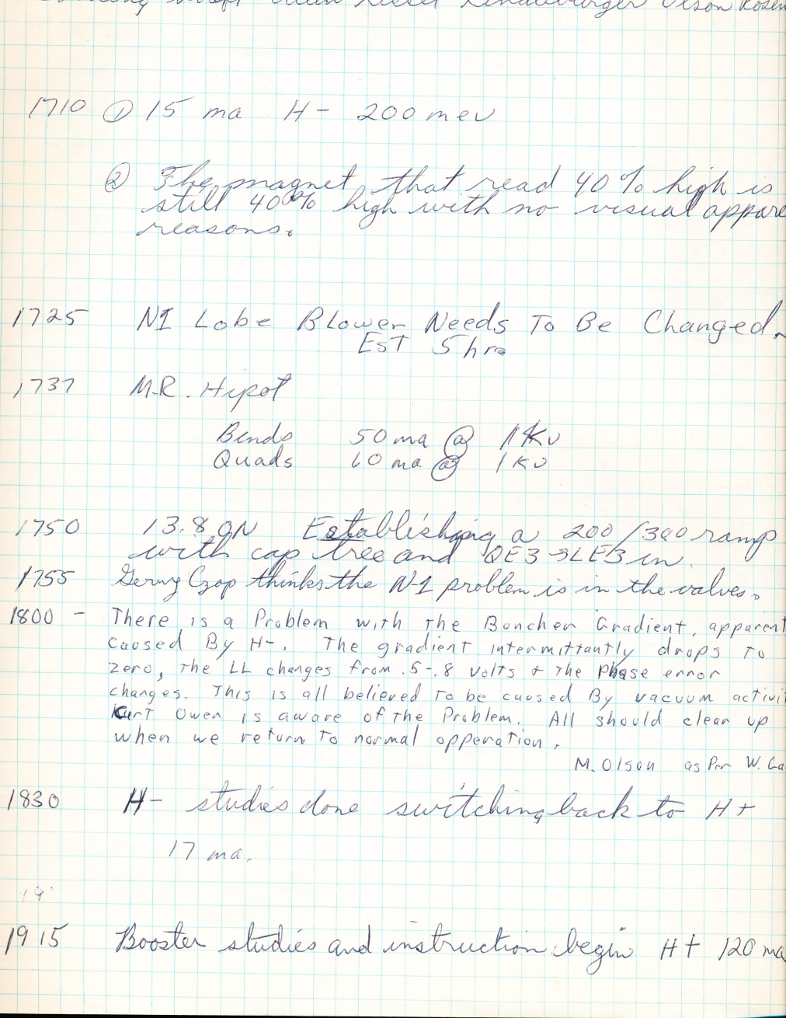
The 1st H- ions accelerated down Linac
Like all good accelerator experiments, it took less than 1 shift to prove that it works !

Slide 19
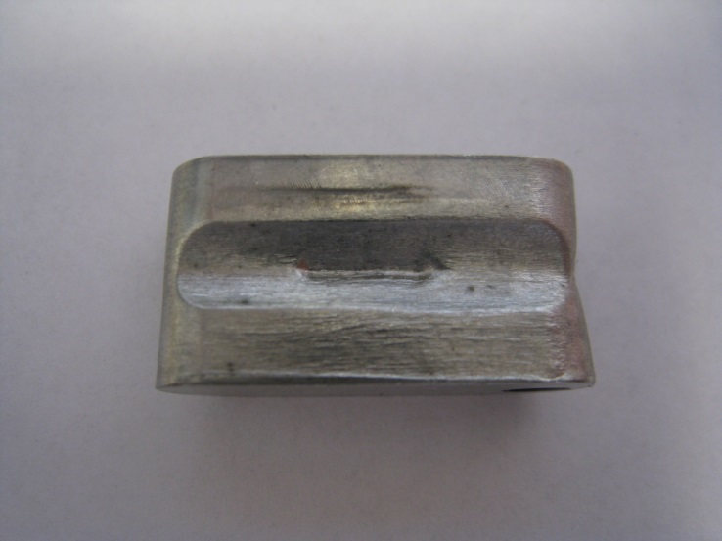
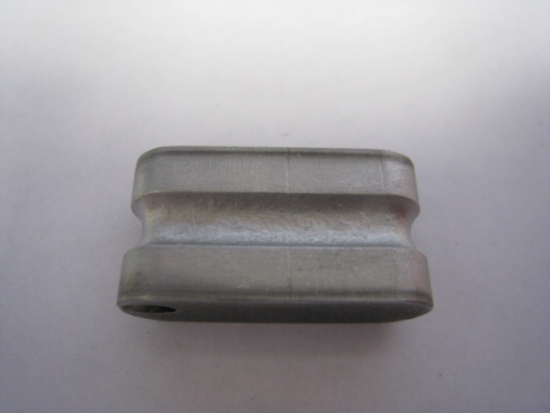
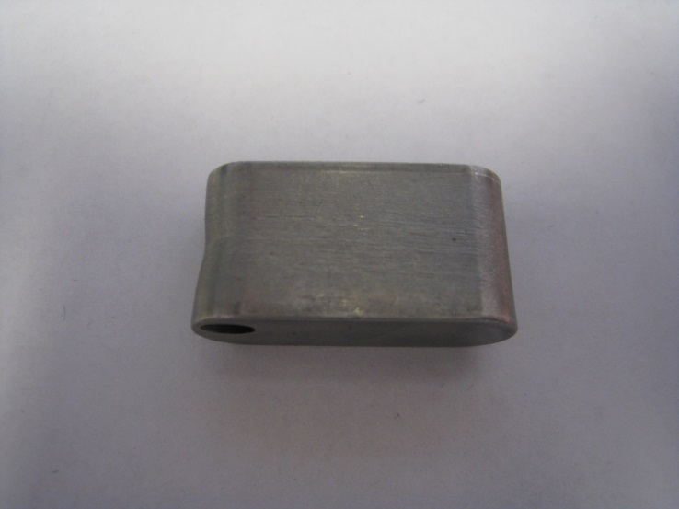
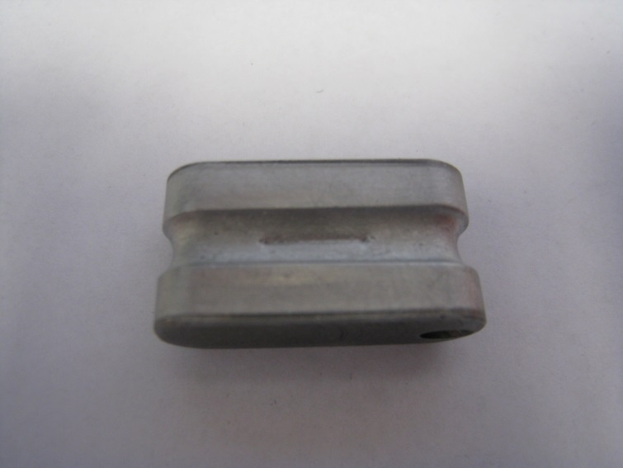
The original cathode was used for years. Then it was decided to grove the cathode on one side to help focus the beam at the anode extraction slit. This was a huge improvement. Later, the cathodes were grooved all the way around thinking that it would reduce “noise” in the extracted beam current which was thought to be the result of too low of a plasma volume.

Slide 20
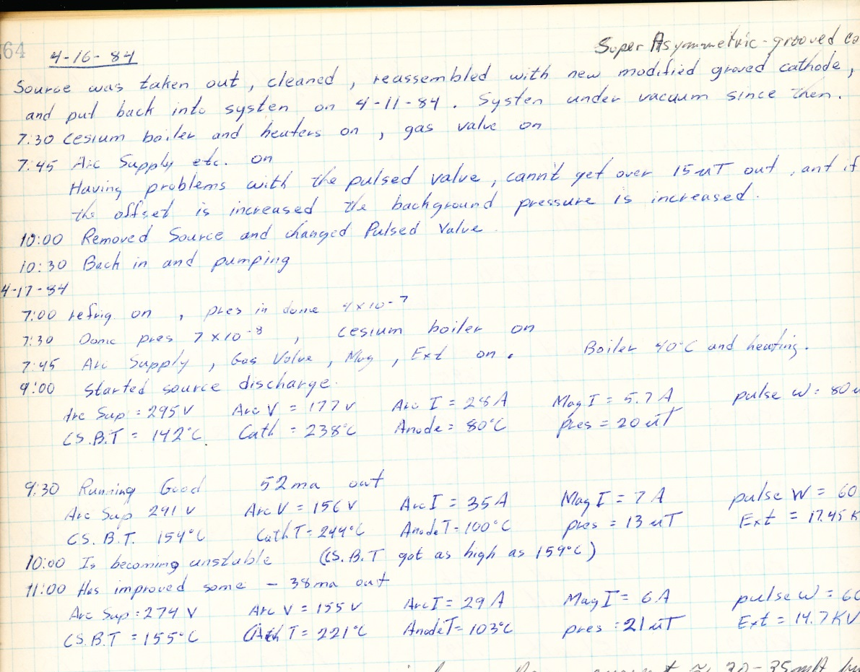
Average power now: 156V x 35A x15 (1/s) x 60(μs) = 4.9W
Arc current went from 180A to 35A with cathode focusing!
This is where things remained until the installation of the new ion source and RFQ……

Slide 21
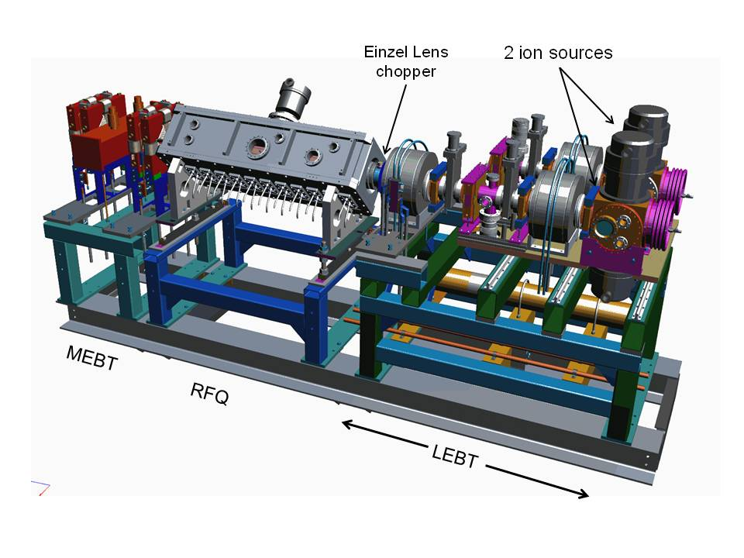
Where we are now…

Slide 22
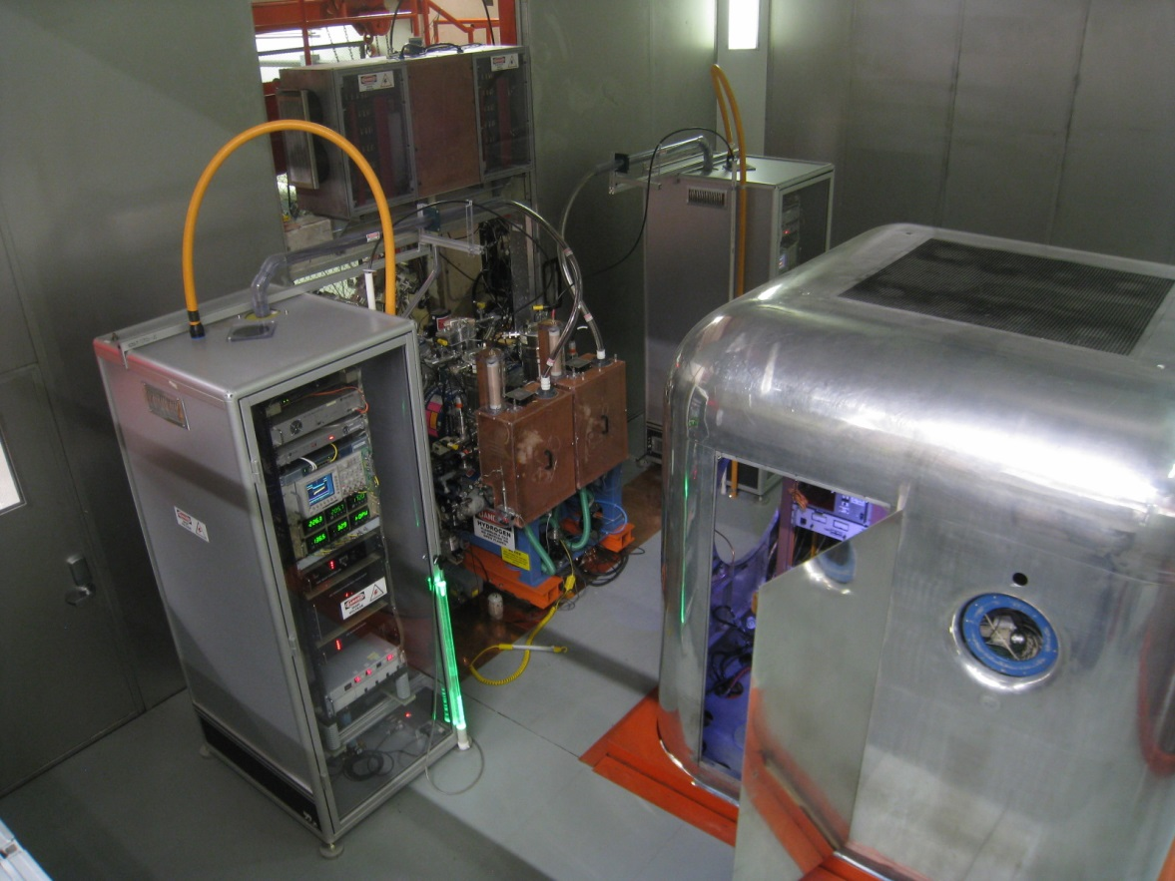
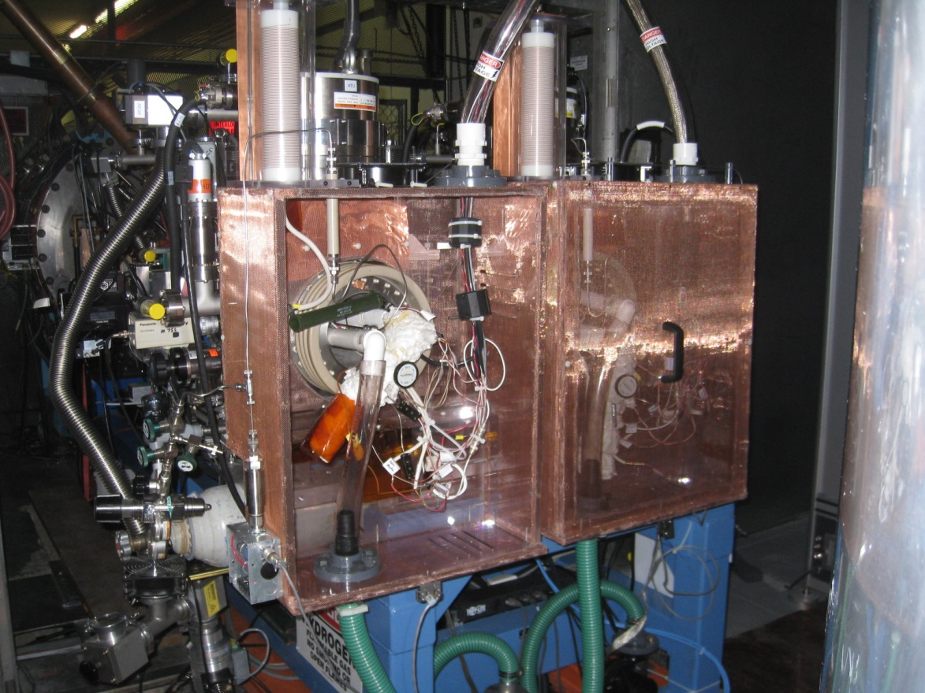
The ion source is based on a design by Jim Alessi of BNL
2 sources

Slide 23
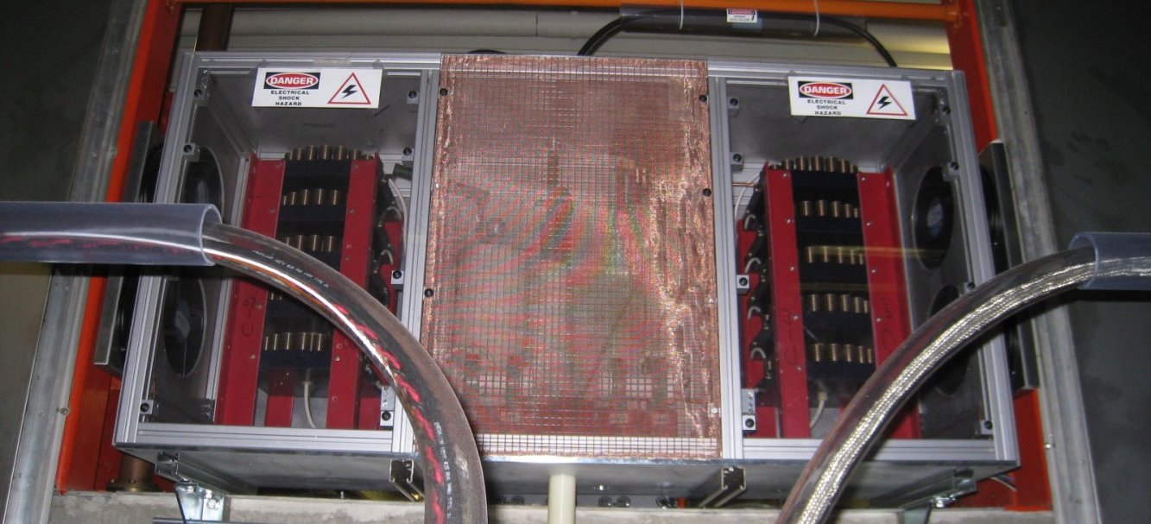
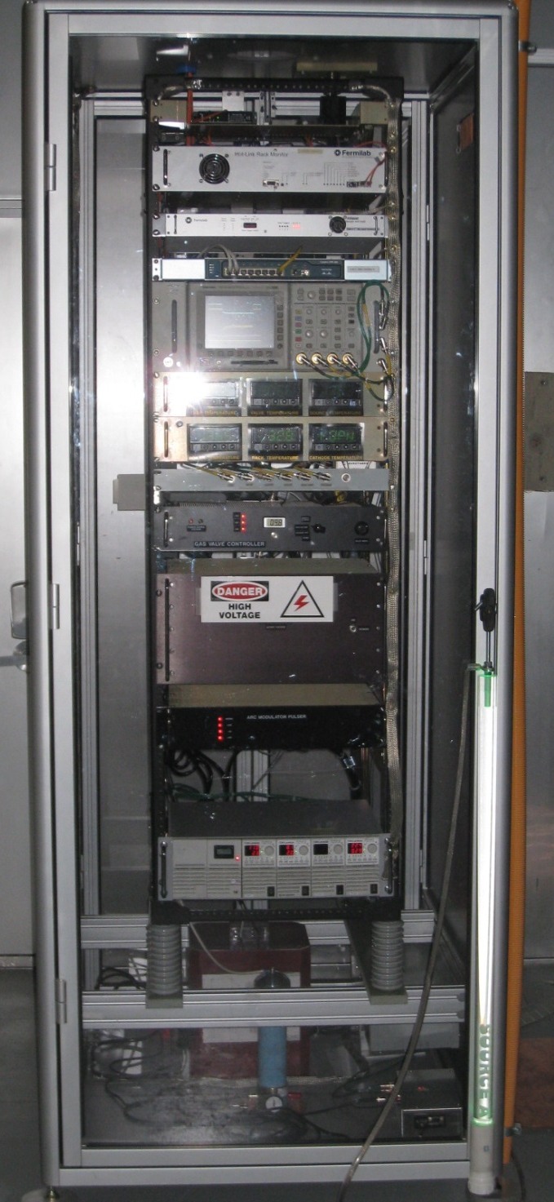
Ion source HV electronics
Einzel lens chopper

Slide 24
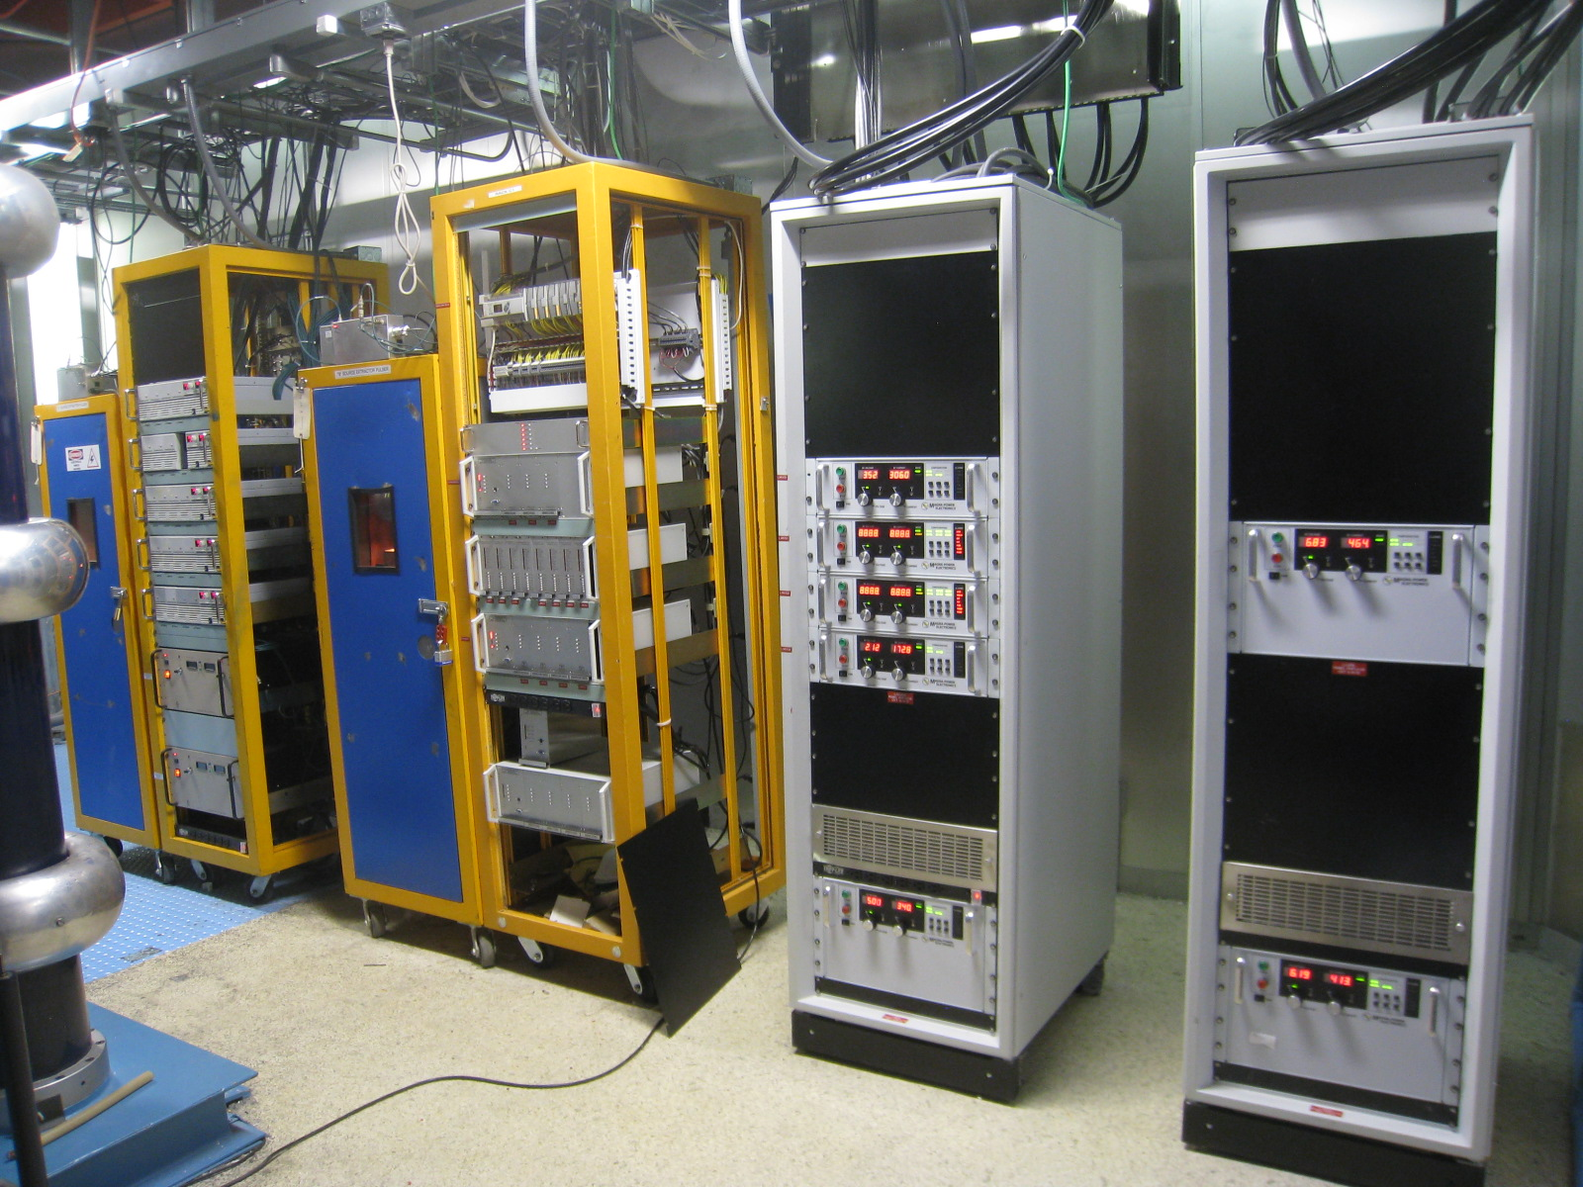
Equipment bellow deck
Extractor pulsers
Supply controls
Trim supplies
Solenoid & Quad supplies
Solenoid supplies

Slide 25
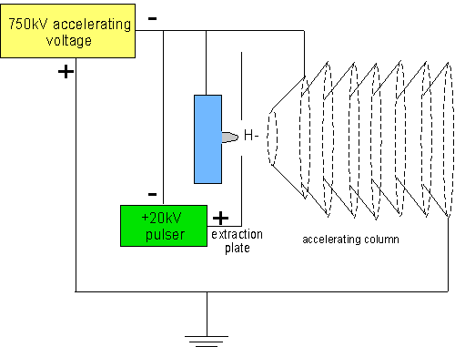
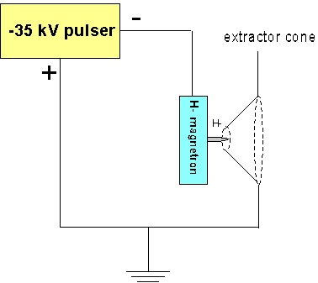
Different extraction scheme
Cockcroft-Walton
New source with RFQ
DC accelerating voltage
Extractor pulsed
Source pulsed to -35kV
Extractor at ground
Higher voltage across extraction gap ( $I ∝V3/2$ )

Slide 26
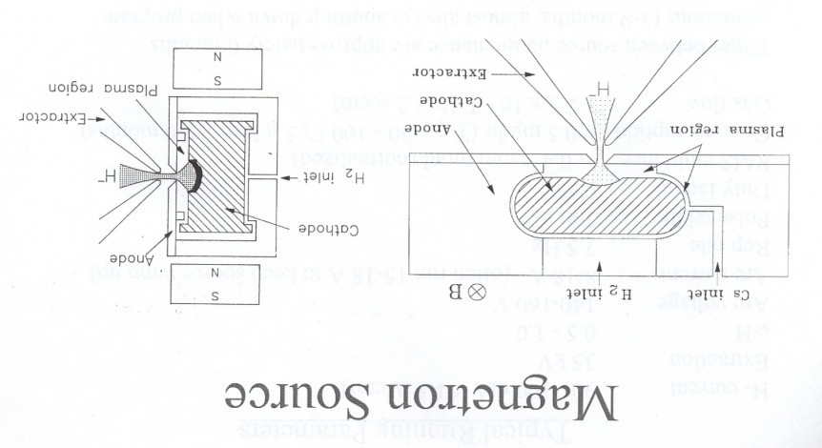
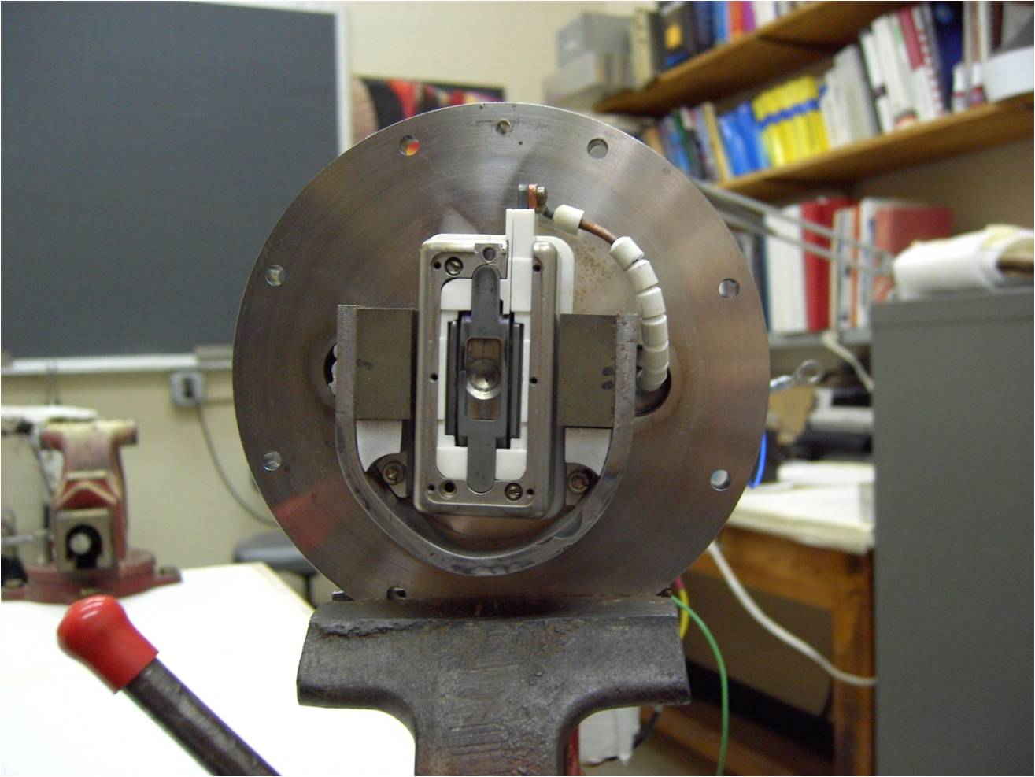
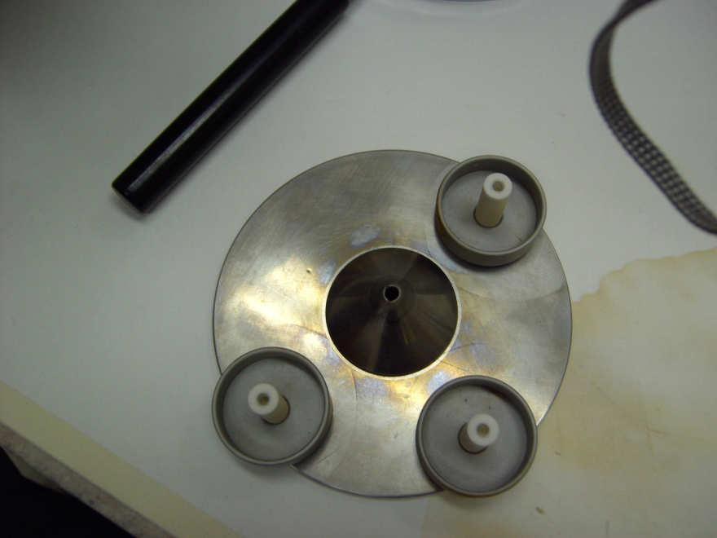
BNL Style Source
Figures: Jim Alessi BNL
Spherical focusing dimple cathode !

Slide 27
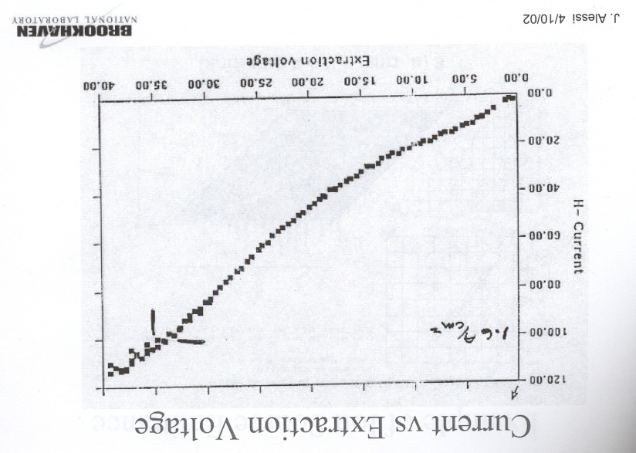
BNL style source, huge improvement!
Parameter | Value
Arc current | 15A
Arc Voltage | 150V
Beam current | 100mA
Power efficiency | 67mA/kW
Source lifetime | 9 months!
Increase in power efficiency comes from:
Spherical dimpled cathode
35kV extraction

Slide 28
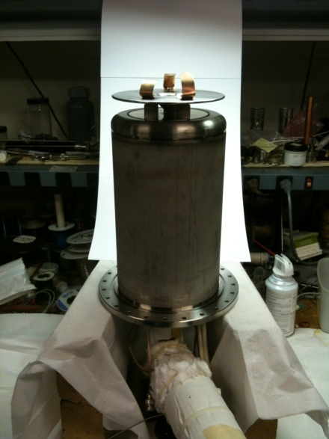
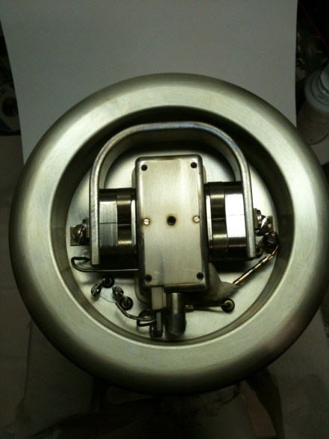
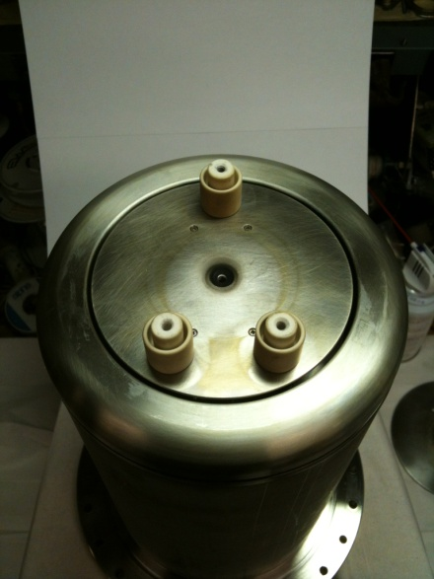
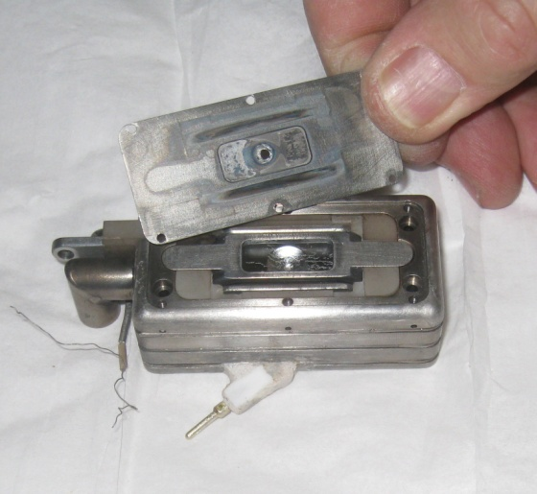
New FNAL magnetron
10 inch source cube
Technicians involved with design
Round aperture

Slide 29
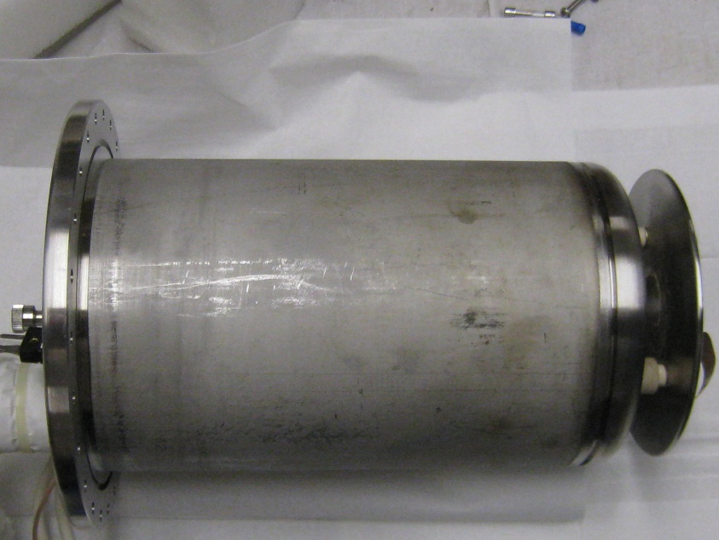
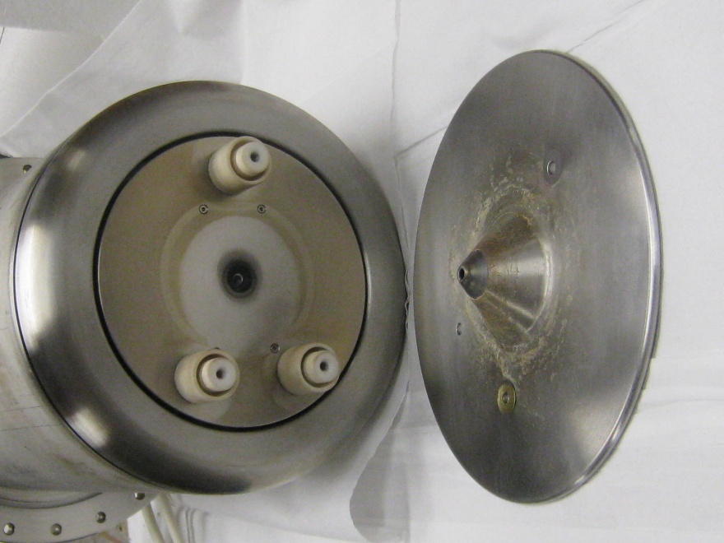
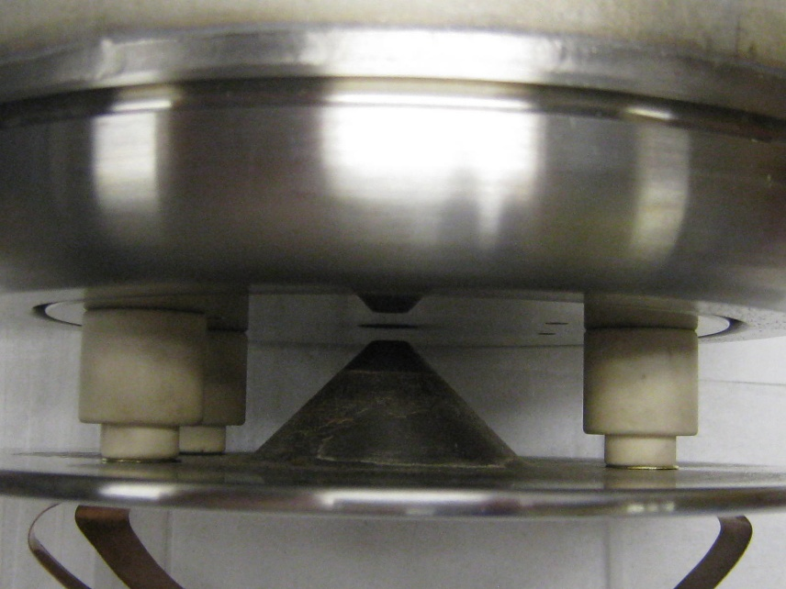
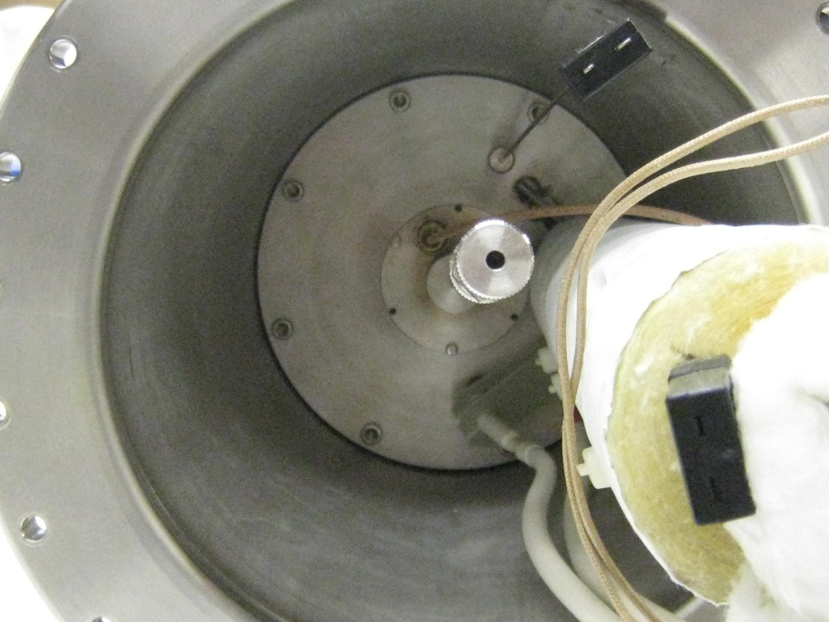
New FNAL source design
anode cover plate
~11in
ceramic extractor standoffs
extraction cone
gas valve
extraction gap .090in
Cs tube
cathode connections

Slide 30
Some studies done on new magnetron
Perveance, able to achieve 1A/cm² @35kV
anode
extractor
Figure: M. Stockli

Slide 31
LEBT emittance with nominal RFQ settings
Vertical 0.25 π mm mrad normalized lσ
Horizontal 0.15 π mm mrad normalized 1σ

Slide 32
Evolution of magnetron cathodes

Slide 33
Extractor sparking, one of our greatest challenges !
There have been 6 main issues that have lead to high spark rates:
Materials used
Magnetic Field
Source pressure
Extraction gap pressure
Cs control
Source electronics

Slide 34
Materials
Materials play a big role, once the damage is done there is nothing left to do other than pull the source and fix it.
Original extractor cone tip made out of molybdenum
Energy of spark would cause damage that would lead to the need to pull the source and fix
BNL uses tungsten for cone tips. They sent us one to try out. Big improvement in eliminating the damage from sparking
Original inner anode cover plate made out of titanium
Severe case of erosion increased the aperture from 0.125in to 0.25in !
Once again BNL (“ahead of the curve”) sent us a molybdenum cover plate which has clearly solved the erosion problem
0.25in
0.125in

Slide 35
Magnetic field
Magnetic field plays a big role in both confinement and sweeping away co-extracted electrons
Magnetrons prefer 1kG in the plasma region for proper confinement.
Original magnets were marginal to start with and ended up too low (~700G) when warmed up.
Redesigned the magnets and yoke with the help of Jim Volk
Original design: 4 SmCo disks
Final design: 2 SmCo rectangular magnets with higher field, thicker yoke

Slide 36
# of electrons inside source
0 Gauss
For all simulations:
Extractor cone = 0V
Cathode = -35.2kV
500 Gauss
1k Gauss
1.5k Gauss
Simulation by
CY Tan

Slide 37
Source Pressure
Cathode (-)
H+,H₂+
1mm
H-
Anode (+)
e-
If source pressure is too high, one possibility is that the path length for the fragile H- ions is so long that the probability is high that some number of them will loose their electron on the way to the extraction aperture, leaving an excess of electrons to be extracted. Leading to sparking.

Slide 38
Source Pressure
Another possibility is low average cube pressure. When the pressure is too low in the extraction gap and we are operating in a different regime of the Paschen curve.
Source pressure
0.09in
Anode (+)
Extractor Voltage
Extractor (gnd)

Slide 39
Cesium Control
Example of too much Cs
Mo: 4.6eV
Cs 2.1eV
Cs boiler temp (yellow)
Cs on Mo: 1.6eV
Extractor Voltage
Example of too little Cs
Cs boiler temp (green)
If the cesium layer is too thick/thin:
Work function increases
H- production decreases
Number of free electrons increases

Slide 40
Examples of excess cesium in the source

Slide 41
Source electronics
Source body looses about 2C
HRM in the HV rack hangs up during heavy sparking. During resets the HRM is off for a few seconds which means that the arc is not on during that time. This allows the cathode and source body to cool off since the only heating is from the arc power: (150V)(15A)(15Hz)(230μs)= 7.8W average power
Cathode looses about 20C due to the arc being off during the resets
HRM resets due to sparking

Slide 42
What we are working on:
Solid State extractor pulsers
New gas valves
2 stage extraction
Removing HRM from HV rack
current regulated arc modulator
Better Cs boiler (no glass, heat tape)
Tungsten dimpled cathode

Slide 43
Current extractor pulser
Vacuum tube based
150μs rise time
Tube lifetime 3 months
Long arc PW needed (230μs)
Source duty factor 0.3%
150μs
DTI Solid State Switches
9.6μs rise time
50kV, 50A switches
Source duty factor 0.12% a decrease of 40% !
Should allow even longer lifetimes

Slide 44
Gas Valves
The current gas valves are Veco PV-10 piezoelectric valves. They are fast and reliable for the most part and have been in use since day one.
Viton wafer provides seal
Piezeo disk
Calibration is done by adjusting the tension on the retainer
End up with a hysteresis curve like these. The valves start to open around 20V and are fully open by 100V

Slide 45
Gas Valves
However, these valves have a terrible temperature dependence !
Even a change as small as 1C changes the arc current by about 1.5A and a change is source pressure of 1x 10^-6 Torr !
This is a big change that can lead to sparking and big changes in beam current!
Veco PV-10 data sheet
~1A
10% / 5degC
~1C

Slide 46
Gas Valves
We are currently testing a solenoid type valve that should have not temperature dependence.

Slide 47
2 stage extraction scheme
_
+
35kV
-8kV
Source
-27kV
27kV
_
+
We only 27kV across extraction gap
Less voltage should reduce sparking
No need to pulse HV rack (it would set at 35kV DC)
Currently testing on test stand
~8kV
pulsed
-35kV – (-27kV) – (-8kV) = 0

Slide 48
HRM removal
Plan to remove HRM and install it in a ground controls rack.
Communication via fiber transceivers will be installed
Will be a big help in reducing the affect of sparking
Will reduce overall spark rate due to asynchronous rebooting of HRM
Thanks to Mike Kucera for pursuing this option !

Slide 49
Cs boiler
W cathode dimple
We us 5g ampules of Cs.
Sometimes Cs gets trapped in the broken glass
Tungsten dimple
Cs on W H- production peak is broader
Need to get rid of heat tape and go to heater like BNL

Slide 50
All of this is cool, but the coolest thing about working on sources is: You don’t have to commit a crime to be on the cover of the Chicago Tribune !

Slide 51
Thanks for your attention !

