Slide 1


Beam Energy Spread in the Booster at Injection
Chandra Bhat
B. E. Chase, Salah Chaurize, Fernanda Garcia,
Kiyomi Seiya, Bill Pellico, Todd Sullivan, Kent Triplett
Acknowledgements: Dave Wildman
PIP Meeting
February 18, 2014

Slide 2
The Proton Improvement PlP
The Proton Improvement Plan, when executed, should enable Linac/Booster operation capable of
  delivering 1.8E17 protons/hour (at 12 Hz) by May 1, 2013
  delivering 2.25E17 protons/hour (at 15 Hz) by January 1, 2016
  While maintaining Linac/Booster availability > 85% and maintaining residual activation at acceptable levels and ensuring a useful operating life of the proton source through 2025.
The Proton Improvement Plan-II Strategy: Increase Booster/Recycler/Main Injector per pulse intensity by ~50% by selecting the Booster Injection energy as 800 MeV which gives 30% reduction in space-charge tune shift.
  Provide a platform for eventual extension of beam power to LBNE from 1.2MW to >2 MW
Conclusions: “Booster is just Forty Years Old!”
  Revisit: Injection, Acceleration, Tran. Xsing, Extraction & …
S. Henderson,
Proton Source Retreat,
Dec. 7-8, 2010
S. Holmes,
P5/BNL,
Dec 16, 2013

Slide 3

Proton Beam Energy Spread at Injection
Past: After the LINAC energy upgrade the beam energy spread is measured (M.Popovic 1995-97)
  Down stream of LINAC ⇐ ΔE|_{full}≤3 MeV
  For partial batch at injection in the Booster by measuring the delta increase of its length
    de-buncher cavity “OFF” ⇐ ΔE|_{full}=2.8 MeV
    de-buncher cavity “ON” ⇐ ΔE|_{full}=1.02 MeV
Present (2013 and 14): With the new ion source & RFQ
  Down stream of LINAC (F. Garcia 2013-14 )
    1) Spectrometer &
    2) Fitting the multi-wire data with the best known lattice of the 400MeV transfer line
  At Injection in the Booster (C. Bhat et. al.)
    By creating a 30-45 nsec notch in 3, 6 and 10 booster turn beam ← Gives intensity dependence of the energy spread.
    Debuncher and Booster Main cavities “ON” and “OFF”
ΔE|_{full}≤1.8 MeV
$\frac{dp}{p}$|_{full}=3E-3 or ΔE|_{full}=2 MeV

Slide 4

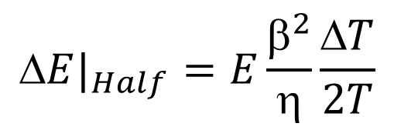
Methodology of the Technique
To=2.216μs for Booster
ΔE
Phase-Space Distribution
t
Beam@Inj
t
WCM
ΔE
t
After Notch
t
$$T$$
ΔE
t
Notch filling
t
$$E|_{Half}=E\frac{β^{2}}{η}\frac{ΔT}{2T}$$
ΔT = Width of the Notch =30-35ns
T = Time required for grazing touch

Slide 5
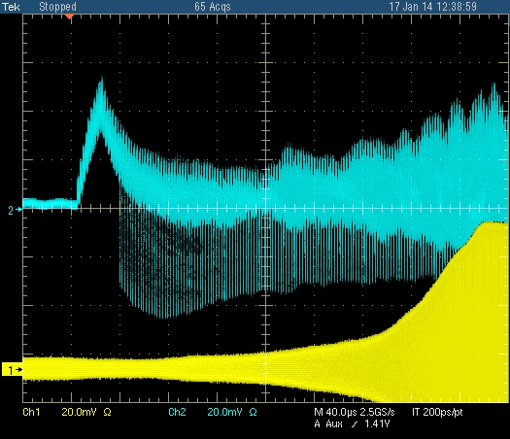
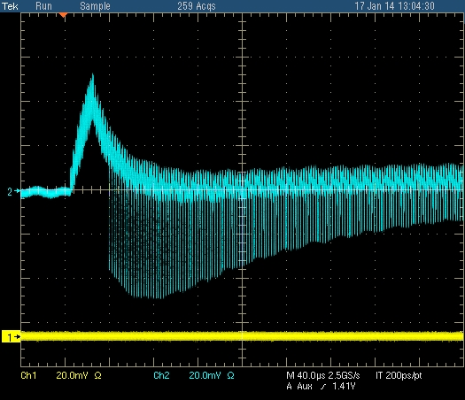
Measurements
10 BT Beam Injection
WCM
Data Set - I
Produce a Notch
B:RFSUM
Data Set - II
~10 μs
Comments: ⇒ “Data Set-I” had a systematic error of
nearly 2BT, but, can be used to get
info. on cycle to cycle B-field/Bdot
variations and its effect on the beam.
⇒ “Data Set-II” has less error for
energy spread

Slide 6
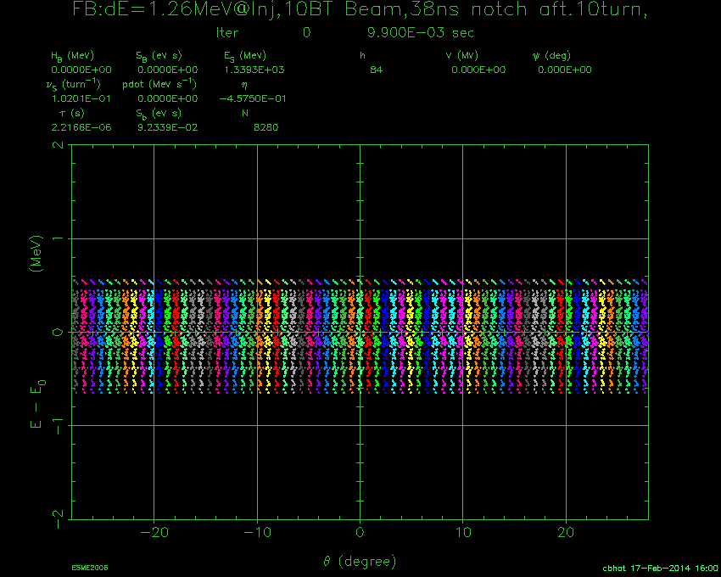
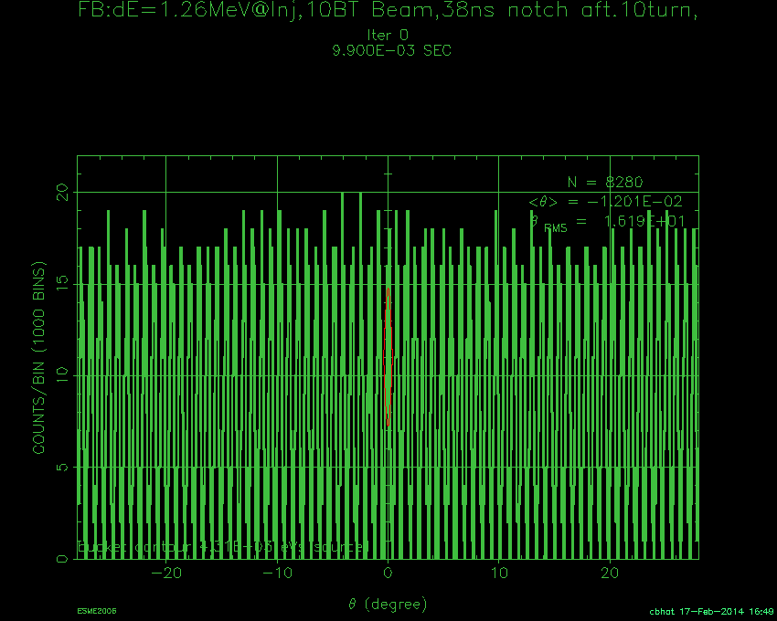
Expectations from Simulations
Booster Cavities OFF (Vrf=0kV)
Inject a beam of 10 Booster turn and a create a notch of 35ns width after about a turn
Phase Space Distributions
WCM Expectations
ESME
ESME

Slide 7
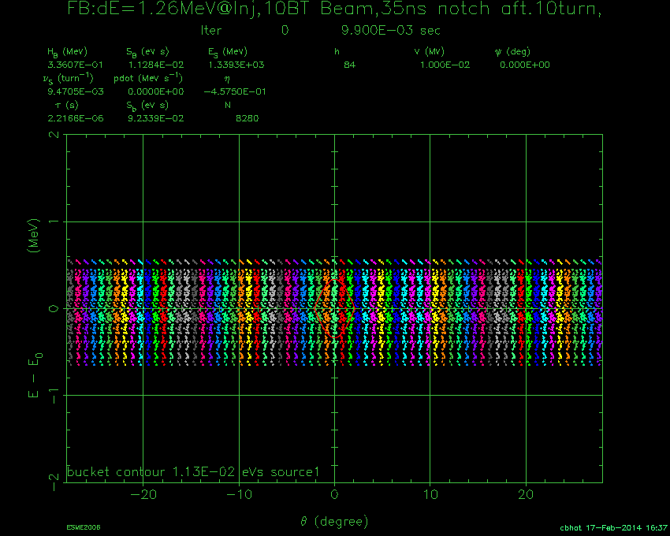

Expectations from Simulations
Booster Cavity ON (Vrf=10kV)
Inject a beam of 10 Booster turn and a create a notch of 38ns width after about a turn
Phase Space Distributions
WCM Expectations
ESME
ESME

Slide 8
Measurements: MR data for Booster & Debuncher
Cavities at different configurations
10BT

Slide 9

How to determine the grazing touch on two shoulders of a notch?
WCM
Notch Depth
After Notch
t
$$T$$
WCM Notch Depth (Arb. Units)
Notch filling
t
Since the WCM is an AC coupled devised, once the two shoulders of a notch touch then the WCM notch depth starts decreasing from turn-to-turn . We determine the excursion point from the data shown on the right. The uncertainty comes from measuring exact notch depth from the WCM data.

Slide 10
Measurements: MR data for Booster & Debuncher
Cavities at different configurations
10BT
10BT
1st trace with notch & Trace with grazing touch
1st trace with notch & Trace with grazing touch
10BT
10BT

Slide 11
Measurements: MR data for Booster & Debuncher
Cavities at different configurations
3BT
10BT
1st trace with notch & Trace with grazing touch
1st trace with notch & Trace with grazing touch
3BT
10BT

Slide 12
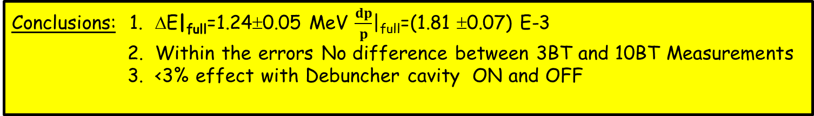
Results from the 20140117 Measurements
Conclusions: 1. ΔE|_{full}=1.24±0.05 MeV $\frac{dp}{p}$|_{full}=(1.81 ±0.07) E-3
2. Within the errors No difference between 3BT and 10BT Measurements
3. <3% effect with Debuncher cavity ON and OFF

Slide 13
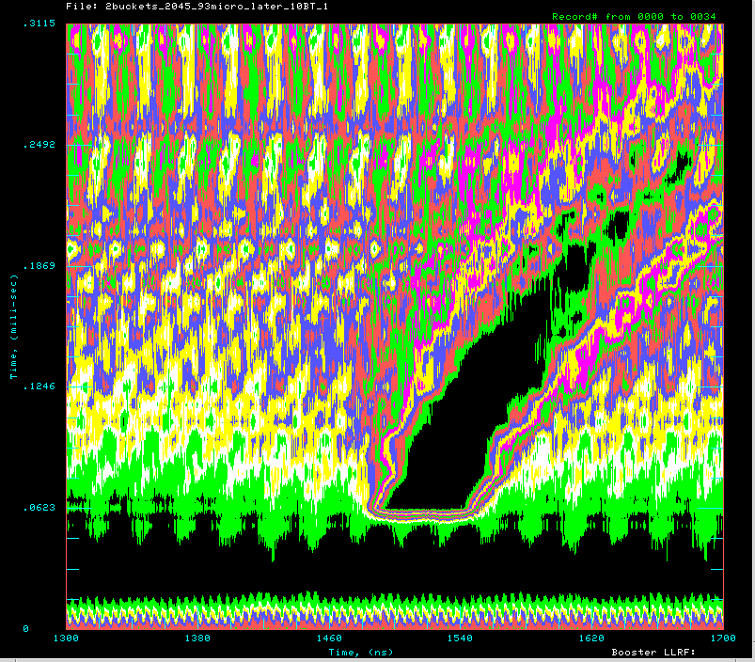
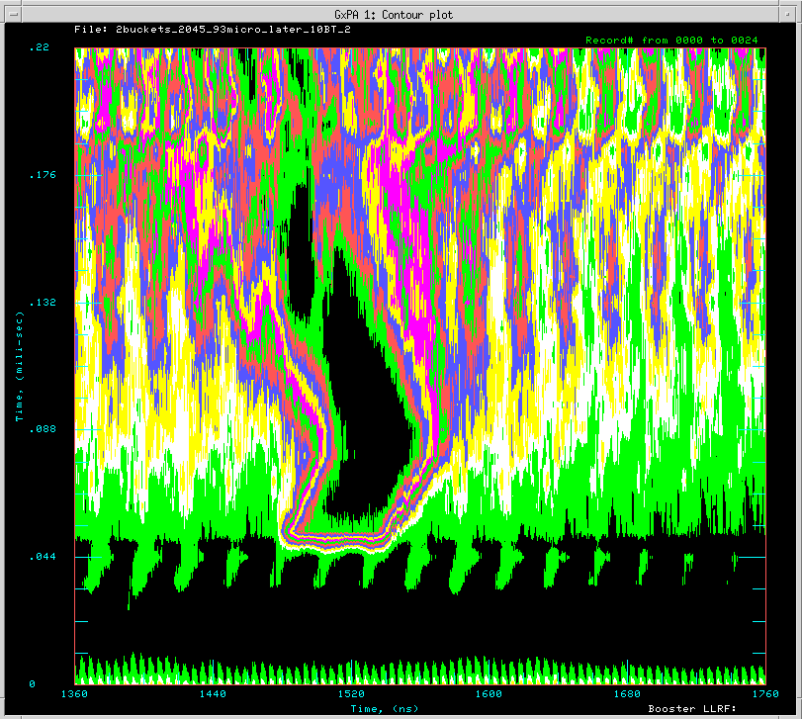
Interesting Facts from the Data Set-I
Motion of Notch-Center
Contour Plots
Ming-Jen’s B62 Program
Notch
>30ns &
Varies from cycle-to-cycle
Does this cause any problem for cogging & clean beam extraction from the Booster?

Slide 14
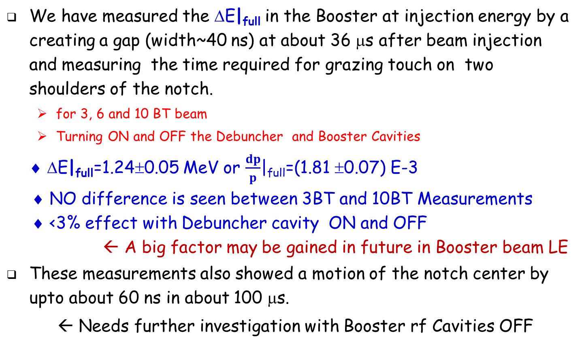
Summary and Conclusion
We have measured the ΔE|_{full} in the Booster at injection energy by a creating a gap (width~40 ns) at about 36 μs after beam injection and measuring the time required for grazing touch on two shoulders of the notch.
  for 3, 6 and 10 BT beam
  Turning ON and OFF the Debuncher and Booster Cavities
♦ ΔE|_{full}=1.24±0.05 MeV or $\frac{dp}{p}$|_{full}=(1.81 ±0.07) E-3
♦ NO difference is seen between 3BT and 10BT Measurements
♦ <3% effect with Debuncher cavity ON and OFF
← A big factor may be gained in future in Booster beam LE
These measurements also showed a motion of the notch center by upto about 60 ns in about 100 μs.
← Needs further investigation with Booster rf Cavities OFF

Slide 15
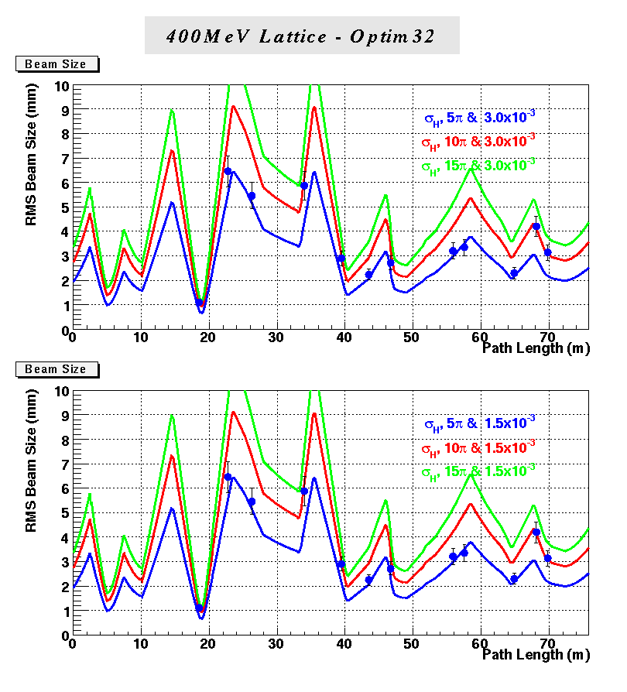
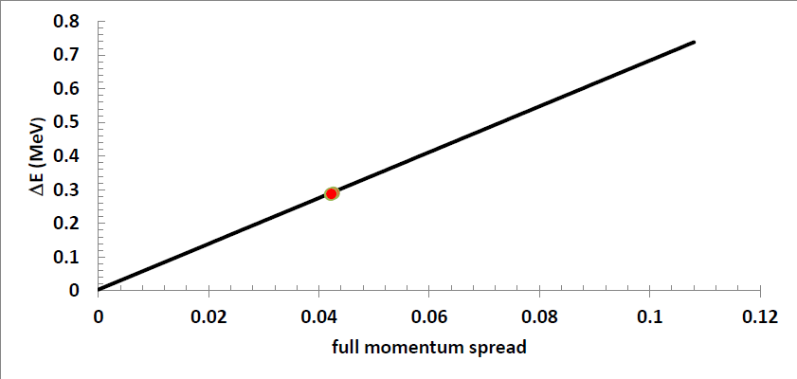
2013-14 Energy Spread Measurements
(Fernanda Garcia)
Energy spread from Multi-wire data fit to the 400MeV beam-line optics 2013
LINAC Downstream Spectrometer measurements of 2013-2014
RMS ΔE (MeV)
Location of the
Debuncher Cavity
RMS Momentum Spread

