Slide 1
PIP Current Status Report March 12, 2014 New Notch Pulser System Testing
S. Chaurize - C. Jensen

Slide 2
Testing/Installation plan
Test cage magnet testing
Run short magnets on new pusler system
Look at rise times and load matching etc.
Gallery Pulser testing and Magnet installation
Pulse new pulser connected to test load at operational TLG rate along with operational notching power supplies.
When system checks out, look for opportunity to connect to single long magnet in tunnel for Beam operation.
Proceed to two short magnets and two long magnets.
Continue in incremental kicker swaps to 4 short and 1 long magnet configuration during daily shutdown opportunities.
Gallery testing and cage testing are independent of each other

Slide 3
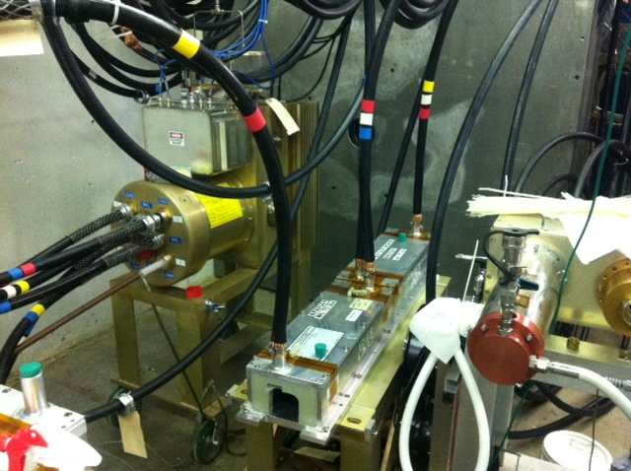
Short Kicker testing with new pulser power supply system in progress
Pulser
Short kicker magnets

Slide 4
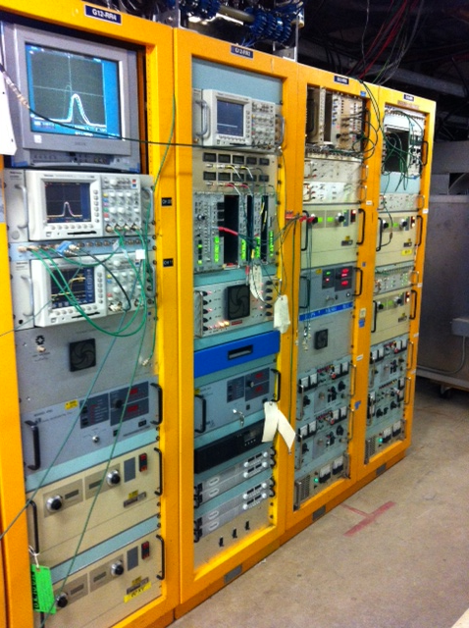
Currently used notching power supply racks New pulser control rack and power supply Installed and ready for testing

Slide 5
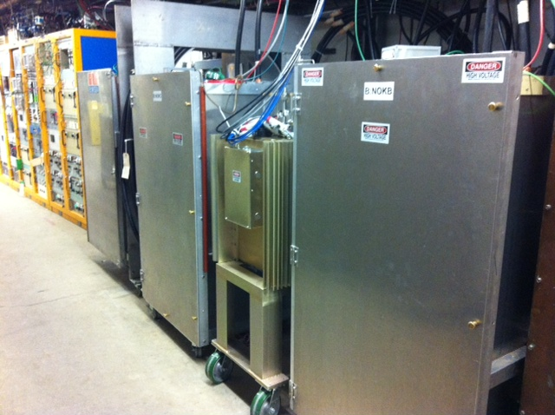
Pulser Ready for Pulse testing In east Booster Gallery
Currently used pulsers

Slide 6
Controls and power supply/load configuration

