Slide 1
2nd harmonic RF perpendicular biased cavity update
C.Y. Tan, W. Pellico, G. Romanov, R. Madrak,
and D. Wildman
04 Apr 2014

Slide 2
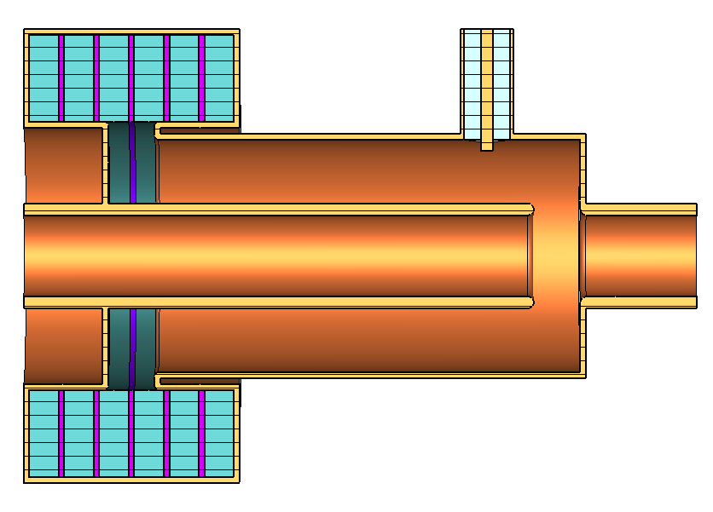
Proposed cavity.
solenoid not shown here
Ferrite
200
70
390
220
40
BeO
490
Ferrite disk: 380 mm outer diam., 230 mm inner diam., 25 mm thickness
BeO disk: 380 mm outer diam., 230 mm inner diam., 5 mm thickness

Slide 3
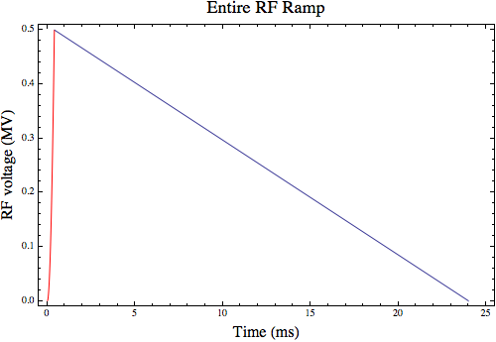
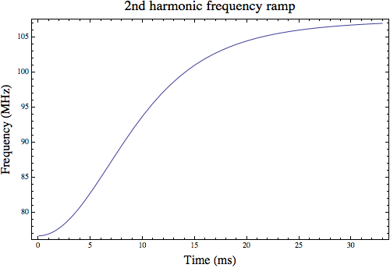
Some possible parameters
Tuning range 76.7 − 107 MHz.
Gap voltage. 100 kV per cavity.
Ramp profile determines losses in the garnet.

Slide 4
CST Model (done by G. Romanov)
Solenoid coil
Complete cavity model with magnetic field generated by solenoid

Slide 5
230 mm
Ferrite tuner details
20 mm
Yoke, steel 1008
This is old picture, not properly scaled. But the marked dimensions are current.
Coil, 12 turns
90 mm
Water cooling channels, 10x5 mm
Ferrite G810, R=190 mm, r=115 mm, l=25 mm
R205
Ceramic AlN, l=5mm
R110
190 mm

Slide 6
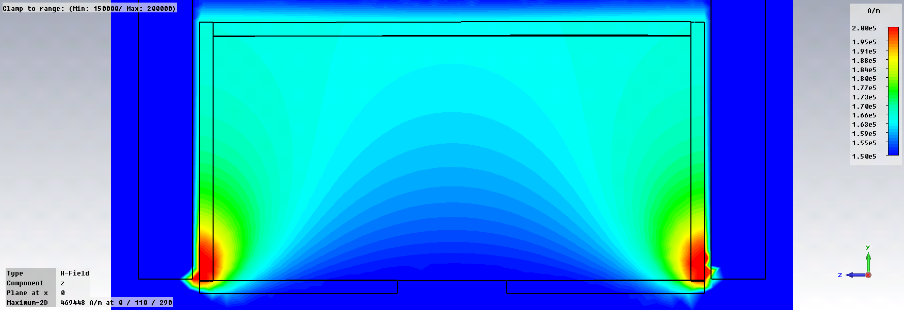
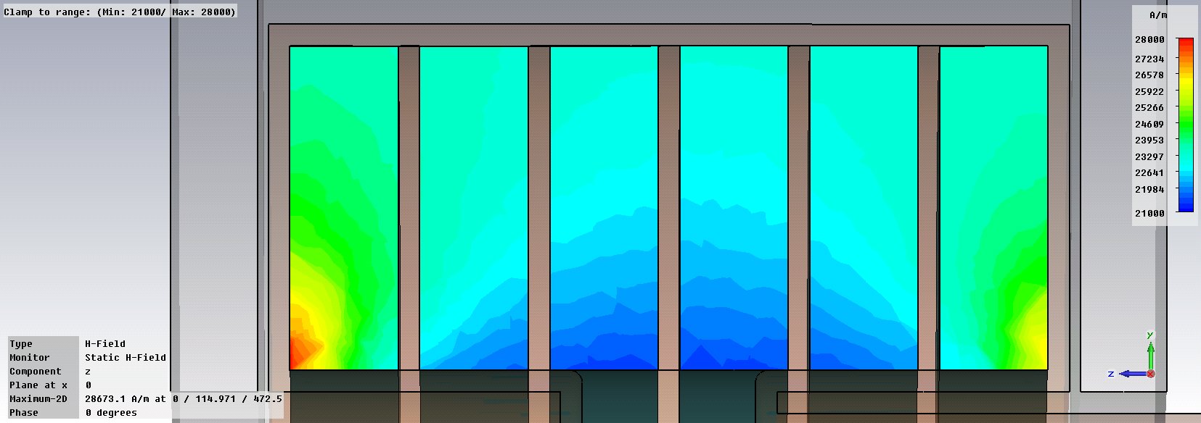
Static field distribution in ferrite
Separate solenoid model
Complete cavity model
Field non-uniformity is about 25-30%

Slide 7
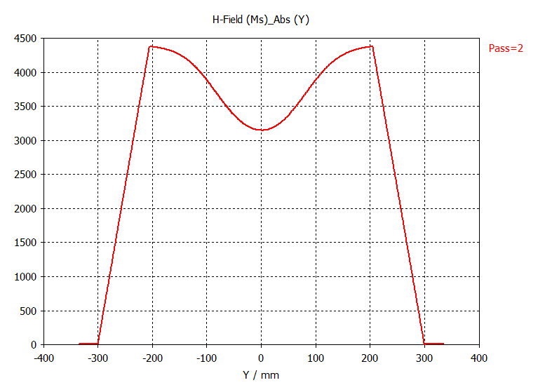
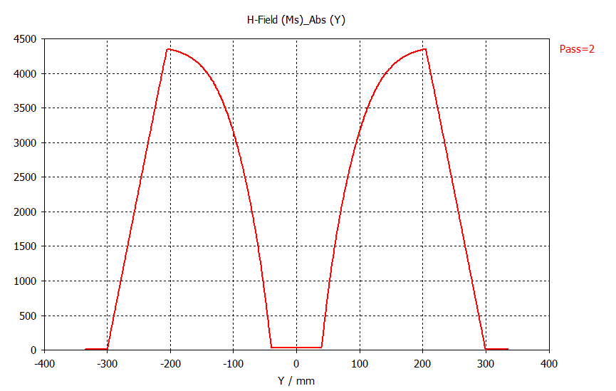
Suppression of fields with steel insert.
Yoke
Coil
Ferrite
Copper drift tube
Steel 1008 insert
Radial distribution of H field at tuner median plane. H field on the axis can be as high as 85 kA/m. With steel drift tube it is suppressed.

Slide 8
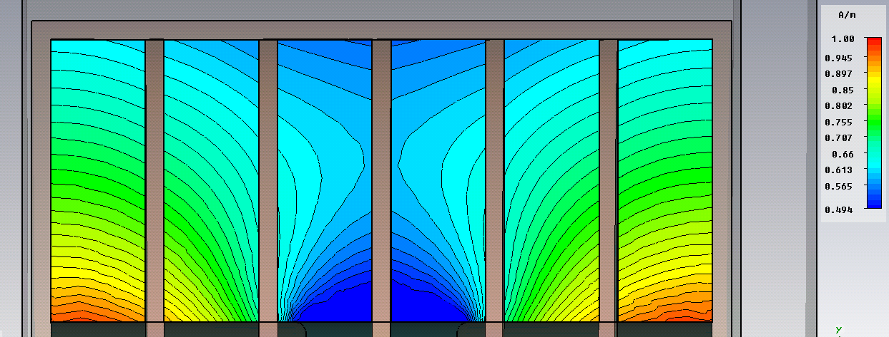
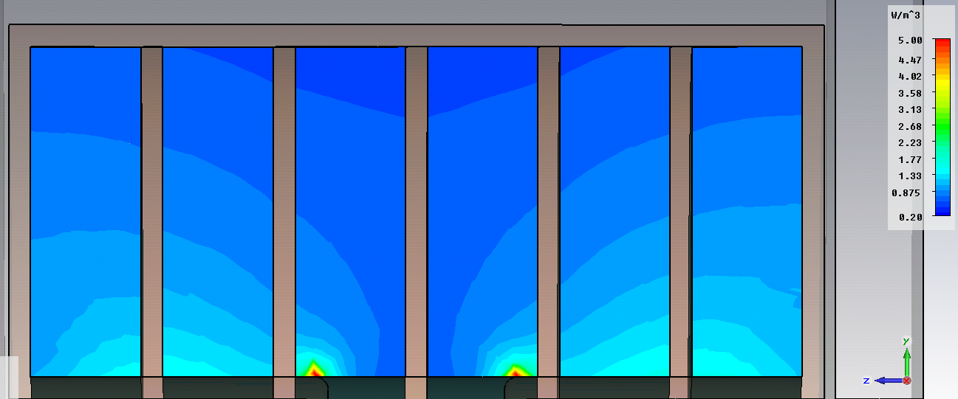
RF magnetic field distribution in ferrite and losses
f=75.6 MHz
These power losses spikes are not real. They are due to the singularity of low frequency mesh that is used for thermal simulations

Slide 9
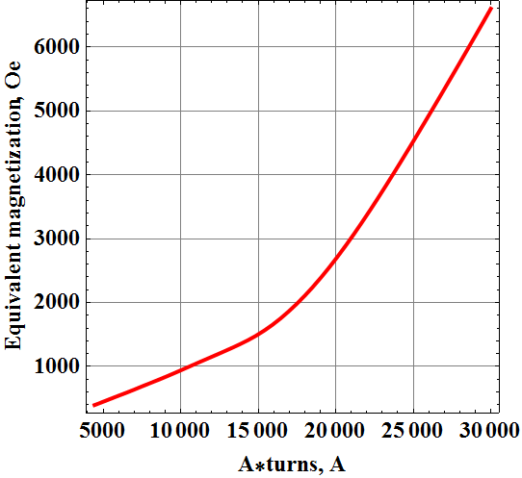
Tuning curves
Conversion of the solenoid current to the equivalent uniform field. We can continue to use uniform magnetization – the results are very close.

Slide 10
Thermal analysis
AlN cooling disks. Thermal losses in the ferrite are 14 kW for V=100 kV. Max T ≈ 75°C with cooling water temperature of 25°C.
Curie temperature

Slide 11
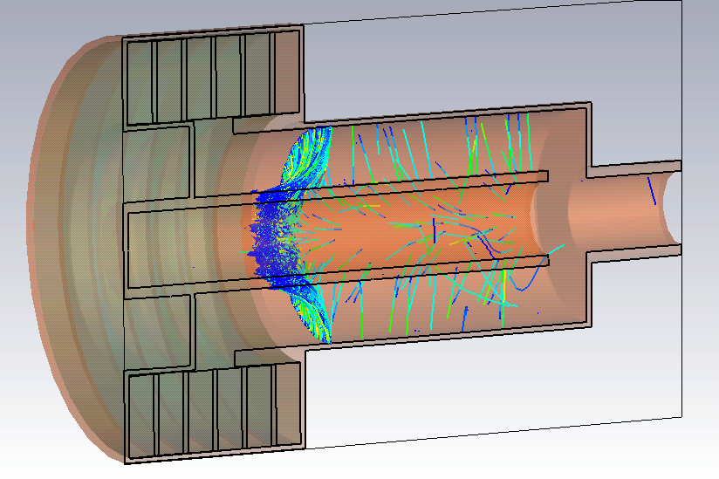
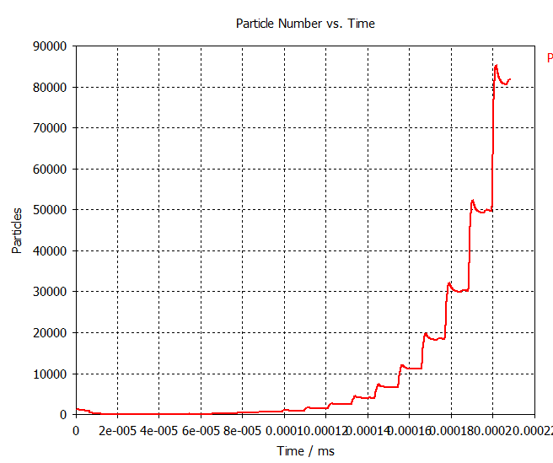
Mulitpacting with maximum solenoidal field
Range: up to 2.5 % of nominal field level
Location of multipacting
Exponential growth of particle number

Slide 12
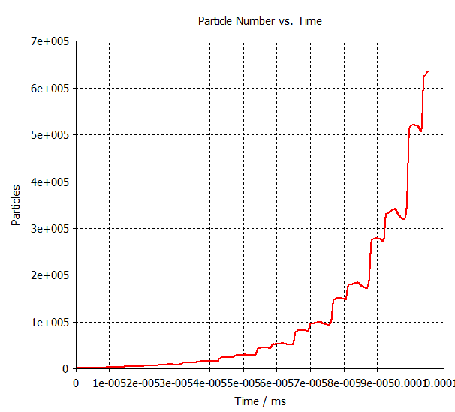
Mulitpacting without solenoidal field
Range: up to 1 % of nominal field level
Location of multipacting
Exponential growth of particle number

Slide 13
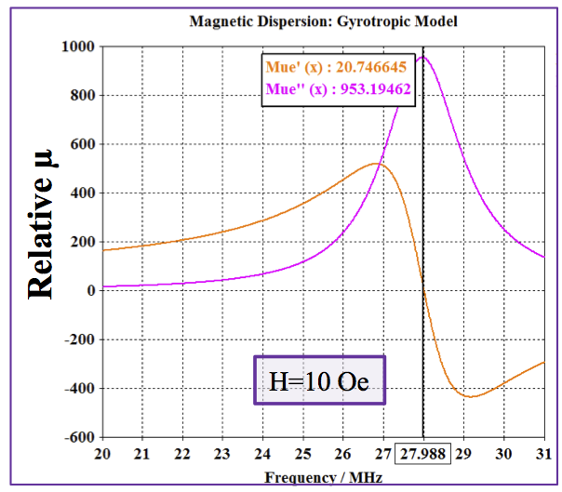
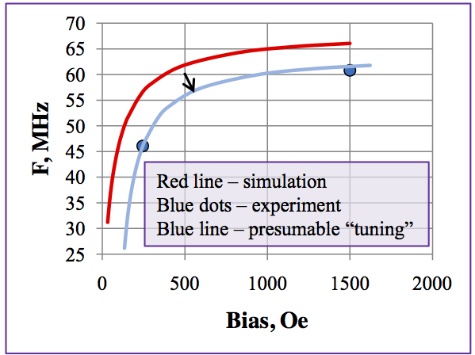
Magnetic permeability (Gyrotropic model)

Slide 14
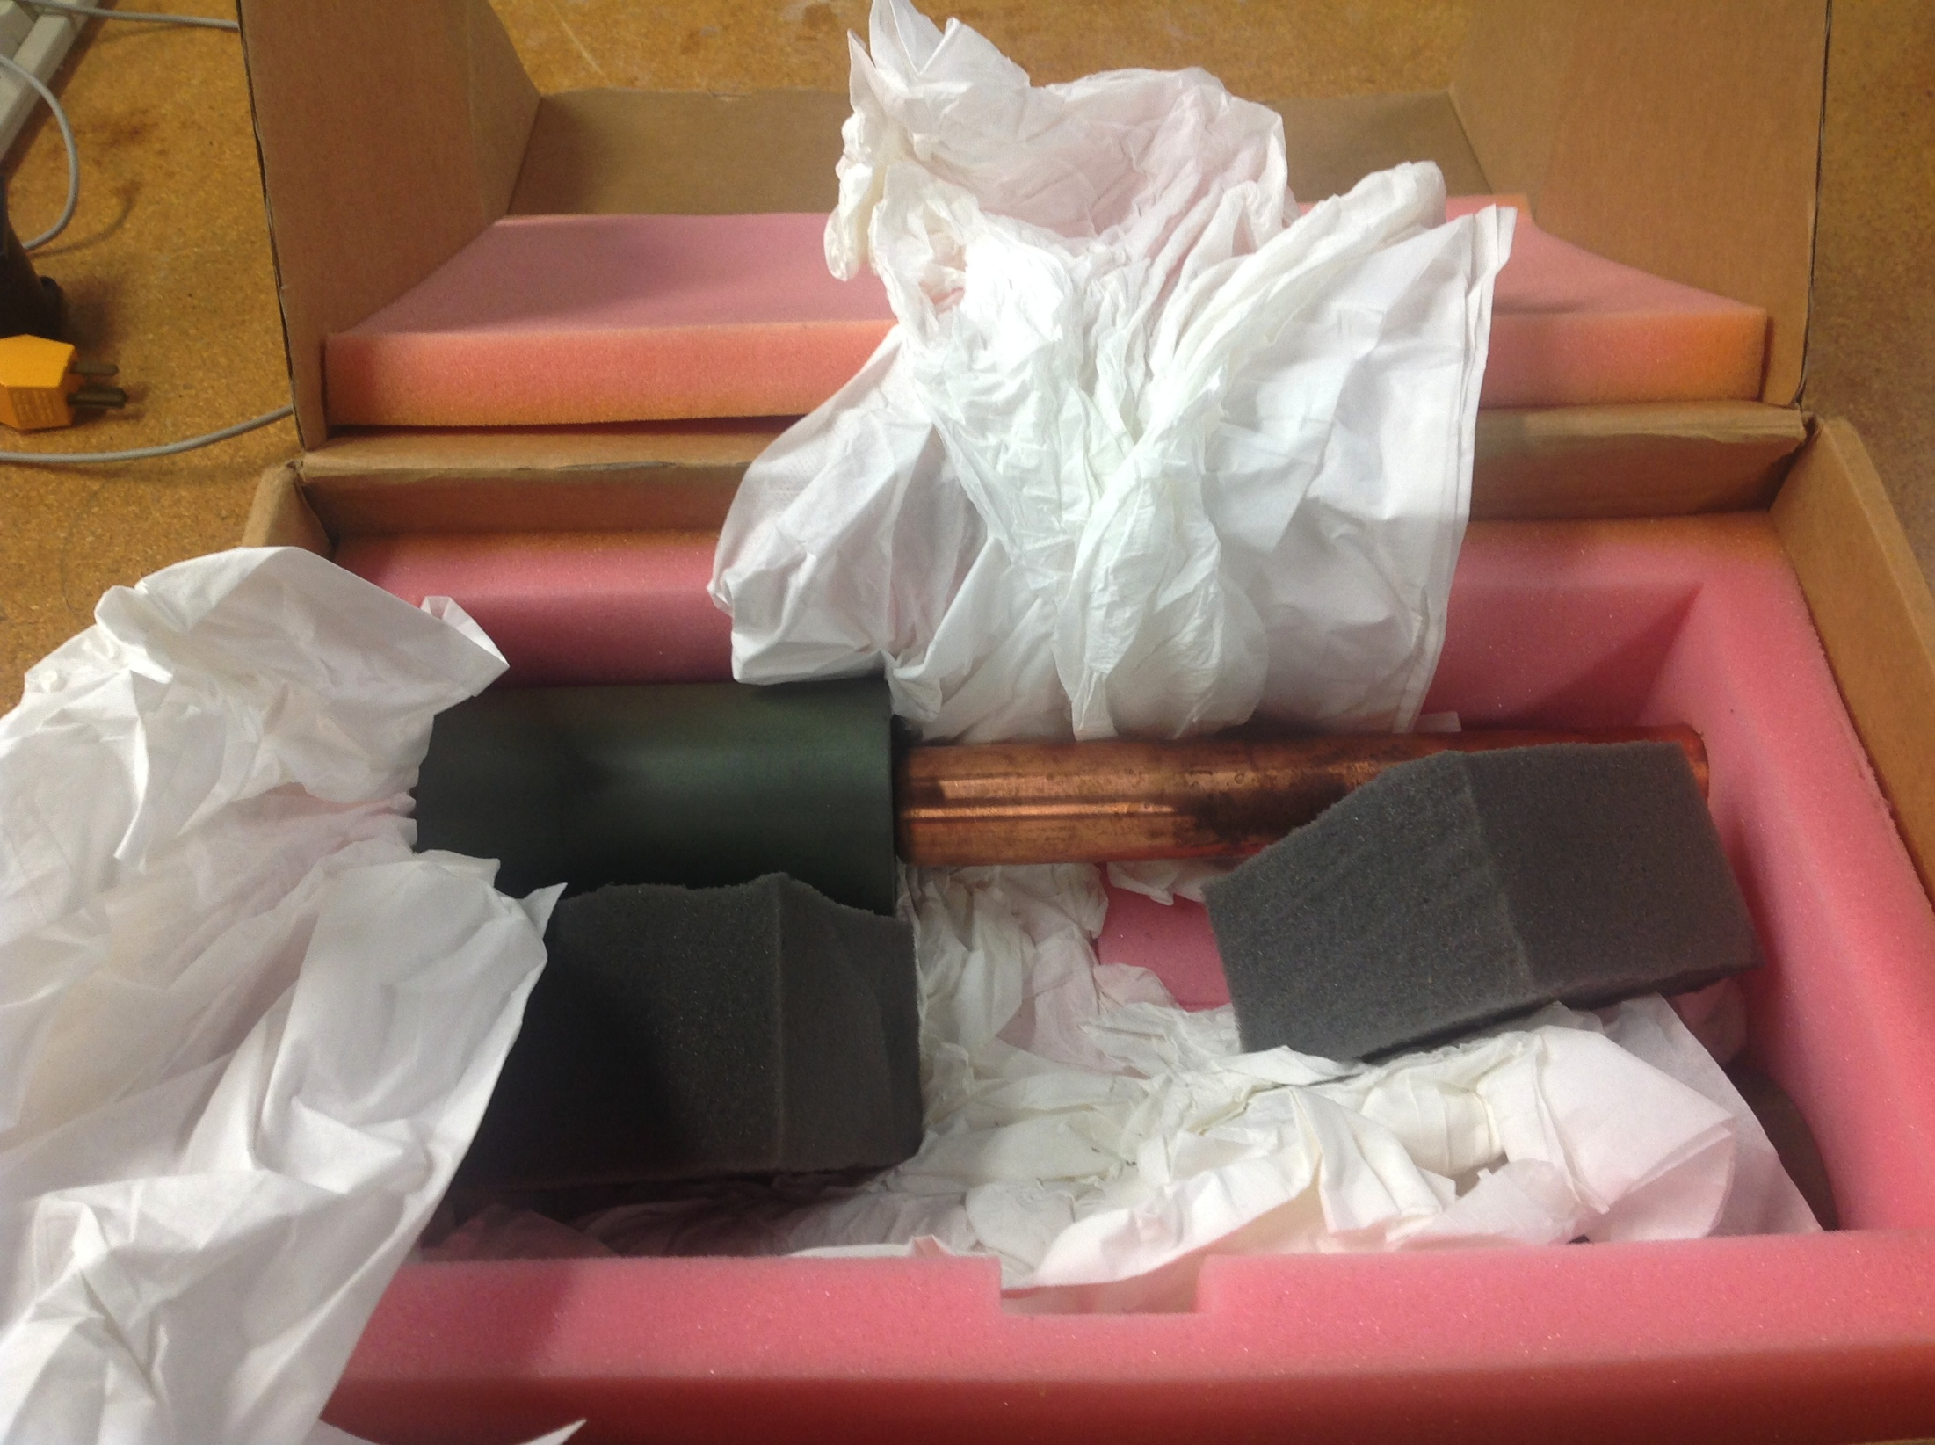
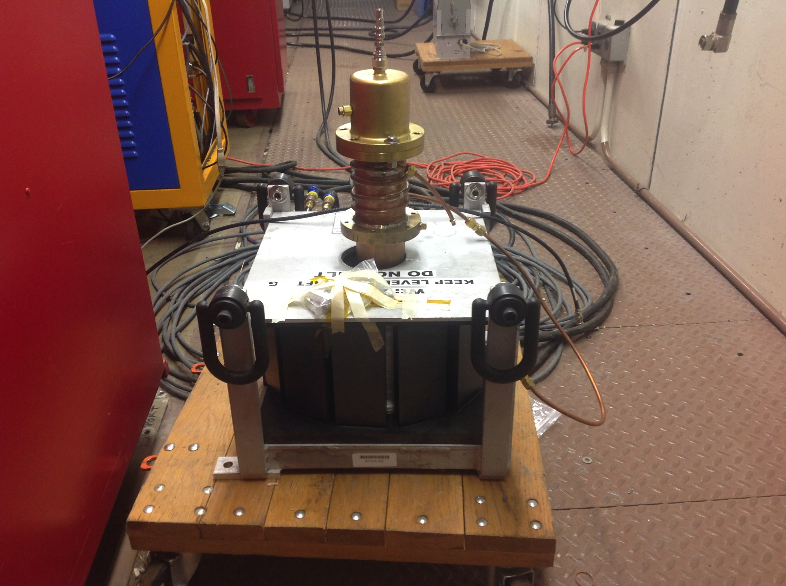
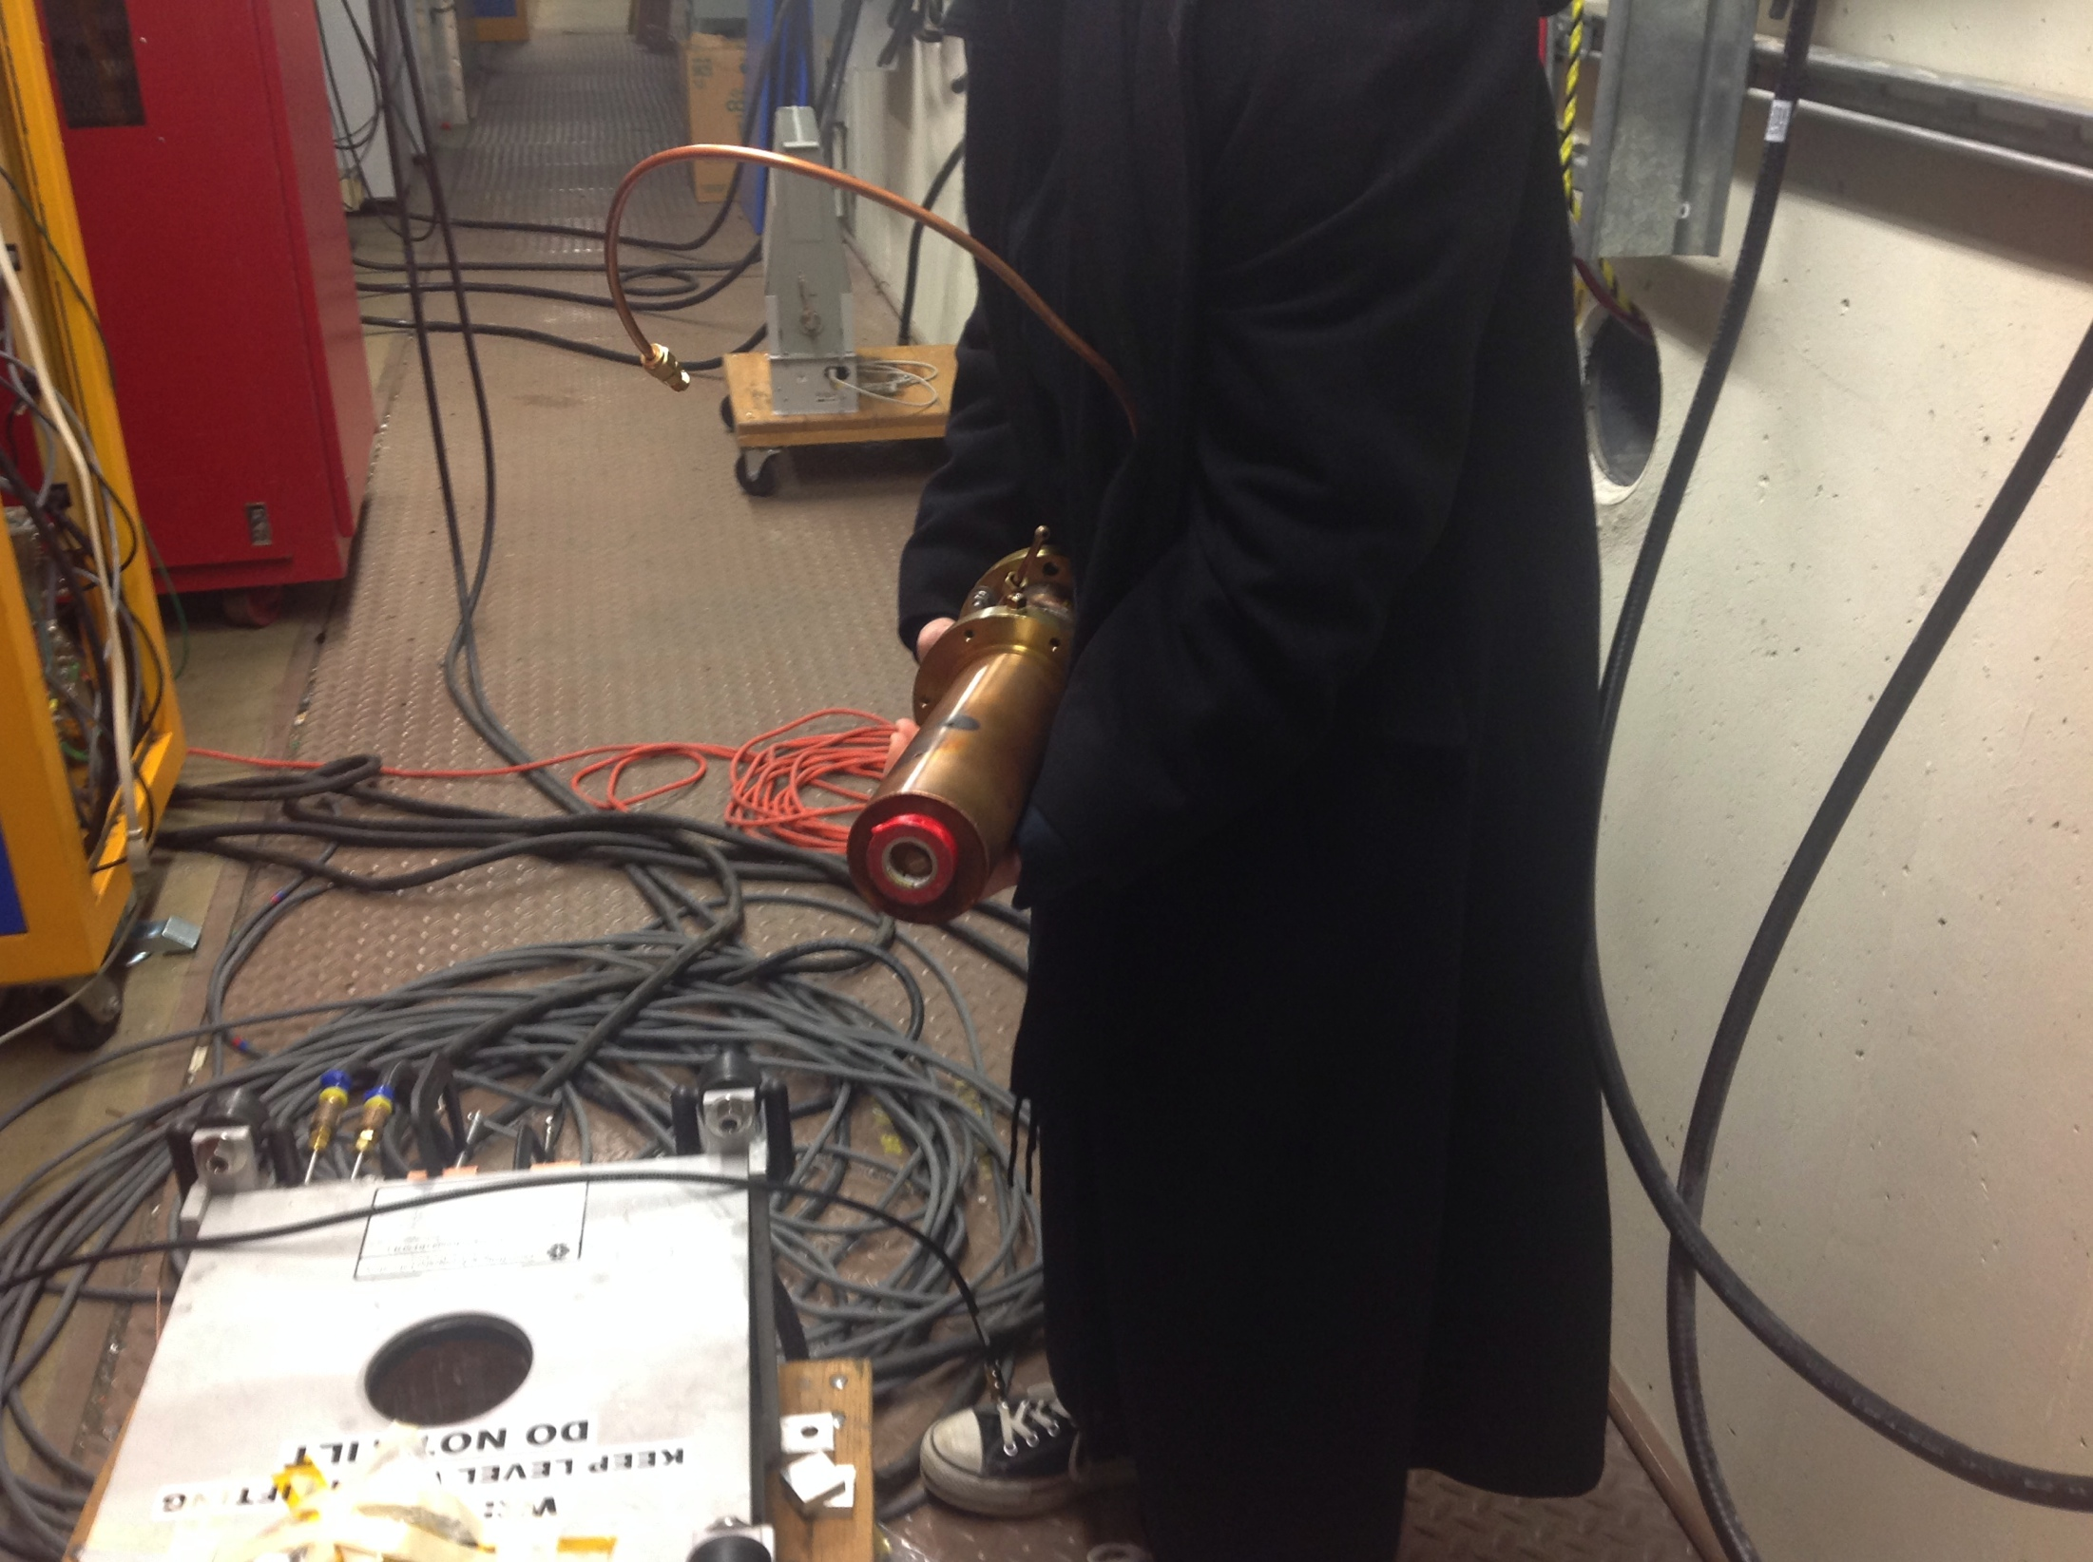
Measuring AL400 (R. Madrak and D. Wildman)

Slide 15
Measured losses
method looks at s11 and from there calculate the loss in the garnet.
This number will scale with the length of the garnet.

Slide 16
Model in ADS used to calculate μ’ from s11 phase data

Slide 17
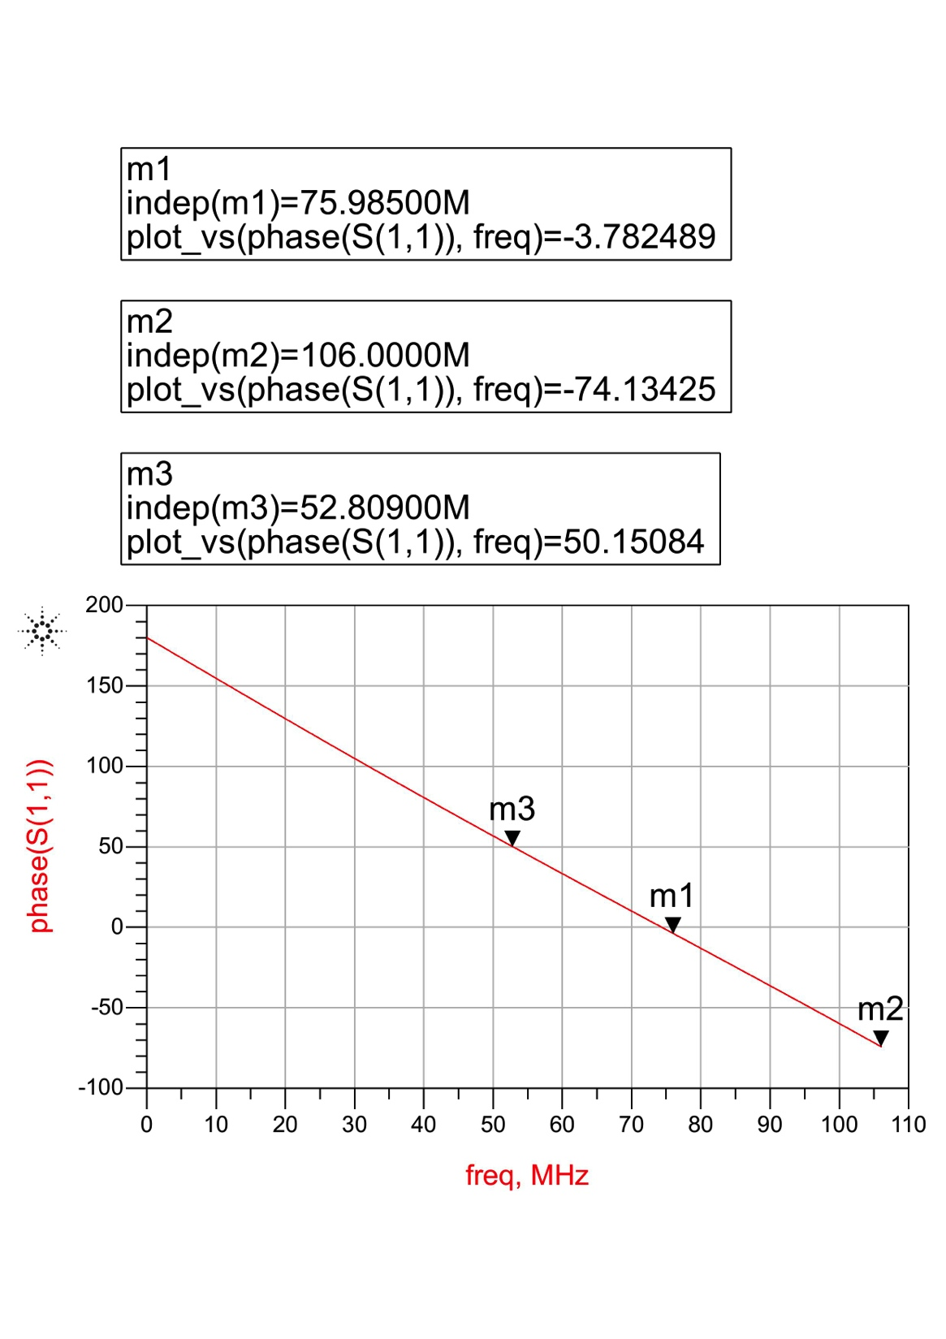
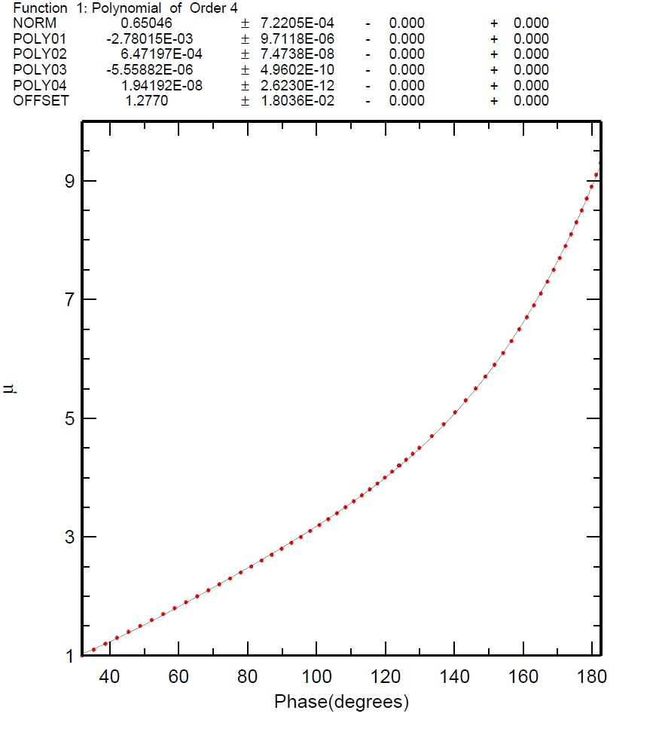
Fits to the s11 phase data

Slide 18
Measured μ
recall μ_{e} = μ’ – iμ’’.
Back of the envelope requires
μ_{max}/μ_{min} = (f_{max}/f_{min})² = (106/76) ²≈ 2.
Sims say ratio is 2.5, then if μ_{min}=1.5, then μ_{max}=1.5×2.5 = 3.75
-0.4 dB loss @ μ’=3.75
s11 = (Pin - Pref )/Pin = 1-Pref/Pin.
In dB = 10 Log10(1- Pref/Pin)
≈10(-0.43 x – 0.21 x²)
Tan[δ] = μ’’/μ’=1/Q
μ’
3.75
24
prop to μ’’

Slide 19
Todo (partial list) to be discussed
Check that solenoid can be built.
PS for solenoid -- kA
Coupler?
PA?
Dimensions OK?
Impedance of cavity? Shunt impedance > 1 MΩ?
How to incorporate μ measurements into simulations?

