Slide 1
PIP Update
April 9th 2014

Slide 2
Agenda
Summary Update
Current Activities/Updates
Chandrashekhara M Bhat – Booster Capture

Slide 3
Update
Linac SBK: Recent phone meetings and manager planning – work progressing (CDR in June)
Linac Laser Notching: Work continues – plan to install laser cavity during shutdown
Modulator work: EE support is proceeding with build up of 25 cell (9 cell looks good)
Linac Beam Physics: Linac – JP gave some results for MEBT & RFQ modifications being considered
Injector: Both sources up and running – next will work on larger volume source (less I variations)
Booster Beam:
Transverse damper – work started last week on turning on system – some issue with clock lock
Cogging software work continues – Kiyomi working on notch creation/sync with present system
Booster optics software – plan to test new tune control via 465 card this week – then move on with beta beating corrections!
Booster Longitudinal dampers - recent meeting to work out plans – preparing to install card in LL room.
Booster RF
Booster RF2 Cavity in staging area – waiting for a decision
RF19 –after ion pump flange replacement - it looks to have a vacuum leak (3+ weeks out)
Additional labor (starting to show bum in hours) – helped prepare cones
New Cavities – Will need to meet to discuss plan
Perpendicular Cavities – recent meeting – discussed plans – solenoid, ferrite, cooling
High mu cores - A new batch, initial results are good μ but q lower than our trial batch
Waiting on additional pieces to be able to build single tuner
Booster Anode Supplies – Work to get ready for summer shutdown
( Rumors that this will not happen or impact shutdown – ignore)
Booster Bias supplies – First one done – preparing for testing then will start on others
Booster Shielding – bi-weekly safety meetings – discussing simulations and next step(s)
When weather clears – will try and set up another round of testing – VME crate moved yesterday
Booster Nothcer – Proceeding with testing, kickers tested good last week

Slide 4
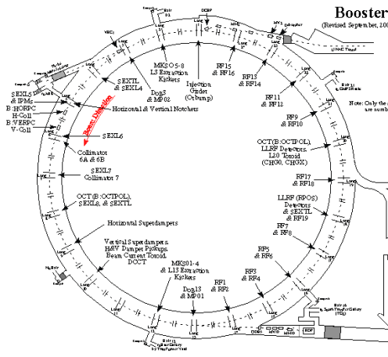
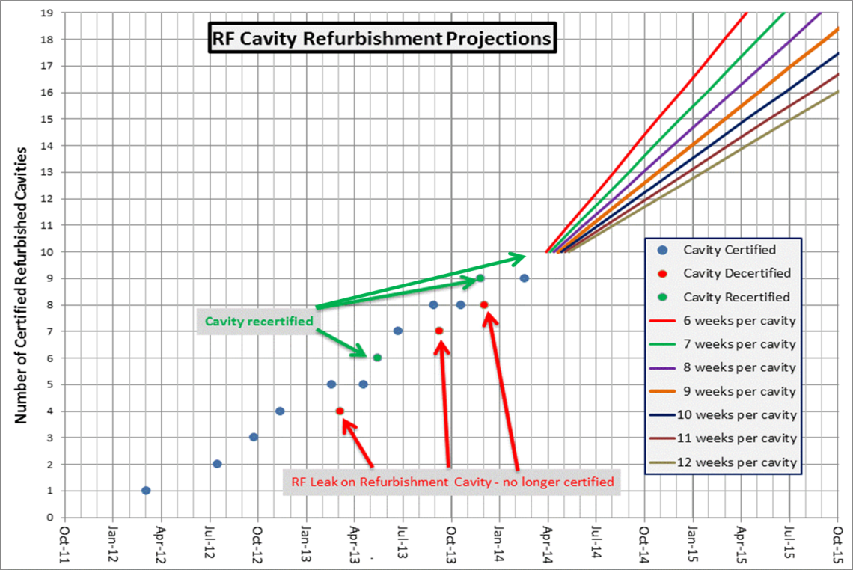
Cavities Refurbishment
10 of 19 cavities have been refurbished
Stats:
Last refurbishment : 5 wks (repair of a refurbished cavity)
Refurb_{last 3 cav.} : 9.8 wks
* Cones and tuners were available

Slide 5
Recent PIP Budget/News
Budget Issues: no news but DOE/Lab meeting tomorrow
Labor: next slide
General: Lots of talk about P5 and DOE – PIPII/PIP
PIP talks planned
PMG – 4/26 ?
Lots of shutdown talk – Regular SD planning
Update of RLS just about done – some Booster items
P5 should report back to lab in April – PIP impact likely

Slide 7
Upcoming Talks
Future Meetings to be Scheduled:
Tom Kubicki – New Booster Cavity Plan
?? – New tuners – plans/ideas
Eddy – Booster damper plans
Bill Pellico - Loss Scans and Shielding Assessment
John Reid - Solid State Installation - Final Report

