Slide 1
PIP Update Linac Utilities for 2014 shutdown
Matthew Gardner, 4/23/14

Slide 2
PIP Linac Utilities
Power Distribution
L1 substation
LCW
Dual Temp system
Backup pump at Chiller 3 (CUB)
Vacuum
New pumps
M.Gardner

Slide 3
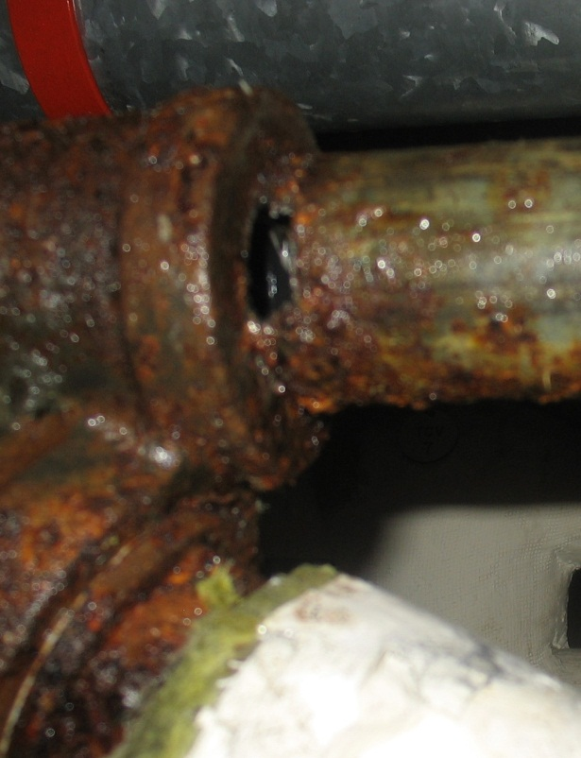
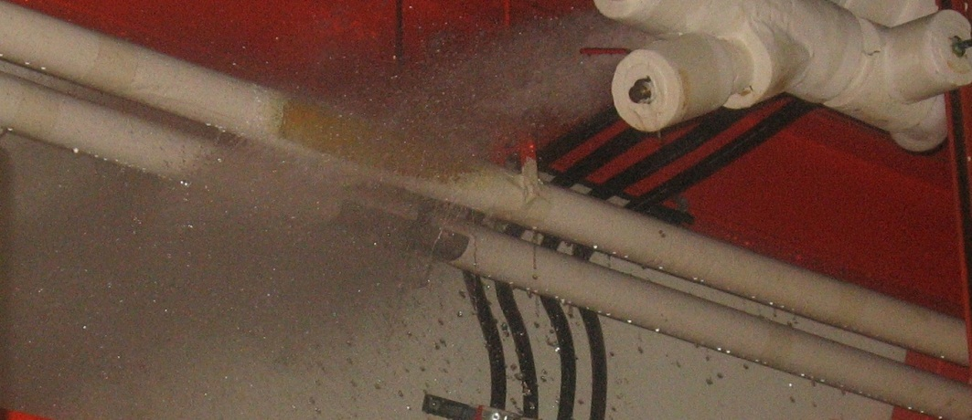
Dual Temp Water System
45 year old pipes
Large, costly leak in August, 2011
Pipe thicknesses were measured
Nearly half of the locations measured were below standard
System has run chilled water only since installation of Klystrons.
M.Gardner

Slide 4
Dual Temp Water System
Repipe
Install new copper pipes over hallway
Drain, purge, and cap old pipes
Move isolation valves to a more accessible location
New pipes can be laid while running, and connected during shutdown when equipment is off.
Cost: $60k
M.Gardner

Slide 5
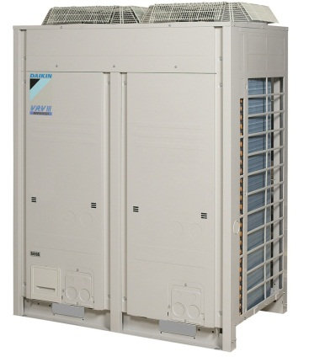
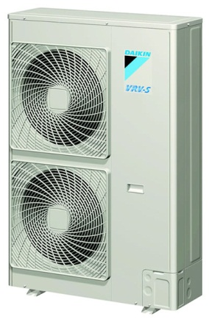
Dual Temp Water System
VRV-III
Type of unit selected for Booster Gallery.
Single unit needed for Linac South Gallery.
Cannot cool when outside temp is below 23F.
VRV-S
Can cool down to -20F ambient
Largest unit is 4 tons, 10 ton capacity is required.
Having 3 units means additional concrete pads, refrigerant piping, and electrical work.
Cost: $35k for units, $100k total.
M.Gardner

Slide 6
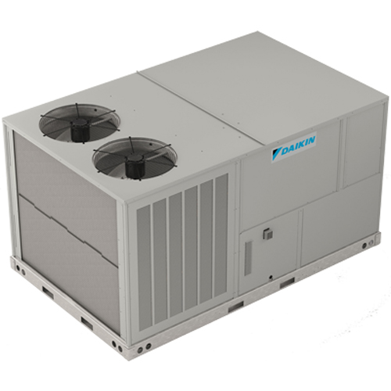
Dual Temp Water System
Rooftop AC units
Requires multiple units, new duct work, and electrical.
Space for duct work is limited in Linac Gallery.
Can be installed without interruption to current system.
Can use outside air for cooling during cold months.
Holes must be cut into roof.
Cost: TBD
M.Gardner

Slide 7
Dual Temp Water System
 | REPIPE | VRV-III | VRV-S | ROOFTOP
LOW AMBIENT | Yes | 23F | -20F | Yes (Outside Air)
Installation Difficulty | Low | N/A | Medium | Medium
Installation duration | 2 weeks | N/A | 4 weeks | 4 weeks
Cost | ~60k | N/A | ~100k | TBD
M.Gardner

Slide 8
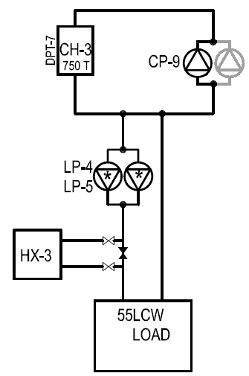
Spare LCW pump for Chiller 3
Single pump for Chiller 3.
All other chillers have multiple pumps
Refurbished pump has been purchased, along with valves and Control Panel.
New pump can be installed while running on HX-3.
M.Gardner

Slide 9
Spare LCW pump for Chiller 3
Timeline
HX-3 heat exchanges with Processed Chilled system.
During colder months, WH cooling also comes from heat exchanging with Processed Chilled system, making the temperature less stable.
Once temperature is consistently warmer the WH chillers will be used. Linac will move to HX-3 while CH-3 maintenance is performed. (4 weeks)
After CH-3 maintenance the backup pump will be installed. (2-3 weeks)
M.Gardner

Slide 10
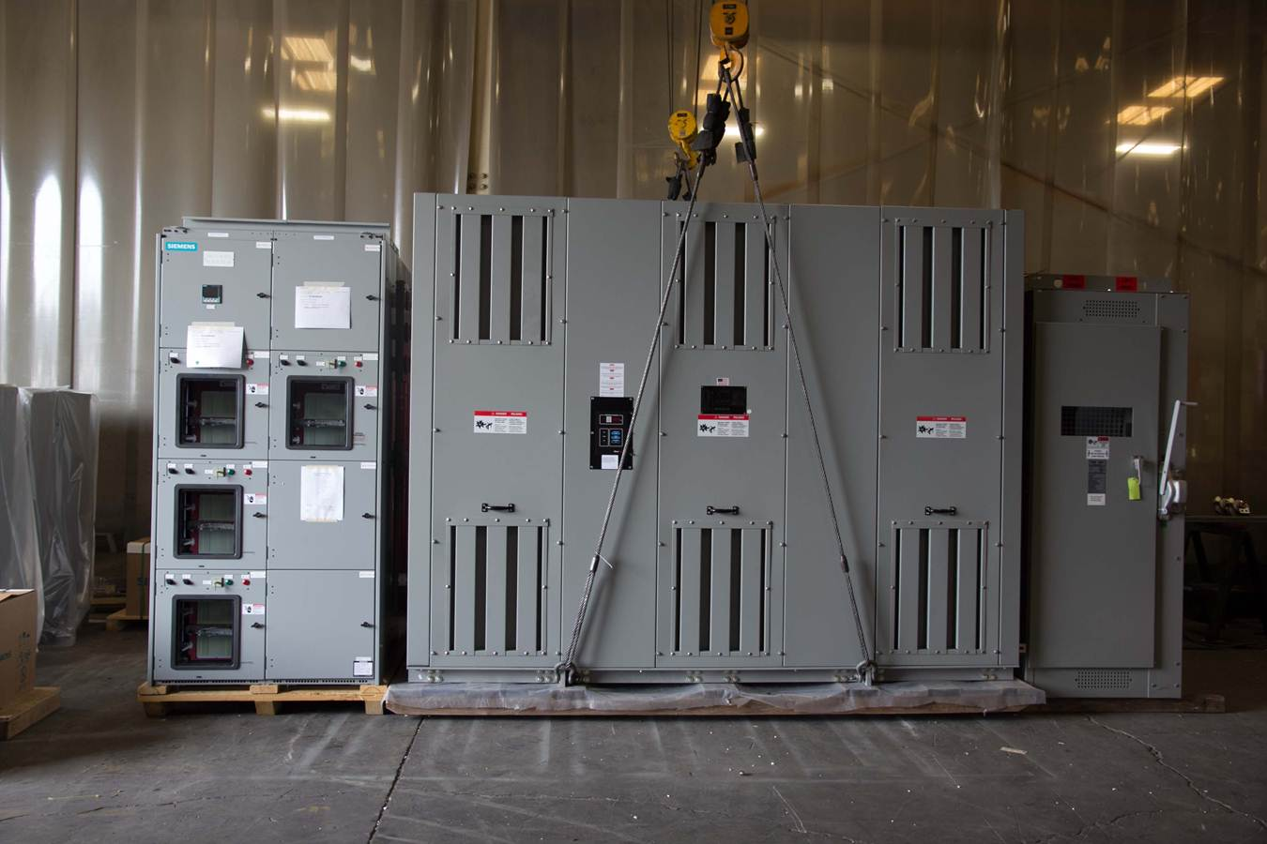
L1 Substation Replacement
M.Gardner

Slide 11
L1 Substation Replacement
Installation
Moving Transformer to Linac Basement – 2 days
Will be done ahead of time
Switching to Temporary Power – 1 day
Dismantle L1 – 2 days
Moving old substation out into storage – 1 day
Moving new substation into position – 2 days
Installing new substation – 5 days
Switching back from Temporary Power – 1 day
M.Gardner

Slide 12
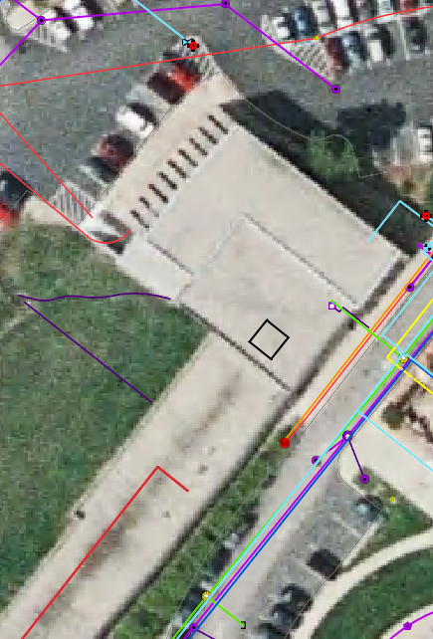
L1 Substation Replacement
Moving the Transformer
Transformer weighs 17,700 lbs
Crane must avoid Utilities, closest approach is 80 feet from the hatch.
250 ton crane required
Can be done before the shutdown.
Crane will disrupt horseshoe traffic, vehicle and pedestrian.
Crane cannot travel before sunrise or after sunset, limits work time to 8:00-17:30
M.Gardner

Slide 13
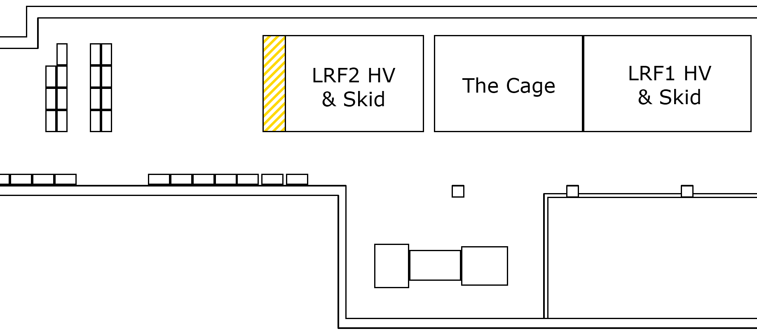
L1 Substation Replacement
Linac Lower Level
L1 Storage Location
L1
M.Gardner

Slide 14
L1 Substation Replacement
Task | Cost (approx) | Cost (weekend)
250 ton Crane | $10k | $12k
New XMFR to Basement | $6k | $7k
Temporary Power (each time) | $5k | $7.5k
Dismantle L1 | $2k | N/A
Remove old XMFR and Install new XMFR (Rigging) | $9k | N/A
Install New XMFR (Electrical) | $9k | N/A
Total | $46k | $54k
Estimates do not include Fermi labor, with time spent by Matt Gardner, Jim Ranson, Ryan Crawford, Greg Meyer, Steve Hays, Scott Crowell, Ray Lewis.
M.Gardner

Slide 15
L1 Substation Replacement
September
Monday | Tuesday | Wednesday | Thursday | Friday | Saturday | Sunday
1 | 2 | 3 | 4 | 5 | 6 | 7
8 | 9 | 10 | 11 | 12 | 13 | 14
15 | 16 | 17 | 18 | 19 | 20 | 21
22 | 23 | 24 | 25 | 26 | 27 | 28
Beam Off
Power Off
Tie in Temporary
Power
Dismantle L1 Substation
Move old Transformer out
Move new transformer in
Install new substation
Switch power to new substation
PIP Status Report
M.Gardner

Slide 16
L1 Substation Replacement
Alternative Options
Fix Price bid through Procurement
High overhead costs
Install New Substation in different location
Can be set up ahead of time, making switch faster
Requires re-routing the high voltage and conduits
LCW and Cable trays would be very close to substation
Other Concerns
Crane
High Traffic area, hard to keep people away during weekday.
Any delays would be costly.
HV Cable
Expensive to replace if damaged during installation( ~$12k )
Cables are on site, delay would be 2-3 days.
Cables were replaced in 2001
M.Gardner

Slide 17
Summary
Dual Temp
Waiting on Cost estimate for Rooftop option
Most work can be done before shutdown
CH-3 Pump at CUB
Working on final design
Can be installed before or during shutdown
L1 Substation
Many difficulties to overcome
Planning is continuing
Estimated cost ~$50k (T&M)
M.Gardner

