Slide 1
PIP Update
April 30th 2014

Slide 2
Agenda
Summary Update
Current Activities/Updates
Nathan Eddy – Booster Longitudinal Damper

Slide 3
Update
Linac SBK: Working on gallery issues – Transformer Oil, Floor loading: (CDR in June)
Linac LN: Mode hopping in the laser diode source, acquiring a new seed source, mechanical drawings for optical cavity
Modulator work: EE support is proceeding with build up of 25 cell
Linac Beam Physics: No news
Injector: Both sources up and running, testing larger volume source in test stand, Gas Testing Next
Booster Beam:
Transverse damper – Trying to get tune measurement up and running
Cogging software work continues – testing on MI cycles continues
Booster optics software – Tested 465 cards for tune control – adjusting software for finer control.
Booster Longitudinal dampers - Update Talk Today
Booster RF
Booster RF2 being worked on, lathe work, tuner work– ready for testing in 2 weeks?
RF19 – Testing started this weekend -
Looking at extra tuners: One that was stored in box removed, One on large bore cavity?
New Parallel Cavities –Perpendicular Cavities – Working on ferrite measurements and simulations /heating estimates - buying ferrite samples
Starting to build new tuner with the new ferrite!! Assembly being done at IB2.
Lots of documentation to go along with new tuner
Booster Anode Supplies – Work continues – Ordering continues
Booster Bias supplies – First one is done and should be part of the test stand cavity testing
Booster Shielding – setting up another round of scans – during cavity install & next day
Booster BPM work – Finishing up specification and documentation, Some parts being ordered
Booster Nothcer – Working out a logic issue on a monitoring card
Need about a week of 24/7 running on our TLG system
Like to connect three loads in gallery to ensure it can work for 700 MeV notching

Slide 4
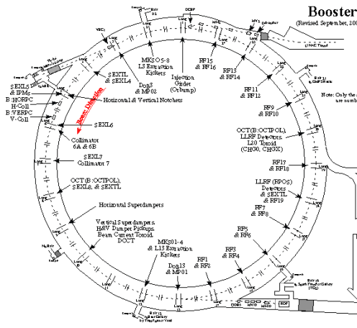
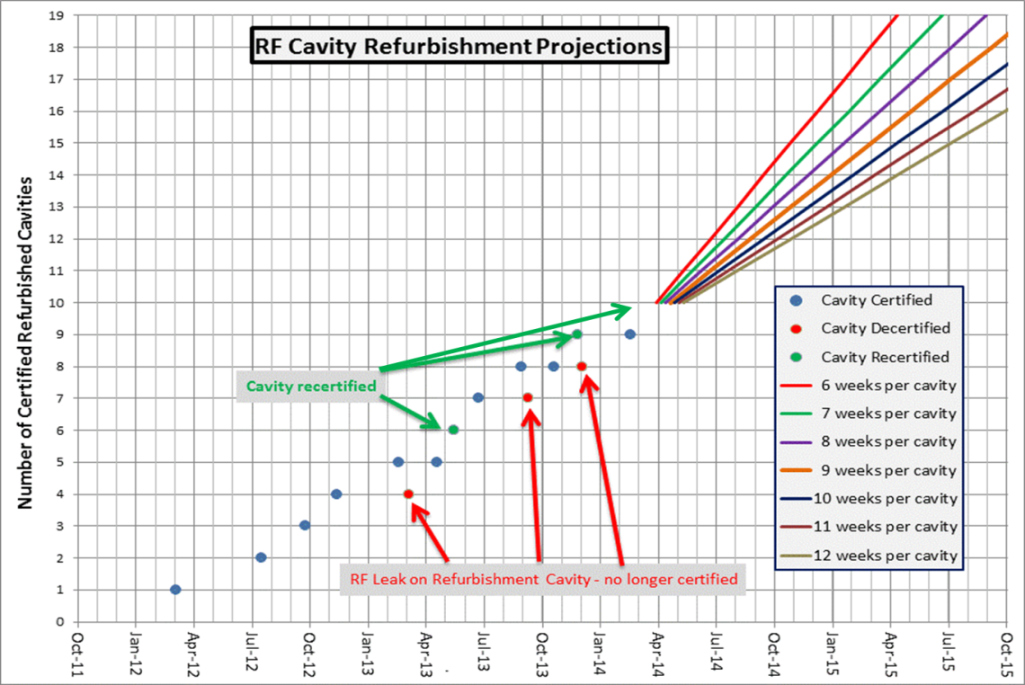
Cavities Refurbishment
10 of 19 cavities have been refurbished
RF 5 will be removed for repair
Install refurbished cavity in slot 2
Pull Cavity RF 5 (need to fix taper)
Pull another cavity for refurb?

Slide 5
Recent PIP Budget/News
Budget Issues: no news from DOE/Lab meeting
Another budget meeting in June (after dust settles)
General: Lots of talk about P5 and DOE – PIPII/PIP
PMG – 4/26 has been canceled – Stuart is departing
Who will replace Stuart – not sure but he has listed PIP as one of his important tasks
Lots of shutdown talk – Regular SD planning
Update of RLS – Some Booster items remain
P5 should report back to lab in April – PIP impact likely
Director is interested in 20 Hz – potential users…..
Too soon to affect what we are doing
Post-Doc position for PIP is open/receiving resumes

Slide 6
Upcoming Talks
Future Meetings to be Scheduled:
Peter/Craig – New Booster BPM Plan
Matt/John – New Tuner
Tom Kubicki – New Booster Cavity Plan
Bill Pellico - Loss Scans and Shielding Assessment
John Reid - Solid State Installation - Final Report

