Slide 1
Electron Beam Profiler for the Main Injector
Randy Thurman-Keup
Instrumentation Department
APT Seminar
17 June 2014

Slide 2
Fellow Conspirators
Instrumentation
  Amber Johnson, Carl Lundberg, Jim Galloway,
  Jim Fitzgerald, Peter Prieto, John van Bogaert,
  Andrea Saewart, Dave Slimmer, Dehong Zhang,
  Brian Fellenz, Alex Lumpkin
Mechanical Support
  Wade Muranyi, Brad Tennis, Elias Lopez, Debbie Bonifas,
  Scott McCormick, Ryan Montiel, Sali Sylejmani, Tom Lassiter,
  James Williams, John Sobolewski, Matt Alvarez, Kevin Duel
Summer Students
  Paul Butkovich, Khalida Hendricks, Danila Nikiforov
APC
  Charles Thangaraj

Slide 3
Motivation
The long range plan for Fermilab calls for large proton beam power in excess of 2 MW for use in the neutrino program
Higher proton intensities are problematic for profile diagnostics that physically intercept the beam

Slide 4
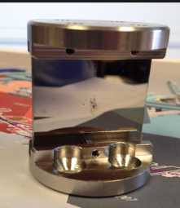
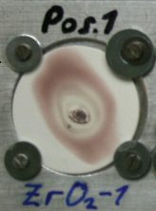
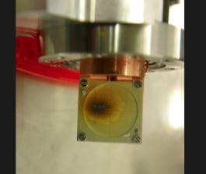
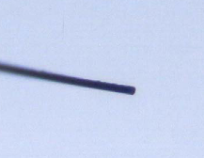
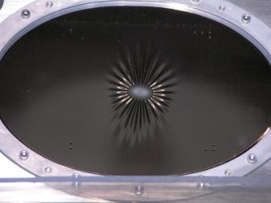
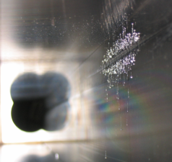
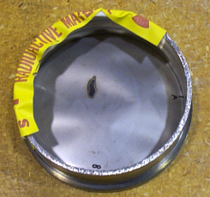
Damage Montage
60 keV electrons
SS OTR mirror
GSI heavy ions
(from Beata Walasek-Höhne)
DESY electrons
YAG:Ce
Broken Flying Wire micrograph
ZrO₂:Al
Ø 30 mm
3 mil Ti vacuum window
10²⁰ 120 GeV protons.
NuMI OTR Al-coated Kapton foil
~ 6.5e19 120 GeV protons
Tevatron Collimator

Slide 5
Motivation
The long range plan for Fermilab calls for large proton beam power in excess of 2 MW for use in the neutrino program
Higher proton intensities are problematic for profile diagnostics that physically intercept the beam
Hence the goal of non-intercepting profile diagnostics
  Laser Based (need electrons; either e beam or H⁻)
  Ionization Profile Monitors (IPM)
  Gas Fluorescence Detectors
  Gas Jets
  Probe Beams

Slide 6
Probe Beam Concept
Probe beam is deflected by electric
and/or magnetic fields of a charge distribution
Deflection
Impact parameter
Probe beam
Charge Distribution
Deflection vs. Impact parameter provides information about the charge distribution in the direction of the impact parameter

Slide 7
Probe Beam History
Beam probe for plasma distribution
  Paul D. Goldan, Collisionless Sheath – An Experimental Investigation, Phys. Fluids 13 1055 (1970).
  C.H. Stallings, Electron Beam as a Method of Finding the Potential Distribution in a Cylindrically Symmetric Plasma, J. Appl. Phys. 42 (1971) 2831. electron beam
  C.W. Mendel Jr., Apparatus for measuring rapidly varying electric fields in plasmas, Rev. Sci. Instrum. 46 847 (1975). He⁺ ion beam
Beam probes for other beams
  J. Shiloh, et al., Electron beam probe for charge neutralization studies of heavy ion beams, Rev. Sci. Instrum. 54 (1983) 46.
  V. Shestak, et al., Electron Beam Probe for Ion Beam Diagnostics, TRIUMF Design Note, TRI-DN-87-36 (1987).
  P. Gross, et al., An Electron Beam Probe for Ion Beam Diagnosis, in proceedings of the European Particle Accelerator Conference 1990, p. 806, 12 – 16 June 1990, Nice, France.
  J. Bosser, et al., Transverse Profile Monitor using Ion Probe Beams, Nucl. Instrum. Methods Phys. Res. A 484 (2002) 1. Xe⁺ ion beam curtain
  P.V. Logatchov, et al., Non-Destructive Singlepass Monitor of Longitudinal Charge Distribution in an Ultrarelativistic Electron Bunch, in proceedings of the Particle Accelerator Conference 1999. electron beam @ VEPP-3

Slide 8
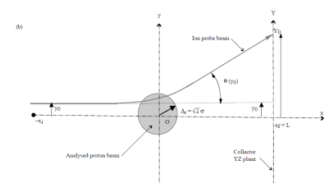
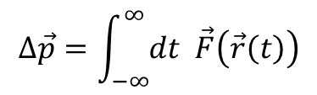
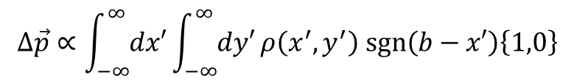
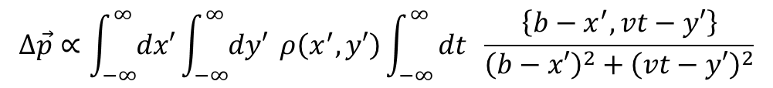
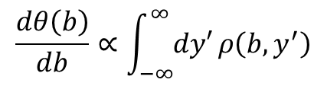
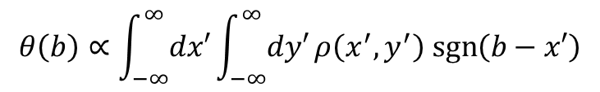


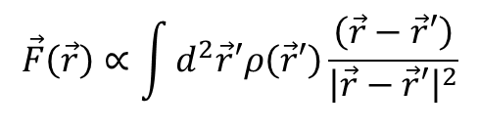


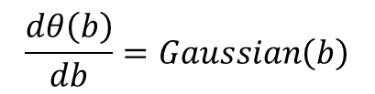

Theory
x
Assume $γ≫1$, no magnetic field, $ρ≠f\left(z\right)$
θ(b)
$$\vec{F}\left(\vec{r}\right)∝\int{d^{2}\vec{r}′ρ\left(\vec{r}′\right)\frac{\left(\vec{r}−\vec{r}′\right)}{{\left|\vec{r}−\vec{r}′\right|}^{2}}}$$
$$∆\vec{p}=\int_{−∞}^{∞}{dt \vec{F}\left(\vec{r}\left(t\right)\right)}$$
b
y
Beam
Assume deflection is very small such that $\vec{r}≈\left\{b,vt\right\}$
$$∆\vec{p}∝\int_{−∞}^{∞}{dx′}\int_{−∞}^{∞}{dy′} ρ\left(x^{′},y′\right)\int_{−∞}^{∞}{dt \frac{\left\{b−x^{′},vt−y′\right\}}{{\left(b−x′\right)}^{2}+{\left(vt−y′\right)}^{2}}}$$
$$∆\vec{p}∝\int_{−∞}^{∞}{dx′}\int_{−∞}^{∞}{dy′}ρ\left(x^{′},y^{′}\right) \text{sgn}\left(b−x′\right)\left\{1,0\right\}$$
Assume again that deflection is very small such that $\vec{p}≈\left\{0,p\right\}$ and $θ≈\frac{\left|∆\vec{p}\right|}{\left|\vec{p}\right|}$
$$θ\left(b\right)∝\int_{−∞}^{∞}{dx′}\int_{−∞}^{∞}{dy′}ρ\left(x^{′},y^{′}\right) \text{sgn}\left(b−x′\right)$$
$$\frac{d}{db}\text{sgn}\left(b−x′\right)∝δ\left(b−x′\right)$$
$$\frac{dθ\left(b\right)}{db}=Gaussian\left(b\right)$$
$$\frac{dθ\left(b\right)}{db}∝\int_{−∞}^{∞}{dy′}ρ\left(b,y^{′}\right)$$
$$\underset{⇒}{ρ=2D gaussian}$$
x profile
$$θ\left(b\right)=erf(b)⁡$$

Slide 9
Reality
The beam has magnetic fields
  Sideways deflection of the probe beam
  Sideways deflection varies with longitudinal shape
The bunch does not have infinite length
  Varying longitudinal shape will alter deflection
    Both electrostatically and magnetically
Deflection may not be all that small
External magnetic fields
Measurement artifacts, etc…

Slide 10
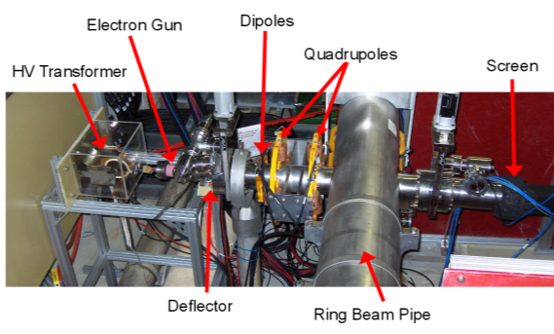
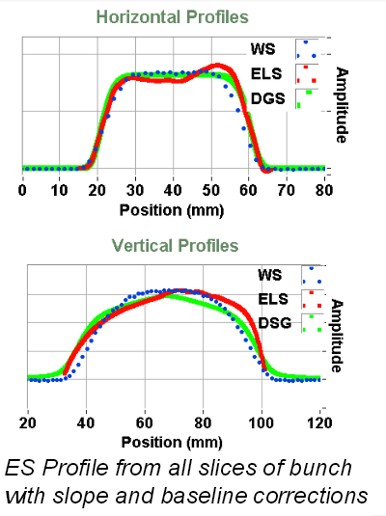
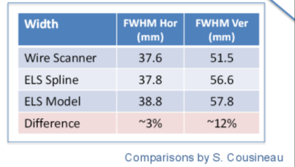
SNS Device
W. Blokland, 9th DITANET Topical Workshop, April 2013

Slide 11
Techniques
Collaborating with Wim Blokland at SNS who has done simulations of the various techniques
Possible techniques for measuring deflection
  Fast scan through peak of bunch
    Requires fast deflector (< 1 ns sweep time)
  Slow scan, akin to flying wires
    Position the beam and record the maximum deflection as the beam passes by
      Leave the electron beam stationary
      Sweep the beam along the proton direction
        Obtain longitudinal distribution
        Probably what we will start with

Slide 12
Fast Scan
Proton Beam
Electron Beam Above
Y
x
X
x
x
Z
x
x
x
x
x
x
x
x
x
Y
x
x
Electron
Beam Below
x
Z
x
x
x
If scan time is too slow
longitudinal and transverse
charge distributions become
entangled
x
x
x
x
x
x
x
x
Y
x
x
Z
x
x

Slide 13
Techniques
Collaborating with Wim Blokland at SNS who has done simulations of the various techniques
Possible techniques for measuring deflection
  Fast scan through peak of bunch
    Requires fast deflector (< 1 ns sweep time)
  Slow scan, akin to flying wires
    Position the beam and record the maximum deflection as the beam passes by
      Leave the electron beam stationary
      Sweep the beam along the proton direction
        Obtain longitudinal distribution
        Probably what we will start with

Slide 14
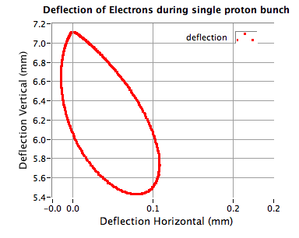
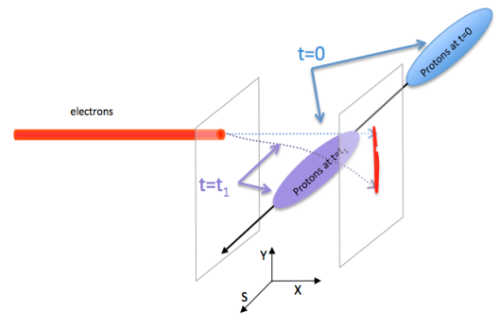
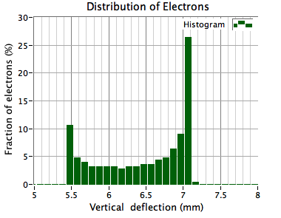
Slow Electron Scan
Stationary Beam
Position the electron beam
Record the deflection of a bunch
Move the electron beam and repeat
Plots courtesy of Wim Blokland

Slide 15
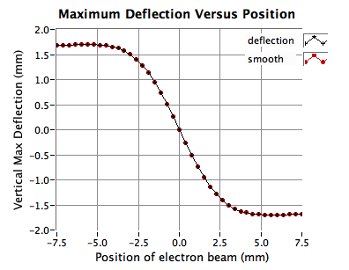
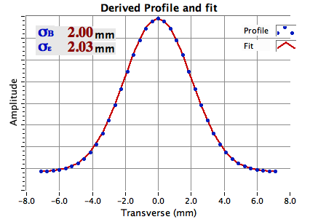
Slow Electron Scan Simulation
Step the electron beam through the proton beam and record maximum deflections
Derivative of deflection vs. position is nominally beam profile
Derivative
Plots courtesy of Wim Blokland

Slide 16
Techniques
Collaborating with Wim Blokland at SNS who has done simulations of the various techniques
Possible techniques for measuring deflection
  Fast scan through peak of bunch
    Requires fast deflector (< 1 ns sweep time)
  Slow scan, akin to flying wires
    Position the beam and record the maximum deflection as the beam passes by
      Leave the electron beam stationary
      Sweep the beam along the proton direction
        Obtain longitudinal distribution
        Probably what we will start with

Slide 17
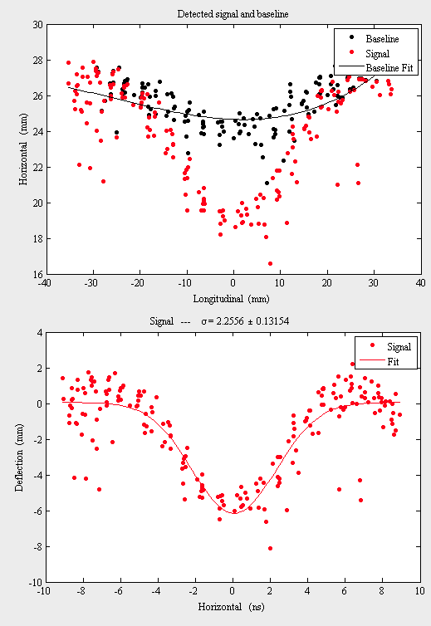
Pseudo-fast plus Slow Scan
Electron Sweep
Background fit not so good
Proton Beam
Sweep the electron beam along the proton bunch
Sweep duration coincides with the duration of the proton bunch
Magnetic field of beam distorts measurement
Beam Simulated Longitudinal σ = 2 ns
Measured Simulated Longitudinal σ = 2.3 ns
Better background gives σ = 2.1 ns
Simulation

Slide 18
Simulation
Fields of proton beam are evaluated on a grid
Electron beam is steered by electrostatic deflector
  Fields are calculated in 2D via Poisson
Electrons are tracked through the fields
  Initial electron beam parameters taken from test stand measurements
  Tracking is done via MATLAB code

Slide 19
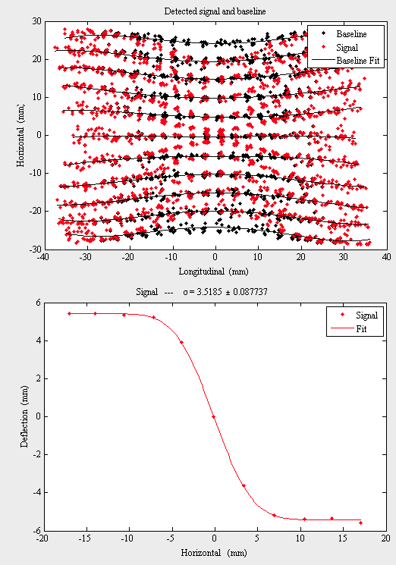
Reconstruction
Beam Simulated Transverse σ = 3 mm
Meas. Simulated Transverse σ = 3.5 mm
Beam Sim. Longitudinal σ = 2 ns
Meas. Sim. Longitudinal σ = 2.3 ns

Slide 20
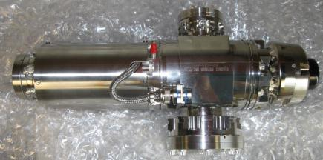
Electron Gun
Commercial source: Kimball Physics electron gun
  Model EGH-6210
  Typically designed for electron microscopes
  LaB₆ cathode, up to 60 KeV, 6 mA gateable, <100μm spot size

Slide 21
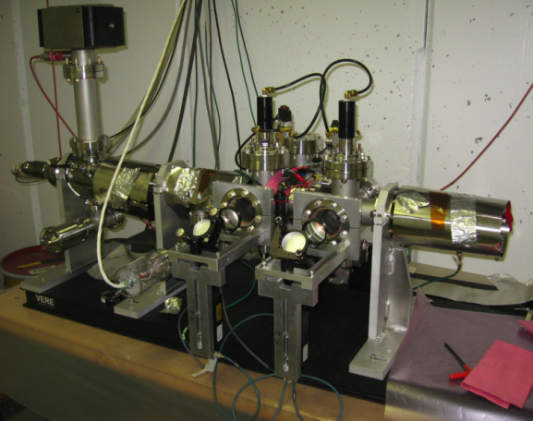
Phase 1 Test Stand
YAG or OTR Screens
Electron Gun
Faraday Cup
Lens / Digital
Camera Imaging
Systems

Slide 22
Gun Tests
Gun has internal solenoid
  Scanned beam through waist
  at first screen
Scanned beam sizes from Ce:YAG screens (1 μA beam)
Scanned beam sizes from OTR screens
(1 mA beam)

Slide 23
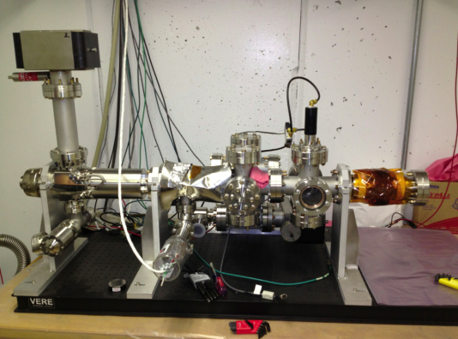
Phase 2 Test Stand
Single OTR Port
Stretched Wires
Hoped to simulate beam with stretched wires…

Slide 24
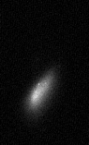
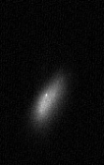
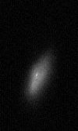


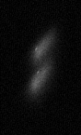
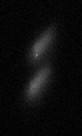
Wire Test
Wire to simulate proton beam
e Beam pulsed on for 40 μs
Wire pulsed for 20 μs
Half the time the beam is deflected
0V
50V
100V
150V
200V
250V
300V

Slide 25
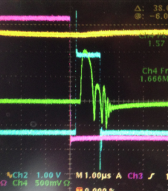
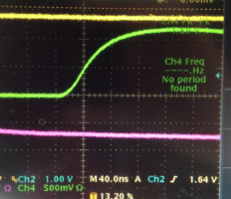
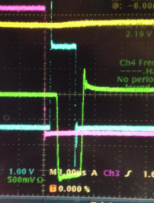
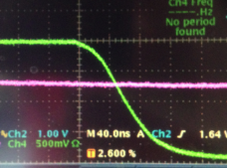
Test of Electrostatic Deflector
~120 V
Deflecting Voltage vs. Deflector Length
Deflector Pulse
80 ns
500 V
Deflector Pulse
15 cm long plates
~190 V

Slide 26
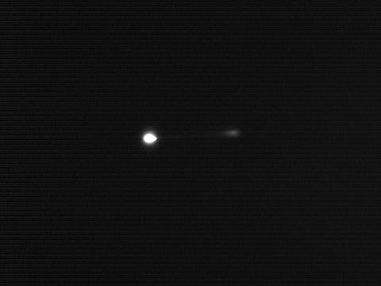
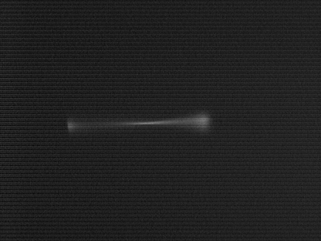
Electrostatic Deflector Test
Short sweep
Effect is similar to proton bunch passing by
Longer sweep
Bright part off screen
Beam size not uniform
  Possibly due to poor pulse quality

Slide 27
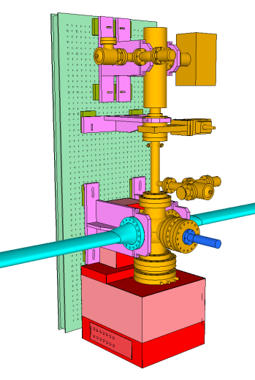
Electron Device
Ion Gauge
Optical Breadboard
~ 60 cm x 150 cm
Ion Pump
60 keV Electron Gun
Kimball Physics
Pneumatic
Beam Valve
Electrostatic Deflector
Main Injector
beampipe
Ion Gauge
Pneumatic
Insertion Device
with OTR Stainless
Steel Mirror
Optical components box
Phosphor Screen

Slide 28
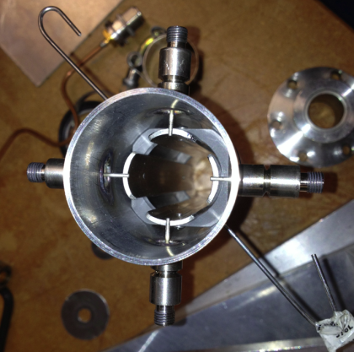
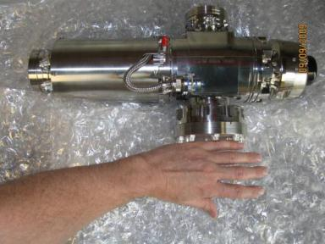
Devices
  Kimball Physics EGH-6210 up to 60 keV
(we will use up to 15 keV for Nova)
6 mA, pulsed, 2 μs to DC @ 1 kHz
LaB₆ cathode, 100 μm spot size
15 cm long ‘circular’ plates
~2.5 cm diameter
Electrostatic Deflector
Thermionic Triode Electron Gun
Plates
Solenoid and
steering magnets
Cathode

Slide 29
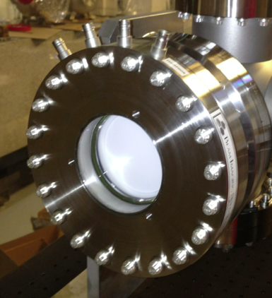
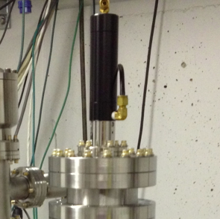
Devices
Beam Imaging Systems, Phosphor Screen
P47 (Y₂SiO₅:Ce3+), 400 nm, 60 ns decay,
0.055 quantum yield (photons/eV/electron)
Conductive coating with drain wire
4” Huntington Pneumatic Actuator
SS Mirror for OTR (calibrate electron
beam size @ proton beam location)

Slide 30
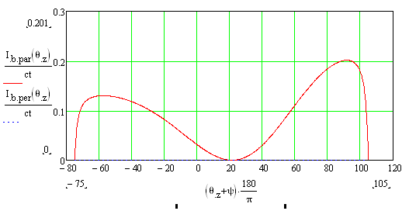
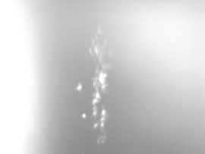
OTR Screen
Electron energy low
  Broad angular distribution
  Mirror should be 15° instead of 45°
Light yield over the 2 ms electron pulse
(E. Bravin, private communication)
Initial beam images determined to be blackbody
  No polarization
  Intensity increased nonlinearly with duration
  Damage to stainless steel mirror observed

Slide 31
Optical Acquisition
Calibration
OTR
f = 40 mm
Selectable Neutral Density
Filters (ND 1,2,3) and
Ver / Hor Polarizers
Megarad CID camera
plus C-mount
objective lens
Image
Intensifier
Motorized Stage
f = 125 mm
Phosphor
f = 40 mm
RS-170 video capture
via computer in service
building
Mirror on Motorized Stage selects OTR or Phosphor
Motorized Stage

Slide 32
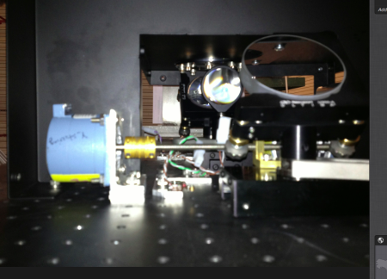
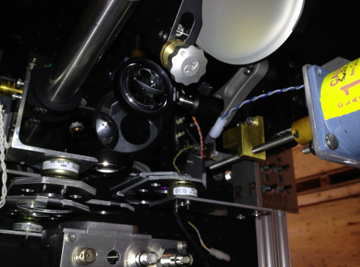
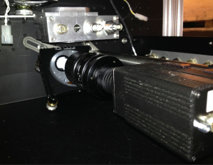
Optics

Slide 33
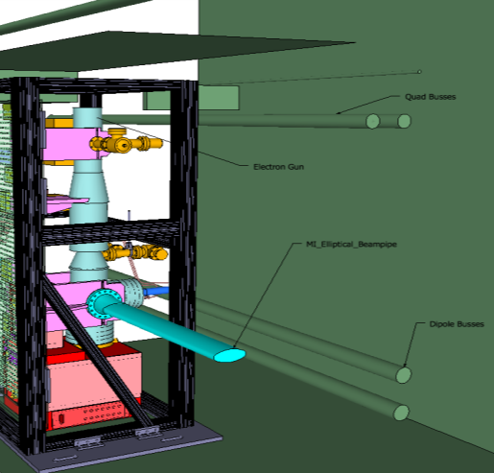

Full Device

Slide 34


Install Location
MI 620
Electron Gun

Slide 35


MI-62 Service Building
Reusing kicker cables to bring
electron gun voltages to tunnel
Also reusing flying wire cables

Slide 36
High Voltage Distribution
p Beam interlock
Interlock
RG-220
e Gun Controller
Service Bldg Transition Box
Custom Cable
to Tunnel
Common (HV)
Filament+
Filament-
Grid
Interlock (not HV)
Interlock
Has all the fancy controls
Vacuum relay
Displays
Manual lockout
RG-220
e Gun
Tunnel Transition Box
Custom Cable
in Tunnel
Interlock
Vacuum relay w/ door switch(?)

Slide 37


Magnetic Fields are a Problem
5 G along beam, 2 G transverse
No field

Slide 38


Magnetic Fields in Tunnel
CST Simulation
Lower Dipole bus goes in proton direction
Quad bus closest to beam is defocusing bus
and goes in direction of protons
Electron beam
Quad busses
3500 A
2 Gauss
B_{horizontal}
B_{vertical}
0 G
Dipole busses
9000 A

Slide 39

From e cloud Measurements
From Michael Backfish thesis

Slide 40

Mumetal Wrapping
Cover “everything”
with 1 or more layers of
mu metal

Slide 41


Mumetal Test
Dipole from A0
With 31 Gauss
3 layers of mumetal reduced the field to 0.2 - 0.4 Gauss
4 - 5 layers knocked it down to 0 - 0.1 Gauss
Mumetal to enclose Hall Probe

Slide 42


CST Simulation of Mumetal
Horizontal B field
  Green is 0 G
2.6 G
Slice through center of
Mu metal transverse to
proton beam
-2.6 G
B vs H

Slide 43

CST Simulation of Mumetal
Fields along
central electron
path

Slide 44



Optics Simulation
Check
magnification
Check
acceptance
Outer edge
of phosphor
Uniform
Source on
phosphor
Pattern
Outer edge
of Intensifier
Uniform
Image on
intensifier
Image on
Intensifier

Slide 45
Summary
Gun mounted in stand
Leak checked (twice)
Cables pulled from MI-62 to device location
  Reused Flying wire cables and Kicker RG-220s
HV Distribution and interlocks being built
Recently reviewed
Plan to install in September shutdown
More studies of magnetic shielding
More studies of measurement systematics

Slide 46
Questions?

Slide 47

Vacuum Topology
Differential pumping in gun
Ion pump on cathode side
Nothing on this side except MI
Have another 30 l/s pump

Slide 48


Gun Internals

Slide 49



Pneumatics
Solenoid Valves
Beam Valve
Input
OTR Actuator

Slide 50


Compressed Air

Slide 51


Slide 52

Simulated Camera Image
Camera frames are ~30 ms
Main Injector cycle is ~1 s
Need to step many times per frame to accumulate data fast enough for measurement
  Complicated to extract each step

