Slide 1
PIP Budget/Schedule Status Ken Domann 7/2/14

Slide 2
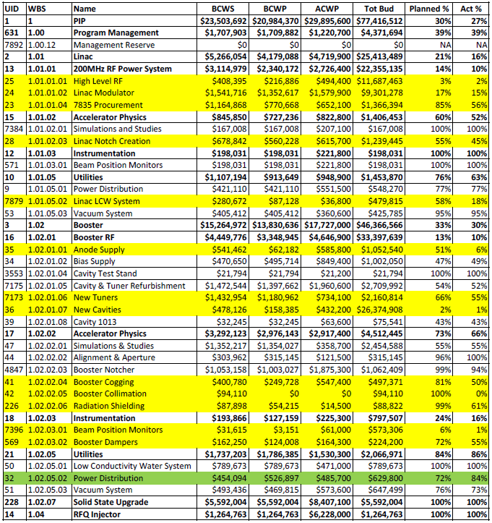
% Compl to WBS Level 4 (Yellow >= 10% Late, Green >= 10% Early)

Slide 3
Milestone Status (5/1/14 – 10/31/14) (Red > 3 months late)

Slide 4
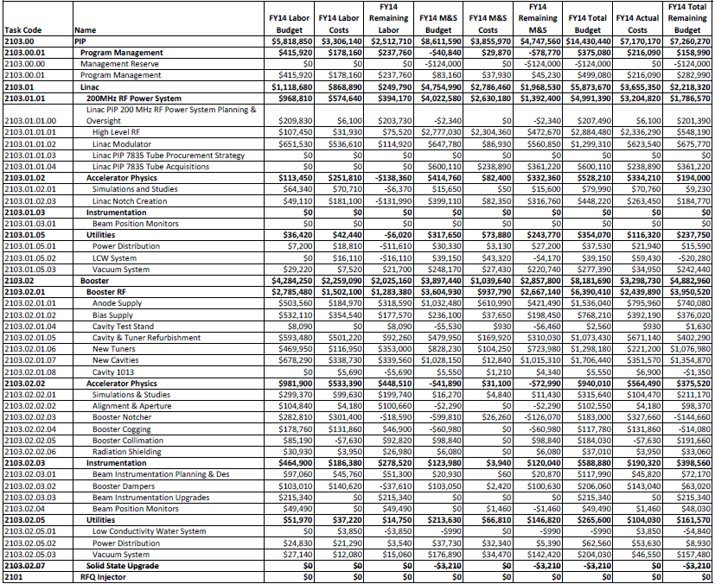
FY14 Total Budget thru April 2014

Slide 5
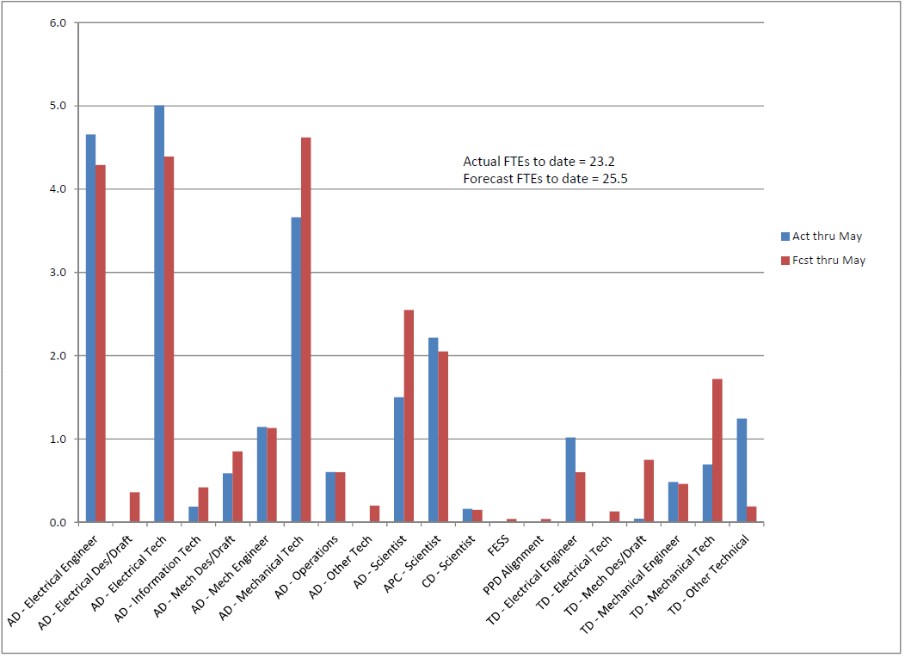
FY14 To-date FTEs by OHAP – Fcst vs Act

Slide 6
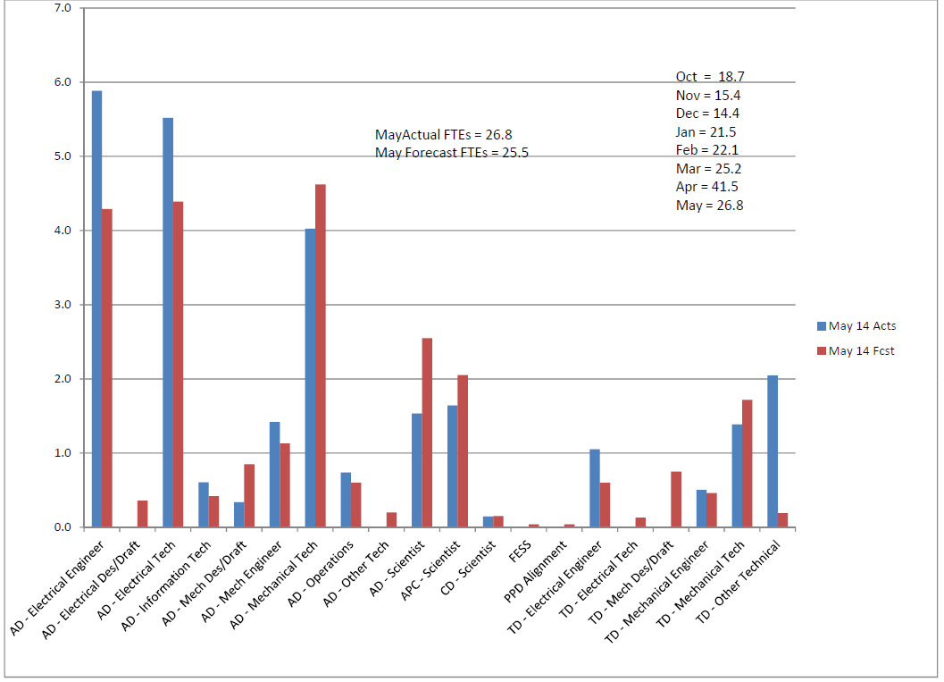
FY14 Monthly FTEs by OHAP – Fcst vs Act

Slide 7
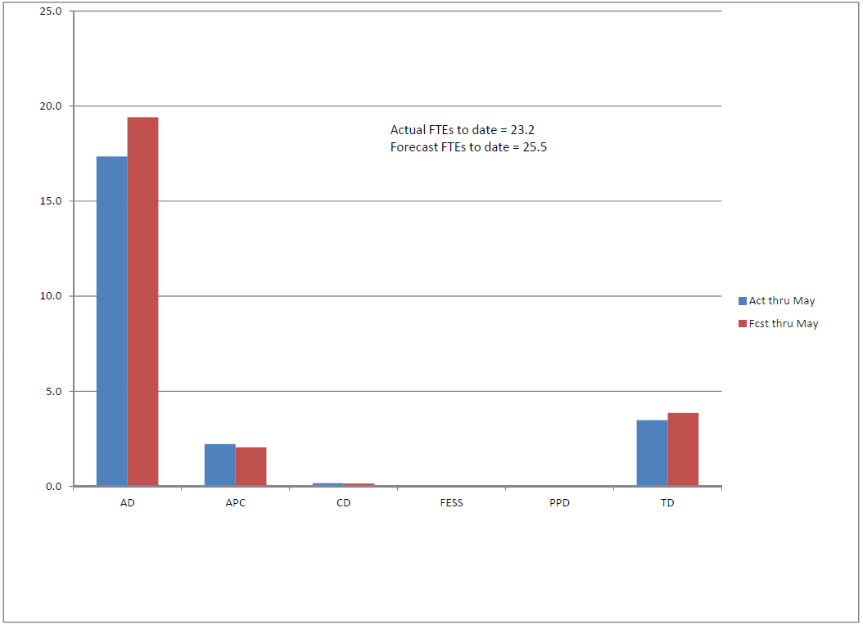
FY14 To-date FTEs by Div – Fcst vs Act

Slide 8
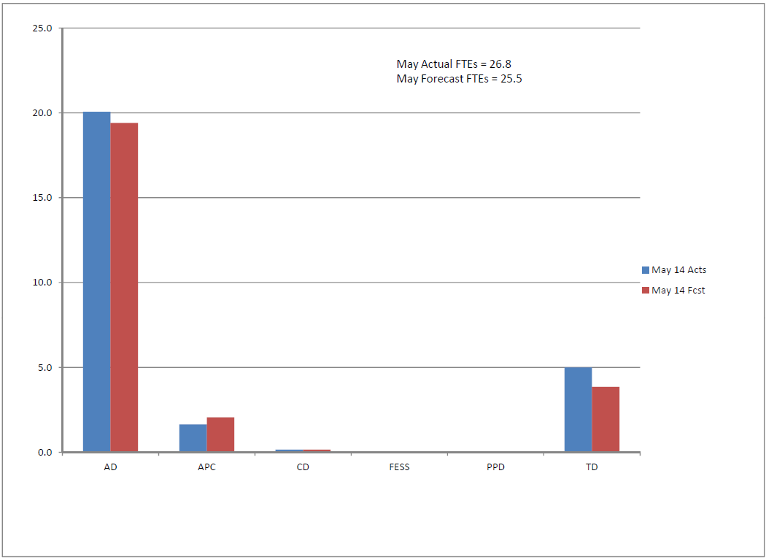
FY14 Monthly FTEs by Div – Fcst vs Act

