Slide 1
Linac Laser Notcher READINESS Review
August 5th, 2014
Kevin Duel – Mechanical Support Engineer

Slide 2
Outline
MEBT Modification and Installation

Slide 3
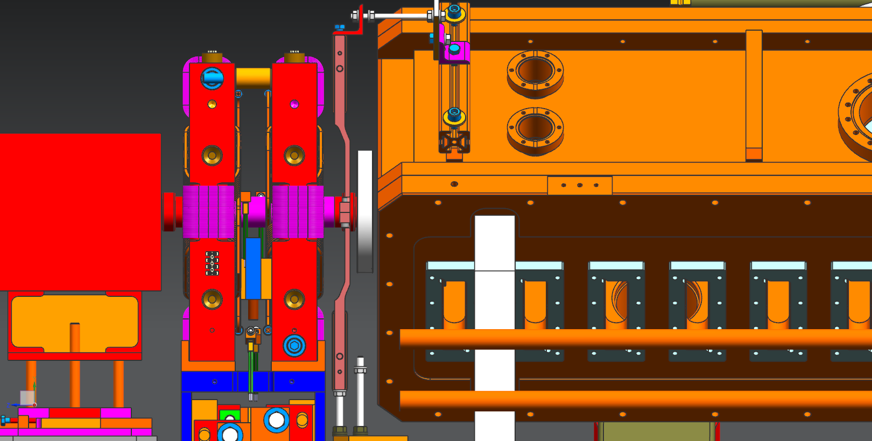
Remove quads, corrector and beam pipe
Notes:
Adjust quads in z to get better access to flange bolts.
Support 6” Conflat flange and use crane to remove quads.

Slide 4
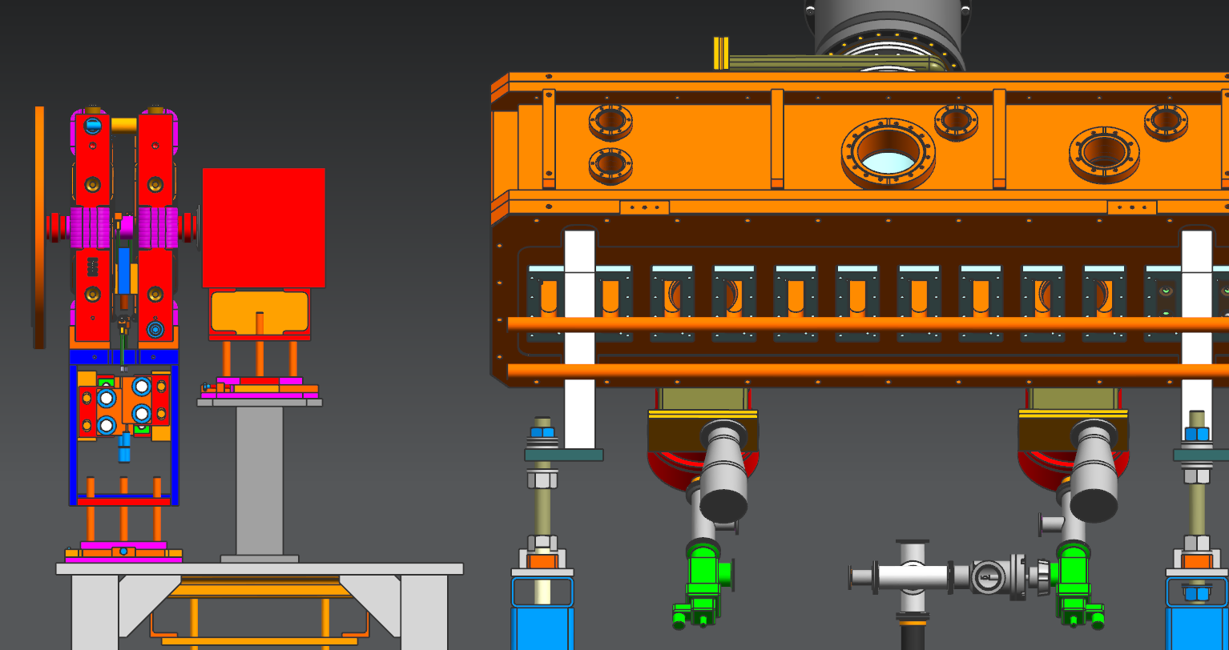
Quads, corrector, and beam pipe removed

Slide 5
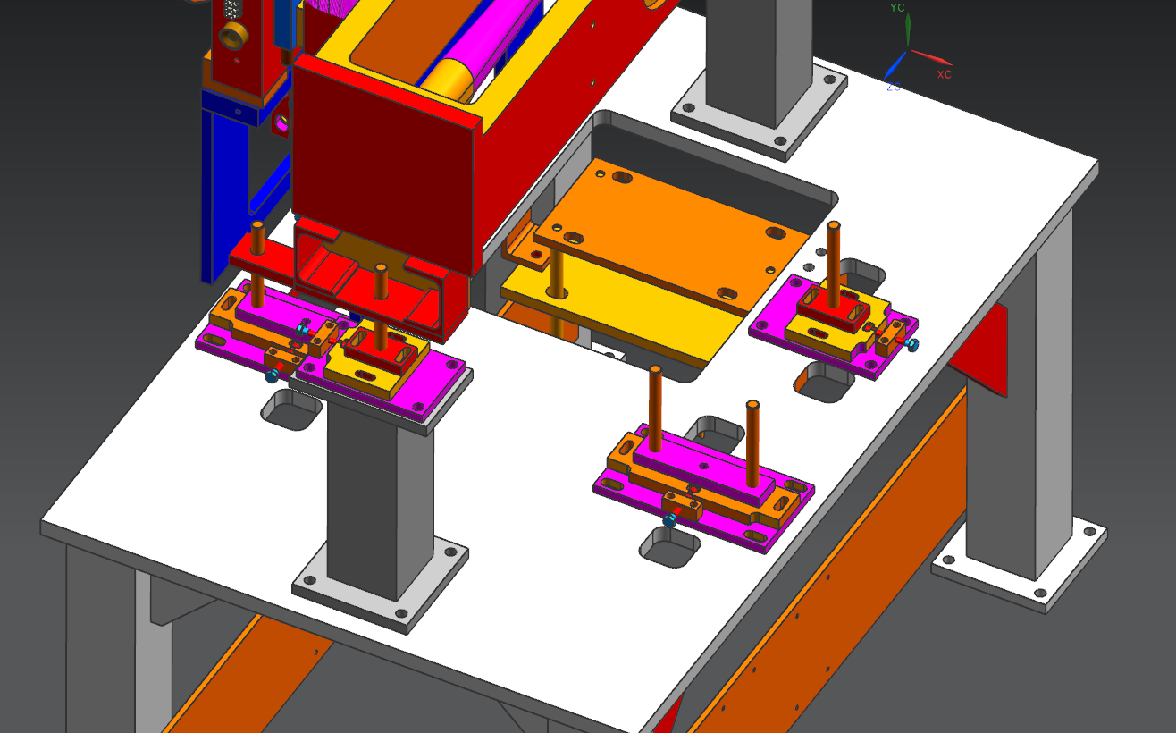
Swap out adjuster stand plates

Slide 6
Cut off 6” Conflat and bellows and cut beam pipe to final length in machine shop
Clean beam pipe after machining

Slide 7
Insert beam pipe through quad and weld on new bellows and KF50 flange
~3/4” from weld to magnet steel for welder
Notes:
Push beam pipe upstream until downstream bellows contacts the quad steel.

Slide 8
Insert beam pipe through quad and weld on new bellows and KF50 flange
~3/4” radially from weld to coils

Slide 9
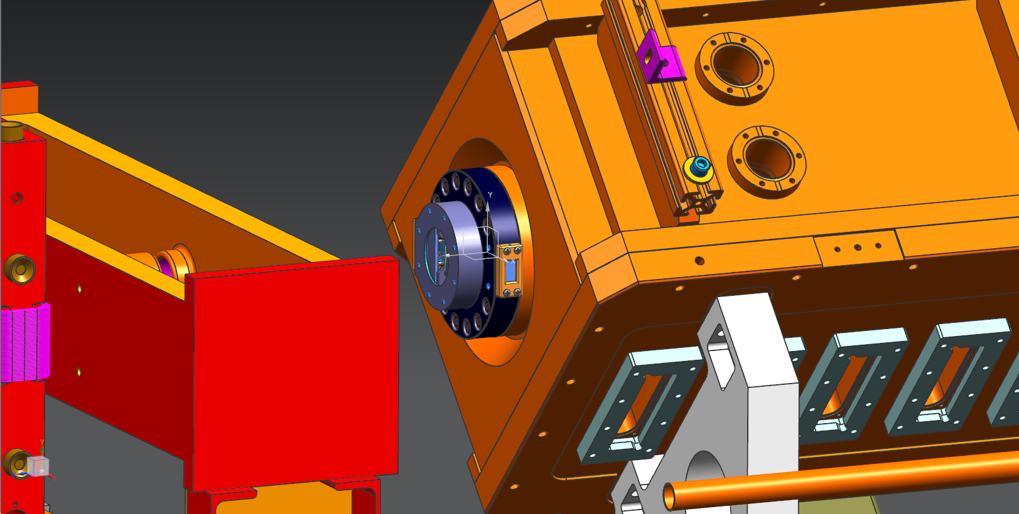
Assemble VC/OC onto RFQ, blank off KF50 port and leak check

Slide 10
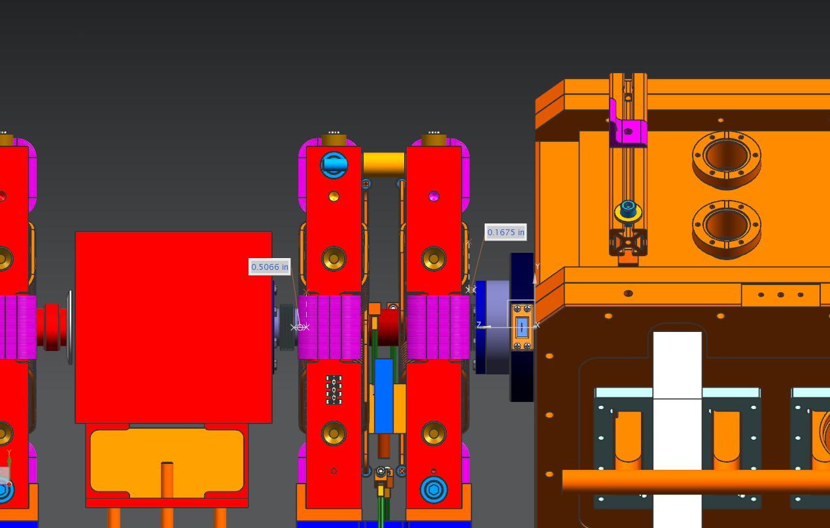
Install quads with new beam pipe, and make up KF50 flanges
New quad position is ~1/2” downstream of current position
~1/2” available to move quad further downstream
~1/8” between KF50 bolt head and quad coils in final position

Slide 11
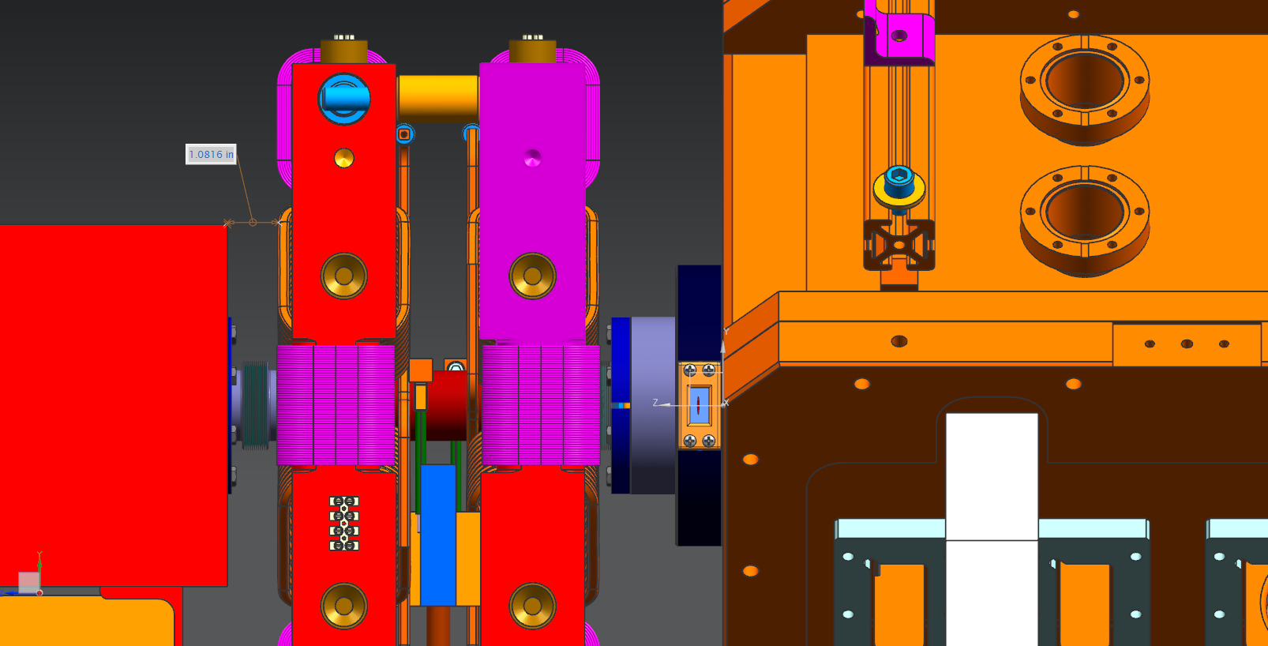
Install quads with new beam pipe, and make up KF50 flanges
~1” between coils and buncher
¾” bolt length including bolt head
.4” clamp length
.22” thread engagement
Notes:
Will only have ~5/8”, might need to use studs and nuts instead

Slide 12
Remaining work
Leak check
Alignment

