Slide 1
PIP Linac Laser Notcher Overview & Plans
DRAFT
David Johnson
Todd Johnson, Kevin Duel, Fred Mach
August 5, 2014
PIP Linac Laser Notcher System Installation Readiness Review

Slide 2
Topics
Notcher System Description
What we are doing in September & why
Jean-Paul and Kevin Presentations
Laser System Status and Plans

Slide 3
Requirements and Technique of Laser Notching of H-
Requirements
  All ions in bunch should see the same photon density
  The 201.25 MHz laser pulses must be phased with the RFQ
  The laser pulse length =/> bunch length ~1.5 to 2 ns
  Uniform temporal profile
  The burst of 201.25 MHz pulses must match the Booster inj rev. freq.
  The 450 kHz burst must have appropriate timing within the linac pulse
  The pulse energy should neutralize > 99% of ions in each bunch
Technique
  Utilize a CW seed laser and wave-guide modulator to create required laser pulse pattern (both 200 MHz and 450 kHz) at low pulse energies (pJ)
  Amplify pulse pattern using a three-stage fiber amplifier (nJ to uJ)
  Further amplify using a free-space solid state amplifier (mJ)
  Create a spatially uniform photon beam
  Insert laser pulse into a linear zig-zag interaction cavity where the laser reflections inside the cavity match the ion velocity
    to reduce required pulse energy by the number N of reflections in the cavity.

Slide 4
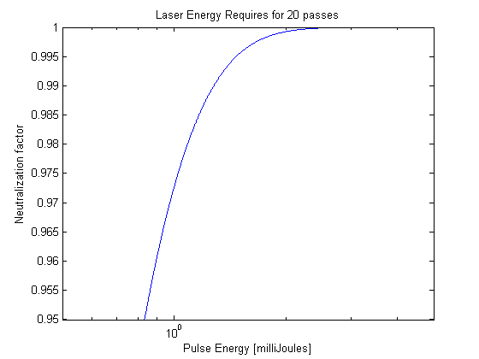
Neutralization vs Pulse Energy
Design value

Slide 5
Laser Notcher System
Optical Cavity
Vacuum can
Laser System
ES&H
Diagnostics
instrumentation
Optical
cavity
Vacuum
interface
Optical
Pattern
Generator
Fiber
Amplifiers
Free
Space
Timing
Controls
Mirror Test
Diagnostics
Pre-amp
Seed
Amplifier
AWG
Modulator
To be installed in the MEBT beam line
September Shutdown
Nd:YAG
DPSS
Amplifier
System
Beam
shaping
Transport
Laser
Dump
LASER SYSTEM & REMAINING COMPONENTS
IINSTALLED APRIL-MAY 2015 SHUTDOWN

Slide 6
Optical cavity &vacuum flange

Slide 7
Why are we installing the optical cavity now?
  Opportunity !
  We are interested in finding out how the dielectric mirrors behave in this location. We believe there should be no problem
    Vacuum level (residual gas) – install metal valve at downstream end of RFQ to allow for RGA.
    Aperture between the mirrors should be sufficiently large that no H- should impact the mirrors
    Electrons from the photoneutralization should exit downstream flange before striking beam pipe (result of simulations)
  Monitor the mirror reflectivity for any degradation with a low power 1064 nm laser and photo diodes-> interface into ACNET.
  We have designed the cavity/vacuum flange to be “easily” removable (flanged at both ends) and the optical cavity to be independent of the vacuum component.
  Kevin will detail the installation plans
  Next few slides show the flange and cavity geometry…

Slide 8
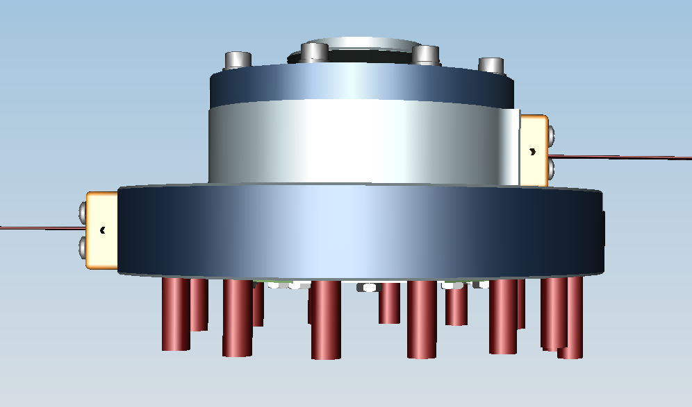
Vacuum Flange / Optical Cavity
TO MEBT
Laser OUT
Laser IN
~1.5” downstream
RFQ flange surface
~0.5” downstream
RFQ flange surface
RFQ

Slide 9
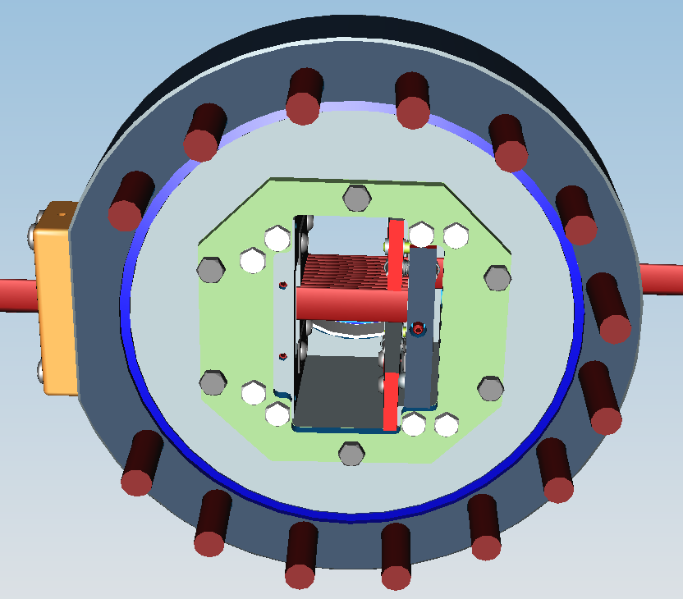
Rear View of VF/OC
Optical Cavity can be easily removed
With 6 precision placed bolts

Slide 10
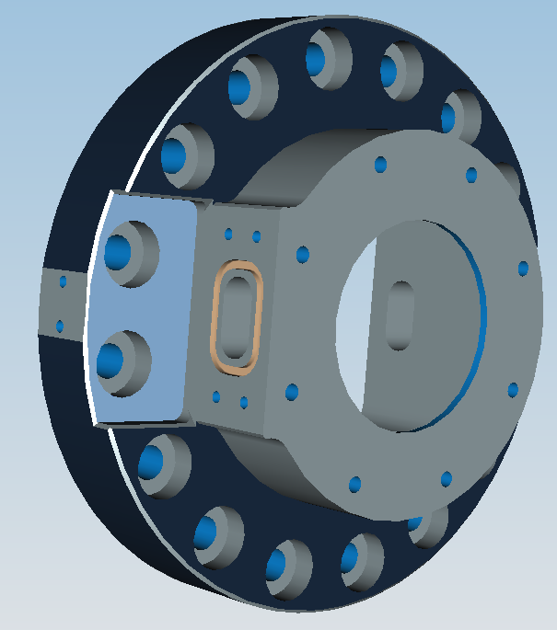
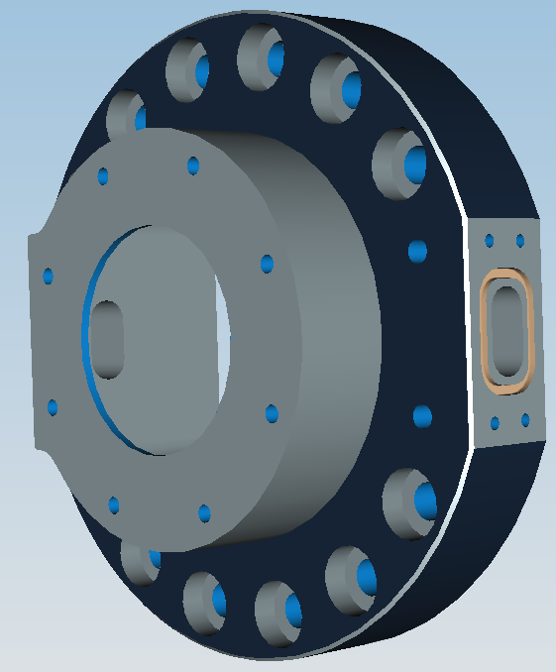
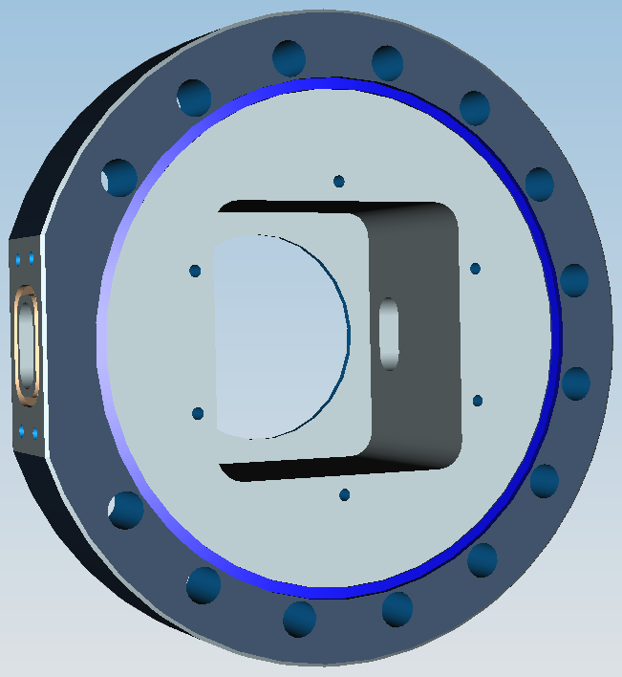
One Piece Vacuum Can (Flange)
Flange to MEBT
Input Viewport
Output Viewport
Sealing surface to RFQ

Slide 11
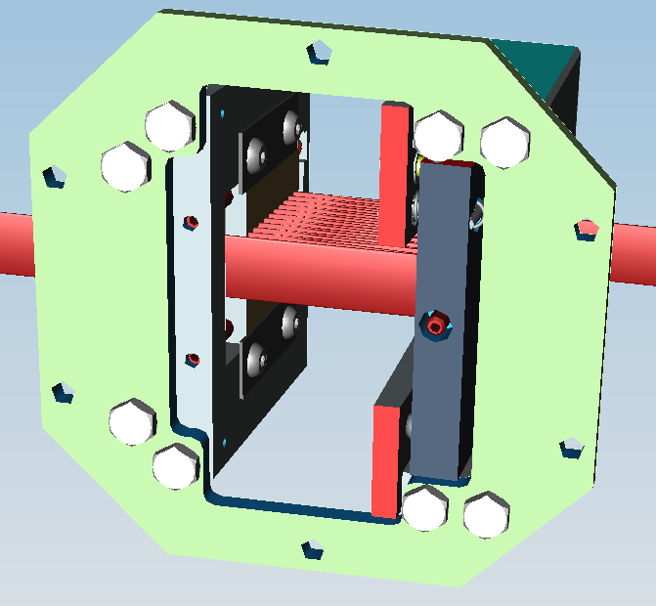
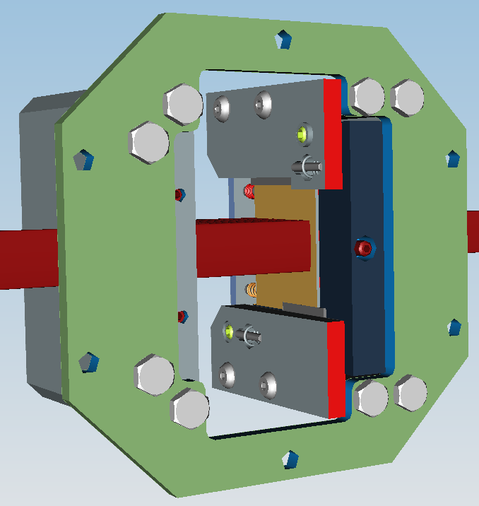
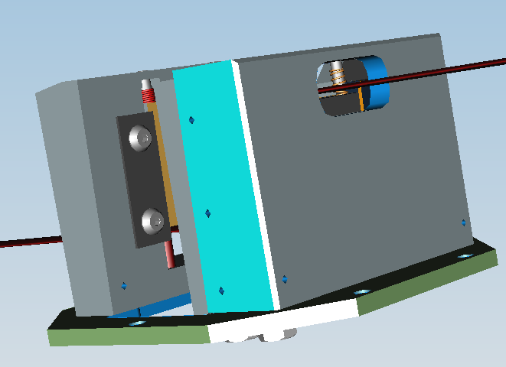
Optical Cavity Structure
Fixed
mirror
Adjustable mirror
Adjustment screws (0.2mm pitch)
Longitudinal Mirror adjustment
Exit port

Slide 12
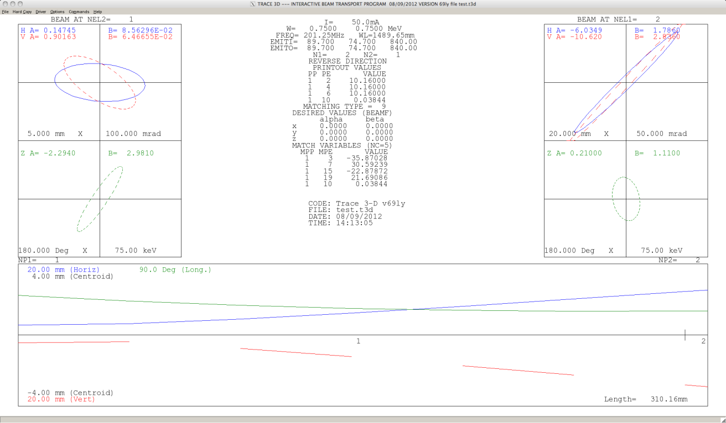
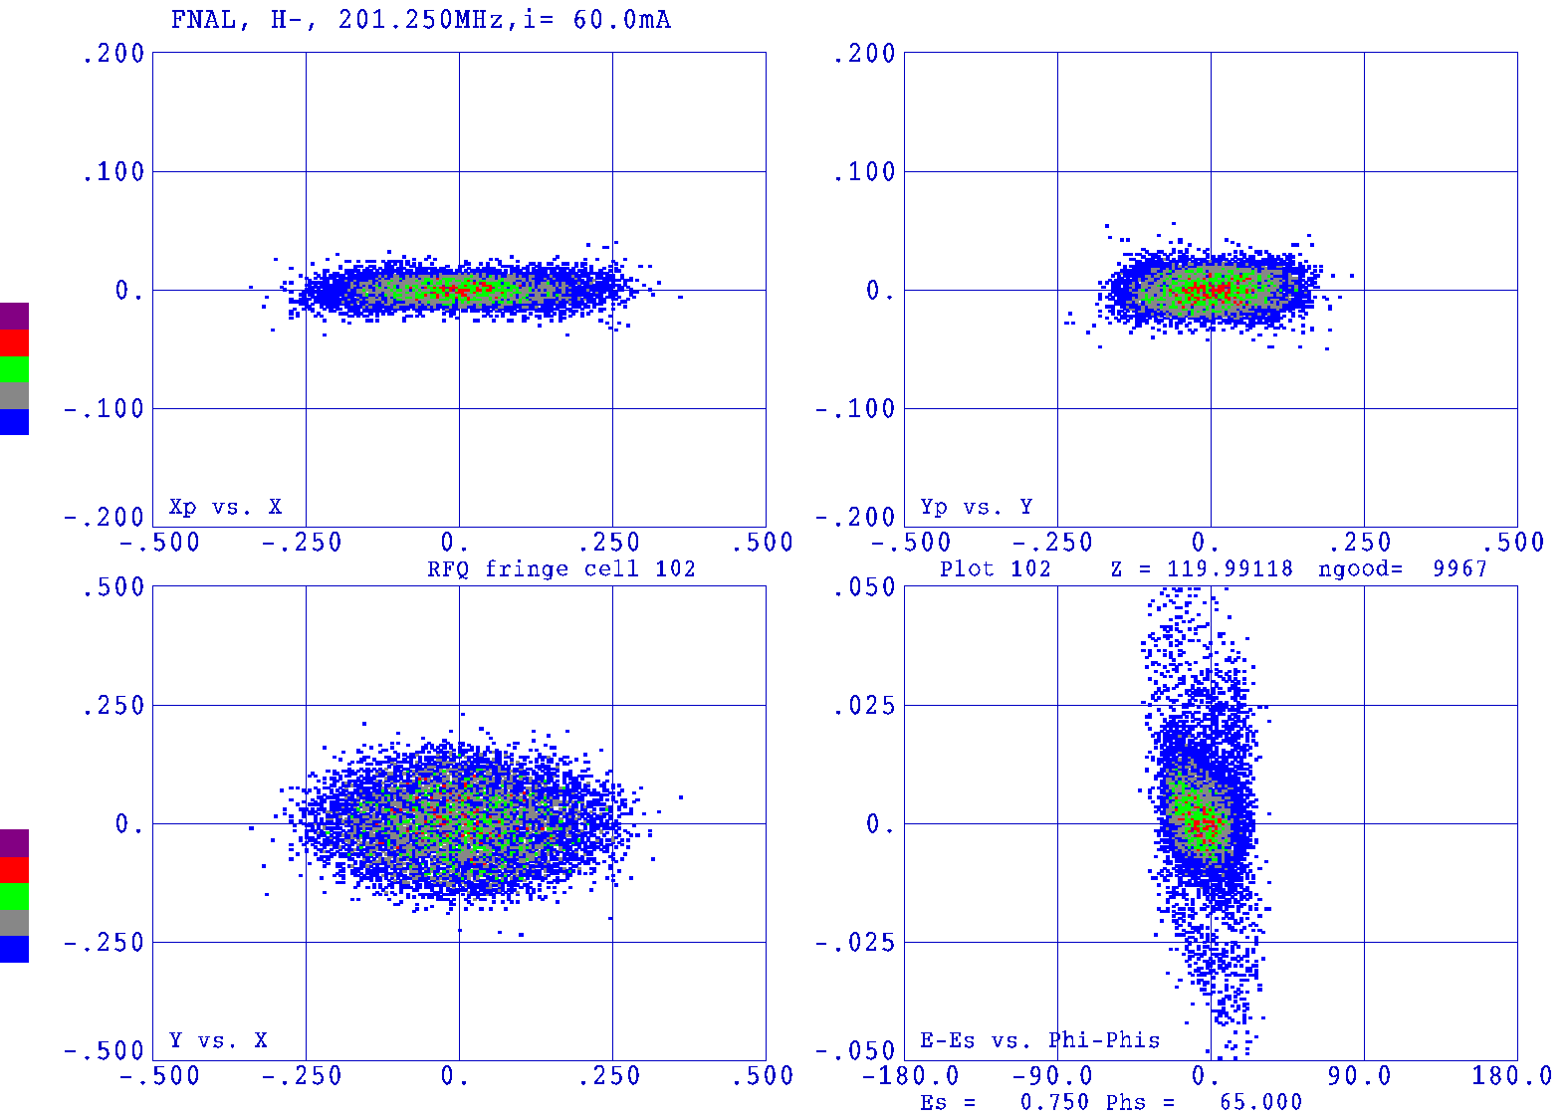
Expected Beam Dimensions
Additional simulations to be shown by JPC
Phase space simulation at end of RFQ (figure 4.40 of 750 KeV Upgrade Plan)
Trace 3D back calculation of beam size at exit of RFQ based upon emittance measurement at 178 kW power August 9, 2012 CY Tan.
Laser beam vertical profile (1/e²) ~ 5 mm.
Initial design assumed that the vertical laser beam dimension of 1 cm.
Beam measurements indicate vertical laser size could be reduced to 6 mm

Slide 13
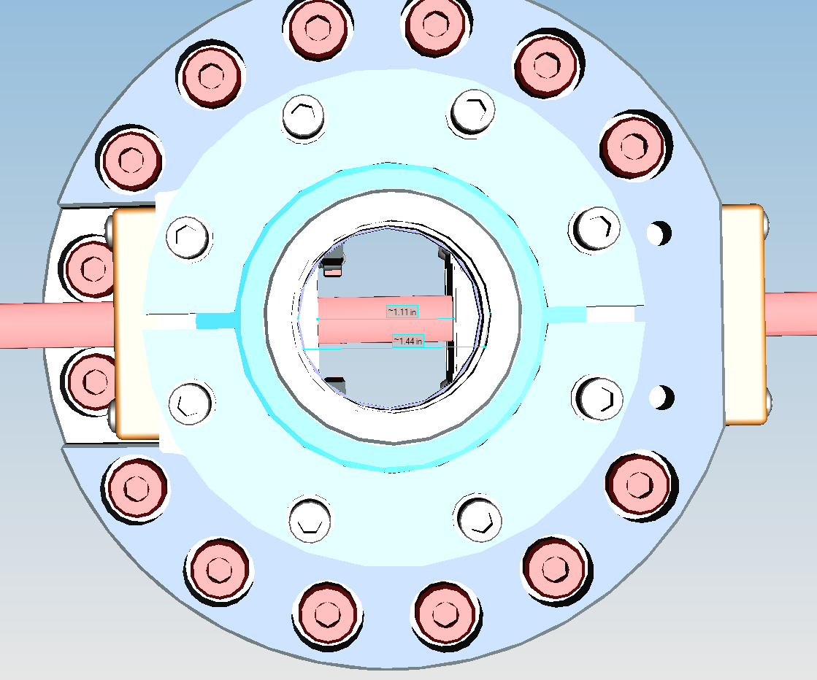
Aperture
(looking from downstream)
Mirror cavity radius 1.49 cm
Beam tube Inner radius 1.83 cm
Expected (horizontal) half-size of H- << 0.5 cm
(X3 smaller than mirror cavity radius)

Slide 14
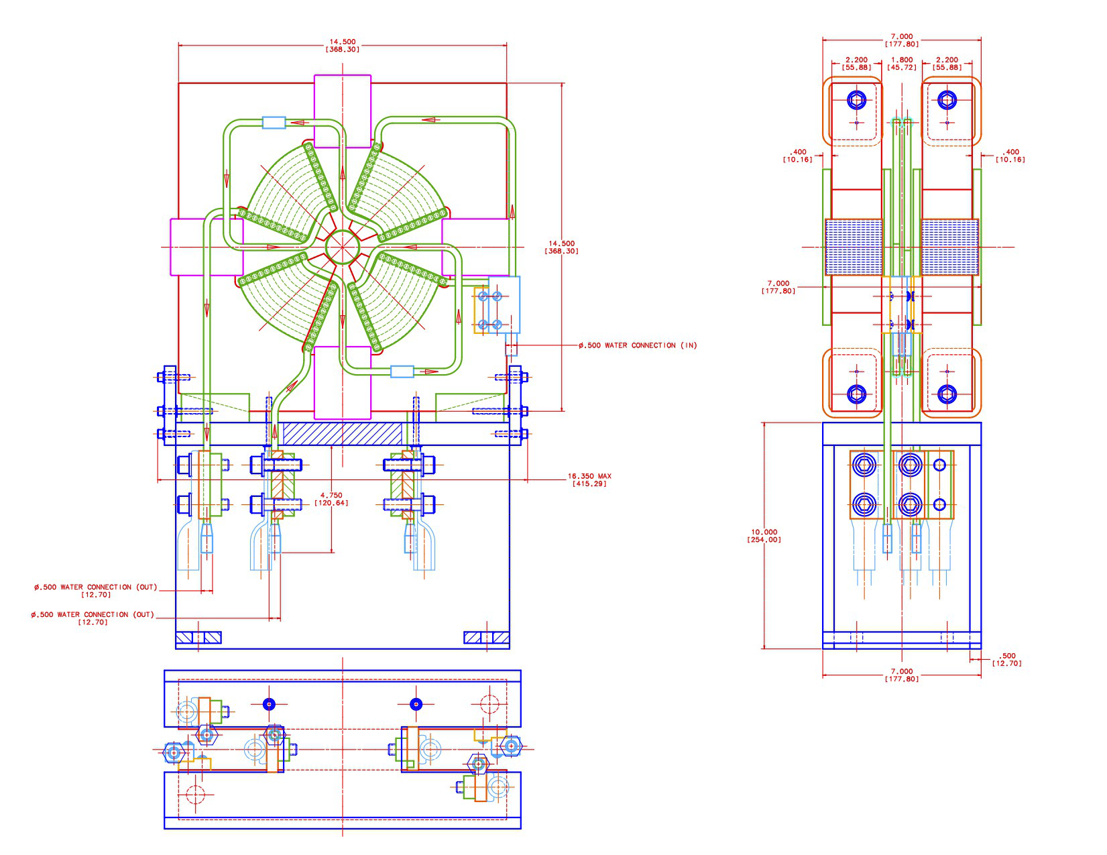
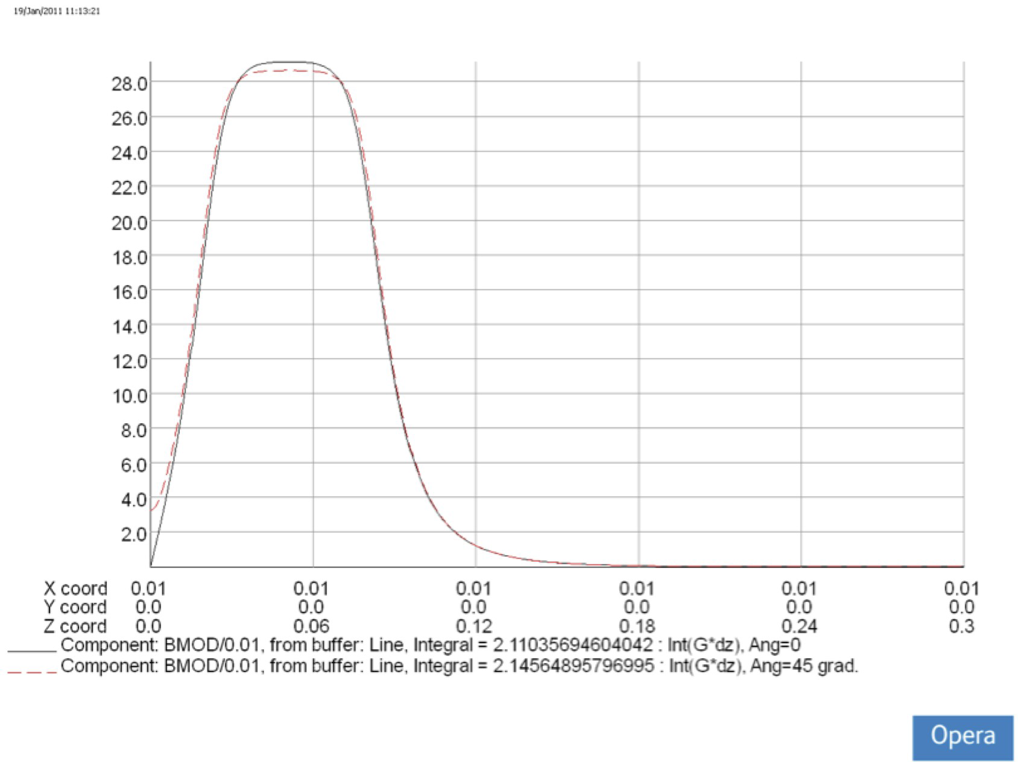
Data For Simulations of Electron Trajectory in Quad Fringe Field
Gradient in upstream quad
3σ = 2.5 mm
Z=0
2.3”
G [T/m]
EOS
2.0”
RFQ flange
Center of doublet
coil
Stripping region
3.1” (0.0787m)
.0251”
½”
0.127 m
0.11 4 m
0.105m

Slide 15
Electron Trajectory Simulations
Electron Beam Trajectories for MEBT Quadrupole Doublet
V. Kashikhin, June 25, 2014
Electron Trajectories calculated by TOSCA3d code for electrons having 409 eV kinetic energy.
The beam of 9 electrons have sizes: +/- 3.6 mm, and +/-2 mm. The coordinate system is shifted -50mm in Z-axis. Coordinates -0.127,0.114,0.105m on the graphs are -0.177,-0.164,-0.155 m. It looks that all electrons go out of 31 mm cylinder surface radius. TPC =0,0,0 is for the beam parallel Z-axis, TPC=90,1,0 is for the beam rotated 1 deg. around X-axis, and TPC=0,1,0 is for the beam rotated 1 deg. around Y-axis

Slide 16
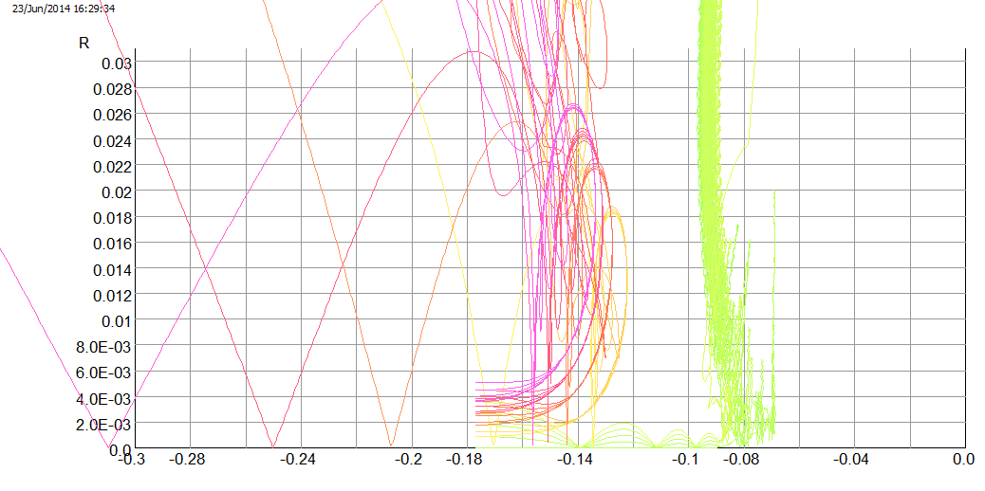
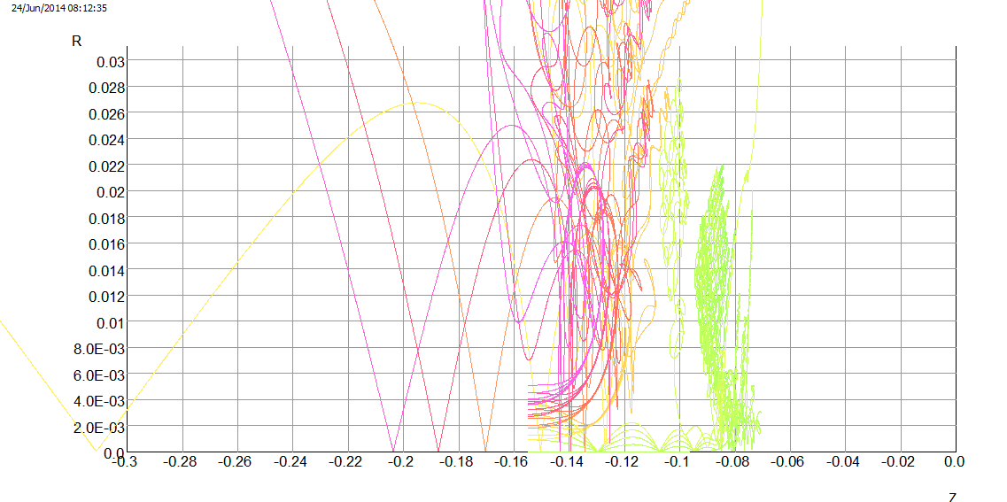
Example of Electron Trajectories in Quad Fringe Field
Vladimir Kashikhin
Z= -127 mm
Z = -105 mm

Slide 17
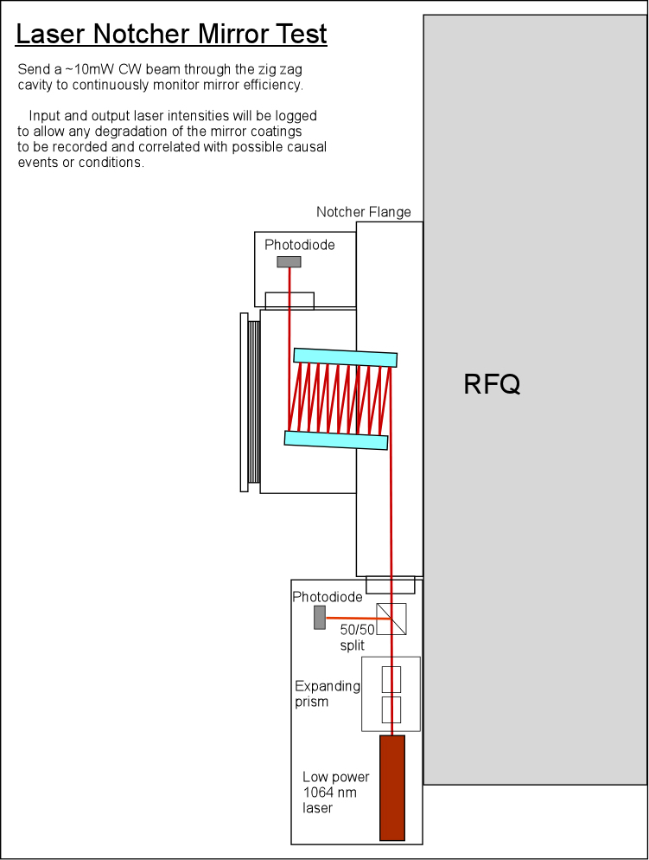
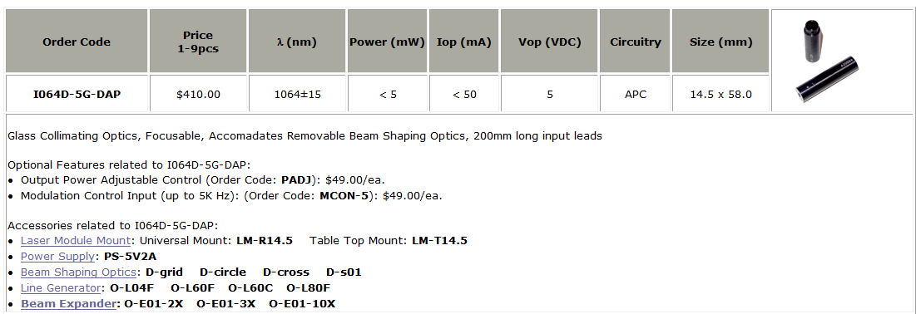
Optical Cavity Mirror Test
From: Todd Johnson
Readout to ACNET
Monitor Photodiodes
and their ratio
(Datalog)
Readout to ACNET

Slide 18
Pre-Shutdown Schedule for Optical Cavity/ Vacuum Flange

Slide 19
Part II Laser System

Slide 20
Burst mode seed pulses to Fiber Amplifier followed by Free Space Amp
λ₁=1064nm
120 mW CW
SW=0.1 nm
Output modulator/Input fiber pre-amp:
201.25MHz pulses (1.25 ns pulse), 458kHz burst
10 GHz Mach-Zehnder
Modulator
L_{i}~1.8dB
Isolator
PM Fiber
Diode + TC
controlled
L_{ins} ~5dB
Pulse Generator
Amplifier, Timing
Line filter
Fiber Amp 2
Fiber Amp 1
Free
Space
Fiber Pre-Amp
*Notch 12 bunches -> 60 ns
10 notches/linac pulse
Clean up filter
Generate 24 us burst at 15 hz
Pulsed at 15 Hz
15 Hz
Free Space Amp
AOM
Grumman CEO DPSS OEM
TRANSPORT BEAM SHAPING OPTICS & OPTICAL CAVITY

Slide 21
Optical Pattern Generator

Slide 22
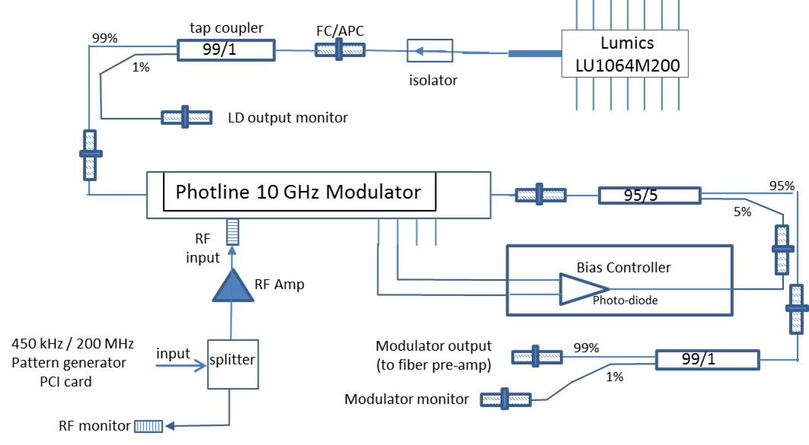
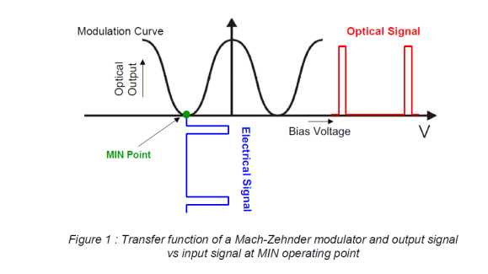
Optical Pattern Generator
Need stable source
Pulse on/off extinction 30 dB
Input: 100 mW CW
Output: 54 pJ (1.5 ns/200 MHz)
294 uW avg power at 450 kHz

Slide 23
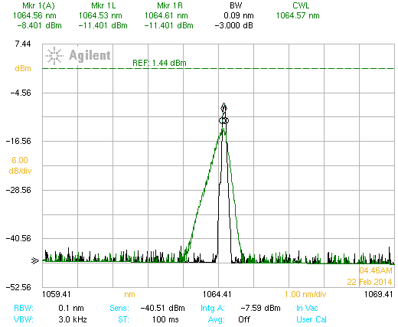
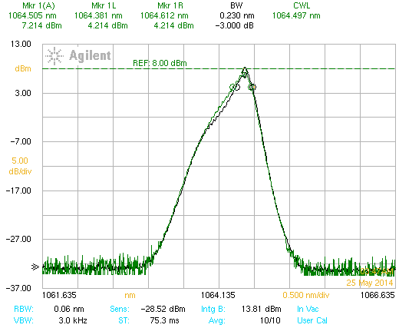
Seed Source
Requirements: center wavelength (1064.15 nm) , spectral width(0.1 to 0.3 nm), stability (< 1% p-p) , optical power (~200 mW)
Current seed source not stable @ 25ºC operation point. Wavelength too high (could be adjusted by Peltier Cooler on FBG.
Current source more stable at 7ºC (but don’t want to rely on this long term). Should work for initial tests of fiber system.
Plan on purchasing a new seed source (looking at options)
Diode at25º C
Peak amp shift ~6 dB
Diode at7º C
~5 dB amp shift

Slide 24
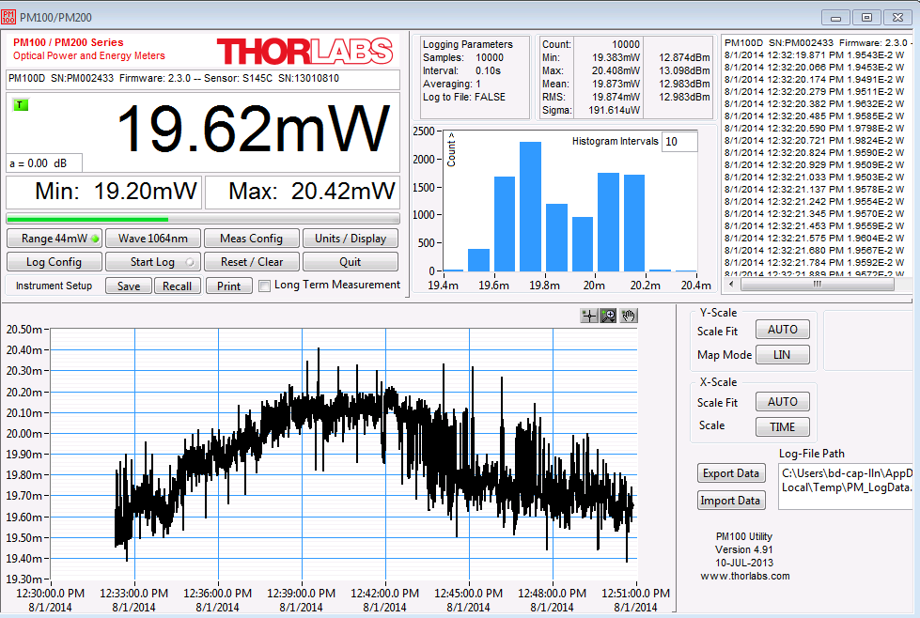
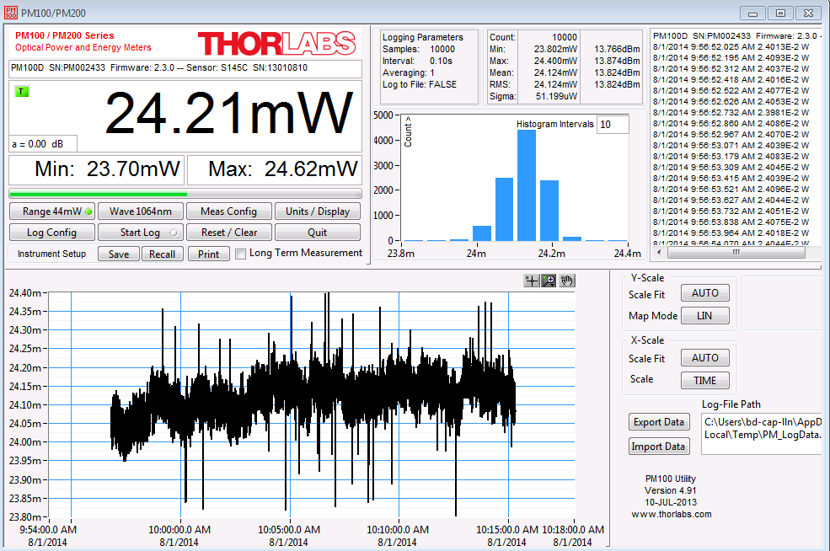
Seed Source Output Stability
Look at output stability at 2 seed source temperatures
25ºC sigma 191 uW p-p 1.025 mW (5.2%)
7ºC sigma 52 uW p-p 0.6 mW (2.5%)

Slide 25
Provides input to specification of seed center wavelength and spectral width

Slide 26
Fiber Amplifiers

Slide 27
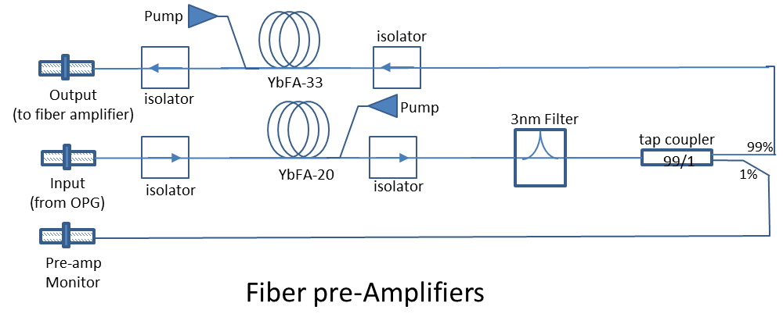
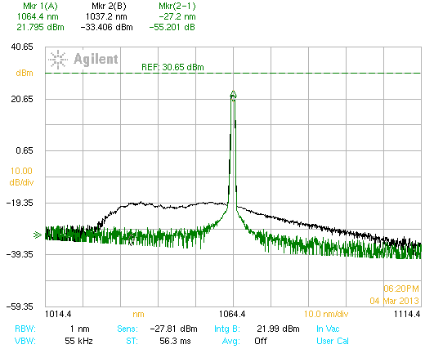
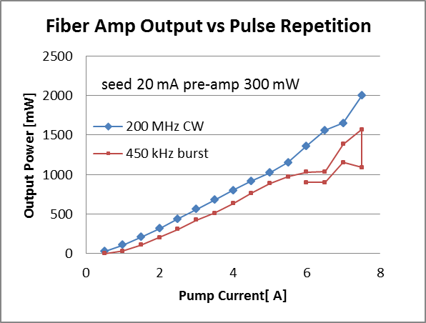
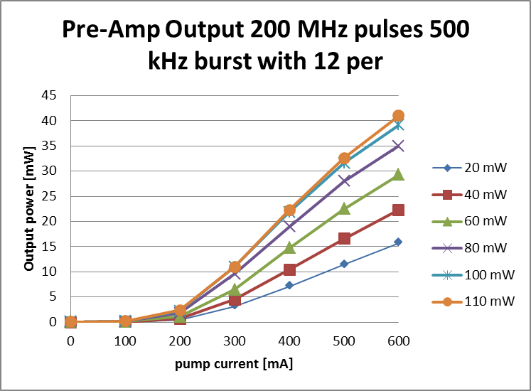
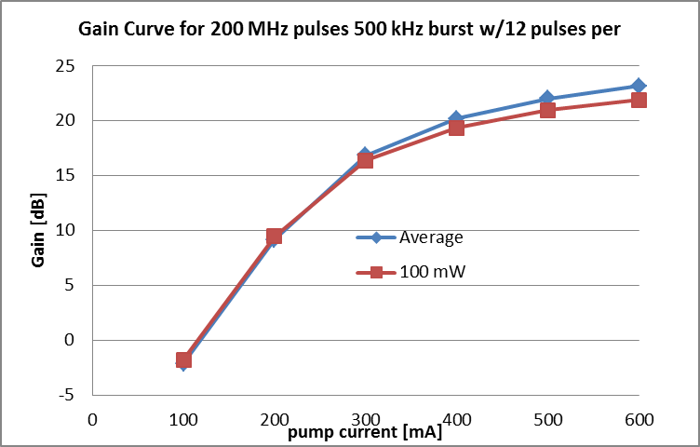
Fiber Pre- Amplifier System
Pump: center λ 970.7 nm
(will shift higher due to heating)
up to 7.3W @8A
Gain Fiber 7.5 meters CorActive DCF-YB-6/128-PM ,
abs @975nm 2.6 dB/m, Core A 33 um²
Gain 17.2 dB
amp
PriTel
Output 385 nJ
2 W
filter
Input 54 pJ
294 μW
Gain 23 dB
Output 100 pJ
590 μW

Slide 28
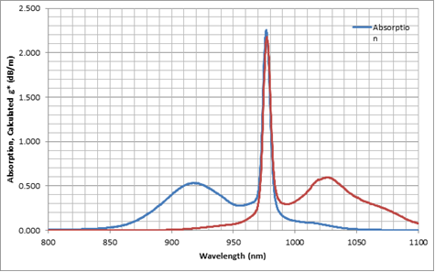
Absorption Spectra for Yd doped Fiber

Slide 29

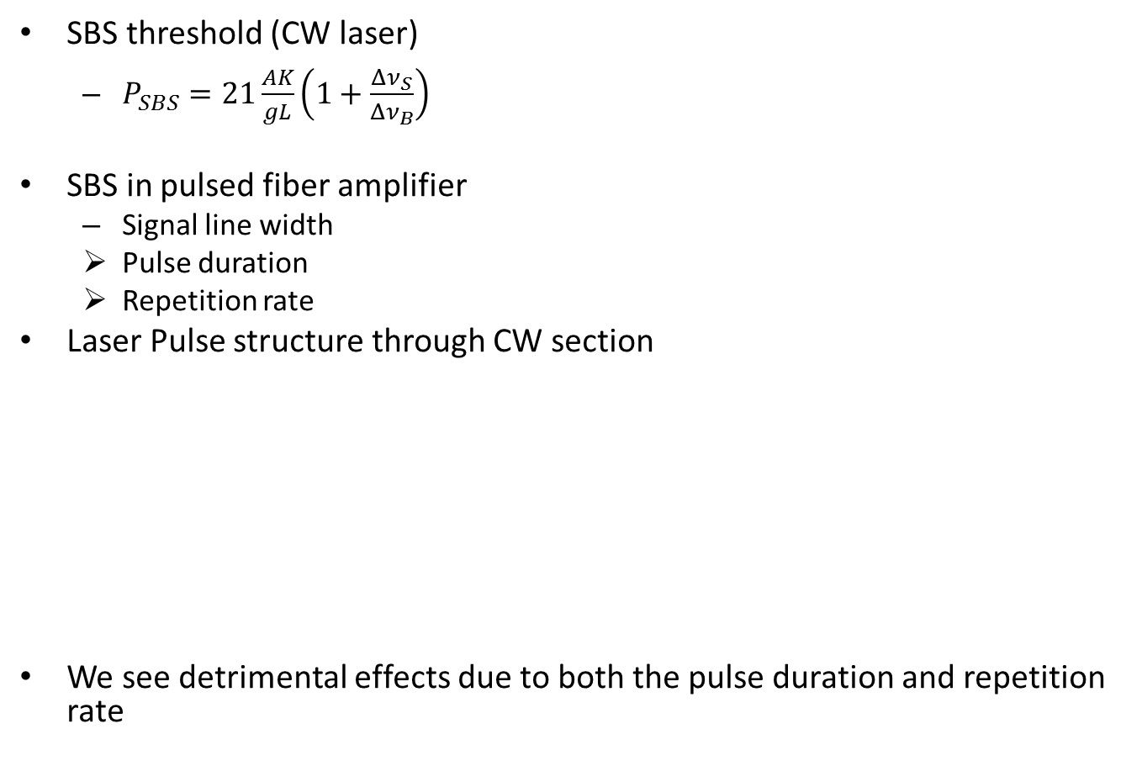

SBS
SBS threshold (CW laser)
  $P_{SBS}=21\frac{AK}{gL}\left(1+\frac{{Δν}_{S}}{{Δν}_{B}}\right)$
SBS in pulsed fiber amplifier
  Signal line width
  Pulse duration
  Repetition rate
Laser Pulse structure through CW section
We see detrimental effects due to both the pulse duration and repetition rate
A = fiber core area
K = polarization factor (=1)
g = peak Brillion gain coefficient
L = effective fiber length
For 0.1 nm line width -> 26 GHz
${Δν}_{S}$= laser line width
$Δν﷮B$= spectral width BGS (<100 MHz)
Repetition rate ~ 450 kHz (Booster revolution frequency)
Notch (N pulses on 201.25 MHz)
Typically N ~ 12 16 pulses (60-80 ns)
This is equivalent to 450 kHz repetition rate of 60-80 ns laser pulses

Slide 30
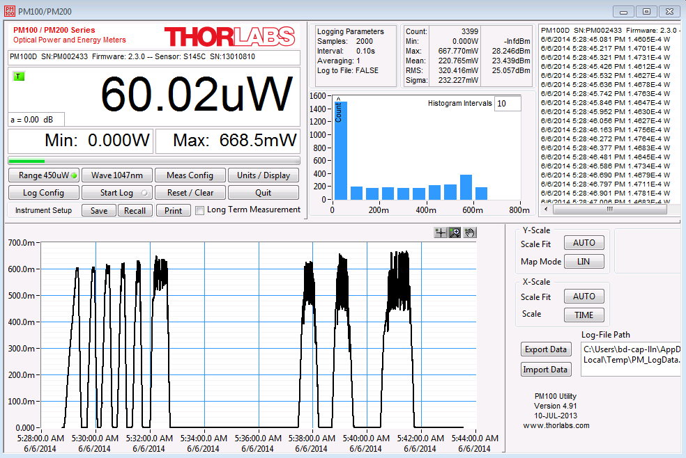

Slide 31
SBS Mitigation Plans
Raise the SBS threshold a factor of 7.5 by:
  utilizing a larger mode area gain fiber (x 3)
  Utilizing a gain fiber with a higher absorption
    Reduce length of gain fiber (x 2.5)
  Better matching pump wavelength to improve optical-optical efficiency
    Reduce pump power
  Potentially reduce un-doped delivery fiber

Slide 32
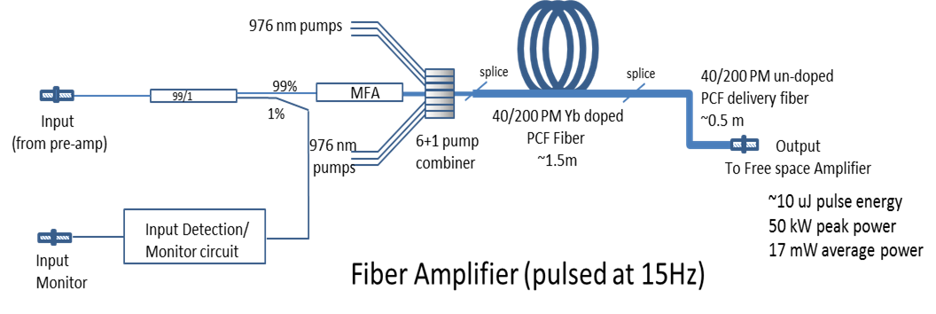
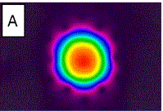
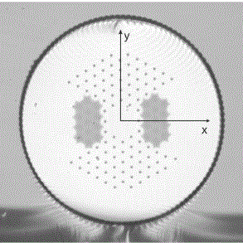
Fiber Amplifier System
Optical Engines
Input 363 nJ 1.96 W
Gain: 14.5 dB
Output to include mode
stripper (to remove any pump
light) and optics to match
into first FS amp.
Single mode, single polarization
Small NA (~0.03)
Large mode area
High peak power levels
High pump absorption (~10 dB/m)
High reliability
Micrograph of PCF fiber

Slide 33
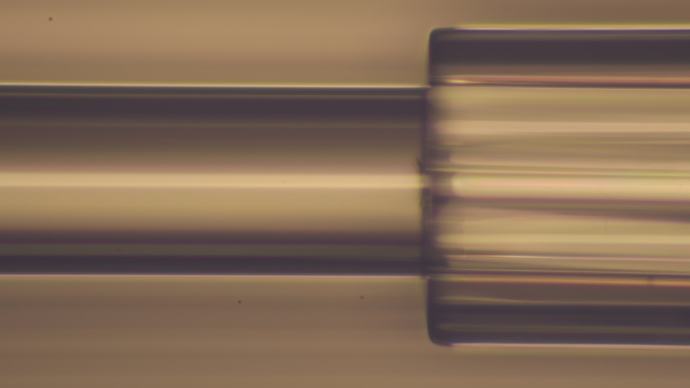
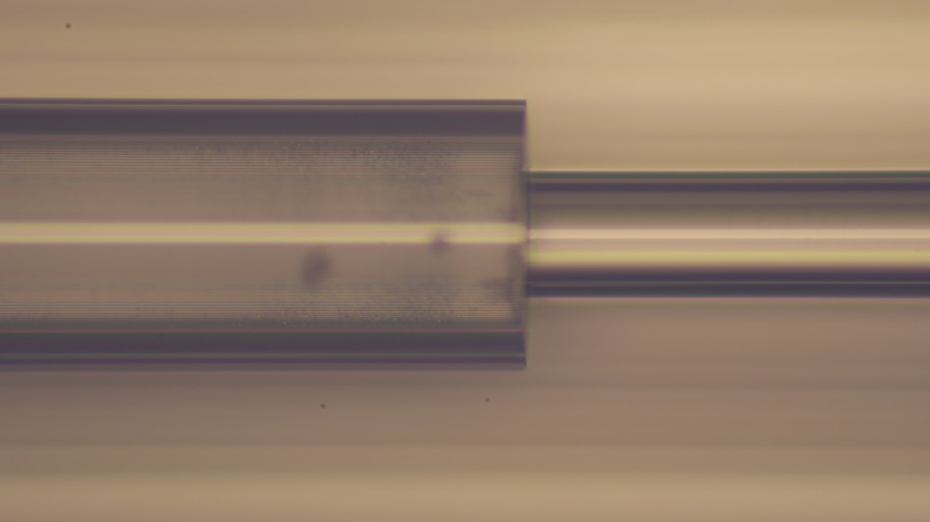
Bundle to taper splice
PCF
Taper

Slide 34
Free space amplifier

Slide 35

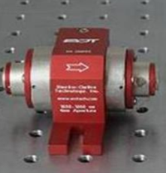
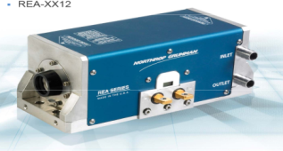
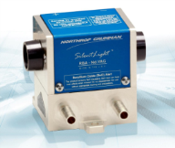
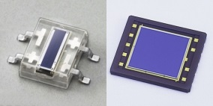
Free Space Amplifier configuration 2.2
(Pulsed at 15 Hz)
Gain: ~ 23 dB (total for both modules)
Output: 2 mJ 10 kW (450 kHZ) 3.2 mW (15 Hz)
Faraday
Isolator
8mm
REA (6.35 mm rod)
2 mJ pulse/2 ns
1 MW peak
HRM
HRM
6.0”
HRM
Faraday
Isolator
4mm
Faraday
Isolator
4mm
RBA (2mm rod)
λ/2
532 nm alignment laser
HRM
3.07”
Telescope to reduce beam
(1/e² diameter to 1.6 mm)
Telescope to expand beam
(1/e² diameter to 5.08 mm)
Beam Stacker
HRM
Fiber port and optics
to generate
1/e² diameter of 1.6 mm
8 uJ pulse/2 ns
4 kW peak
HRM
HRM
BPM
090
Input fiber
From fiber amplifier
045
135
000
Polarization orientation
Used by EOTech

Slide 36
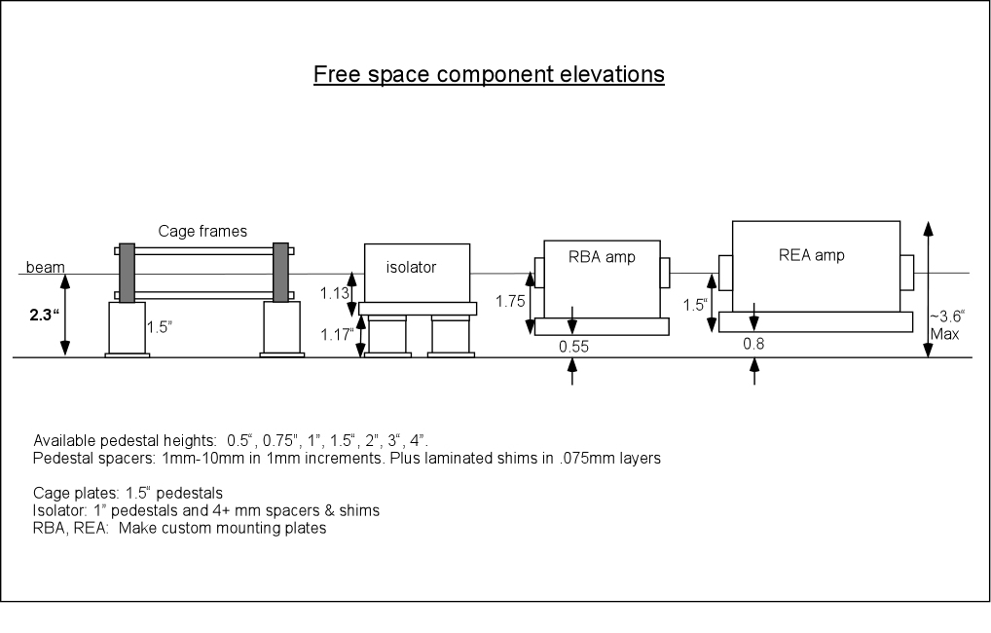

Slide 37
Installation

Slide 38
Tdk-Lambda GEN50-30E
Tdk-Lambda GEN100-24
Tdk-Lambda GEN100-24
OPG (2U)
REA controller (2U)
PCI Expansion Chassis (2U)
Reserved (2U) for potential AOM
Laser Notcher Rack Layout ( July 2014)
4slot VME (2U)
RBA controller (2U)
SPARE 1U
LD- USB interface / MOD&BIAS - USB interface
LCD/Keyboard (1U)
PCI slots (AWG/clock /expansion)
Timing card/moto5500 controller/8ch D/A
RS-232 interface
PriTel fiber amplifiers (2U)
Rack mount computer (1U)
RS-232 interface
USB interface
RBA PS (1U)
REA PS (1U)
REA PS (1U)
1
3
5
7
9
11
13
15
17
19
1.75” x 20U = 35”

Slide 39
Es&h

Slide 40
Laser Safety
We are in constant contact with Matt, Dave, and Ray every step of the design to assure personnel safety.
  Laser development lab
  Installation and operation of the laser system in Linac MEBT
    Interlocks
    Operational procedures
    Alignment procedures
  Installation of the mirror test laser system

Slide 41
diagnostics

Slide 42
Plans
Optical Cavity
  We should have all components for aligning the optical cavity by 1st or 2nd week in August. If all goes well (and no modifications are needed) should only take a couple of hours for alignment. Internal components will be ultrasonically cleaned and we will be wearing gloves for assembly.
  We should have the vacuum flange in hand during the 1st or 2nd week in August for installation of view ports and then vacuum certification.
OPG
  We are still in search of a new butterfly seed source with stable output and spectral width of ~0.1 to 0.3 nm and a central wavelength of 1064.3 +/- 0.2 nm
  We may need to add a Peltier Coolier to the FBG on the seed source to adjust the central wavelength of the seed to match the gain spectrum of Nd:YAG
Fiber pre-amp
  PriTel is actively working on constructing the power amplifier with LMA.
  We hope to
Fiber Amplifier (Optical Engines)

Slide 43
Extra/old slides

Slide 44
PRE-Shutdown Plans
Assume we start the shutdown 1st week in September.
Optical cavity & vacuum flange in shop being fabricated
All other components on order
Order components for mirror test
Receive optical cavity & components
Ultrasonically clean components (will work gloved after this)
Assemble optical cavity
Alignment of optical cavity in laser lab
Receive vacuum flange
Ultrasonically clean vacuum flange
Install viewports
Leak check
Assemble optical cavity into vacuum flange
Re-check alignment
Check alignment with mirror test components
Leak check full system
Ready for installation

