Slide 1

Booster (PIP) PIP II
How to make 50+ year old Booster make the jump
Fermilab APT Seminar
November 11, 2014
W. Pellico

Slide 2
Outline
Present Booster operations
  Booster numbers today
  PIP numbers and goals
PIP II Booster
    PIP II Booster parameters
    Systems impacted by PIP II plan
      Injection/Capture
      RF
      20 Hz operations
      Beam dynamics/loss control
      Misc. – Long term viability and reliability
  What is the plan
  Cost and schedule ideas

Slide 3
Proton Delivery Scenario
(approximate, no shutdowns shown)
15 Hz
~PIP End
Total beam thru Booster
Ramp up flux -tuning/loses
Preparing for PIP II
POT/quarter, (x10²⁰)
7.5 Hz
NuMI/NOvA
g-2
BNB
We are here, we are here, we are here
Summer shutdown
SY120
mu2e
FY

Slide 4
PIP Planning
near term vs. longer term
Get to 15 Hz
Increase flux
  Loss control
  Shielding
  Beam physics
Reliability
Viability
PIP II interface
  PIP modified to better align to PIP II
PIP was planned to be a ~5 year campaign: Why?
Due to fact that after NOvA and BNB (as well as Muon/G-2) would require more flux than the PS could deliver in planned timetable – required a rapid response
Additionally, the PS would need to keep running reliably for 15+ years required a long term strategy

Slide 5
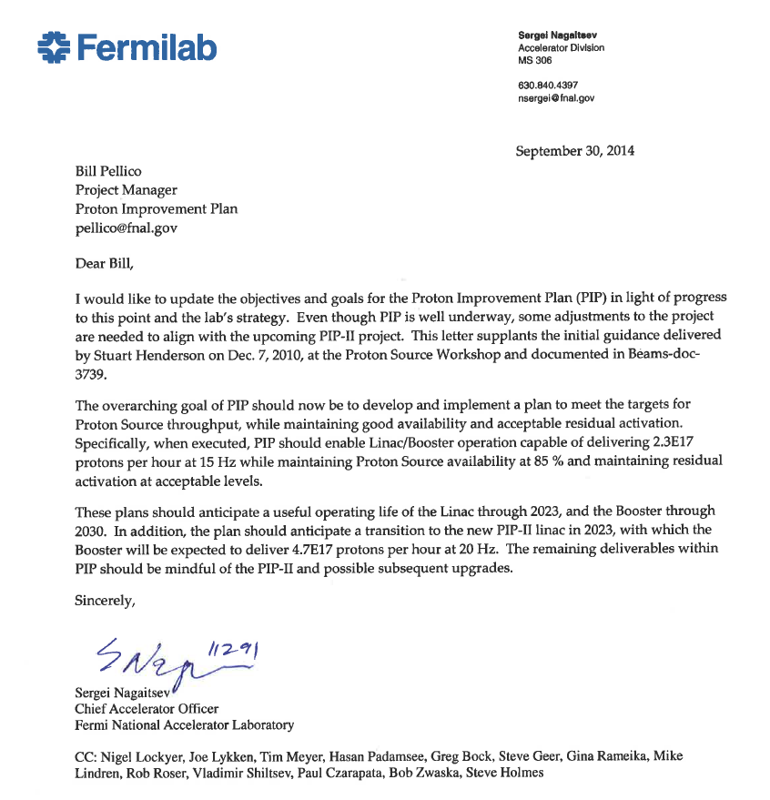
Scope change to PIP
Modifications to PIP objectives that reflect present laboratory planning. This letter from Sergei will be added to PIP docs and reflected in PIP planning.
Extend Booster operations to 2030
Linac Operations till 2023
Consider transition to PIP II

Slide 6
Present Booster (PIP underway)
Average numbers for 1 year
Parameter | Sept. 2005 | Now
Ave. Extraction Intensity | 3.8E12 | 4.5E12
Ave. Beam Power Lost | 510 W | 440 W
Notch Bunches | 4 | 3
Efficiency | 84.5 | 90.4
MI Batches | 7 | 11
Booster Rep Rate | 5 Hz | 7.5 Hz
Booster Flux (E17/hour) | 6.5 | 11
NOvA Flux (E16/hour) | 3 | 7
BNB Flux (E16/hour) | 2 | 3
NOvA Beam | 184 kW | ~280 kW
Rate Limited
Loss Limited
Operational Limit
Set for reliability
Off right now
As high as ~340 kW
Will try for 400 kW

Slide 7
When PIP Completed –
Major Booster Upgrades
Updated Utilities (vacuum, LCW and power)
Additional RF Cavities and Voltage (3 additional)
Refurbished Cavities for 15 Hz operations
New Anodes, Modulators and updated Bias supplies
RF solid state drives
New notch absorber/kicker systems
New digital BPM and damper systems
Updated beam optics software and control
Updated low level hardware
New cogging system
Total Loss Monitor (TLM) system operational
Harmonic cavity(s) – injection/transition

Slide 8
Once PIP Completed
Only remaining original hardware in Booster will be the gradient magnet system and some small fraction of utilities
  All other systems will either be relatively new (<10 years) or significantly upgraded
Linac upgrades will allow reliable delivery (>85 % uptime) of beam till 2023
  Plans for longer lifetime operations, 2025 and beyond, will not be pursued such as the replacement of high power 7835 triode

Slide 9
PIP Booster Parameter Table
Parameter | PIP Done
Ave. Extraction Intensity | 4.3E12/pulse
Ave. Beam Power | < 510 Watts
Local loss points limits remain
Bunches removed (either in Linac or Booster) | 3
Efficiency | 95%
Booster Rep Rate | 15 hz
MI Batches | 12 every 1.33sec
Rate Availability for other users | 6 Hz
Booster Flux Capability | ~2.3E17p/hr
Longitudinal Energy Spread | < 6 Mev
Transverse emittances (4.3E12) | <14 π-mm-mrad
Booster Uptime | >85%

Slide 10
PIP II Booster
PIP Done – Now Another Push
50% higher flux than the planned PIP operations which is expected to double present flux level. (4.3e12 protons @15Hz at the end of PIP)
30% decrease in space charge tune shift @ 800 MeV.

Slide 11
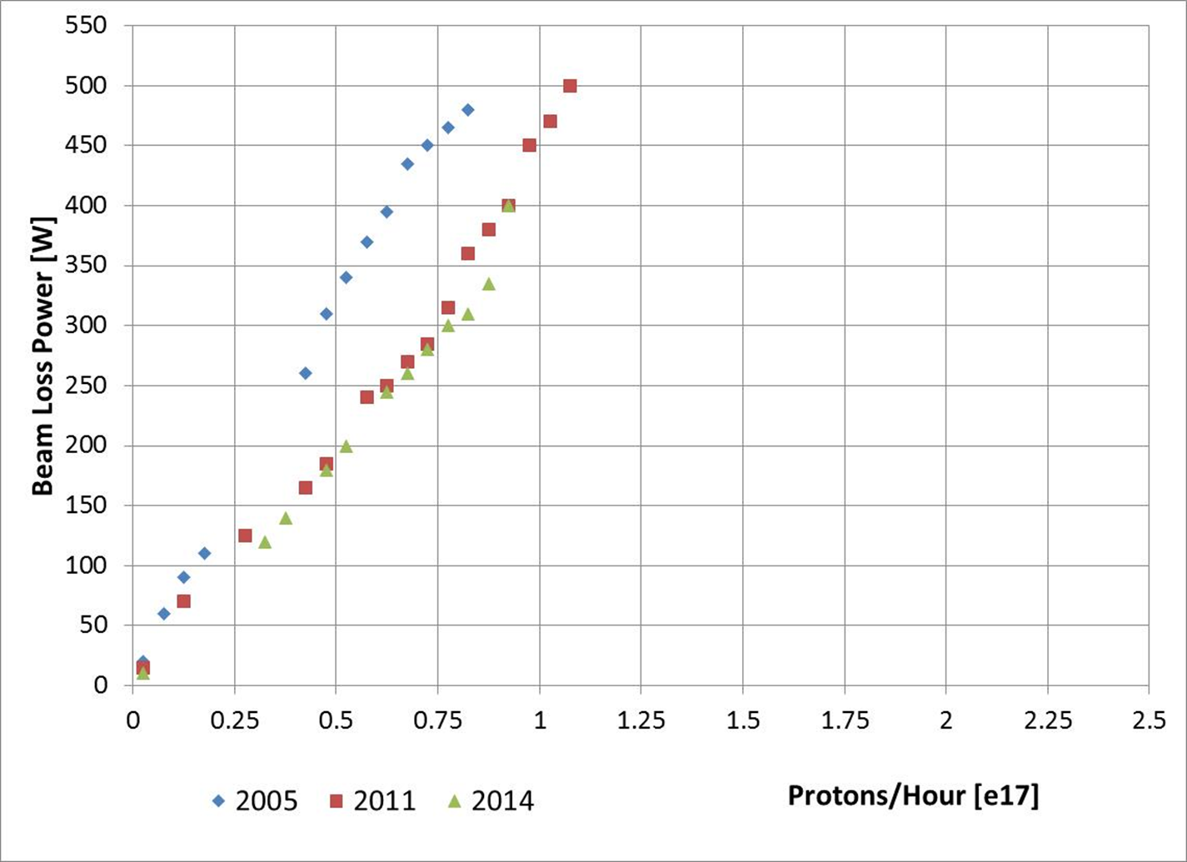
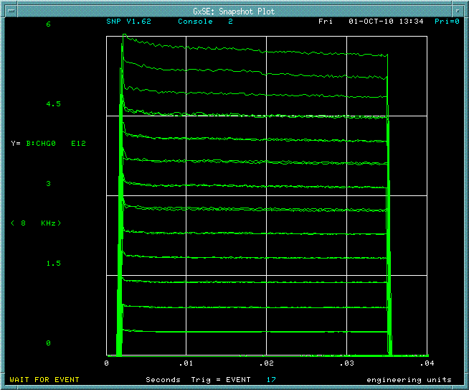
Requirement For Booster Operations
4.3E12 ppp with 81 bunches to Recycler
  9 Hz to FULL 15 Hz operation for entire Fermilab exp. program
  Delivering 2.3E17 protons/hour (at 15 Hz) in 2016
525 W Administrative Limit
20 Hz and 6.4e12/c is 460e15/h !
15 Hz and 4.3e12/c 232e15/h

Slide 12
Overview Of Required R&D
  New injection point at L11
    New injection girder
    Space charge mitigation: painting
    New stripping foil system
    H⁰ , H⁻ absorber
  RF Cavity investigation/design/construction
  RF capture
    capture scheme: paraphasing or direct injection into buckets
    2nd harmonic cavities (considered but probably unnecessary)
  Transition crossing
    RF focusing method
    RF focus free method (flattening of RF amplitude)
      2nd or 3rd harmonic cavities. (can also be used in RF focusing method)
    γ_{t} jump system (not likely)
      requires resurrection/rebuild of old system

Slide 13
Overview Of Required R&D (cont’d)
Damper upgrades and collimation system
  longitudinal quadrupole damping when going through transition
  longitudinal coupled bunch mode damping at high field
  transverse dampers for coupled bunch modes
Evaluation of present collimation system w.r.t. expected PIP II
Beam quality at extraction
  emittances determined by Recycler admittances
20 Hz operations and components
  GMPS
  pulsed systems
  controls

Slide 14
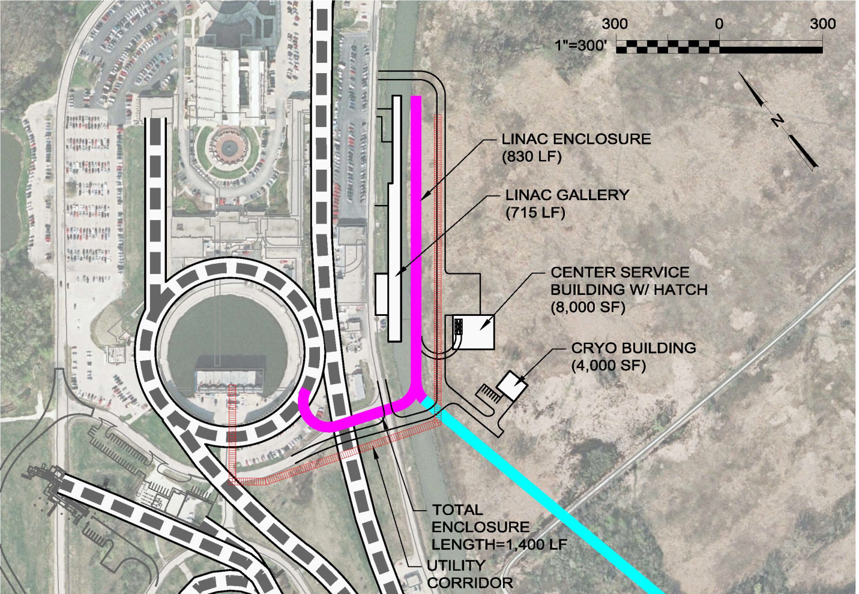
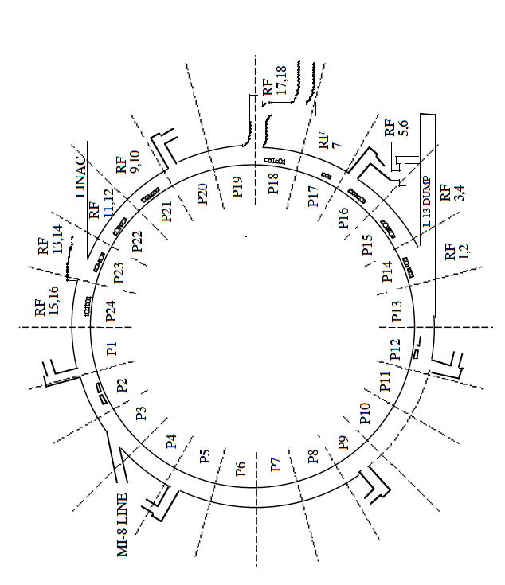
New Injection Point Into Booster
New injection point at L11
Old injection point at L1

Slide 15
New Injection Girder
Beam can enter either horizontally or vertically
A new 3 bump system that can take 800 MeV beam (2x stronger)
Beam painting to mitigate space charge effects because of longer injection time (0.6 ms)
Carbon foil for stripping (15 turns vs 315 turns)
  Lifetime effects
New beam absorber for H⁰ and H⁻
  Build inside a gradient magnet
  Design new stronger and shorter gradient magnets to make space for an absorber (preferred)

Slide 16
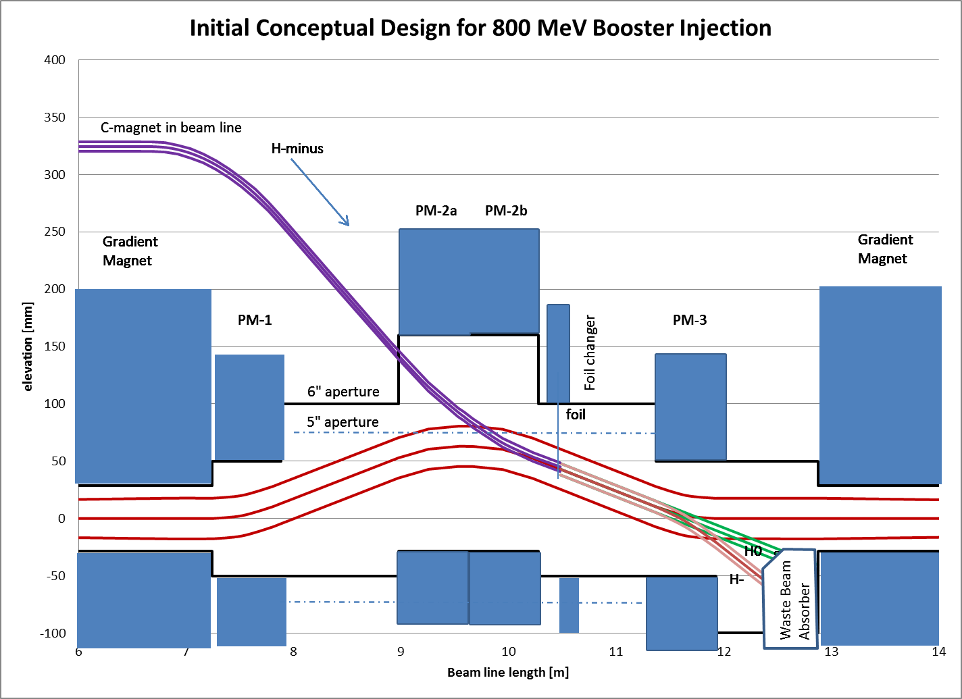
Vertical Injection Concept
Using a three-bump chicane within the unmodified length of the long straight section
Provided by Dave Johnson

Slide 17
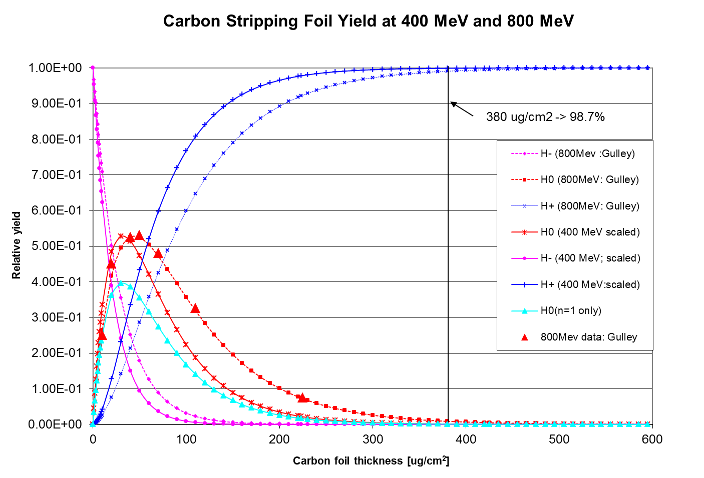
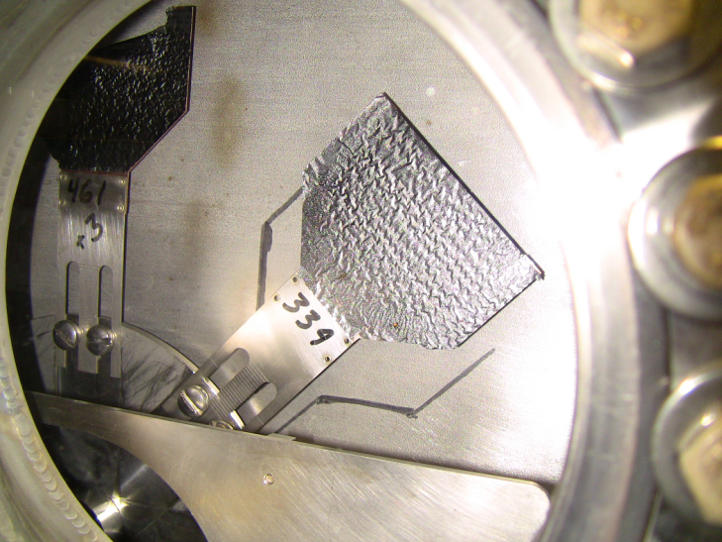
Injection Girder - Foil
Provided by Dave Johnson
For a std. foil thickness 380 μg/cm² (1.15 μm)
400 MeV -> 99.9% efficiency to protons
800 MeV -> 99.1% efficiency to protons
To match 400 MeV efficiency at 800 MeV foil thickness needs to increase to
~545 μg/cm²
At 800 MeV with 7E12 injected at 20 Hz
Injection power increases to ~ 17 kW
For a 0.1% loss -> ~17 W on downstream gradient magnet
-> Need to provide injection absorber
The space is very tight making an effective design difficult!
current foil holder
current foil

Slide 18
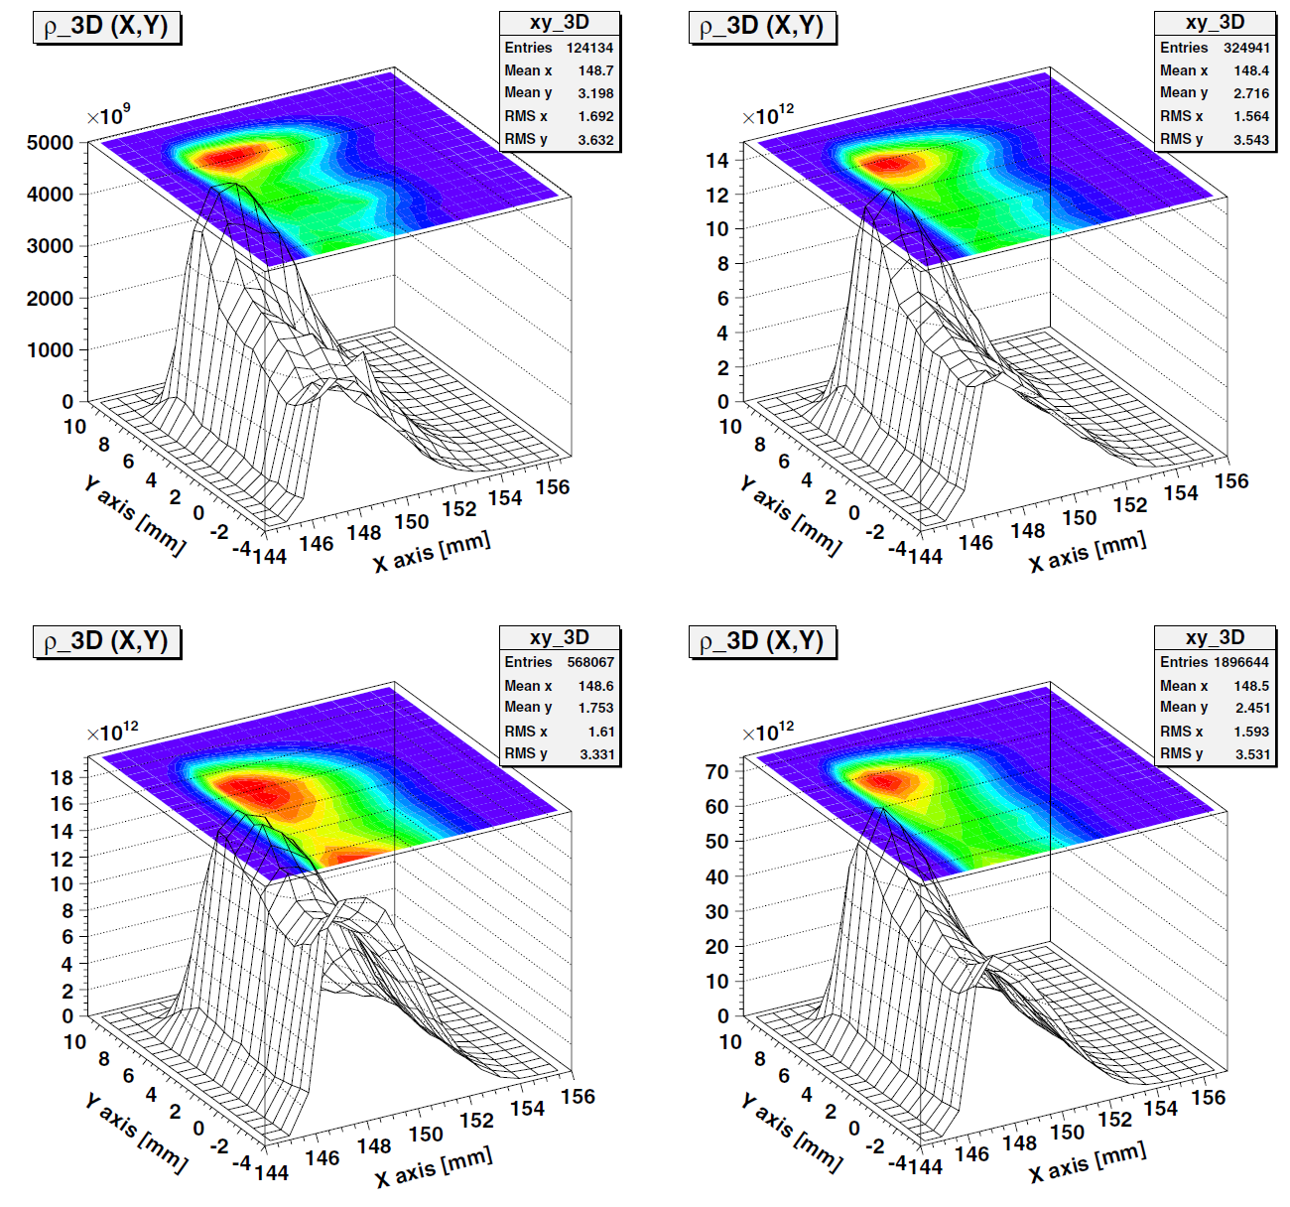
Stripping Foil
Provided by Leonid Vorobiev
Example of foil heating simulations
Particle hit number on the foil during 1st, 4th, and 6th cycles are: 62067, 162470, and 284034, respectively
Total hit number: 948322
Average number of interactions with foil: 33 for each injected particle
Hit density at the maximum of the distribution: 1.31E14 proton/mm² at 2.52E11 particles injected at every turn

Slide 19
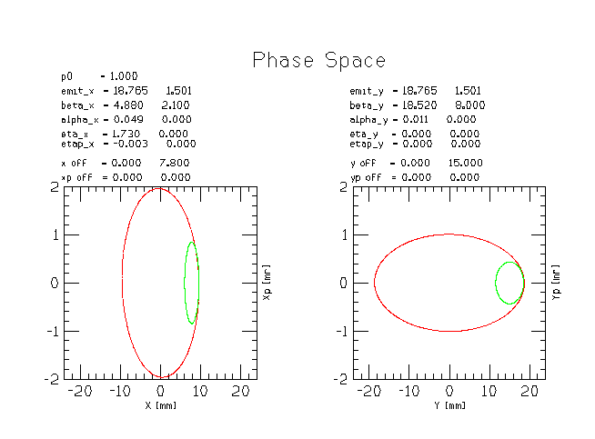
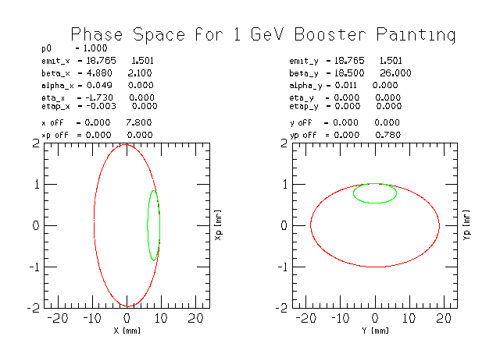
Injection Painting For Space Charge Mitigation
Green: injected beam
Red: phase space after painting
Beam line matching conditions for two painting scenarios.
Left paint in both planes in the ring (SNS) and right paint horizontal in ring and steer (angle mismatch) from beam line (JPARC)

Slide 20
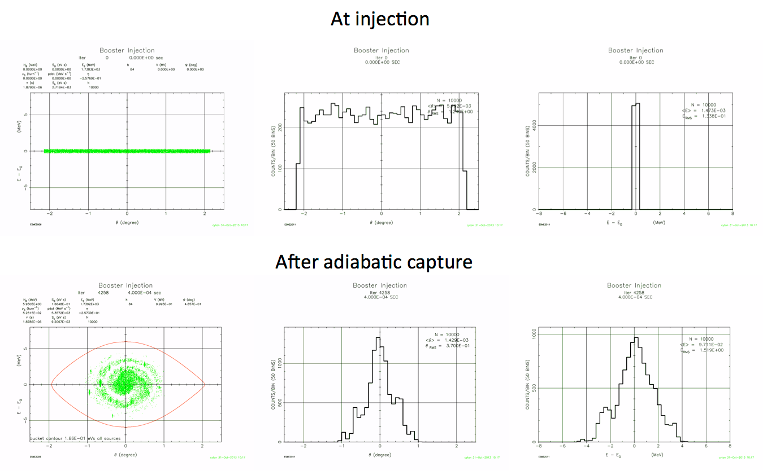
Capture (adiabatic at 800 MeV)
0.6 ms injection time
0.4 ms adiabatic ramp to full voltage (1 MV)

Slide 21
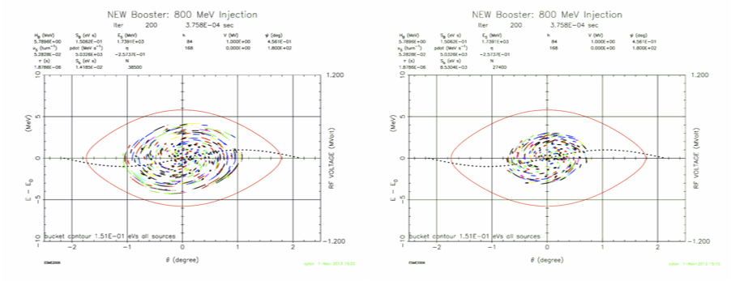
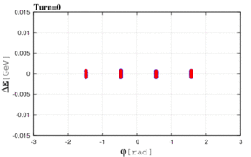
Capture
(bucket to bucket injection)
ORBIT3D
Chopping 180 deg
ESME 1D
Chopping 120 deg
Provided by Leonid Vorobiev
0.6 ms injection time
Chopping is required to get the correct bunch pattern into the bucket
Linac 2mA beam current for 0.6 ms provides 7.5E12 particles
May need flattened front porch for injection
Using Linac energy control vs. Booster ramp control needs to be studied

Slide 22
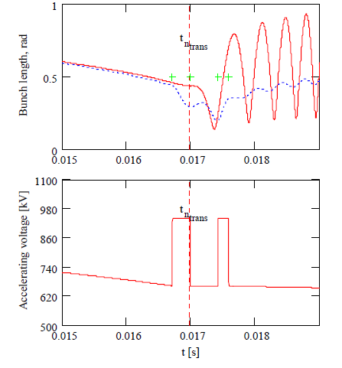
Transition Crossing
Transition crossing at 4.2 GeV
More RF for focusing during transition
~25% more RF implies 3 – 4 more
RF cavities using present design
(22 – 23 cavities)
Example shown here is the compensation of the effect of space charge that is defocusing before transition & focusing after transition
Increase RF voltage before transition
Increase RF voltage again to damp out quadrupole oscillation.
Using quadrupole damper effectively also requires RF overhead

Slide 23
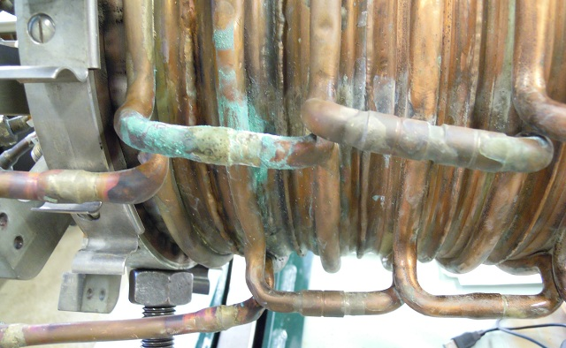
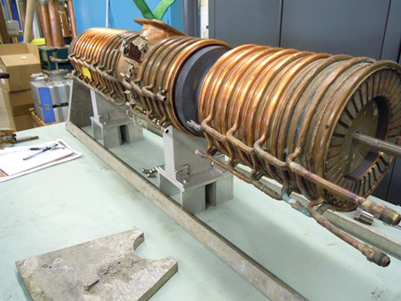
RF Cavity
PIP is refurbishing cavities…
  They will not be new cavities when completed
    Concern with long term reliability
    Repairing only obvious problems that prevent 15 Hz operations
  So under PIP, work on understanding our present RF cavity design and optimization and also a parallel biased cavity design.
  PIP II transition effort needs to
  define new cavity requirements and
  implement plan
Fixing broken or soon to break components –takes 10 weeks per cavity but
they are not ‘new’ cavities
Remove core/loop as needed

Slide 24
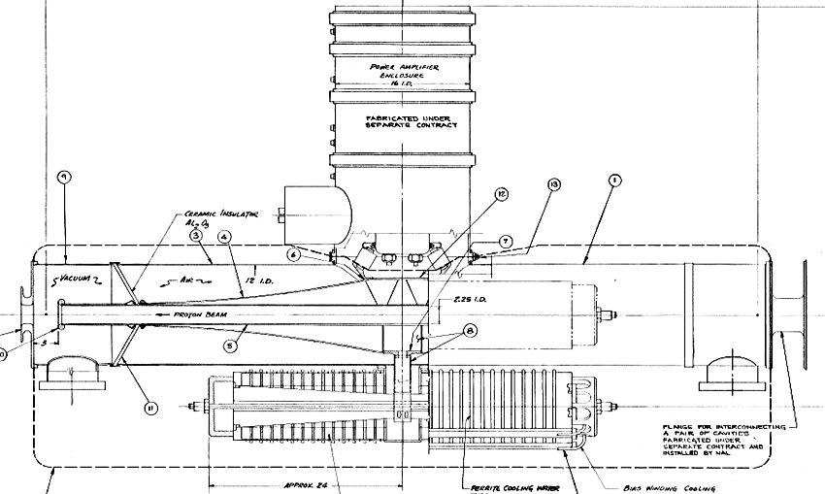
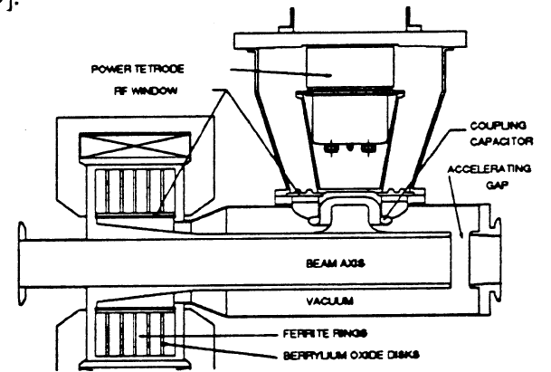

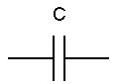
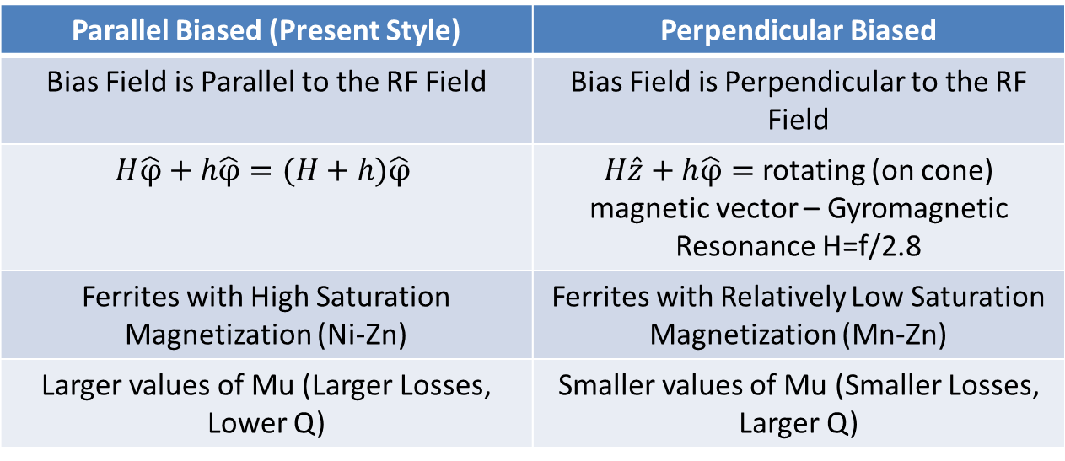
Tunable Cavities (two options being studied)
h
H
H
h
Parallel Biased (Present Style) | Perpendicular Biased
Bias Field is Parallel to the RF Field | Bias Field is Perpendicular to the RF Field
$$H\hat{φ}+h\hat{φ}=(H+h)\hat{φ}$$ | $H\hat{z}+h\hat{φ}=$ rotating (on cone) magnetic vector – Gyromagnetic Resonance H=f/2.8
Ferrites with High Saturation Magnetization (Ni-Zn) | Ferrites with Relatively Low Saturation Magnetization (Mn-Zn)
Larger values of Mu (Larger Losses, Lower Q) | Smaller values of Mu (Smaller Losses, Larger Q)

Slide 25
Extraction
PIP to PIP II RF changes
Assuming no harmonic component to GMPS
Extraction

Slide 26
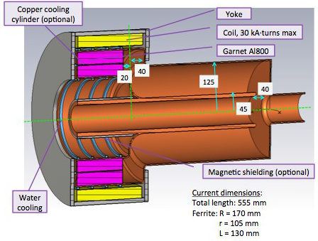
Perpendicular Biased Cavities
Simulations of use at injection for PIP and possible
use as main RF cavity is underway
The goal is 100 kV gap for a cavity that is about half the length of present Booster/MI cavity
factor of 4x V/m
Ferrites with relatively low saturation magnetization
(Mn-Zn)
Smaller values of Mu (smaller losses, larger Q)
Small space required but high gradient
Cooling is difficult
Vacuum windows location
Designed by G. Romanov – CY Tan
Example here: 2nd harmonic cavity

Slide 27
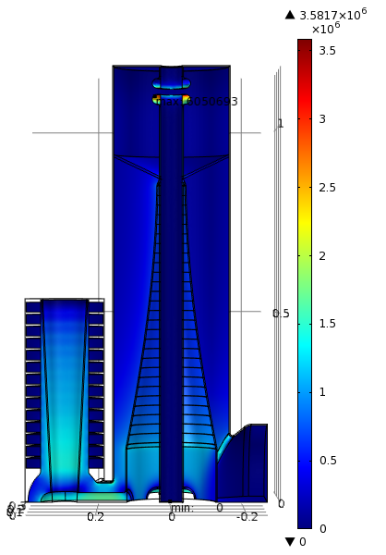
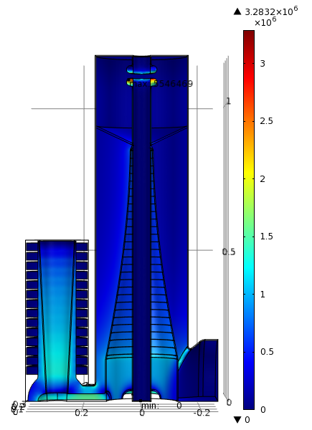
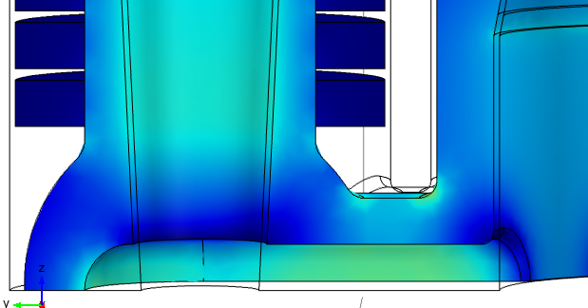
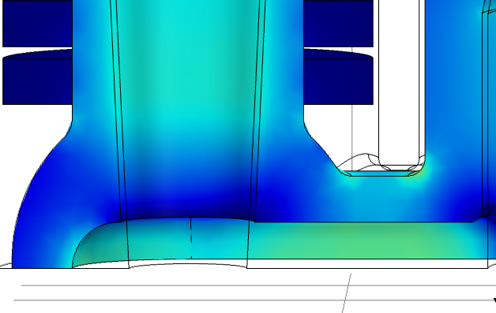
Max Electric Field Simulations
Booster Style Cavity
Designed by M. Hassan
Electric Field for 55kV
Electric Field for 60 kV
3.3 MV/m
Ferrites with high saturation magnetization (Ni-Zn)
Larger values of Mu
  larger losses, lower Q
Known technology and operations
Relatively limited by the heating in the ferrites
Large size
Low gradient
3.6 MV/m
1.7 MV/m
1.85 MV/m

Slide 28
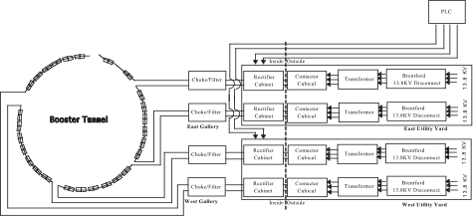
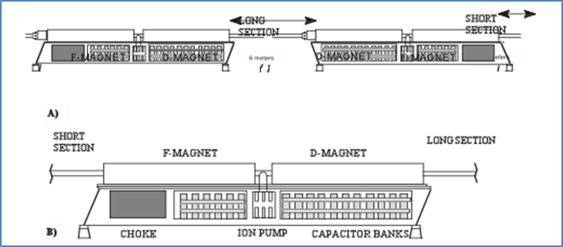
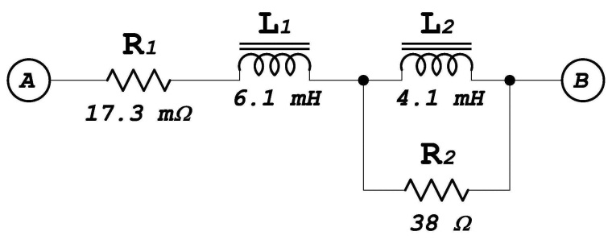
Booster Magnet System
Data from G. Krafczyk
The present system has 96 magnets in a 24 cell arrangement
The 4 PS’s are MR style 720 Hz update rate SCRs
Regulation is done via a reference magnet with B-dot coil and transductor electronics
A sinusoidal drive signal is to excite the system
Corrections for losses and line voltage variations are done by a card in a VXI crate
Regulation is good to about a part in 4000
The conversion of GMPS controls from 15 to 20 Hz does not look difficult
Gradient magnet model

Slide 29
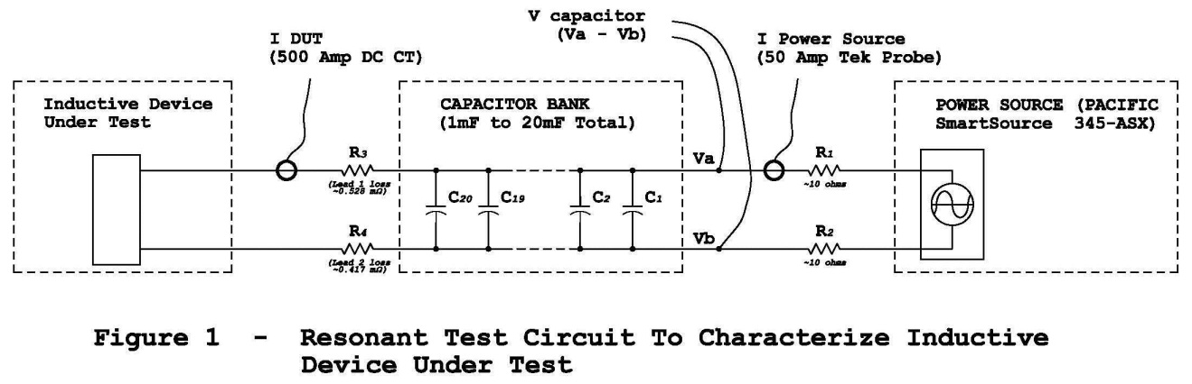
Booster Magnets - 20 Hz
We have looked at Booster 20 Hz operations several times…most recently by EE support (George Krafczyk)
  ‘Measurements were performed on both a Booster gradient magnet and a Booster choke with the intent to compare the 15 Hz losses with the 20 Hz losses for a proposed Booster upgrade.’
  This analysis suggests that running the Booster at 20 Hz with a current equal to the present 15 Hz Booster will require about 3.9% more power. Capacitor voltage will increase by about 32% and the resonant capacitor at each “Girder” must decrease from ~8.33 mF to ~4.69 mF. This also carries the implication that the RMS current per µF will also increase as well.

Slide 30
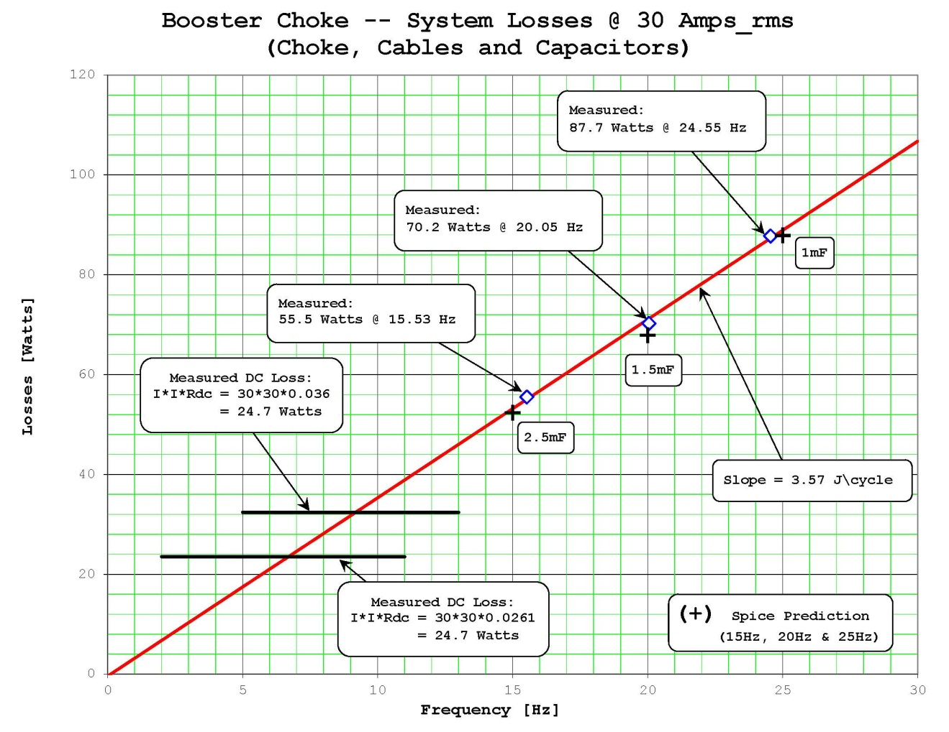
Booster Magnets - 20 Hz
Summary
Girder drive voltage increase by about 9.2 v (p-p)
Capacitor voltage increases by 32%
Slight increase in RMS current for Choke, magnets and caps
Designed to run at 10 GeV (did extract for a brief period at higher energy) the gradient magnet power system is capable of higher voltage operation. Present magnet power system runs on 4 power supplies but can operate with only 3 supplies. Booster at 20 Hz would require all 4 PS to operate.
Data from G. Krafczyk

Slide 31
Kickers and Septa Systems
(Assuming a new injection girder)
Kickers/Notchers
The average anode current for the extraction kickers will go from ~15mA at 15 Hz at 55KV on the PFL and a 1.8 uS pulse width to ~20mA at 20 Hz. These currents are well within the allowed 2 Amps max average anode current limit for the cx-1168 thyratron. These current levels would also indicate that there will be no excessive heating losses in the RG-220 cables or of the Kicker magnets themselves
In general one would expect that with the increased rep rate that PFL cable and connection failure rates will also increase
Average power into the resistive loads will rise from ~400 W to ~540 W under the same conditions. The present loads are already water cooled and the load resistors are rated wattage-wise to be able to work without problems with this increase but will need to be tested at that level none the less
Septa Magnets
Thermal testing was done on the two spare septa, BSE-105 and BSE-106. The testing on BSE-105 was the most thorough and included 15Hz equivalent runs at 200, 400, 600 and 800 Amps rms
Testing showed that all the monitored points plateaued within a reasonable time with one exception. This point is on the magnet skin where the power feed-throughs enter and exit the magnet
External cooling plates were clamped around this area of the magnet. The additional cooling plates showed that the magnet skin temperature in this area plateaued nicely with a temperature reduction of ~8 deg C at the 2.5 hour point
The present pulse power supplies were designed to handle these higher operating voltages. The ability to run at higher voltage means one could entertain the idea of reducing the output pulse width to reduce the rms current

Slide 32
Misc - 20Hz Operation
Controls – need to understand issues and how to best stage work
  Software & hardware systems for 20Hz need to be upgraded and/or modified. The entire clock system is based on 15Hz. The following would have to modified.
  Time Line Generator (TLG), Tevatron Clock System (TCLK), IRM’s, Frontends, Beam Budget Monitor
    What is required for just Booster to operate vs the rest of AD systems?
  Data collection, data sampling impacting other accelerator controls systems
Utilities (most updated already under Proton Plan and PIP)
  Would need to look at feeder situation – already being discussed as a add-on to PIP I or PIP II.
    Have rough cost estimates from FESS HV personnel
  Review electrical power, transformers, panels, and cabling to run at 20Hz
    Not expected to be an issue
Safety
  Does the new shielding and improvements work for 20 Hz – need to be discussed

Slide 33
Dampers
Systems are critical present operations and will need to handle higher PIP II intensities and changes to RF cavities
Longitudinal coupled bunch mode dampers
  More RF volts?
    Increase the number of RF cavities from 18 to 21 using present design will increase impedance -
    Higher peak beam currents
  PIP I is working on modernizing present longitudinal system (digital ) but will it be sufficient for PIP II? ( Will operate new system – before making decisions on PIP II)
Quadrupole dampers
  Part of understanding transition and longitudinal simulations.
Transverse dampers
  PIP I upgrading analog dampers to digital dampers. Need to first operate new system then decide the next step.

Slide 34
Plan
Complete a transition document – give it a name other than PIP! Underway
Assign some high level management structure Underway
Generate a list of tasks Underway
  Assign managers Underway
  Define goals Underway
  Define required resource and schedule (RLS)
    Labor, M&S and time
    Additional requirements – ie. shutdowns
Resource allocation approval
(Same process as PIP)
Proton Source Task Force 2010
Proton Source Workshop 2010
Booster 15 Hz Operation
2015
PIP Begins
2011
PIP Deisgn Handbok & Project Controls 2012
RFQ Injector & Booster RF Solid State Complete
2013
Linac High Power RF System Completed
2019
Project Complete
2019
End of Proton Plan Effort
2018
PIP will take ~8 years (with planning and resource fluctuations)
Starting today this transition effort has about 8 years to complete

Slide 35
PIP II Operations –
Developing a Strategy
PIP II Operations
PIP Successful Conclusion
PIP II Linac
Booster/MI/Recycler
Utilities/Controls
Understood
Objectives – Documented Plan
Defining and documenting what needs to be done

Slide 36
Developing a Strategy
First Step: Produce a document by this spring that outlines the plan
(Steve Holmes et. al)
Proton Improvement Plan/Proton Improvement Plan-II: Transition Plan
October 2014
The Proton Improvement Plan is currently underway with stated goals of achieving reliable, 15 Hz, beam operations of the existing Linac and Booster at a per pulse intensity of 4.2×10¹² protons, over the period through 2025.
Proton Improvement Plan-II is a proposal for enhanced performance of the proton complex at Fermilab based on the replacement of the existing 400 MeV Linac with a new 800 MeV Superconducting Linac. It is anticipated such a replacement will occur in the 2023-2025 timeframe, and should enable Booster operations at a per pulse intensity of 6.4×10¹² protons at 20 Hz, over the period through at least 2030. This document describes modifications to the current Proton Improvement Plan and suggested transitional modifications to the accelerator complex, to effectively prepare for and accommodate Proton Improvement Plan-II.

Slide 37
Transition Outline
(Work in progress)
Table of Contents
Introduction
Performance Goals
Goals and Scope of the Proton Improvement Plan (done)
Goals of PIP (done)
PIP scope – original and as modified for PIP-II (mostly done – pushing through RLS)
Deliverables/Key Performance Parameters that will define the completion of PIP
Goals and Scope of PIP-II
Goals and Scope of Work for PIP-II
Booster/Recycler/Main Injector Performance Requirements in the PIP-II Era
Scope of Work to Prepare Booster/Recycler/Main Injector for PIP-II
Transition Period Resource Requirements and Schedule
Difficult part – information required may take time…will adjust as required

Slide 38
Developing a Strategy
Second Step: Develop a Resource Loaded Schedule
Produce a RLS , labor and funding profile, that meets the timeline and available resources. Part of the required funding will come from re-purposing some of the PIP funds to align the Booster to PIP II. Additional resources will likely be needed to complete all tasks
‘Campaigns’ have greater flexibility to adjust to program planning and is our preferred option
PIP Funding Profiles
 | PIP Design Handbook | Revision October 2013 | Revision May 2014 | Example revision
TOTAL | 86,739,203 | 89,568,000 | 89,568,000 | 89,568,000
FY12 | 17,346,668 | 13,956,000 | 13,956,000 | 13,956,000
FY13 | 14,779,844 | 8,612,000 | 8,612,000 | 8,612,000
FY14 | 19,437,625 | 11,000,000 | 10,000,000 | 10,000,000
FY15 | 19,873,626 | 15,000,000 | 12,000,000 | 8,000,000
FY16 | 14,188,092 | 16,000,000 | 16,000,000 | 10,000,000
FY17 | 1,113,348 | 16,000,000 | 16,000,000 | 10,000,000
FY18 | 0 | 9,000,000 | 9,000,000 | 10,000,000
FY19 | 0 | 0 | 4,000,000 | 11,500,000
FY20 | 0 | 0 | 0 | 6,000,000
FY21 | 0 | 0 | 0 | 1,500,000
Resource profile of past
PIP resource adjustments and a possible
Booster PIP II work funding profile

Slide 39
Conclusion
In light of the P5 recommendations and laboratories PIP II plan, PIP objectives have been modified
This basically means PIP will no longer pursue a total klystron replacement of the Linac low energy high power RF system or replacement of Booster cavities
However, the basic underlying PIP goals remain in place…to deliver 2.3E17 protons per hour at 15 Hz while maintaining availability > 85% at present activation levels
The lifetime and alignment adjustment to PIP is underway
“and also ensuring a useful operating life of the Linac through 2023 and the Booster source through 2030. “
The transition to PIP II is more than PIP and the first steps have been taken to outline the process.
A transition document is being prepared and is expected to be released this spring
This document will describe the transition and tasks required for the Booster (and other AD systems)
“…to deliver 4.7E17 protons per hour at 20 Hz.”

