Slide 1
PIP Budget/Schedule Status Ken Domann 11/19/14

Slide 2
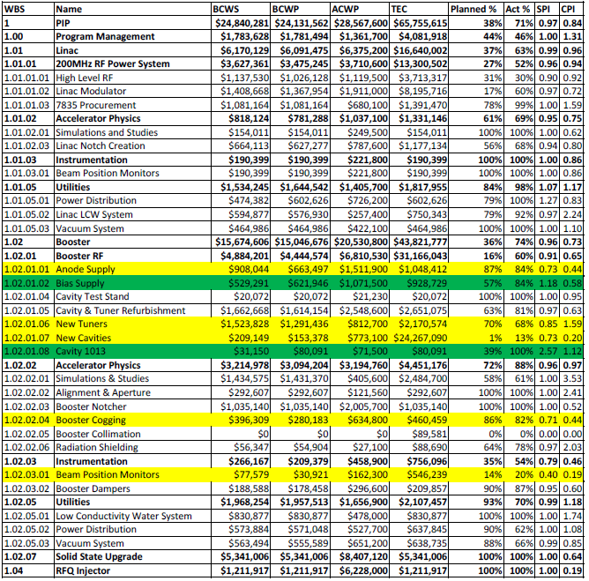
% Compl to WBS Level 4 (Yellow >= 10% Late, Green >= 10% Early)

Slide 3
Milestone Status (10/1/14 – 3/31/15) (Red > 3 months late)

Slide 4
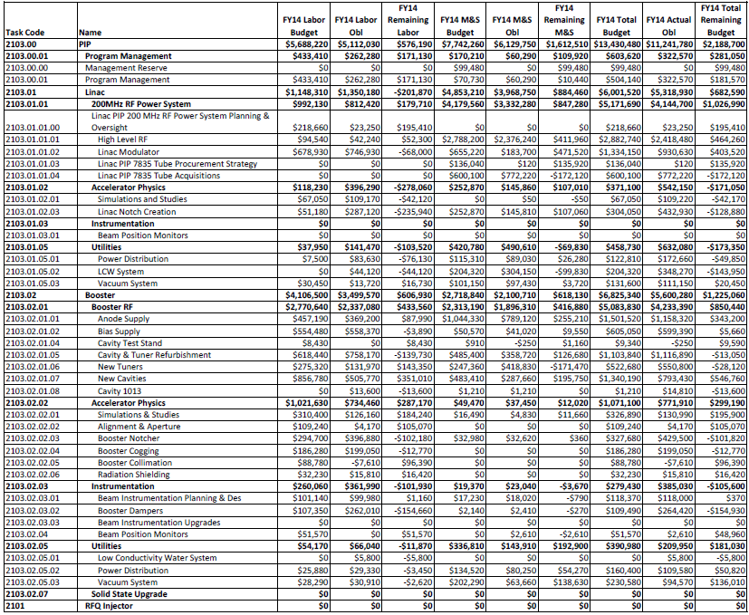
FY14 Total Obl Budget thru September 2014 (NA)

Slide 5
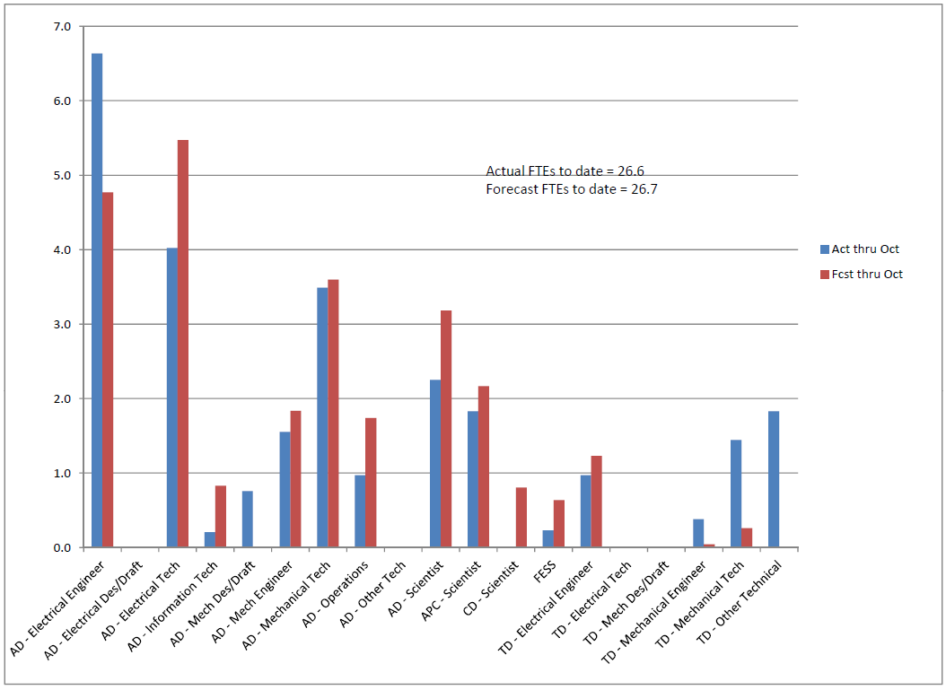
FY14 To-date FTEs by OHAP – Fcst vs Act

Slide 6
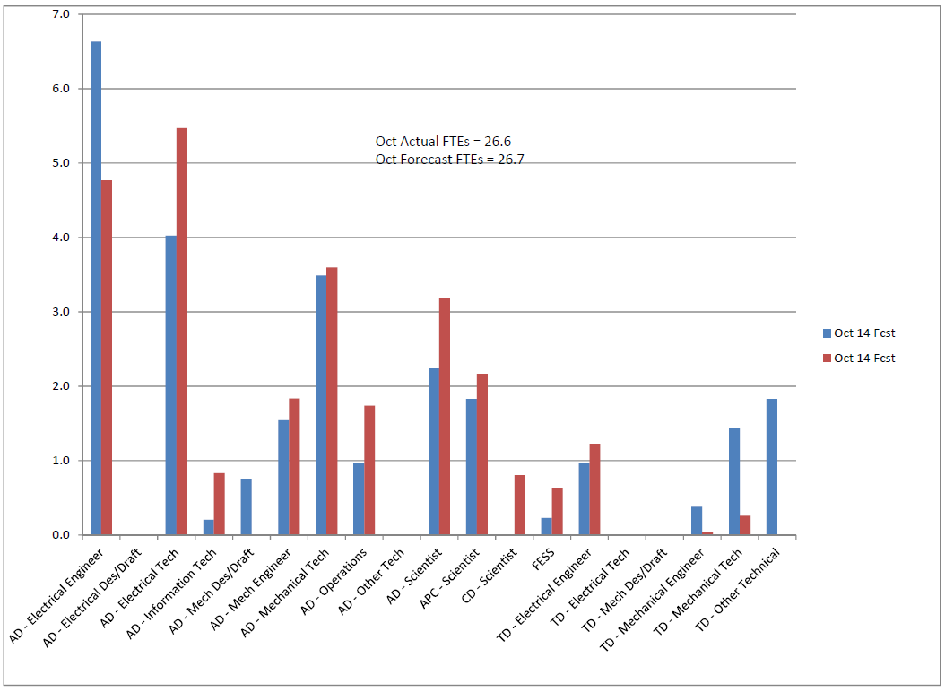
FY14 Monthly FTEs by OHAP – Fcst vs Act

Slide 7
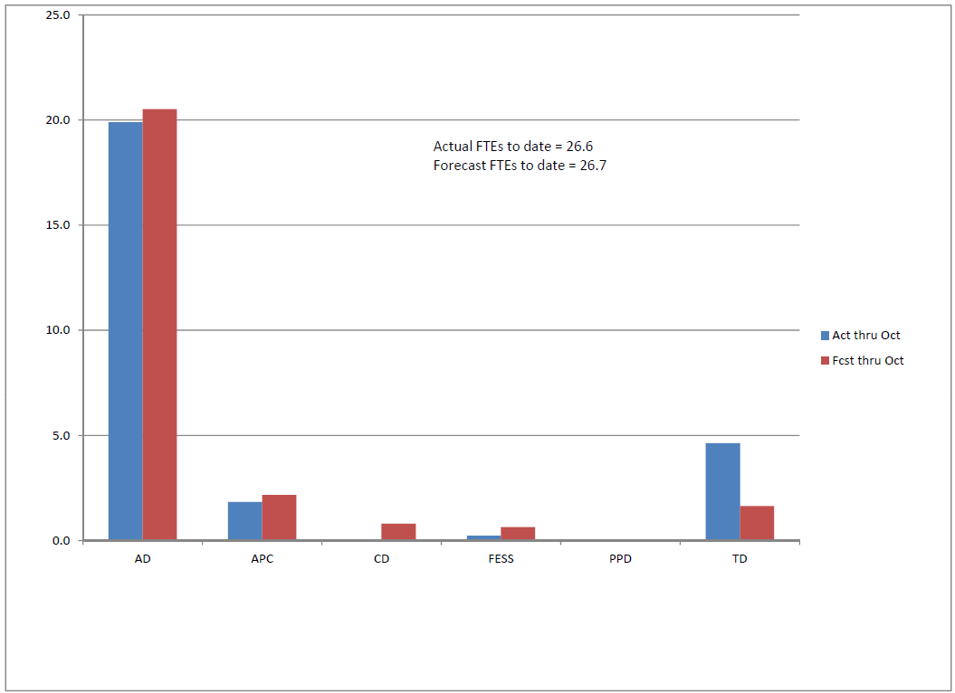
FY14 To-date FTEs by Div – Fcst vs Act

Slide 8
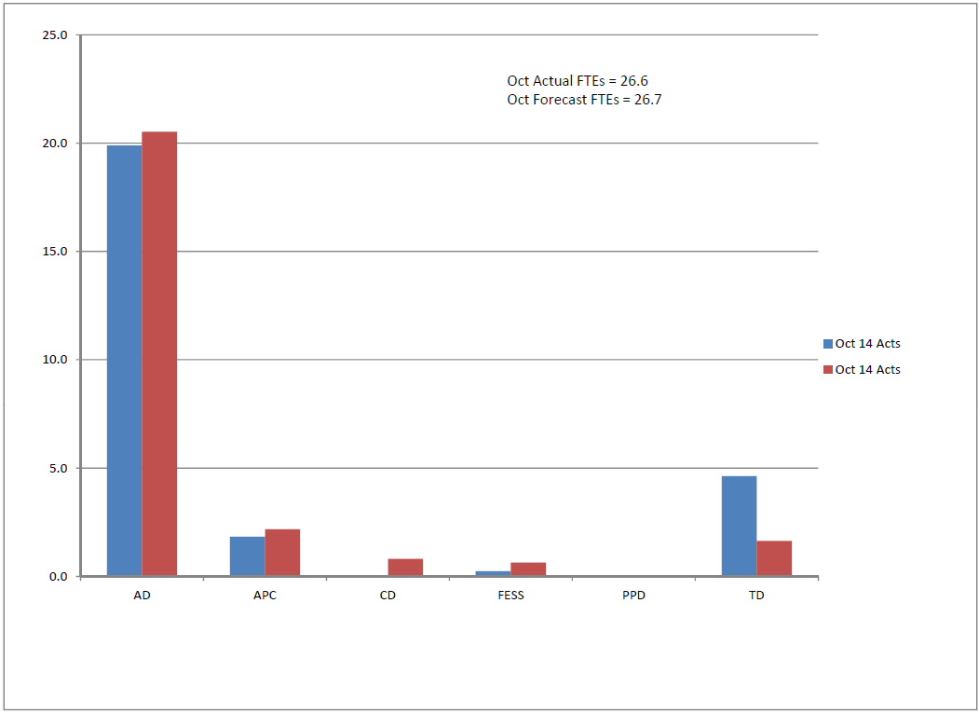
FY14 Monthly FTEs by Div – Fcst vs Act

