Slide 1
Enhancements of the Fermilab Booster to Reduce Losses and Extend Lifetime: The Proton Improvement Plan
Robert Zwaska
11 November 2014
HB2014

Slide 2
PIP Introduction
PIP is a critical Fermilab “project” to address desired increases in proton production to meet the present and near term experiments
PIP’s scope is specific to the FNAL Proton Source
Proton flux
Machine reliability
Machine long term viability
Official start in FY12
This talk focuses on a few RF and injection/extraction issues
More on beam dynamics issues in K. Seiya’s talk this afternoon
Project Overview
Notching
Kickers
Laser Neutralization
200 MHz sources
Modulator
PA (tube or klystron)
Booster Cavity Refurbishment

Slide 3
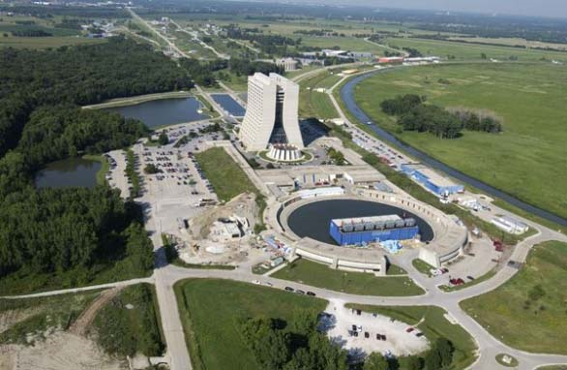
Present Proton Production
Linac produces 400 MeV H⁻
Bunched at 200 MHz
35 mA for up to 40 us at up to 15 Hz
Booster produces 8 GeV protons (Booster neutrinos, muons, etc.)
Bunched at 53 MHz
Up to 5e12 (typically 4.3e12) in 1.5 us
Ramps at 15 Hz
Historically <<= 7 Hz with beam
Main Injector produces 120 GeV protons (NuMI)
Bunched at 53 MHz
Up to 5e13 (typically 3.7e13) Operates as quickly as 1.33 s
With Recycler integration, designed for 700 kW
Has run at 400 kW

Slide 4
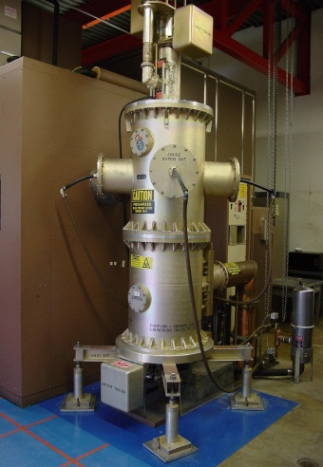
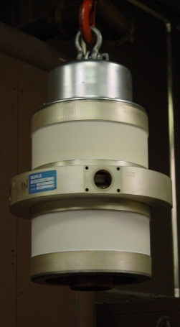
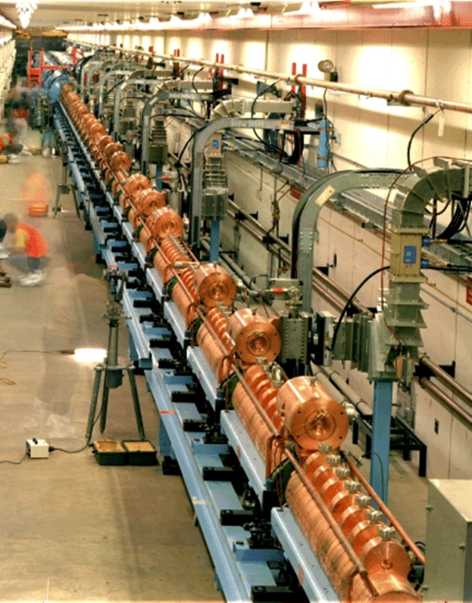
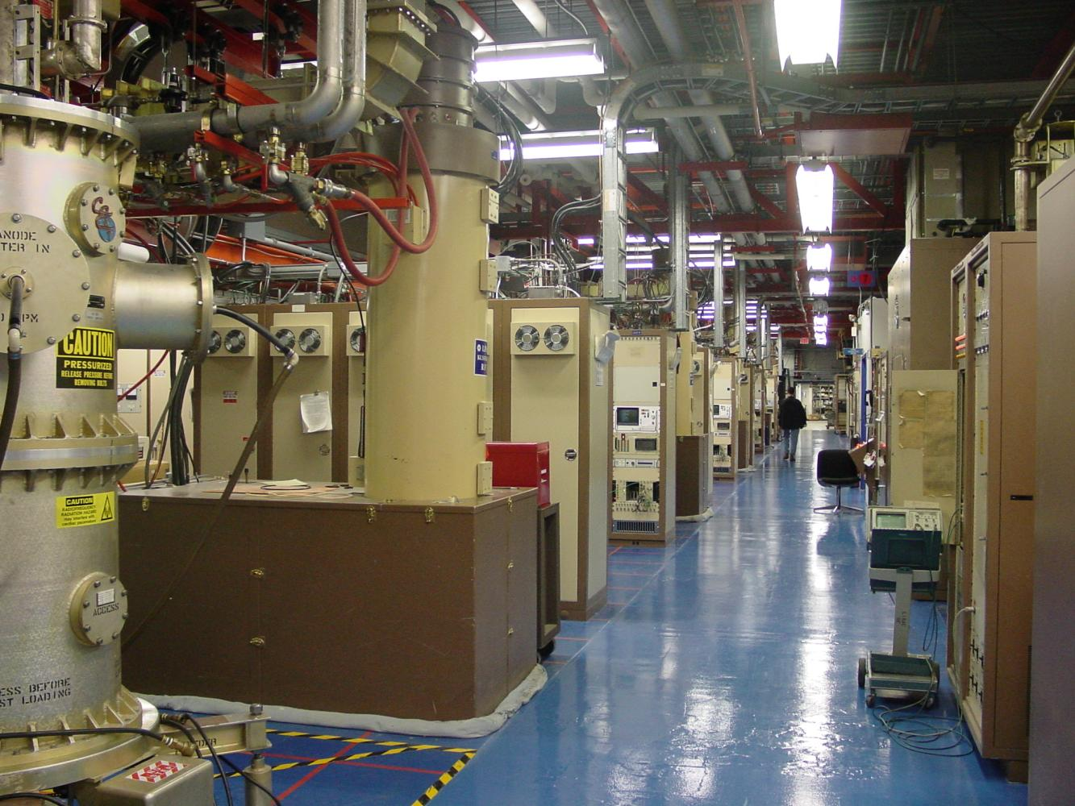
Linac Overview
Linac Overview
Designed for high intensity single shot proton injection
Linac
Length (m) | 200
Pulse Frequency | 15 Hz
Kinetic Energy (MeV) | .750 - 4
Frequency (MHz) | 201 & 804
Current (operational) | 33 ma (Historical low)
Linac Lattice | LE ? HE - Photo
Nº of cavities | 5 DTLs, 7 SC, 3 small
7835
7835 Socket
750 keV
NTF
400 MeV
1
Tank 2
Tank 3
Tank 4
Tank 5
0
M1
M2
M3
M4
M5
M6
M7
LE Linac
Flat top | 350 | usec
Raise Fall time | 75 | usec
Average Axial Field | 1.5 | MV/m
Rep Rate | 15 | Hz
RF Peak Power | 3.5 | MW
Peak Current | 35 | mA
Beam width | 20 | usec
Power to the beam | 787.50 | KW
Average RF Power | 19.16 | KW
Peak Power | 3.50 | MW
High Energy Tunnel
High Energy Linac Gallery

Slide 5
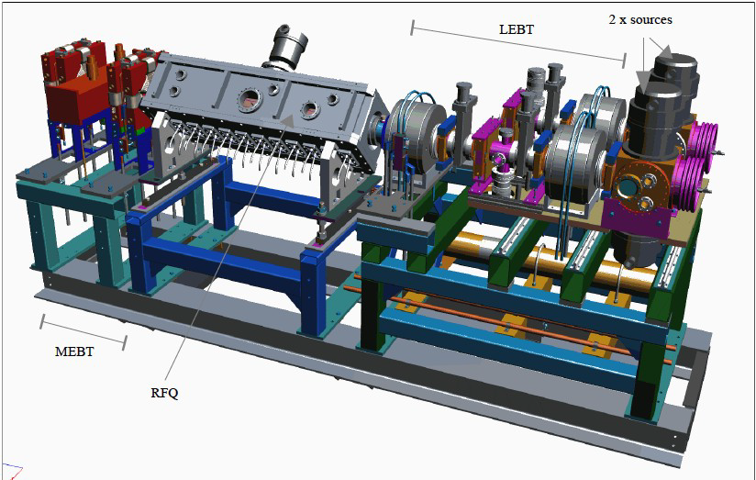
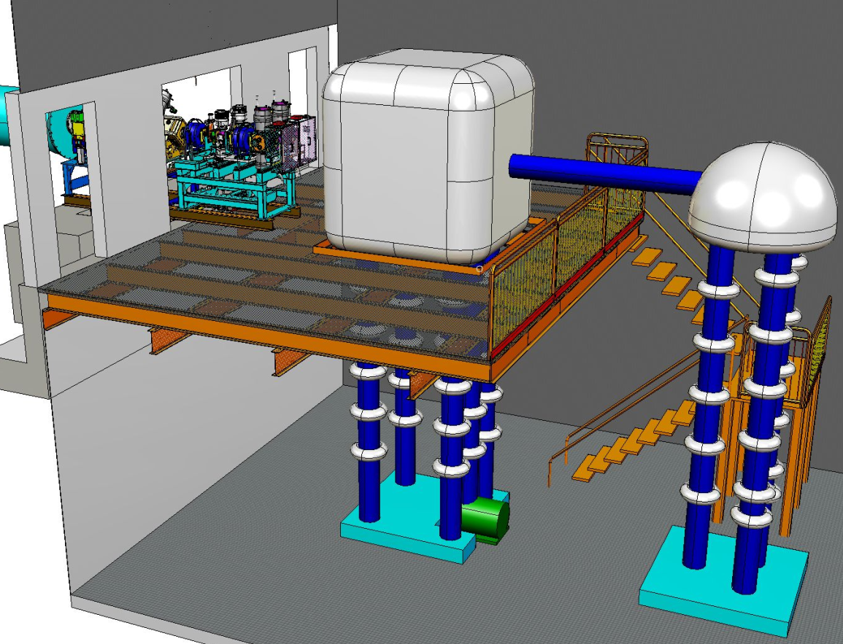
Pre-Injector Upgrade - RFQ
FNAL considered using RFQ in late 1980's
BNL and FNAL worked with LBNL on a RFQ design
200MHz built for BNL but FNAL cancelled order
FNAL initiated the Pre-injector upgrade in 2008
Fermilab retired C-W in August 2012 after 43 years
Parameter | Value (units)
Energy | 35 – 750 (keV)
Frequency | 201.25 (MHz)
Length | 120 (cm)
Design current | 60 (mA)
Peak cavity power | ~ 140 (kW)
Radial aperture | 0.3 (cm)
Duty Factor | 0.12%

Slide 6
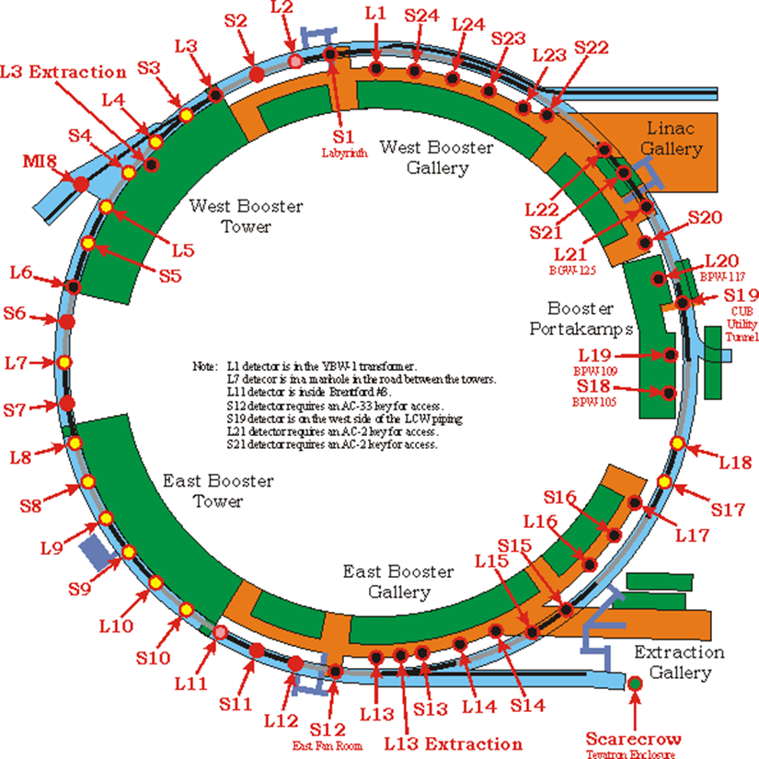
Booster Overview
H⁻ ions are stripped and multi-turn injected onto the Booster
Protons are accelerated from 400 MeV to 8 GeV in 33 msec
Fast cycling synchrotron
Fast magnet ramping
Frequency of 15 Hz
Single turn extraction
Booster
Booster
Circumference (m) | 474
Harmonic Number | 84
Kinetic Energy (GeV) | 0.4 - 8
Momentum (GeV/c) | 0.954 - 8.9
Revolution period (μsec) | τ_{(inj)} 2.77 – τ_{(ext)} 1.57
Frequency (MHz) | 37.9 - 52.8
Batch size | 4.5 E12
Focussing period | FDooDFo (24 total)
Combined Function Magnets
No failures after initial phase…
but 8 spares have been refurbished as part of PIP…

Slide 7
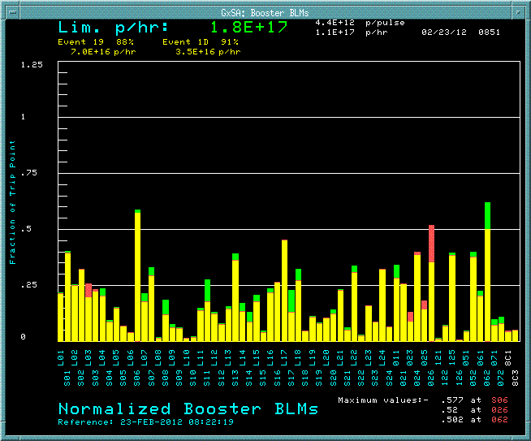
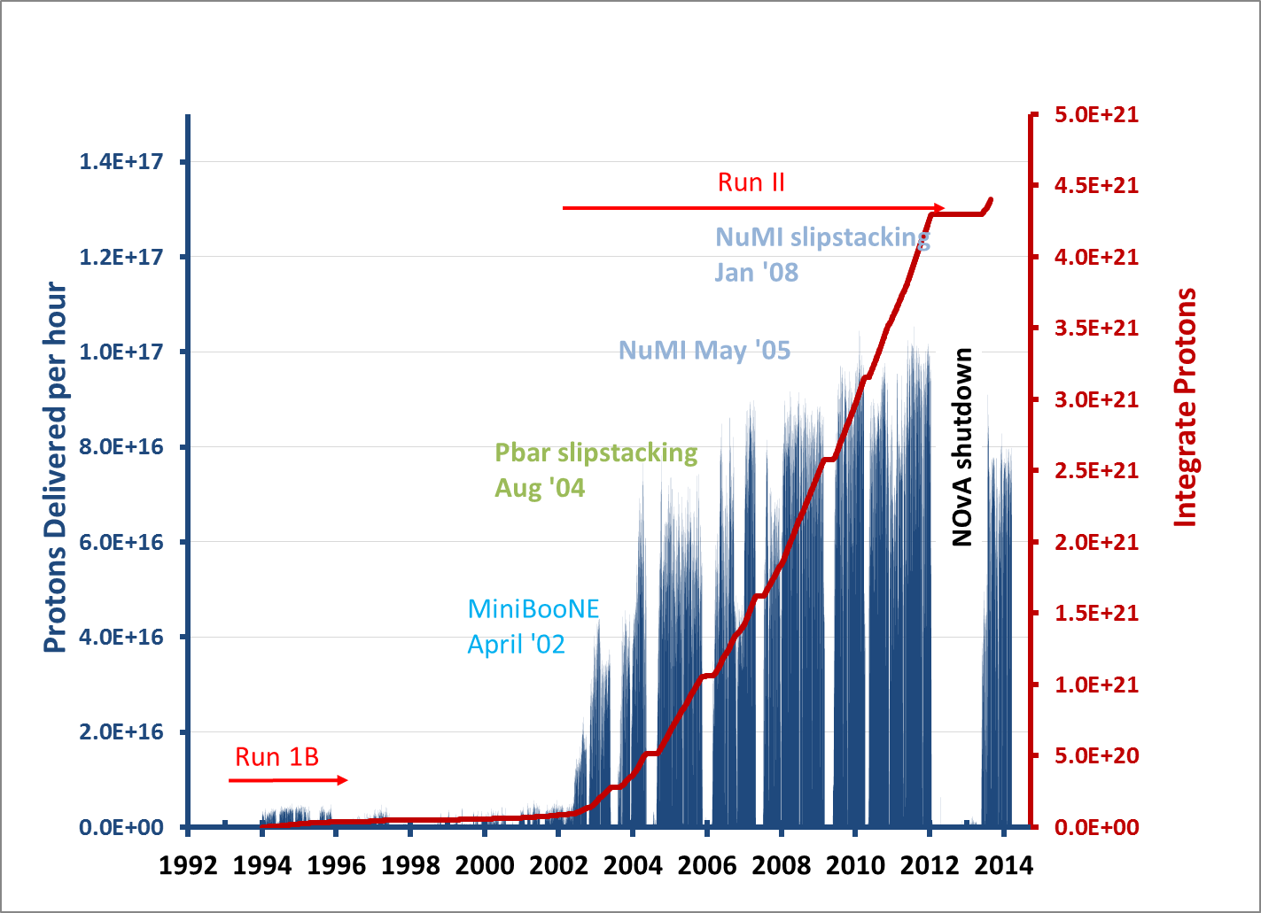
Booster
loss profile
Where PIP started
Loss limited until 2010
then cycle rate limited

Slide 8
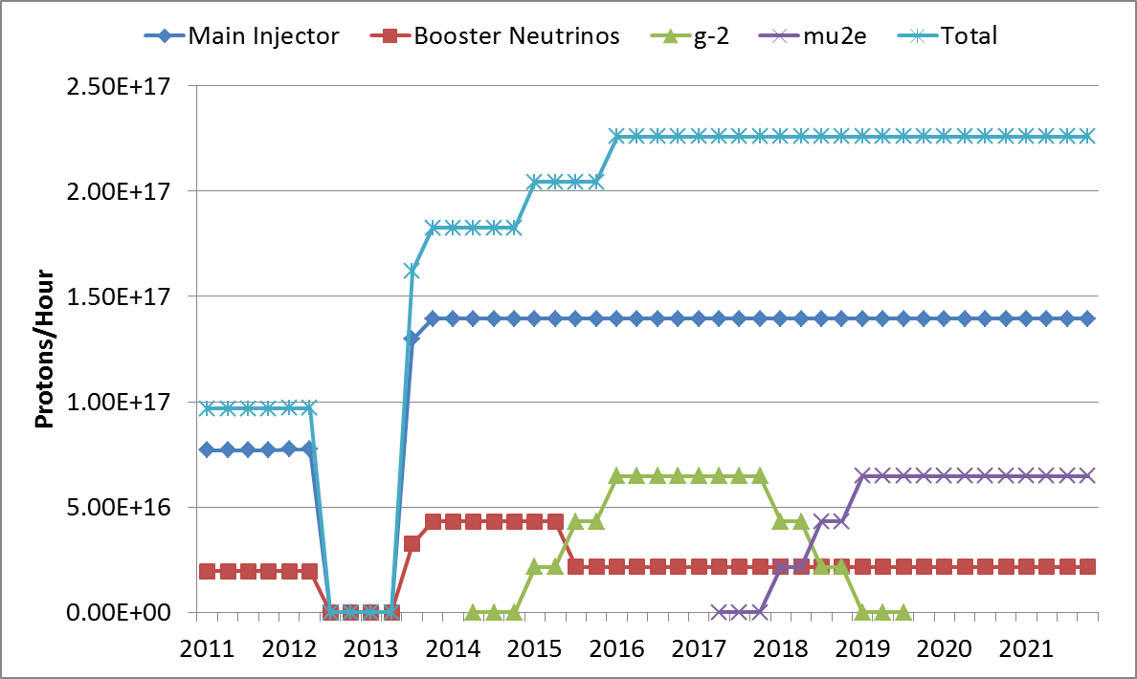
Requested Proton Flux
15Hz beam
15Hz pulse
120 GeV ν
(NOvA, LBNx)
NOvA Shutdown
g-2
Mu2e
Existing
Capability
8 GeV ν

Slide 9
Original Goals for the Proton Improvement Plan
The Proton Improvement Plan should enable Linac/Booster operation capable of
Delivering 2.25E17 protons/hour (at 15 Hz) in 2016
while
Maintaining Linac/Booster availability > 85%, and
Maintaining residual activation at acceptable levels
and also ensuring a useful operating life of the proton source through 2025
The scope of the Proton Improvement Plan includes
Upgrading (or replacing) components to increase the Booster repetition rate
Replacing components that have (or will have) poor reliability
Replacing components that are (or will soon become) obsolete
Studying beam dynamics to diagnose performance limitations
Implementing operational changes to reduce beam loss

Slide 10
Scope change to PIP
Modifications to PIP objectives to reflect present laboratory planning.
Extend Booster operations to 2030
Linac operations till 2023
Consider transition to PIP II

Slide 11
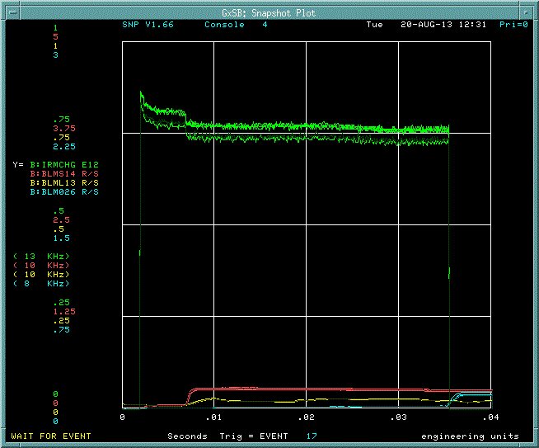
Beam and Losses through Cycle
Beam Intensity
Extraction
RF Capture
700 MeV Notch
Transition
Loss Monitors’ Responses

Slide 12
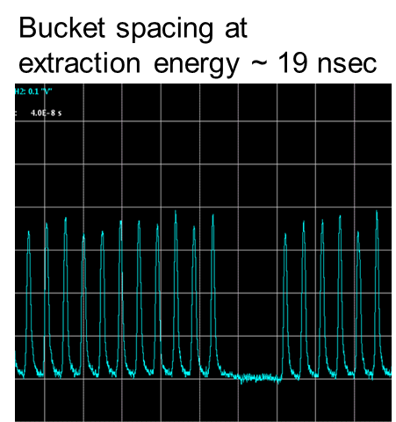
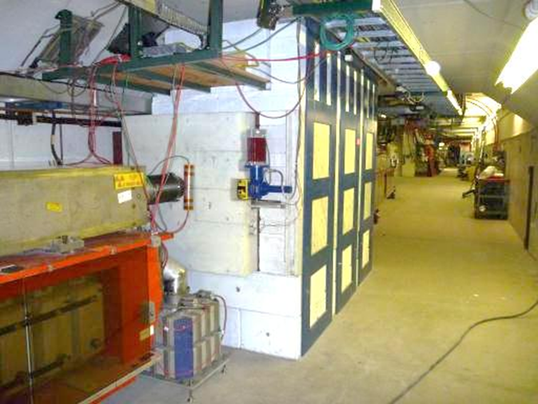
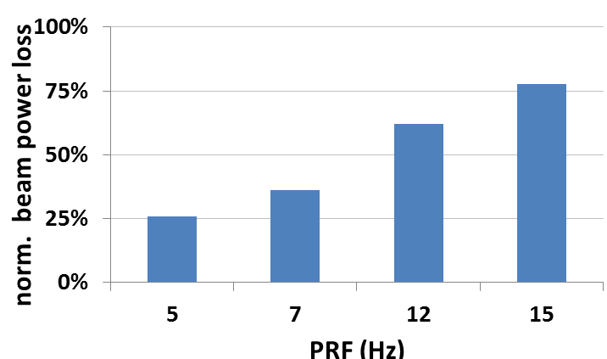
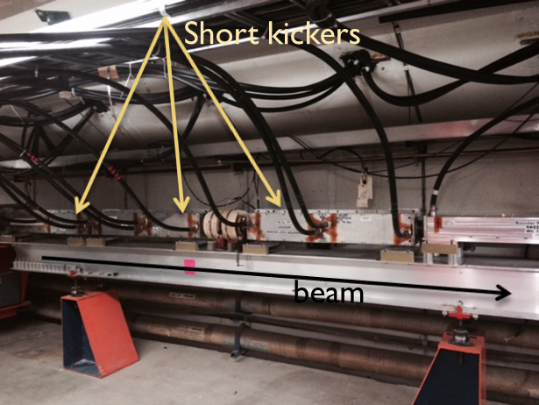
PIP : Notching
Booster beam requires a notch to allow for the rise time of extraction kicker
40-50 ns notch
Notch is created by kicking the beam @ 2 different cycle times
400 / 700 MeV losses down to 5% / 9%
PIP phase approach
Phase I: notch relocation & new absorber
Phase II: kicker magnets & power system replacement
Phase III: create notch in Linac
Absorber L13 (2013)

Slide 13
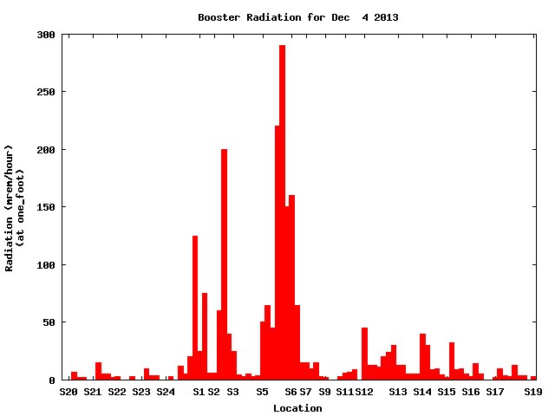
Notcher & Absorber Controlling Beam Losses
Activation decrease of ~1200mrem/hr
Rad Survey Data
Dec 2013
The plot above shows the difference between two radiation activation surveys after running similar flux for a week. The new system has greatly reduced residual activation in several areas of Booster.
The new notcher system directs the beam to an absorber – old system was not designed for high flux and the kicked ‘notched’ beam into collimators -- uncontrolled
Collimators
Notcher Absorber

Slide 14
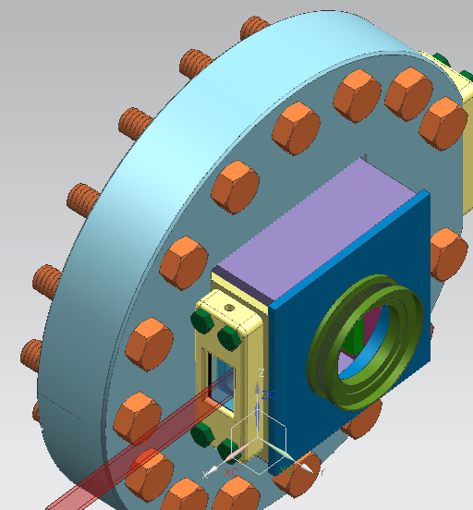
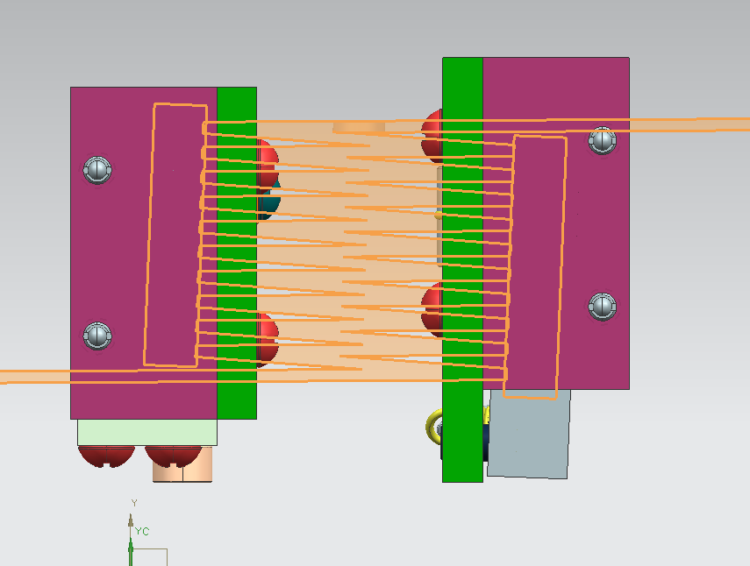
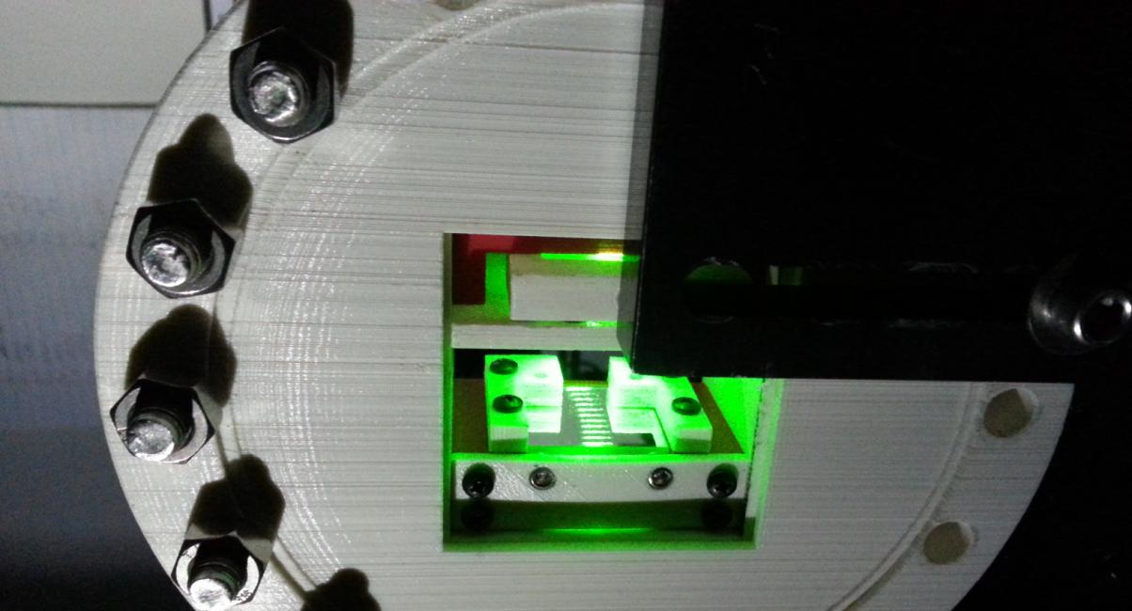
Laser Notcher
Neutralize a portion of the Linac beam with a pulsed laser
Remove the majority of the loss from the Booster entirely
Prototype of the laser front-end is operating
Atypical laser
Multiple timescales
High-pulse power
Moderate average power (few W)
Interaction region installed in Linac

Slide 15
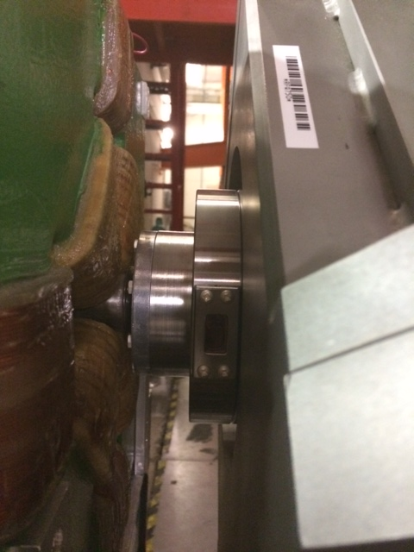
PIP – Accelerator Physics: Linac Laser Notch
Neutralize portion of the 750 keV beam using a pulsed laser
Create laser pulse pattern for 200 MHz and 450 kHz
Amplify pulse using a three-stage fiber amplifier
Create spatial uniform photon beam
Insert laser into a zig-zag interaction cavity
Optical cavity
200 MHz pulses
installed
done
in-progress
450 kHz “notch” spacing
10-12 bunches
VC/OC installed Sep’14
beam
System internal review - Aug’14
APT Seminar – Mar’14
Final installation expected FY15
Laser port

Slide 16
PIP – Linac 200 MHz RF system: issues & risks
The 201.25 MHz RF power system has been a big concern for over a decade in regards long term operational reliability and viability
The issue of retaining the 201.25 MHz RF system is
specialized maintenance required and extensive downtime generated by the tube modulator
F1123 discontinued production for over 10 years
short lifetime, high-cost & limited market of the final power amplifier
The risk of retaining the 201.25 MHz RF system is that
power tubes could become unobtainable to support operations until 2025
additional vacuum tubes could become obsolete in the modulator &
F1123 no longer be rebuilt -> years of operation ~ 6 years
PIP plan to address these issues is
build-up 4 year in-house inventory of the 7835
develop a workable plan to replace the final amplifier in case tube line production is discontinued
replace the high voltage modulator with present day technology

Slide 17
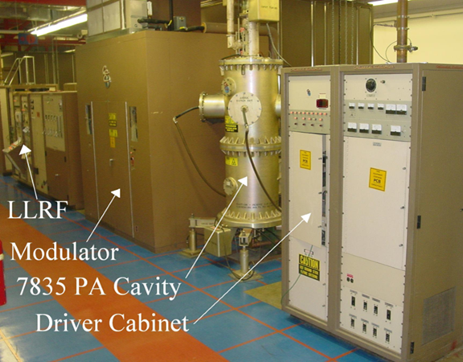
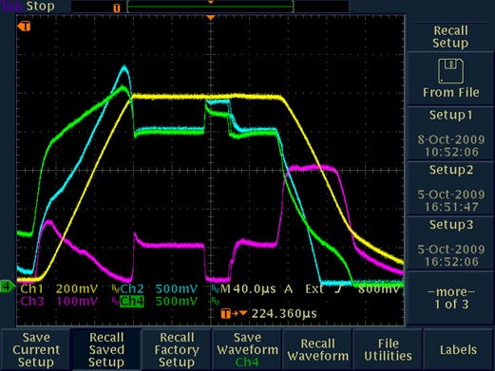
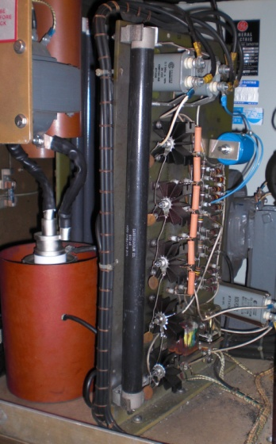
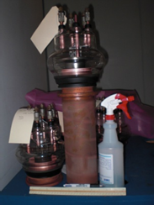
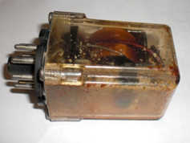
PIP – Linac 200 MHz RF system: Modulator
Modulator provide pulsed power to the plate of the 7835 triode
Plate modulation to provide tank field control
Modulator contribution to Linac downtime is ~57%
Depending on the nature of the fault, each event may bring the system down from a few minutes up to tens of hours
MTBF: ~ 10 hrs
DC pwr sply – built directly to the frame
Switch tubes no longer manufactured
Rely on rebuilds to operate
Outdated relays & interlocks
Minimal diagnostic capability
30kV
350 A
10-35kV
100-350 A
0.6MW
3.5MW
60kV
35 amp
DC PS
Modulator
F1123
3 triodes
FPA 7835
plate
gradient
voltage
current
FFPW

Slide 18
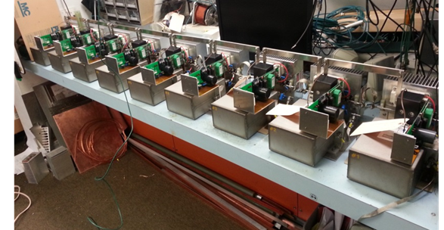
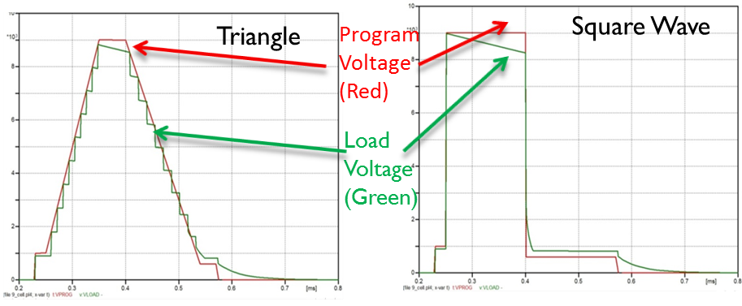
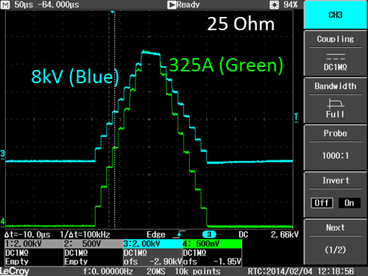
PIP – Linac 200 MHz RF system: Modulator
Modulator upgrade – 35 kV, Marx-topology modulator to drive triode
Could even drive klystron with proper pulse transformer
SLAC “ILC-like” modulator (uses 3 kV cells)
ILC Mark modulator (-120 kV/140Amp w/ 32 cells)
modified ILC (35kV/350 Amp w/ 15 cells)
AD/EE designed using modulator specification
designed with 1 kV cells, requiring 53 cells total
built 9 cell modulator for testing (see pictures)
building 25 cell modulator for further testing
plan to build full 53 modulator prototype in FY15
AD/EE design
best meets original specifications
lower cost than SLAC
in-house expertise

Slide 19
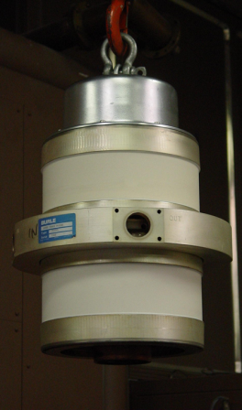
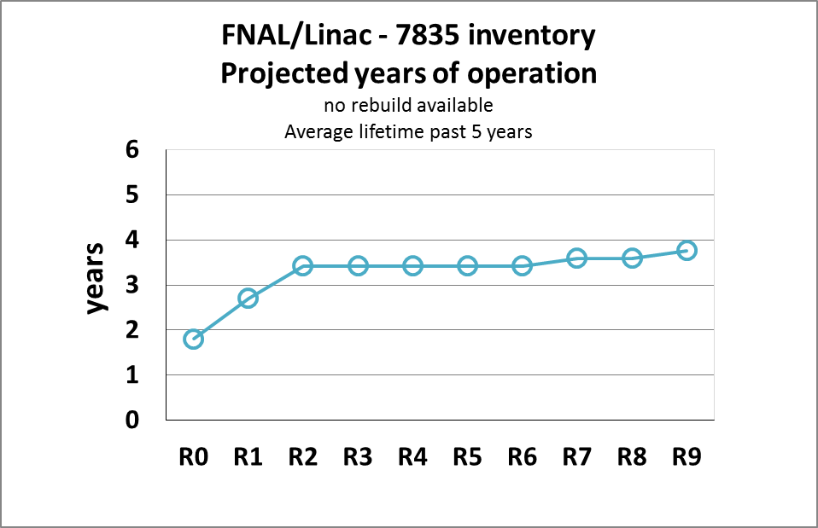
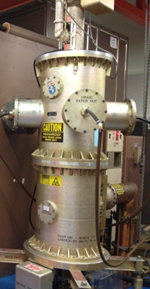
PIP – Linac 200 MHz RF system: PA
201.25 MHz final power amplifier
Single vendor: Photonis USA (former Burle)
National laboratories are the only users (FNAL,BNL,LANL*)
Typical delivery time: 200 days
Operation needs: 5 tubes
Lifetime: ~ 8-10 months
*LANL upgraded one tank to diacrode Jul/2014
12k -15k
7.5k
There is no RF conditioning at the vendor site
Typical 15 days/tube for 2 techs
6 tubes conditioned annually
Time consuming effort
(4-5 months)

Slide 20
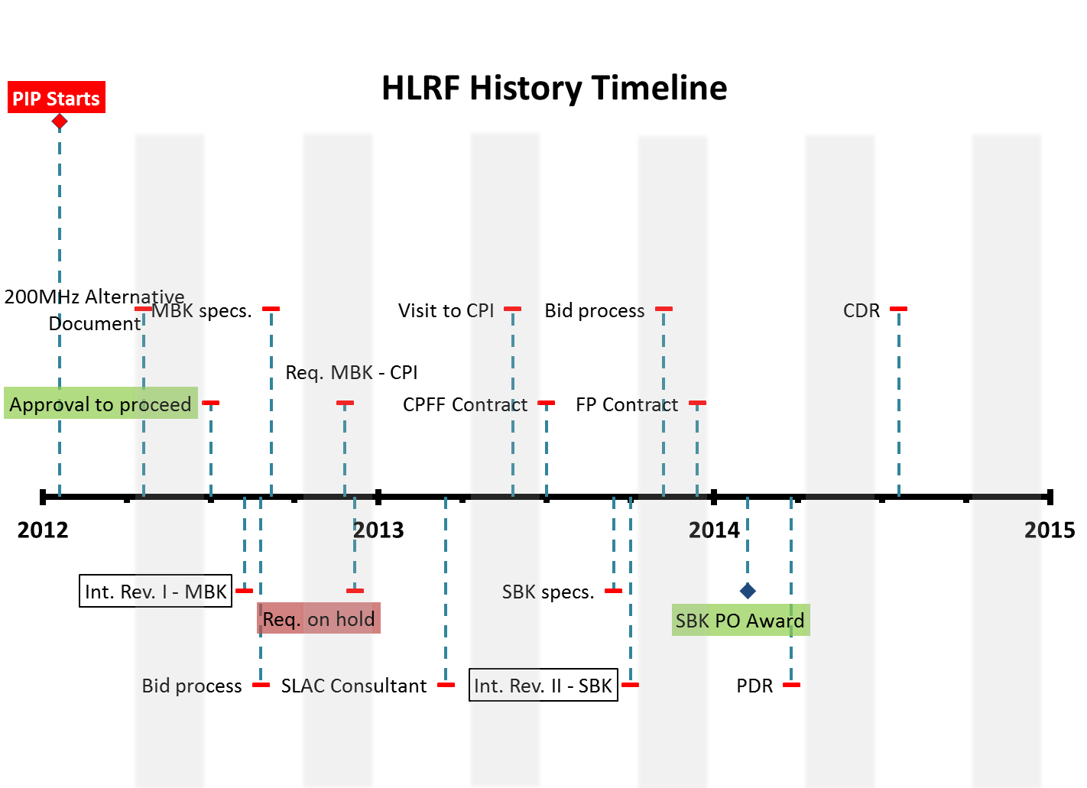
PIP – Linac 200 MHz RF system: HLRF
Study conducted in 2012 discussed alternatives to the triodes
Tetrodes (LANL design)
Klystron-based 200 MHz RF
“SNS-like” 400 MHz Linac
Cost took in consideration series of criteria evaluated against over the expected lifetime of the Linac
Criteria: supply chain, technical risk, M&S/labor construction, upgrade time, maintenance cost and program interruption time
After careful consideration,
the 201.25MHz klystron-based
RF power system was chosen as
a plausible replacement for the
7835 triode
A prototype is being designed and built at CPI

Slide 21
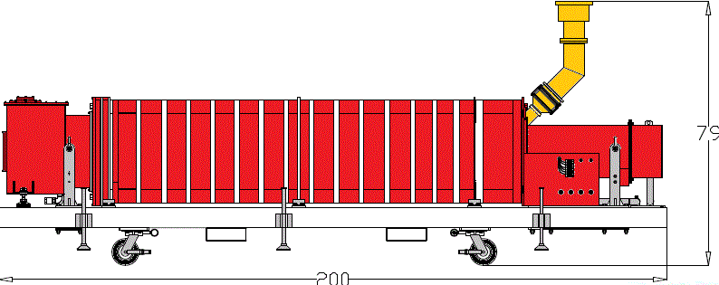
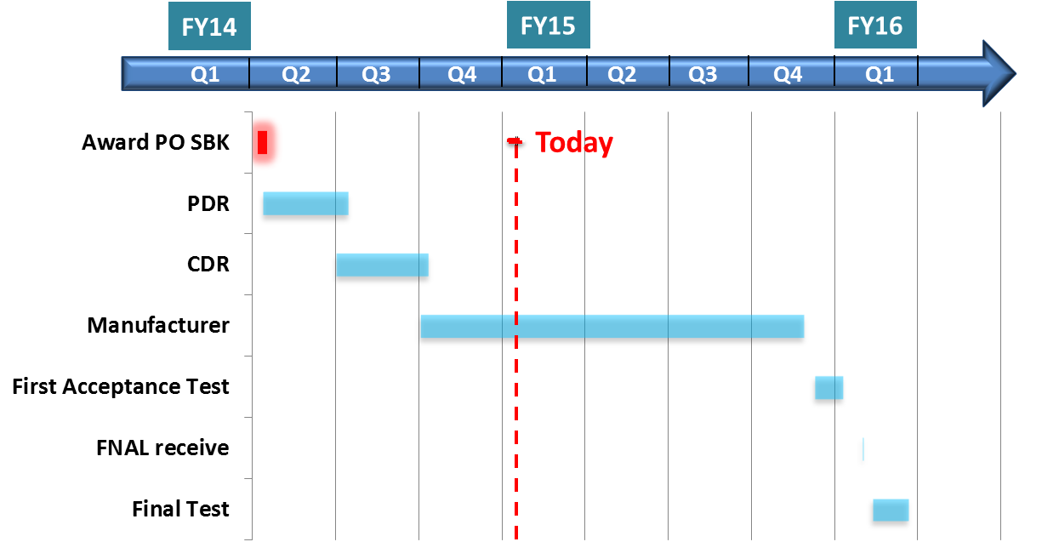
PIP – Linac 200 MHz RF system: HLRF
5 cavity RF
circuit design
Courtesy:
Collector
5.5
2.5
0
51
45
40
Gun
IC
OC
5.0 MW
122 kV, 85.2 A
P_{in} 340 W
Peak power (MW)
Gain (dB)
6’
16’
0 100 200 300 400 500
Drive power P_{in}(kW)
DTL
f₀: 201.25 MHz
Saturated efficiency: > 48%
Perveance: 2.0 mA/V^{1.5}
PRF: 15 Hz
Pulse length: 450 msec
J_{cath} : 1 A/cm²
Expected lifetime: > 200 hrs
PIP to PIP-II adjustment:
task completes after successful acceptance-test

Slide 22
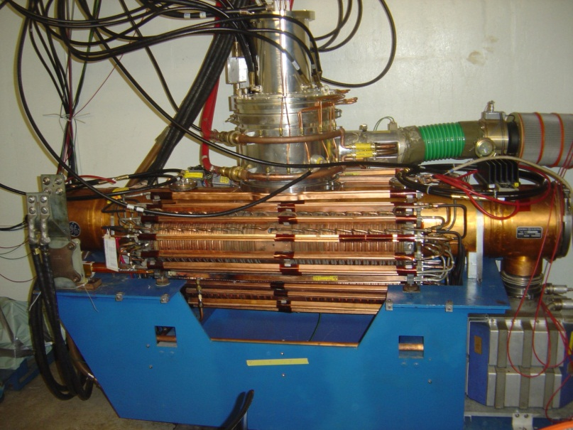
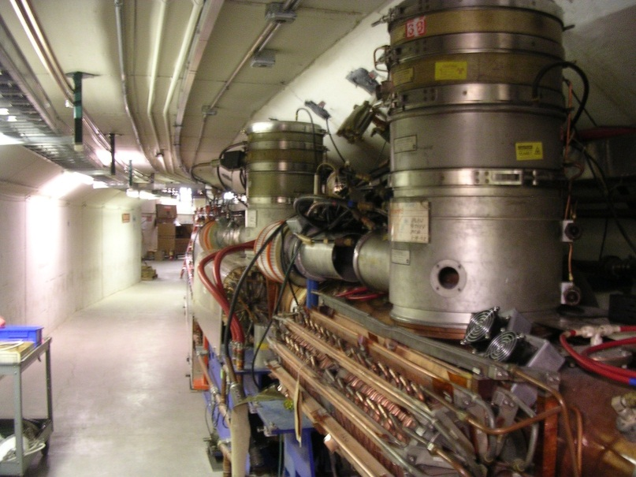
Booster RF cavity
Designed in 1969 – several small modifications but largely original cavity
- 19 stations
- 2 gaps @ ~ 24 kV
- Tunable 24 – 53 MHz
- Power amplifier system already upgraded to solid-state in PIP

Slide 23
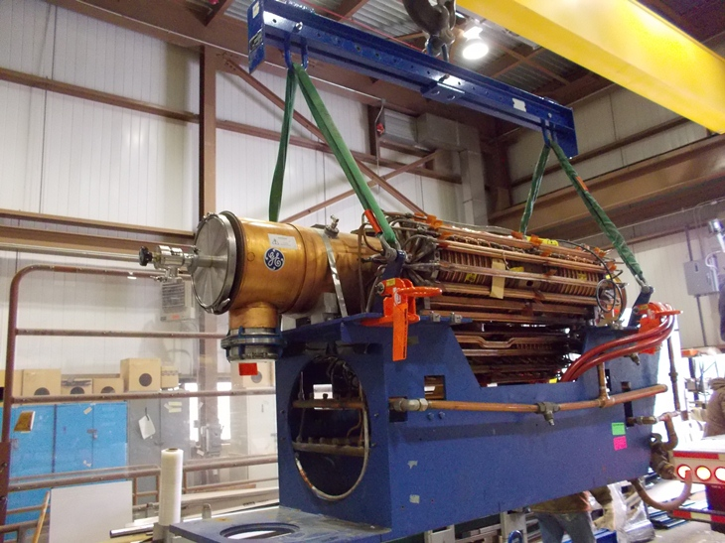
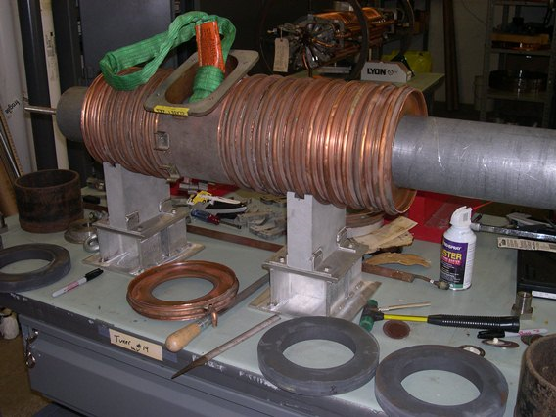
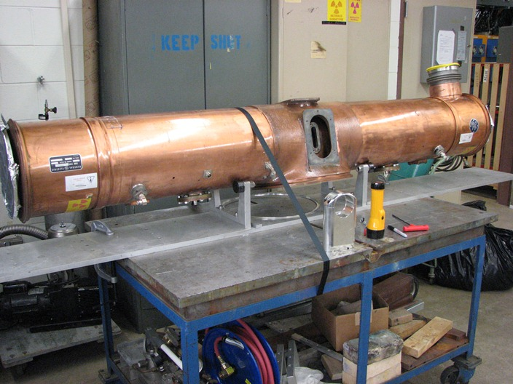
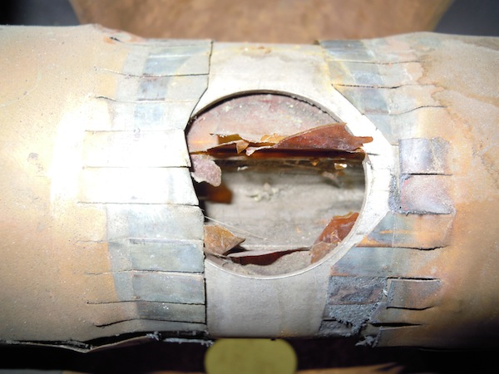
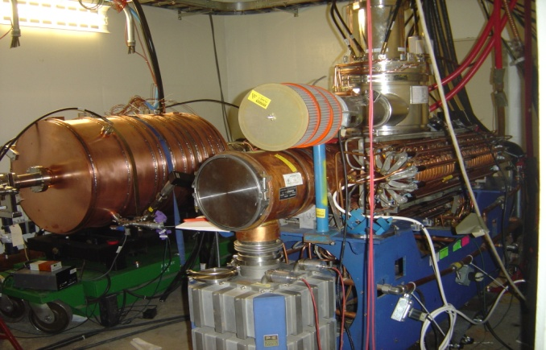
Booster PIP - Refurbishment of 40 year old cavities
(Weeks)
Cool-down
Rebuild - Cones & Tuners
Re-Assemble
Remove Tuners
Rebuild Stems/Flanges
Testing
Cavity Removal
Cavity Removal - Stripping
Tuners Rebuild
Rebuild and Test

Slide 24
Booster refurbishment
Goals: Completion of Refurbishment in FY15
(19+1) cavities after refurbishment is complete
(+1) comes from an originally rejected cavity
22 cavities will be the final number
2 cavities will come from the Proton Driver project after modifications to their aperture
Reliable 15 Hz operations will require overhead
Uncertain failure rate at 15 Hz operations
At least 17 cavities for 4.5e12 protons per pulse
longitudinal beam quality is decreased, higher losses through transition.
Make 20 spare tuners (3 tuners per cavity)
New tuners will be made by TD for refurbishment as well as for long term operations.
Reduced repair time
Lower worker exposure rate

Slide 25
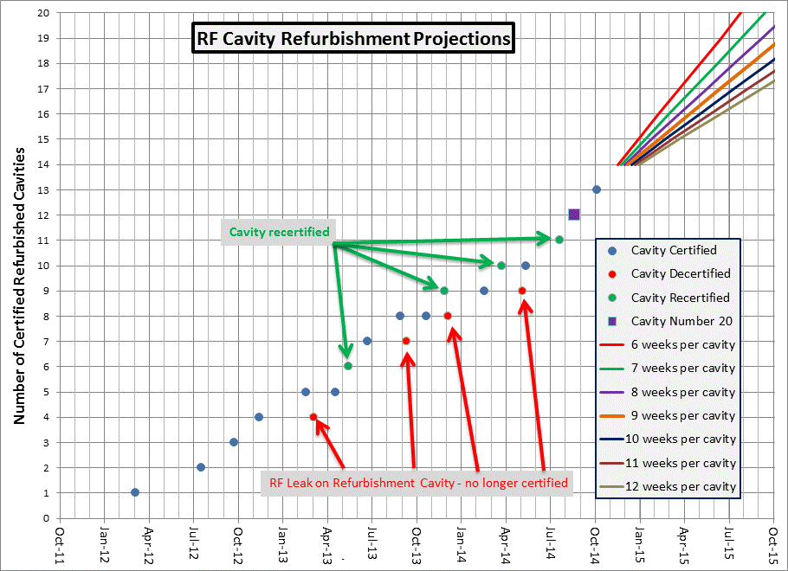
Booster RF cavity refurbishment status

Slide 26
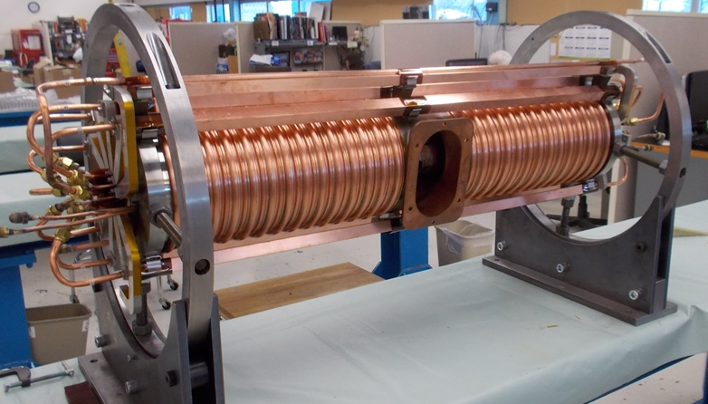
New tuners
Build new tuners to replace complete failures, accelerate refurbishment process, and reduce worker dose
New tuner has been in service for 10 weeks of running
Placed requisition for ferrites (enough for 20 tuners)
worked with vendor (National) for 2+ years to get recipe for ferrites correct
Delivery before end of year – ready to build immediately

Slide 27
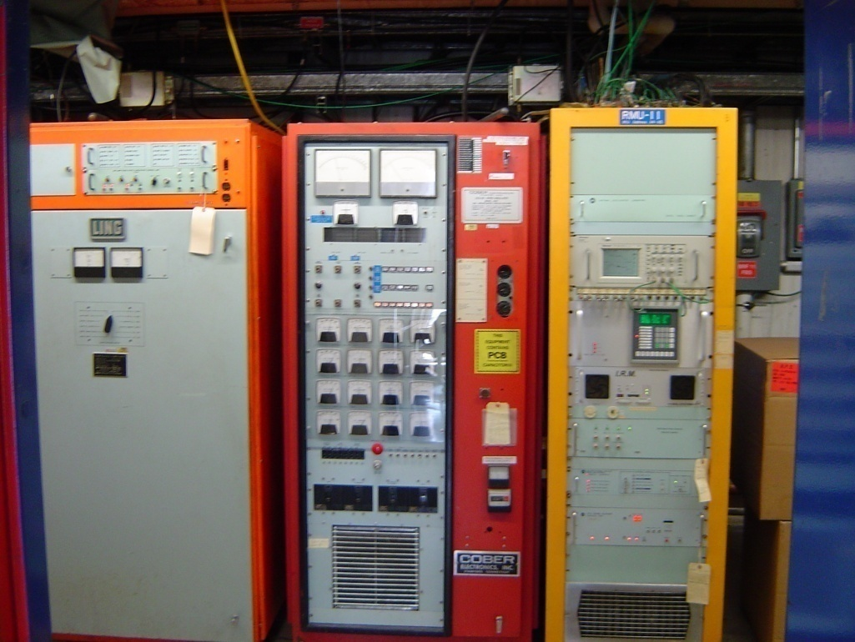
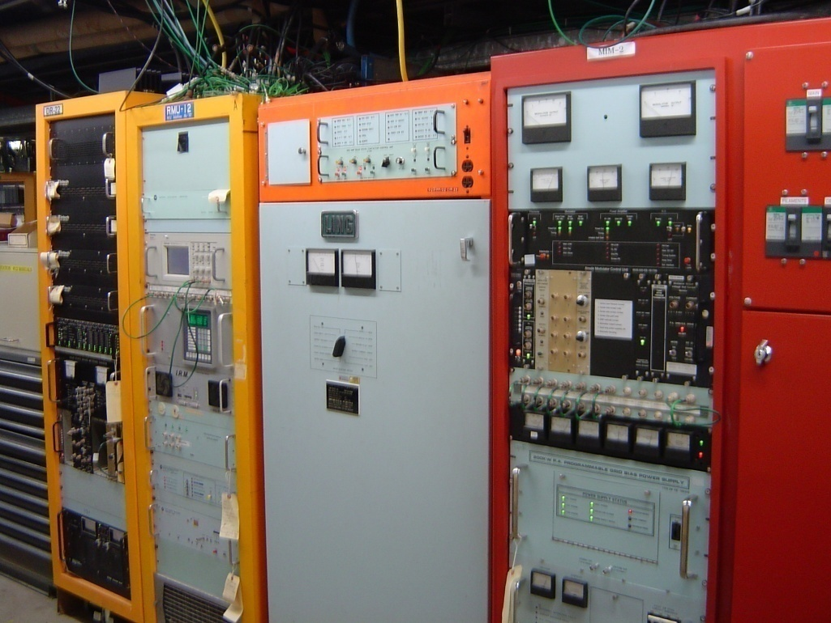
Booster RF station (Solid State upgrade completed in FY13)
Ferrite Bias Supply
Modulator
Control Rack
SSD
Controls
Ferrite Bias Supply
Modulator
Original Booster RF Station
Upgraded RF Station
with SSD + New Modulator

Slide 28
Proton Improvement Plan Bill Pellico Bob Zwaska, Deputy Kenneth Domann, Project Controls Valeri Lebedev, Senior Physicist
Booster Keith Gollwitzer
200 MHz RF Power System Fernanda G. Garcia
High-Level RF J. Steimel
Linac Modulator Trevor Butler
7835 Procurement Fernanda G. Garcia
Instrumentation Craig Drennan
Utilities
Matthew Gardner
Power Distribution Ryan Crawford
RF John Reid
Anode Supply Ryan Crawford
Bias Supply Pat Sheahan
New Tuners Matt Slabaugh
New Cavities C.Y. Tan
Cavity 1013 Matt Slabaugh John Reid
Accelerator Physics Bob Zwaska
Booster Collimation Valeri Lebedev
Radiation Shielding Keith Gollwitzer
Alignment & Aperture Kiyomi Seiya
Booster Notcher Salah Chaurize
Low-Conductivity Water System David Hixson
Power Distribution Ryan Crawford
Vacuum System Dave Augustine
Solid State Upgrade John Reid
Power Amplifier Steve Kotz
Driver Module Tom Kubicki
Cavity Test Stand Pat Sheahan
Linac Notch Creation Dave Johnson
Simulations & Studies Valery Kapin
Accelerator Physics Valeri Lebedev
Vacuum System Dave Augustine
Modulator Rene Padilla
Installation Rene Padilla Steve Kotz
Instrumentation Craig Drennan
Dampers Nathan Eddy
Utilities Todd Sullivan
Booster Cogging Kiyomi Seiya
Beam Position Monitors Nathan Eddy
Simulation & Studies Bob Zwaska
Linac Fernanda G. Garcia
Cavity & Tuner Refurb. Matt Slabaugh
RFQ Injector C. Y. Tan
Beam Position Monitors Nathan Eddy
Low-Cond. Water System Matt Gardner

Slide 29
Conclusion
PIP has been working for three years
Many infrastructure upgrades already performed
Notching improvements are straightforward path to higher throughput
Control loss with improved notching in Booster
Eliminate loss with laser notching in MEBT
200 MHz RF: replace modulators, reduce risk on power amplifiers
Booster cavities: refurbish all, gain overhead, replace many parts
Transition time coming for PIP:
Increased proton demand to be realized with Recycler commissioning, new experiments
Scope adjustments to anticipate a PIP-II Linac replacement

Slide 30
Enhancements of the Fermilab Booster to Reduce Losses and Extend Lifetime: The Proton Improvement Plan
Robert Zwaska
11 November 2014
HB2014

