Slide 1
Laser Notcher Demonstration Experiment
Dave Johnson, Todd Johnson, Matt Gardner. Rick Tesarek, Vic Sacrpine

Slide 2
Start up of Quantel Laser
ES&H SOP and interlock laser system
Modifications to allow 15 Hz operation
Spatial profile
Temporal profile

Slide 3
Set up timing system
Need to provide two triggers to laser system (Flash lamp & Q-switch) to synchronize the laser with the

Slide 4
What have we accomplished
Commissioned Quantel Laser
Set up optics on bench (very limited space)
Set up timing to Phase lock to RFQ bunches
  Provide a trigger for looking at BPM/WCM signals (need to average)
  Timing system moved to PreAcc control room and integrated with Linac timing events and RFQ RF signal

Slide 5
Remaining Items
Order additional optics for Demonstration Experiment
Order components for safety enclosure
Test out trigger for averaging beam signals
Modify optical bread board for mounting
Finalize position of rack to the MEBT

Slide 7
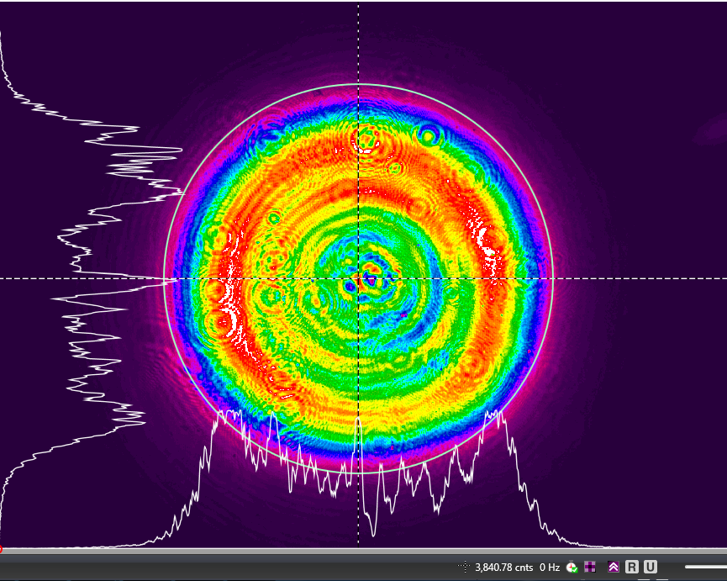
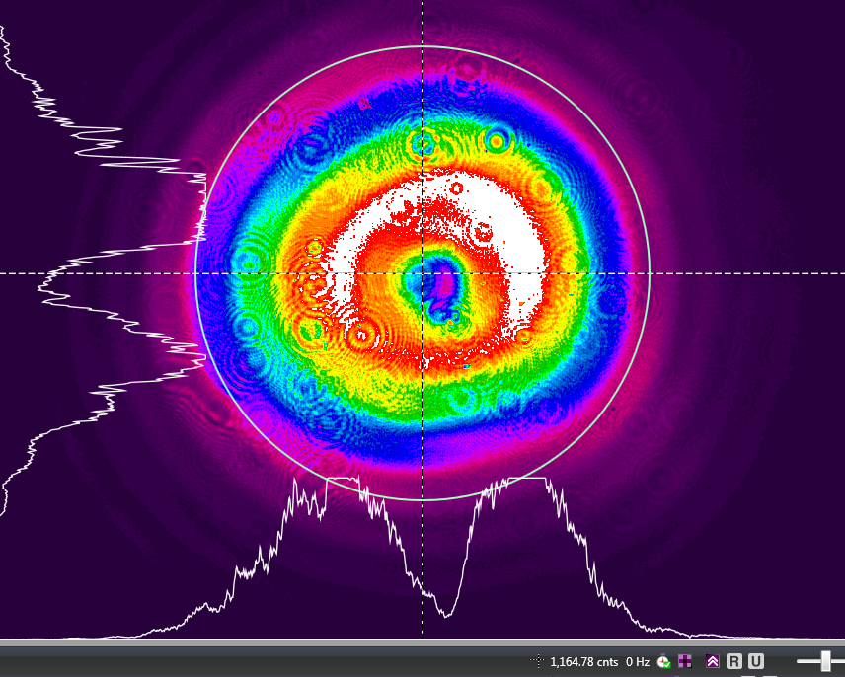
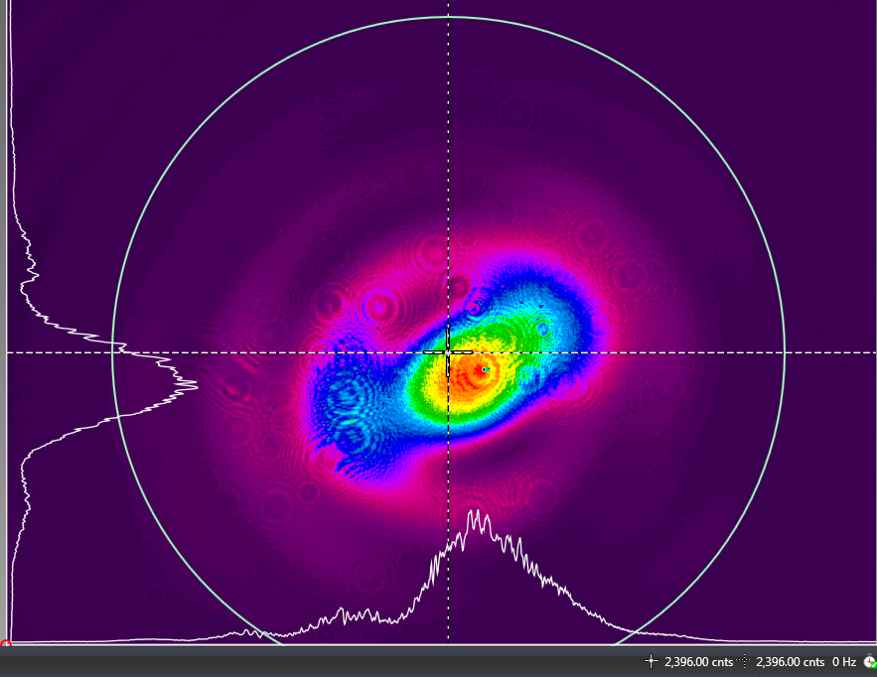
Evolution of Laser Spatial Profile

Slide 8
Notcher Flange
~2”
Piezoelectric steering mirrors
Optical Bread Board
Potential laser path
6-8”
Adjustable
telescope
Stacker
18”
Matching telescope
36”
TOP

Slide 9
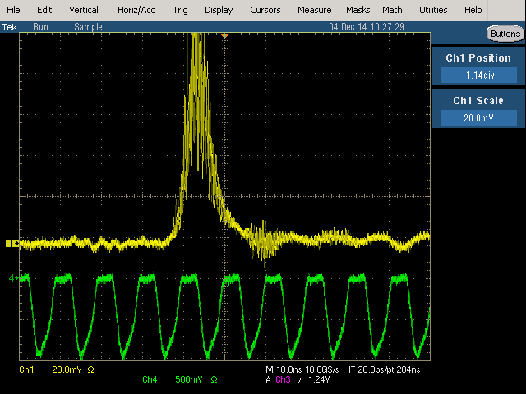
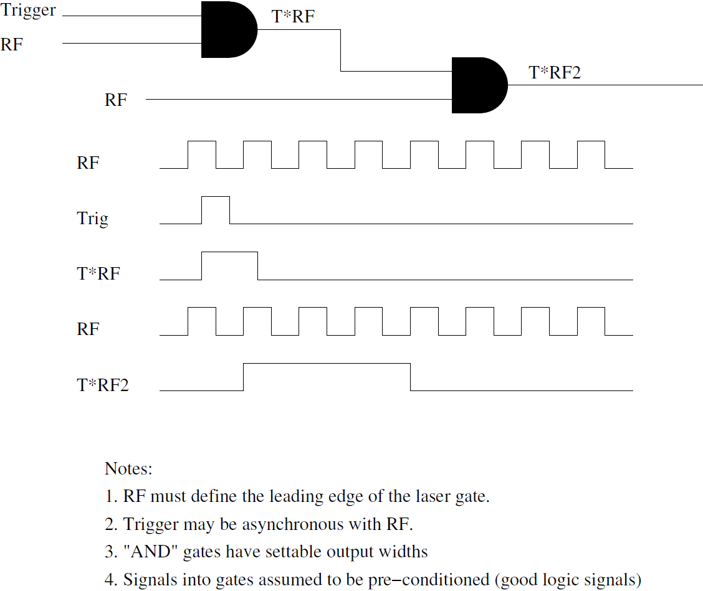
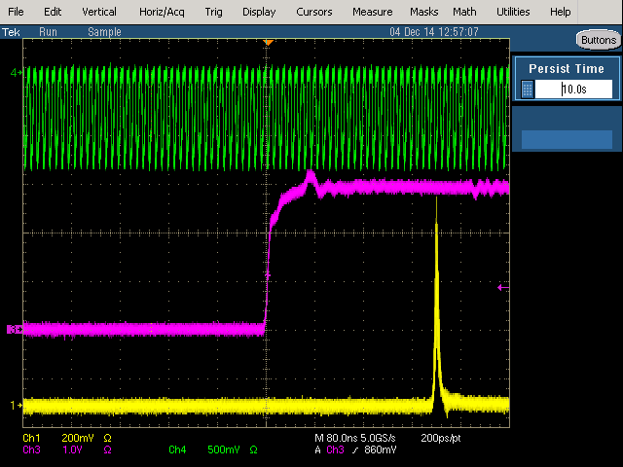
Phase locking to 200 MHz

Slide 10
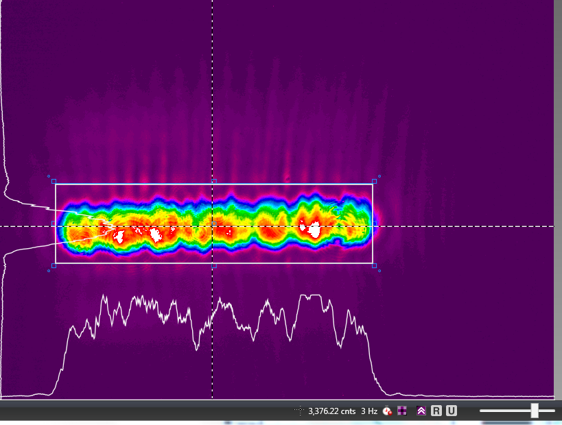
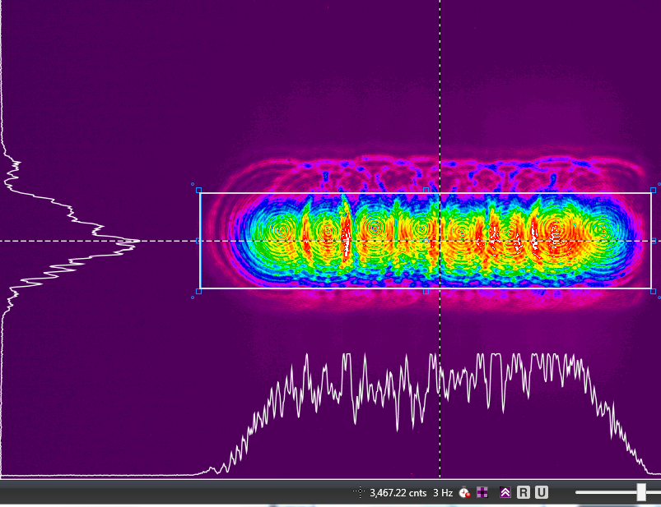
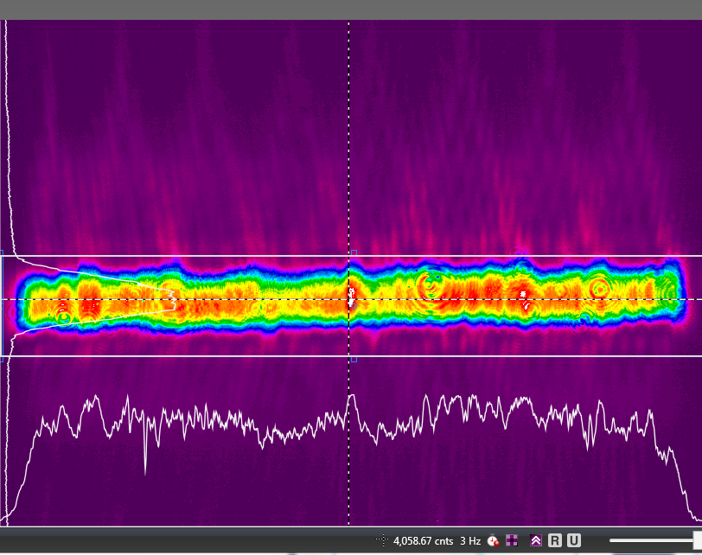
LASER Output from Stacker

