Slide 1
Design modifications. Reproducing of Al800 measurements in CST MWS.
January 14, 2015
G.Romanov, Y.Terechkine

Slide 2
Content
Design modifications.
Cooling cylinder.
Cooling cylinder + taper.
Bill Pellico’s proposal.
Reminder of the material unknowns.
Simulations of Robyn’s measurements of Al800 garnet.
Model of the set up.
Magnetostatic simulations.
Simulation with original AL800 parameters.
Dielectric constant of Al800.
Garnet B(H) curve.
Fitting B(H) for Al800.
Conclusion on B(H), ΔH and ε of the Al800 garnet.

Slide 3
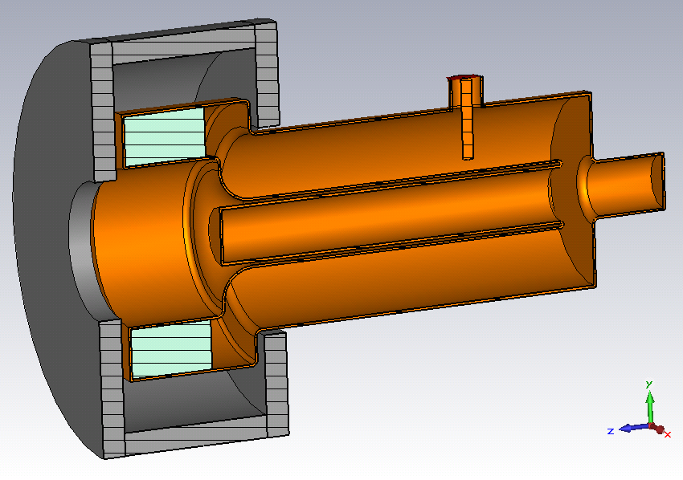
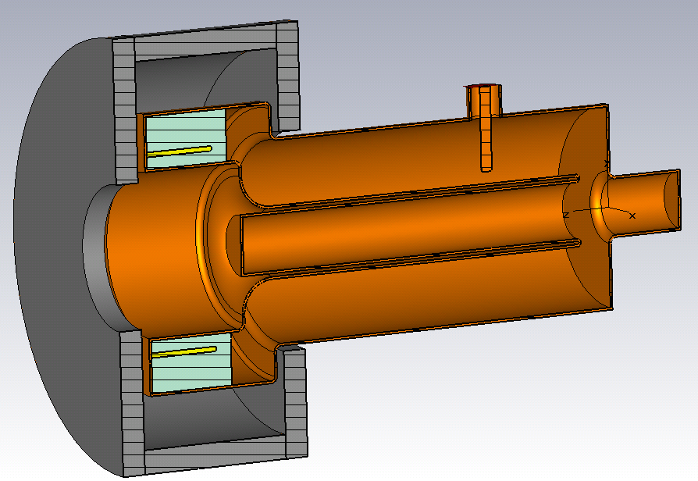
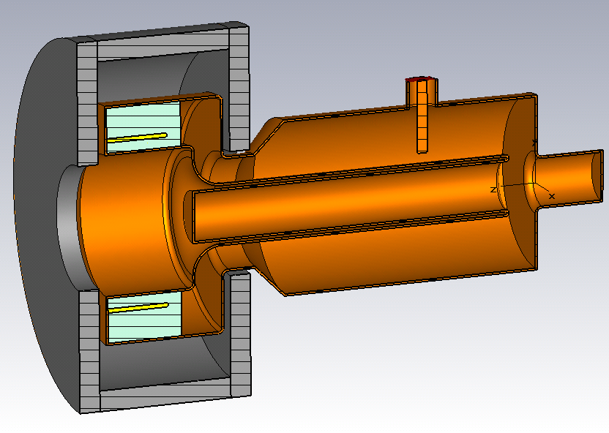
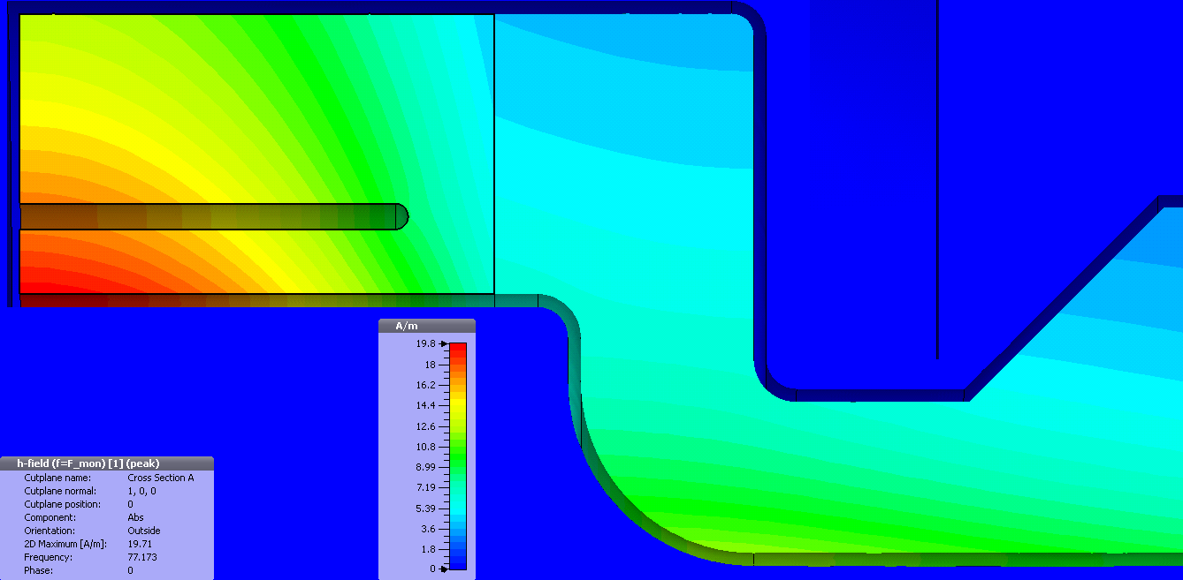
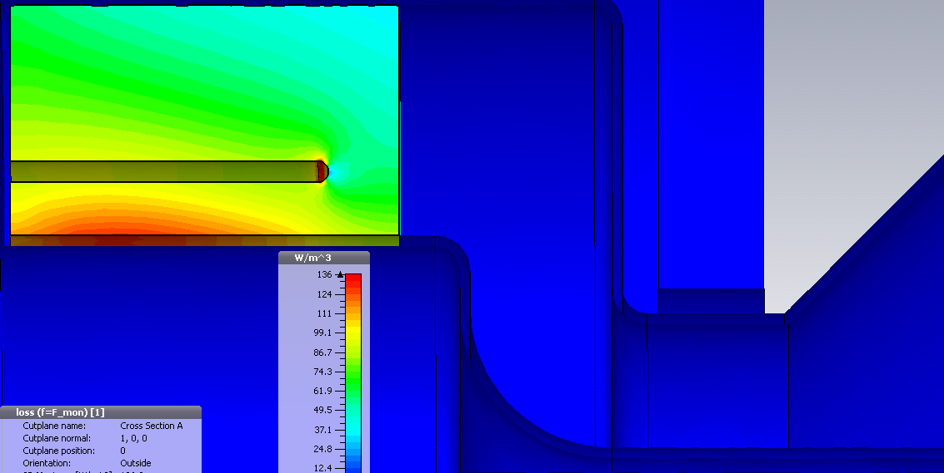
Design modifications
Ferrite: L = 110 mm, ΔH = 31 Oe at 9.4 GHz, tanδ_E = 0.0002
Base
Cooling cylinder
Taper +
Cooling cylinder
H field
H field
H field
Volume losses
Volume losses
Volume losses
F, MHz | 76.2 | 78.15 | 77.18
Peak losses in the ferrite at V=100 kV | 49 | 52 | 55

Slide 4
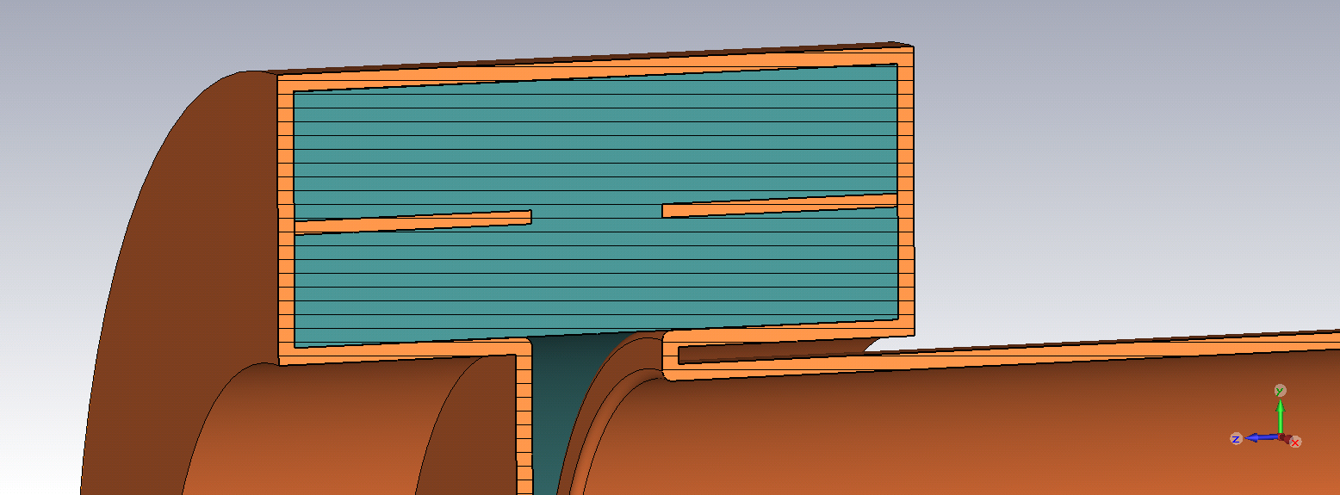
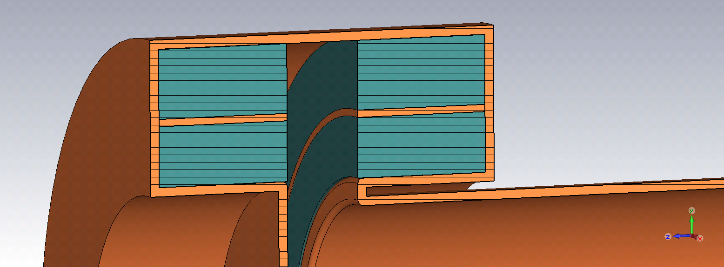
Bill’s proposal (speculation, no simulations yet)
Using copper cooling cylinders instead of beryllium disks in
the original design. It should work in general.
Variant 1.
Overheating of the central part is possible.
Original design
Variant 2.
The gap will be a source of field non-uniformity.
This variant is actually what we are considering now.

Slide 5
Reminder
In CST the loss mechanism within ferrites at RF frequencies is associated with precessional
damping. This damping is commonly described by a damping coefficient, commonly referred
to as α in the Landau–Lifshitz equation. It can be introduced directly or using the half–power ferromagnetic resonance (FMR) linewidth ΔH. These two quantities are related to each other by
α = γΔH/4πf =>
where f is the frequency at which the swept field linewidth is measured and γ= 2.8 GHz/kOe, ω – operating frequency.
ΔH – uniform spin-precession resonance
ΔH_{k} – spin-wave resonance
ΔH_{eff} – effective linewidth
“Domen”, ΔH=31 Oe, f=9.4 GHz
Thermal losses ≈ 4 kW at 100 kV
“Shapiro”, ΔH=1.5 Oe, f=9.4 GHz
Thermal losses ≈2 kW at 100 kV
Which ΔH to use?
Try to get answer from the measurements.

Slide 6
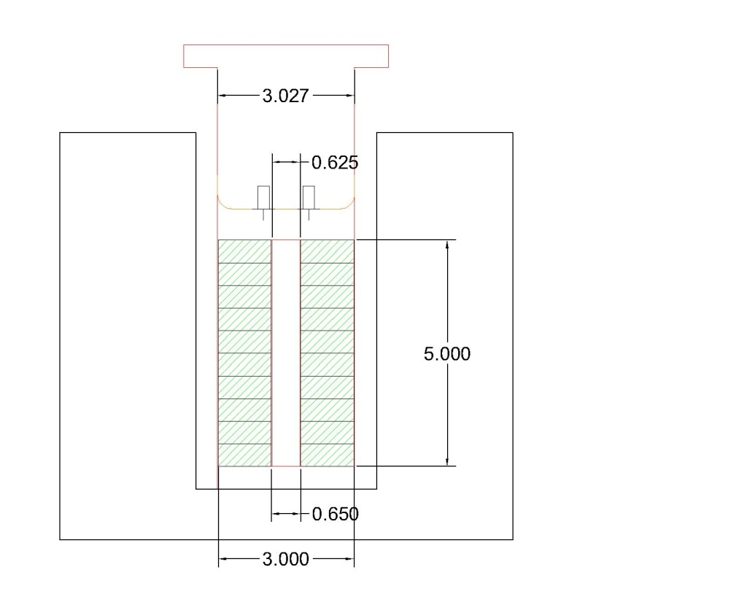
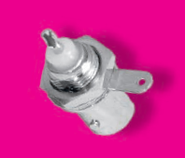
CST model of the Al800 set-up
Sketch of the set-up from Robyn
CST model
This is a thin piece
of copper with
BNC connectors
with BNC connectors
as pickups
Al800 garnet
Antenna
Outer conductor ID: 3.027:
Inner conductor OD: 0.625”
Shorted end
Garnet OD/ID 3”, 0.65”
Solenoid coil,
112 turns
Copper cavity
Solenoid yoke,
CMD ferrite

Slide 7
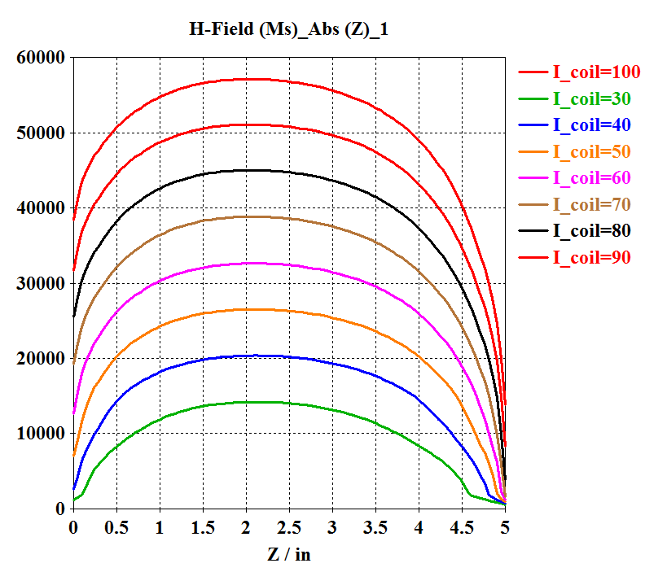
Magnetostatic solver
H field
|H| field
Robyn: In empty resonator H_int (Oe) = 7.477·I_sol(A)
along y = 0.4”
In this simuations both yoke CMD ferrite and Al800 garnet are non-linear. But CMD can be replaced in by material with fixed µ = 2000 without compromising accuracy of simulations (Y. Terechkine, verified by CST simulations).

Slide 8
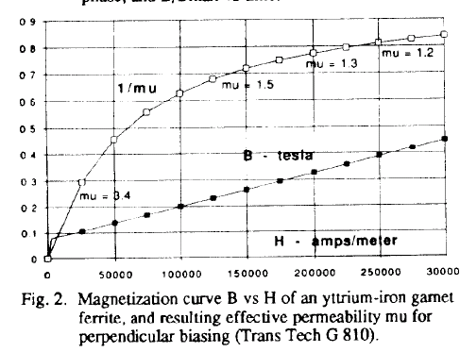
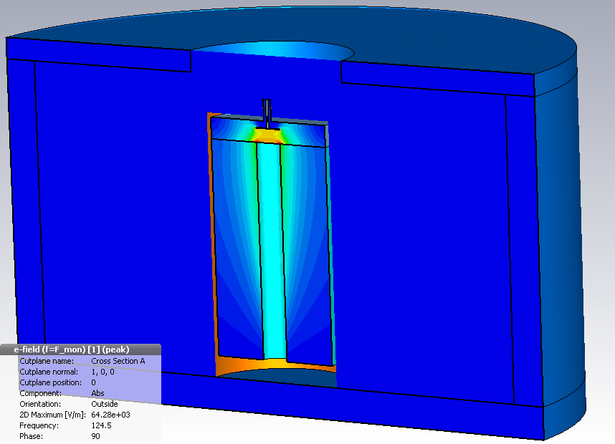
Simulations of Al800 set-up with original G810 parameters
dH = 40 Oe at 9.4 GHz; M_{s} = 810 Oe; ε = 14.4, 13.86 and 10.4; tanδ_e=0.0002
TRIUMF
Since electrical field is strong in the ferrite, impact of ε is significant. Upper 123 MHz is dominated by ε, since µ ≤ 2.
Assume that ε drops from static value of 13.8 to 10.4-10.5 and remains constant in 70-123 MHz interval. The
tanδ_e=0.0002 is constant as well.

Slide 9
Fitting B(H) for Al800.

Slide 10
Conclusion
Verify that ε of Al800 is constant over the 70-120 MHz interval, specify its magnitude.
Check and confirm tanδ_e=0.0002 in the 70-120 MHz interval.
Measure static B(H).
Measure unloaded Q and compare with simulations to obtain ΔH.
Start thermal simulations with new garnet parameters.

