Slide 1
Possible Mock Booster Harmonic Cavity
Robyn Madrak
01/14/2015

Slide 2
Basics
Main purpose: to test the higher order mode damper before we have a real cavity
Constraints
We will not yet have the real (large) solenoid
We will not yet have the real (large) pieces of AL800
It is assumed that all tests will be low power and the cavity will not be under vacuum

Slide 3
HOM damper ideas (Tan) – damper is a cavity attached to the main cavity:

Slide 4
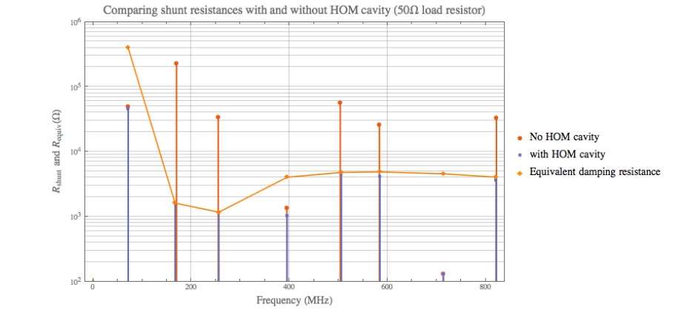
Tan’s Calculations for this type of HOM Damper

Slide 5
Options
O^{th} order: make a quarter wave cavity out of Al or Cu with no garnet, with f₀ ~ 76 MHz. (It will be long)
1st order: Make the cavity similar as similar to the real one as possible
For the non-garnet section, dimensions are the same
For the garnet section, the OD is 3” and the ratio of ID/OD is the same as in the real cavity
In this case the garnet part can fit in the test solenoid which we have
We would have to order another lot of 3” garnet pieces (affordable)
2nd order: Any other ideas?

Slide 6
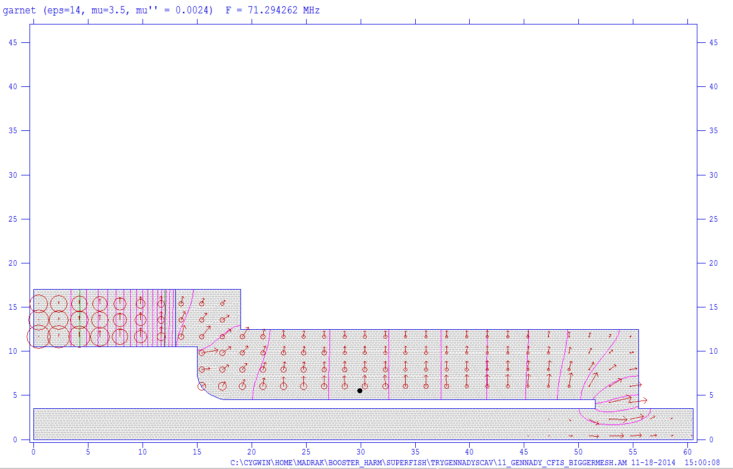
Superfish Simulation of Real Cavity
Used :
garnet length = 13 cm
R = 17 cm
r = 10.5 cm
ε = 14
= 3.5
μ’’ = 0.0024

Slide 7
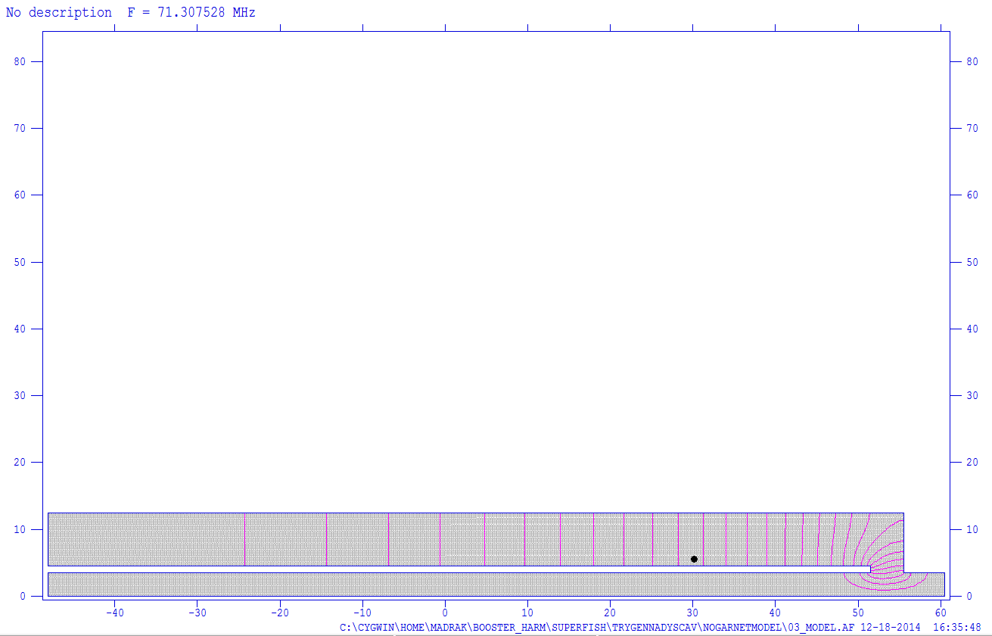
Superfish Simulation of Quarter Wave Cavity with no garnet
Adjusted cavity length until f₀ was the same as that of the cavity on the previous page
Then, ran scans for HOM frequencies in both cavities

Slide 8
Results: Rsh vs f(mode)

Slide 9
Results: Q vs f(mode)

Slide 10
Results
Frequencies of modes are very different
Rsh and Q values are very different
General trend of Rsh and Q as a function of frequency very different
May be possible to use anyway to test HOM damper comparatively (we won’t measure the exact values of the HOMs in the real cavity, but will be able to quantify the damping as a function of frequency.

Slide 11
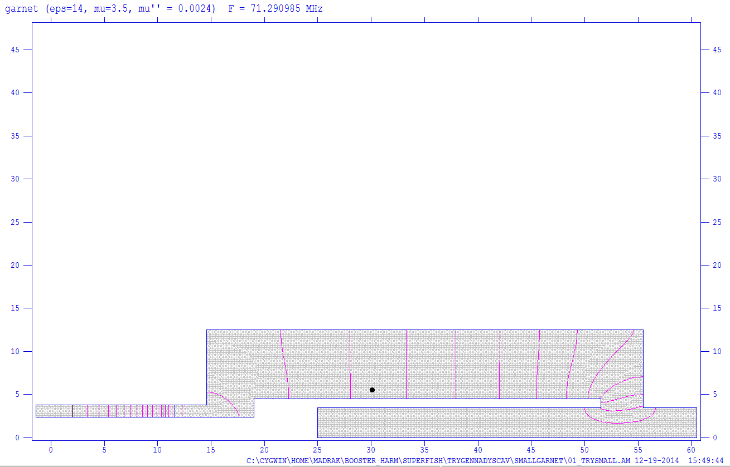
Cavity with small garnet
To get the frequency to come out the same, had to tweak some lengths (shown
in red)
Garnet section:
L=13 cm
OD = 3” (R = 3.81)
ID = 1.853” (r=2.353)
R/r = 17/10.5
For the vacuum part,
the OD, ID and
length are the same
as in the real cavity
vac part here
Real cav: l = 2cm
Here: l = 3cm
air part here
Real cav: l = 4cm
Here: l = 4.4 cm

Slide 12
Results: Rsh vs f(mode)

Slide 13
Results: Q vs f(mode)

Slide 14
Mode frequencies only up to 510 MHz
Y axis is arbitrary; this is just to show frequencies

Slide 15
Quote
Simulations done using 13 cm long garnet
Got a quote for toroids assuming Gennady’s new length (11 cm)
Assumption is 10 toroids will be stacked
Ordering extra may not be a bad idea. They are difficult to get into the outer conductor which has an ID close to the garnet OD
Here is our quotation for your consideration:
Toroid, AL-800
OD = 3.000" +/-0.005"
ID = 1.853" +/-0.007"
Thickness = 0.433" +/-0.003"
Quantity = 20 pcs
Price: $225/pc
NRE: $450
Lead time: 6-7 weeks ARO
Other terms: as in the past

Slide 16
Comments
Is it worth it to make the ‘small garnet’ cavity (instead of a long one with no ferrite)
How well do we trust superfish? (hopefully well enough to trust comparative results)
With the ‘small garnet’ cavity, since the solenoid which will accommodate the 3” garnet must sit upright, this cavity will have to stand on end (not impossible to deal with )
Other concerns?

