Slide 1
New High Mu Ferrites
Jan 28th, 2015

Slide 2
Order for 250 high mu cores was placed in August, 2014 with National Magnetics
First 32 received Dec 2014
All within spec
Low and high power tests as expected
Test results very similar to previous samples
Cores were very consistent with each other
Second batch of 27 received Jan 2015
All within spec
Lower mass (~100g)/lower mu/higher fo @ zero bias
Despite differences, high power testing was very similar to previous set of cores
Cores were very consistent

Slide 3
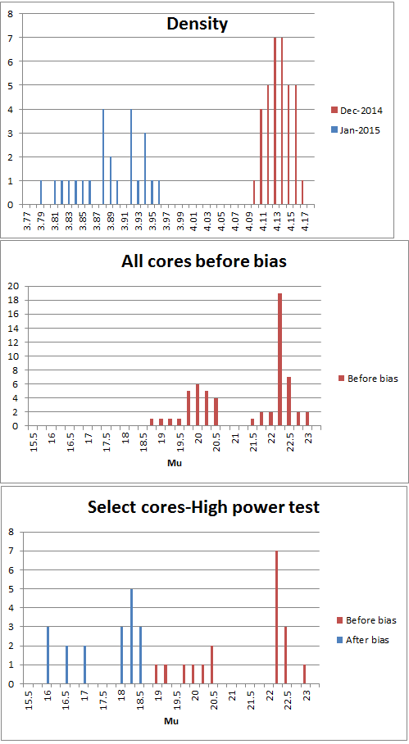

Slide 4
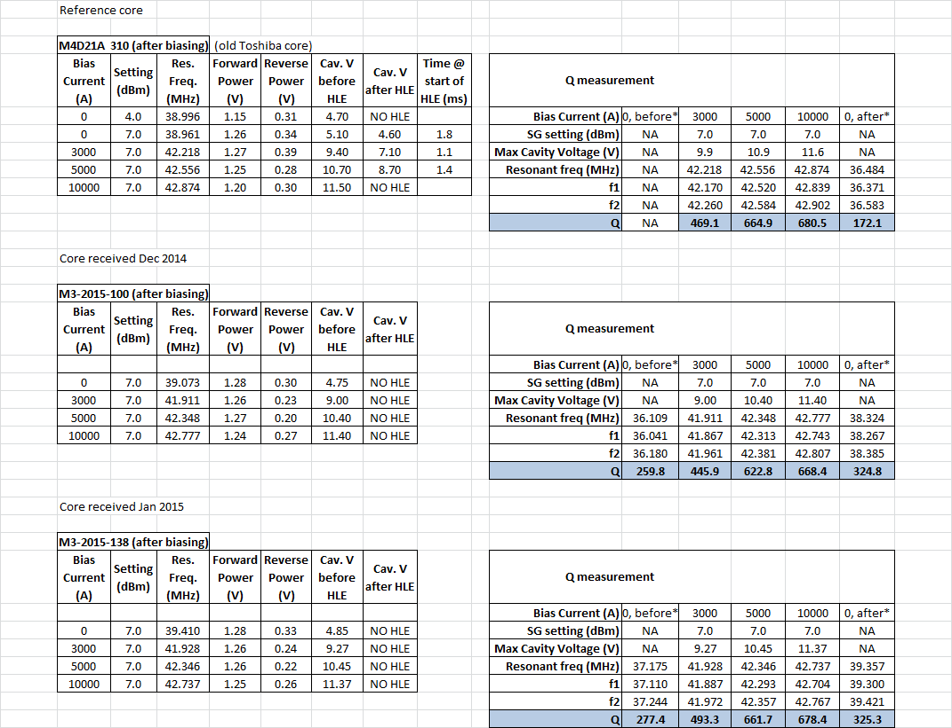

Slide 5
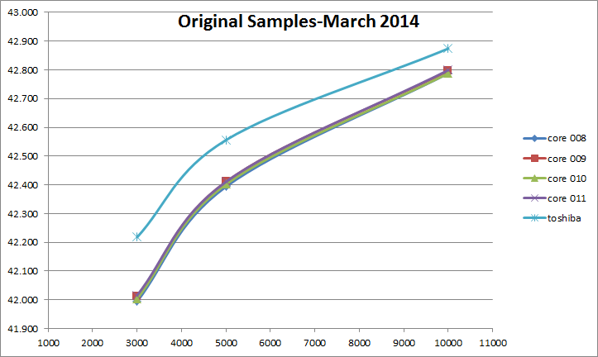

Slide 6
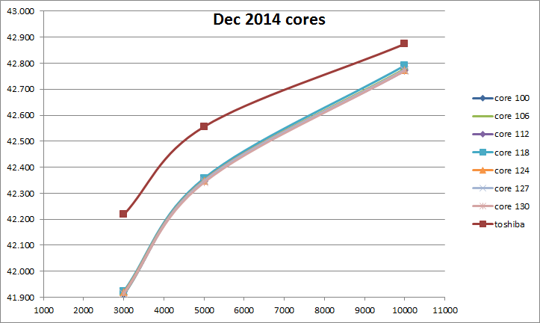

Slide 7
