Slide 1
Status of Magnetic cogging
March 11, 2015
K. Seiya, S. Chaurize, C. Drennan, W. Pellico,
A. K. Triplett, A. Waller

Slide 2
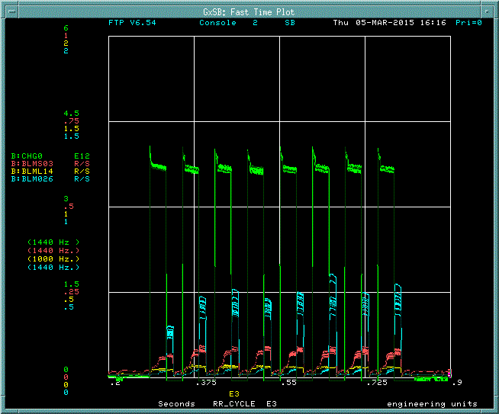
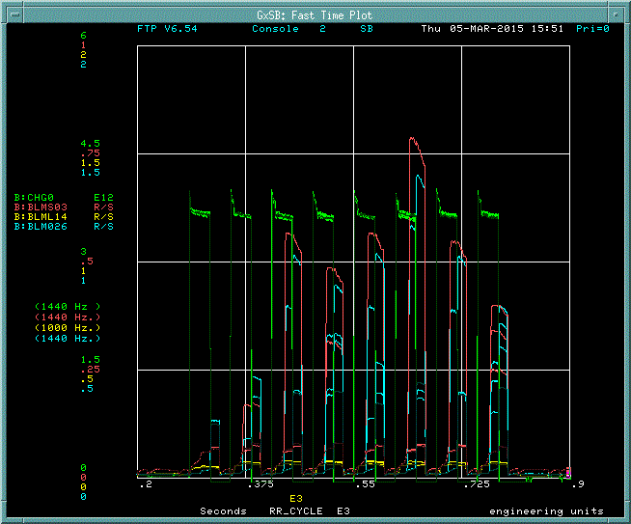
Booster intensity and beam loss on MI 2 + 6 operation
Magnetic Cogging
RF Cogging
Intensity
Loss @ extraction

Slide 3
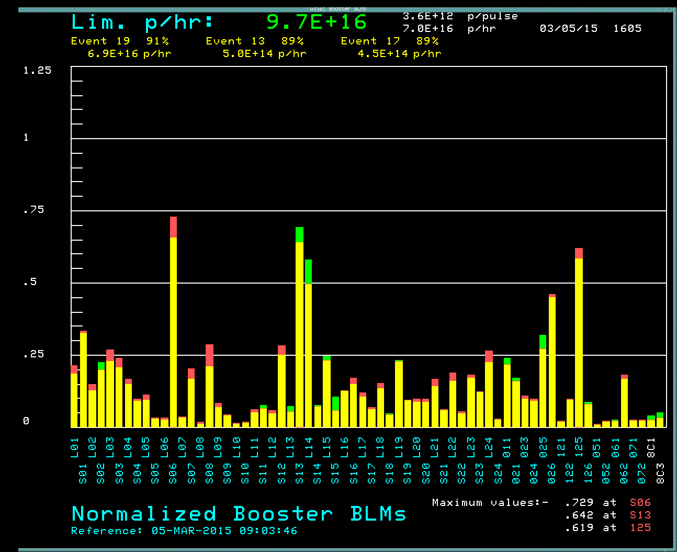
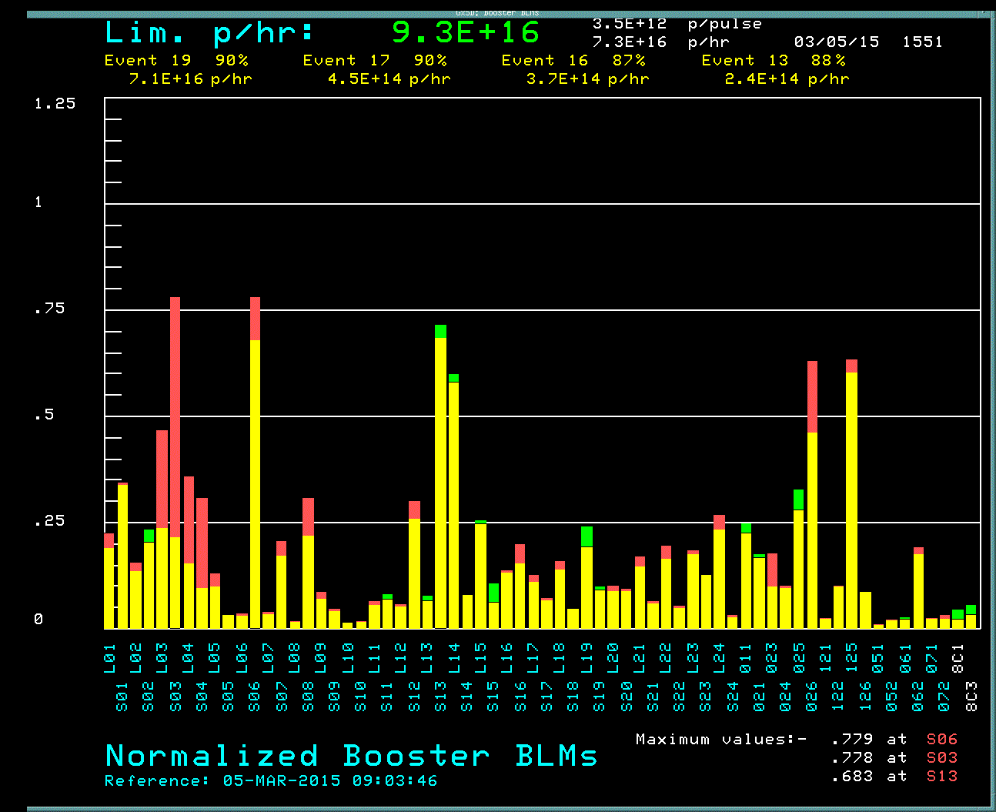
Beam loss in the Booster
Magnetic Cogging
RF Cogging

Slide 4
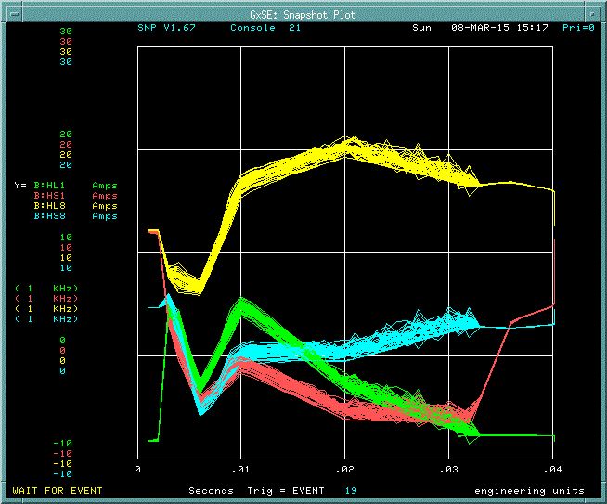
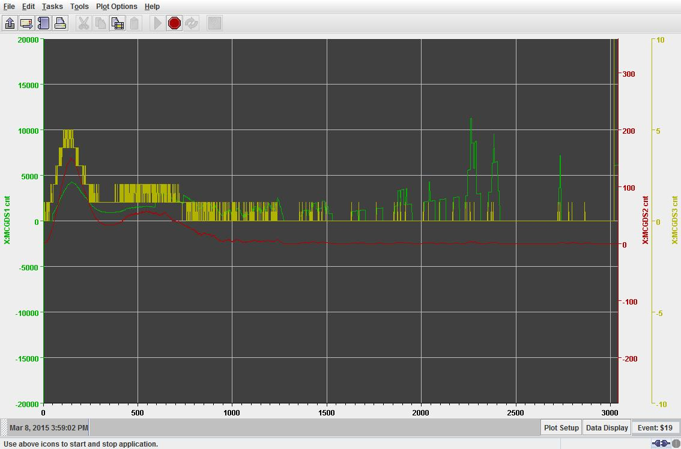
Current offset to the correctors
Bucket error
32 turns average
32 turns average x Gain curve
II
Corrector current offset
Corrector current offset ~ +/- 1A

Slide 5
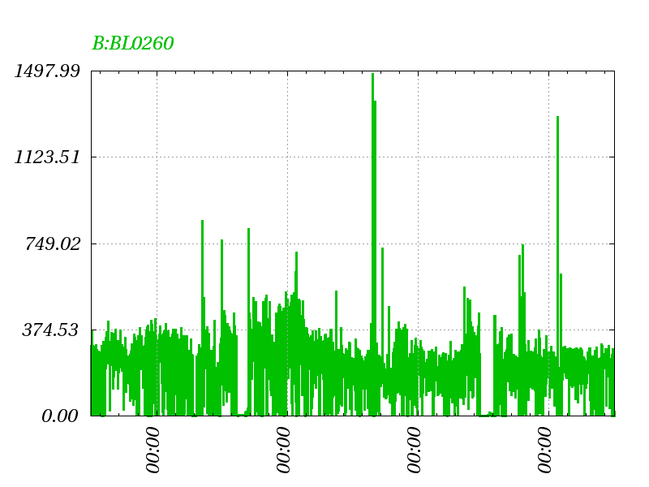
Beam loss at extraction last 4 week
Magnetic Cogging

Slide 6
Plan
Move notch from 700 to 400MeV.
Beam Extraction Sycn.
Fix +/- 1 bucket error between the end of cogging and the phase lock.
Set ACNET parameters.
Cogging with Linac Notch.

Slide 7
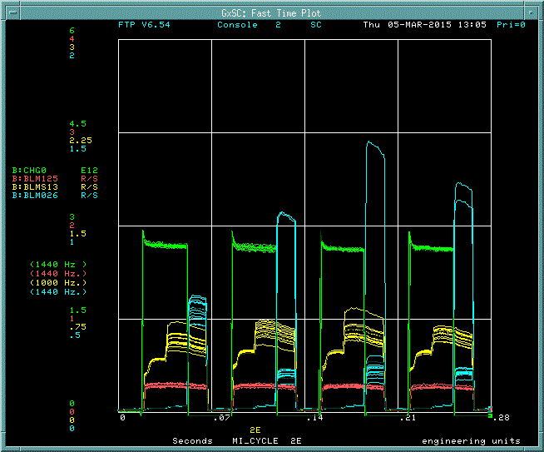

Slide 8
Beam Extraction Sync Block Diagram
OAA
(MI/RR desired position)
Notcher
RPOS feedback
Beam Extraction Sync
Module
Cogging VXI Module
Notch
Trigger
Module
Ext. kicker
New
Cogging VXI Module
Notch(extraction kicker gap) – Booster extraction kicker – MI/RR injection kicker

Slide 9
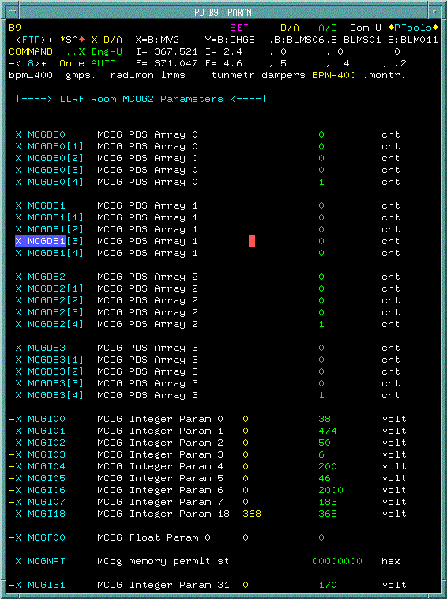

Slide 10
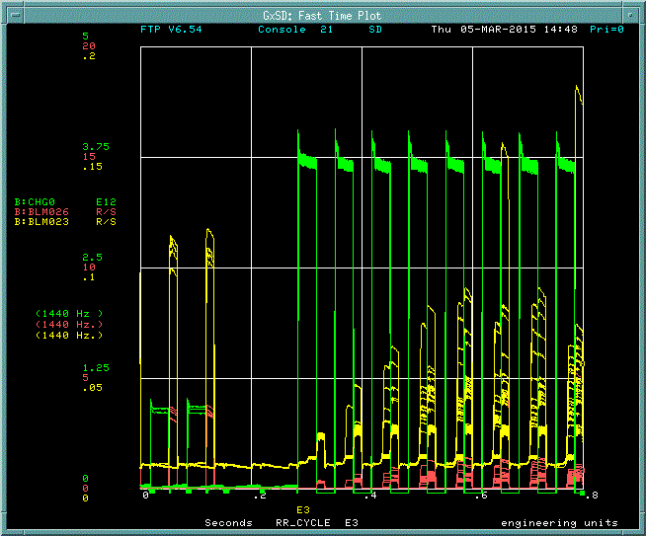
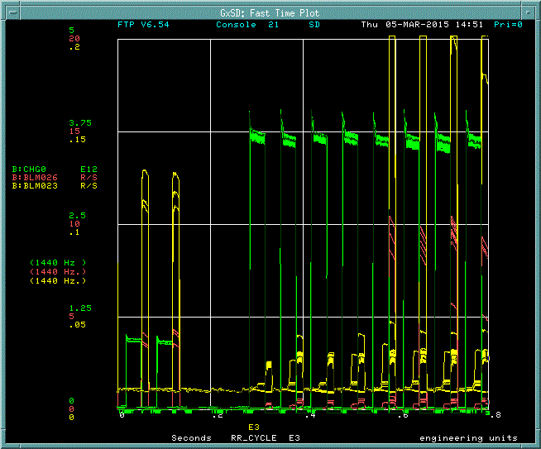

Slide 11
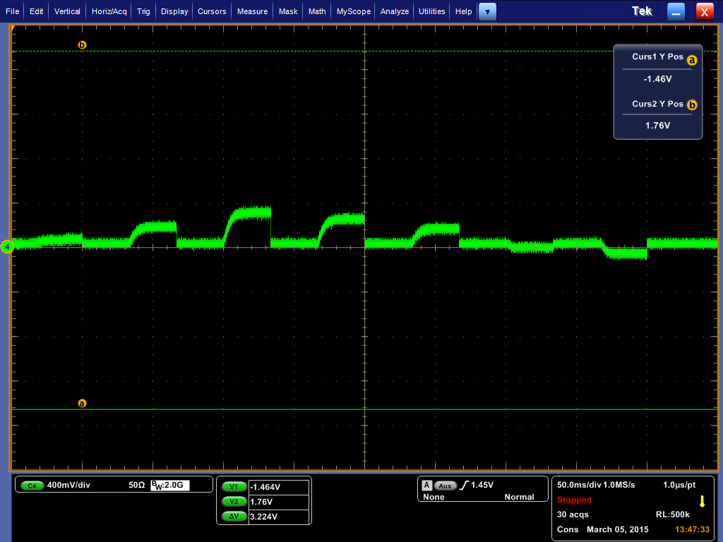
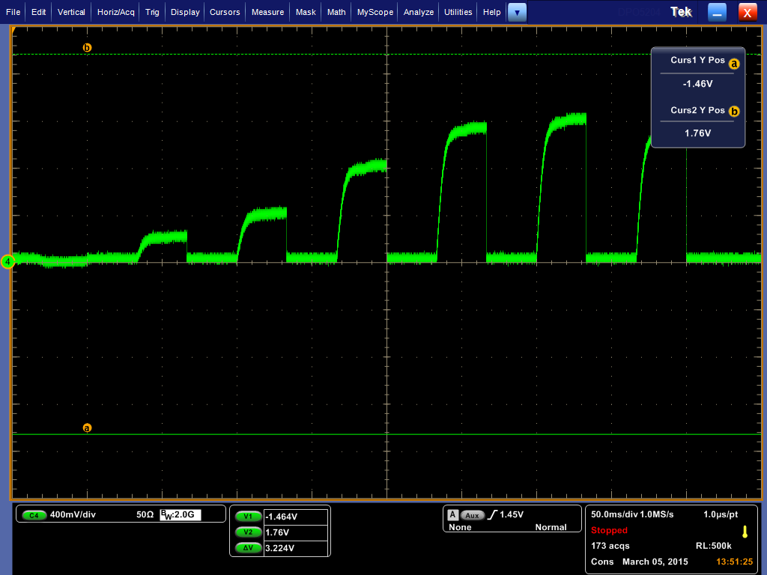

Slide 12
