Slide 1
Early Beam Injection in the Fermilab Booster & its Implementation Plan
Chandra Bhat
Todd’s Operation Meeting
20150212
Abstract:
Over the past 6-8 months we have made significant progress in understanding the Early Injection Scheme (EIS) via simulations as well as by the experiments in the Booster. The studies needs dedicated beam time, hence, we developed 1-shot sequence which will help us to make progress in the beam studies even during the nominal beam operation. The results from the simulations on the EIS shows that one can operate Booster at a lower rf power, produce lower emittance beam and no beam losses under current operational scenario. The conclusions from a preliminary analysis (presented here) of the beam data from EIS are, 1) one can lower the rf power by ~15%, 2) beam delivery efficiency is about 90%, comparable to that with the current operation, even with a part of the scheme implemented in the tests. We present game plan for implementation of the full scheme in operation.

Slide 2
Schematic of the
Beam Capture in the Booster
New Scheme: Capture in
Stationary Buckets ($\dot{p}$=0)
Start End
Begin
Injection
Early Beam Inj. Scheme can produce lower emittance beam to downstream accelerators
Booster B-curve
Bmin
Early Beam Inj.
Scheme
260μs for rf capture
(no debunching)
≈ 40μs
injection
150μs
Present operation:
Beam Inj.
360μs for
rf capture and acceleration
~60μs
debunching
1/30s≈0.0333s
1/30s≈0.0333s
Change in Es <0.24MeV
the energy acceptance >±2MeV
Beam ΔE < ±0.8MeV
f_{sy} = 8kHz-27kHz for Vrf=0.035MV-0.4MV

Slide 3
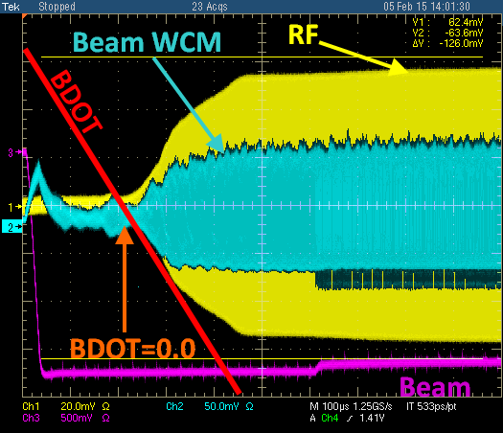
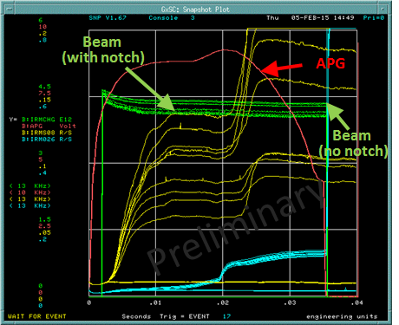
Beam Studies on Early Injection Scheme
The Beam studies were made on $17
Following Changes were made:
beam injection at 144 μs earlier than BDOT=0.0
⇒ B:RSTDLY changed to 64491µs from nominal value of 64635 µs
New RF, ROF and Paraphase curves, B:VFINJ
Additional tuning was needed at transition crossing (some times)
13BT
The beam lifetime was good for > First 1 ms!

Slide 4
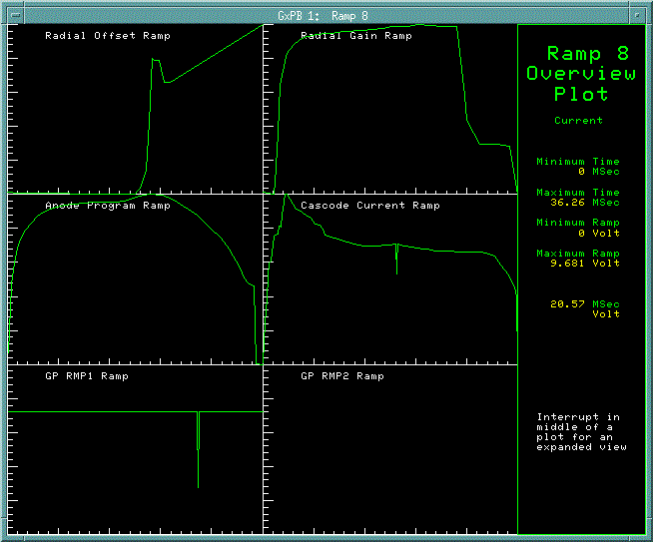
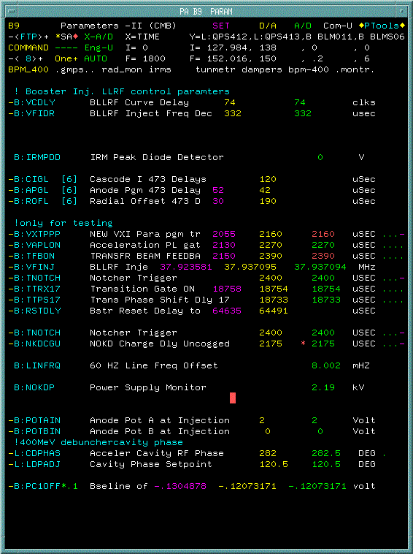
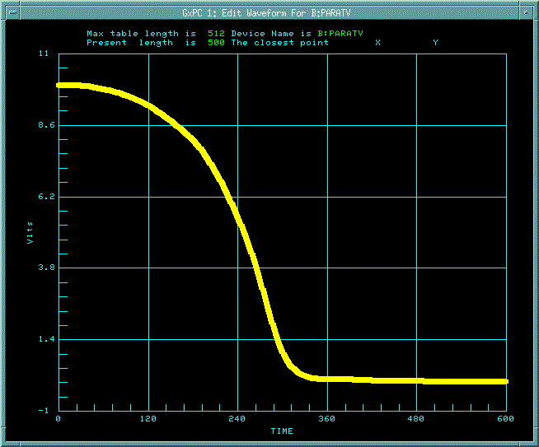
New Settings for a few Parameters
B:ROF
B:RAGT
B:APG
B:CIGT
B:PARAT

Slide 5
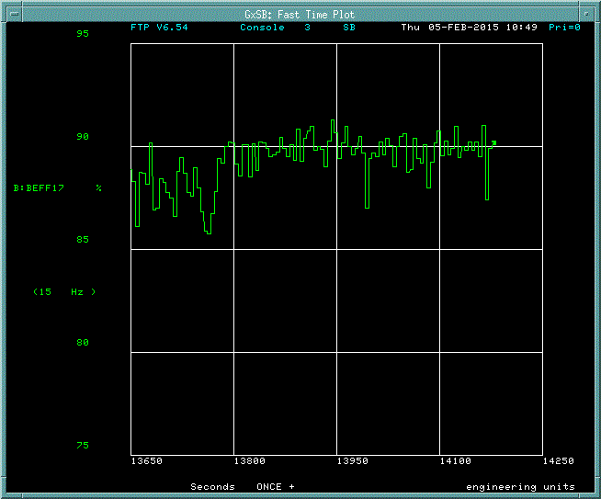
Beam Efficiency on $17 with 13BT
~90% efficiency was achieved. Goal is (82/84) ≈ 97% with notch.

Slide 6
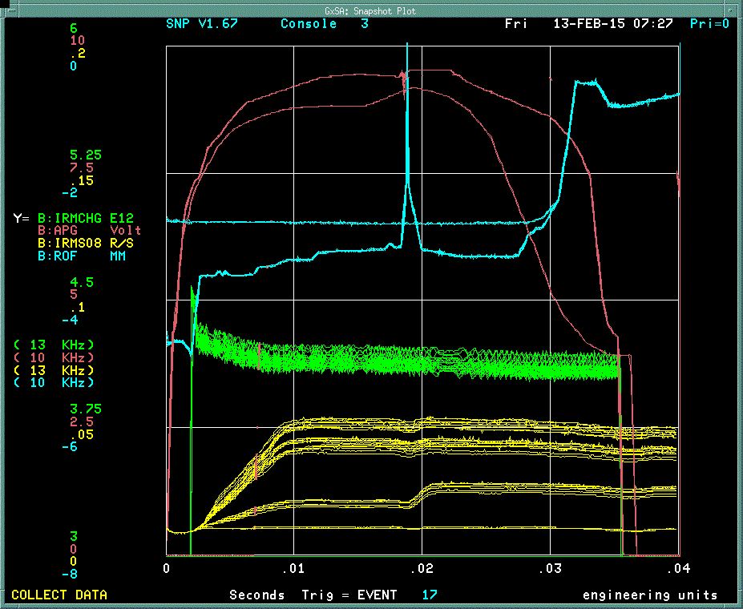
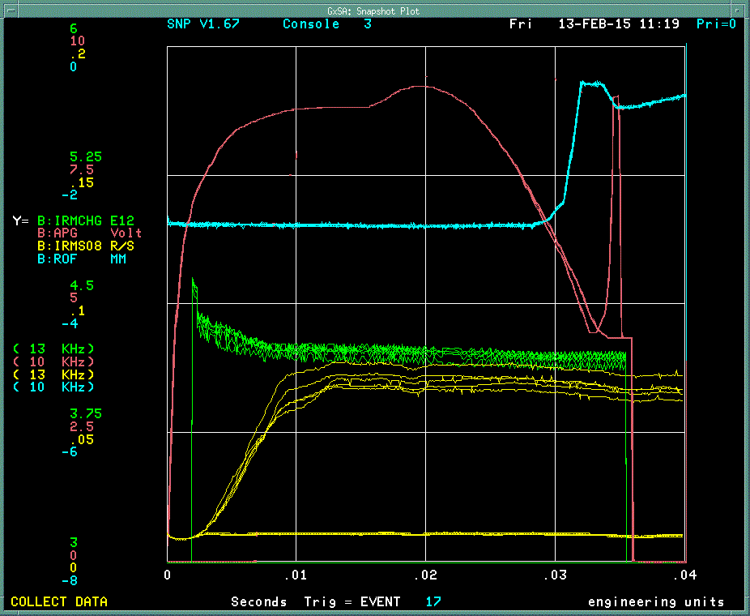
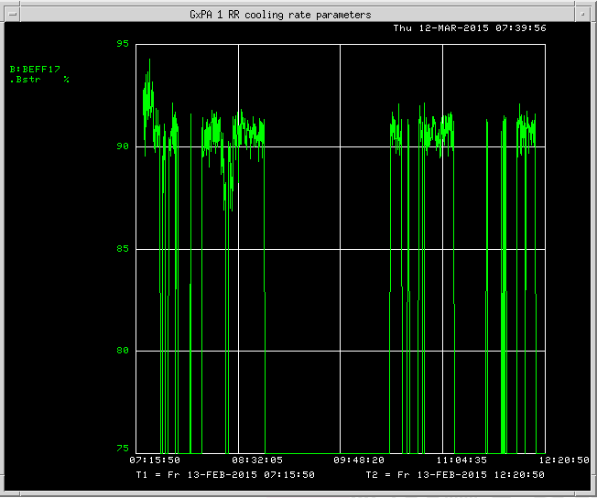
Studies Continued with B:RSTDLY=64635 (standard Val.)
Did continue our beam studies to optimize the APG and ROF curves on $17, B29 (Ramp 8) to smooth and reduce the RF power.
APG-New
APG-Nominal
APG-New
B:ROF-New
B:ROF-New
B:ROF-Nominal
Beam
Beam
Fast bunch rotation
BLM data
The difference between new and nominal APG (Vrf) curves on the cycle are shown for comparison.
>90% beam efficiency with 13BT.

Slide 7
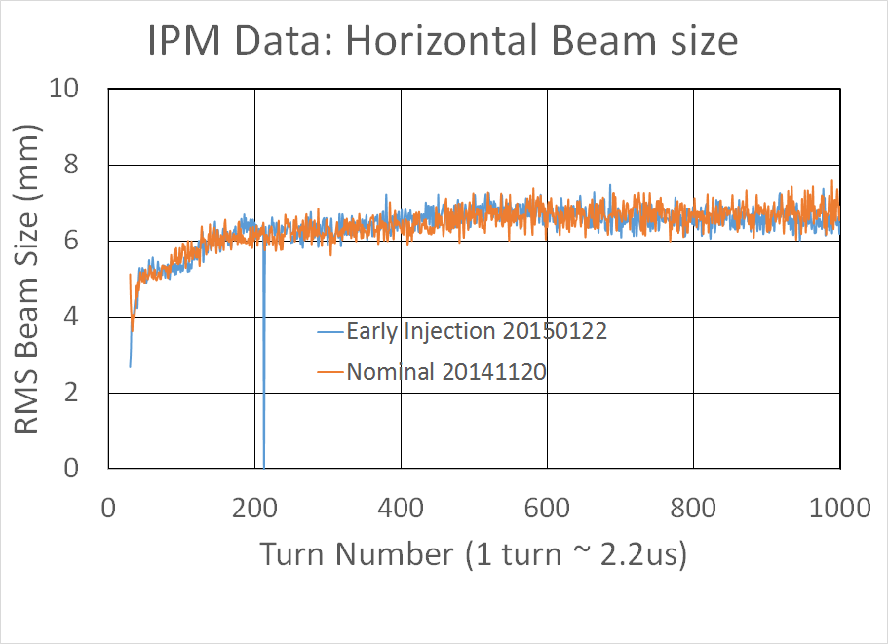
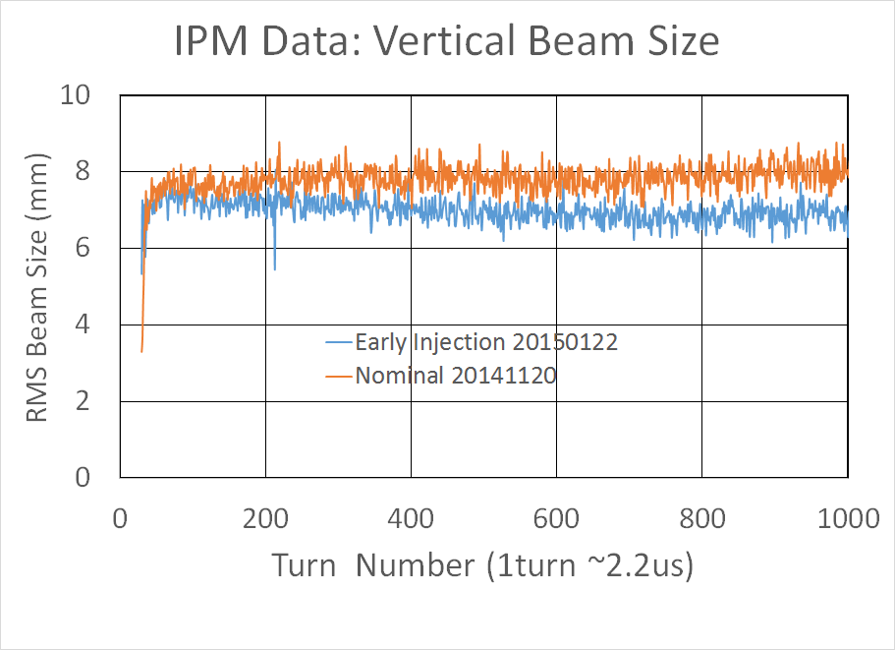
Samples of Transverse Beam Sizes for the First 2 ms
Data are for 14BT beam

Slide 8
Game plan & Issue
Early Injection Scheme can be made operational immediately
Set the B:RSTDLY = 64491 µs
Set new values for B:VFINJ, B:TTRXnn (turn dependent), … parameters indicated in earlier. This enables us to start beam capture immediately after Bmin.
Our immediate goal is to provide the beam with efficiency >85% (so far we have proved efficiency ~90% with 13BT). ← We may have to inform the users about this new development and why we are doing this.
← No showstopper
We will continue to optimize various parameters for better efficiency (similar to what is currently being done). This tuning is transparent to down-stream machines. Also improve on
PARAT, APG, ROF … curves, tune, chromaticity curves etc.,
This gives us an ability to make progress; reaching 97% efficiency with notch in place .

Slide 9
Game plan & Issue (cont.)
So far, we have taken only the partial benefits of Early Injection Scheme, i.e.,
Start beam rf capture immediately after Bmin though beam injection is about 144 µs earlier (in contrast, operationally we wait for 100s of µs on the up-ramp before rf paraphrase is turned on).
To take full benefit we need
To move the beam capture soon after the completion of the beam injection, i.e., B:VCDLY and B:VFIDR need to be referenced to TCLK
Currently, we use a calculated frequency curve which does not match with the value at injection (therefore we adjust B:VFINJ). We need better frequency synchronization bet. LLRF and real freq..
We also work on fast bunch rotation at extraction which is more clean and gives better lower energy spread beam to slip-stacking in RR.
If LINAC can give us more number of turns we can accommodate them!

Slide 10
Backup slides

Slide 11
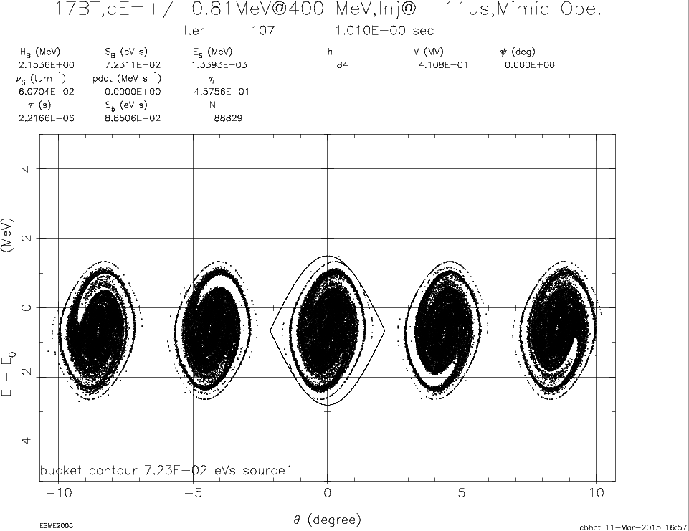
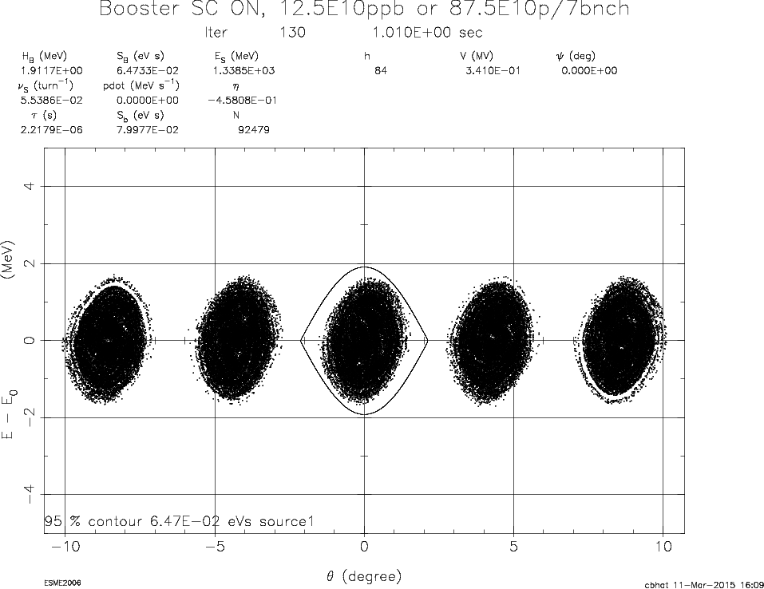
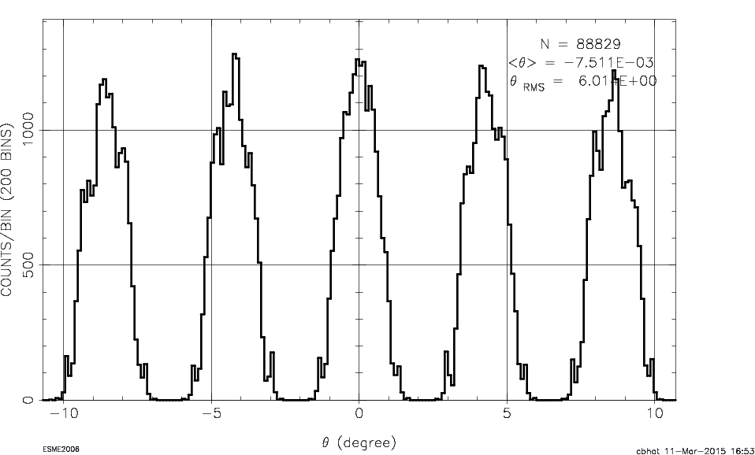
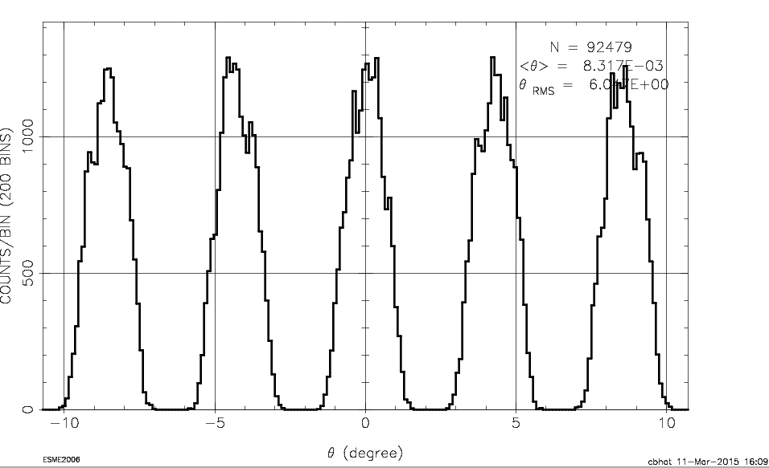
Simulation of Beam Capture at Injection
Used dE_{full} @ Inj= ±0.8 MeV (Measured at Inj.)
Operational Scheme:
Beam inj. at -11 μs w.r.t. Bmin (17BT)
Early Injection Scheme:
Beam Inj. at -144μs w.r.t. Bmin (17BT)
~220μs after Bmin – end of capture
~150μs after Bmin – end of capture
Vrf (@400 μs) = 0.81 MV
Bucket Area = 0.07 eVs
ε_{L} = 0.06 eVs
~2% Beam loss
even without SC effects
Bucket Area=0.065 eVs
ε_{L} = 0.045 eVs
No Beam loss

Slide 12
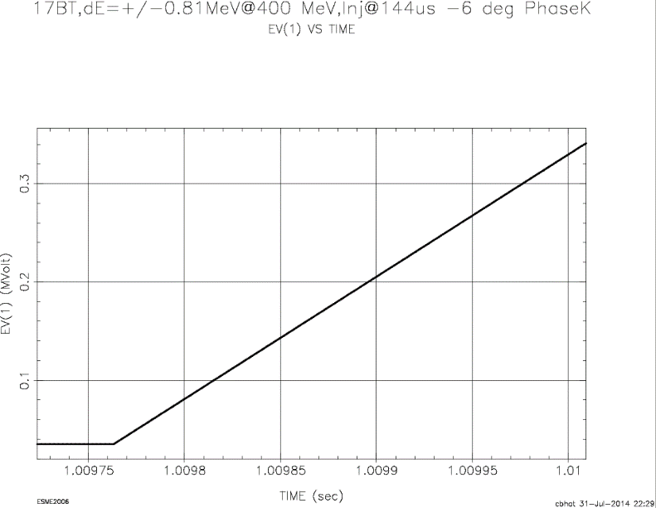
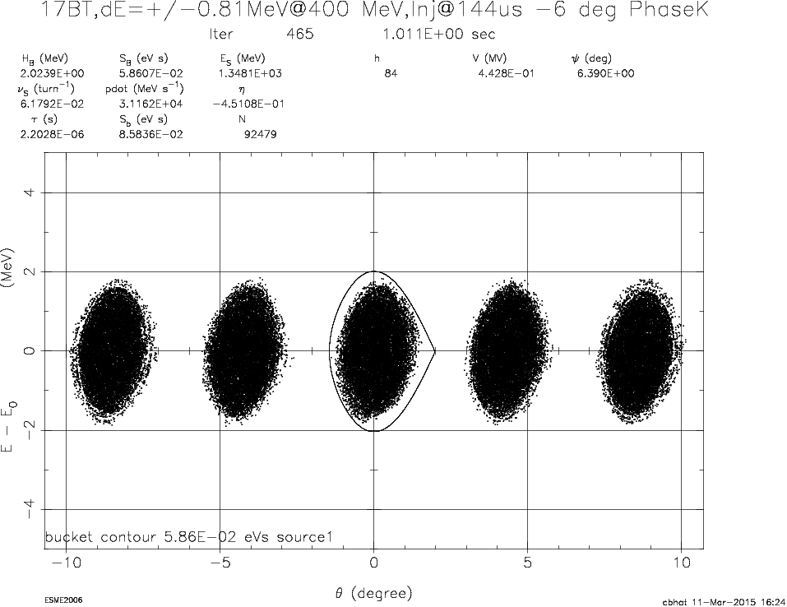
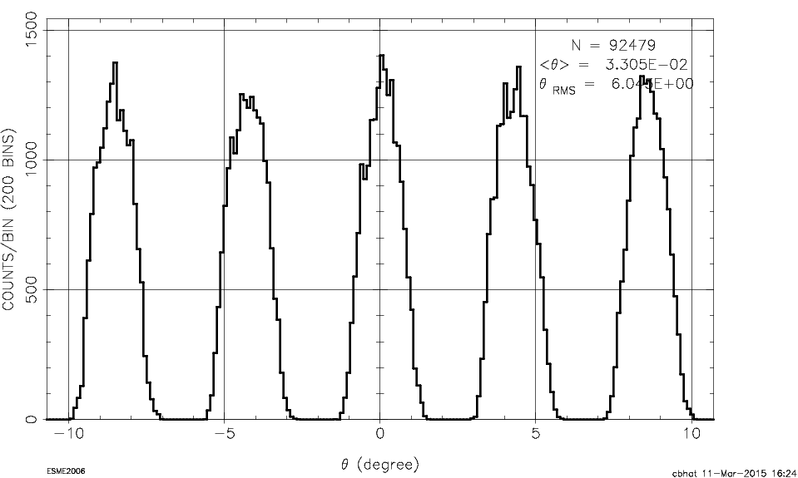
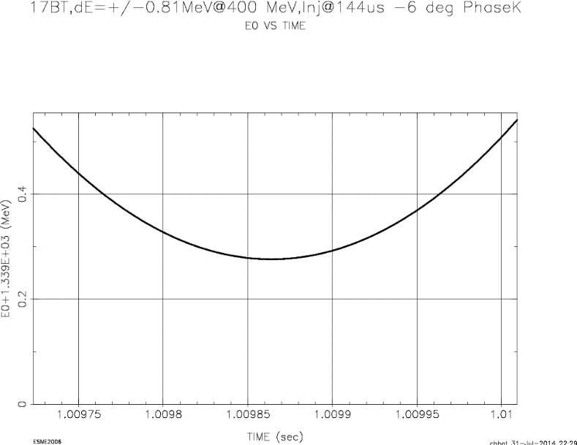
Early Inj. Scheme: Beam at ~1ms w.r.t. Inj.
Beam Inj. at -144μs w.r.t. Bmin (16BT)
Simulations with longitudinal SC(symmetric)
Vrf
1ms w.r.t. Beam inj.
Bmin(E_{s}min)
End of
Capture
Injection region
E_{s}
Vrf (@400 μs) = 0.44 MV
Bucket Area=0.06 eVs
ε_{L} ≈ π × 0.008µsc × 1.8 MeV = 0.045 eVs
No Beam loss even with SC effect
~30% lower rf power on average over the cycle
Bmin(E_{s}min)

Slide 13
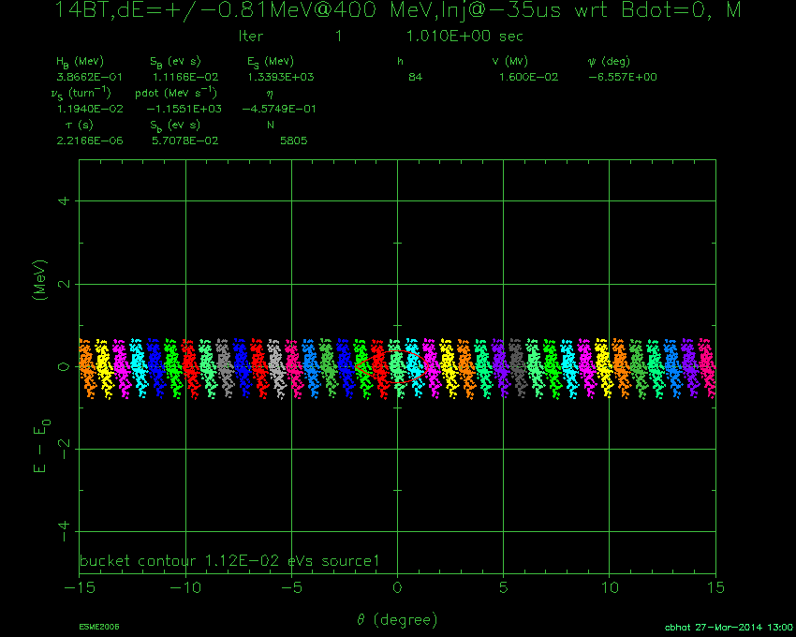
Simulation for Injection → Extraction in the Booster
Proposed Scheme: Inj@Bdot=0 at -100μs, Capture from -64 μs to 135μs, with a phase kick of ~ 6 deg after transition crossing.
This video is for Inj → Extraction
Mimic of Operational Scheme
VIDEO
VIDEO

Slide 14
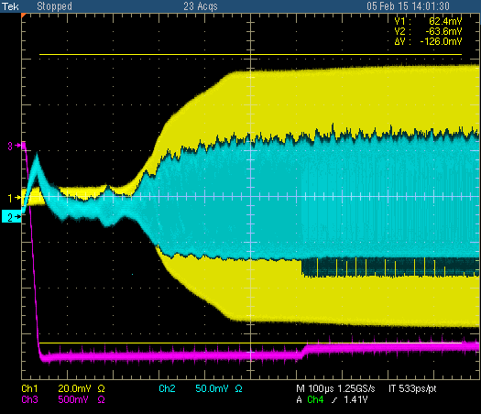
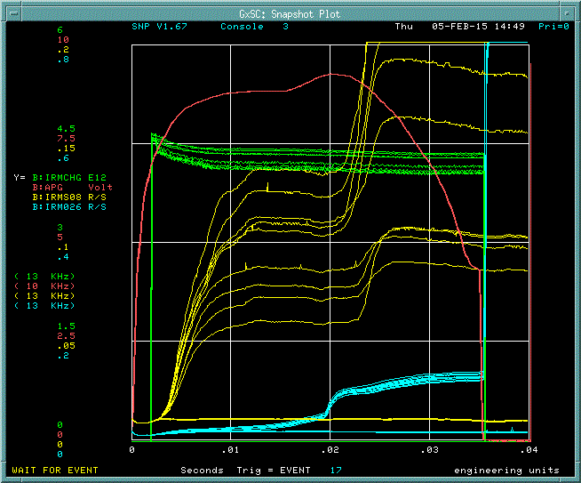
Recent Beam Studies on Early Injection
Beam WCM
RF
BDOT
Beam
(with notch)
APG
BDOT=0.0
Beam
(no notch)
Beam
Preliminary

Slide 15
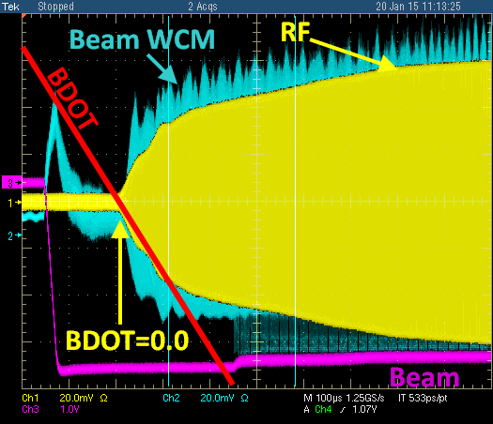
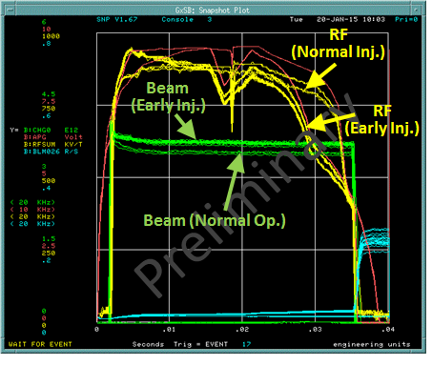
Beam Studies on Early Injection Scheme
Conditions:
beam injection at 144 μs earlier than BDOT=0.0
New RF, ROF and Paraphase curves
Additional tuning was done at transition crossing
12 BT after transition tuning
Flans:
We would like to start beam capture as early as possible after the beam injection with proper frequency curve. This needs some changes to the timing and hardwares. This work is in progress.

