Slide 1
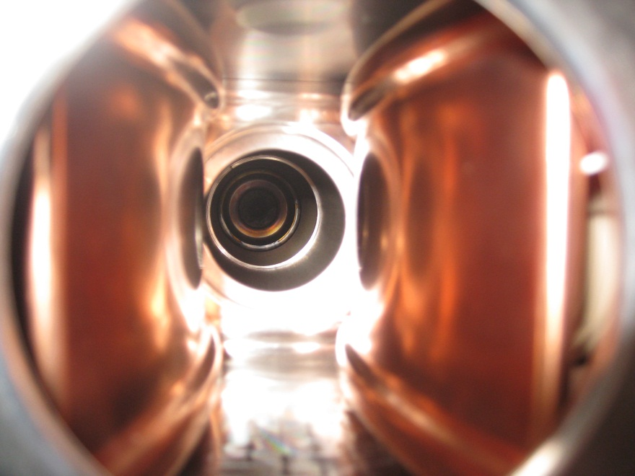
March 17, 2015
Chopping and Transport of
Low-Energy Ion Beams for FRANZ
C. Wiesner, M. Droba, O. Meusel, D. Noll,
O. Payir, U. Ratzinger, P. Schneider
IAP, Goethe-Universität Frankfurt am Main

Slide 2
Outline
Introduction: Neutron Production
Overview: The FRANZ Facility
LEBT and Chopper System
  E×B Chopper Concept
  Numerical Simulations
  Experimental Results
3) Conclusion

Slide 3
Introduction: Neutron Research
Material Science
Sensitivity for magnetic properties
High penetration depth in material
Sensitivity for different isotopes
Sensitivity to light elements (e.g. hydrogen)
Neutron imaging
Test radiation durability (detectors, fusion materials)
Cancer treatment (BNCT)
Neutron capture process relevant for ADS, nuclear astrophysics, …
Notes:
Siehe „ Strategiepapier zur Neutronenforschung in Deutschland: 2015-2045“
Opportunities for material science

Slide 4
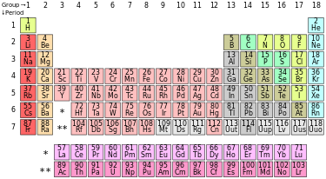
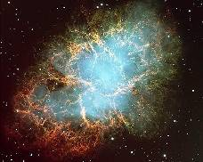
Introduction: Nuclear Astrophysics
Stellar nucleosynthesis:
About 50% of the element abundances beyond iron are produced via the s-process.
s-process takes place in AGB stars.
Neutron temperature:
k_{B}T = 8 to 90 keV [Reifarth et al., 2014].
Modelling requires neutron capture cross-sections from 1 to 400 keV.

Slide 5
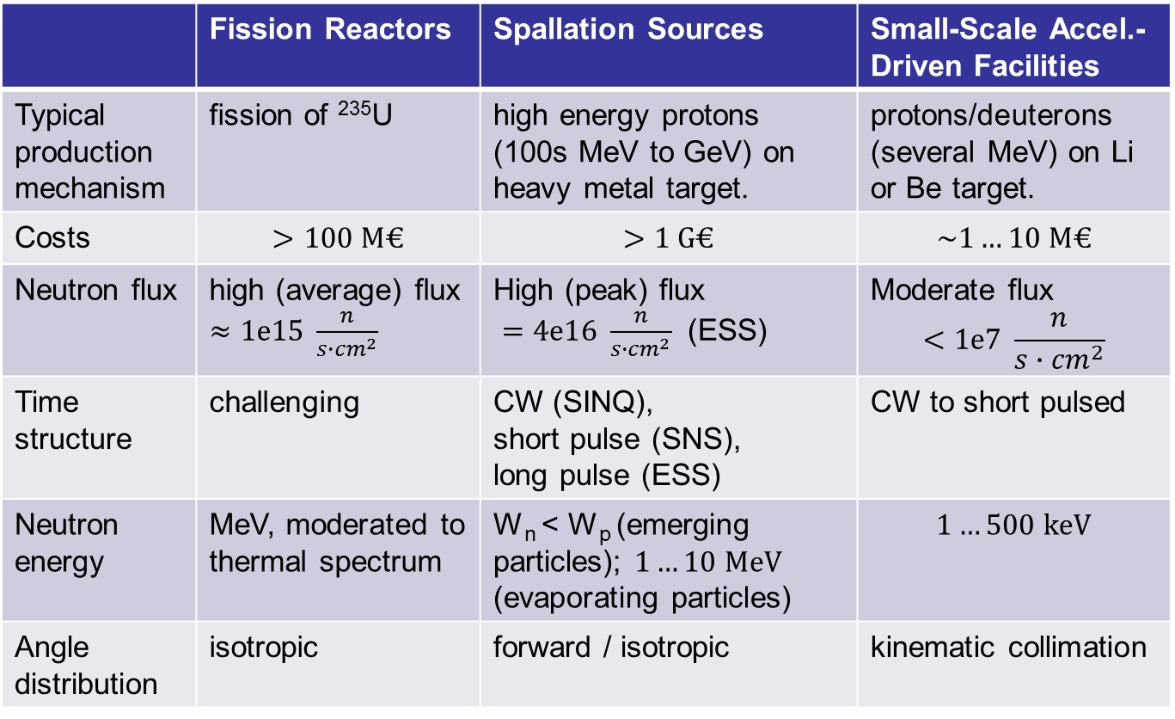
Introduction: Neutron Production Facilities
Spallation Neutron Sources
Short Pulse
Synchrotrons or compressor rings
Pulse length: ~μs
Long Pulse
Linacs
Pulse length: ~ms
Continuous
Cyclotrons
 | Fission Reactors | Spallation Sources | Small-Scale Accel.-Driven Facilities
Typical production mechanism | fission of ²³⁵U | high energy protons (100s MeV to GeV) on heavy metal target. | protons/deuterons (several MeV) on Li or Be target.
Costs | $$>100 M€$$ | $$>1 G€$$ | $$\sim 1…10 M€$$
Neutron flux | high (average) flux $≈1e15 \frac{n}{s∙{cm}^{2}}$ | High (peak) flux $=4e16 \frac{n}{s∙{cm}^{2}}$ (ESS) | Moderate flux $$<1e7 \frac{n}{s∙{cm}^{2}}$$
Time structure | challenging | CW (SINQ), short pulse (SNS), long pulse (ESS) | CW to short pulsed
Neutron energy | MeV, moderated to thermal spectrum | W_{n} < W_{p} (emerging particles); $1…10 MeV$ (evaporating particles) | $$1…500 keV$$
Angle distribution | isotropic | forward / isotropic | kinematic collimation
Notes:
FRM-II, München: >400 Mio Euro Kosten, 20MW Nennleistung. 8E14 n/s/cm^2
ILL, Grenoble: 55 MW Leistung
PIK, Gatchina, (St.Petersburg): 100 MW Therm. Leistung, neutron flux: 5e15 cm-2 s-1
TRIGA (66 weltweit): Leistung: 20kW bis 16 MW.
„TRIGA-Reaktoren können im Puls-Betrieb gefahren werden. Das heißt, dass der Reaktor ungeregelt bis in den prompt überkritischen Zustand angefahren wird. Der Neutronenfluss und damit die Wärmeleistung steigt sehr schnell an, bis der negative Temperaturkoeffizient der Reaktivität der Brennstäbe den Reaktor wieder unterkritisch macht.^{[1]} Die Impulsdauer beträgt etwa 30 ms. Wegen der Restwärme in den Brennelementen muss der Reaktor dann bis zum nächsten Impuls abkühlen. Bei diesem Betrieb werden sehr hohe Impulsleistungen und Neutronenflussdichten erreicht, die im kontinuierlichen Betrieb nicht möglich wären.“
„TRIGA is no ordinary light water reactor because much of its "moderation" of neutrons is due to the hydrogen that is mixed in with the fuel itself. Therefore, as the fuel temperature increases when the control rods are suddenly removed, the neutrons inside the hydrogen-containing fuel rod become warmer than the neutrons outside in the cold water. These warmer neutrons inside the fuel cause less fissioning in the fuel and escape into the surrounding water. The end result is that the reactor automatically reduces power within a few thousandths of a second, faster than any engineered device can operate. In other words, the fuel rods themselves act as an automatic power regulator, shutting the reactor down without engineered devices. “
Der totale Neutronenfluss im Kern eines typischen Druckwasserreaktors liegt bei etwa 10¹³ cm⁻²s⁻¹.
Die Spallations-Neutronenquelle SINQ erreicht 10¹⁴ cm⁻²s⁻¹, der Forschungsreaktor FRM-II 8×10¹⁴ cm⁻²s⁻¹.^{[4]}
In einem Fusionsreaktor wird die Wand des Plasmagefäßes ebenfalls einem Neutronenfluss von etwa 10¹⁴ cm⁻²s⁻¹ ausgesetzt sein^{[5]}.
„Reactor-based sources now produce 10¹⁵ n/(cm² s), and spallation sources generate greater than 10¹⁷ n/(cm² s).”
“nuclear fission produces neutrons with a mean energy of 2 MeV (200 TJ/kg, i.e. 20,000 km/s), which qualifies as "fast". However the range of neutrons from fission follows a Maxwell–Boltzmann distribution from 0 to about 14 MeV in the center of momentum frame of the disintegration, and the mode of the energy is only 0.75 MeV, meaning that fewer than half of fission neutrons qualify as "fast" even by the 1 MeV criterion.”
… Moderation..
Fast reactors use unmoderated fast neutrons to sustain the reaction

Slide 6
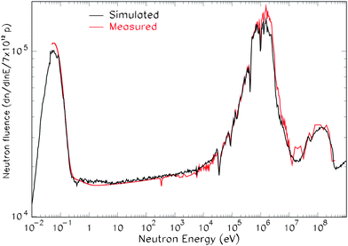
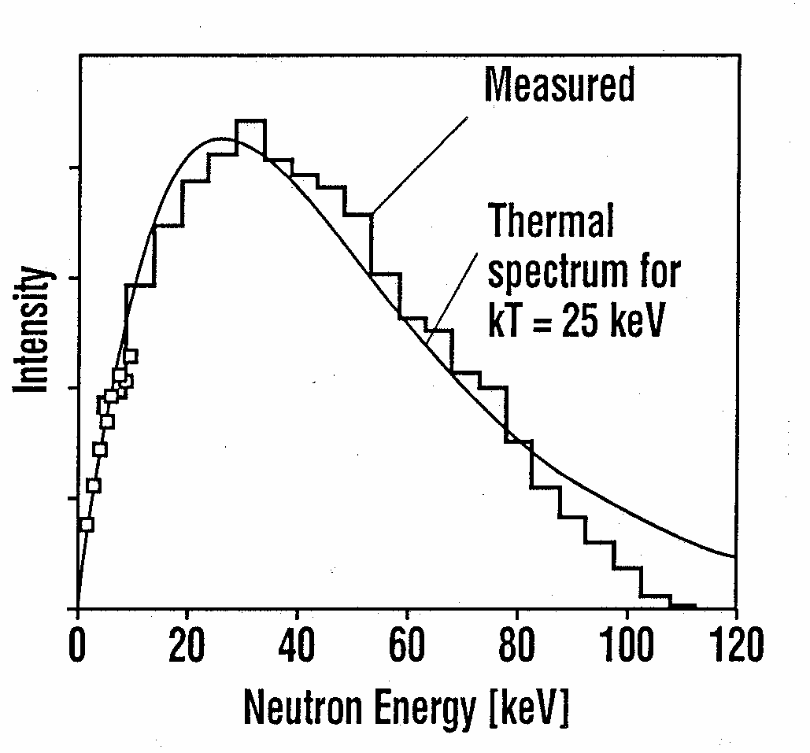
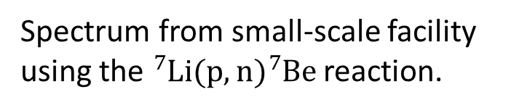
Neutron Energy Spectrum
Spectrum from Spallation Source
(20 GeV protons on Pb target)
Spectrum from small-scale facility
using the ${}_{ }^{7}{Li(p,n){}_{ }^{7}{Be }}$reaction.
n energy:
1…100 keV
Arai and Crawford, p.18
Measured at n-TOF, CERN (flight path: 200m) [Colonna et al., 2010].
Measured at FZ Karlsruhe for a primary proton energy of 1.991 MeV (flight path: 0.8m) [Beer et al., 2001].
Notes:
Colonna: “Simulated and measured neutron fluence per proton pulse, available for measurements in the experimental area, at 200 m from the spallation target.“
The neutron fluence is defined as the neutron flux integrated over a certain time period.
n-tof: 5E4 n/s/cm^2 between 1… 100 keV (2007)

Slide 7
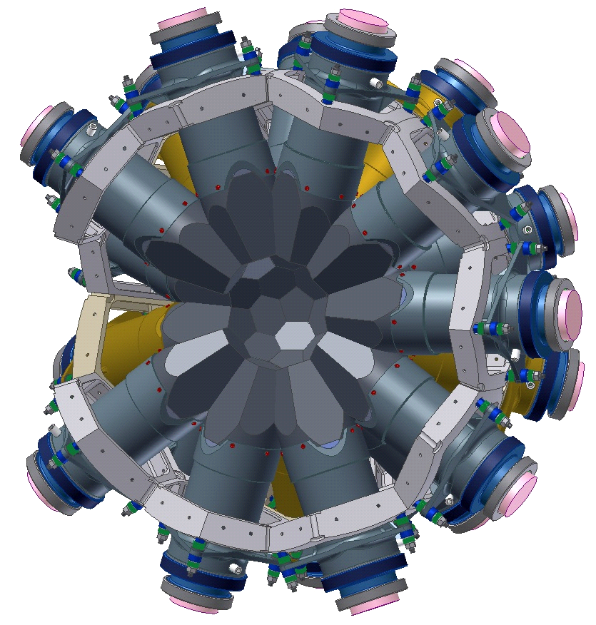
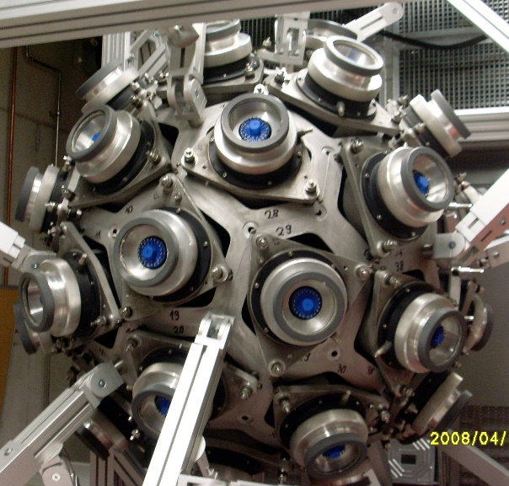
Time-of-Flight (TOF) Method
TOF method allows to measure the neutron capture cross-sections as a function of the neutron energy.
Pulsed primary beam and fast (<1 ns) gamma calorimeter required.
Adequate neutron spectrum assures low background.
© R. Reifarth
80 cm flight path
E_{n} = 1..200 keV
I [a.u]
Prompt Flash
Other Reactions
(n,γ)
on sample
0
130
160
TOF [ns]
E_{n}=200 keV
E_{n}=128 keV
4π BaF₂ detector at Frankfurt.

Slide 8
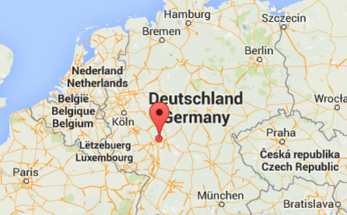
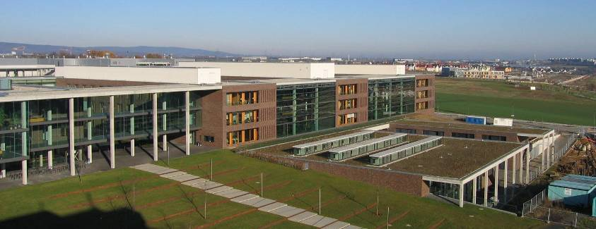
Frankfurt Neutron Source FRANZ
FRANZ is currently under construction at Frankfurt University:
Deliver neutrons for nuclear astrophysics and material sciences
Accelerator test bench
Education of students in accelerator physics
Experimental Hall, IAP
Physics Building, Goethe-Universität Frankfurt

Slide 9
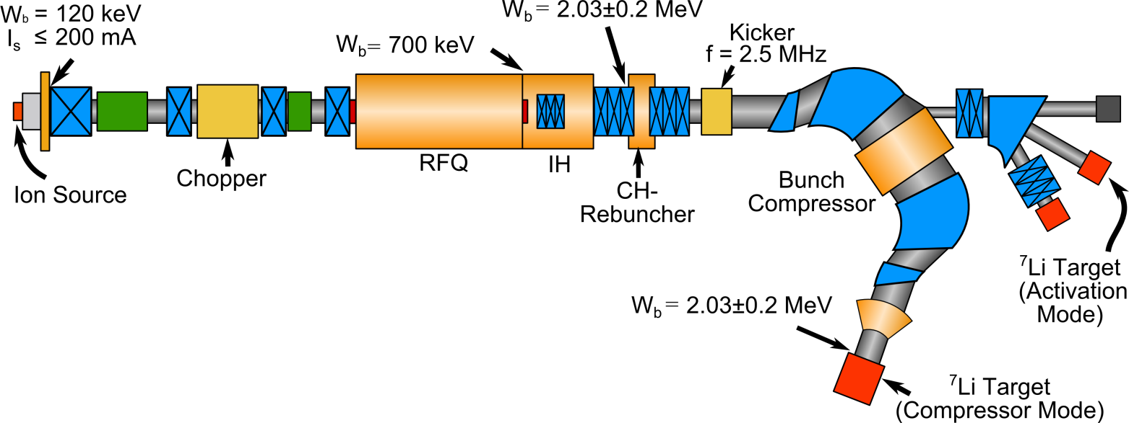
Frankfurt Neutron Source FRANZ
Frankfurt Neutron Source FRANZ
Activation Mode:
2 mA, cw operation
LEBT
Goal in Compressor Mode:
This requires a primary proton beam
Deliver a high (peak) neutron flux,
produced via the ⁷Li(p,n)⁷Be reaction,
for the energy-dependent measurements of n-capture cross sections (using TOF).
with high intensities (50-200 mA),
at 2 MeV beam energy,
with a challenging time structure
(1 ns, 257 kHz).

Slide 10
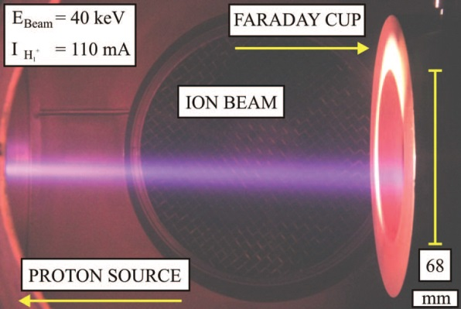
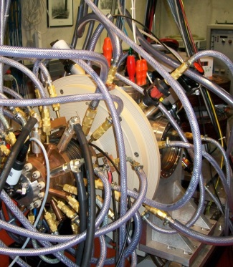
Frankfurt Neutron Source FRANZ
Frankfurt Neutron Source FRANZ
LEBT
High-Current Ion Source
Arc-discharge driven ion source
Proton current: 50 mA (240 mA)
Current density: 480 mA/cm²
DC operation
Proton fraction > 90 %
Beam energy: 120 keV
ε_{rms, norm} < 0.08 mm∙ mrad
© K. Volk, W. Schweizer
Notes:
At the moment, the ion source is undergoing a detailed
test program at a dedicated ion source test stand. A proton
beam current density of 480 mA/cm2 was achieved during
dc operation using a total arc power of 9.7 kW. For an emission
opening radius of 4mm, a proton current of 240mA
was extracted at 50 keV beam energy. By manipulating the
plasma properties, the percentage of the undesired hydrogen
fractions, H+
2 and H+
3 , can be reduced to less than 10% [5].
First beam emittance measurements show an 89%-rms emittance
of ǫ rms, norm = 0.08mm·mrad at 52 keV energy and
at a normalized beam current of 85mA [6].

Slide 11
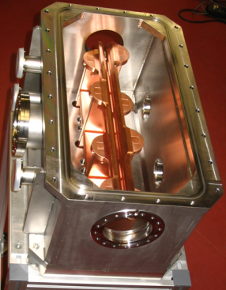
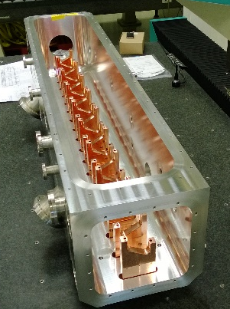
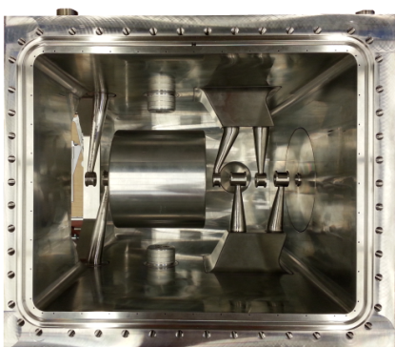
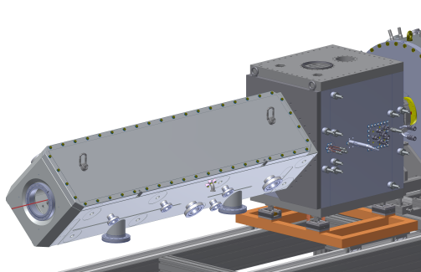
Frankfurt Neutron Source FRANZ
Frankfurt Neutron Source FRANZ
LEBT
2.4 m
RFQ test module
2 MeV Linac Section
CW operated
f_{rf} = 175 MHz
RFQ under construction
IH is being copper plated
RFQ test module tested
with P_{rf} ≈ 115 kW/m
700 keV
2 MeV
120 keV
RFQ
IH
© M. Heilmann, U. Ratzinger, A. Schempp

Slide 12
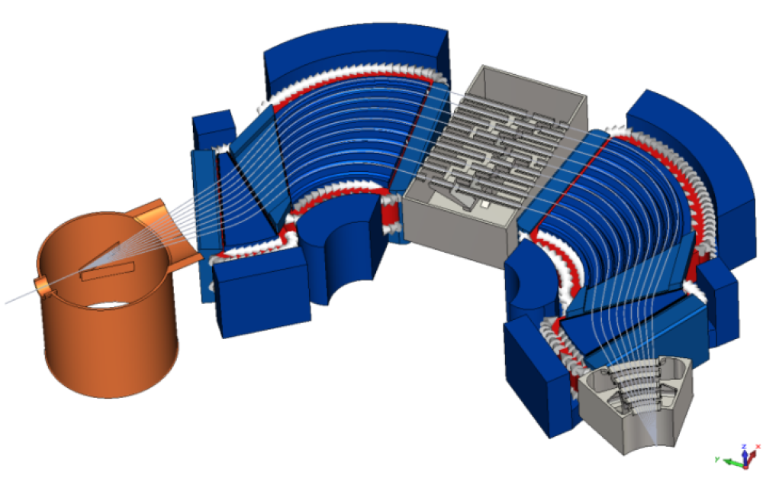
Frankfurt Neutron Source FRANZ
Frankfurt Neutron Source FRANZ
LEBT
DC
t_{p} > 50 ns,
257 kHz
t_{p} =1 ns,
257 kHz
Bunch Compressor
Mobley Type
Electric Kicker (f = 2.5 MHz)
Magnetic Guiding System
Rebuncher Cavities
L. P. Chau et al., LINAC’10, MOP100

Slide 13
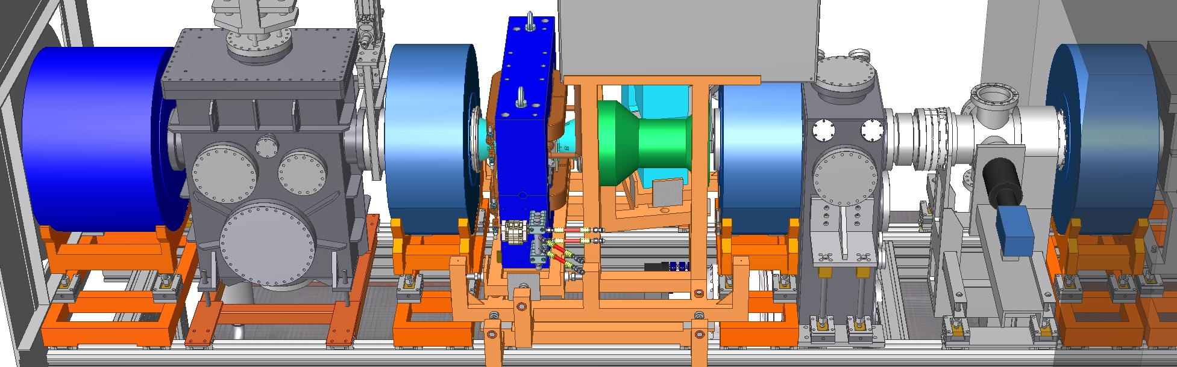
Frankfurt Neutron Source FRANZ
Frankfurt Neutron Source FRANZ
LEBT
DC
t_{p} > 50 ns,
257 kHz
t_{p} =1 ns,
257 kHz
LEBT Section
Chopper
Bunch Compressor
Mobley Type
Electric Kicker (f = 2.5 MHz)
Magnetic Guiding System
Rebuncher Cavities
Sol1
Sol2
Sol3
Sol4
L. P. Chau et al., LINAC’10, MOP100

Slide 14
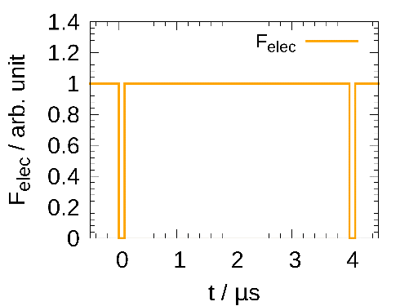
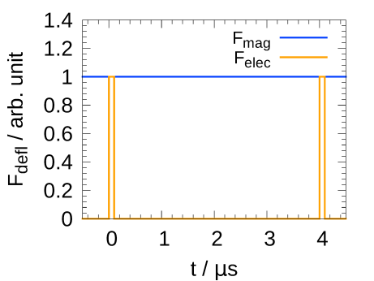
E×B Chopper: Motivation
Requirements: Chopping a dc beam at
– low energy (120 keV)
– high intensity (50 mA)
– high repetition rate (257 kHz),
– producing a short beam pulse: 50 ns / 3.9 μs.
High duty cycle for electric field.
Electric Deflection
Disadvantages: Risk of voltage breakdowns, especially at high beam intensities and especially for a high duty factor of the electric deflection field.
Magnetic Deflection
Low duty cycle for
electric field.
Disadvantages: High power consumption, especially at high repetition rates.
Concept
Combining static magnetic and pulsed electric deflection in an E×B (Wien-filter) field configuration.

Slide 15
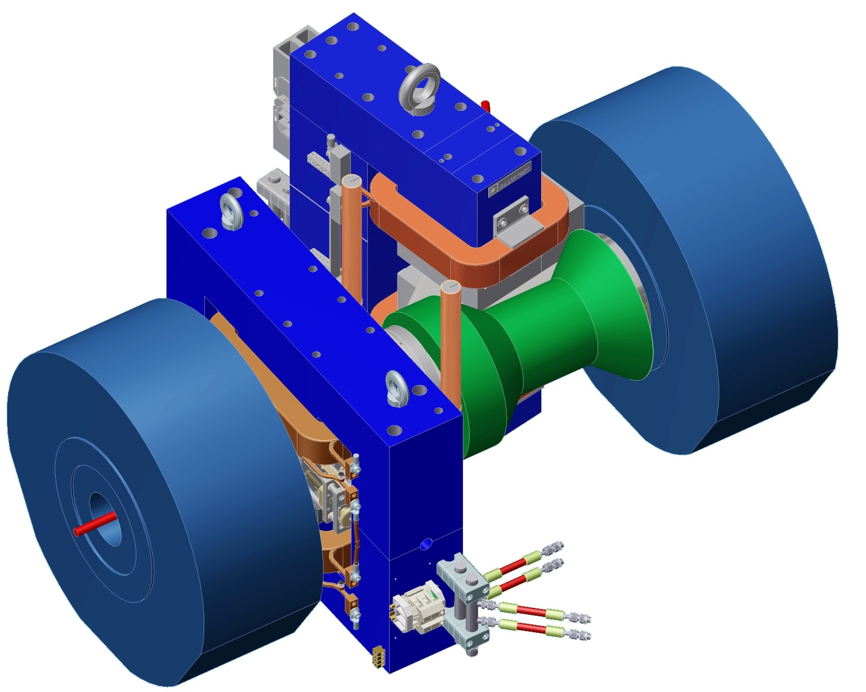
E×B Chopper: Concept
Separation Magnet
Dumped Beam
Chopper Magnet
Pulsed
Beam
Sol3
Shielding Tube
DC
Beam
Sol2
0.8 m

Slide 16
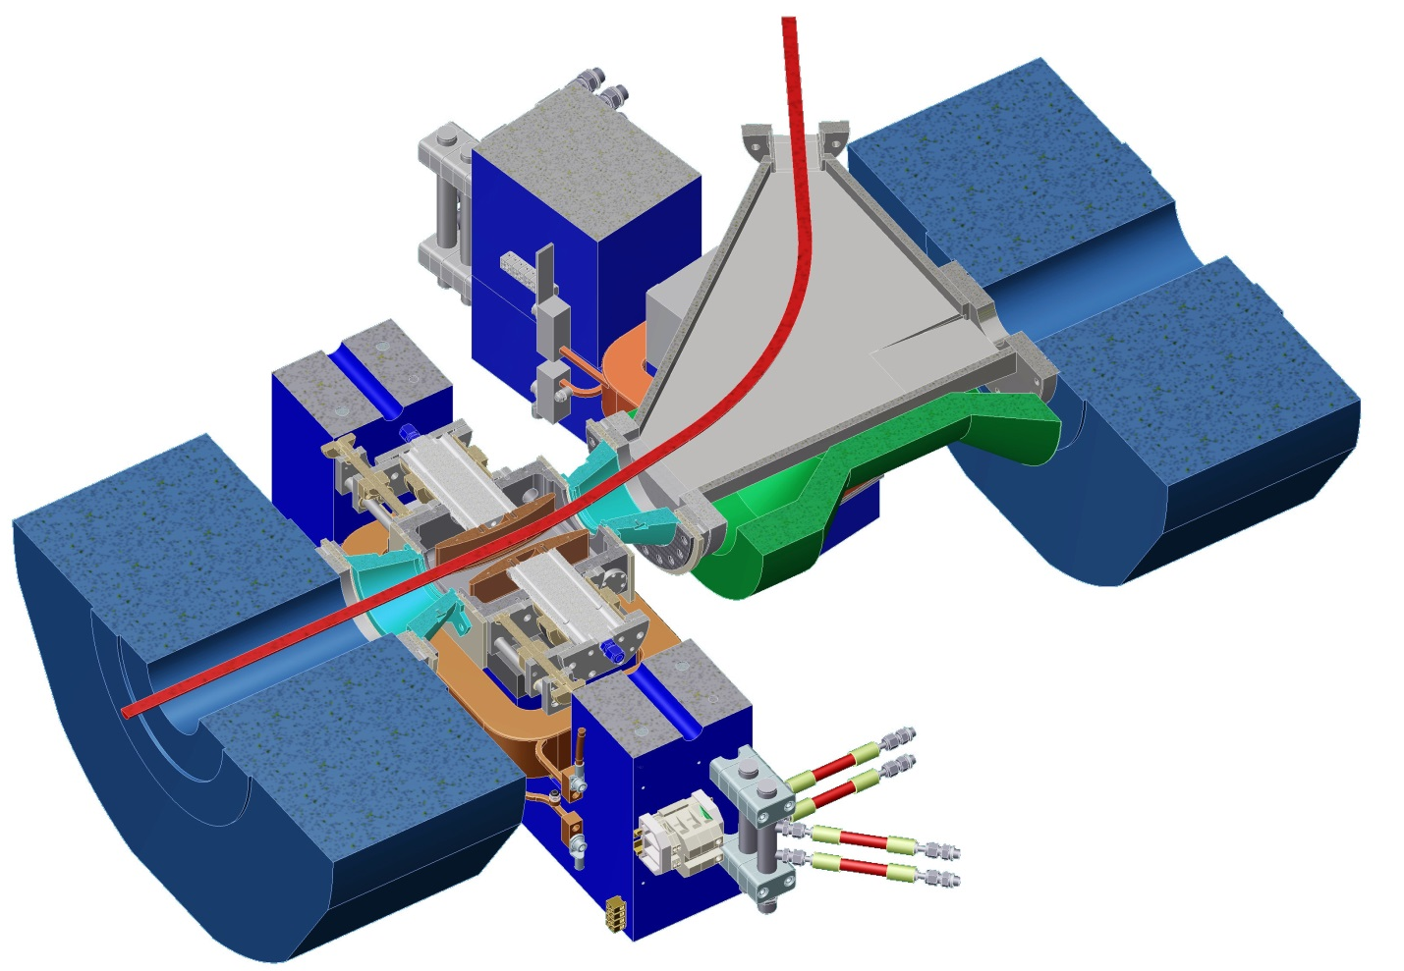
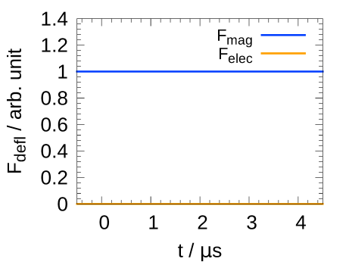
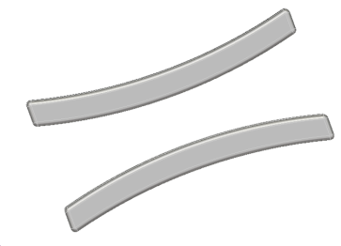
E×B Chopper: Concept
Separation Magnet
Dumped Beam
B₀ ≈ 250 mT
Chopper Magnet
B₀ ≈ 60 mT
Sol3
Shielding Tube
Electric Deflector
DC
Beam
Sol2
V_{defl} = 0 kV

Slide 17
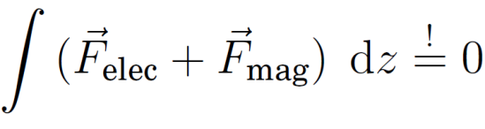
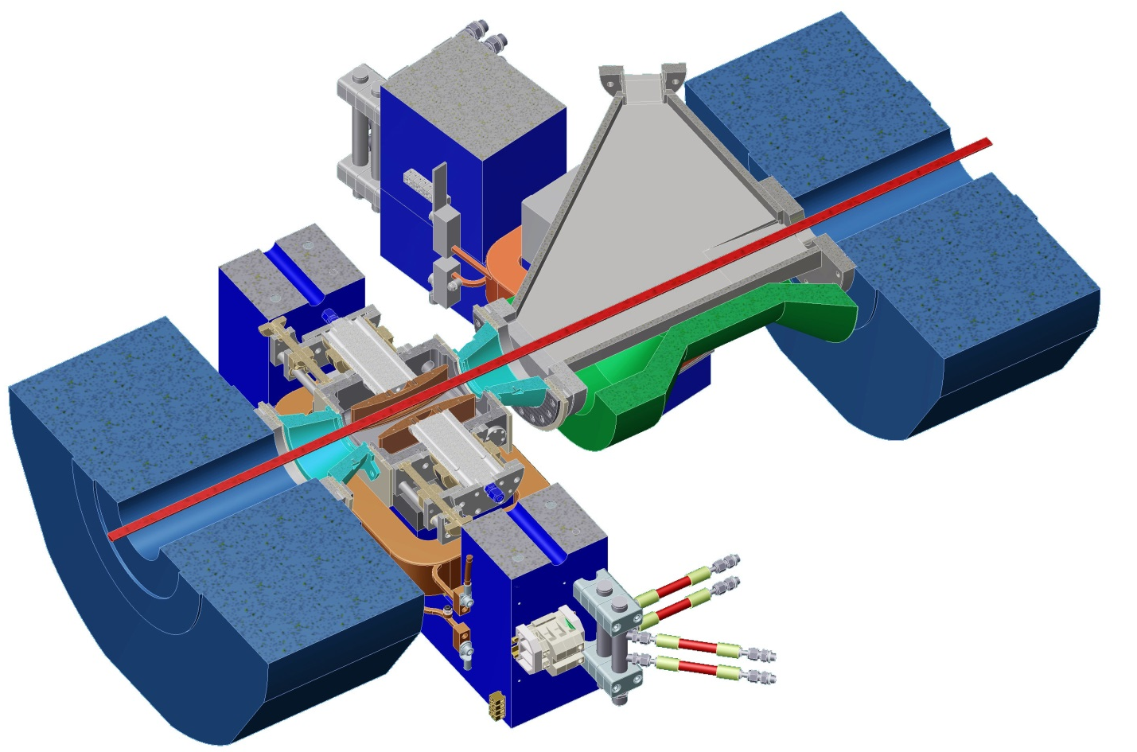
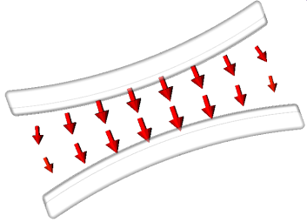
E×B Chopper: Concept
Separation Magnet
B₀ ≈ 250 mT
Chopper Magnet
Pulsed Beam,
f_{rep} = 257 kHz,
τ = 50 ns … 350 ns
B₀ ≈ 60 mT
Sol3
Shielding Tube
Electric Deflector
DC
Beam
Sol2
V_{defl} = 12 kV

Slide 18
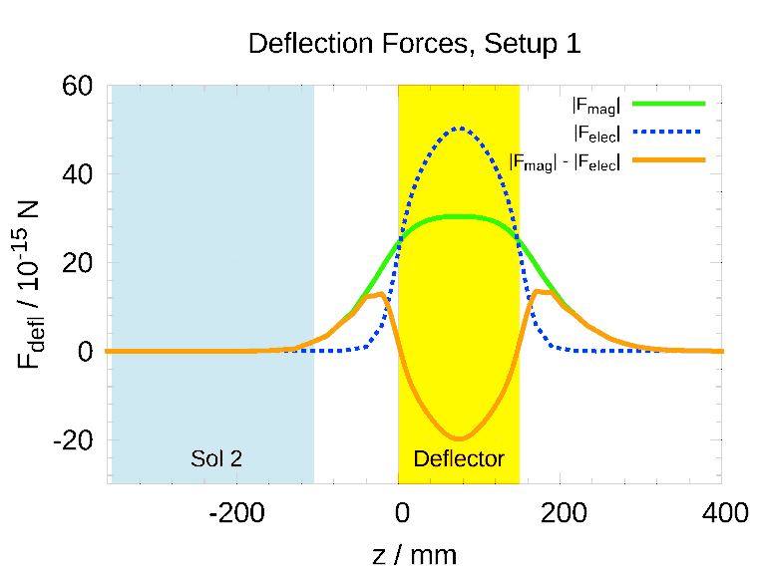
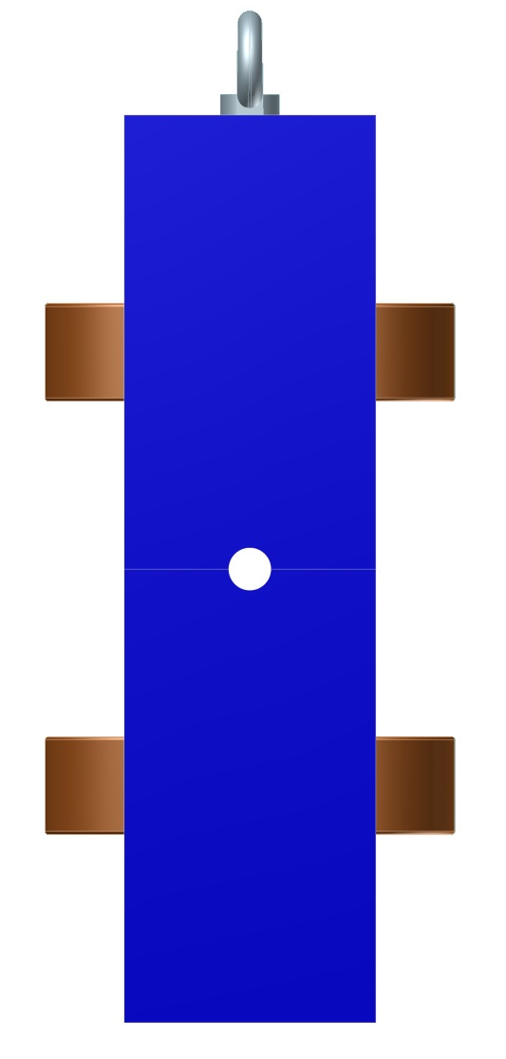
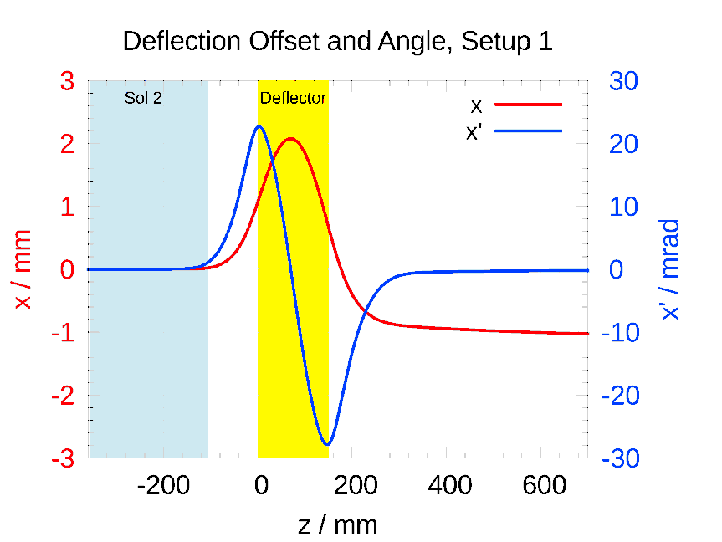
Beam Dynamics in Static E×B Fields
Longitudinal Matching of Deflection Forces
Magnetic
Dipole
Beam
(p, 120 keV)
y
z

Slide 19
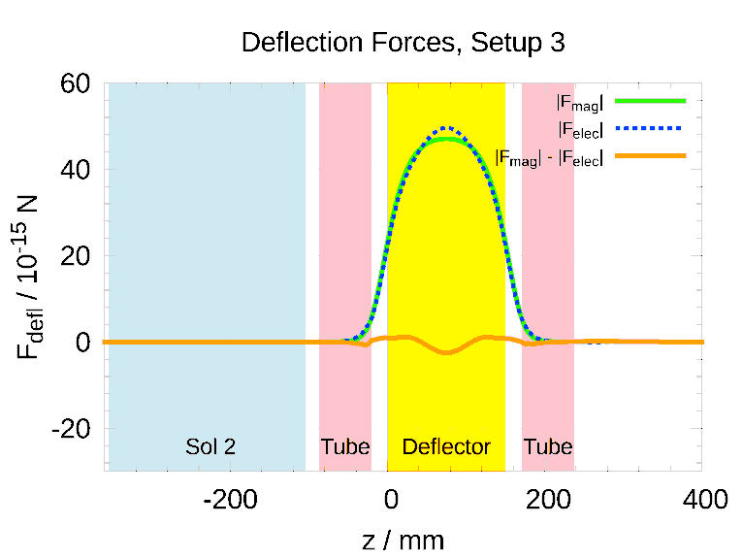
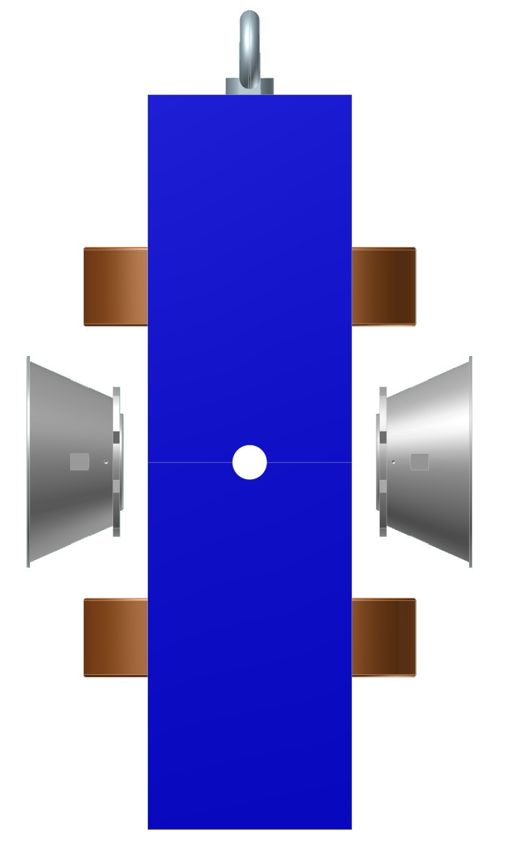
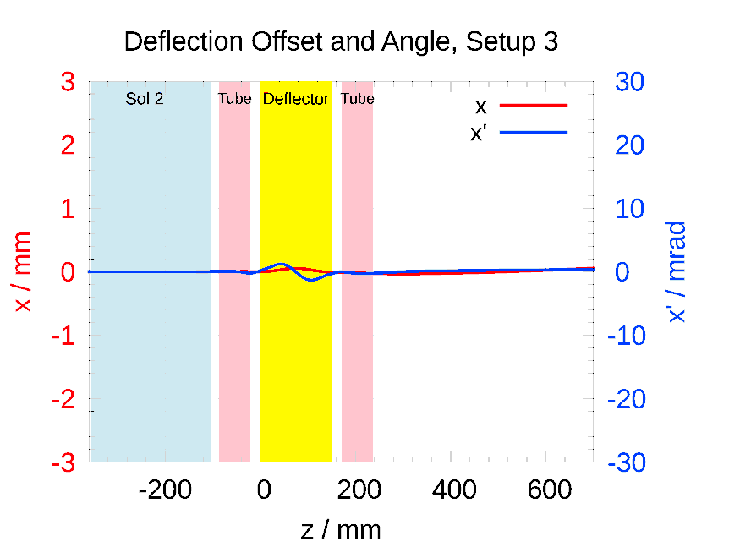
Beam Dynamics in Static E×B Fields
Longitudinal Matching of Deflection Forces
Magnetic
Dipole
Shortening
Tubes
Beam
(p, 120 keV)
y
z

Slide 20

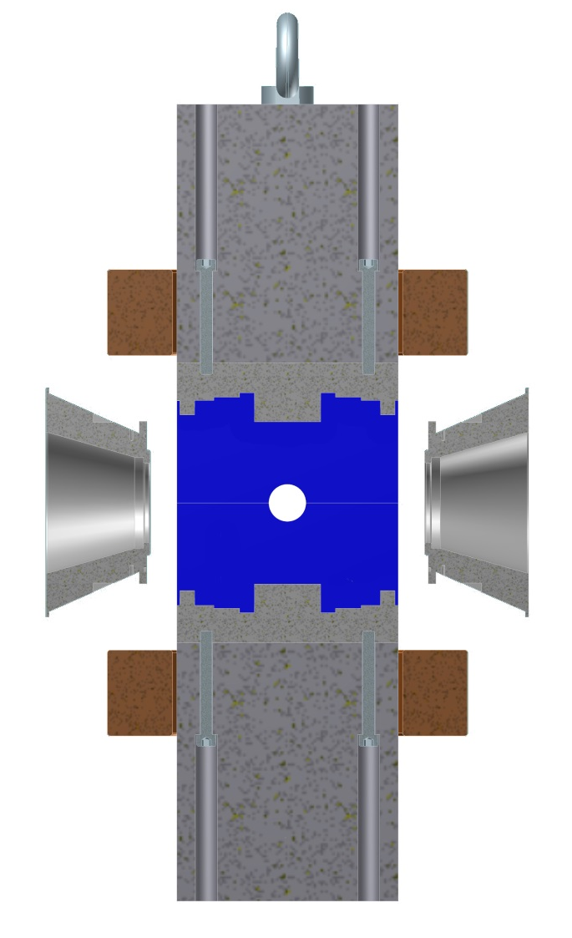
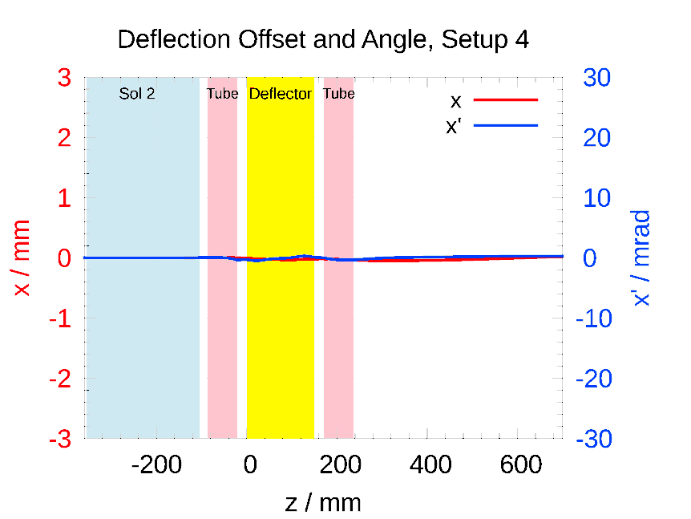
Beam Dynamics in Static E×B Fields
Longitudinal Matching of Deflection Forces
Magnetic
Dipole
Optimized
Pole Profile
Shortening
Tubes
Beam
(p, 120 keV)
y
z

Slide 21
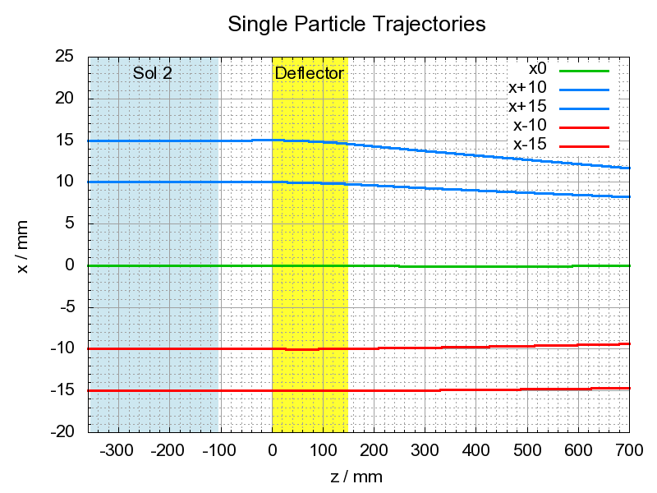
Beam Dynamics in Static E×B Fields
Transverse Matching of Deflection Forces
Particle Tracking, Protons, 120 keV.

Slide 22
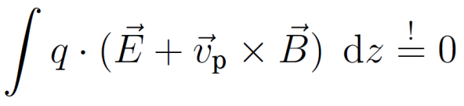
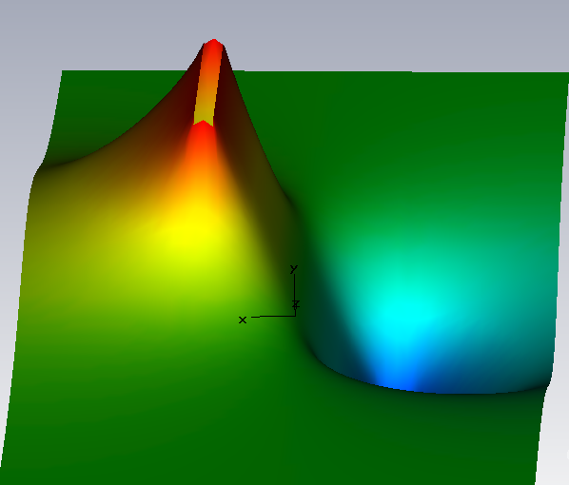
Beam Dynamics in Static E×B Fields
Effect 1: Wien-Focusing Effect.
F_{elec}
F_{mag}
Velocity Change:
v_{l} < v₀ < v_{r}
+
̶
Deceleration
Acceleration
→ Focusing Effect in x direction.
Beam

Slide 23
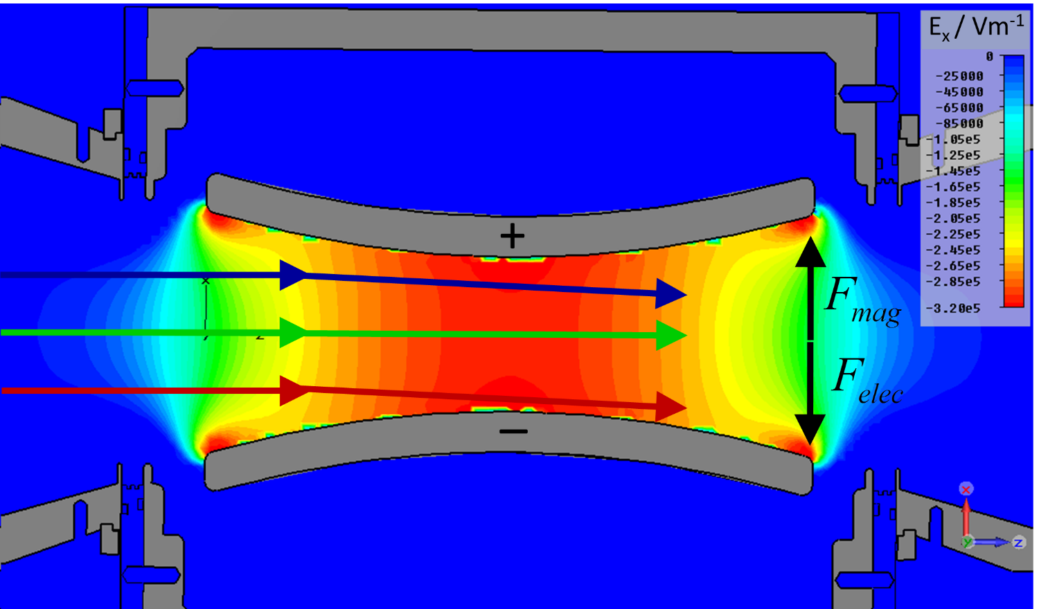
Beam Dynamics in Static E×B Fields
Effect 2: Given inhomogeneous field distribution.

Slide 24
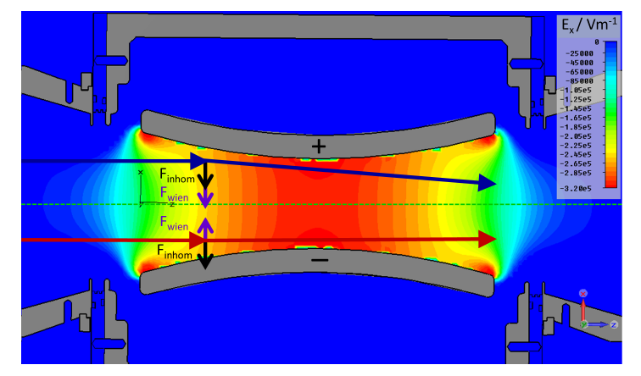
Beam Dynamics in Static E×B Fields
Superposition of both effects.

Slide 25
Beam Dynamics in Static E×B Fields
Particle Tracking, Protons, 120 keV.

Slide 26
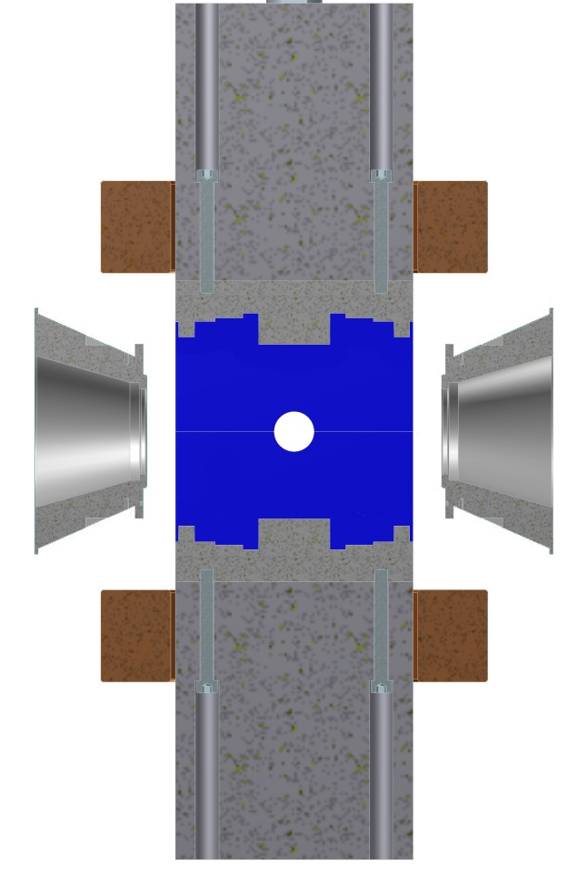
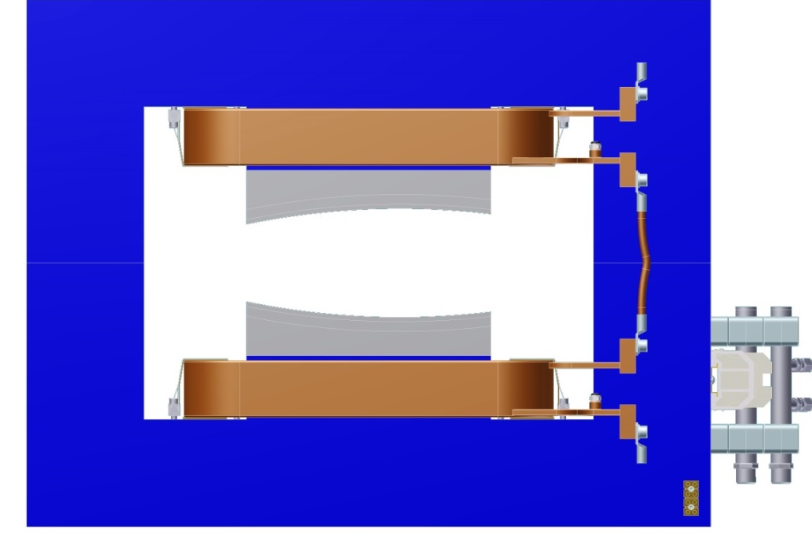
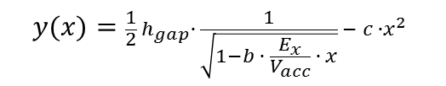
Beam Dynamics in Static E×B Fields
Longitudinal Matching of Deflection Forces
Transverse Matching of Deflection Forces
Magnetic
Dipole Yoke
Optimized Pole Profile:
Longitudinally
Optimized
Pole Profile
Field
Homogenization
$$y(x)=\frac{1}{2}{ h}_{gap}∙ \frac{1}{\sqrt{1−b ∙ \frac{E_{x}}{V_{acc}} ∙ x}} − c ∙x^{2}$$
Shortening
Tubes
Compensation of
Velocity Change
Beam
y
x
Beam
y
z
Field Simulations
using CST EMS.
Minimizing horizontal beam movement
Minimizing position offset
- Focusing in both transverse planes
- Preserving cylindrical symmetry

Slide 27
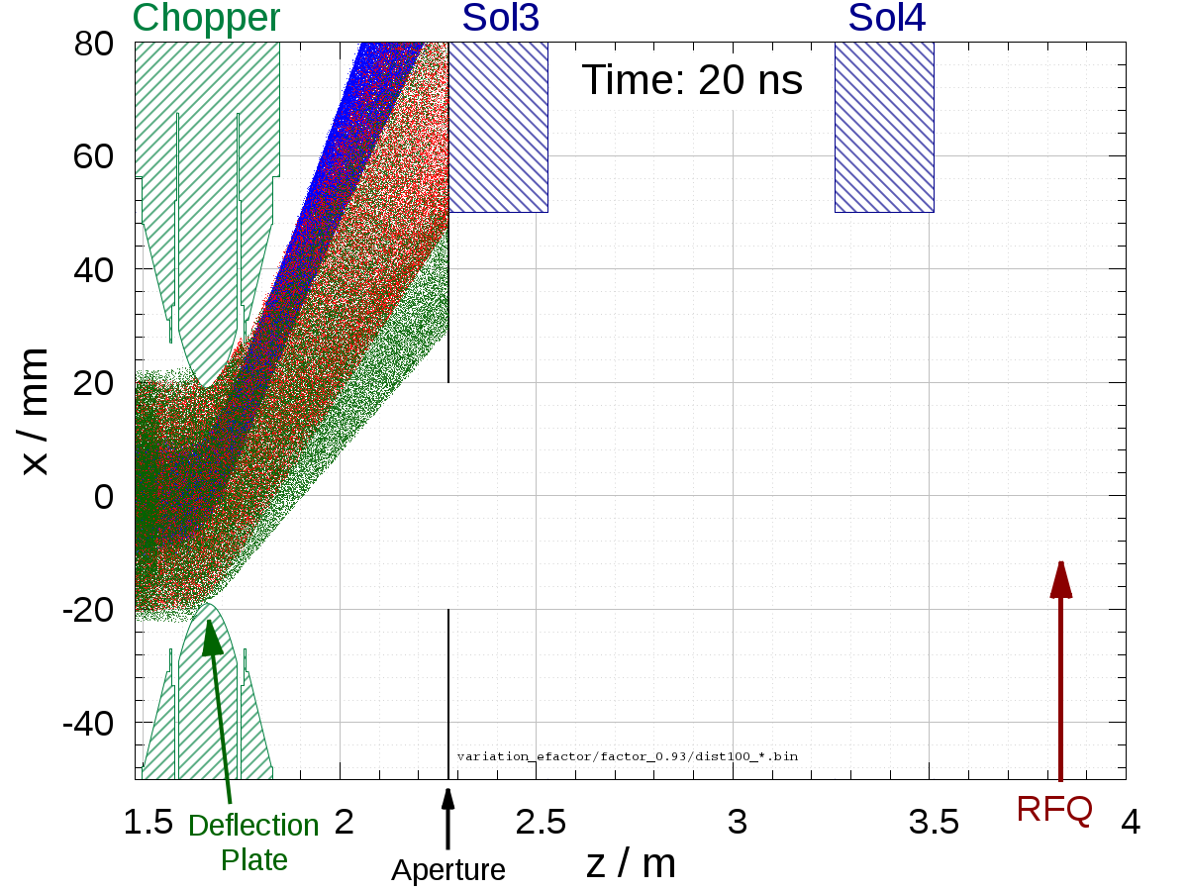
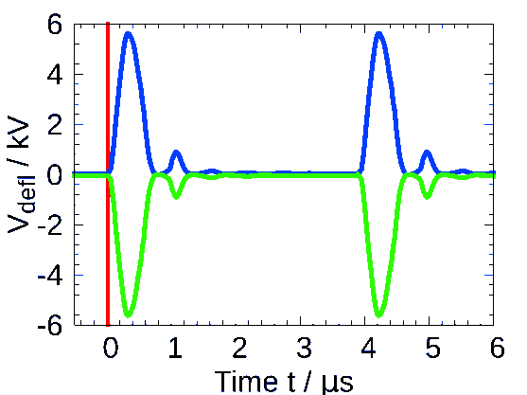
Beam Shaping Simulation
p, 50 mA
H₂⁺, 5 mA
H₃⁺, 5 mA
Input Data
W_{b} = 120 keV
I_{proton} = 50 mA
Matched Input Distribution
3d E-field of deflect. plates
3d B-field of chopper magnet
3d B-field of solenoids
Measured
HV Pulse
Beam
Beam dynamics calculations using PIC-Code Bender.
By Daniel Noll.

Slide 28
Beam Shaping Simulation
p, 50 mA
H₂⁺, 5 mA
H₃⁺, 5 mA
Voltage Pulse
Beam dynamics calculations using PIC-Code Bender.

Slide 29
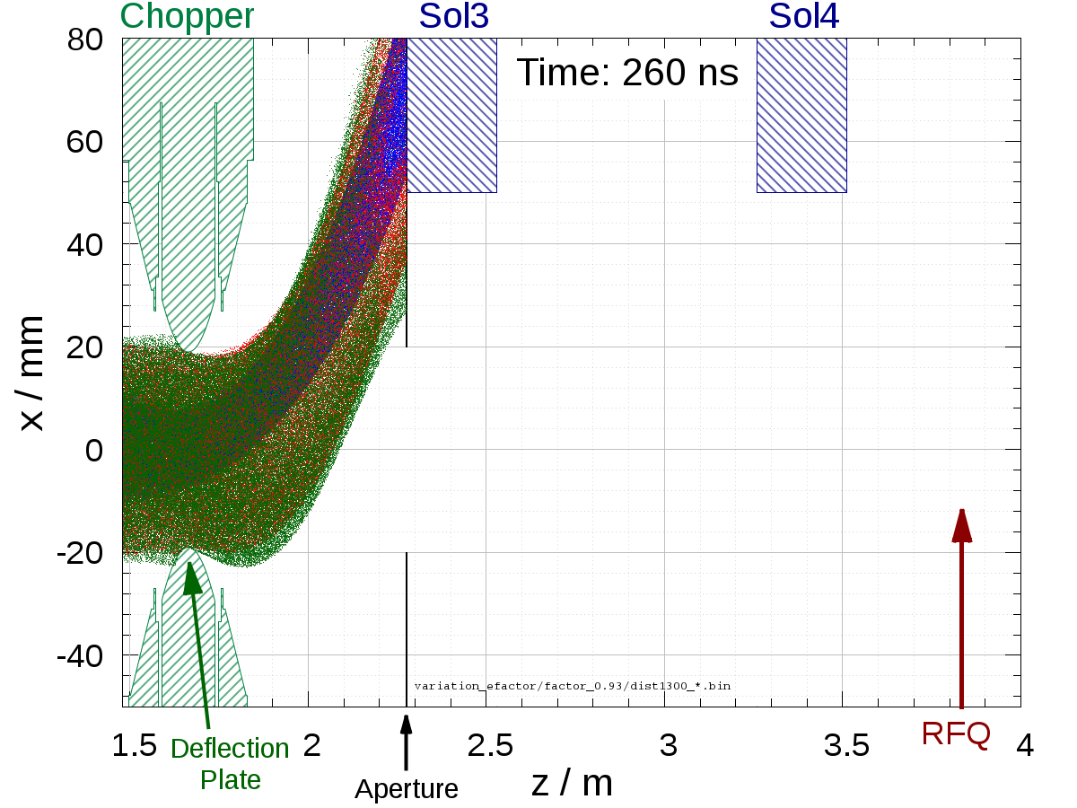
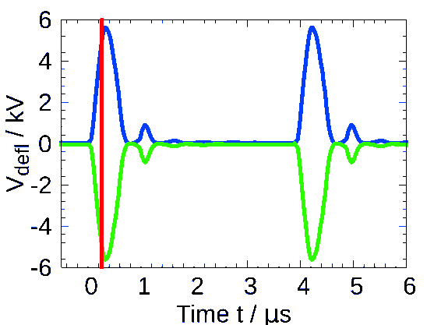
Beam Shaping Simulation
p, 50 mA
H₂⁺, 5 mA
H₃⁺, 5 mA
Voltage Pulse
Beam dynamics calculations using PIC-Code Bender.

Slide 30
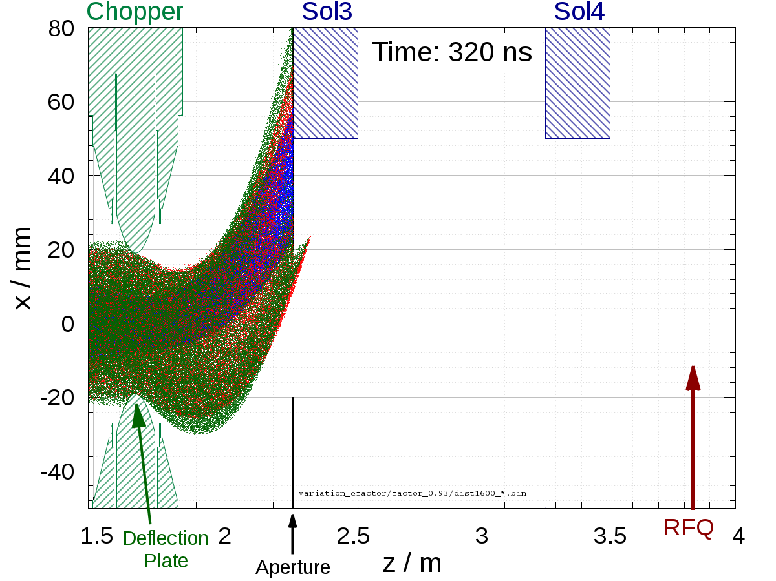

Beam Shaping Simulation
p, 50 mA
H₂⁺, 5 mA
H₃⁺, 5 mA
Voltage Pulse
Beam dynamics calculations using PIC-Code Bender.

Slide 31


Beam Shaping Simulation
p, 50 mA
H₂⁺, 5 mA
H₃⁺, 5 mA
Voltage Pulse
Beam dynamics calculations using PIC-Code Bender.

Slide 32


Beam Shaping Simulation
p, 50 mA
H₂⁺, 5 mA
H₃⁺, 5 mA
Voltage Pulse
Beam dynamics calculations using PIC-Code Bender.

Slide 33


Beam Shaping Simulation
p, 50 mA
H₂⁺, 5 mA
H₃⁺, 5 mA
Voltage Pulse
Beam dynamics calculations using PIC-Code Bender.

Slide 34


Beam Shaping Simulation
p, 50 mA
H₂⁺, 5 mA
H₃⁺, 5 mA
Voltage Pulse
Beam dynamics calculations using PIC-Code Bender.

Slide 35


Beam Shaping Simulation
p, 50 mA
H₂⁺, 5 mA
H₃⁺, 5 mA
Voltage Pulse
Beam dynamics calculations using PIC-Code Bender.

Slide 36



Beam Shaping Simulation
p, 50 mA
H₂⁺, 5 mA
H₃⁺, 5 mA
Beam Pulse
Voltage Pulse
Beam dynamics calculations using PIC-Code Bender.

Slide 37



Beam Shaping Simulation
p, 50 mA
H₂⁺, 5 mA
H₃⁺, 5 mA
Beam Pulse
Voltage Pulse
Beam dynamics calculations using PIC-Code Bender.

Slide 38



Beam Shaping Simulation
p, 50 mA
H₂⁺, 5 mA
H₃⁺, 5 mA
Beam Pulse
Voltage Pulse
Beam dynamics calculations using PIC-Code Bender.

Slide 39



Beam Shaping Simulation
p, 50 mA
H₂⁺, 5 mA
H₃⁺, 5 mA
Beam Pulse
Voltage Pulse
Beam dynamics calculations using PIC-Code Bender.

Slide 40

Beam Shaping Simulation
Simulated Pulse Shape
at the RFQ Entrance
Results of
Numerical Simulations:
Time requirements fulfilled.
50 ns flat top:
  Position offset below ±0.3 mm (necessary condition: longitudinal matching of deflection forces).
  Low emittance.
  Cylindrical symmetry preserved (necessary condition: transverse matching of deflection forces).
Low transmission for H₂⁺ and H₃⁺ ions (pulsed velocity filter).
50 ns
Simulated without collimator system in front of the RFQ.

Slide 41




Chopper Hardware Design
Electric Deflector
Deflection Chamber
V₀ = ±6 kV
f_{rep}= 257 kHz
l_{plate} = 15 cm
h_{plate} = 8 cm
Beam
Magnetic Dipole
Deflection Chamber in Dipole
Yoke
B₀ = 130 mT
I_{coil} = 130 A
l_{dipole} = 15 cm
h_{gap}= 11 cm
Exchangeable
Pole Plates
Coils

Slide 42

Commissioning
Concrete Shielding
for linac and neutron target
HV Terminal: 150 kV
LEBT Section and E×B chopper

Slide 43

Measurements: DC Beam
Emittance measurement behind Solenoid 1
He⁺,
10 keV,
0.9 mA

Slide 44

Measurements: DC Beam
He⁺,
10 keV,
0.9 mA
Measured using
slit-grid device,
installed behind Sol1.
Simulated using Lintra code, assuming 85% space charge compensation.

Slide 45


Measurements: DC Beam
He⁺,
10 keV,
0.9 mA
Phase-space angle
Kurtosis

Slide 46


FRANZ LEBT: Overview
Faraday
Cup 2
Ion Source:
He⁺, 14 keV
L = 3.7 m
Beam Current
Transformer
Sol4
Sol1
Sol2
Sol3
Faraday Cup 1
HV Pulse
Generator
E×B Chopper
Aperture: r = 50 mm

Slide 47

Measurements: Repetition Rate
Beam chopping at 257 kHz experimentally achieved.
Ratio of Pulsed to DC Beam Current of
95.2% ± 1.6%
achieved.
f_{rep} = 257 kHz
He⁺, 14 keV
r_{aperture} = 50 mm
I_{dipole} = 40.0 A

Slide 48


Measurements: Pulse Shape
Reliable chopping and transport was achieved even for high-perveance beams.
Rise Time:
120 ns ± 10 ns
50 ns
Gen. perveance K = 2.73e-3
(equivalent to 175 mA, p, 120 keV).
He⁺, 14 keV
r_{aperture} = 50 mm
I_{dipole} = 40.0 A
Notes:
K equivalent to 21.9 mA, H-, 30keV

Slide 49


Measurements: Variation of Wien Ratio
sweep
He⁺, 14 keV
r_{aperture} = 50 mm
I_{dipole} = 40.0 A
const.

Slide 50


Measurements: Variation of Wien Ratio
sweep
He⁺, 14 keV
r_{aperture} = 50 mm
I_{dipole} = 40.0 A
const.

Slide 51

Measurements: Variation of Wien Ratio
sweep
He⁺, 14 keV
r_{aperture} = 50 mm
I_{dipole} = 40.0 A
const.

Slide 52

Measurements: Variation of Wien Ratio
sweep
He⁺, 14 keV
r_{aperture} = 50 mm
I_{dipole} = 40.0 A
const.

Slide 53

Measurements: Variation of Wien Ratio
sweep
He⁺, 14 keV
r_{aperture} = 50 mm
I_{dipole} = 40.0 A
const.

Slide 54

Measurements: Variation of Wien Ratio
sweep
He⁺, 14 keV
r_{aperture} = 50 mm
I_{dipole} = 40.0 A
const.

Slide 55

Measurements: Variation of Wien Ratio
sweep
He⁺, 14 keV
r_{aperture} = 50 mm
I_{dipole} = 40.0 A
const.

Slide 56


Measurements: Variation of Wien Ratio
sweep
He⁺, 14 keV
r_{aperture} = 50 mm
I_{dipole} = 40.0 A
const.

Slide 57

Measurements: Variation of Wien Ratio
Highest flat-top charge achieved for the theoretically derived Wien condition.
Adequate matching of electric and magnetic deflection forces.
sweep
He⁺, 14 keV
r_{aperture} = 50 mm
I_{dipole} = 40.0 A
const.

Slide 58
LEBT: PXIE and FRANZ
 | PXIE | FRANZ – Commissioning | FRANZ - II
 | H⁻ | He⁺ | p
Beam Energy | 30 keV | 14 keV | 120 keV
Beam Current | 5 (10) mA | < 3.5 mA | 50 (200) mA
Beta | 0.8% | 0.27% | 1.6%
Gen. Perveance | 6.25E-04 | 2.74E-03 | 7.81E-04
Chopping in (center of) LEBT | yes | yes | yes
Pulse Length | > μs | 100 ns to μs | 100 ns to μs
Rep. Rate | 1 to 60 Hz | 103 to 257 kHz | 103 to 257 kHz
Numbers of Solenoids | 3 | 4 | 4
Notes:
Time structure complementary.

Slide 59







Conclusion
  Accelerator-driven neutron source FRANZ currently under construction.
  E×B chopper and LEBT section have been commissioned with beam:
  ready for pulsed & dc operation.
  The LEBTs for FRANZ and PXIE allow…
    investigation of high-perveance beams…
    …with positive (FRANZ) and negative (PXIE) ions…
    …in dc or in pulsed mode…
    …using different neutralization schemes,…
    which is a promising basis for further cooperation.

Slide 60
Thanks to…
FRANZ team: M. Heilmann, B. Klump, O. Meusel, H. Podlech, U. Ratzinger, A. Schempp, P. Schneider, M. Schwarz, W. Schweizer, K. Volk.
NNP group: A. Ates, M. Droba, S. Klaproth, O. Meusel, D. Noll, O. Payir, P. Schneider, H. Niebuhr, B. Scheible, K. Schulte, J. Wagner, K. Zerbe.

Slide 61


Blue skies,…
…and fascinating science.
Thank you for your attention!
…green rivers…

Slide 62
Backup

Slide 63
Beam Measurements

Slide 64


Measurements: DC Transmission
Helium Beam
E_{b} = 14 keV
I_{sol1} = 147 A
I_{sol2} = 70 A
I_{sol3} = 140 A
I_{sol4} = 183 A
V_{repell} = -200V
Length: 3.5 m
Perveance K = 1.76 · 10 −3 (equiv. 113 mA, p, 120keV)
Test Ion Source
Notes:
Check Divergenzwinkel Quelle klein/groß
Emittanz
Check Parameter Netzteil

Slide 65

Measurements: Transmission of Chopped Beam

Slide 66

Measurements: Noise Correction

Slide 67

Measurements: Noise Correction

Slide 68

High-Perveance Beams

Slide 69





Measurements: Beam Energy Variation & TOF
Helium Beam
E_{b} = variable
Rep.Rate = 257 kHz
r_{slit} = 50 mm
I_{sol1} = 176.6… 60.1 A
I_{sol2} = 0 A
I_{sol3} = 182…64.9 A
I_{sol4} = 0 A
I_{dipole} = 35.0 A
U_{pulser} = 44.1…19.2 V
d_{tof} = 1.349 m
TOF
TOF (p, 120keV) = 231.6 ns

Slide 70


Slide 71
Simulations

Slide 72

Pulsed Beam Dynamics: Beam Shaping
Simulated Beam Pulse Behind Chopper
Input Parameters
W_{b} =120 keV
I_{proton} = 50 mA
3d E-field calc. deflec. Plates
3d B-field calc. solenoids
3d B-field calc. Chopper magnet
3d B-field calc. septum magnet
Using 2nd Non-Central Moments!

Slide 73


Pulsed Beam Dynamics: Beam Shaping
Simulated Beam Pulse Behind Chopper
Input Parameters
W_{b} =120 keV
I_{proton} = 50 mA
3d E-field calc. deflec. Plates
3d B-field calc. solenoids
3d B-field calc. Chopper magnet
3d B-field calc. septum magnet

Slide 74

Pulsed Beam Dynamics: Beam Shaping
Offsets Behind Chopper (no solenoids)
Input Parameters
W_{b} =120 keV
I_{proton} = 50 mA
3d E-field calc. deflec. Plates
3d B-field calc. solenoids
3d B-field calc. Chopper magnet
3d B-field calc. septum magnet

Slide 75

Pulsed Beam Dynamics: Beam Shaping

Slide 76


Pulsed Beam Dynamics: Beam Shaping
Sim. Beam Pulse Behind Chopper
Sim. Beam Pulse at RFQ Entrance
40 ns
70 ns
100 ns
110 ns

Slide 77

Pulsed Beam Dynamics: Beam Shaping

Slide 78


Simulations: Variation of Wien Ratio
Input Parameters
W_{b} =120 keV
I_{proton} = 50 mA
3d E-field calc. deflec. Plates
3d B-field calc. solenoids
3d B-field calc. Chopper magnet
3d B-field calc. septum magnet

Slide 79



Effective Fields

Slide 80





Pulsed Beam Dynamics: Beam Shaping
Variation of Aperture Radius

Slide 81



DC Beam Transport
Beam Matching in LEBT Section
Halo Collimation
Ion Source
p, 120 keV:
Transmission: 98%
100% Beam Envelope
Electric Deflection Plates
Matching of Defl. Forces

Slide 82
HV Pulse Generator

Slide 83




HV Pulse Generator
Requirements:
f_{rep} =250 kHz
V₀ = ± 5 kV
MOSFETs
(Thomson-Board)
Ferrite Cores
R = 47 kΩ
Diodes

Slide 84

HV Pulse Generator

Slide 85






Repeller Electrodes/ Shortening Tubes
Electric Deflection Field:
→ Electron Flux on Deflector Plates
Decompensation of Proton Beam
→ Installation of Repeller Electrodes
In situ HV tests:
V = - 5 kV
Requirements: V = -0.5 kV
155 mm
70.5 mm
Beam Potential:
Homogenous Beam,
I_{b} = 50 mA, r_{b} = 10 mm
→ Φ_{b} = 400 V
→ 500 V_{repell} required.
Insulating Flanges
& Sleeves
Material:
Magnetic Steel

Slide 86
Technical Design

Slide 87


Chopper Dipole: Field Measurements

Slide 88
LEBT Simulations

Slide 89

DC Beam Transport
100% Proton Envelope
W_{b} = 120 keV,
IGUN Input Distribution
Halo Collimation
Ion Source:
p: 50 mA
H₂⁺: 5 mA
H₃⁺: 5 mA
Total Transmission
p: 97.2%
H₂⁺: 1.0%
H₃⁺: 0.3%
Ion Source
RFQ
Sol1
Sol2
Sol3
Transport Simulation (Lintra)

Slide 90

DC Beam Transport
Ion Source Distributions

Slide 91


DC Beam Transport

Slide 92

DC Beam Transport

Slide 93

DC Beam Transport: RFQ Matching

Slide 94

DC Beam Transport

Slide 95
Beam Separation System

Slide 96

Beam Separation: Concept
Beam separation desirable for high beam power.
Three different „massless“ septa systems and one conventional system were developed and optimized.

Slide 97

Beam Separation: Halfpipe Septum
C-Type
Magnetic Dipole
Beam separation desirable for high beam power.
Three different „massless“ septa systems and one conventional system were developed and optimized.
Halfpipe Massless Septum proved to be the most promising.
Coils
Shielding Tube
(Vacuflux 50)
On-Axis
Beam
y
Pre-Deflected Beam
x

Slide 98

Beam Separation: Halfpipe Septum
C-Type
Magnetic Dipole
Coils
Shielding Tube
(Vacuflux 50)
On-Axis
Beam
y
Pre-Deflected Beam
x

Slide 99

Beam Separation: Halfpipe Septum
C-Type
Magnetic Dipole
Coils
Shielding Tube
(Vacuflux 50)
B field on axis
reduced from
B_{y} = -31.6 mT to
B_{y} = -0.3 mT.
y
x

Slide 100




Beam Separation: Beam Simulation
Sim. with
septum field
Sim. without
septum field
Emittance of 50 ns Flat Top
No Septum:
With Septum:

